Slide 1
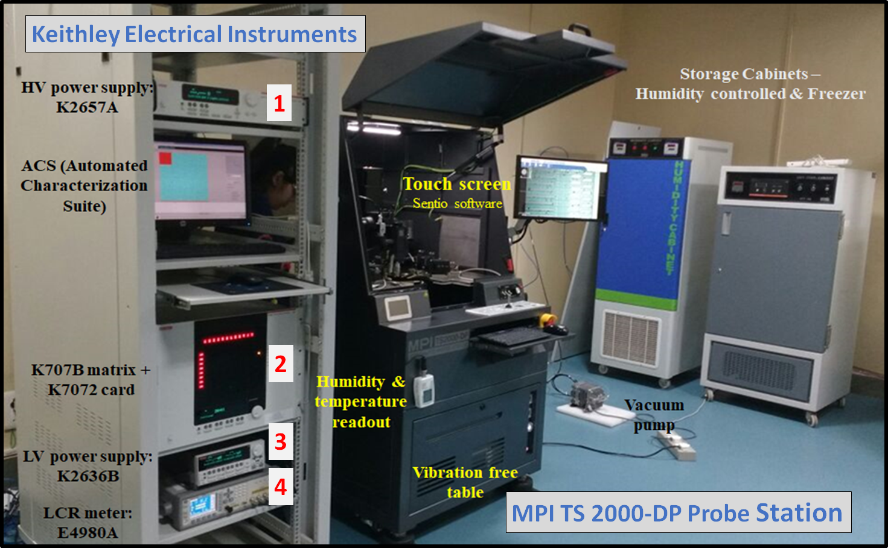
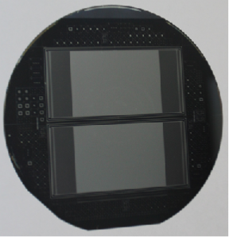
Development of an automated and programmable characterization system
for silicon multi-strip sensors
Geetika Jain, Chakresh Jain, Ajay Kumar, Abhijeet Sisodia, Mansi Saxena, Surabhi Sharma, Ashutosh Bhardwaj, Kirti Ranjan
Centre for Detector & Related Software Technology, Department of Physics & Astrophysics, University of Delhi, INDIA
Tracker system constitutes mostly of silicon sensors
To maintain physics performance in radiation environment
Stringent constraints on sensor tolerance criteria
Also difficult to replace faulty sensors, if any
Motivation for Development of System
Crucial to ‘Quality Assure’ the sensors!
→ University of Delhi motivated to develop an Automated & Programmable Characterization System.
Some ‘Highlights’ of the System
(i) EM shielded, dark measurement chamber
(ii) Motorized chuck movement in XYZ$θ$
(iii) 2 micro-positioners attached to chuck to maintain reverse bias condition
(iv) Control over temperature & humidity
(v) Voltage capability of 1.5 kV
(vi) Measuring range: Current (pA-mA), Capacitance (pF-µF)
(vii) Interfacing through ‘Automated Characterization Suite’
Silicon Multi-Strip Parameters to be monitored
Environmental conditions (#2) : Temperature, Humidity
Global Measurements (#2) : Total Leakage Current, Backplane Capacitance
Strip Parameters (#4) : Strip Leakage Current, Poly-silicon Resistance, Dielectric Current, Coupling Capacitance
Inter-Strip Scans (#2) : Inter-strip Resistance, Inter-strip Capacitance
Sensor Tested on System:
Bharat Electronics Limited, India fabricated
p-on-n, poly-silicon resistor biased & AC-coupled

