Slide 1
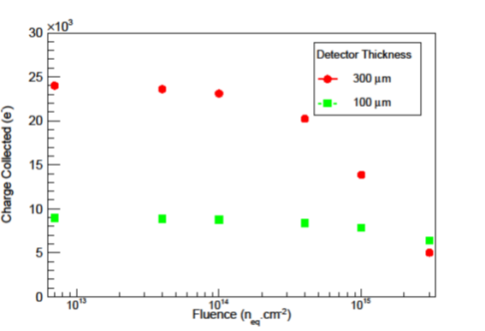
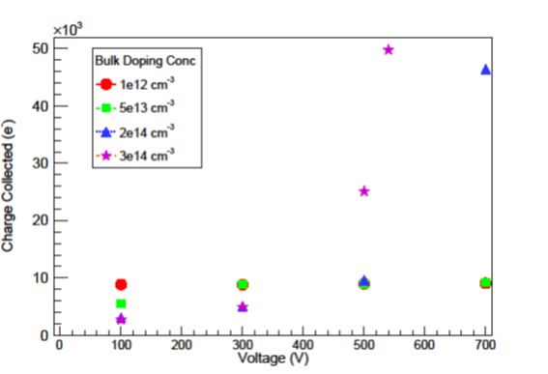
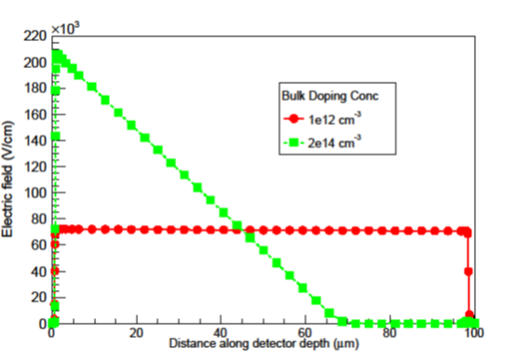
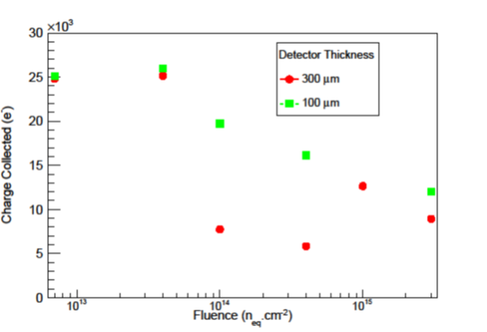
Radiation hardness investigation of thin and low resistivity bulk Si detectors
Geetika Jain, Surabhi Sharma, Chakresh Jain, Ashutosh Bhardwaj, Kirti Ranjan
Centre for Detector & Related Software Technology, Department of Physics & Astrophysics, University of Delhi, INDIA
Motivation for Study: Si detectors placed close to particle collision point
→ Damage to charge collection properties by harsh radiation environment
Development of new Si detector technology mandatory!!
Possible candidate: Low resistivity or High bulk doping concentration ($N_{b}$) Si substrate
Charge Collected (e)
For N_{b} = 1 x 10¹² cm⁻³ → resistivity = 13 k$Ω$.cm
Fluence
Investigation Technique Used: TCAD Silvaco Simulation Tool!
For d = 100 $μ$m
At 500 V
Non-Irradiated Behaviour of low resisitivity substrate
High charge collection observed at large N_{b} after a certain applied bias voltage.
Reason: E.field peaks at frontside due to stronger PN junction → leads to charge multiplication, thereby high CC.
Charge Collected (e)
Electric Field (V.cm⁻¹)
Voltage
Distance along detector depth
For N_{b} = 3 x 10¹⁴ cm⁻³ → resistivity = 44 $Ω$.cm
Irradiated Behaviour of low resisitivity substrate
CC decreases with fluence but with a characteristic peak in CC before gradually decreasing. This is an observed characteristic for low resistivity substrates – eg. HVCMOS.
RADIATION HARDER THAN HIGH RESISTIVITY SUBSTRATE!*
Charge Collected (e)
Fluence

