Slide 1
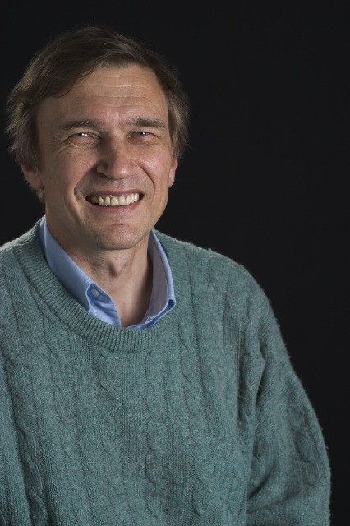
Single Event Upsets in the ATLAS IBL Front End ASICs
IBL pixel front end chip FE-I4-B in 130 nm technology was designed with Single Event Upset (SEU) hard configuration memory. It is exposed to 92.5 10¹¹ cm⁻²/fb⁻¹ hadrons with E>20 MeV according to PYТHIA/FLUKA simulations in the LHC 13 TeV pp collision fills with peak luminosities up to 2.1 10³⁴cm⁻²s⁻¹ .
Inside the pixels Dual Interlocked Cell (DICE) latches were used with SEU cross-section measured for FE-I4-A in the 24 GeV proton test beam is 1.1 10⁻¹⁵ cm⁻² .
SEU upsets in the global and local pixel configuration memory were observed during LHC fills: module desynchronization, dead modules, quiet pixels, noisy pixels.
ATLAS Pixel detector with IBL at R=3.3 cm efficiently operates at high luminosity with expected SEUs.
Global configuration SEUs mitigated by refreshing the memory during ECR every 5 seconds without dead time.
Plans to introduce the gradual refreshing of Local pixel configuration during ECR in 2018 .
Local pixel memory SEUs in the enable bit and 1->0 transitions in TDAC and FDAC are consistent with test beam results.
SEUs with 0->1 transitions in local TDAC and FDAC are five times higher than test beam results. Probably due to Single Event Transients(SET) glitches
Test beam
Alexandre Rozanov, Aix Marseille Univ, CNRS/IN2P3, CPPM, Marseille, France, for ATLAS Collaboration

