Slide 1
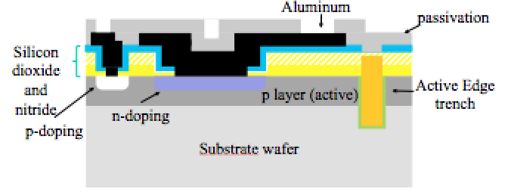
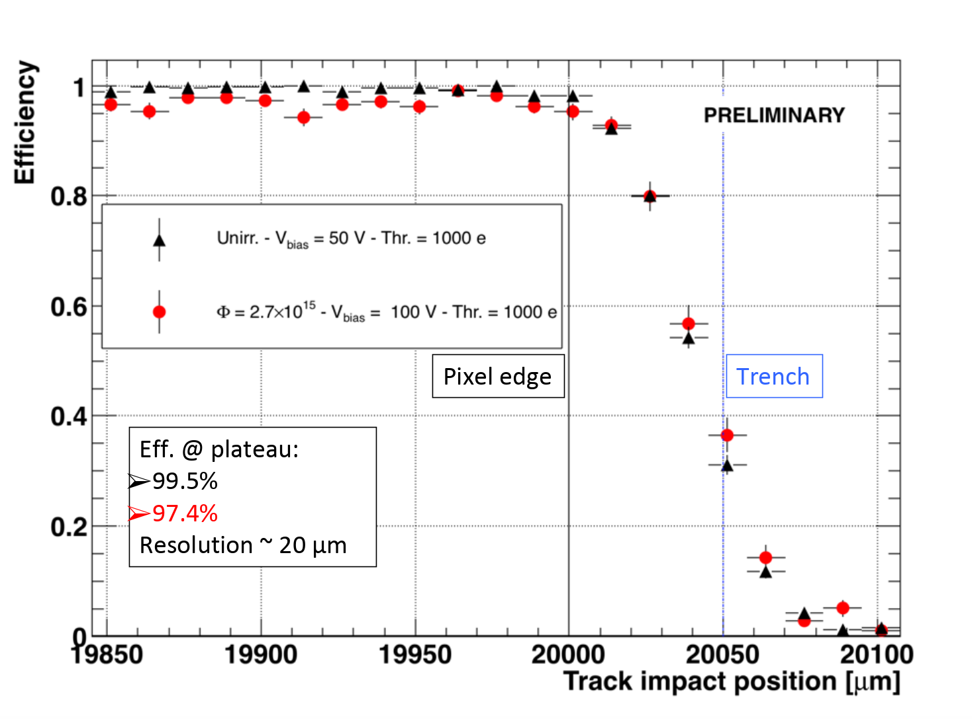
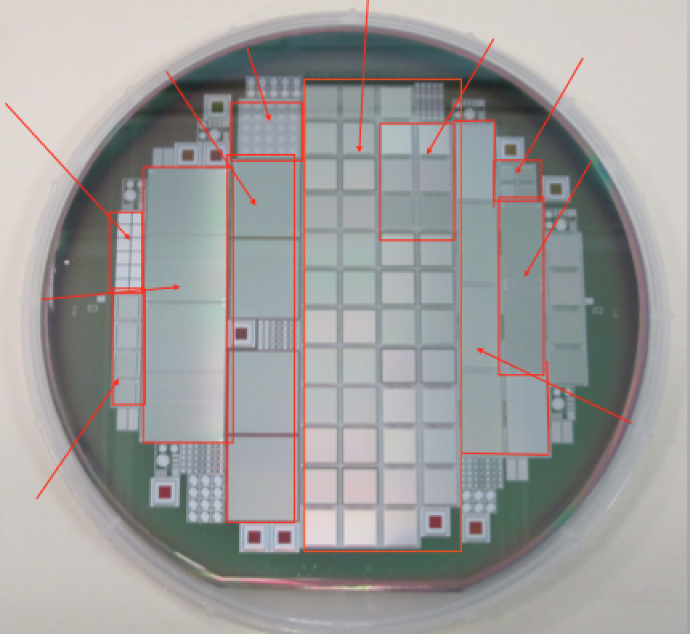
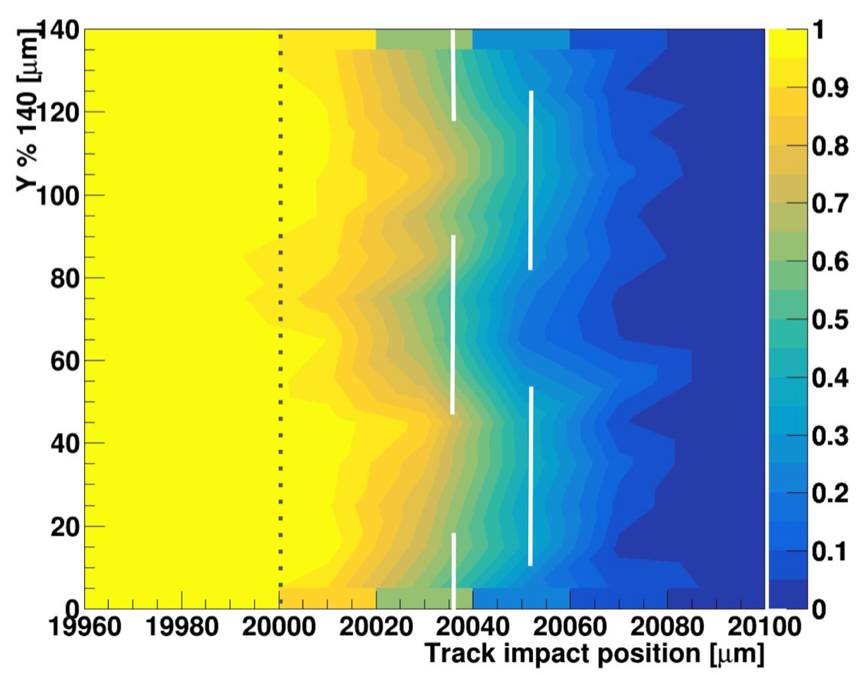
Active-edge FBK-INFN-LPNHE thin n-on-p pixel
sensors for the upgrade of the ATLAS Inner Tracker
Giovanni Calderini, Marco Bomben, Louis D’Eramo, Audrey Ducourthial, Ilaria Luise, Giovanni Marchiori,
Alvise Bagolini, Maurizio Boscardin, Sabina Ronchin, Nicola Zorzi, Luciano Bosisio, Gian-Franco
Dalla-betta, Nanni Darbo, Gabriele Giacomini, Marco Meschini, Alberto Messineo
The FBK active edge process
The staggered trench
Should avoid uncontrolled
detachment of the device during the removal of mechanical support (backthinning)
The characterization at beam-tests
The common ATLAS-CMS production
Still significant hit efficiency
in the region between pixel
and trench
Few % reduction in efficiency after 2.7 x 10¹⁵ n_{eq} / cm²
PSI46
FEI4
HGTD
R4S
CHIPIX
CLIC
RD53
LPHNE FE-I4 ALPINE
RD53
The map of hit efficiency
in the edge region shows a dependence following
the profile of the trench
FCP

