Slide 1
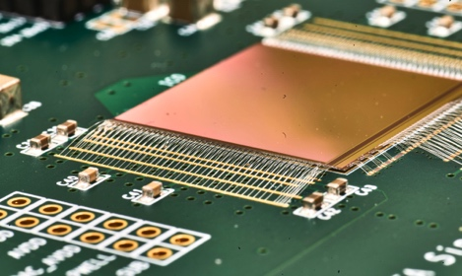
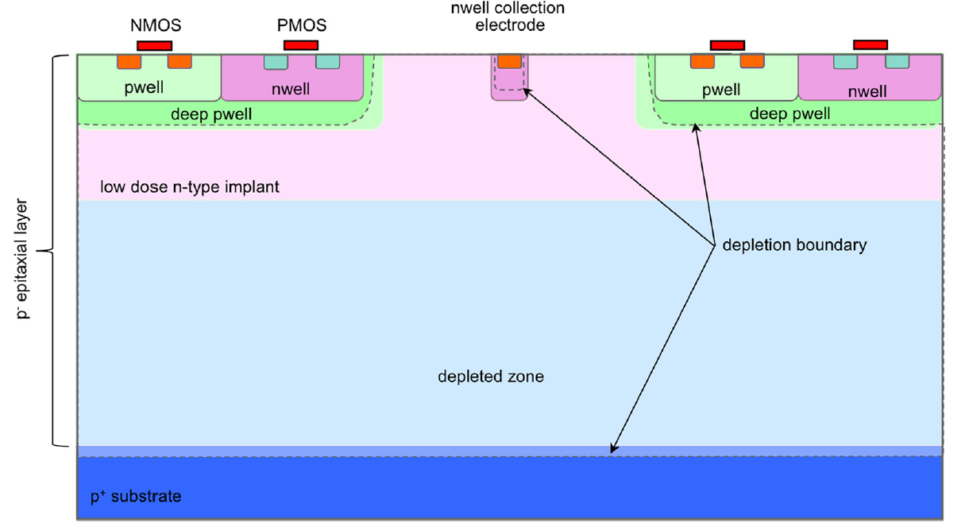
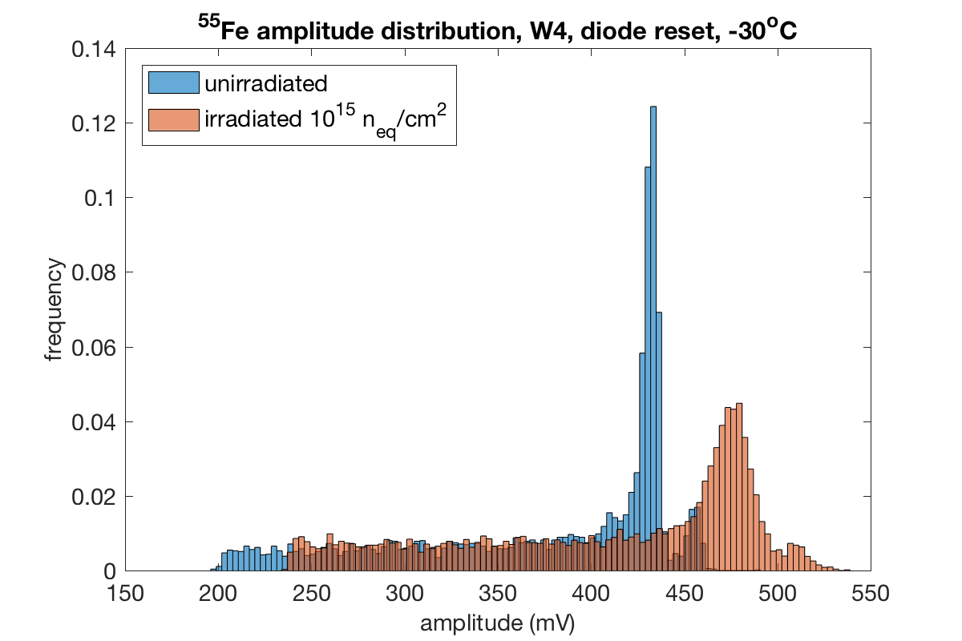
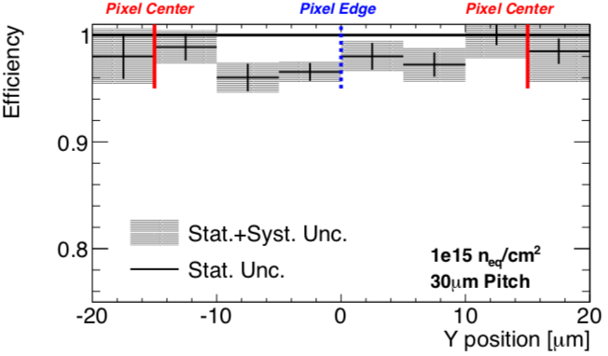
The MALTA CMOS sensor for the ITK outer pixel layer in ATLAS
Development of a radiationhard CMOS sensors with high hit-rate capability. MALTA features small electrodes to minimize capacitance, noise and power and is produced in modified TJ 180nm process for radiation hardness and fast signal response (25ns)
CMOS process with additional n- layer increases depletion volume → fast charge collection by drift in the full bulk
The MALTA Sensor is a full-size 512x512 pixel sensor (36μm pitch)
TJ 180nm modified process
2018 MALTA: Low capacitance FE with high-speed asynchronous readout architecture
Sensor functional - small ENC ~ 8e- and threshold dispersion ~15e- due to small C_{D}
Irradiation tests on-going
MALTA Preliminary tests
TJ Investigator Irradiation
Beam profile unirrad, ⁹⁰Sr
unirrad, ⁵⁵Fe
efficiency 97.4%
after 10¹⁵ n_{eq}/cm²
1e15 n
MALTA monitor channels

