Slide 1
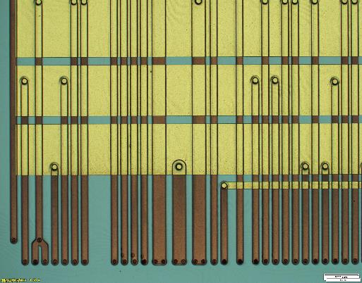
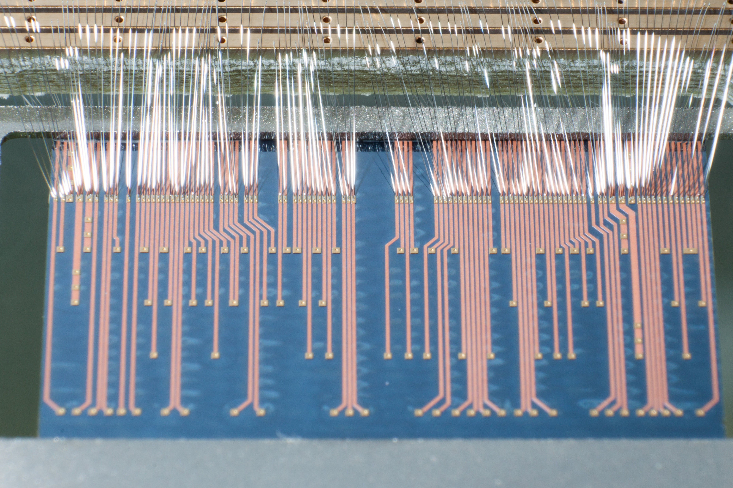
Advanced Through Silicon vias for Pixel Detectors
Pixel Detector Module Concept using TSV:
More compact hybrid pixel detector modules with active area maximization, no wire-bonds, and 4-side abuttable
Deploy via-last TSVs into the readout chip’s IO Pads to bring all IOs (power, slow control, high speed readout) to the chip’s backside
Usage of the chip backside for wiring and absorb some functionality of the module flex PCB into the Redistribution Layer (RDL)
Integrate the fine pitch bump bonding process on thin, large chips chip into post processing of the readout wafers
Main goals of the ATLAS FE-I4 TSV Run:
Establish high yield TSV + RDL process for hybrid pixel modules
Straight side vias through ultra thinned readout wafers with 2x2 cm² chip size
Target wafer thickness of 80 - 100 µm with via diameter of 60 µm
ATLAS FE-I4 wafer: backside after RDL+UBM-Pad process
TSV cross-section
Standard module
ATLAS Pixel
ATLAS FE-I4 chip via RDL and TSV through chip backside
TSV pixel module

