Slide 1
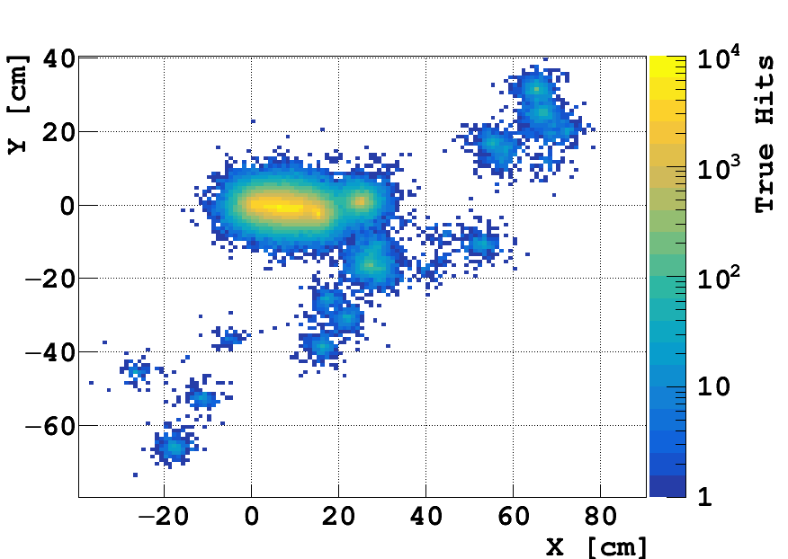
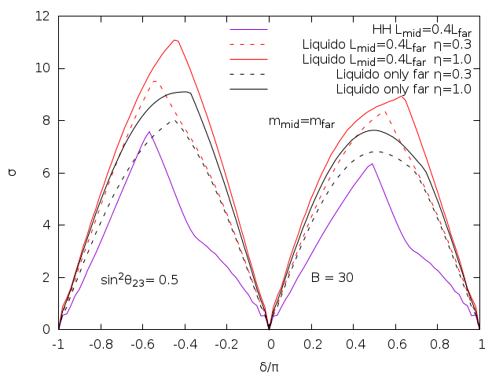
Neutrino-Antineutrino Identification in a Liquid Scintillator Detector Towards a novel decay-at-rest-based neutrino CPV framework
M. Grassi [APC/CNRS (Paris FR)], F. Pessina, A. Cabrera, S. Dusini, H. Nunokawa, F. Suekane
What: visualize (anti)neutrino interactions taking place in a liquid scintillator loaded with a heavy element (eg. Pb)
Why: perform a low-systematics neutrino CP violation experiment by measuring oscillation probabilities of (anti)neutrinos emitted by pion and muon decay at rest
30MeV Electron
only Multiple Baselines
& Single Baseline
& Multiple Baselines
30MeV Positron
Sensitivity N(σ) = √Δχ ²
GAMMAS’ COMPTON SCATTERINGS
only Multiple Baselines
& Multiple Baselines η=0.3
& Multiple Baselines η=1.0
& Single Baseline η=0.3
& Single Baseline η=1.0
CP Violating Phase (δCP/π)

Slide 2
Neutrino-Antineutrino Identification in a Liquid Scintillator Detector Towards a novel decay-at-rest-based neutrino CPV framework
M. Grassi [APC/CNRS (Paris FR)], F. Pessina, A. Cabrera, S. Dusini, H. Nunokawa, F. Suekane
What: visualize (anti)neutrino interactions taking place in a liquid scintillator loaded with a heavy element (eg. Pb)
30MeV Positron
30MeV Electron
GAMMAS’ COMPTON SCATTERINGS
only at Multiple Baselines
& at Single Baseline
& at Multiple Baselines
Why: perform a low-systematics neutrino CP violation experiment by measuring oscillation probabilities of (anti)neutrinos emitted by pion and muon decay at rest
Sensitivity N(σ) = √Δχ ²
CP Violating Phase (δCP/π)

Slide 3
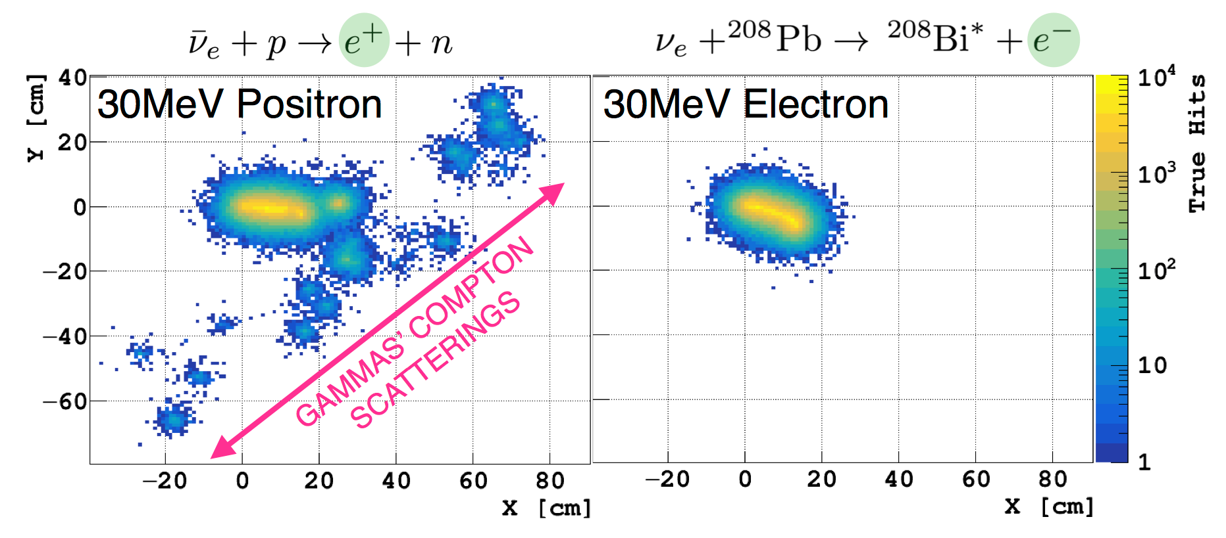
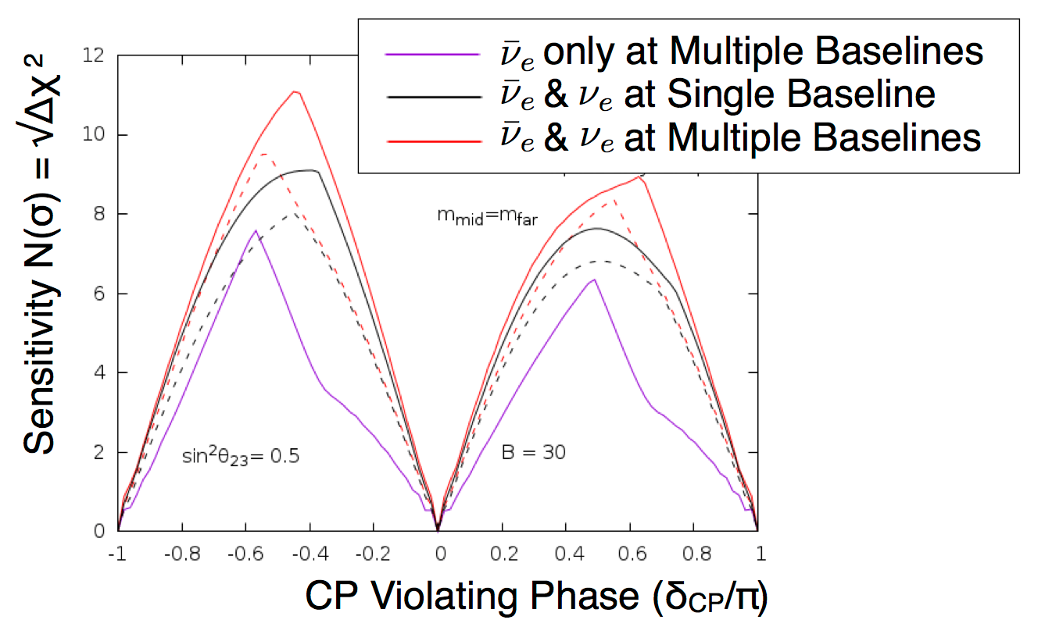
Neutrino-Antineutrino Identification in a Liquid Scintillator Detector Towards a novel decay-at-rest-based neutrino CPV framework
M. Grassi [APC/CNRS (Paris FR)], F. Pessina, A. Cabrera, S. Dusini, H. Nunokawa, F. Suekane
What: visualize (anti)neutrino interactions taking place in a liquid scintillator loaded with a heavy element (eg. Pb)
Why: perform a low-systematics neutrino CP violation experiment by measuring oscillation probabilities of (anti)neutrinos emitted by pion and muon decay at rest

