Slide 1
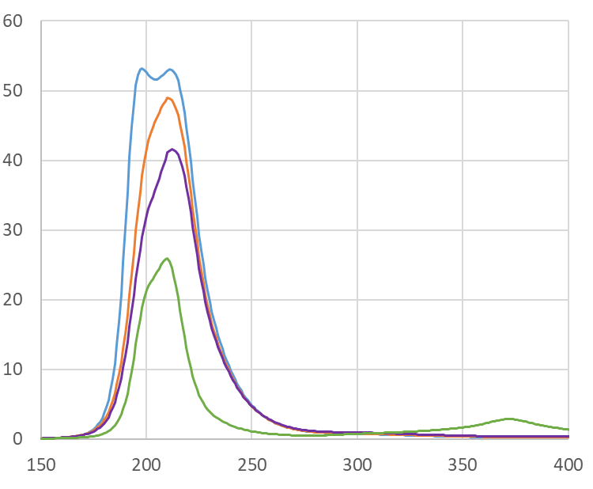
A large area SiPM for efficient detection of the fast scintillation component of BaF₂
D. G. Hitlin, Lauritsen Laboratory, Caltech M. Hoenk, J. Hennessey, A. Jewell, Jet Propulsion Laboratory, Caltech G. Paternoster, A. Gola, FBK
τ = 0.6/630 ns BaF₂
Making use of the very fast barium fluoride scintillation component at 220nm
for fast timing and high rate capability requires a means of suppressing the larger slow component at 300nm
Caltech/JPL and FBK are developing a SiPM with an integrated interference filter for this purpose
This requires reduction of SiN passivation layer on an FBK device and fabrication of an integrated metal/dielectric filter, which has higher efficiency than an external filter
SiPM with thin entrance window and guard ring structure
Calculated transmittance of several 5 layer filters
Native BaF₂ spectrum & calculated response with 5 layer filter on 10nm SiN
5 layer (no oxide, no SiN
85%
630ns
Transmission (%)
5 layer (10 nm SiN)
5 layer (20 nm SiN
15%
600ps
Arbitrary scale
5 layer (20 nm SiO₂, 30 nm SiN)
Wavelength (nm)
Wavelength (nm)
Test wafers are in production

