Slide 1
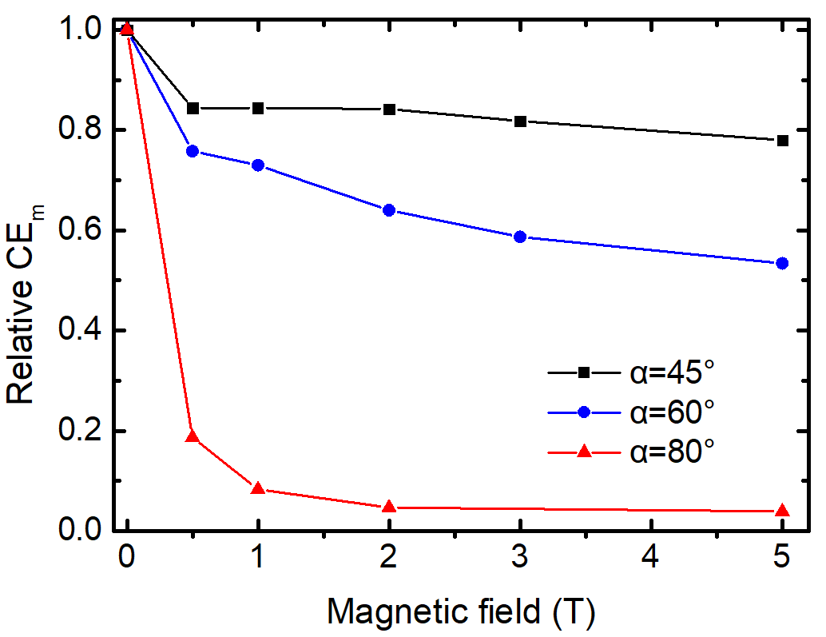
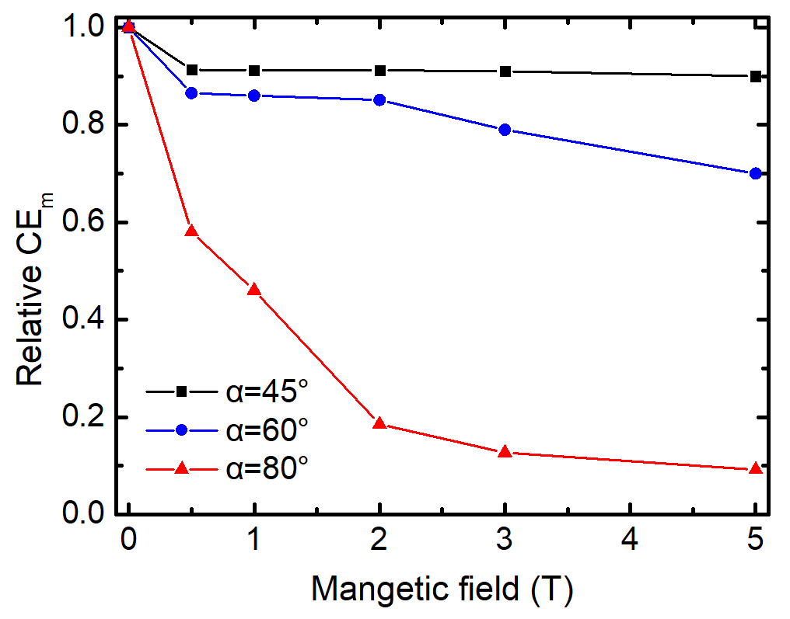
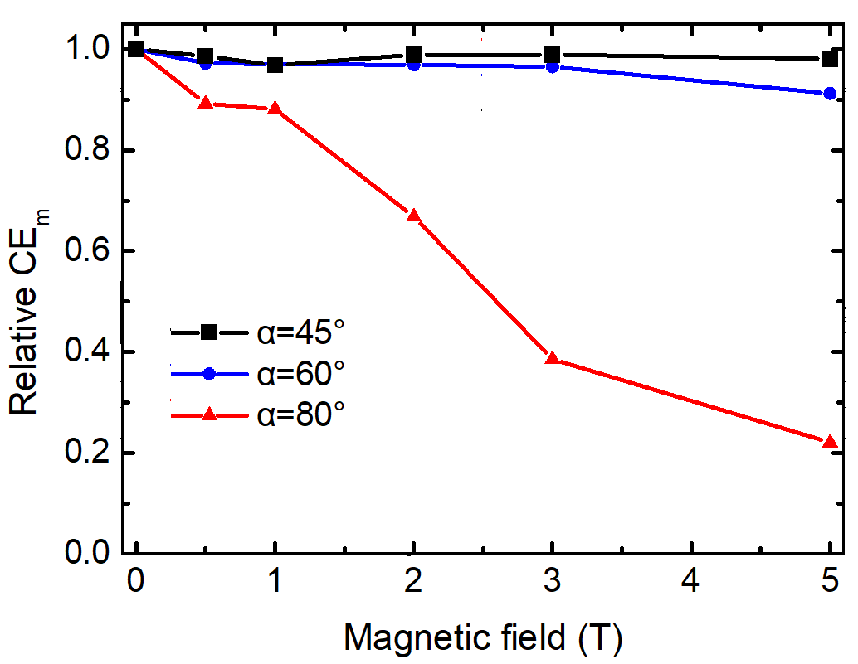
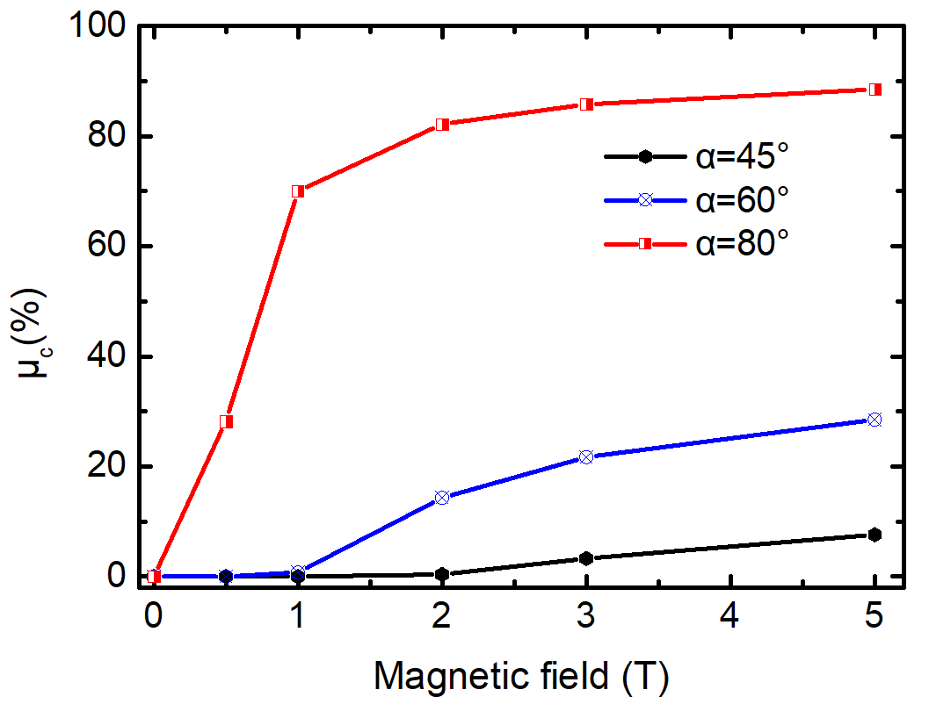
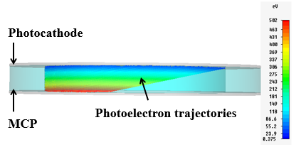
Design of the microchannel plate photomultiplier
Tube for applications in strong magnetic fields
Ping Chen*, Jinshou Tian, Wenwlong Wen, Shulin Liu, Yonglin Wei
*chenping@opt.cn
Xi’an Institute of Optics and Precision Mechanics (XIOPM),
Chinese Academy of Sciences (CAS)
Several examples of MCP-PMTs with different photocathode and MCP spaces and bias voltages are simulated in magnetic fields up to 5 T. It’s found that photoelectrons strike back to photocathode with enhancing magnetic fields, which not only reduces gain but also decreases the photocathode lifetime. To have more than 60% CEm in magnetic field up to 5 T, electric field stronger than 500 V/mm and α less than 45°should be guaranteed.
Fig. 1 Relative CEm as a function of
magnetic field at d=2 mm and U=500 V.
Fig. 2 Relative CEm as a function of
magnetic field at d=1 mm and U=500 V.
Fig. 3 Relative CEm as a function of
magnetic field at d=0.3 mm and U=300 V.
Note：CEm is the probability of photoelectrons hitting MCP,
d is the distance between photocathode and MCP,
U is the electric potential between photocathode and MCP, α is the
Magnetic field angle with respect to the normal direction of cathode.
Fig. 4 Photoelectron trajectories for magnetic
field of 3 T at d=2 mm and U=500 V.
.
Fig. 4 Probability of photoelectrons striking photocathode as a function of magnetic field at d=2 mm and U=500 V.

