Slide 1
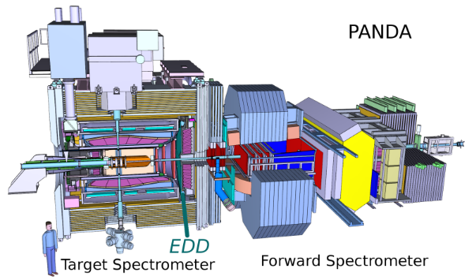
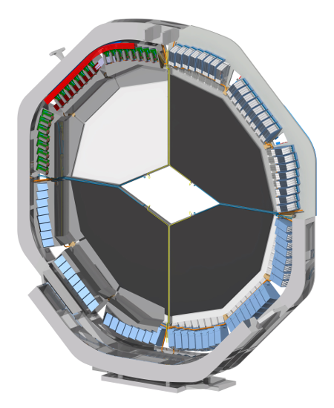
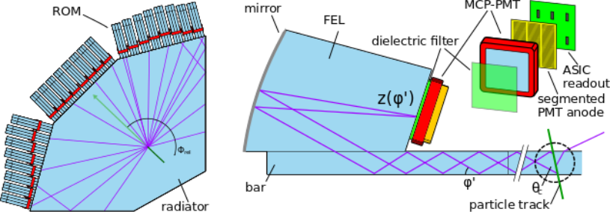
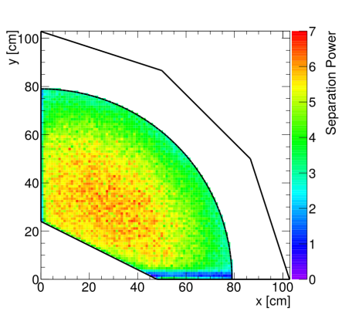
The Endcap Disc DIRC detector of PANDA
PID in PANDA at FAIR
DIRC Cherenkov system
using quartz radiator discs
Klaus Föhl
on behalf of the
PANDA Cherenkov Group
II. Physikalisches Institut
Heinrich-Buff-Ring 16
D-35392 Gießen, Germany
Monte
Carlo
EDD cut-away view from downstream
Kaon/pion 3 s.d. at 4 GeV/c

