Slide 1
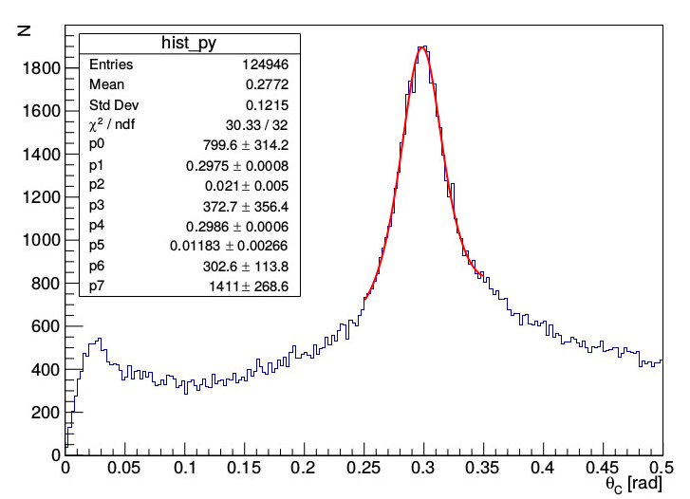
First Experience with the Belle II Aerogel RICH Detector
Aerogel RICH detector was assembled in 2017
The main purpose is to separate charged kaons from pions for momenta between 0.5-4.0 GeV/c
First global cosmic ray data were taken in February and first beam collision data were taken in April 2018
Cherenkov rings, created by cosmic rays and by charged particles from beam collisions, have been observed
A clear peak is seen in Cherenkov angle distribution
Kaon identification efficiency was studied and will be calibrated with first collision data
Presented by:
Manca Mrvar
Jožef Stefan Institute Ljubljana, Slovenia
manca.mrvar@ijs.si
(on behalf of Belle II ARICH group)

