Slide 1
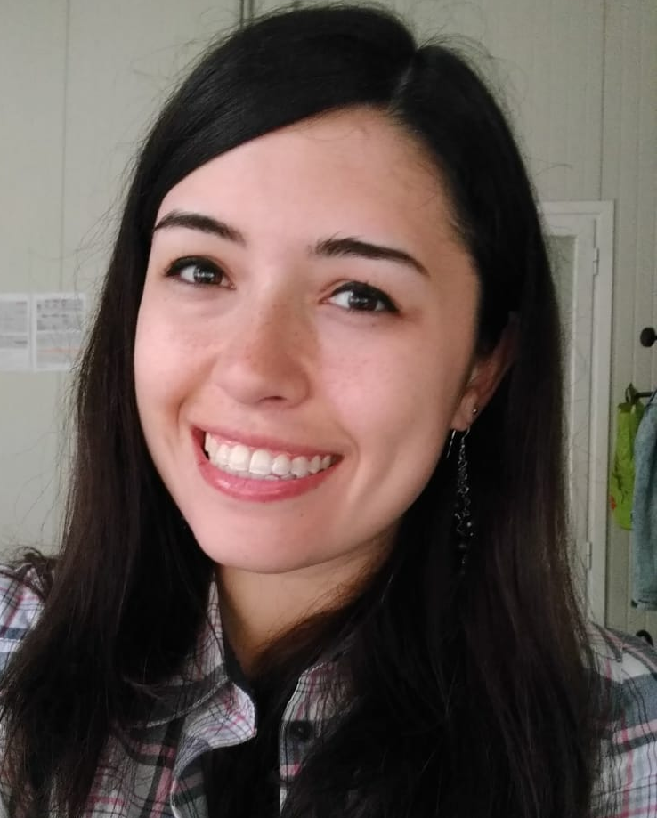
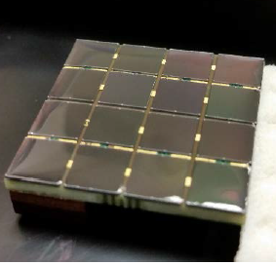
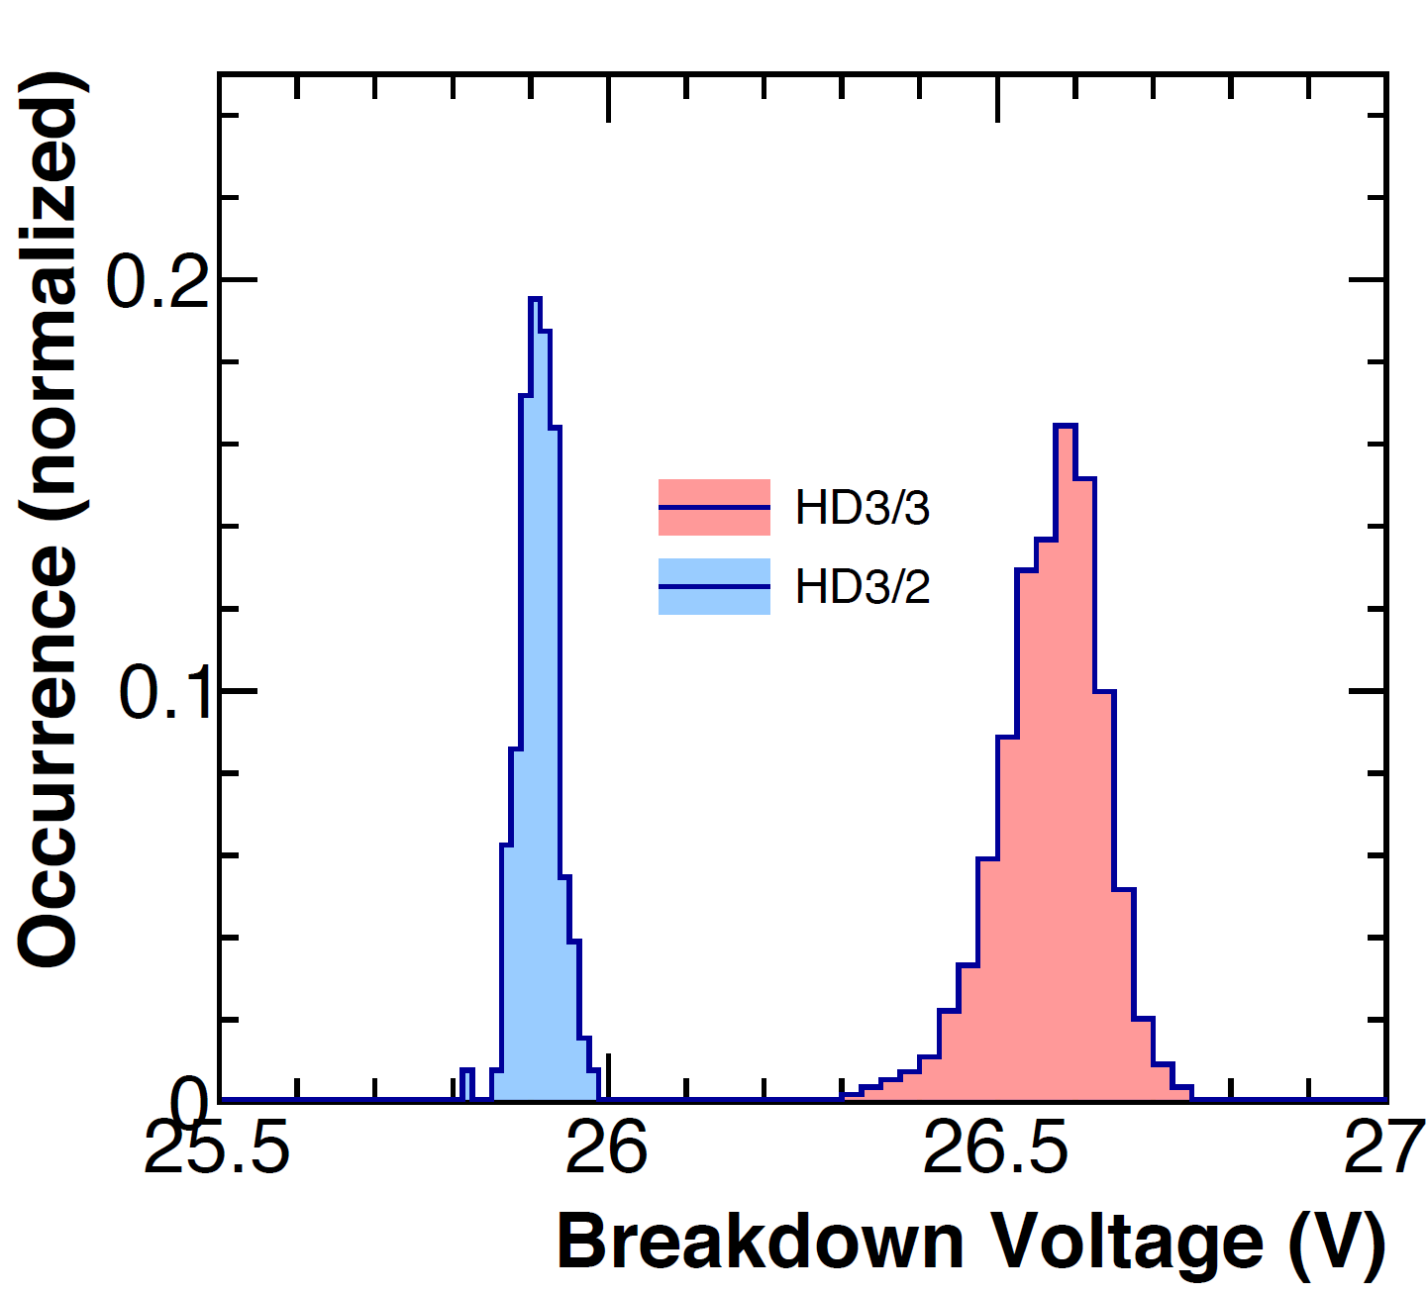
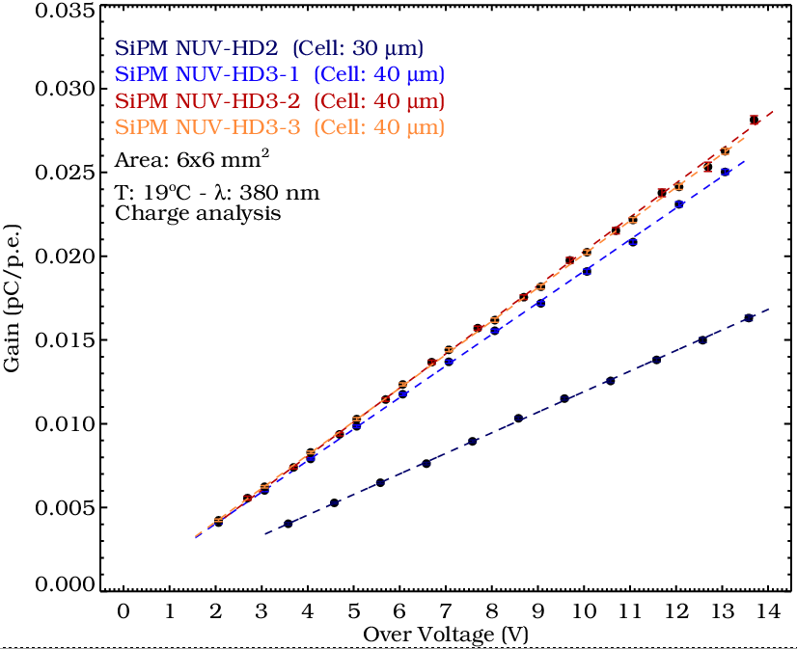
Characterization of FBK NUV-HD SiPMs for the pSCT camera proposed for the CTA experiment
G.Ambrosi, M.Ambrosio, C.Aramo, B.Bertucci, E.Bissaldi, A.Boiano, C.Bonavolontà, M.Caprai, L.Consiglio, L.Di Venere, E.Fiandrini, N.Giglietto, F.Giordano, F.Licciulli, S.Loporchio, V.Masone, M.Movileanu, R.Paoletti, A.Rugliancich, L.Tosti, V.Vagelli, M.Valentino for the CTA Consortium
FBK NUV HD3 6x6 mm² SiPM performances
Matrix configuration validation tests
Gain uniformity
Signal-to-Noise Ratio uniformity
Different generation and substrates compared

