Slide 1
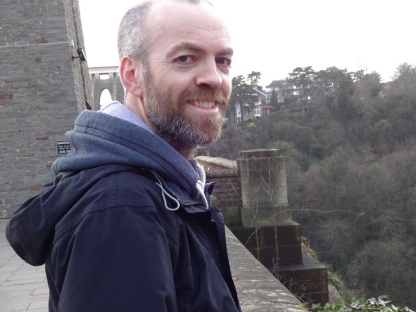
The TORCH PMT, a close packing, long life MCP-PMT for Cherenkov applications with a novel high granularity multi-anode
J S Milnes^{(a)}*, T M Conneely^{(a)} & J Lapington^{(b)}
TORCH was an ERC funded R&D project proposed to upgrade LHCb Particle ID capabilities in the 2-10 GeV/c region, a collaboration between CERN, Photek and the Universities of Oxford and Bristol. Photek’s role was to develop a novel square MCP detector with < 100 ps photon timing accuracy and the following technical aims:
A lifetime of 5 C/cm² of accumulated anode charge or better
A multi-anode readout equivalent to 8x128 pixels, fine pitch resolution target σ = 0.12 mm
Close packing on two apposing sides with a fill factor of 88% or better (53 mm width within a 60 mm envelope)
Photek Ltd, St Leonards on Sea, East Sussex, UK.
University of Leicester, Leicester, UK
*Presenting Author

