Slide 1

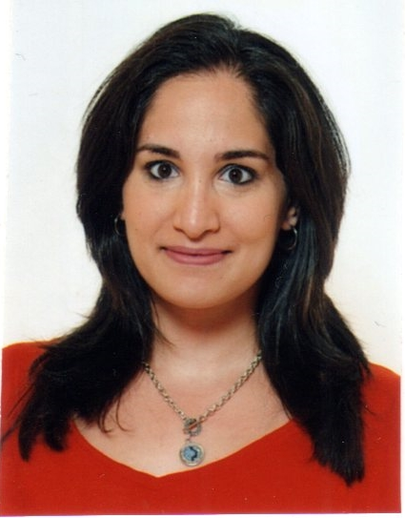
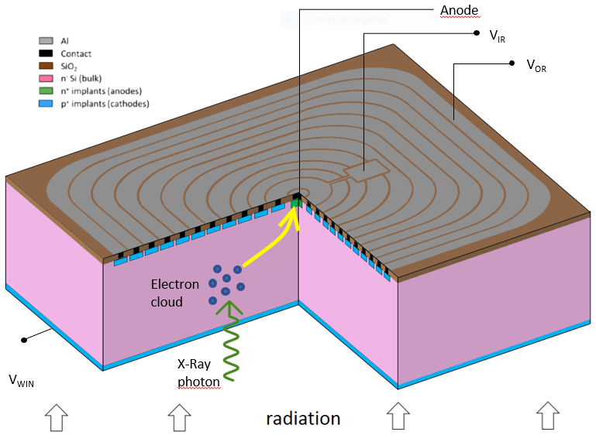
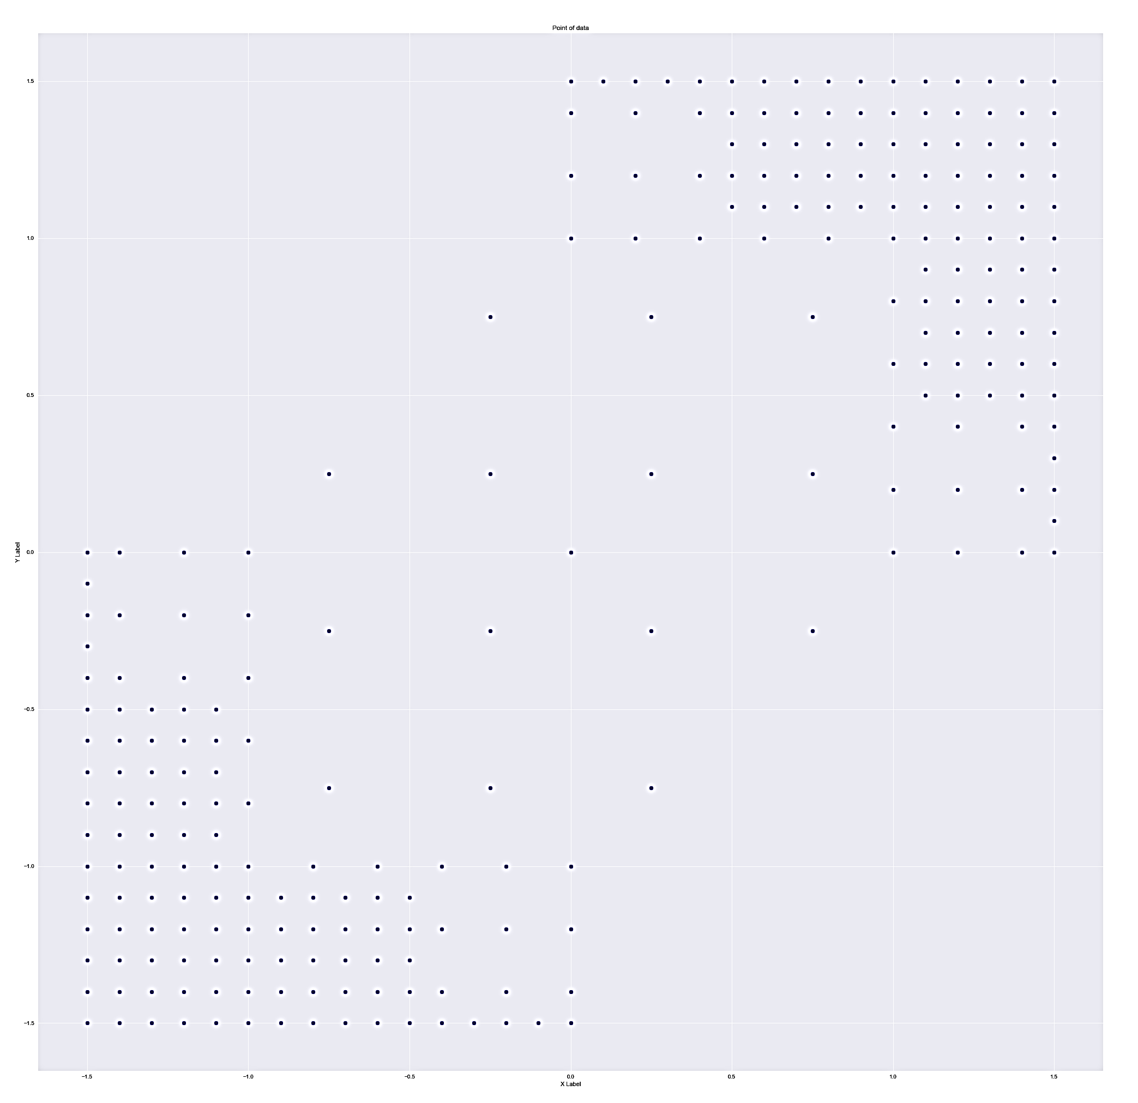
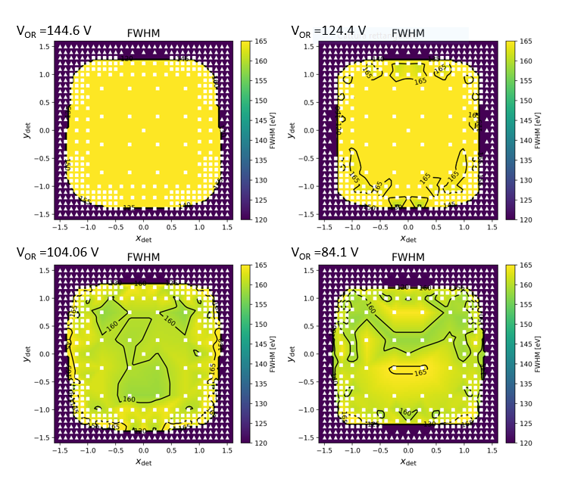
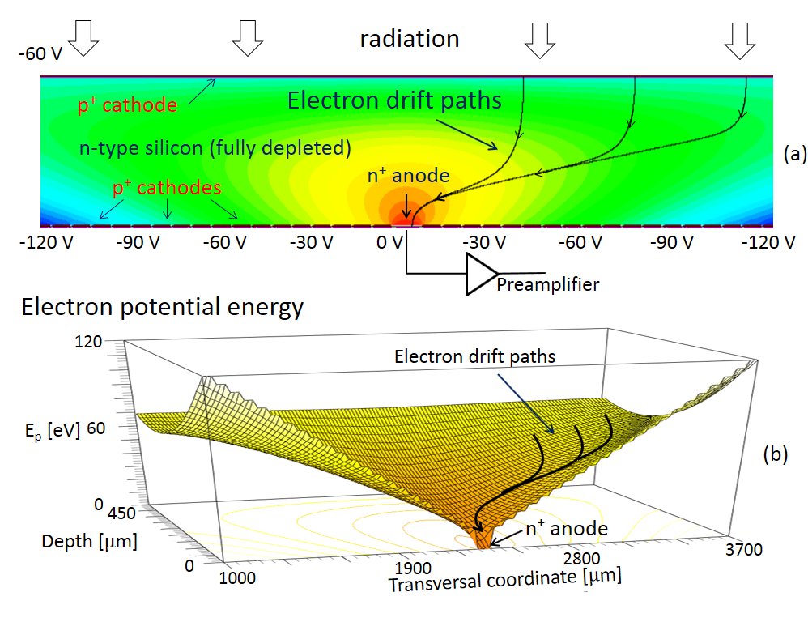
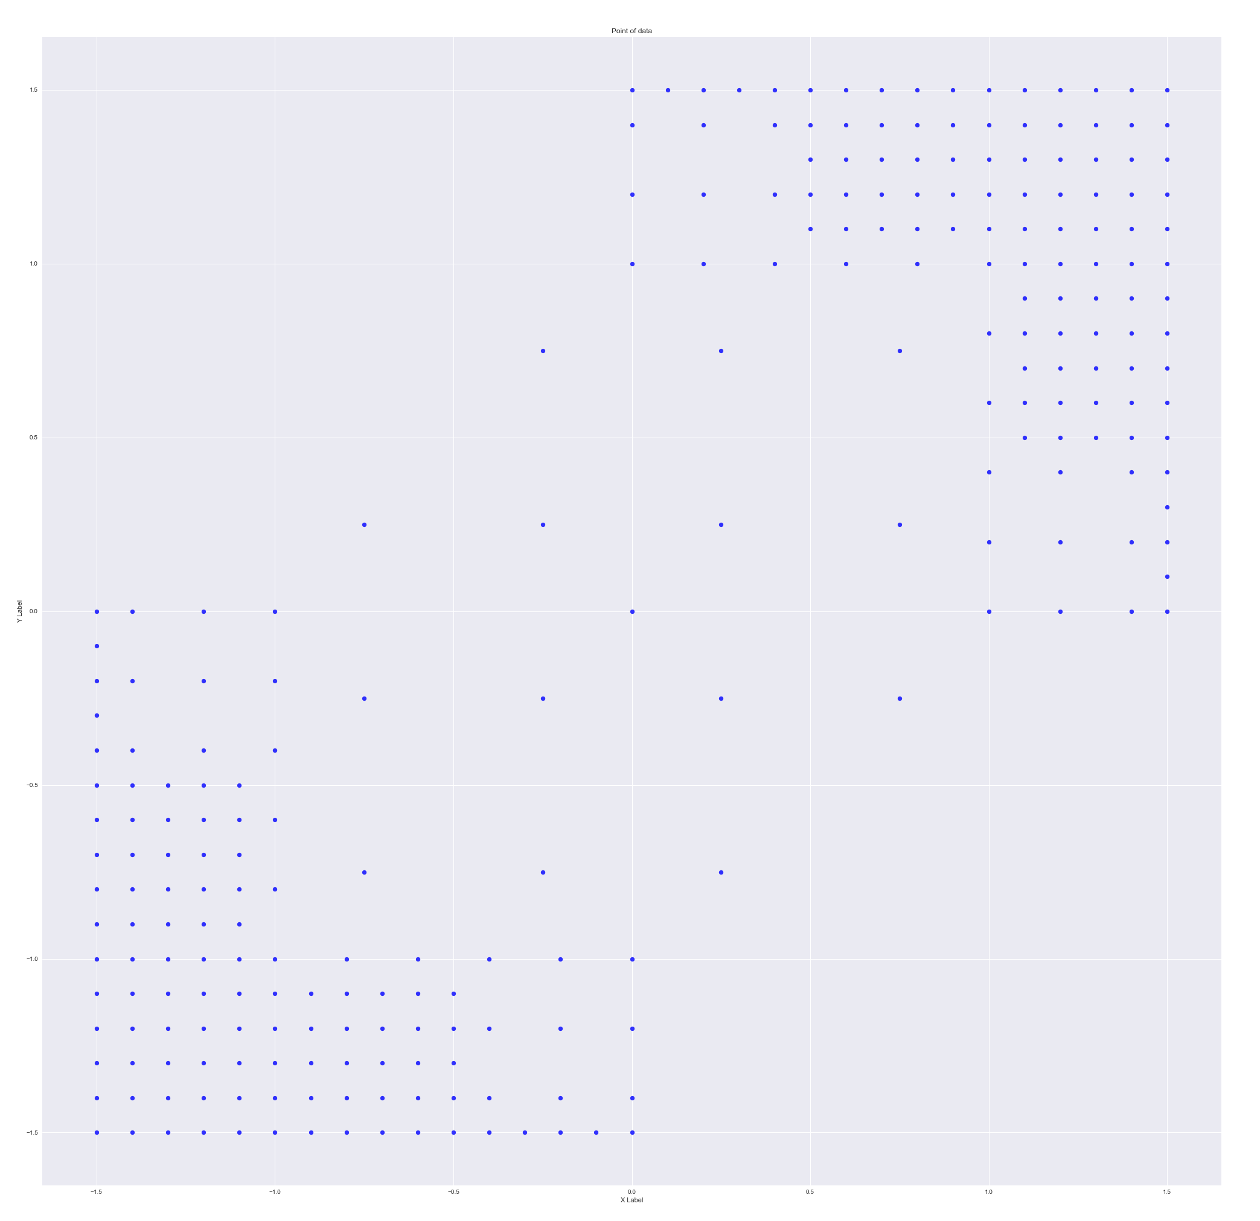
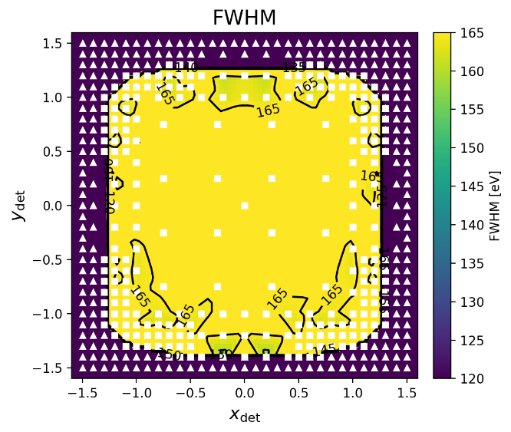
High precision mapping of single-pixel Silicon Drift Detector for application in astrophysics and advanced light source
D. Cirrincione^{1,2}, M. Ahangarianabhari^{3,4}, F. Ambrosino⁵, I. Bajnati^{6,5}, P. Bellutti^{7,8}, G. Bertuccio^{3,4}, G. Borghi^{7,8}, J. Bufon^{9,1}, G. Cautero^{9,1}, F. Ceraudo^{6,5}, Y. Evangelista^{5,10}, S. Fabiani^{5,10}, M. Feroci^{5,10}, F. Ficorella^{7,8}, M. Gandola^{3,4}, F. Mele^{3,4}, G. Orzan¹, A. Picciotto^{7,8}, M. Sammartini^{3,4}, A. Rachevski¹, I. Rashevskaya⁸, S. Schillani^{9,1}, G. Zampa¹, N. Zampa¹, N. Zorzi^{7,8} and A. Vacchi^{1,2}
1 INFN Trieste – 2 Dipartimento di Matematica ed Informatica, Università di Udine – 3 Politecnico di Milano – 4 INFN Milano – 5 INAF-IAPS, Roma – 6 CEA Saclay, Paris – 7 Fondazione Bruno Kessler, Trento – 8 TIFPA – INFN Trento – 9 Elettra-Sincrotrone Trieste – 10 INFN Roma Tor Vergata
ReDSoX collaboration
https://web.infn.it/redsox2
SDD with 3x3 mm² sensitive area
Outer ring voltage (V_{OR}) | Windows voltage (V_{WIN}) | Inner ring voltage (V_{IR})
-144,6 V | -85,10 V | -23,8 V
-124,4 V | -80,66 V | -21,13 V
-104,06 V | -80,85 V | -19,81 V
-84,1 V | -80,97 V | -18,59 V
Point-by-point mapping tests in different positions and bias condition
Analysis of complete charge collection to optimize new design of detectors

