Slide 1


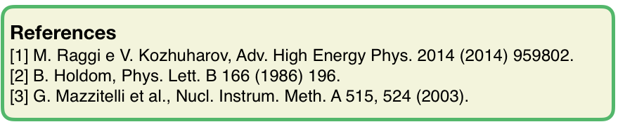
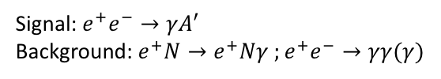
The investigation on the dark sector at the PADME experiment
Summary
The PADME experiment [1],at Laboratori Nazionali di Frascati (LNF) of INFN, is designed to be sensitive to the production of a low mass gauge boson A’ of a new U(1) symmetry holding for dark particles [2]. The DAΦNE Beam-Test Facility of LNF [3] is providing a high intensity, mono-energetic positron beam impacting on a low Z target to provide e⁺e⁻ annihilations, where the dark photon can be produces along with an ordinary photon. Simulation studies predict a sensitivity on the interaction strength (ε² parameter) down to 10⁻⁶, in the mass region 1 MeV <M_{A’}< 23.7 MeV, for one year of data taking with a 550 MeV beam. In 2018 the first run will take place, and early data will give the opportunity to compare the detector performance with the design requirements. Right now, an intense activity is taking place to install and commission the PADME experimental apparatus on site.
Signal: $e^{+}e^{−}→γA′$
Background: $e^{+}N→e^{+}Nγ{ ;e}^{+}e^{−}→γγ(γ)$

