Slide 1
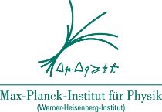
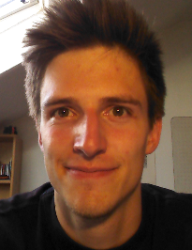
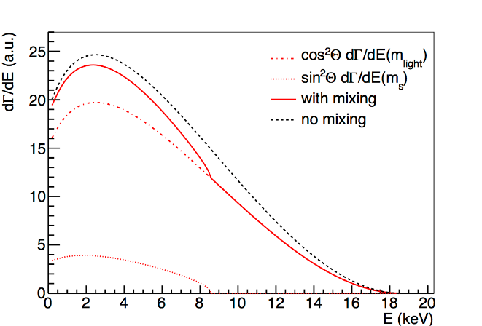
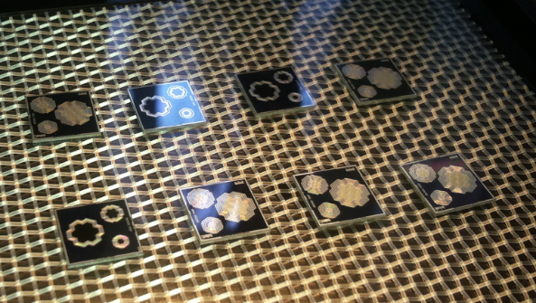
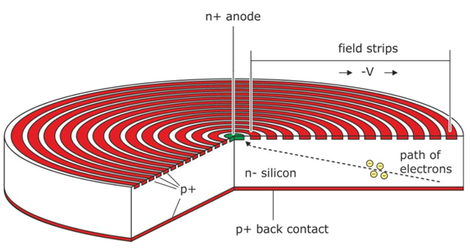
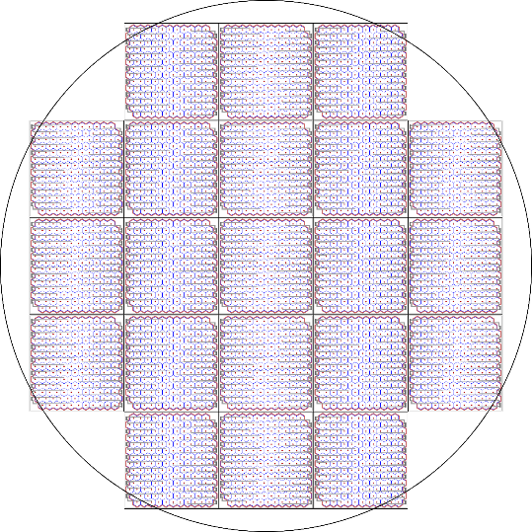
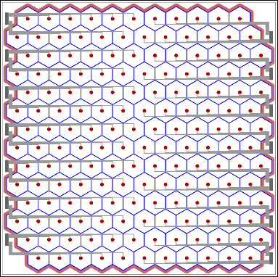
Development of a silicon drift detector system for the TRISTAN project - Future search for sterile neutrinos Tim Brunst¹, Luca Bombelli², Marco Carminati³, Carlo Fiorini³, David Fink¹, Thibaut Houdy¹, Peter Lechner⁴, Susanne Mertens^{1,5} ¹Max-Planck-Institut für Physik, ²XGLab S.R.L. Bruker Nano Analytics, ³Politecnico di Milano, ⁴Halbleiterlabor der Max-Plack-Gesellschaft, ⁵Technische Universität München
The TRISTAN project is an upgrade of the KATRIN detector system to search for a sterile neutrino signature in the entire tritium beta decay spectrum.
Amoung others, this requires the handling of rates up to 10⁸ cps, an energy resolution better than 300 eV @ 20 keV and an energy threshold smaller 1 keV for which the silicon drift detector (SDD) is best suited.
First prototype detectors have been produced and tested in order to optimize the production parameters and guarantee the best performance of the final detector system.

