Slide 1


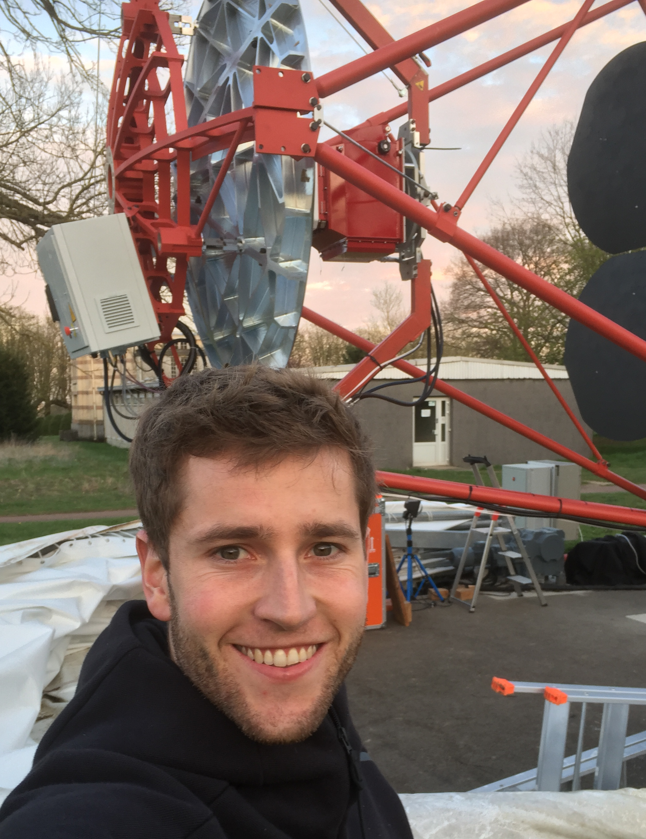
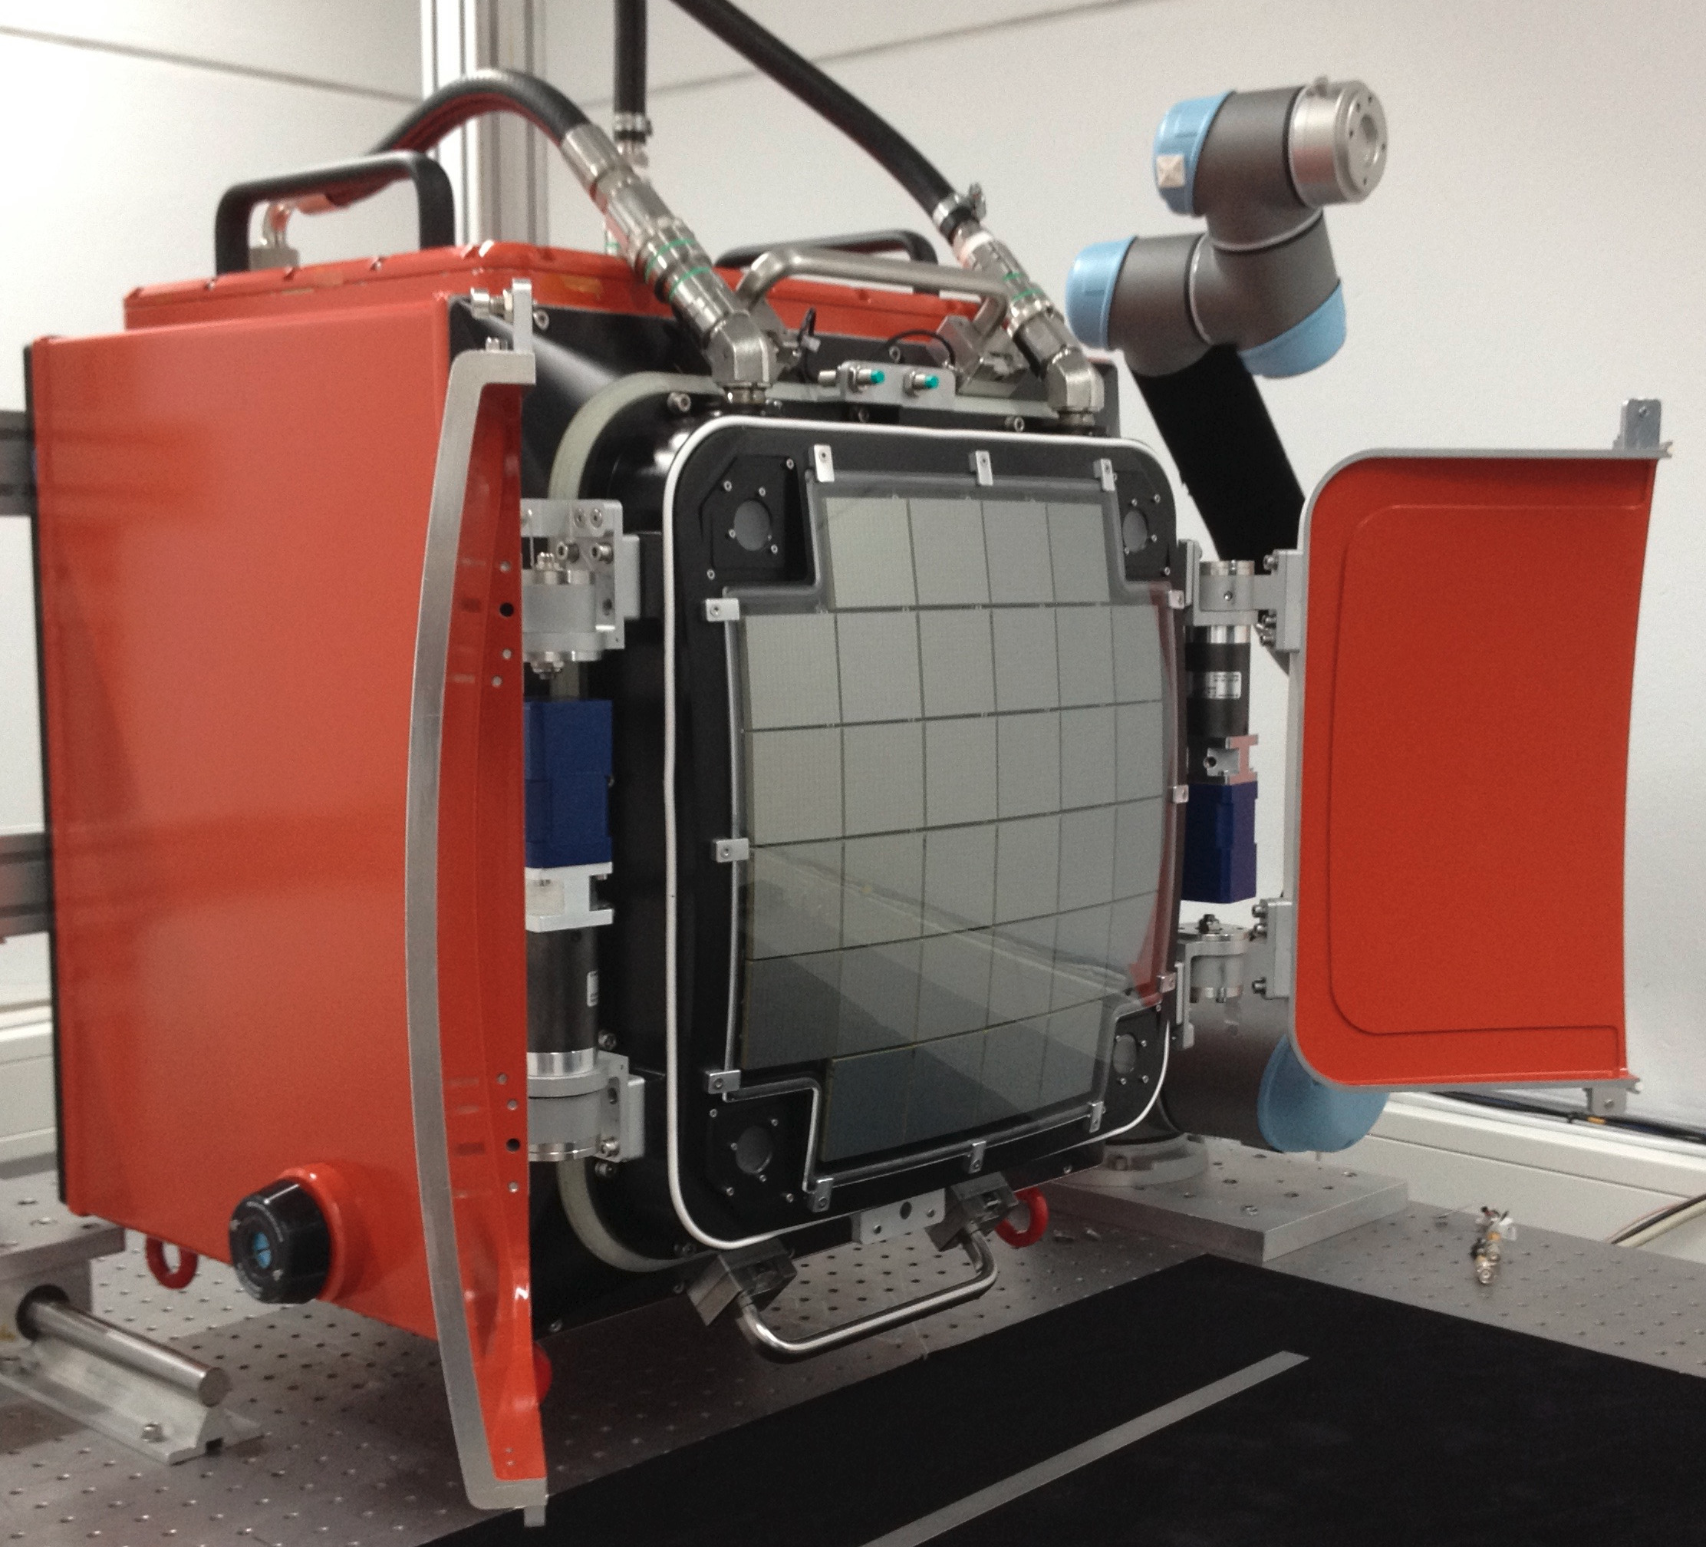
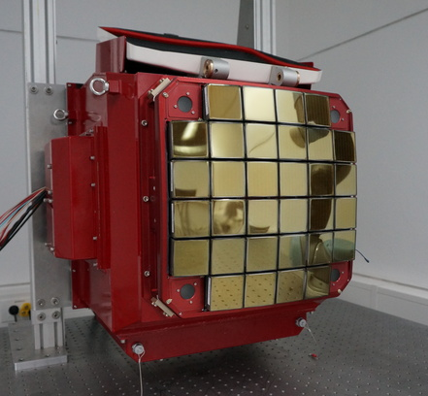
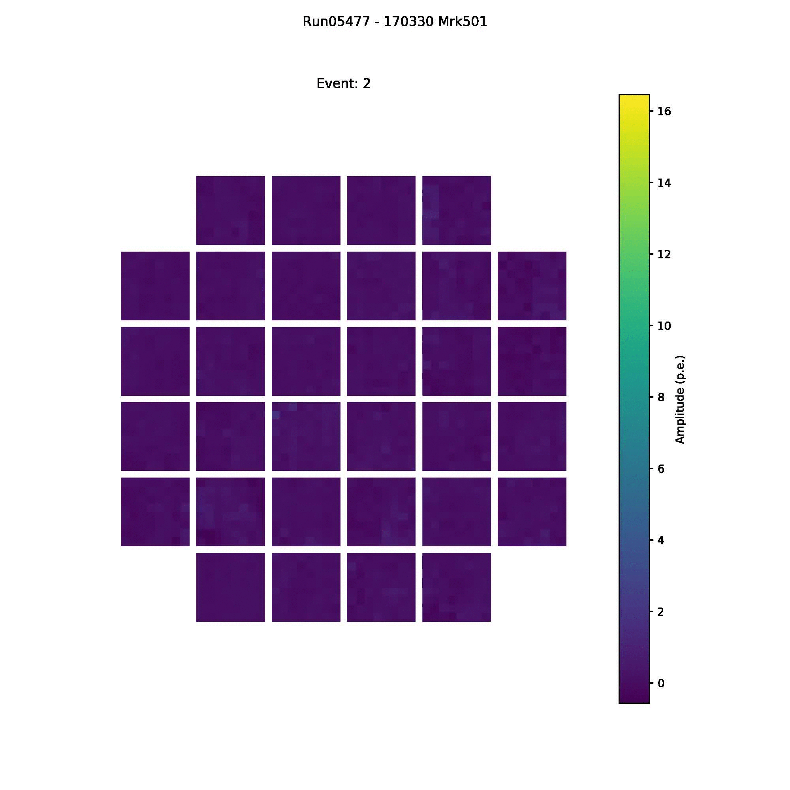
CHEC – a Compact High-Energy Camera for CTA
CHEC:
Design option for Small-Sized Telescopes of CTA based on Schwarzschild-Couder (SC) optics
Very compact (0.5 diameter)
Low-cost (150 k€)
2048 pixels, each 0.15°
Sampling and digitising at 1 GSa/s
Full waveform readout
CHEC-M
2 full-camera prototypes:
CHEC-M: Multi-Anode Photomultipliers (PM)
  Testing & characterisation completed
  First CTA camera prototype & first SC
  camera ever seeing Cherenkov light
CHEC-S
Justus Zorn
for the CTA GCT project
CHEC-S: Silicon PM + upgraded electronics
  Commissioning & testing on-going
  Better performance in many aspects
64 pixels
1100 V
1950 pixels
~2.5 V_{OV}
~25ºC
1000
100
Counts
Counts
10
1
0.00
0.05
0.10
Charge (a.u.)
Charge (a.u.)
CHEC-M Cherenkov images
CHEC-M & CHEC-S single photoelectron spectra
Notes:
<number>

