Slide 1
SiPM-based PET detector module for a 4π span scanner
PM 2018 – 14th Pisa Meeting on Advanced Detectors
R. Chil, D. Perez-Benito, J.M. Udias, M. Desco, J.J. Vaquero

Slide 2
Outline
Motivation
Geometry
IcoPET
Scintillator
MPPC SiPM design
Results
Conclusions & future work

Slide 3
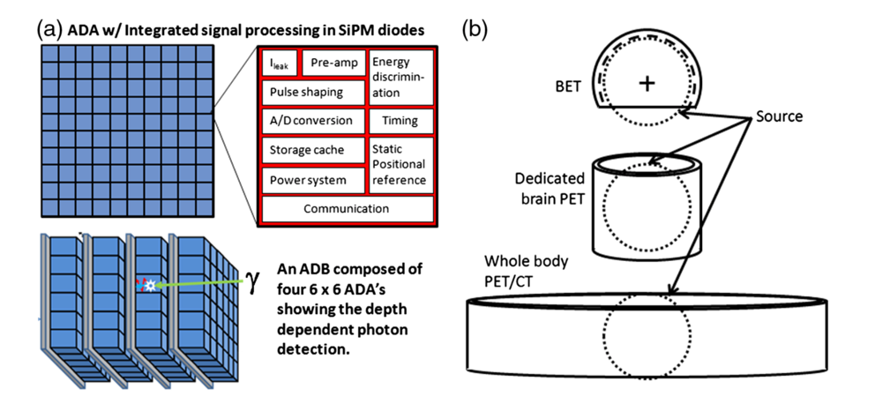
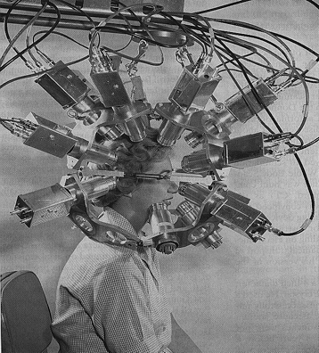
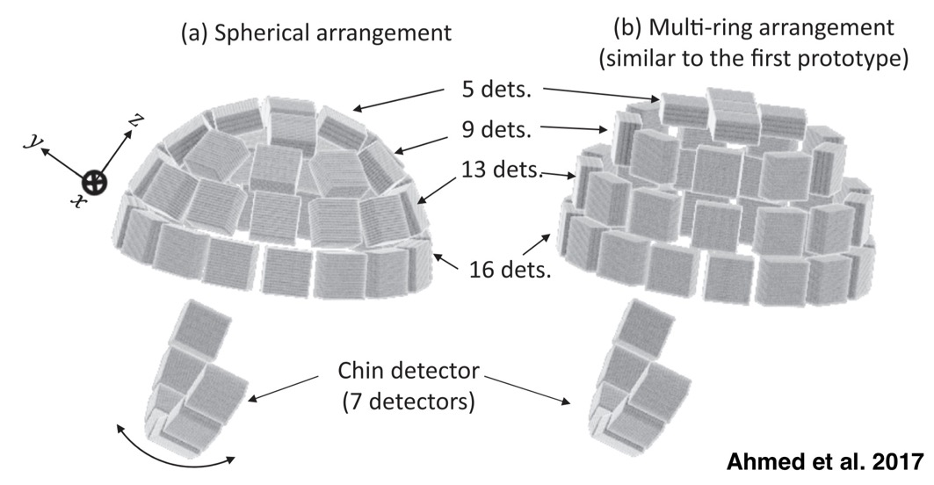
Motivation
Schmidtlein et al. 2017

Slide 4
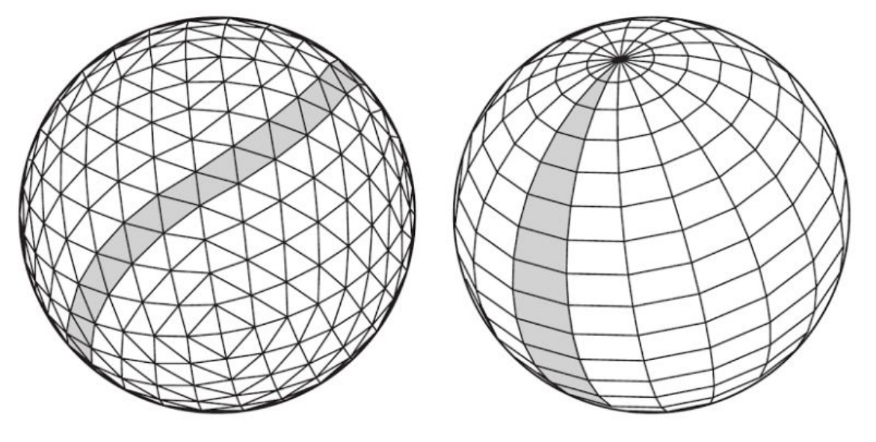
Geometry: Discrete Sphere

Slide 5
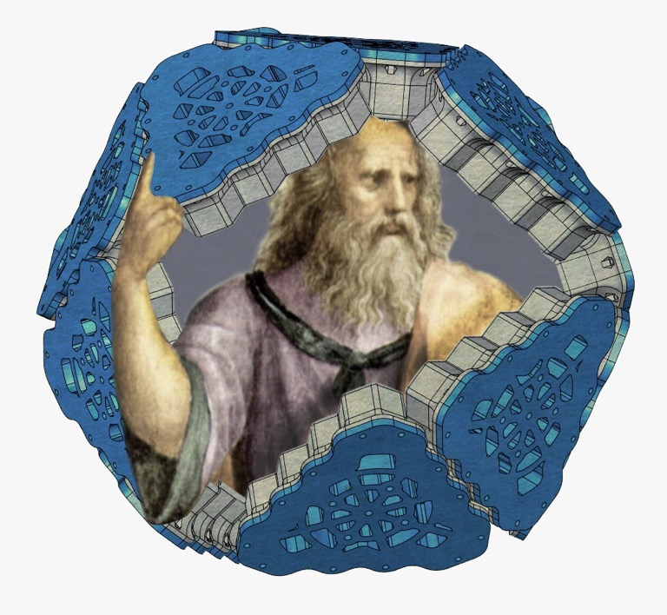
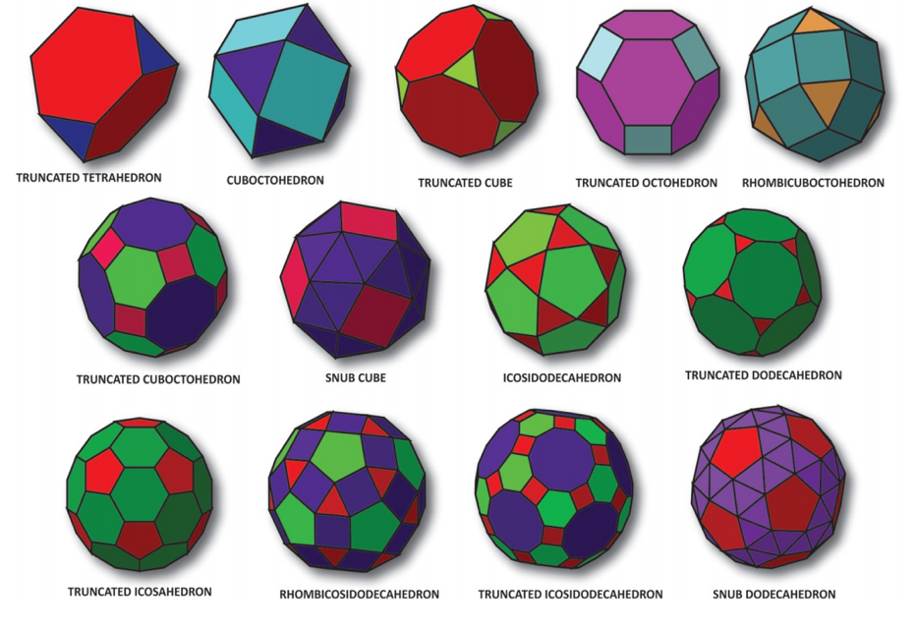
Geometry: Plato vs Archimedes
Platonic solids
Equidistant faces for similar sensitivity
Similar faces facilitates the reconstruction problem and the electronics
Faces with normal facing the center for better geometry efficiency
Avoid sharp angles
Archimedean solids

Slide 6
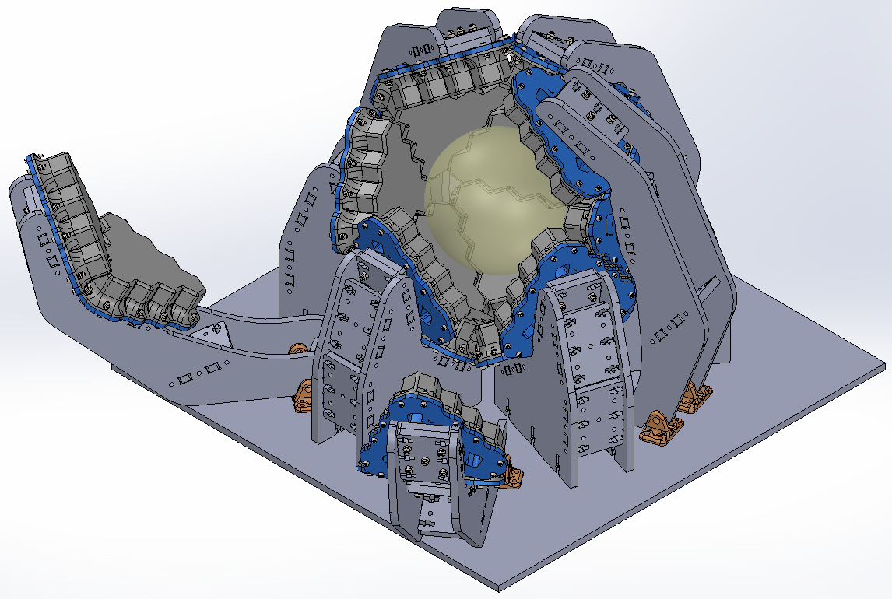
IcoPET – Proof of Concept (PoC)
Geometrical efficiency of 73% over 4π, 234 mm diameter inscribed sphere, FOV of 152 mm of diameter.

Slide 7
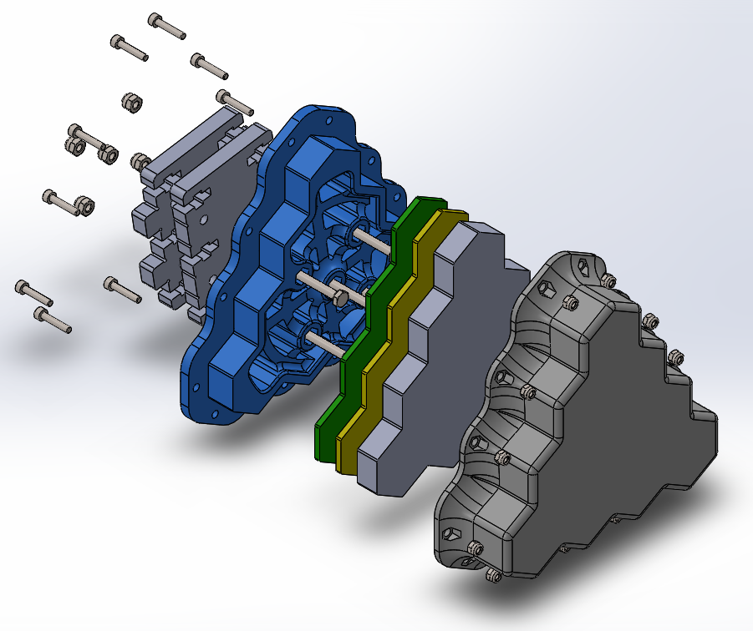
Face view
Power supply and OF data link
Electronic PCB
Scintillator
Chassis and heat sink
SiPM Matrix
Cover and light shield

Slide 8
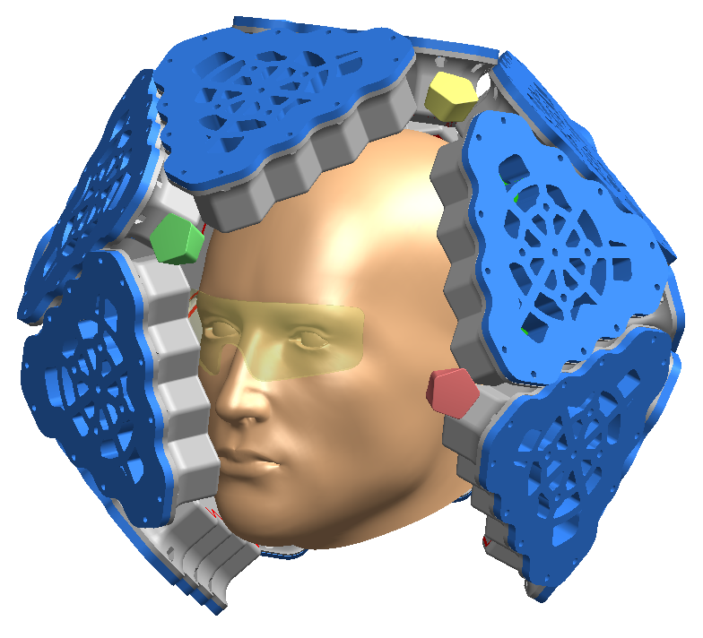
IcoPET – Clinical head scanner
Yellow virtual reality “goggles”
Pentagons: light sources (yellow) and cameras (green) for anatomical reference.
Extensible design to 15 or 21 scintillator crystals per facet.

Slide 9
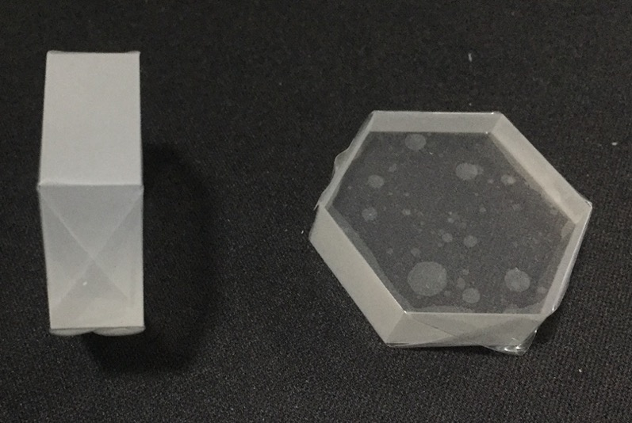
Scintillator
LYSO of 17.61 mm of edge and 10 mm thickness
181 SSLE pixels of 1.24 mm hex side

Slide 10
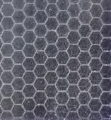
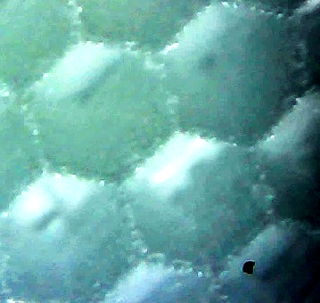
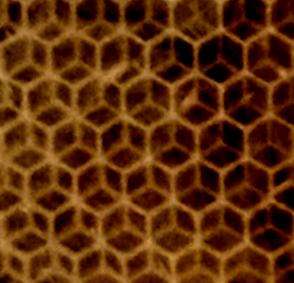
Sub Surface Laser Engraving
Better light guiding (towards round pixels)
Optimal solution of circle packing problem
Uniform distance between centers of neighbor pixels
Depth of Interaction (DoI)
vs
Konstantinou et al. IEEE TRPMS vol. 1, no. 5, Sep 2017

Slide 11
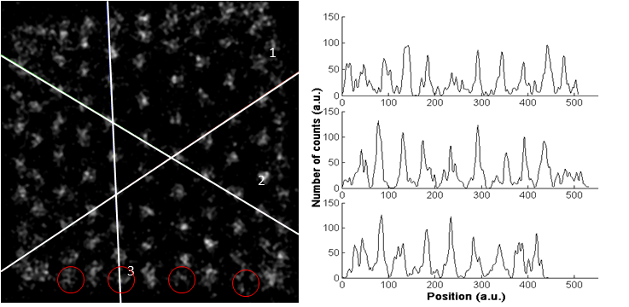
SSLE hexagonal engraving
$$PR=\frac{{FWHM}_{peak}}{{Distance}_{peak}}$$
Low count rate Pixel Resolvability (PR): 0.32 (square MPPCs)
Konstantinou et al. IEEE TRPMS vol. 1, no. 5, Sep 2017

Slide 12
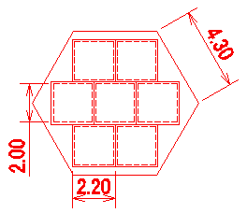
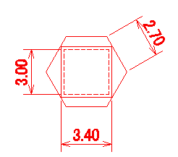
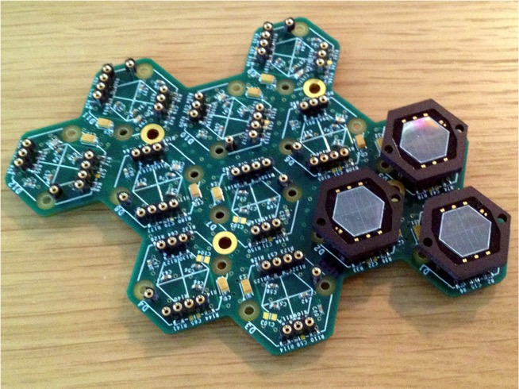
MPPC design - Earlier studies
The highest-density lattice arrangement of circles is the hexagonal packing arrangement, in which the centers of the circles are arranged in a hexagonal lattice (honeycomb).
First designs
Hamamatsu S12516
SST-1M Consortium for the CTA

Slide 13
Single Hexagonal MPPC design

Slide 14
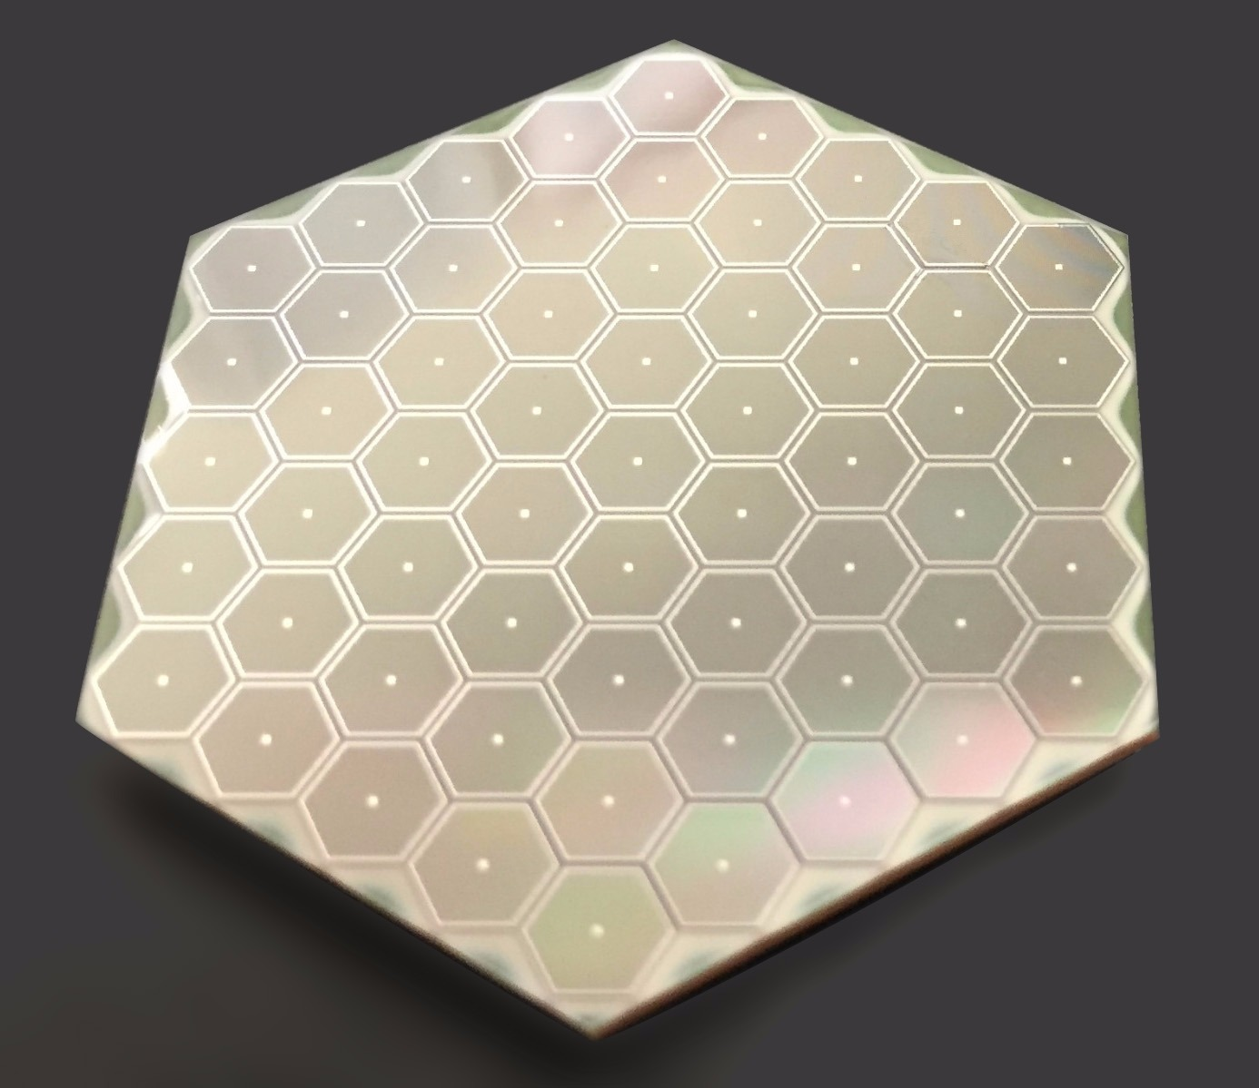
Hexagonal MPPC Array design

Slide 15
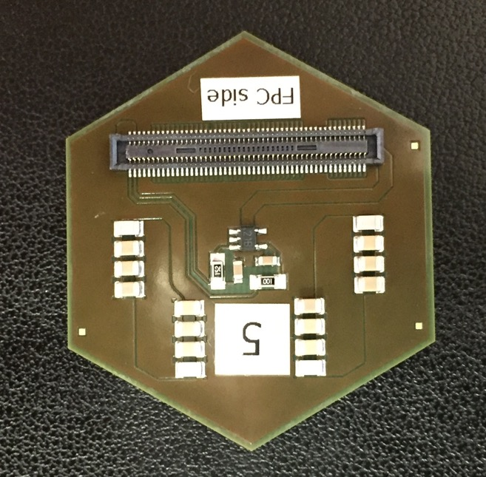
Hexagonal MPPC Array design
Notes:
Back side

Slide 16
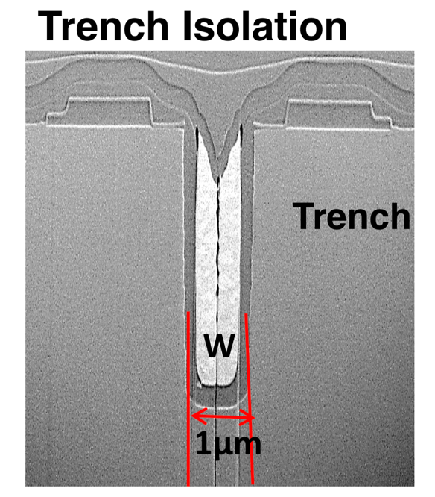
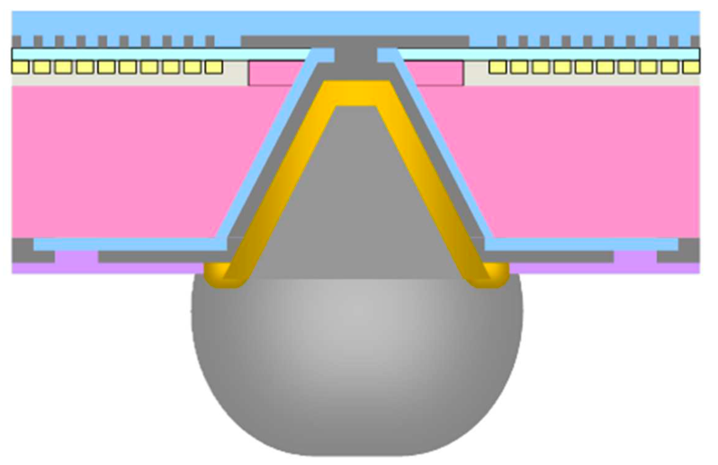
Hex-MPPC construction
Through Silicon Via (TSV) Technology
Optimization of Trench and Active area

Slide 17
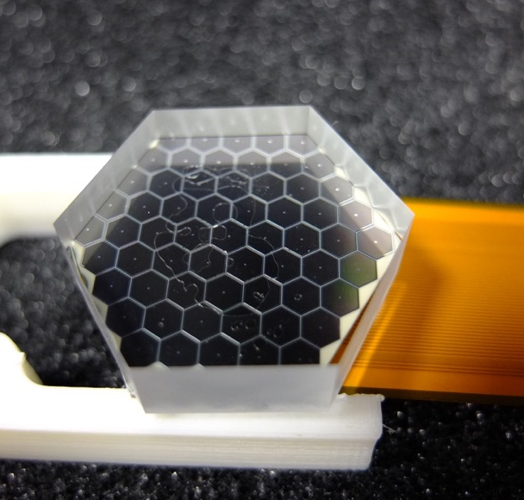
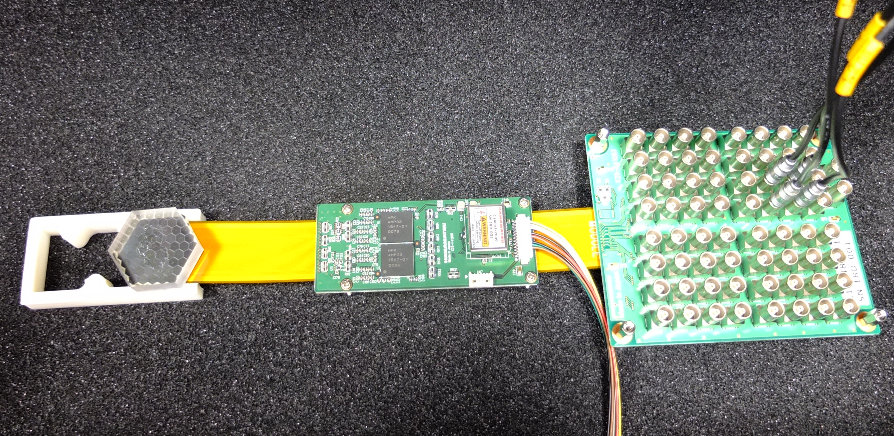
Hexagonal MPPC test bench
Monolythic LYSO crystal coupled the Hex MPPC
61 preamp pixel channels + energy channel + HV (temp. compensation)

Slide 18
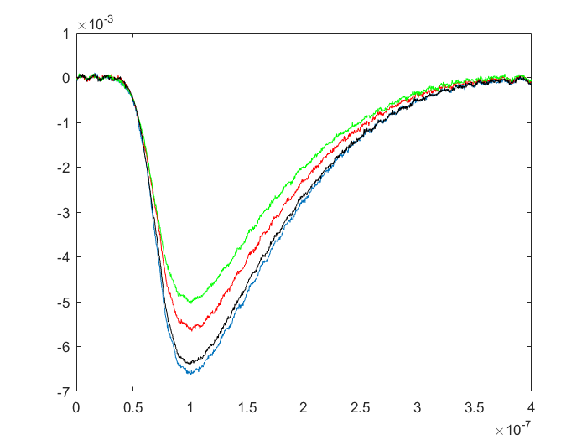
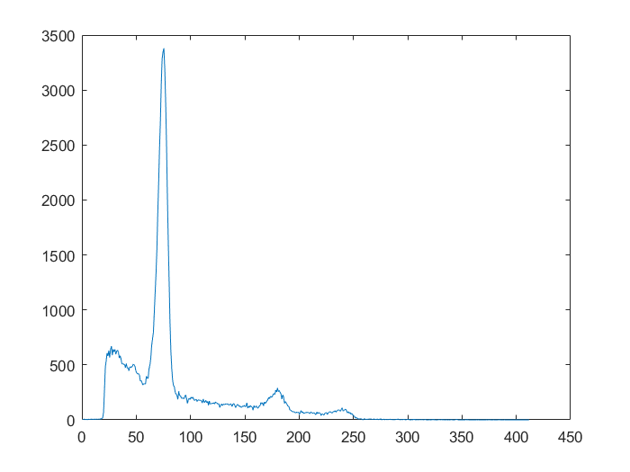
Single Hexagonal MPPC channel signals
Individual MPPC signals
Energy spectrum
511 keV
counts
volts
1274 keV
s
channel
Four central channels, pre-amp gain = -1, Z_{L}= 51 ohms, RC constant= 75 ns
LYSO monolithic crystal, ²²Na point source

Slide 19
Conclusions and future work
Design of a new geometry as PoC for head PET scanner
Development of flexible crystal SSLE method
Implementation of a new hexagonal SiPM
Total characterization of hexagonal MPPC
Assemble of two facets in coincidence
Readout electronics integration

Slide 20
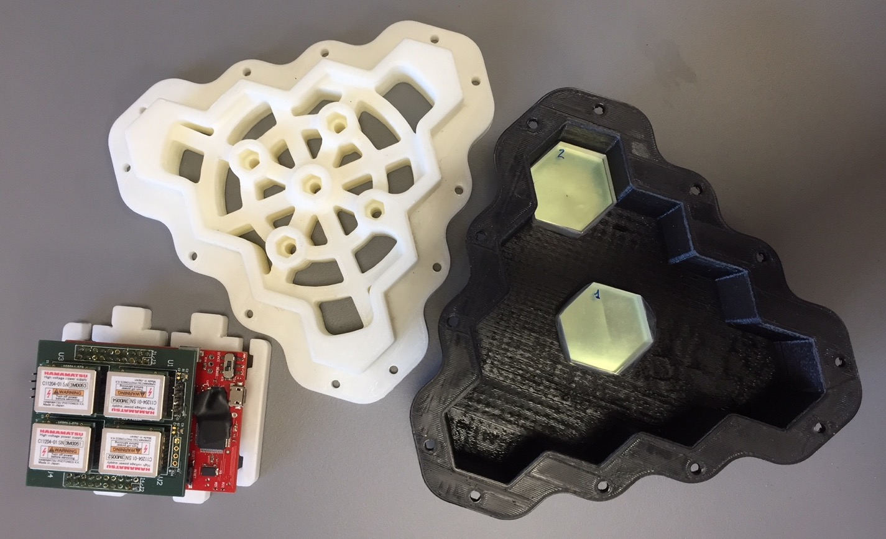
Thanks!

Slide 22
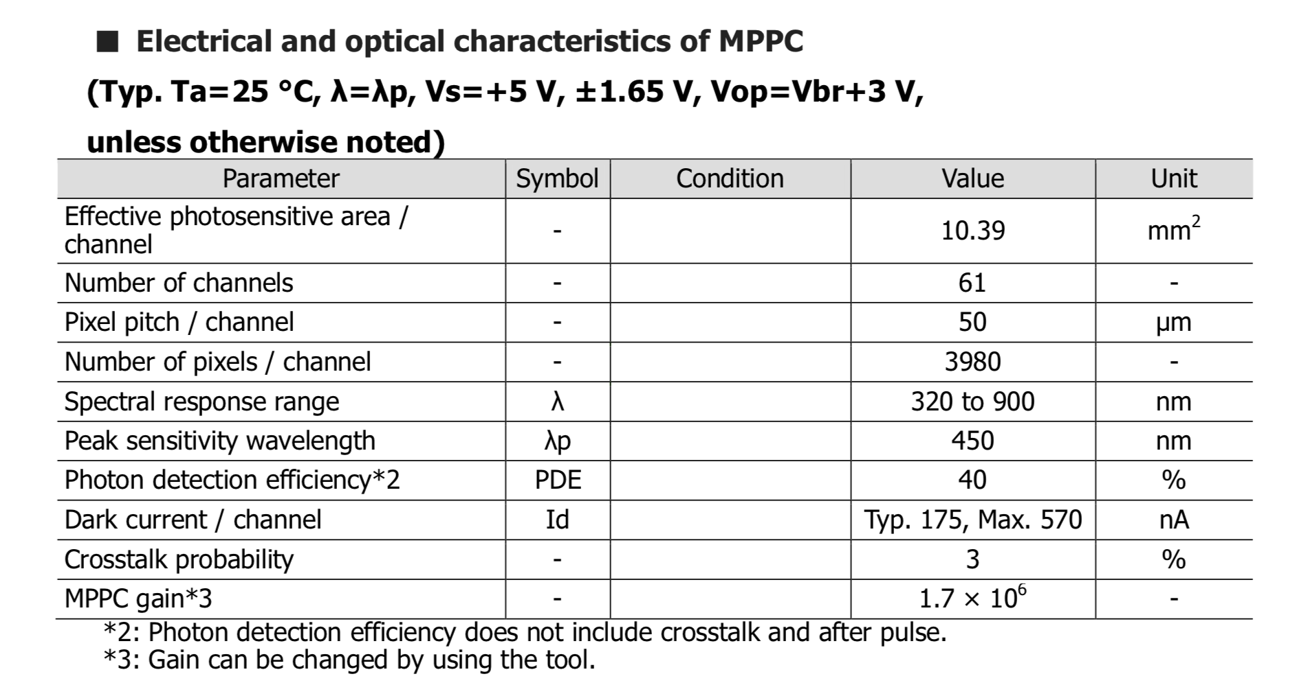
Hexagonal MPPC

Slide 23
Pre-amp

Slide 24
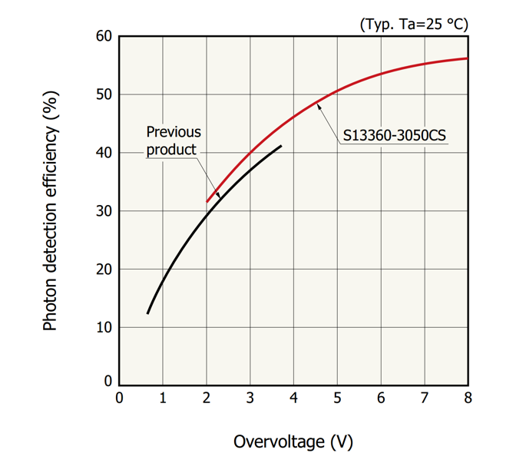
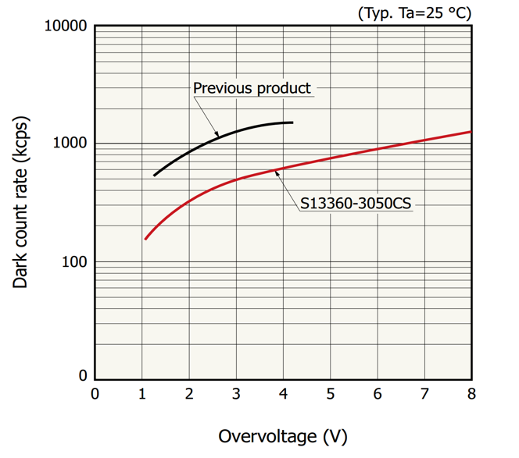
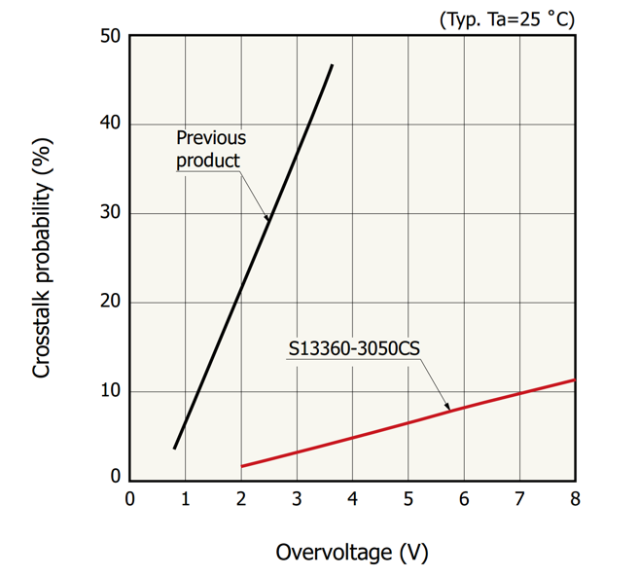
Hexagonal MPPC: Hamamatsu results

Slide 25
Hexagonal MPPC results

Slide 26
Hexagonal MPPC results
Hex MPPC 61CH (LVR+TSV)

Slide 27
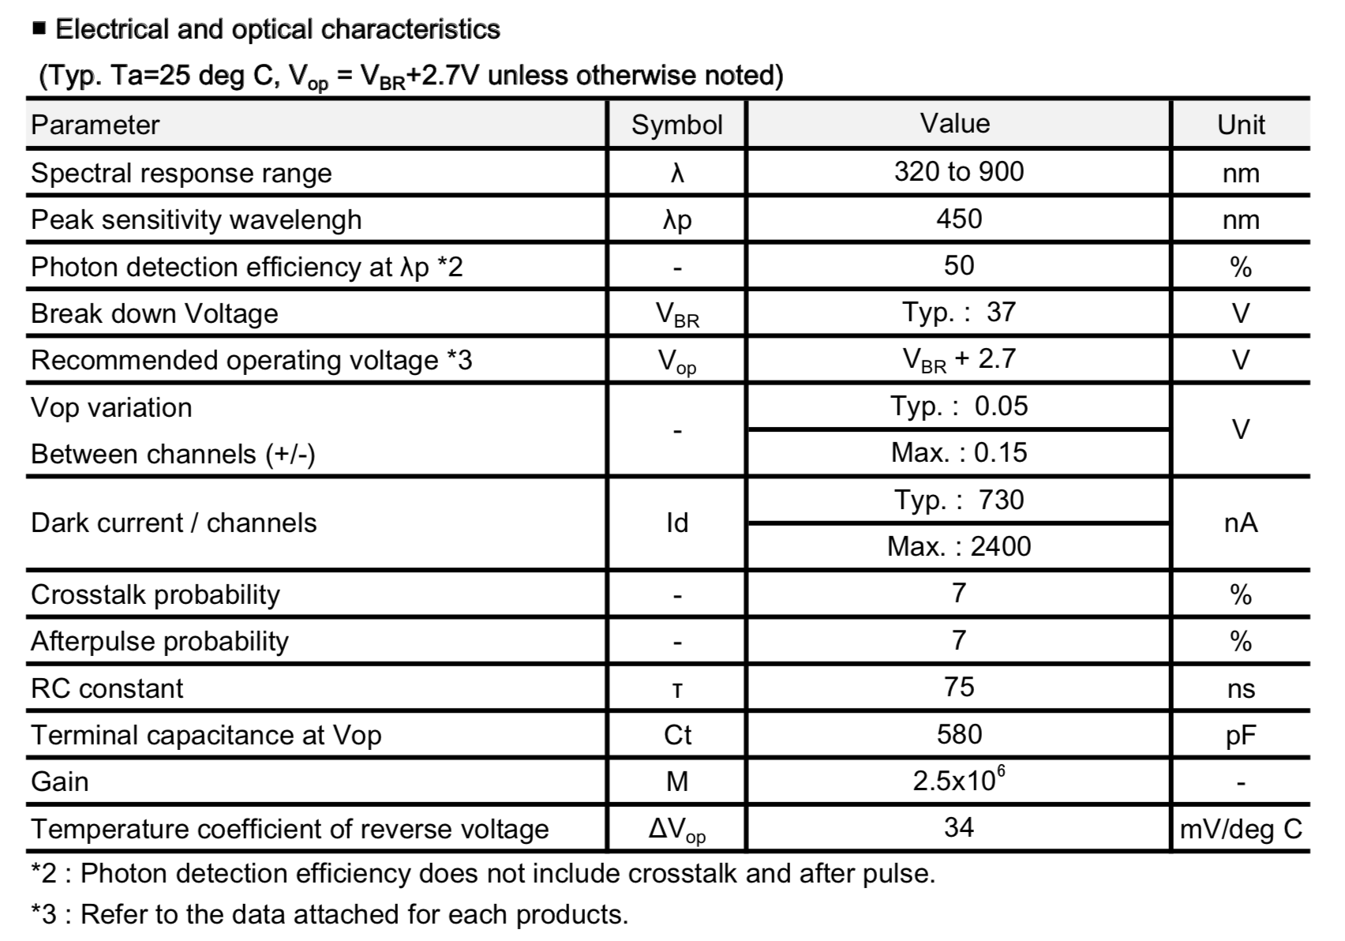
Hexagonal MPPC results

