Slide 1
14th Pisa Meeting on Advanced Detectors 2018, Isola D’Elba, Italy
77K superconducting electronics based on
coherent operation of SQUID arrays
for advanced detection in physics
Boris Chesca
Physics Department, Loughborough University, UK
Collaborators
Loughborough University (simulations, design, measurements)
Experimental: PhD/postdoc, Daniel John
Marat Gaifullin
Master students: Matthew Kemp, Jeffrey Brown, Richard Pollett
Theory: PhD Jonathan Cox,
Sergey Savelev
Nottingham University (fabrication): Christopher Mellor

Slide 2
Low temperature superconducting detectors
@ (300mK-4.2K): very successful !

Slide 3
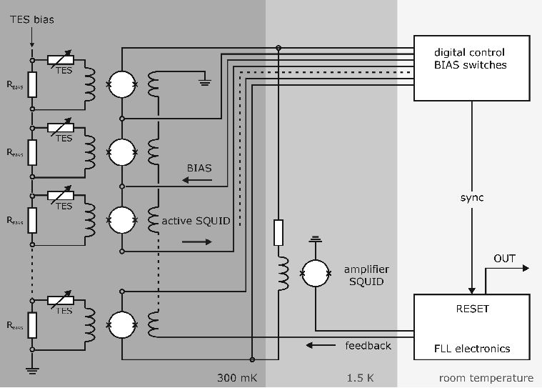
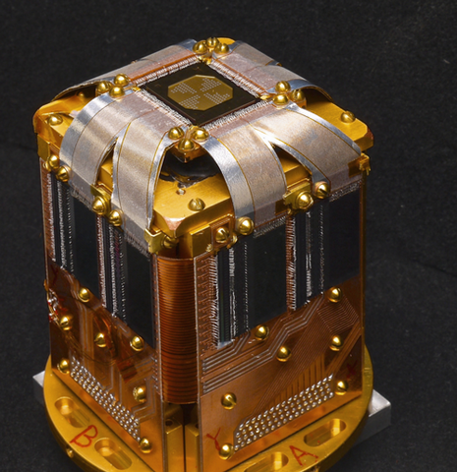
Superconducting X-ray detectors @ (300mK-1.5K)
x-ray emission, absorption, and scattering spectroscopy
Transition Edge Sensors
(TES)
SQUID
amplifier
SQUID
multiplexers
National Institute of
Standards and Technology
NIST, US
National Synchrotron Light Source (NSLS) at Brookhaven National Laboratory
Advanced Photon Source (APS) at Argonne National Laboratory
Stanford Synchrotron Radiation Lightsource (SSRL) at SLAC National Laboratory
time-resolved hard-X-ray absorption spectroscopy (Lund Kemicentrum, NIST)
particle-induced X-ray emission at the Jyväskylä Pelletron accelerator.
spectroscopy of pionic atoms at the Paul Scherrer Institute.

Slide 4
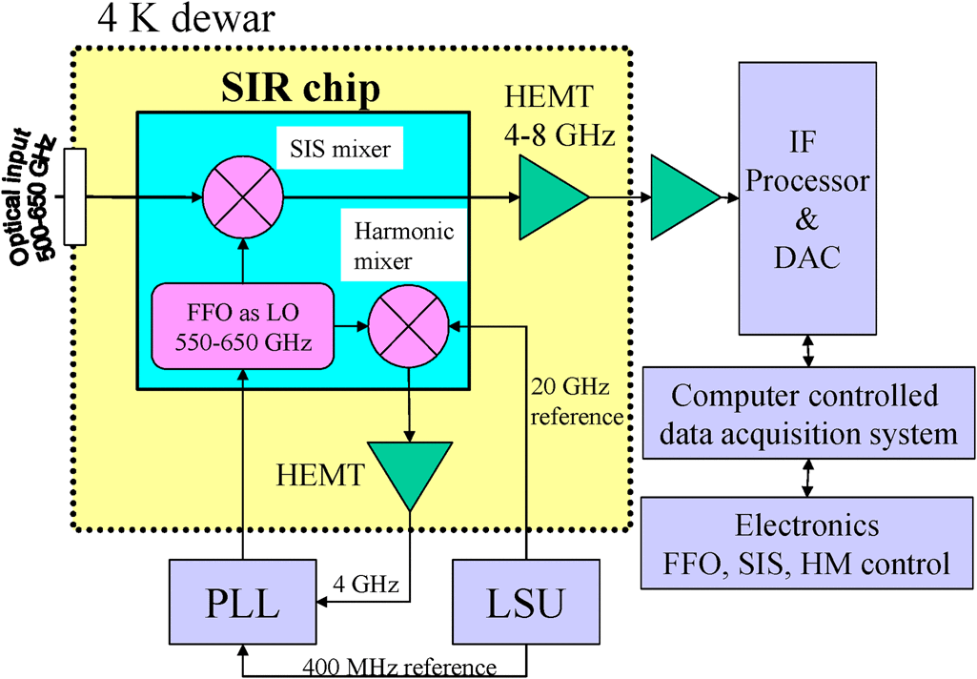
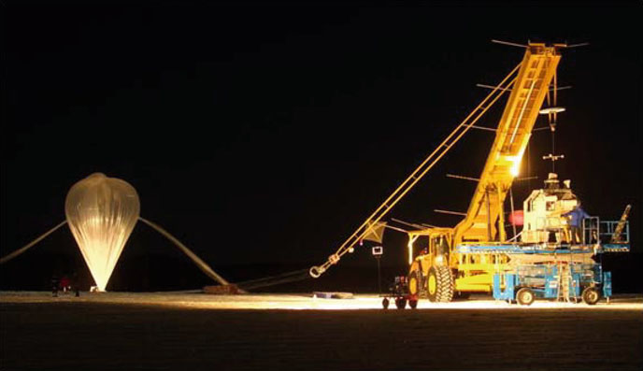
Superconducting Integrated Receiver, SIR
for atmospheric spectroscopy
SIS-mixer with quasi-optical antenna,
Flux-Flow oscillator (FFO) as the local oscillator
harmonic mixer to phase-lock the FFO
Block-diagram of a SIT
Valery Koshelets et al, 2011
TELIS-MIPAS launch, Esrange, Sweden; March 2009
Balloon size: 400,000 m³ ; payload weight: 1,200 kg

Slide 5
SQUID-arrays @ 77 K better
than single-SQUID @ 4.2 K
first time since discovery of high temperature superconductors in 1986

Slide 6
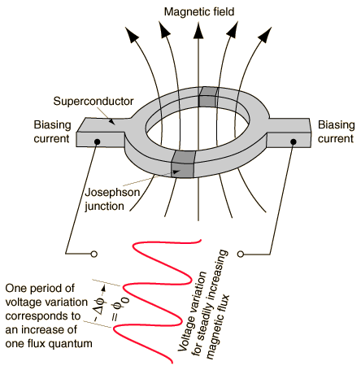
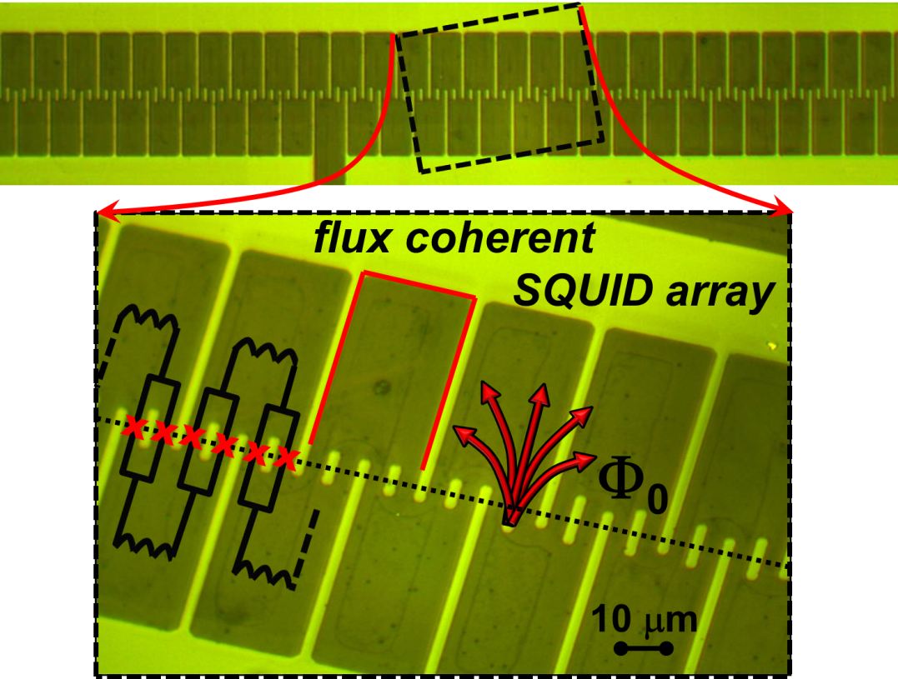
SQUID arrays
SQUID
N SQUID array
Noise_{Array} = N^{1/2} Noise_{SQUID}
V_{Array} = N V_{SQUID}
[
]
1
[
]
Noise Noise
V V
=
Array
N^{1/2}
SQUID
flux coherent & non-interacting SQUID array

Slide 7
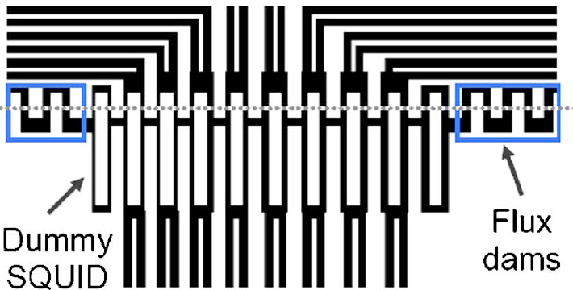
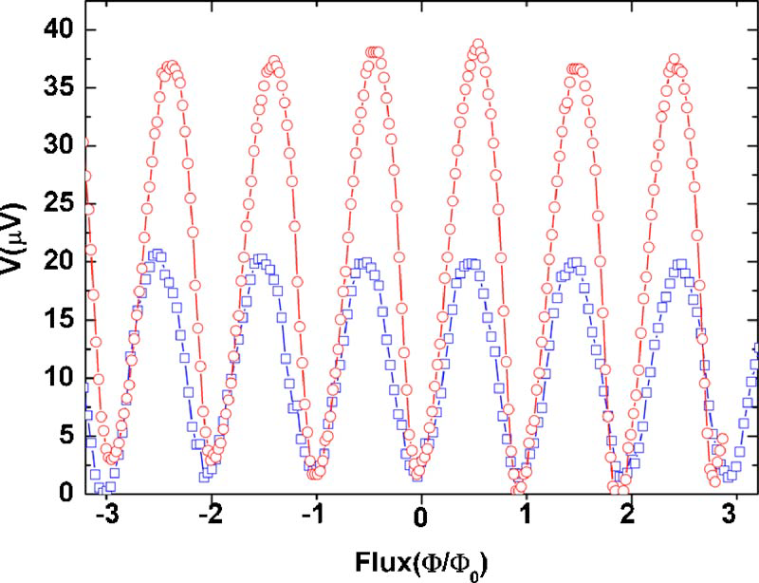
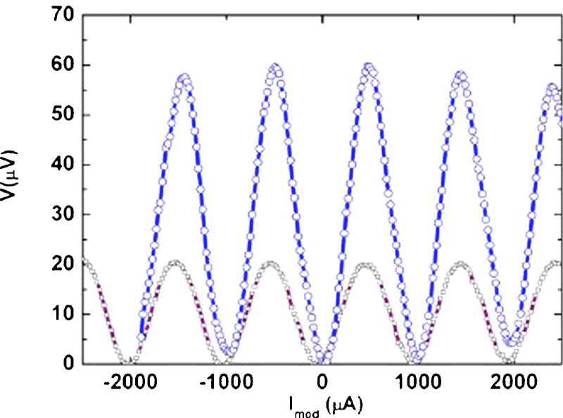
V_{Array} = N V_{SQUID,} small arrays (N=10)
V_{Array} = N V_{SQUID} true for 2 SQUIDs
V_{Array} = N V_{SQUID} NOT true for 10 SQUIDs!
2 SQUIDs
1 SQUID
10 SQUIDs
1 SQUID
Chiu-Hsien Wu et al, J. Appl. Phys. 100, 064510 (2006);

Slide 8
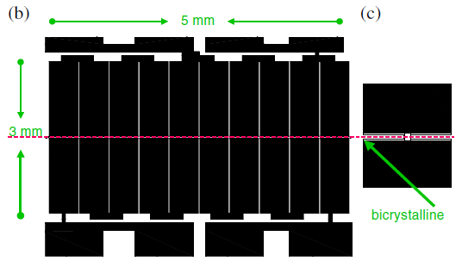
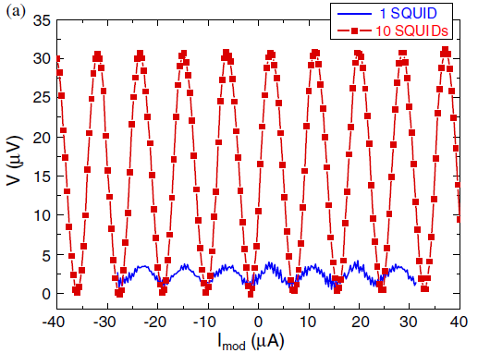
V_{Array} = N V_{SQUID} , small arrays (N=10)
2D flux focuser
C. H. Wu et al, Supercond. Sci. Technol. 19, S246 (2006)

Slide 9
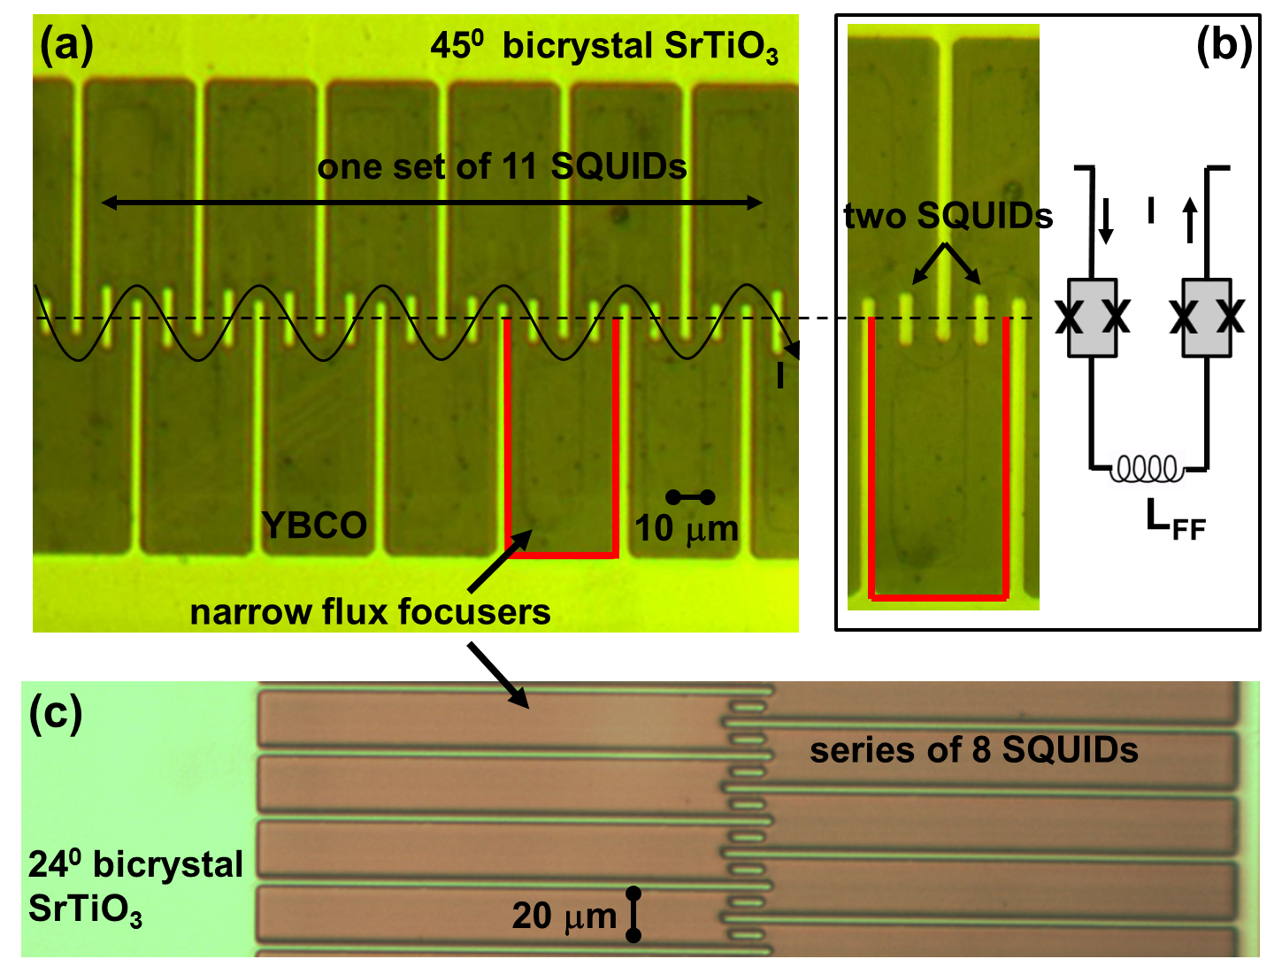
Large SQUID arrays (N=484, 770)
B. Chesca, D. John, C. Mellor, Appl. Phys. Lett. 107, 162602 (2015)
International Patent, PCT: B. Chesca, D. John, WO2017006079 A1(2017)

Slide 10
SQUID arrays @ 77K better than SQUIDs @ 4.2 K
B. Chesca, D. John, C. Mellor, Appl. Phys. Lett. 107, 162602 (2015)

Slide 11
Flux-flow microwave
generators/receivers @ 77K
first time since discovery of high temperature superconductors in 1986

Slide 12
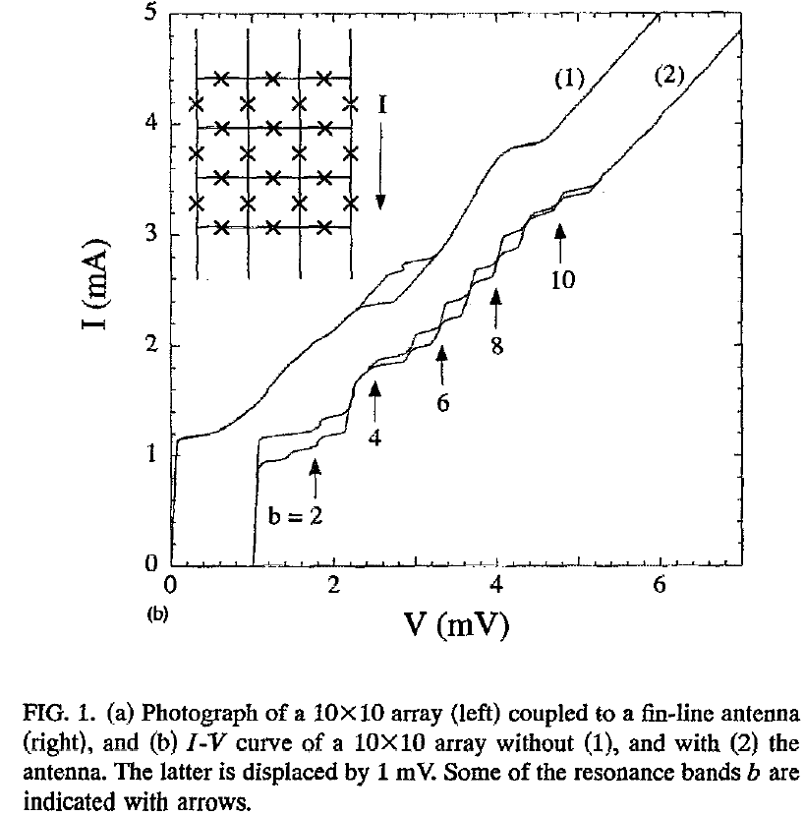
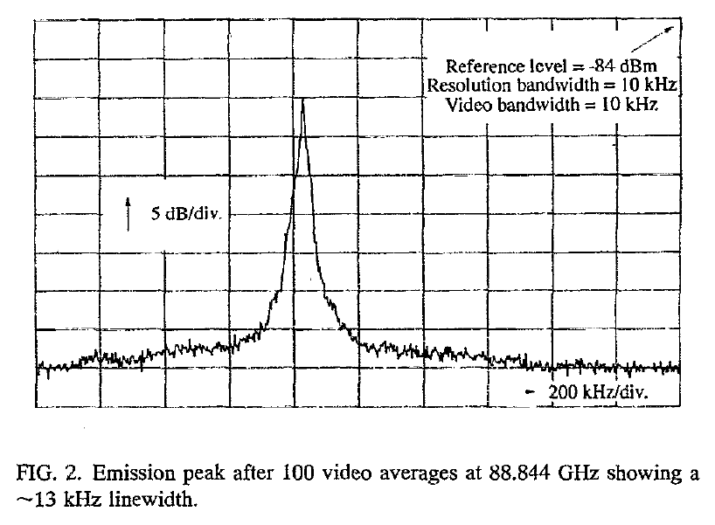
10x10 JJ array as tunable microwave generators @ 4.2K
53-230 GHz
P. A. A. Booi, and S. P. Benz, Appl. Phys. Lett. 64, 2163 (1994)

Slide 13
Flux-flow resonances in asymmetric 440 SQUID arrays
B-field tunable power of about 0.1 µW within the range (1.5-25) GHz @ 77K
P=0.5(I×I_{step}/I_{c})²R_{N}/N
B. Chesca, D. John, C. Mellor, Supercond. Sci. Technol. 27, 085015 (2014)

Slide 14
Flux-flow resonances in asymmetric 440 SQUID arrays
B. Chesca, D. John, C. Mellor, Supercond. Sci. Technol. 27, 085015 (2014)

Slide 15
Conclusions
• Remarkable performances shown by very large arrays-based devices @ 77K
series arrays: magnetometers
asymmetric parallel arrays: flux-flow microwave generators/receivers
• Great potential
to replace single-SQUID based devices @ 4.2K
performance can be further improved by optimization

