Slide 1
The CMS High Granularity Calorimeter for the High Luminosity LHC
Manfred Valentan (HEPHY Vienna)
on behalf of the CMS collaboration
14th Pisa meeting on advanced detectors

Slide 2
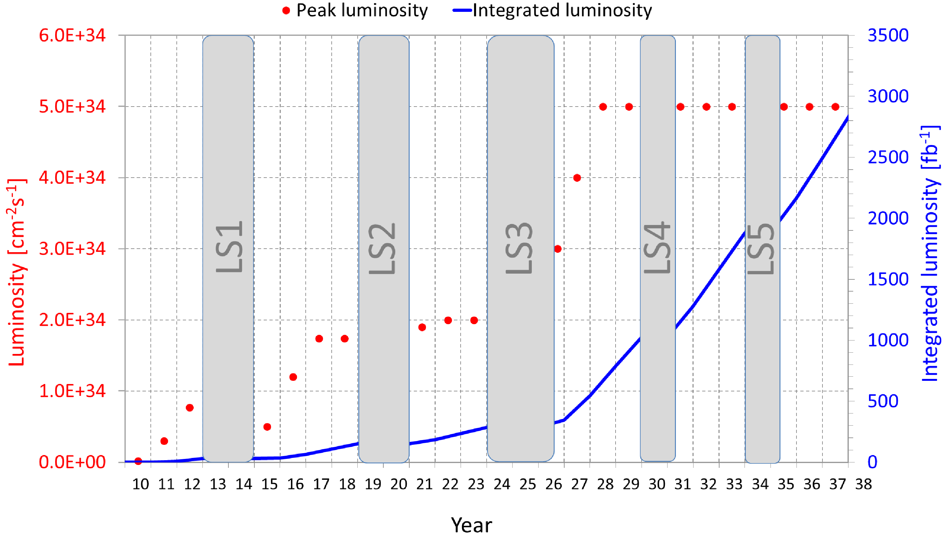
In the near future…
Luminosity step
Phase 0
Phase 1
Phase 2 (HL-LHC)
…the LHC will increase its luminosity considerably

Slide 3
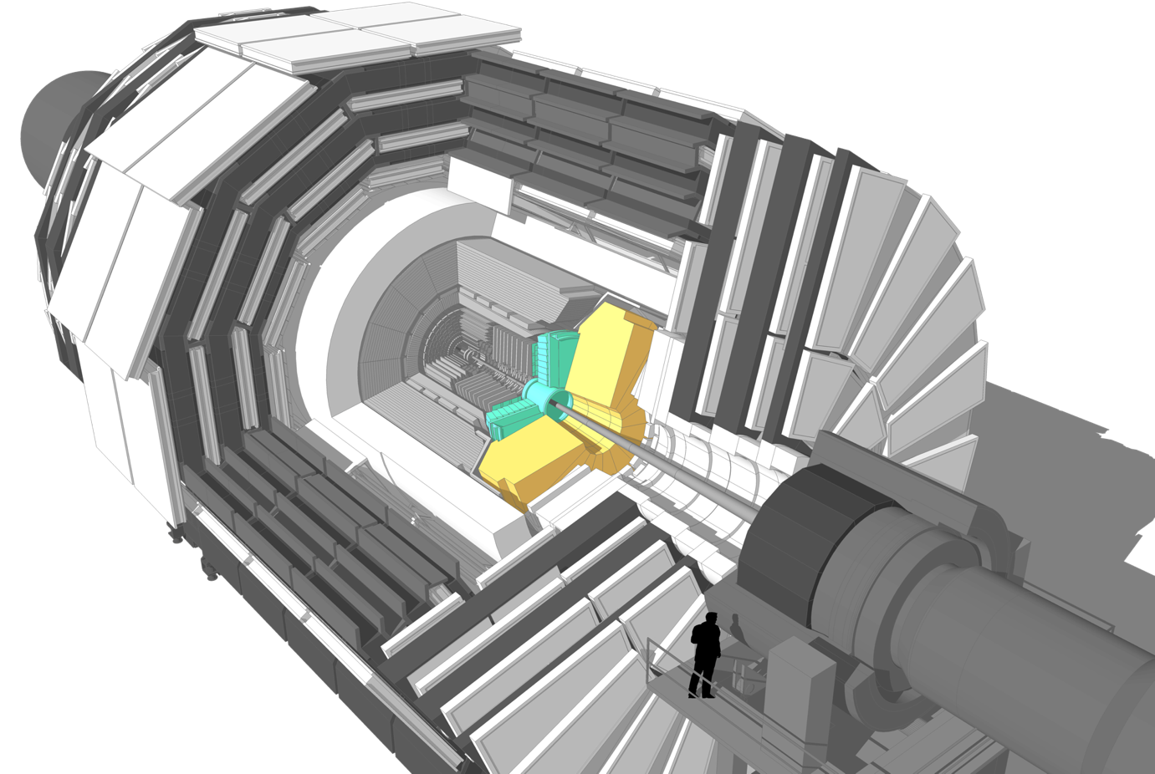
In the near future…
…we have to replace the endcap calorimeters

Slide 4
Outline
Why can‘t we reuse the existing technology?
  Challenge 1: Pileup
  Challenge 2: Radiation
Concept of the new endcap calorimeter
  Silicon sensors + scintillator/SiPM
  Mechanics
  Front-end electronics
Expected performance
  Precision timing
  Beam tests
Summary

Slide 5
Outline
Why can‘t we reuse the existing technology?
  Challenge 1: Pileup
  Challenge 2: Radiation
Concept of the new endcap calorimeter
  Silicon sensors + scintillator/SiPM
  Mechanics
  Front-end electronics
Expected performance
  Precision timing
  Beam tests
Summary

Slide 6
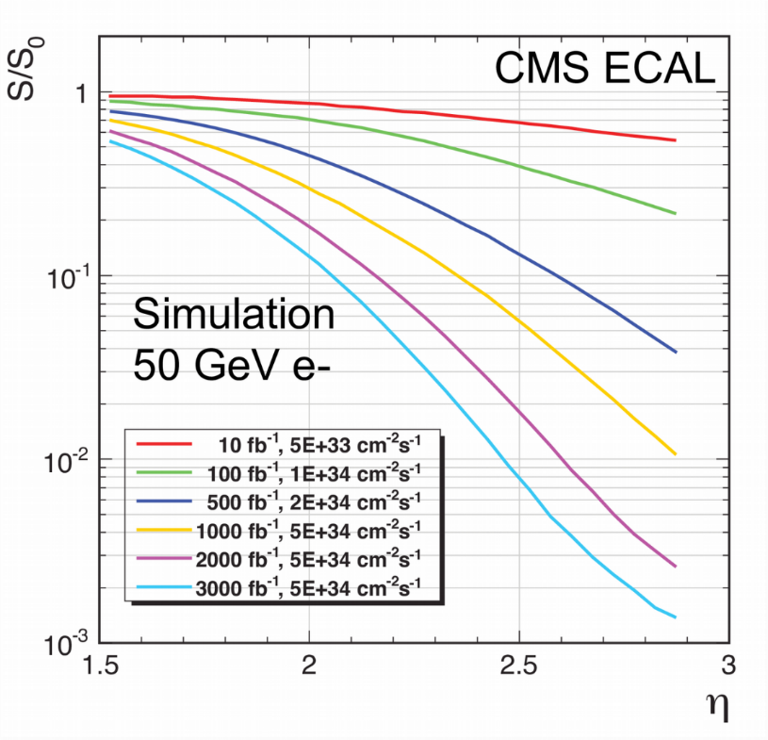
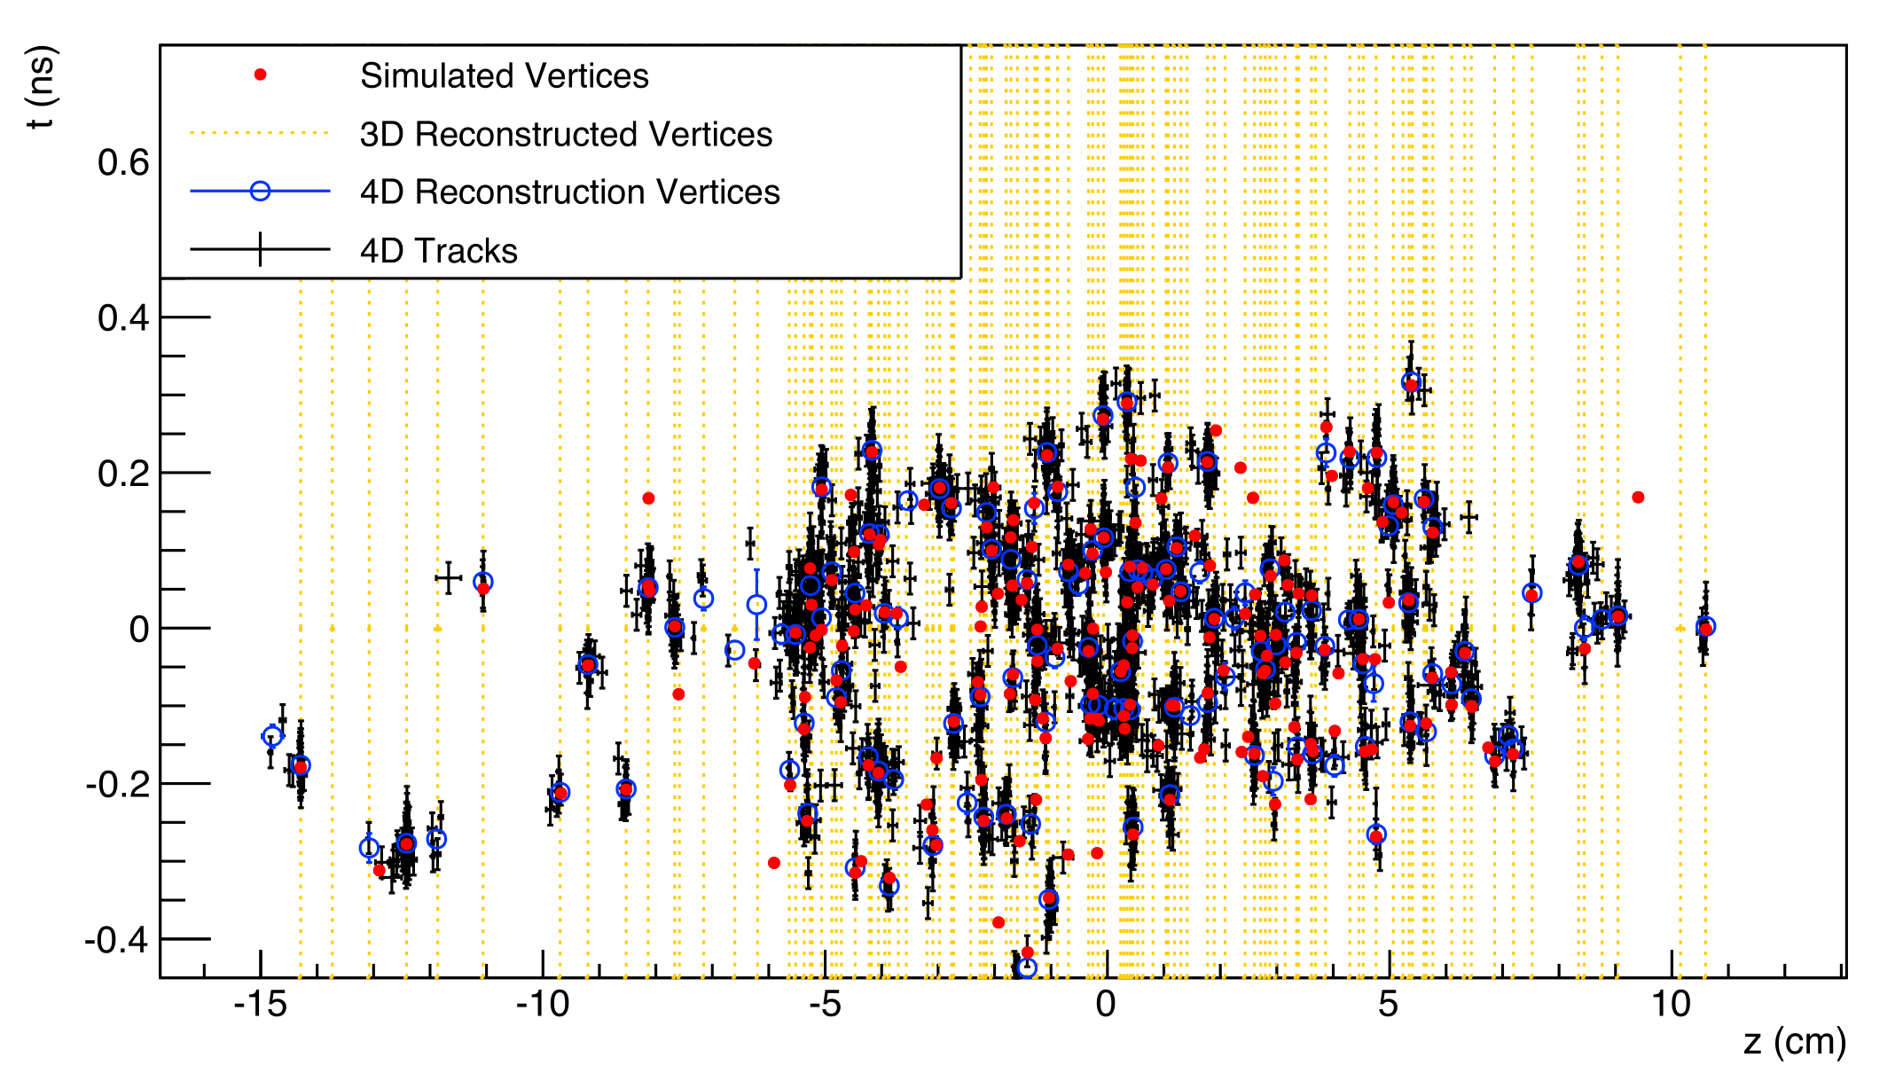
Challenges: Pileup and radiation
Pileup
  Present: up to 40 interactions per beam crossing
  Future: 140 – 200 interactions!
  Vertices spread across a nanosecond
  Resolve by using precise timing and transverse granularity
  Target time resolution of 10 – 30 ps
Radiation (example)
  Currently lead tungstate (PbWO₄) crystals
  Deterioration of signal yield by color centers
  Scaling of LASER monitoring limited, error increases constant term of energy resolution
  Resolve by using radiation-tolerant sensor material
Relative signal
Time in ns
Vertex z position in cm
Pseudorapidity

Slide 7
Outline
Why can‘t we reuse the existing technology?
  Challenge 1: Pileup
  Challenge 2: Radiation
Concept of the new endcap calorimeter
  Silicon sensors + scintillator/SiPM
  Mechanics
  Front-end electronics
Expected performance
  Precision timing
  Beam tests
Summary

Slide 8
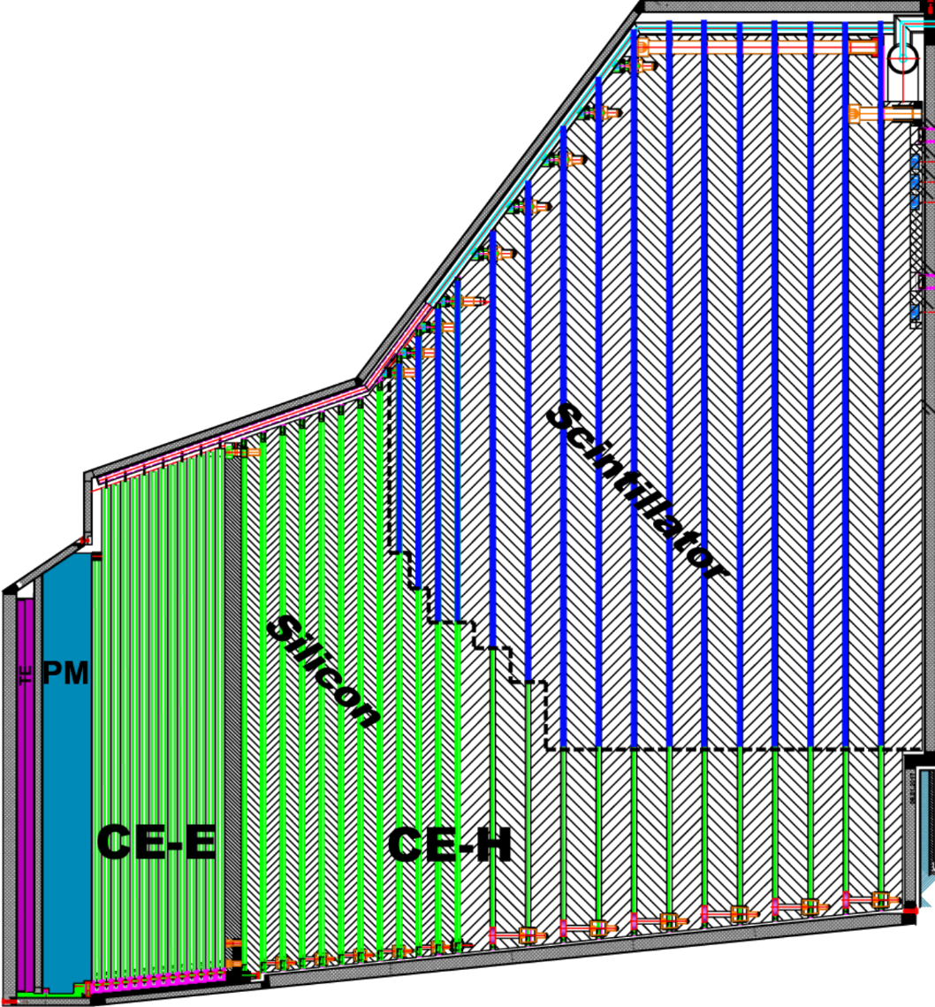
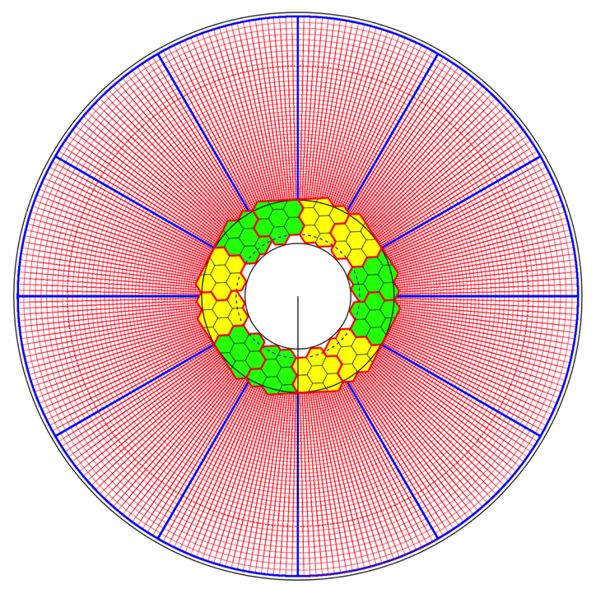
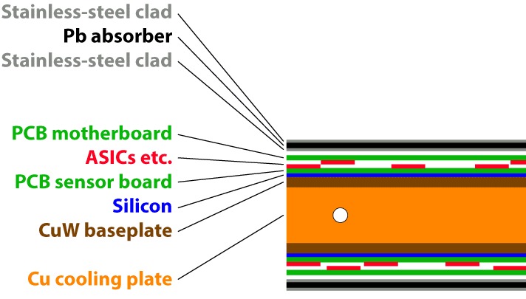
Endcap calorimeter cheat sheet
Sampling calorimeter
Unprecedented transverse and longitudinal readout segmentation
  Silicon in high radiation areas
  Scintillating tiles in the low-radiation region
Covering 1.5 < η < 3.0, operated at -30 °C
Nomenclature
  HGCal = High Granularity Calorimeter
  CE = Calorimeter Endcap (official CMS name) = HGCal
  CE-E = Calorimeter Endcap - electromagnetic section
  CE-H = Calorimeter Endcap - hadronic section
All silicon
Si + Scintillator

Slide 9
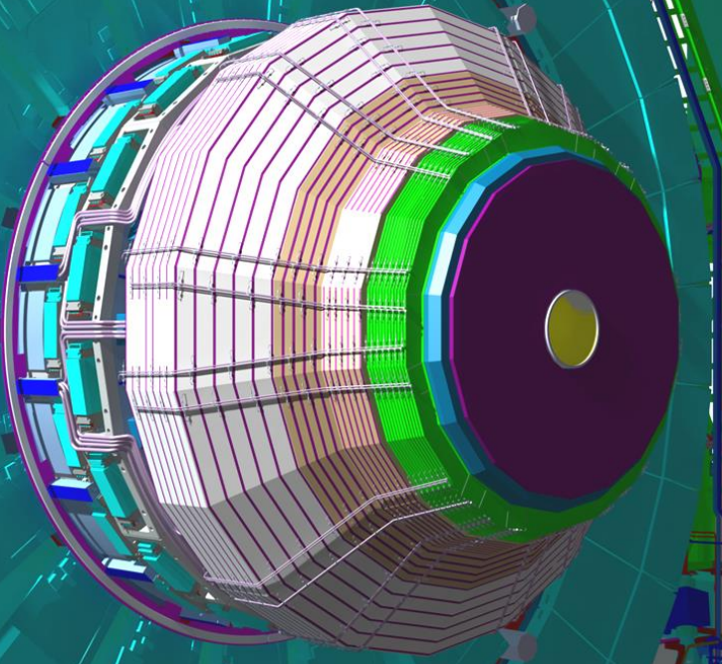
Endcap calorimeter cheat sheet
Per endcap | CE-E | CE-H (Si) | CE-H (Si + Scint)
Active | Silicon sensors |  | Scintillators
Absorber | Pb, CuW, Cu | Stainless steel, Cu
Depth | 26 X₀, 1.7 λ, 34 cm | 9 λ
Layers | 28 | 8 |  | 16
Weight | 23 t | 205 t
For both endcaps | Silicon sensors | Scintillators
Area | 600 m² | 500 m²
# Modules | 27,000 | 2500
Channels Size | 0.5-1 cm² | 4-30 cm²
# Channels | 6 Mio | 400k
Op. temperature | -30 °C | -30 °C

Slide 10
Outline
Why can‘t we reuse the existing technology?
  Challenge 1: Pileup
  Challenge 2: Radiation
Concept of the new endcap calorimeter
  Silicon sensors + scintillator/SiPM
  Mechanics
  Front-end electronics
Expected performance
  Precision timing
  Beam tests
Summary

Slide 11

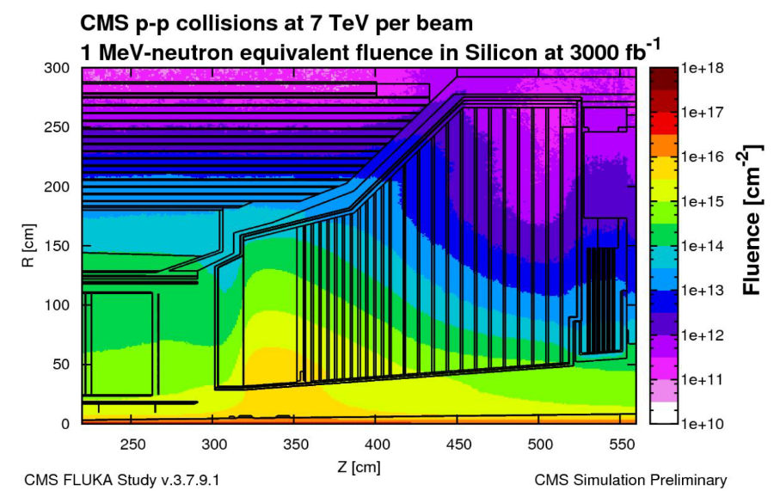
Radiation environment
8 x 10¹³ n_{eq}/cm²,
3 kGy
Scintillator
Silicon
1 x 10¹⁶ n_{eq}/cm²
2 MGy

Slide 12
Why silicon?
Relatively good understanding of and handle on mitigating radiation damage
  Can mitigate leakage current noise contribution by cooling to -30 °C
  Can mitigate signal loss by going to thinner sensors and higher bias voltage
Photolithography allows basically any desired lateral granularity
Potential to reach intrinsic time resolution of O(20 ps)
  Behavior depends only on S/N even at 10¹⁶ n/cm²
320 µm
Put thin sensors in high radiation regions!
200 µm
Signal in ke⁻
120 µm
Fluence in n_{eq}/cm²

Slide 13
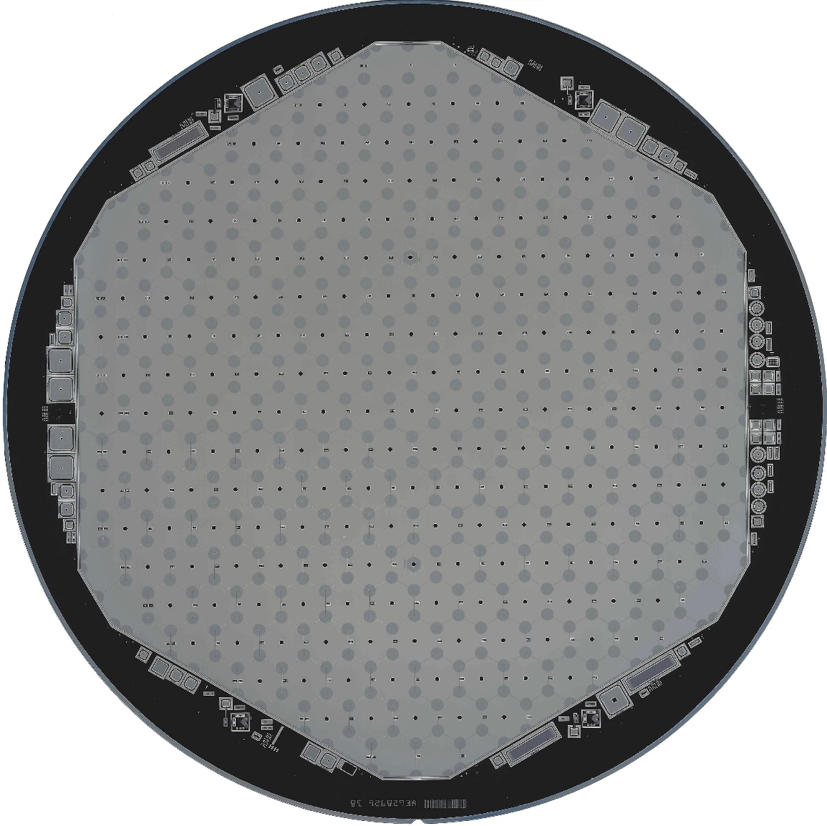
Silicon Sensors
Hexagonal on 200 mm p-type silicon wafer
  to maximize wafer area usage
  to minimize number of modules
  p-type more radiation-tolerant than n-type
Planar DC-coupled diodes as active cells
  192 cells (1 cm²) on 200 and 300 µm sensors
  432 cells (0.5 cm²) on 120 µm sensors
Three vendors have delivered prototypes
Three thicknesses based on radiation and occupancy considerations
Thickness [µm] | # cells | Cell size [cm²] | Cell C [pF] | Bulk polarity | Expected Fluence [E15 n cm⁻²] | # wafers (8 inch) | # partial 8 inch wafers
300 | 192 | 1.18 | 45 | p (n) | 0.1-0.5 | 13164 | 1284
200 | 192 | 1.18 | 65 | p | 0.5-2.5 | 8712 | 144
120 | 432 | 0.52 | 50 | p | 2-7 | 3000 | 324
 |  |  |  |  | Total: | 24876 | 1752

Slide 14
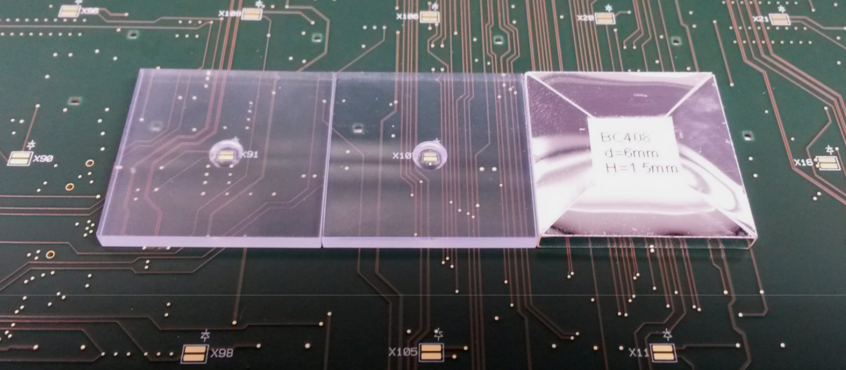
Scintillating tiles
Scintillating tiles of 4 – 30 cm² with Silicon photomultiplier (SiPM) readout
Put in low radiation part of the detector
Two materials considered:
  Polyvinyltoluene (PVT) and Polystyrene (PS)
SiPM-on-tile concept as used in the CALICE AHCAL
  SiPM sits in a dome of the tile. This aids the light collection and integration
dome
SiPM
scintillating tile wrapped in reflective foil
scintillating tile
Notes:
CALorimeter for Linear Collider Experiment Analog Hadron CALorimeter

Slide 15
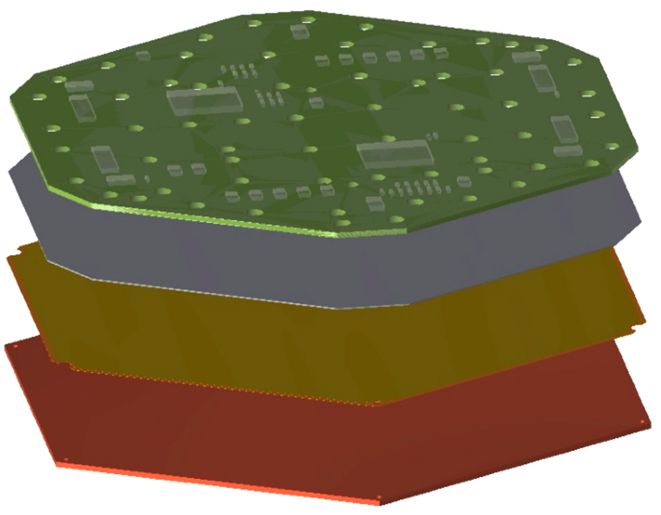
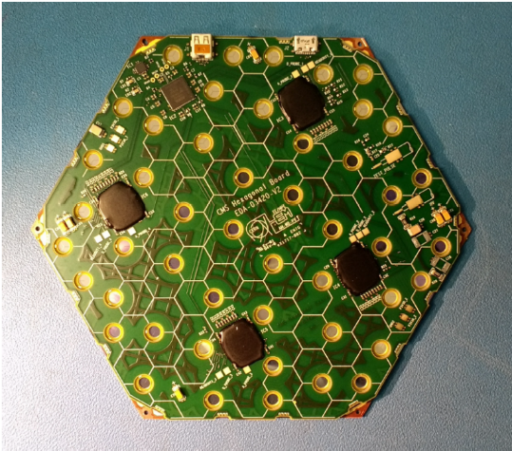
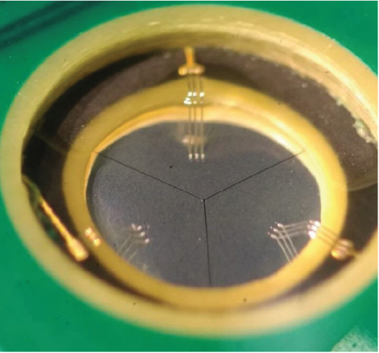
Silicon Sensor Modules
Full-area hexagonal “Hexaboard” PCB
  Holds readout chips, holes for wirebonding
  Gold-plated Kapton for backplane connection
  CE-E: Cu-W backplate as absorber and for cooling
  CE-H: Carbon fiber or Cu backplate
Multiple assembly sites with gantries
  12 modules per day per site
PCB
Silicon
Kapton
Baseplate
6“ (150 mm) prototype module
Readout chip
Wire bonding
holes

Slide 16
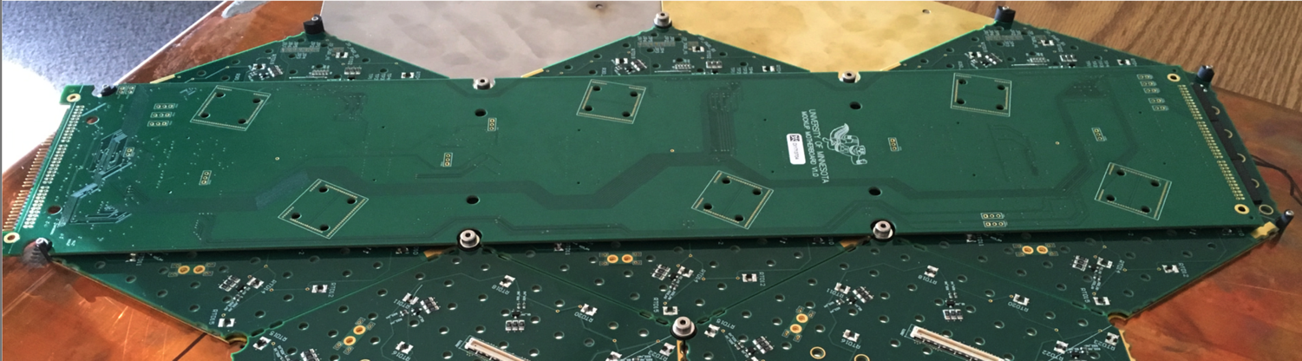
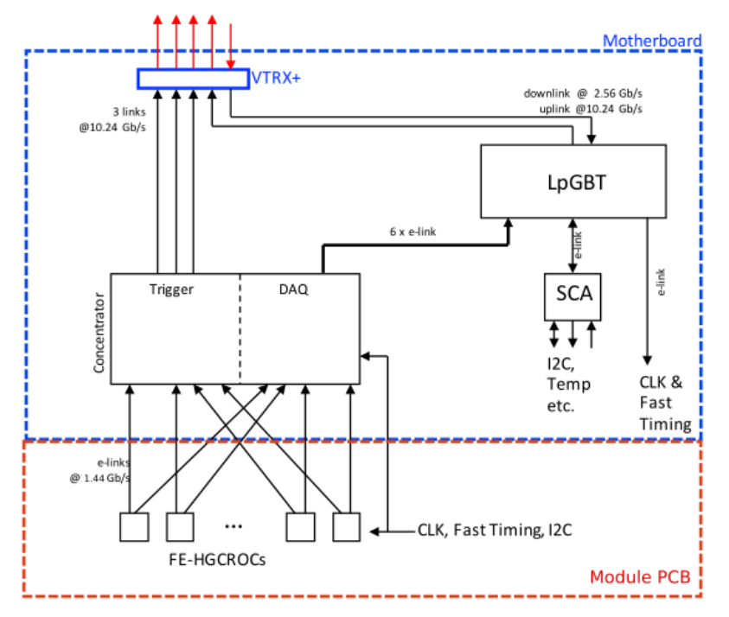
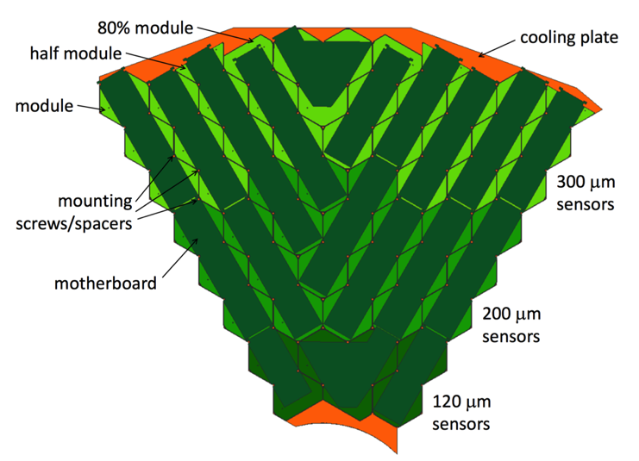
Readout chain
Module PCB (a.k.a. “Hexaboard“)
  Readout chip “HGCROC“
  current prototype SKIROC2-CMS
  Dynamic range 0.2 fC to 10 pC
  Noise < 2500 electrons for 65 pF load
  Fast shaping < 20 ns for precise timing and out-of-time pileup mitigation
  10-bit ADC, ToT with 12-bit TDC,
  ToA with 10-bit TDC, chip variant for SiPM
Motherboard
  Concentrator chip: correlates signals from multiple modules
  aggregates, formats and serializes data
  receives and distributes fast control signals
Motherboard
Module PCB

Slide 17
Outline
Why can‘t we reuse the existing technology?
  Challenge 1: Pileup
  Challenge 2: Radiation
Concept of the new endcap calorimeter
  Silicon sensors + scintillator/SiPM
  Mechanics
  Front-end electronics
Expected performance
  Precision timing
  Beam tests
Summary

Slide 18
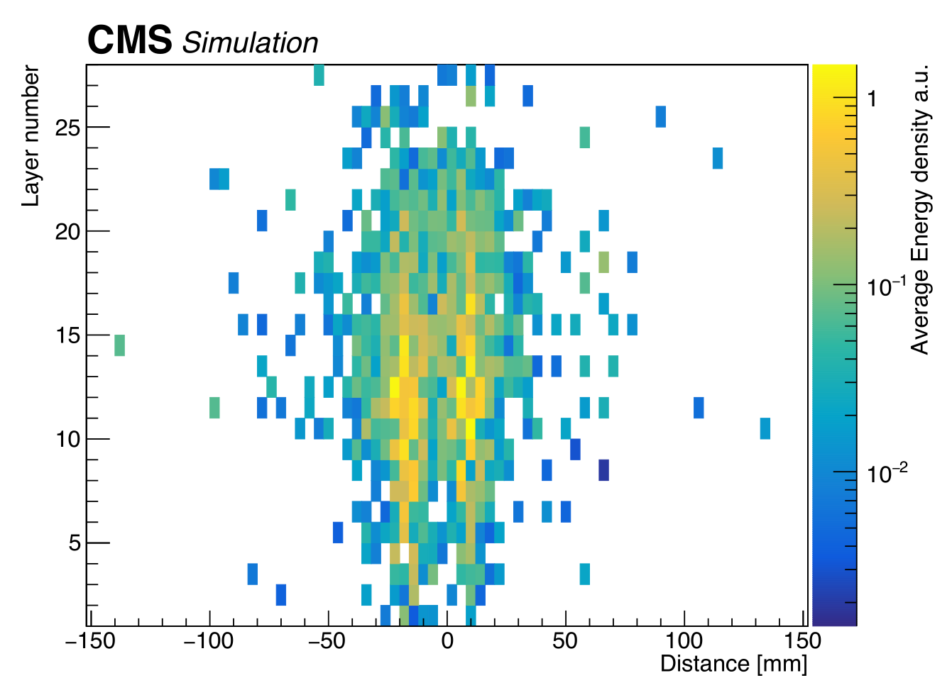
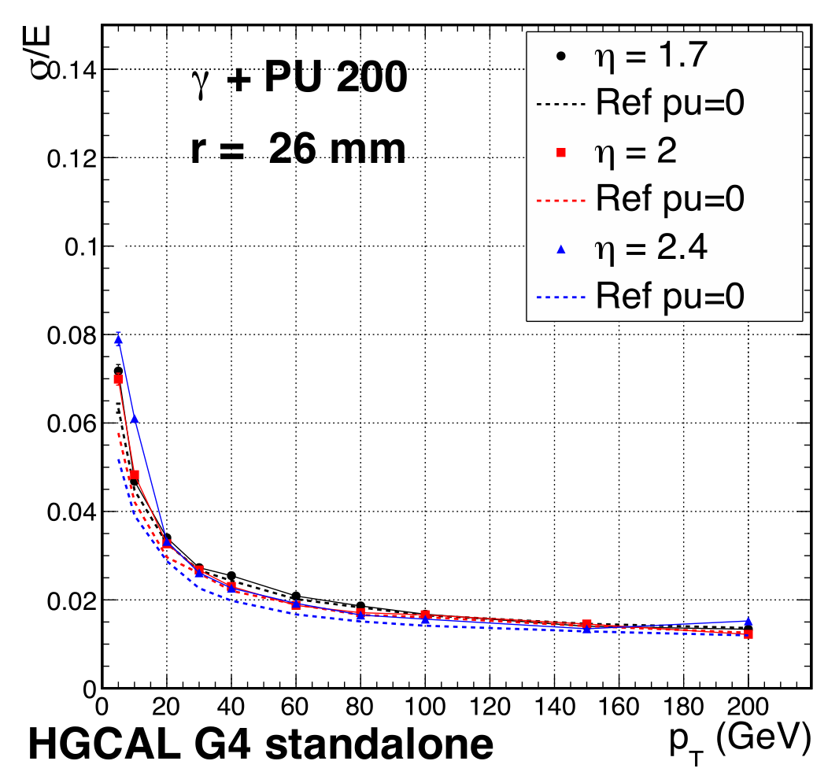
Expected performance
Compact design and chosen materials result in narrow showers
  5D-reconstruction (energy, x, y, z, time) ideally suited for particle flow
  Pileup rejection is facilitated by the narrow showers in the first layers
  Excellent electron ID capabilities, sufficient depth for muon identification
EM shower direction resolution: < 7 mRad for p_{t} > 25 GeV
EM shower position resolution: 0.6 mm (from beam test)
3000 fb⁻¹: SNR decreases, resulting noise hardly visible in energy resolution,
as long as channel-to-channel intercalibration uncertainty < 3% -> MIP calibration
σ/E ≥ 24%/√E ⊕ 0.8%
Two-photon separation
Layer number
Relative energy resolution
Intrinsic photon
energy resolution
Photon distance in mm
Poster!
Transverse momentum in GeV

Slide 19
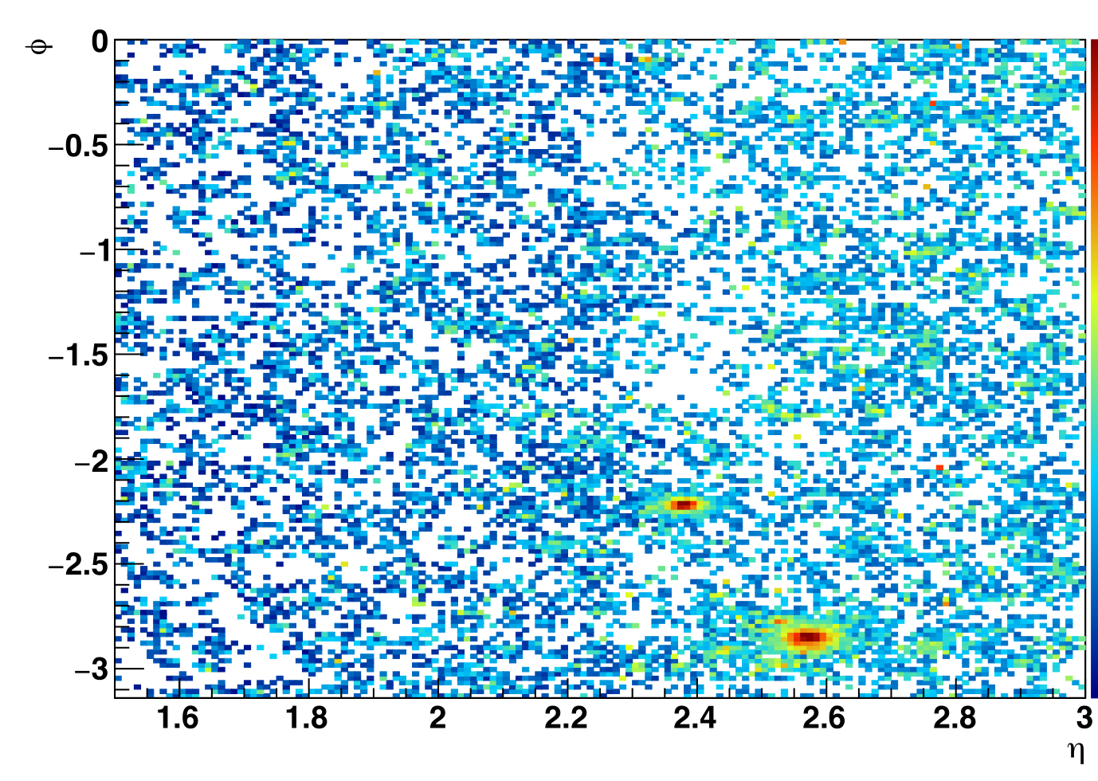
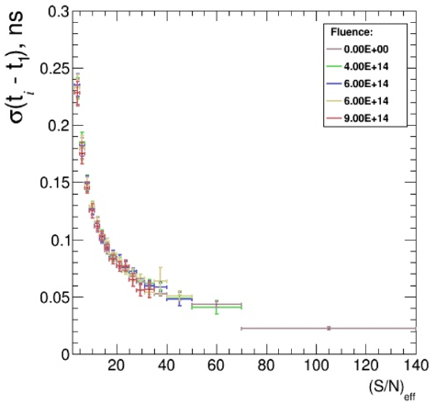
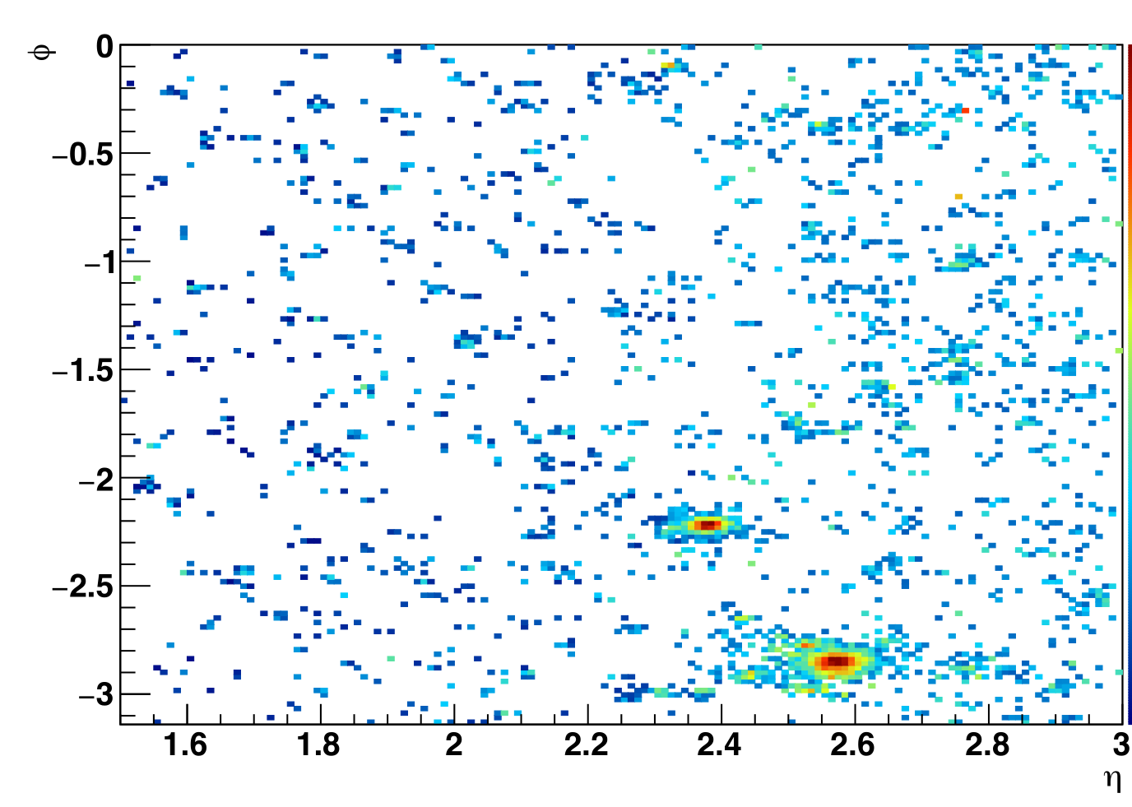
Precision timing
Background rejection in forward direction is particularly challenging
  Simplest approach: Use timing cut on hits
  Ultimate approach: Combine Particle Flow with precision timing (including timing layer)
25 ps timing expected for
  Electromagnetic showers > 2 GeV
  Charged hadrons > 5 GeV
Vector boson fusion jet
& photon shower
|Δt| < 90 ps
Polar angle in Radiants
Time resolution in ns
25 ps
Pseudorapidity
Poster!
Signal-to-noise ratio

Slide 20
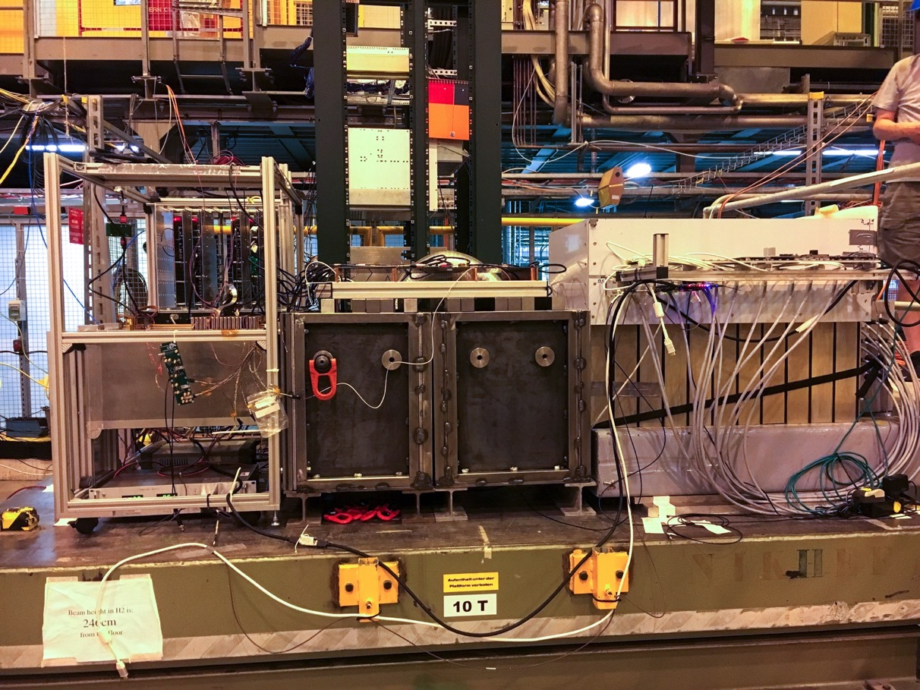
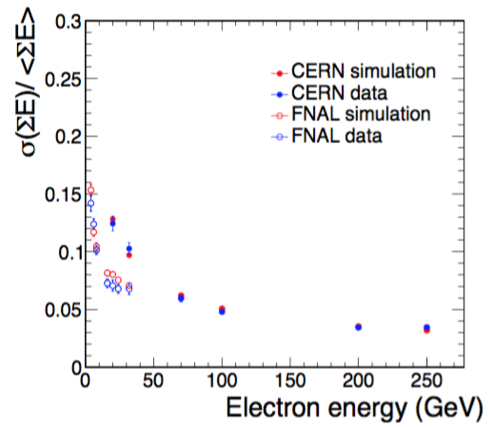
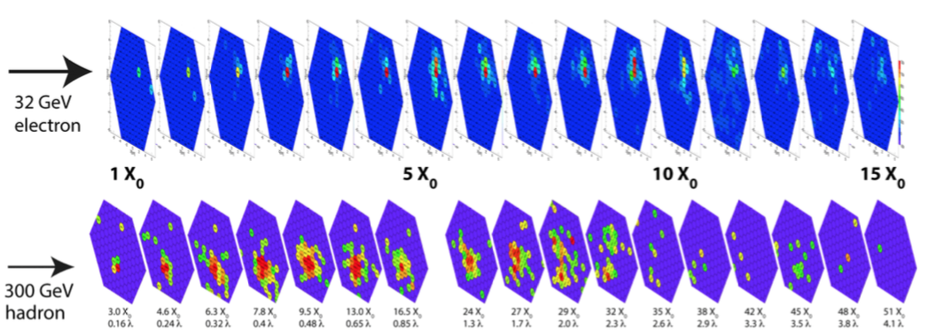
Beam tests
Si + Pb CE-E
Si + SS
Front CE-H
CALICE AHCAL
as rear CE-H
Relative energy resolution
e⁻, µ, π
Electron energy in GeV
MIPs seen in all parts
5% match to simulations
20 ps time resolution

Slide 21
Outline
Why can‘t we reuse the existing endcap calorimeters?
  Challenge 1: Pileup
  Challenge 2: Radiation
Concept of the new endcap calorimeter
  Silicon sensors + scintillator/SiPM
  Mechanics
  Front-end electronics
Expected performance
  Precision timing
  Beam tests
Summary

Slide 22
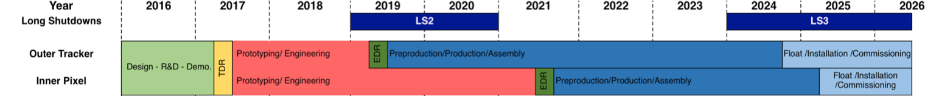
Summary
We use silicon for the new endcap calorimeter
  Handle on radiation damage, precision timing, granularity
It will be the largest silicon detector in HEP up to now
  600 m², as opposed to 200 m² of the CMS Tracker
The Technical Design Report was recently approved by CERN
  Since April 18, 2018 we are live, now we have to do it…
7 years until installation, extremely ambitious project!
Further information at the posters:
Detector Performance Studies for the
CMS High Granularity Calorimeter
Precision Timing Capabilities of Silicon Pad Sensors in the CMS HGCAL
Reference: CMS Collaboration, “The Phase-2 Upgrade of the CMS endcap calorimeter, Technical Design Report”, CERN-LHCC-2017-023, CMS-TDR-019

Slide 23
Backup
Backup

Slide 24
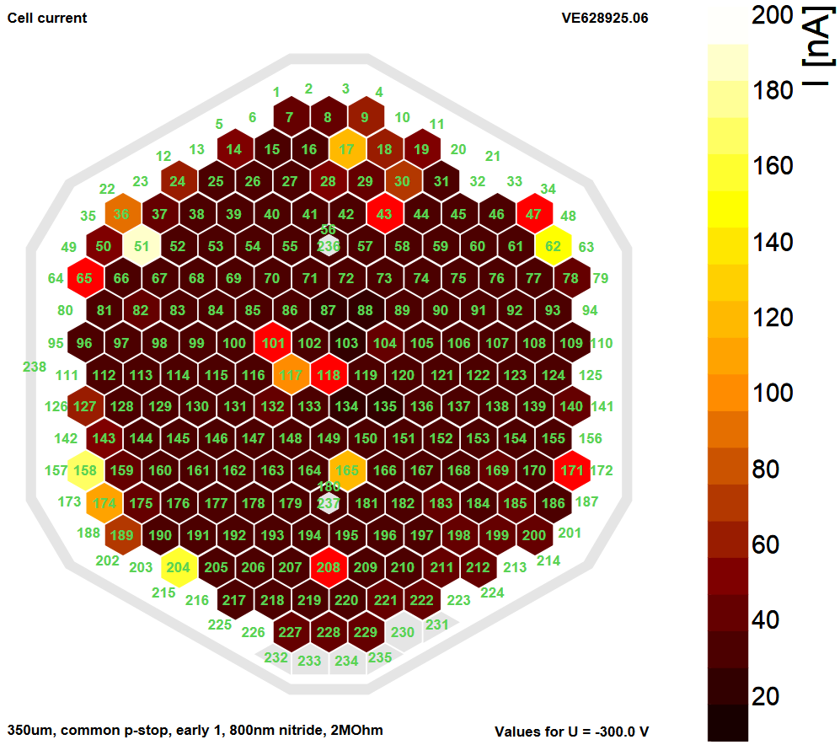
Silicon Sensor Measurements
Cell leakage current at -300 V bias
200 mm prototype
Individual diode cells have no common biasing structure
  Needs seven-needle method or probecard to put surrounding cells to GND
Measure current and capacitance characteristics, and intercell quantities

Slide 25
Cassettes and disks
Silicon-only layer in CE-E
(Calorimeter Endcap Electromagnetic)
60° cassettes (yellow and green)
Different sensor thicknesses (dark and light)
Mixed layer in CE-H
(Calorimeter Endcap Hadronic)
Silicon sensors at high η
Scintillators and SiPMs at low η

Slide 26
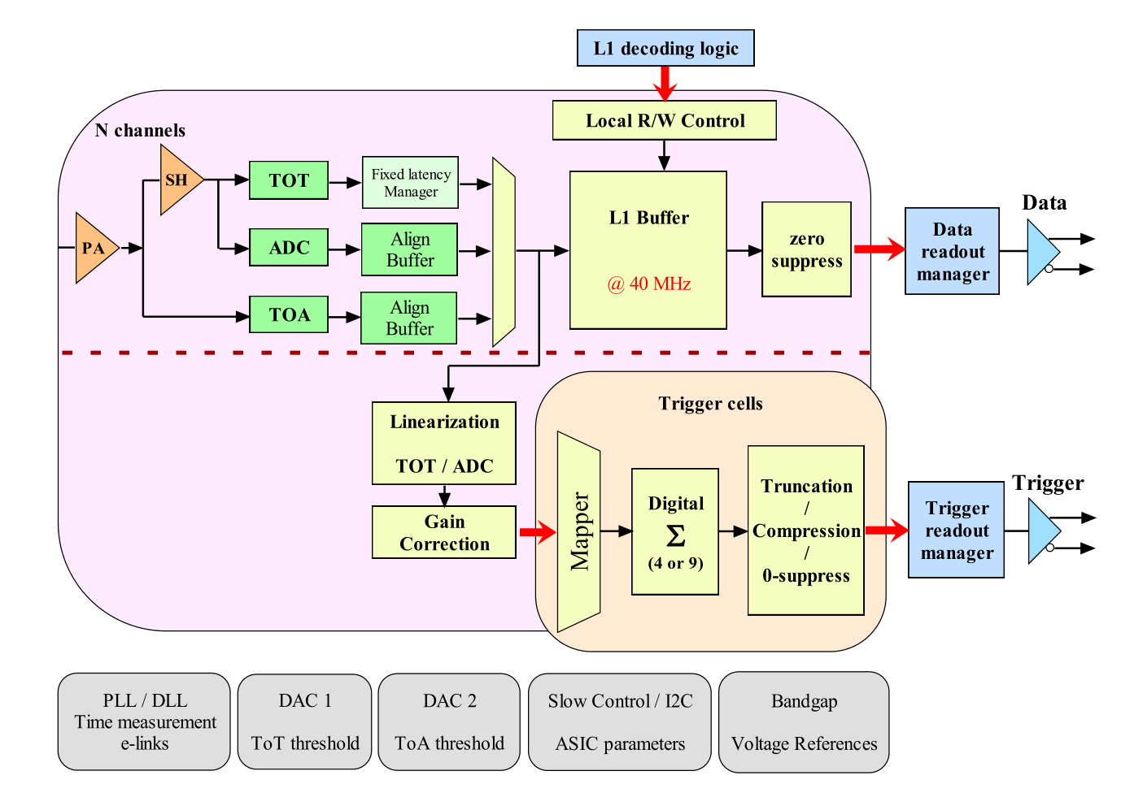
Readout chip
Requirements
  Large dynamic range from 0.2 fC to 10 pC (16 bit)
  Noise below 2500 e⁻ for 65 pF load capacitance
  Allow for time measurements of better than 30 ps for large signals
  On-detector digitisation, zero suppression and trigger sums
  Leakage current compensation of ~20 uA/channel
  Radiation resistance to 2 MGy and 10¹⁶ neq/cm²
  All that at max. 20 mW/channel
Baseline
  130 nm CMOS technology
  ADC with 11 bit for 0 to ~0.5 pC
  ToT with 12 bit for ~0.5 to 10 pC
  ToA with 24 or 12 ps binning
  Large buffers to accommodate
  12.5 μs latency of L1 trigger
Status
  SKIROC2-CMS designed for testbeam
  First HGCROC version under study
  at the moment

