Slide 1

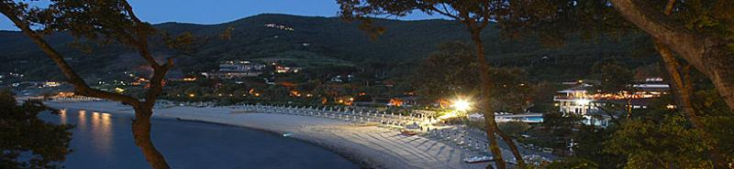
14th Pisa Meeting on Advanced Detectors
La Biodola, Isola d'Elba (Italy)
May 27 - Jun 02, 2018
CUPID-0, challenges and achievements in the struggle of 0-background double-beta decay experiments
Ioan Dafinei
for the CUPID-0 collaboration
14th Pisa Meeting on Advanced Detectors
La Biodola, Isola d'Elba, May 27 - Jun 2, 2018
Ioan Dafinei
INFN Sezione di Roma, ITALY

Slide 2
outline
introduction
bolometric approach in 0νDBD research
CUPID challenge
CUPID-0 achievements
concluding remarks
1/20

Slide 3
Introduction
the interest of 0νDBD process
(A;Z) → (A;Z+2) + 2e⁻
violation of the lepton number conservation laws
proof that neutrino is his own antiparticle (Majorana nature of neutrino)
provide some insight into the absolute mass of neutrinos
the interest of bolometric approach
calorimetric technique based on the use of crystals cooled down to mK temperatures where their specific heat is extremely low and goes like T³
small energy deposit can be detected as sizable temperature variation (ΔT∝ΔE/C).
advantages:
energy resolution (as good as 0.1%)
effciency on 0νDBD larger than 80%
crystals available for almost all nuclides of interest
high intrinsic radio-purity affordable
2/20

Slide 4
challenges
handling
packaging
transport
storage
crystals
  radio-purity
  chemical purity
  high production yield (for enriched crystals)
temperature sensors
light detectors
surface detectors
heaters
holding structure (towers)
electronics
cryogenic system
screenings
data acquisition and analysis
…
…
3/20

Slide 5
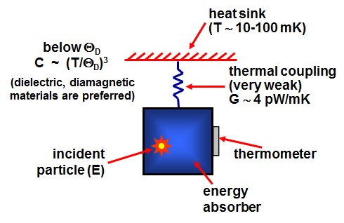
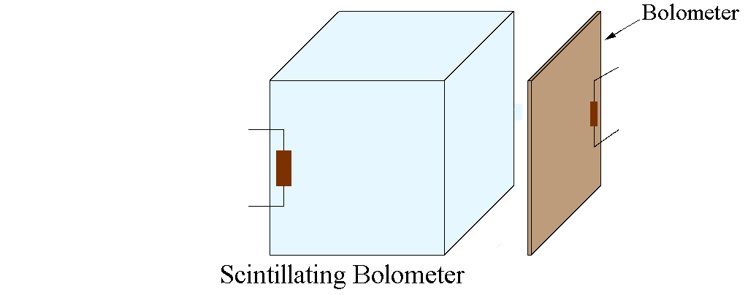
Scintillating bolometers
bolometer
background-free experiment is possible:
α-background: identification and rejection
β/γ-background: ββ isotope with large Q-value
4/20

Slide 6
CUPID
CUORE (Cryogenic Underground Observatory for Rare Events) Upgrade with Particle IDentification
G. Wang et al. (CUPID interest group), arXiv:1504.03599v1, 14 Apr 2015,
CUPID: CUORE (Cryogenic Underground Observatory for Rare Events) Upgrade with Particle Identification
CUPID is a proposed future tonne-scale bolometric neutrinoless double beta decay (0νDBD) experiment to probe the Majorana nature of neutrinos and discover Lepton Number Violation in the so-called inverted hierarchy region of the neutrino mass. CUPID will be built on experience, expertise and lessons learned in CUORE, and will exploit the current CUORE infrastructure as much as possible. In order to achieve its ambitious science goals, CUPID aims to increase the source mass and dramatically reduce the backgrounds in the region of interest. This requires isotopic enrichment, upgraded purification and crystallization procedures, new detector technologies, a stricter material selection, and possibly new shielding concepts with respect to the state-of-the-art deployed in CUORE.
5/20

Slide 7
CUPID challenges
large detector mass
  several hundreds kg
  possibly enriched material
background close to zero at the ton ∙ year exposure scale
region of interest of a few keV around 0νDBD transition energy
isotopic enrichment and related improvements regarding crystal production
active alpha rejection
improved material selection
reduced cosmic activation
new with respect to CUORE
Wednesday, 30 May, 09:10; Speaker: Antonio Branca
CUORE: the first bolometric experiment at the ton scale for rare decay searches
Wednesday, 30 May, 10:00; Speaker: Nicola Casali
Cryogenic light detectors for background suppression: the CALDER project
see also at this Conference
6/20

Slide 8
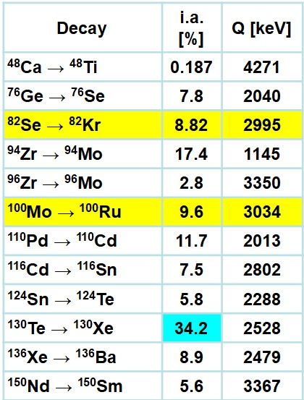
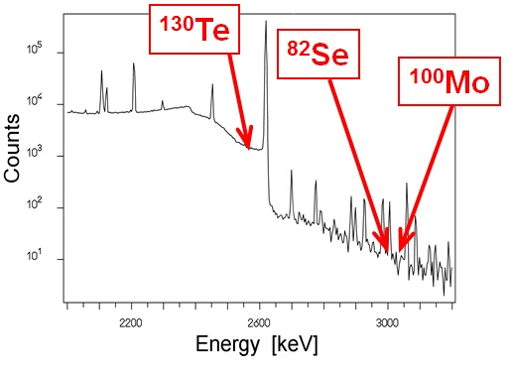
crystals for 0νDBD
(bolometric approach)
main (CUPID) candidates today: (alphabetic order)
Li₂MoO₄
TeO₂
particle identification with:
LD: Cherenkov radiation
Surface Effects
ZnSe
7/20

Slide 9
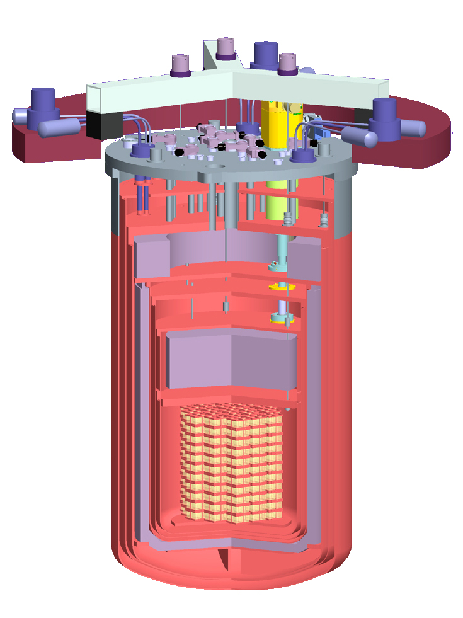
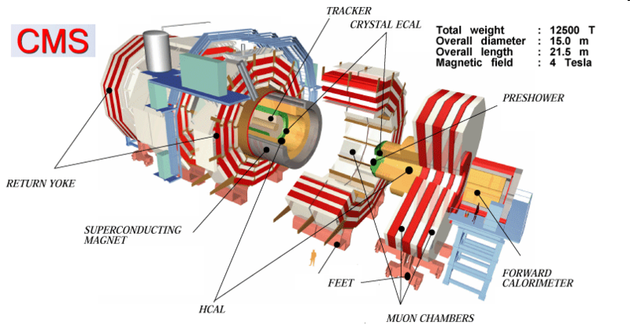

the challenge of large scale 0νDBD experiments
~80tons
PbWO₄
~1ton
TeO₂
~1ton
TeO₂
Compact Muon Solenoid
8/20

Slide 10
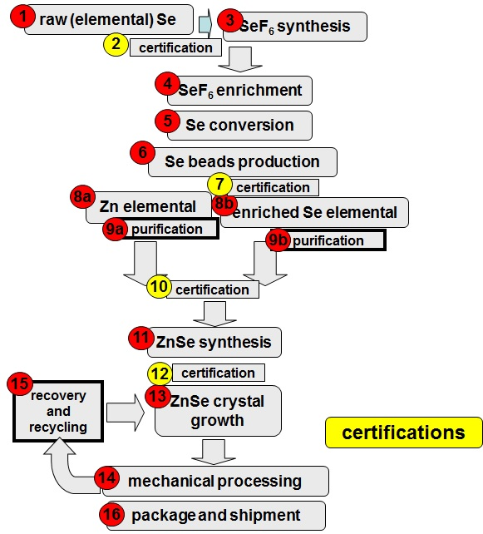
Zn⁸²Se crystals production
crystals production cycle
similar for any crystal candidate
enrichment: ⁸²Se from 8.82% to 96.30% (made at URENCO, Almelo, Holland)
Zn⁸²Se synthesis and crystal growth:
made at ISMA Kharkiv Ukraine with strong INFN contribution
final processing (cutting and polishing):
made at LNGS, INFN Italy
production yields:
synthesis: 98.35%
(99.55% at S-1, 99.40% at VTT and 99.40% at HTT)
crystal growth*: 95%
cutting*: 96,72%
shaping and polishing*: 99%
_________________________
* including recovered material for recycling
Journal of Crystal Growth 475 (2017) 158–170
Production of ⁸²Se enriched Zinc Selenide (ZnSe) crystals for the study of neutrinoless double beta decay …
9/20

Slide 11
Zn⁸²Se crystals production
crystal processing:
at LNGS-INFN
10/20

Slide 12
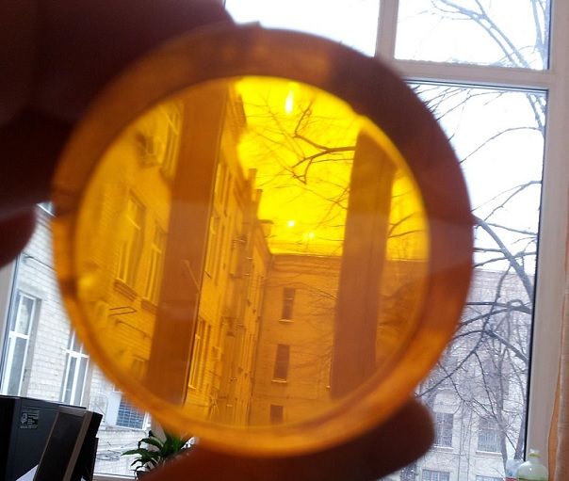
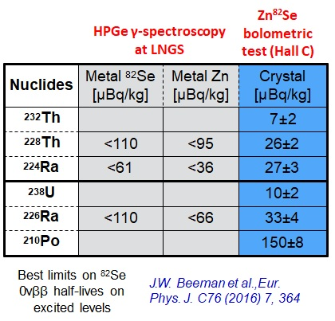
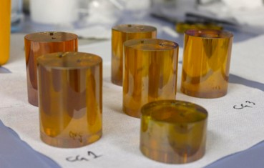
Zn⁸²Se crystals production
polished
radio-purity measured during crystal production
confirmed by CUPID-0 data
https://arxiv.org/pdf/1802.06562.pdf
ready to use
11/20

Slide 13
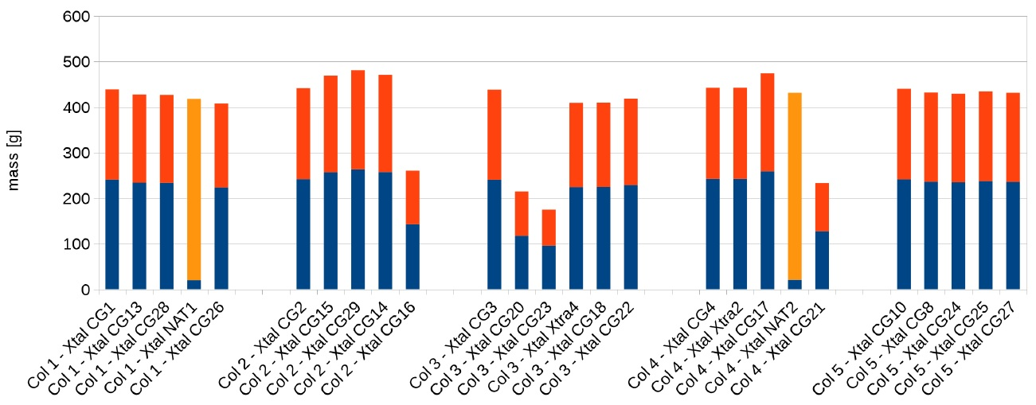
mechanical processing
(aiming at maximizing the total mass of ⁸²Se)
Crystal mass*
*in blue, the ⁸²Se content
12/20

Slide 14
⁸²Se recovery in view of recycling
⁸²Se extraction from scraps:
chemical + physical (double distillation)
Main reaction:
3ZnSe + 8HNO₃ → 3Zn(NO₃)₂ + 3Se ↓ + 4H₂O + 2NO ↑
Parasitic reaction:
ZnSe + 8HNO₃ → Zn(NO₃)₂ + H₂SeO₃ + 3H₂O + 6NO₂ ↑
work performed at Nijnii Novgorod, Russia
mass of extracted ⁸²Se ultrapure (99.9999% purity):
6.7÷6.8 kg i.e. 98% to 99% recovery yield
13/20

Slide 15
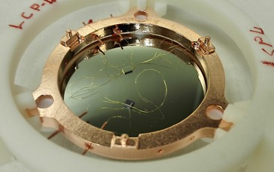
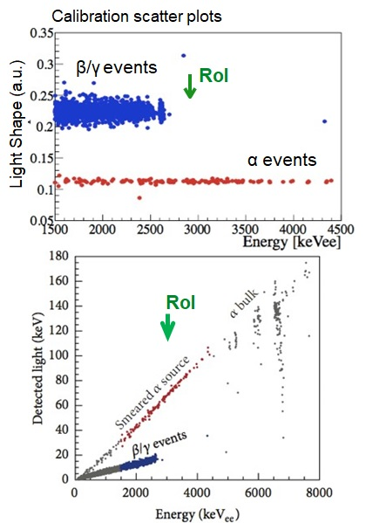
light detectors (LD)
(for α background rejection)
data from R&D phase!
degraded α source is used
Well established technology for bolometric LDs
LD: Ge wafer + SiO coating (60 nm) + Ge-NTD
Light vs Heat: possible α leakage in β/γ ROI
Pulse Shape Analysis of Light: efficient particle-ID
LUCIFER: J.W. Beeman et al., 2013 JINST 8 P05021
CUPID-0 operates 31 LDs
14/20

Slide 16
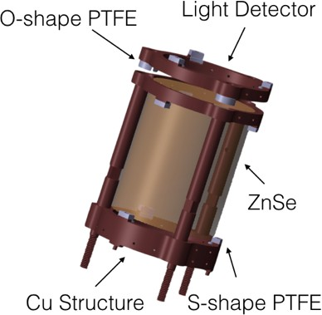
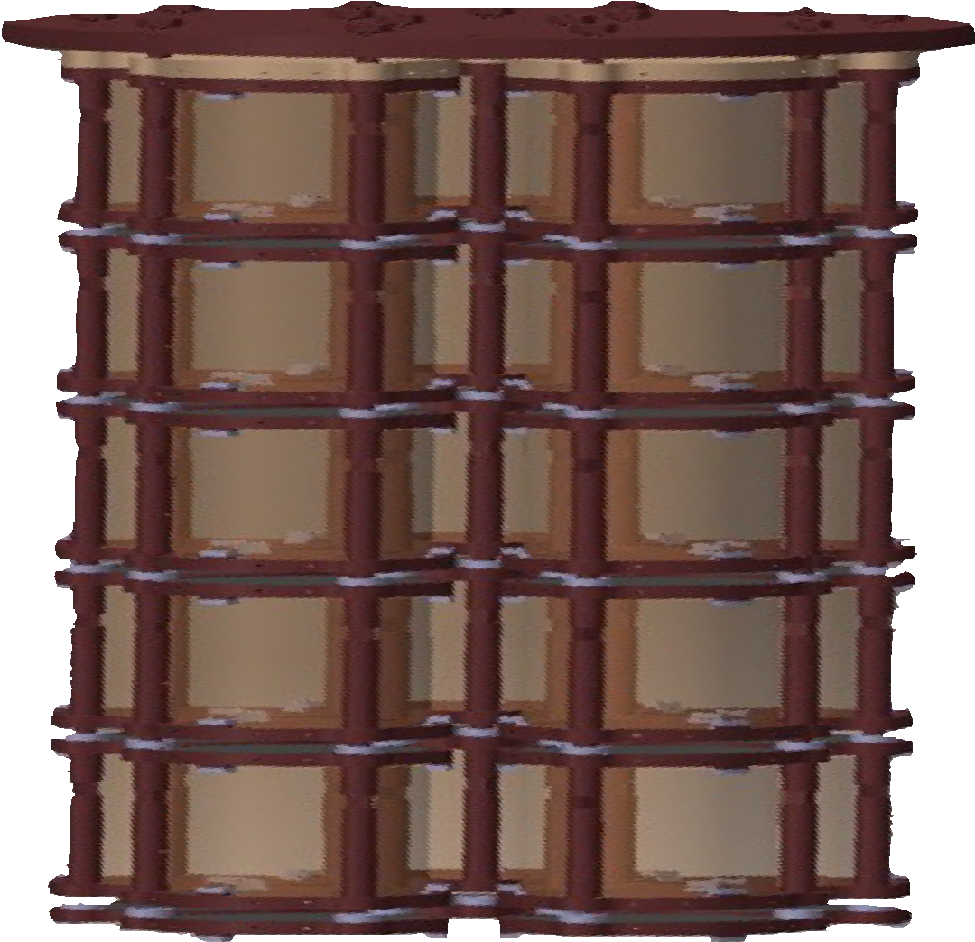
CUPID-0 detector assembling
(first array of scintillating bolometers based on enriched Zn⁸²Se crystals)
30cm
26 bolometers (24 enr + 2 nat) in 5 towers
10.5 kg of ZnSe
5.17 kg of ⁸²Se -> N_{ββ} = 3.8x10²⁵ ββ nuclei
LD: Ge wafer operated as bolometer
Simplest modular detector ➜ scale up
Copper structure (ElectroToughPitch)
PTFE holders
Reflecting foil (VIKUITI 3M)
15/20

Slide 17
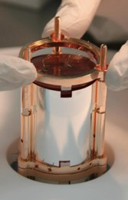
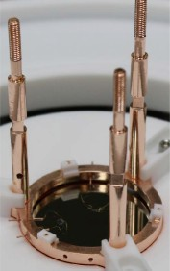
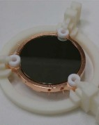
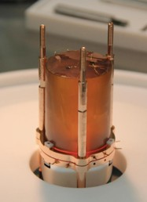
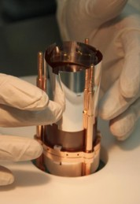
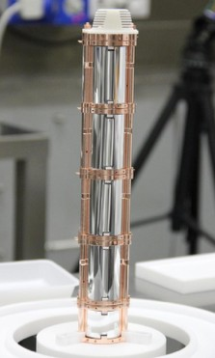
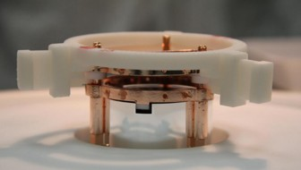
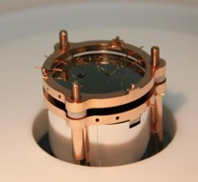
CUPID-0 detector assembling
(performed in ~2 weeks inside a low-Rn underground clean room at LNGS)
#3 Fixing of ZnSe
#1 LD installation
#2 ZnSe and light reflector installation
#4 LD installation
#5 Tower completed
16/20

Slide 18
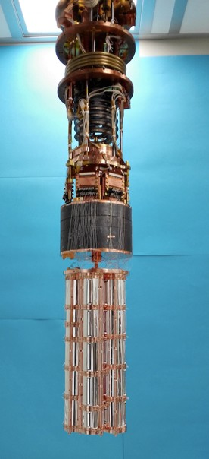
CUPID-0 detector installation
(in the former Cuoricino/CUORE-0 cryostat in hall A at LNGS)
improvements wrt Cuoricino/CUORE-0
double stage pendulum for low vibrational noise
better LD performance
cryostat wiring: can host up to 120 channels
CUPID-0 uses 67 chns
BKG goal in the Rol ~ 10⁻³ counts/(keV kg y)
(thanks to α discrimination capability and high Q-Value)
commissioning start in March* 2017
data taking start in June 2017
*data of first month not used for scientific reports
17/20

Slide 19
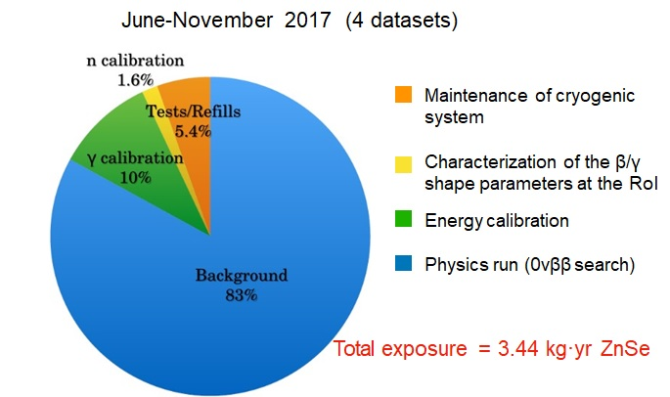
CUPID-0 results in a glance
O. Azzolini et al., CUPID-0: the first array of enriched scintillating bolometers for 0νββ decay investigations, arXiv:1802.06562, accepted by PRL
O. Azzolini et al., First Result on the Neutrinoless Double Beta Decay of ⁸²Se with CUPID-0, arXiv:1802.07791v2, accepted by EPJC
see more, here
18/20

Slide 20
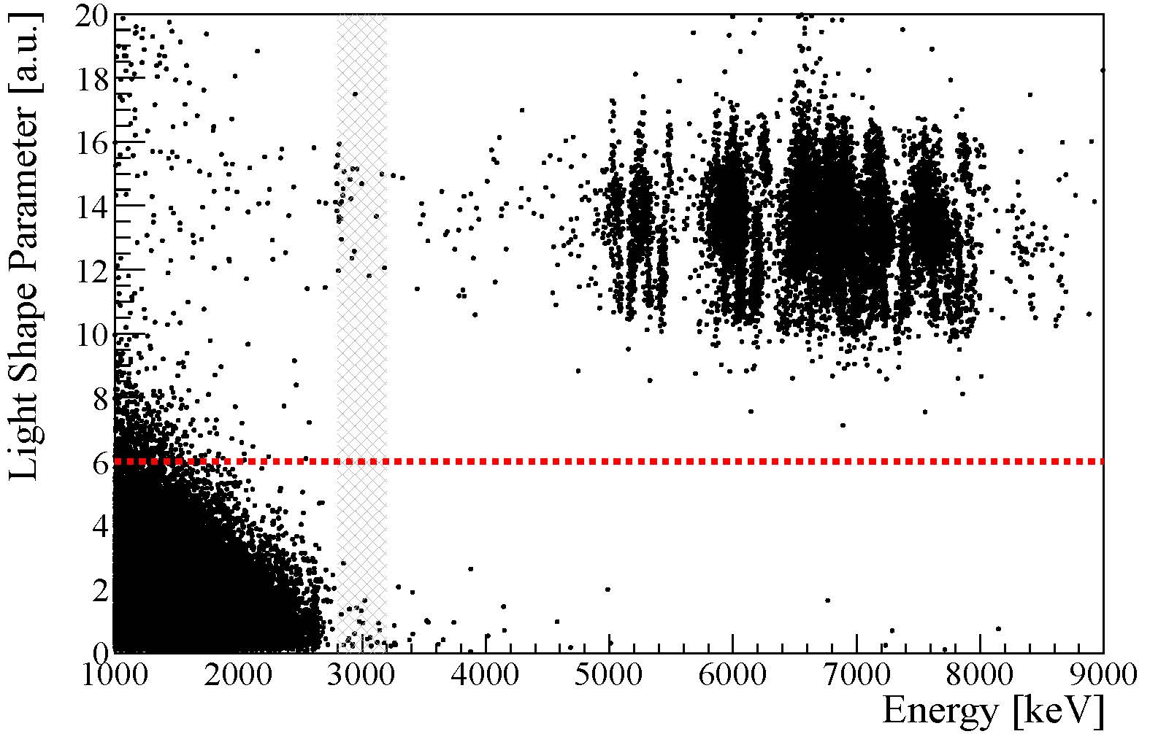
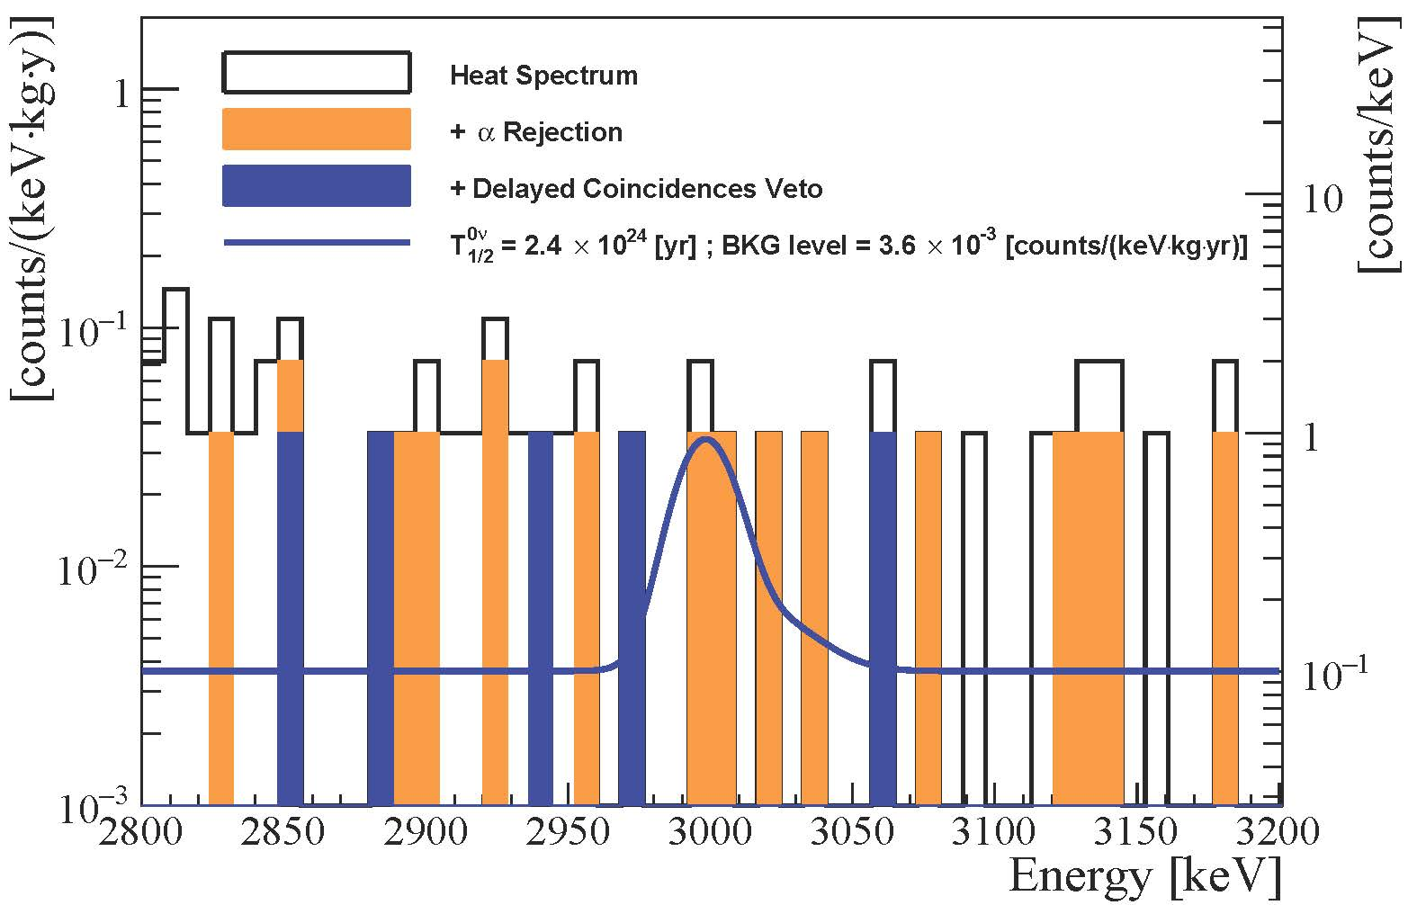
CUPID-0 results in a glance
Single-hit events in the Light Shape Parameter-Energy plane
The energy spectrum in the analysis window.
The blue line is the fitted spectrum together with a hypothetical signal corresponding to the 90% C.I. limit of T_{1/2}^{(0ν)} = 2.4∙10²⁴ yr
19/20

Slide 21
concluding remarks
0νDBD is among the most exciting challenges in physics
lately, the conditions have matured for a 1 ton experiment based on enriched bolometers with particle identification
CUPID-0 is the first large array of enriched scintillating bolometers for 0νDBD search, currently taking data from spring 2017
the complete α-background rejection was demonstrated and allowed to reach an unprecedented BKG level for a bolometric experiment
the analysis of the first data (3.44 kg y of ZnSe) allowed to set the best limit on ⁸²Se 0νDBD half-life
energy resolution (exposure weighted)
total signal efficiency
20/20

Slide 22
CUPID-0
O. Azzolini¹, M.T. Barrera¹, J.W. Beeman², F. Bellini^{3,4}, M. Beretta^{5,6}, M. Biassoni⁶, C. Brofferio^{5,6}, C. Bucci⁷,
L. Canonica^{7,8}, S. Capelli^{5,6}, L. Cardani⁴, P. Carniti^{5,6}, N. Casali⁴, L. Cassina^{5,6}, M. Clemenza^{5,6}, O. Cremonesi⁶,
A. Cruciani⁴, A. D'Addabbo⁷, I. Dafnei⁴, S. Di Domizio^{9,10}, F. Ferroni^{3,4}, L. Gironi^{5,6}, A. Giuliani^{11,12}, P. Gorla⁷, C. Gotti^{5,6}, G. Keppel¹, L. Marini^{9,10}, M. Martinez^{3,4}, S. Morganti⁴, S. Nagorny^{7,13}, M. Nastasi^{5,6}, S. Nisi⁷, C. Nones¹⁴, D. Orlandi⁷, L. Pagnanini^{7,13}, M. Pallavicini^{9,10}, V. Palmieri^{†1}, L. Pattavina^{7,13}, M. Pavan^{5,6}, G. Pessina⁶, V. Pettinacci⁴, S. Pirro⁷,
S. Pozzi^{5,6}, E. Previtali⁶, A. Puiu^{5,6}, F. Reindl⁴, C. Rusconi^{7,15}, K. Schaeffner^{7,13}, C. Tomei⁴, M. Vignati⁴, A. S. Zolotarova¹⁴
¹INFN Laboratori Nazionali di Legnaro, I-35020 Legnaro (Pd) - Italy
²Lawrence Berkeley National Laboratory , Berkeley, California 94720, USA
³Dipartimento di Fisica, Sapienza Universit_a di Roma, P.le Aldo Moro 2, 00185, Roma, Italy
⁴INFN, Sezione di Roma, P.le Aldo Moro 2, 00185, Roma, Italy
⁵Dipartimento di Fisica, Universit_a di Milano Bicocca, I-20126 Milano - Italy
⁶INFN Sezione di Milano Bicocca, I-20126 Milano - Italy
⁷INFN Laboratori Nazionali del Gran Sasso, I-67100 Assergi (AQ) - Italy
⁸Massachusetts Institute of Technology, Cambridge, MA 02139, USA
⁹Dipartimento di Fisica, Universit_a di Genova, I-16146 Genova - Italy
¹⁰INFN Sezione di Genova, I-16146 Genova - Italy
¹¹CNRS/CSNSM, Centre de Sciences Nucl_eaires et de Sciences de la Mati_ere, 91405 Orsay, France
¹²DISAT, Universit_a dell'Insubria, 22100 Como, Italy
¹³Gran Sasso Science Institute, 67100, L'Aquila - Italy
¹⁴IRFU, CEA, Universit_e Paris-Saclay, F-91191 Gif-sur-Yvette, France
¹⁵Department of Physics and Astronomy, University of South Carolina, Columbia, SC 29208 - USA

