Slide 1
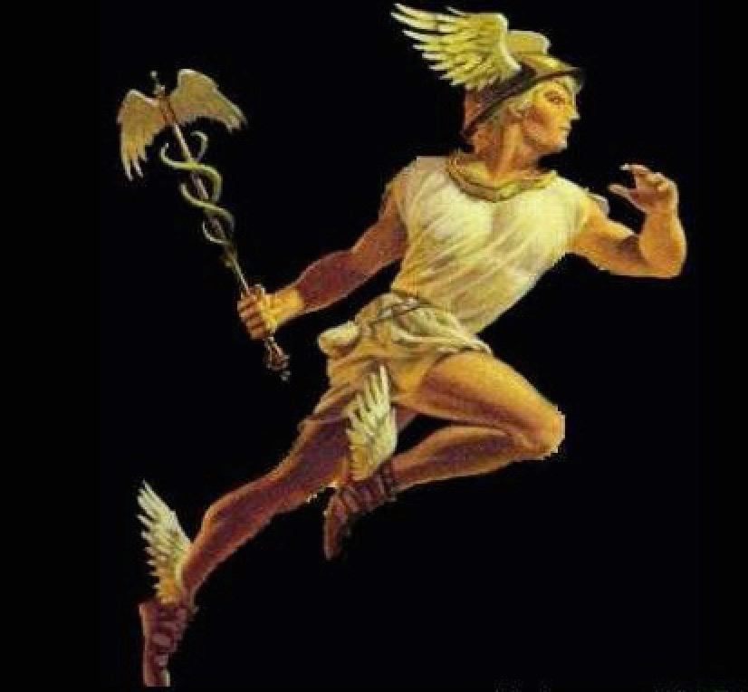
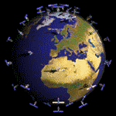
HERMES: An ultra-wide band X and gamma-ray transient monitor on board a nano-satellite constellation
F. Fuschino INAF/OAS & INFN Bologna
on behalf HERMES collaboration

Slide 2
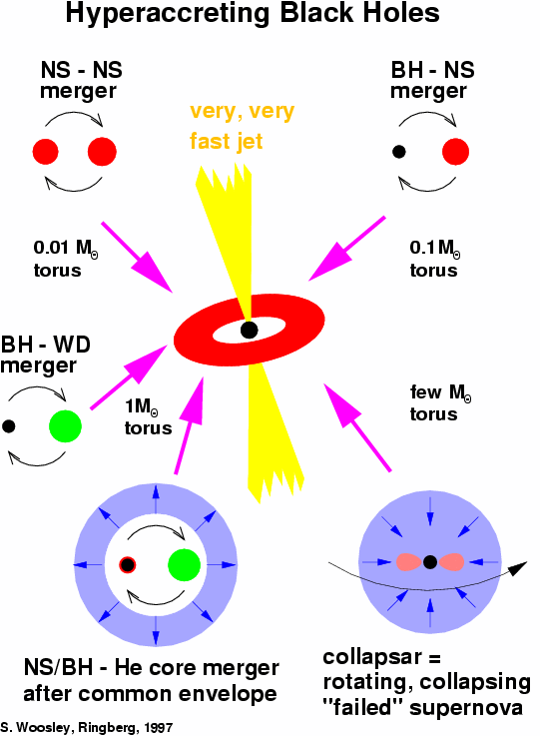
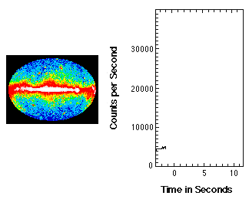
GRBs in a nutshell
Sudden bursts of soft γ-rays up to 10⁻³ ergs/s/cm² (μW/m²)
Short
Long
Notes:
Focus sui transienti

Slide 3
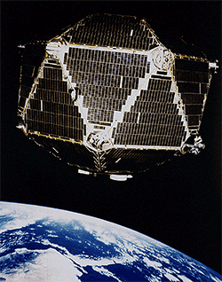
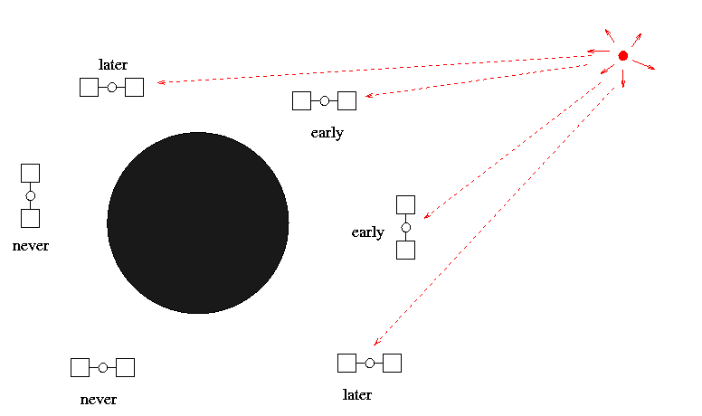
The discovery of GRBs by the Vela satellites
First launch 1963 (6 satellites)
Last Advanced Vela launch 1970 (6+6 satellites)
In operation till 1985
First 6 Vela equipped with X-ray and γ-ray detectors with limited timing capabilities: rough positions
Advanced Vela equipped with silicon
photodiode sensors with millisec
timing: ~10deg positions
Modularity —> improved performances

Slide 4
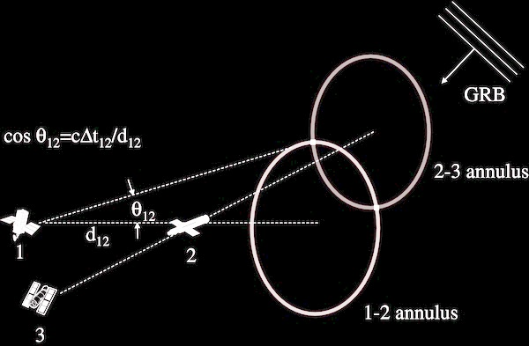
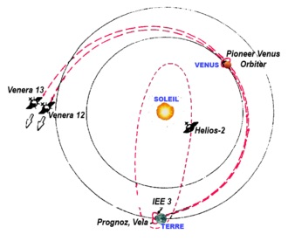
InterPlanetary
Network
First IPN 1976
4-6 spacecrafts. Baseline ~ 1 AU
Second IPN ~1990
PVO, Ulysses, CGRO, Wind
Third IPN 2000
~ 20 spacecrafts
Localisations: arcmin-deg
Main disadvantage: long data acquisition ~days

Slide 5
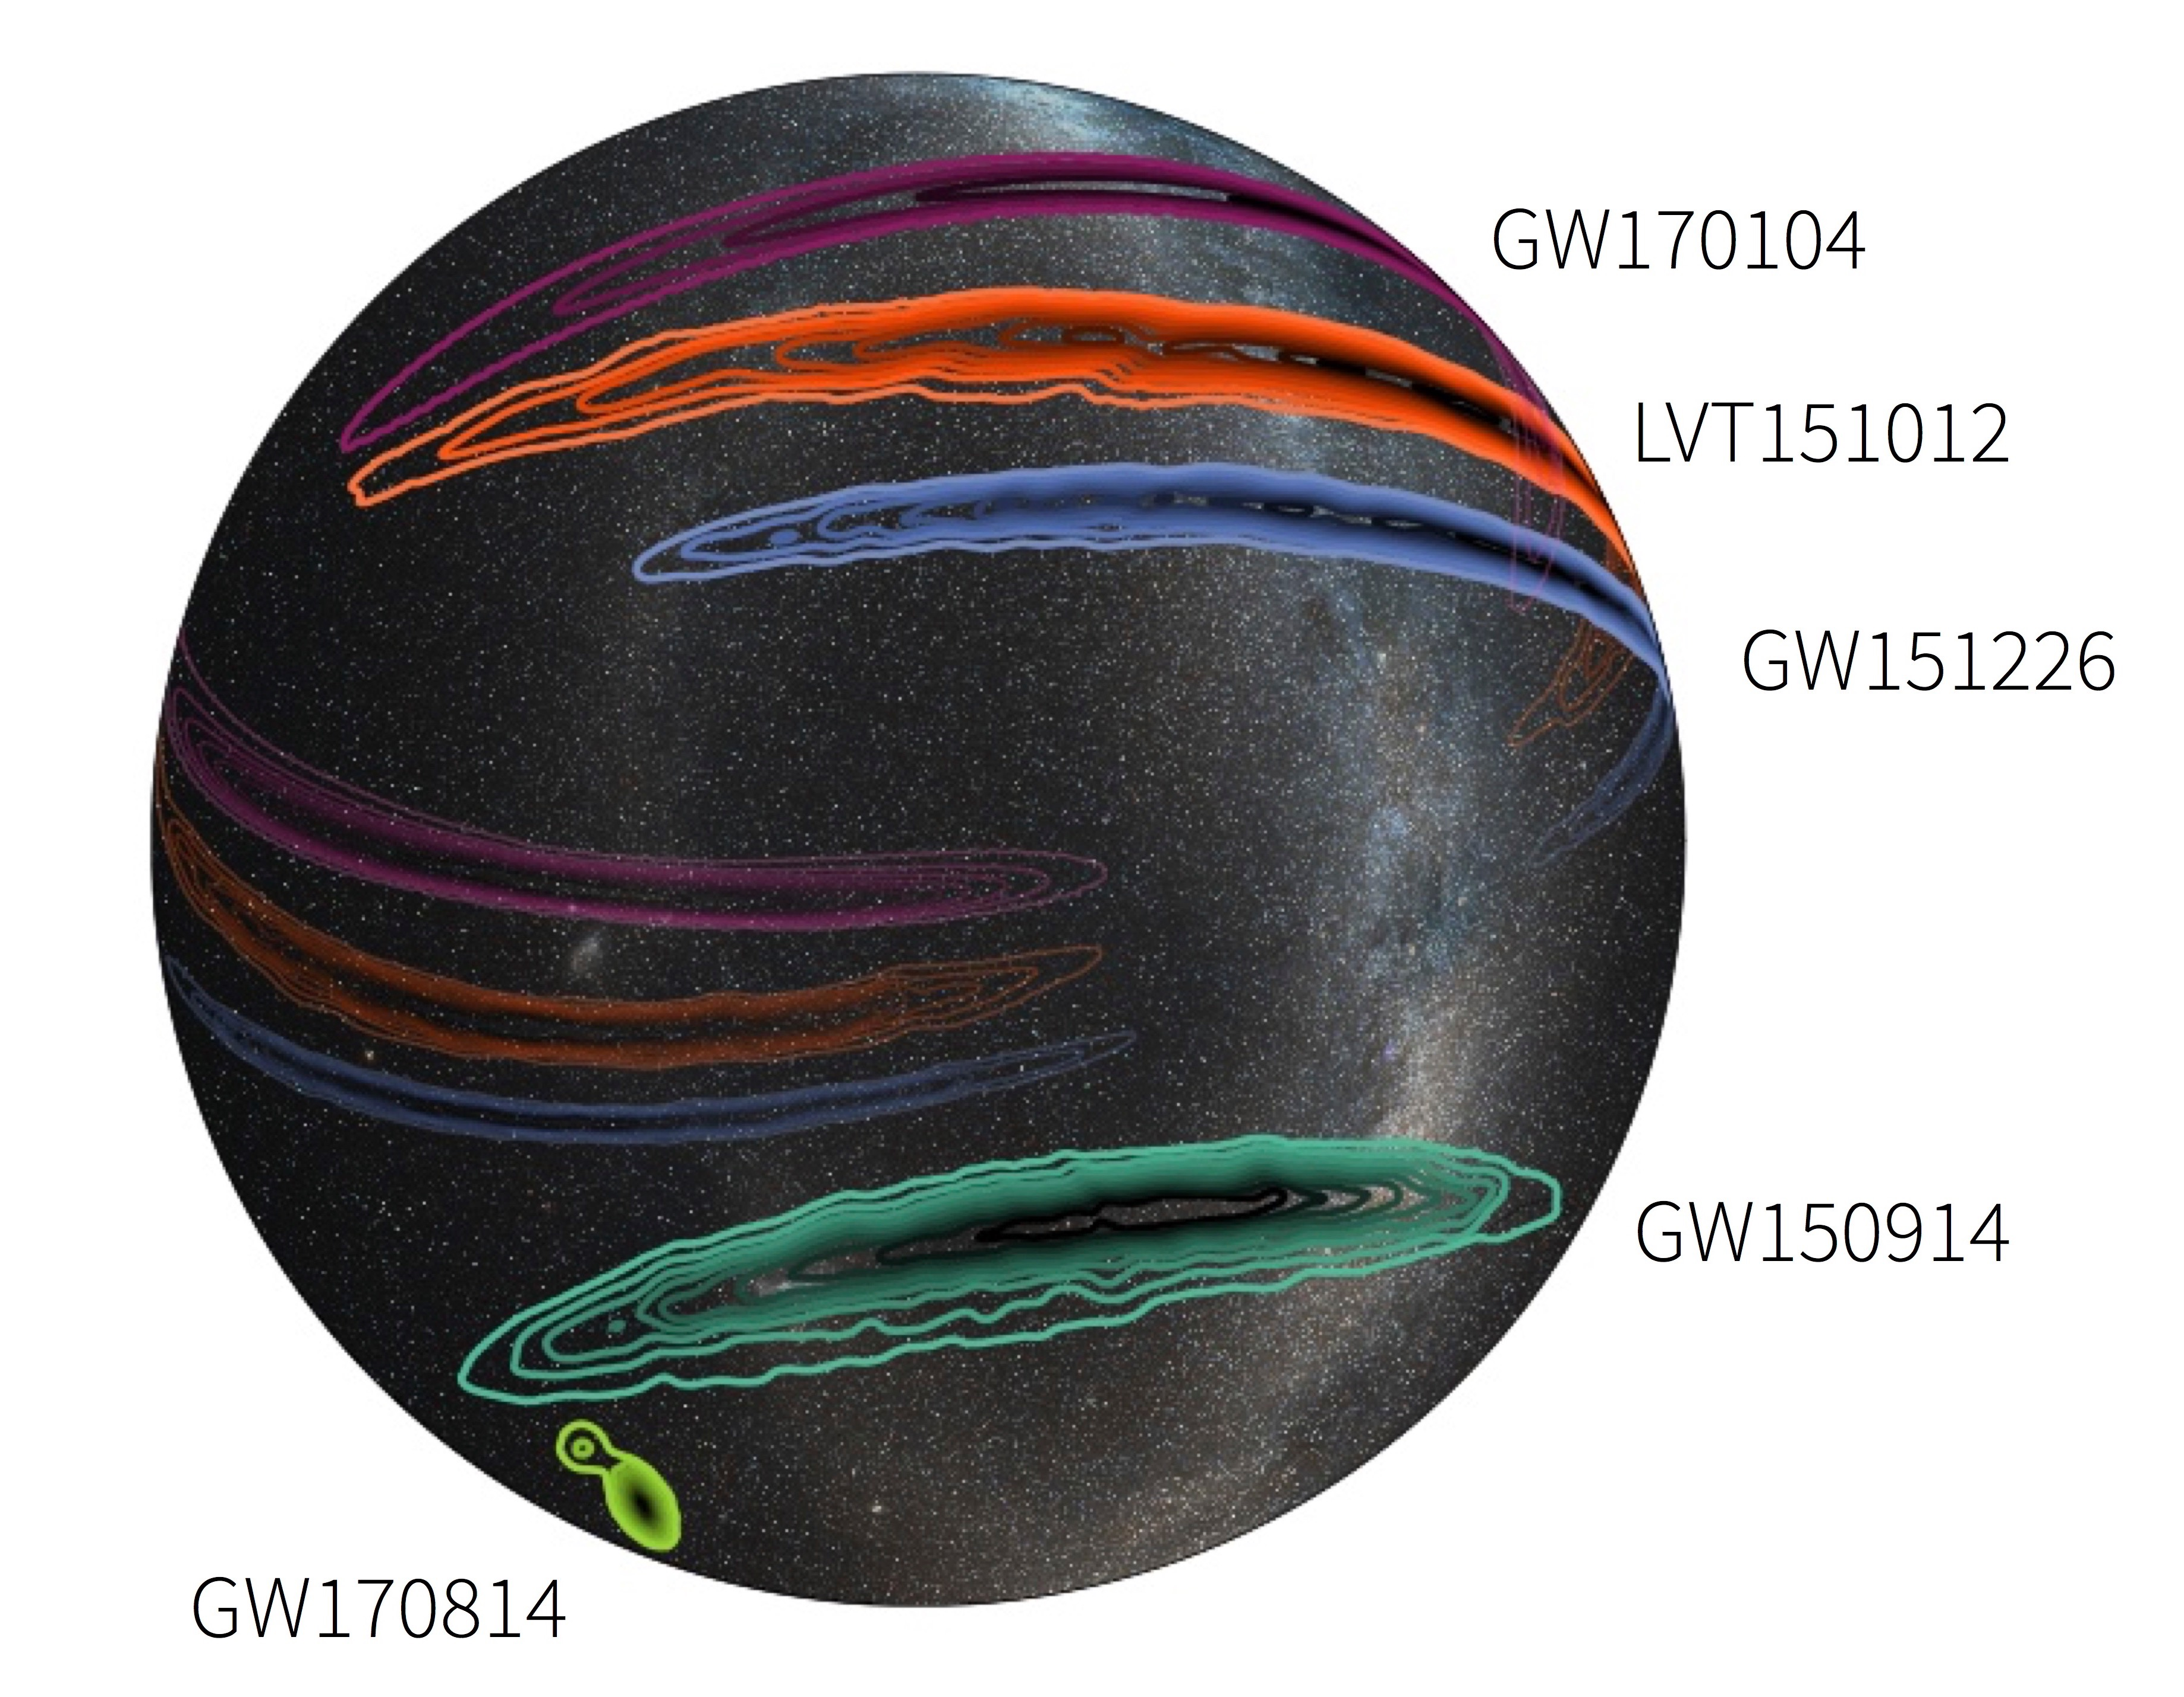
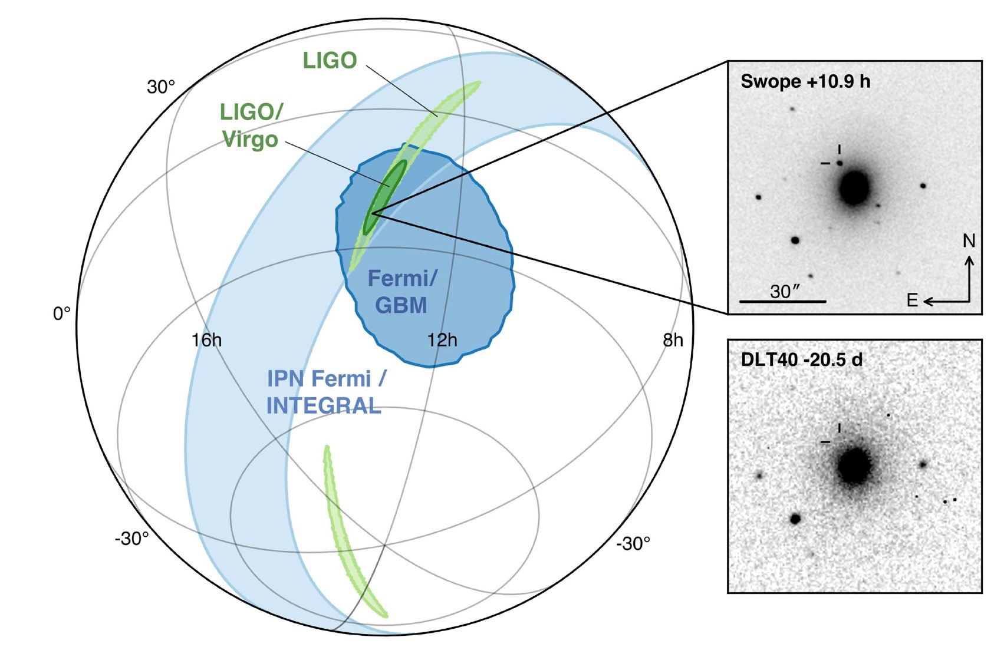
The multimessenger revolution
Advanced Ligo/Virgo provide position with accuracy
~ tens deg
Large volumes difficult to survey at optical λ.
Tens/hundreds/thousands optical transients.
Best strategy:
~ all sky prompt search for transients at high energies. Negligible probability to find an uncorrelated HEA transient at the time of GWE

Slide 6
Mission concept
Disruptive technologies: cheap, underperforming, but producing high impact. Distributed instrument, tens/hundreds of simple units
HERMES constellation of cubesat
2016: ASI funds for detector R&D
2018: MIUR funds for Technological pathfinder (Progetti premiali 2015) – 3nsat
2017 progetti premiali 2016 proposal for Scientific Pathfinder – 3+3nsat
2018 H2020 Space proposal
Current
Current
Next Step
Future

Slide 7
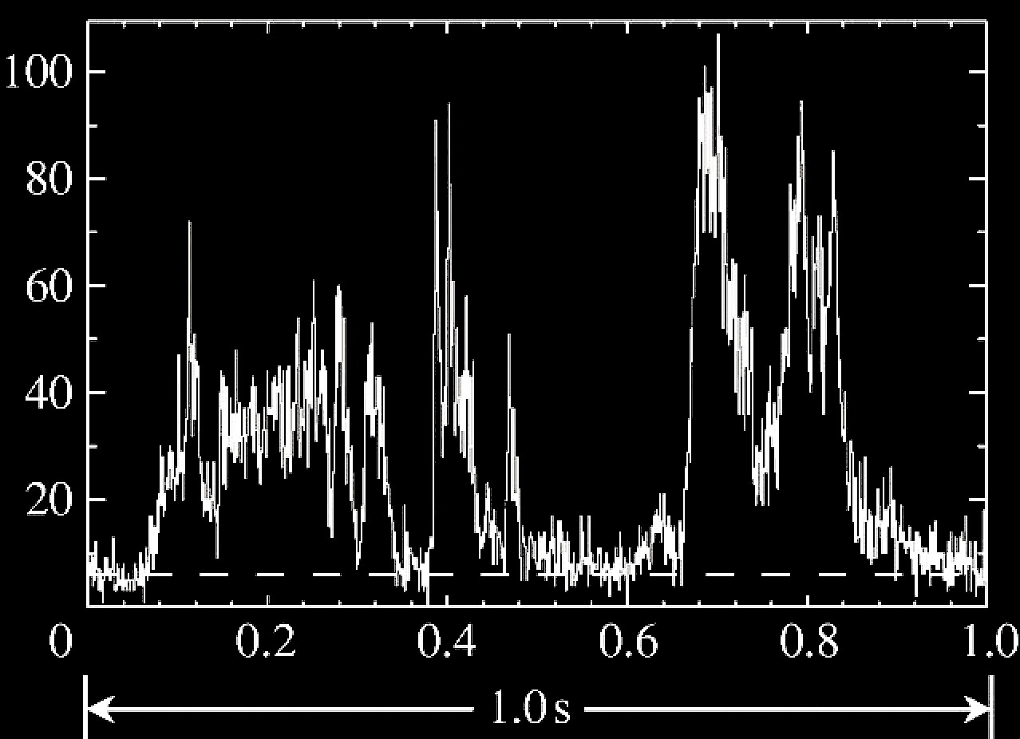
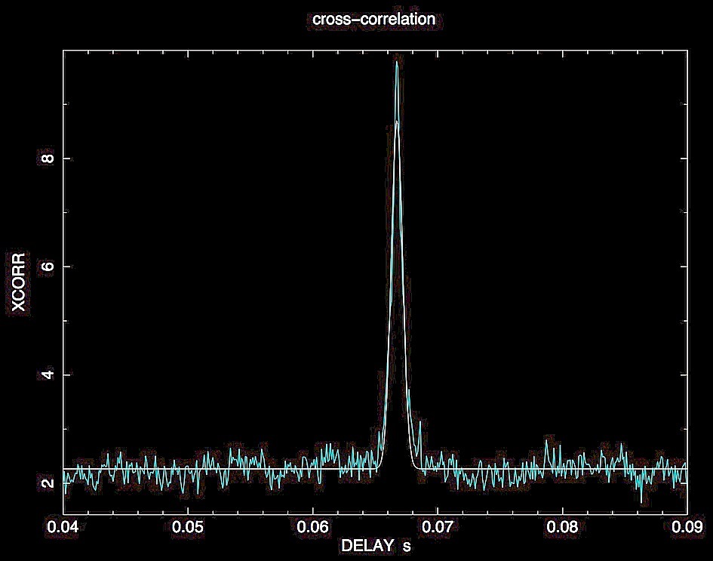
Mission concept
Measure GRB positions through delays between photons arrival times:
σPos = σCCF x c / <B> / (Nx(N −1− 2)^{1/2}
+
GRB front
cΔt
σCCF~10μs
σPos~10arcsec
if <B>~7000km, N~100
Baseline
=

Slide 8
Requirements
≈hundreds of satellites (final constellation);
a ≥50cm² detector per satellite;
total collecting area ≥1m² (final constellation);
Energy range 3-2000 keV;
Temporal resolution ≈100ns;
Attitude reconstruction < a few m;
Download full burst info in minutes;
Arcmin-arcsec positions of ~a few dozen GRB/yr;
Prompt(minute) localisation;
Sub-μs timing;
Δt/ΔE~3μs/100keV 30μs/1MeV—> MQG~Mplanck (quantum Astronomy);

Slide 9
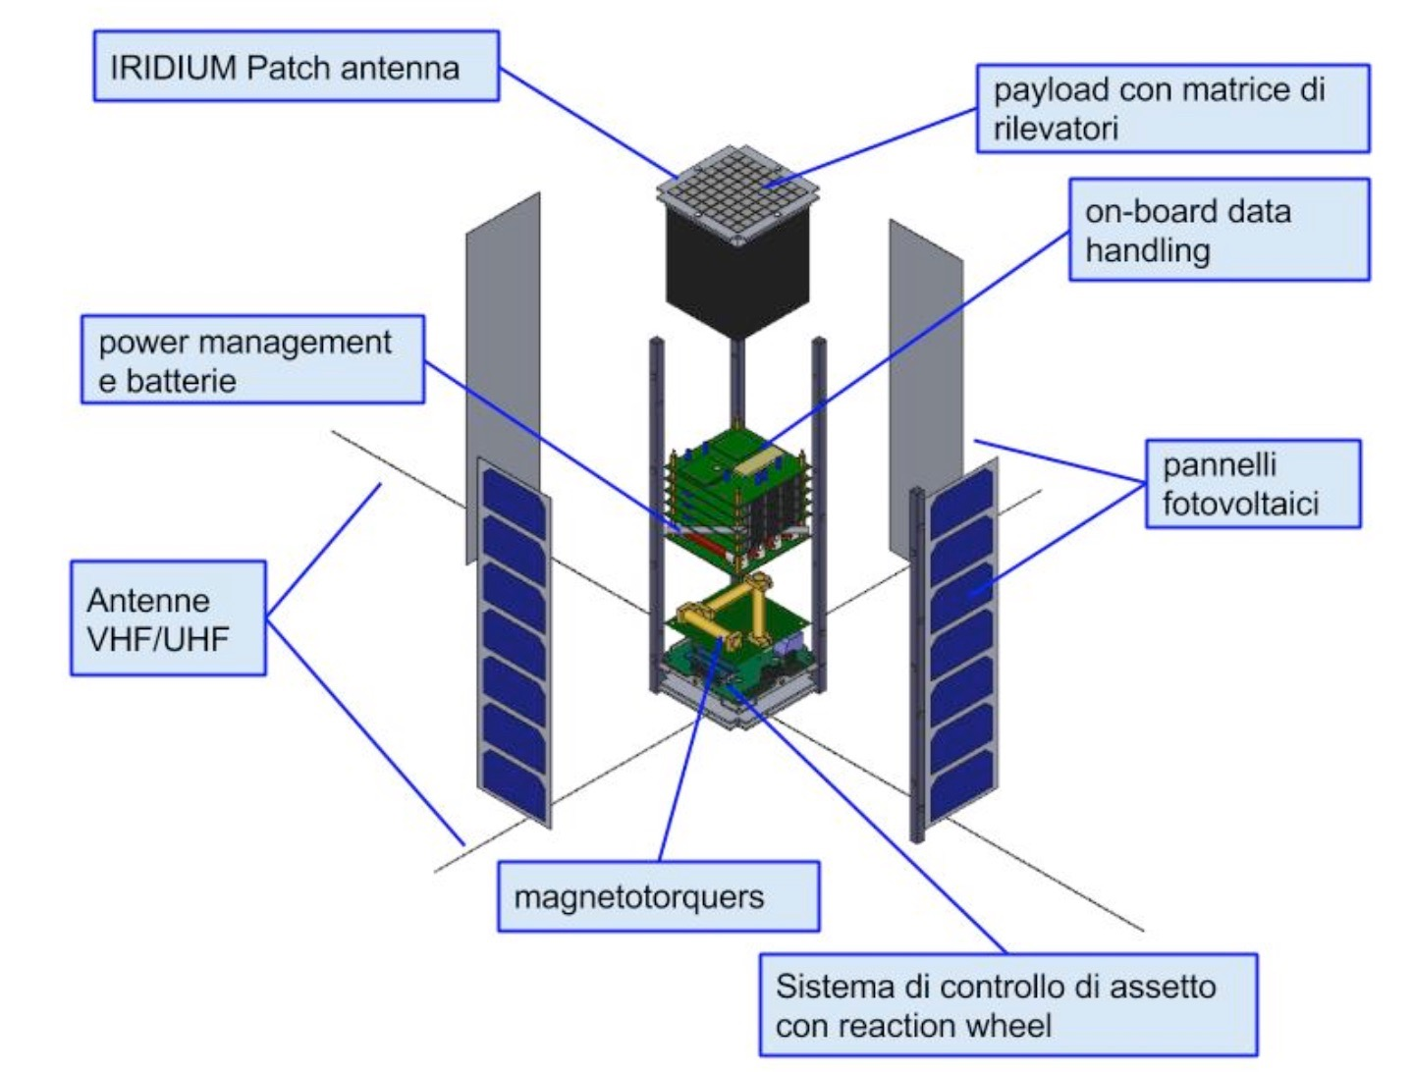
Spacecraft
payload: detector, electronics
power management batteries
solar
panels
Lavagna+2017
3Ucubesat – simplest basic
configuration ~ 50cm² detector
AOCS,
reaction wheel

Slide 10
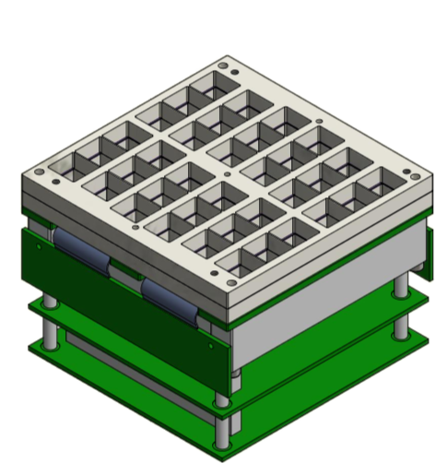
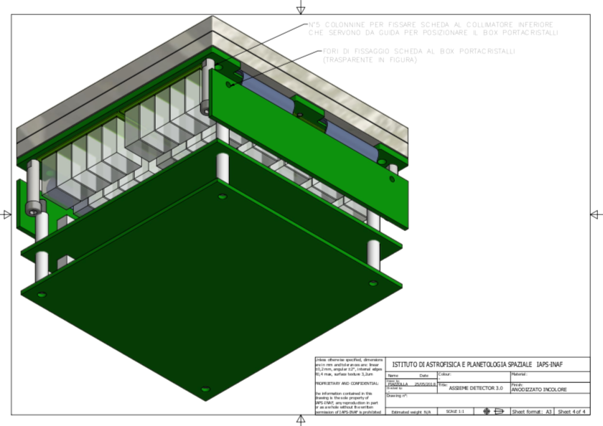
Payload
Scintillator cristal (GAGG) + Photo detector (SDD)
3-2000 keV
~50 cm² coll. area
a few sr FOV
Temporal res. ≈100 ns
Power < 4W
~1.8kg

Slide 11
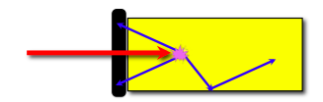
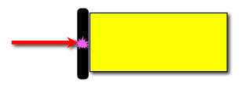
HERMES efficiency
Dual Simultaneous Functionality for SDDs:
Scintillator readout system
for Higher Energy X/γ-rays
Solid State Detector
for Low Energy X-rays
Feasible only with
SDDs & Low Noise FEE

Slide 12
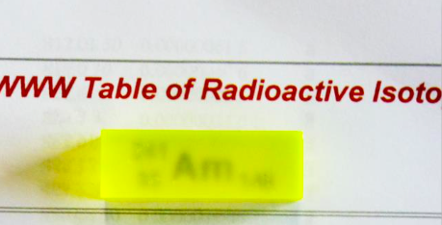
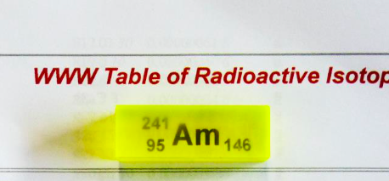
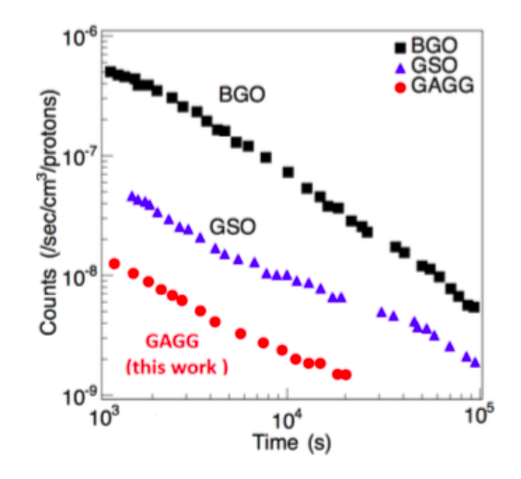
Ce:GAGG
Cerium-doped Gadolinium-Aluminum-Gallium Garnet
1x1x3cm
Ce:Gd₃(Ga_{x}Al_{1-x})₅O₁₂ (x=1-5, typ.=3)
Measured @ Bo-Lab ~23 e⁻/keV
Available from industry since ~2014
1x1x3cm
• Light output: 40 – 60 ph/keV
• No intrinsic background
• Not hygroscopic
• Decay time ~90 ns
• High density (6.63 g/cm3)
• Peak emission at 520 nm
• Hardness: 8 Mohs scale
• Energy resolution ~ 5% @ 662 keV
Measured @ Bo-Lab ~30 e⁻/keV
10krad 70MeVp+
Very promising literature radiation tests
Planned further test to better understand
Afterglow effects
Yoneyama+2018

Slide 13

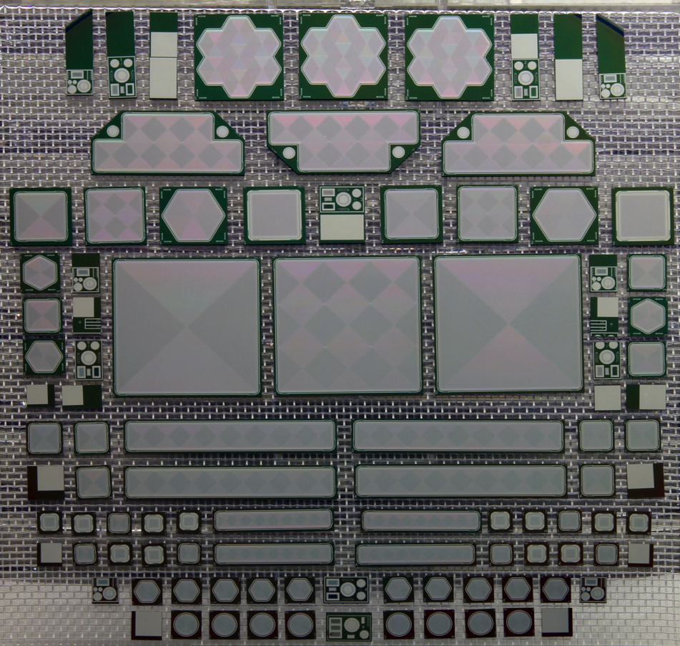
SDD within Collaboration
Funded by INFN – P.I. Prof.A.Vacchi
6’’ Silicon wafers
Single cell SDD
with 900 mm² sensitive area
Largest SDD
ever built (~ 80cm²)
SDD Quantum Efficiency (QE) > 80%
Low anode capacitance (few tens of fF)
Low leakage current (tens of pA/cm²)
Notes:
Tecnologia SDD principio di funzionamento e caratteristiche e FEE giusta
Descrizione redsox come temi di apllicazione
Dal disegno al prodotto finito

Slide 14












Collaboration
The
Nuclear Physics
and
Synchrotron light
applications
Design, production &
costs funding
Extremely Low Noise
Front End Electronics
Design and production
High Energy
Astrophysics
applications
Integration SDD & FEE

Slide 15
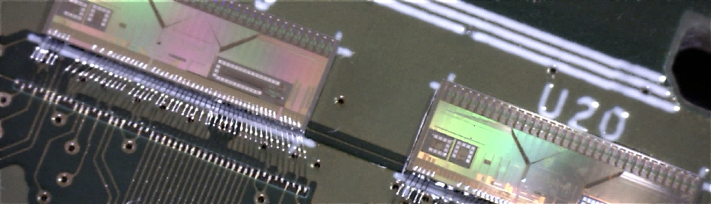
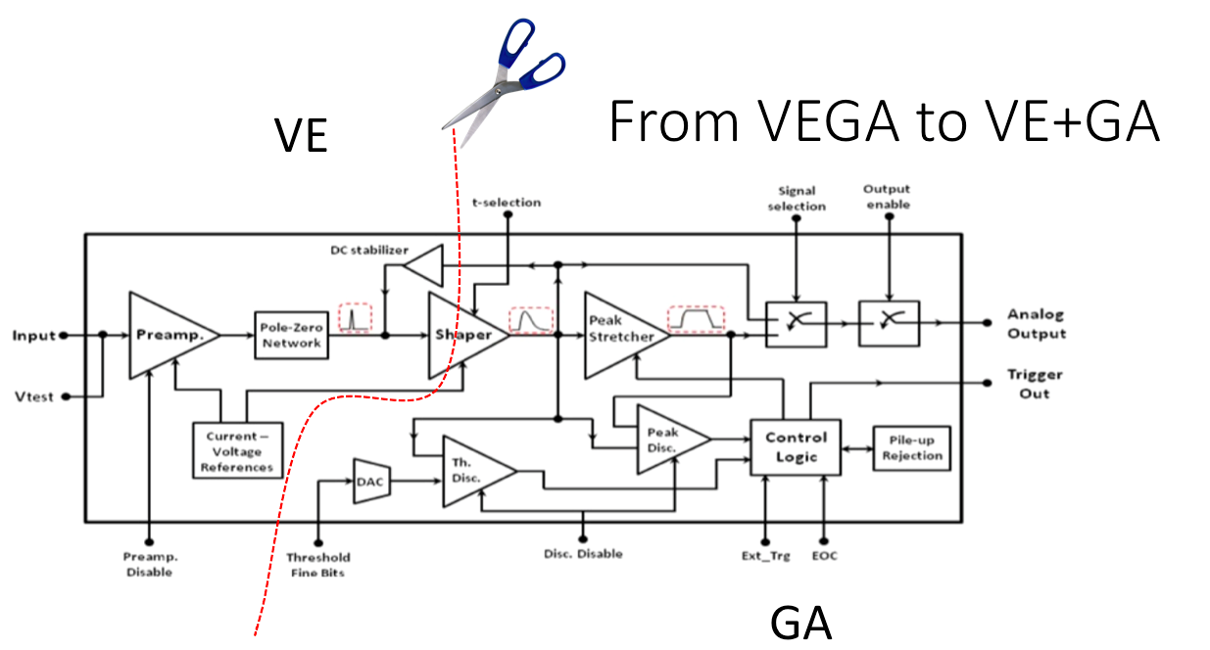
The HERMES Front-End-Electronics
Coordinated by Bertuccio (poliMi) & Malcovati (UniPV)
The Heritage :VEGA ASIC (LOFT –M3 Phase-A)
32 parallel channels
~ 0.5 mW / channel
ENC ~ 15 e- r.m.s. ➔ 185eV @5.9keV (-30°C)
Ahangarianabhari+2014
Campana+2014
TWO separated dies:
VE (single channel ~ 0.9x0.6mm)
Premplifier
Shaper (first stage)
GA (32ch ~ 16.5x2.5mm)
Shapers (second stage)
Discriminators
Sample & hold
32ch multiplexer
Post-layout simulations guarantee
ENC ~ 15 e- r.m.s. with 1mW/channel (VE+GA)
Europractice submission 24.05
AMS CMOS 0.35μm

Slide 16
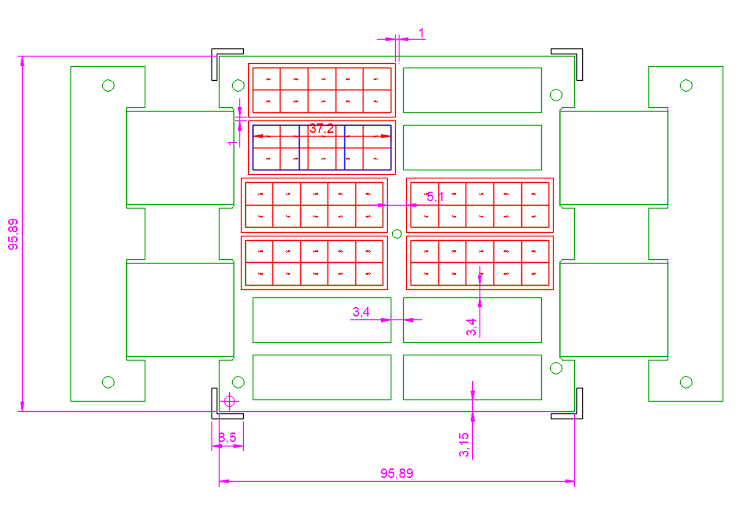
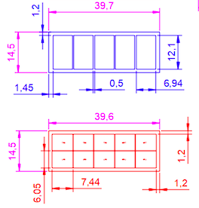
SDD design & arrangement (FEE board)
Rigid-Flex PCB
EXTERNAL FRAME
VE chips
GA chips
Flat Cables
Crystal coupled
with 2ch SDD
X-rays ➔ single
γ-rays ➔double
Gross area ~ 91.95 cm2
Effective Area ~ 54.01 cm2
12 SDD arrays;
120 channels (120 VE);
4 GA;

Slide 17
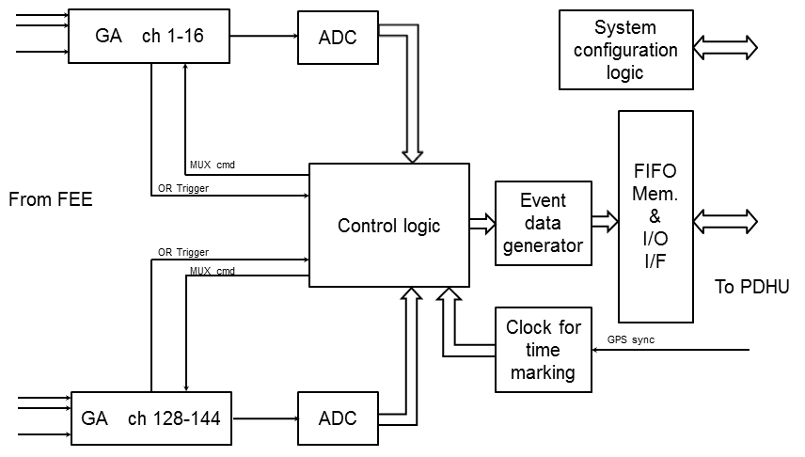
BEE board (block diagram)
GA ch 1-32
GA ch 96-128
Time Marking
Channel Adressing
Event Data Genrator (Single/double)
PDHU I/F
32ch / GA
ADC ≥ 11bit
FPGA-based Control Logic

Slide 18
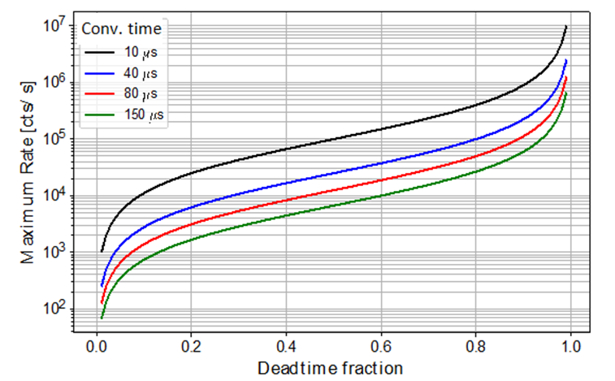
BEE deadtime effects
With 32ch readout blocks
ADC non yet selected
Power VS. deadtime Tradeoff

Slide 19
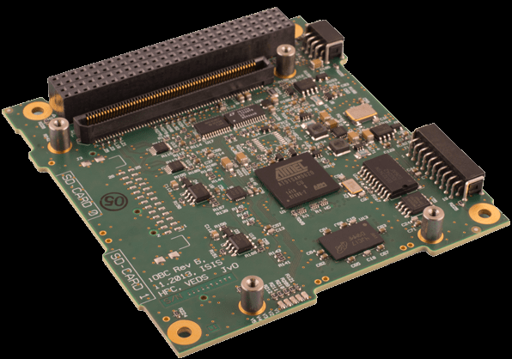
PDHU
trigger logic:
continuous comparison background rate
VS
current rate on different timescales (sub-ms to tens of secs)
PDHU The ISIS on-board computer (iOBC)
Dimensions: 96 x 90 x 12.4mm (incl. FM daughter board) Mass 100g with EM daughter board Power Consumption: 400mW average
Scientific data processing (trigger logic), Scientific RMs, HKs, TCs,
P/L configuration, operative modes, TM generation, I/F with OBDH…

Slide 20
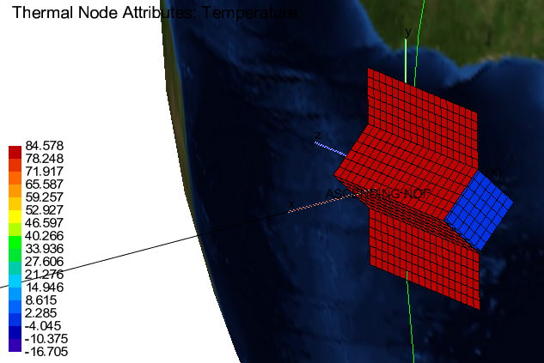
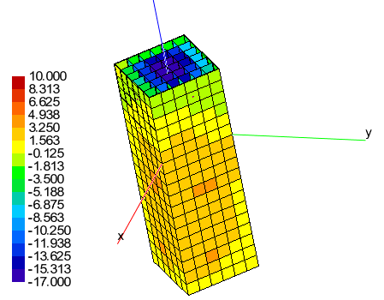
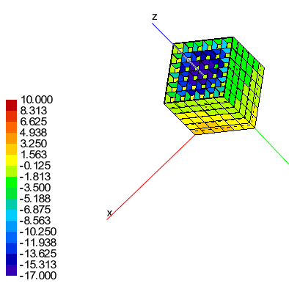
Preliminary Thermal results
SVM T
Sun Array T
PLM T
Worst (hot) case temperature of SA and SVM in polar orbits are similar to equatorial results

Slide 21
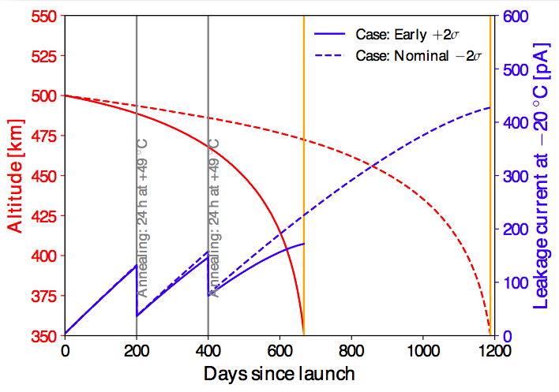
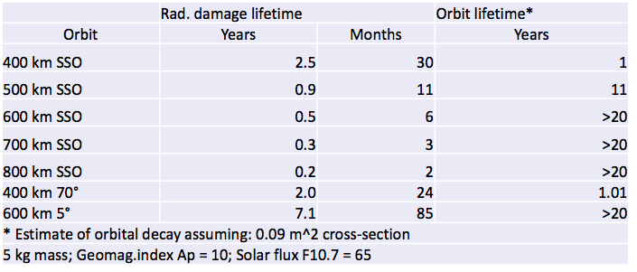
Preliminary lifetime estimation
SPENVIS + AP8MIN derived p+ flux
Leakage Currrent increase with the
Non-Ionizing Energy Loss
Annealing parameters
from Moll+02

Slide 22
Programmatics
Progetto Premiale 2015 (Technological pathfinder – 3nsat) – Coordinated by ASI
KO May 2018 (in few week)
PDR T0+9
CDR+QR T0+15 QM—> PFM1
AR T0+24 —> PFM2+PFM3
Launch mid 2020 (VegaC maiden flight or Vega)
NEXT: Scientific pathfinder – 3+3nsat; towards FULL Constellation

Slide 23
HERMES people
Burderi, Fiore, Negri, Vacchi, Pirrotta, Puccetti, Carpentiero, Lavagna, Lunghi, Labanti, Fuschino, Campana, Morgante, Feroci, Evangelista, Ambrosino, Piazzolla, Del Monte, Di Cosimo, Malcovati, Grassi, Bertuccio, Gandola, Ahangarianabhari, Fiorini, La Rosa, Sottile, Santangelo, Tenzer, Bayer, Guzman, Pliego, Puehlhofer, Diebold, Amelino-Camelia, Riggio, Sanna, Di Salvo, Iaria, Celletti, Nava, Bongiorno, Piranomonte, Antonelli, Papitto, Della Valle, Capozziello, De Laurentis, Pucacco, Costa, Amati, Frontera, Rosati, Baldazzi, Rignanese, Zampa, Rachevski, Rashevskaya, Scarano, Gambino, Calderini, Ubertini, Natalucci, Pacciani, Rapisarda, Rubini, Di Salvo, Zaccheo, Perelli, Gronchi, Arzano, D’amico, Palmisano, Ghirlanda, Ghisellini, D’Avanzo ….
HERMES is open to ideas and collaboration
Want to be involved? Send an e-mail
fabrizio.fiore@inaf.it
burderi@dsf.unica.it

