Slide 1
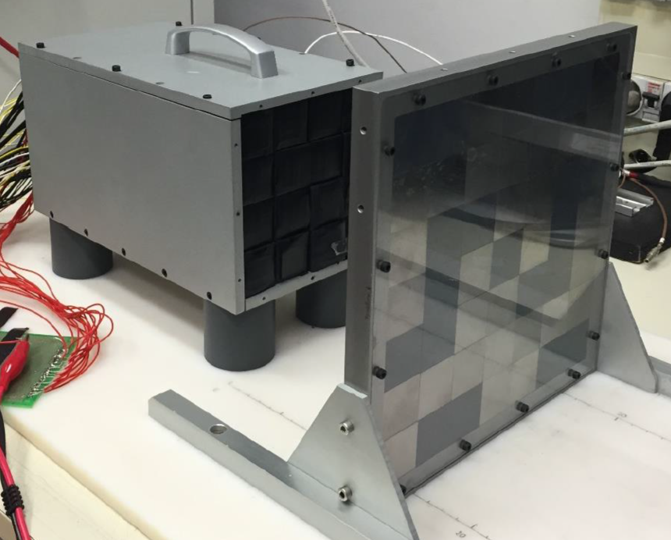
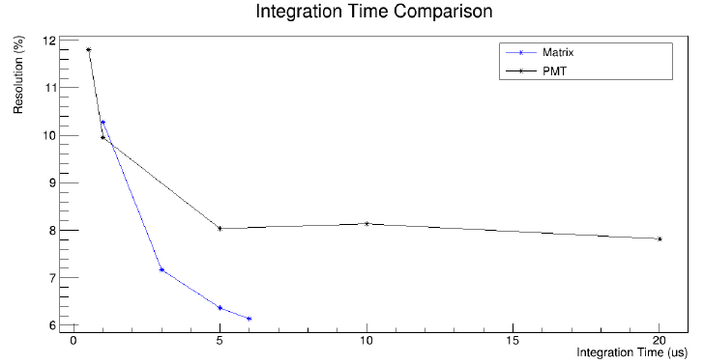
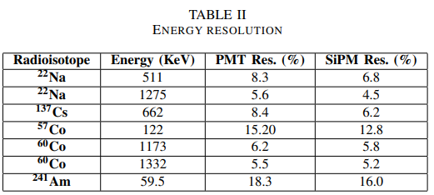
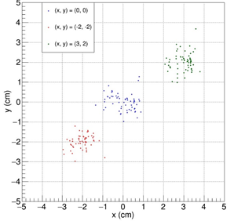
A gamma-ray imaging camera for ambient radioactivity detection
Set-up
4x4 CsI(Tl) Scintillator matrix
Coded mask technique (7x7 Tiles made with Tungsten and PVC)
PMT-based photodetection vs SiPM-based photodetection
CAEN Digitizer V1725 for data acquisition
Energy Resolution SiPM vs PMT
Better resolution for integration gate grater than 0.5 µs
¹³⁷Cs 662 KeV Line
5 µs integration gate
Point Spread Function
PSF of about 20 mrad, corresponding to 2 cm for a source at 1 m
¹³⁷Cs Imaging

