Slide 1
SiPM Arrays for Space-Based Detectors
  Dr. Anthony L. Hutcheson
High Energy Space Environment Branch
Space Science Division

Slide 2

Who We Are
U.S. Naval Research Laboratory
  The corporate laboratory for the United States Navy
  Main campus located in Washington, DC
  Conducts basic research concerning the Navy's environments of Earth, sea, sky, and space
  Pioneered naval research into space
    Vanguard: America’s first satellite program
High Energy Space Environment Branch
  Advancing the understanding of the high energy environment through:
    the development and deployment of advanced detectors in space
    simulation of environments & operating concepts
    interpretation and theoretical modeling of observed phenomena

Slide 3
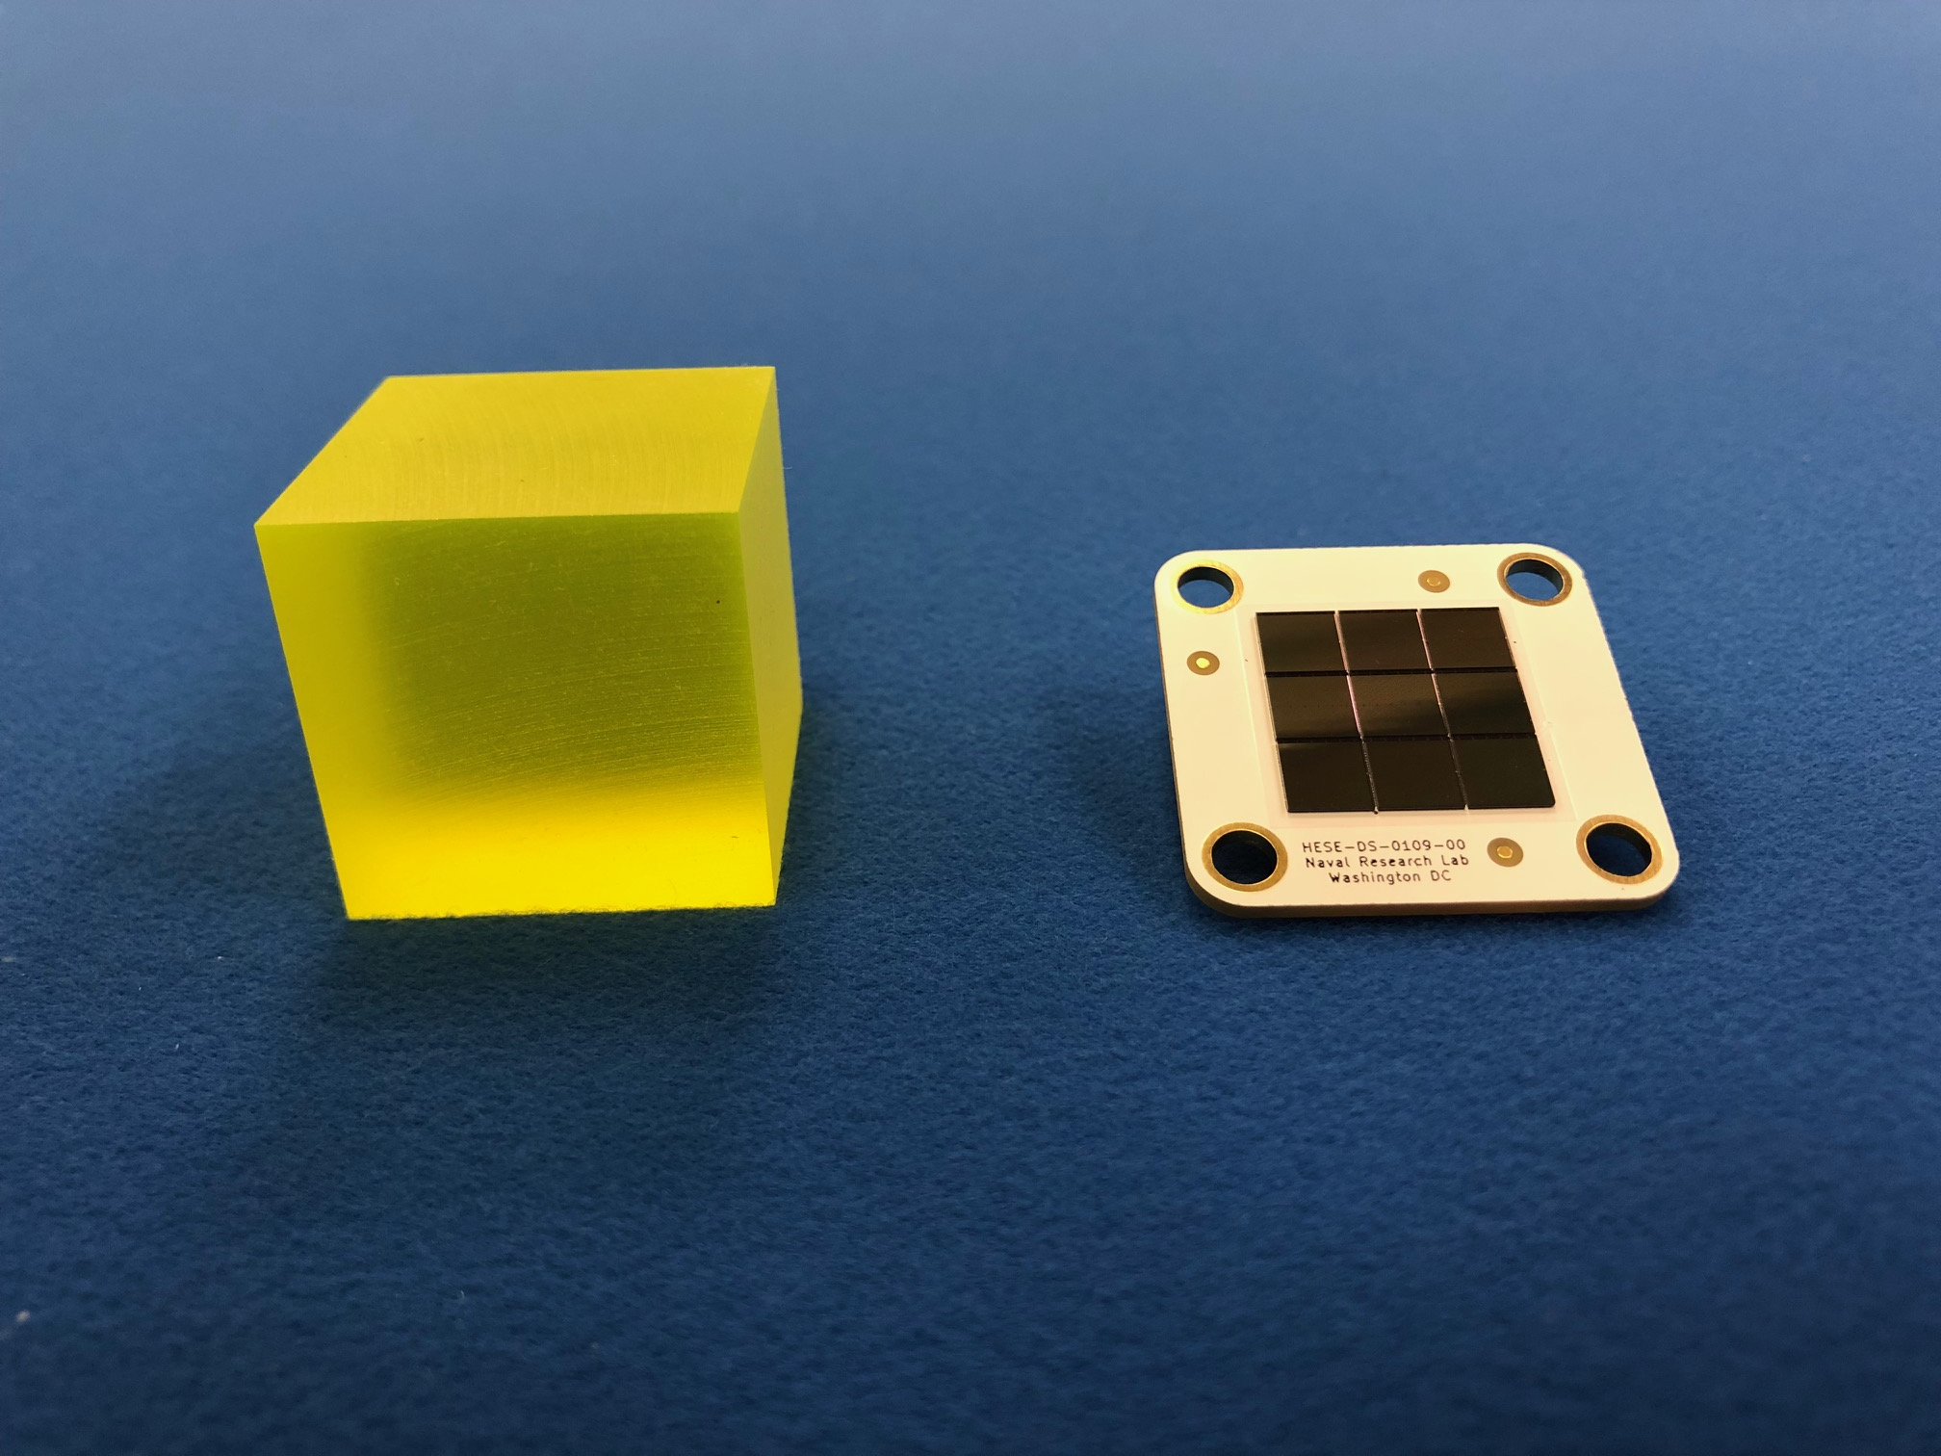
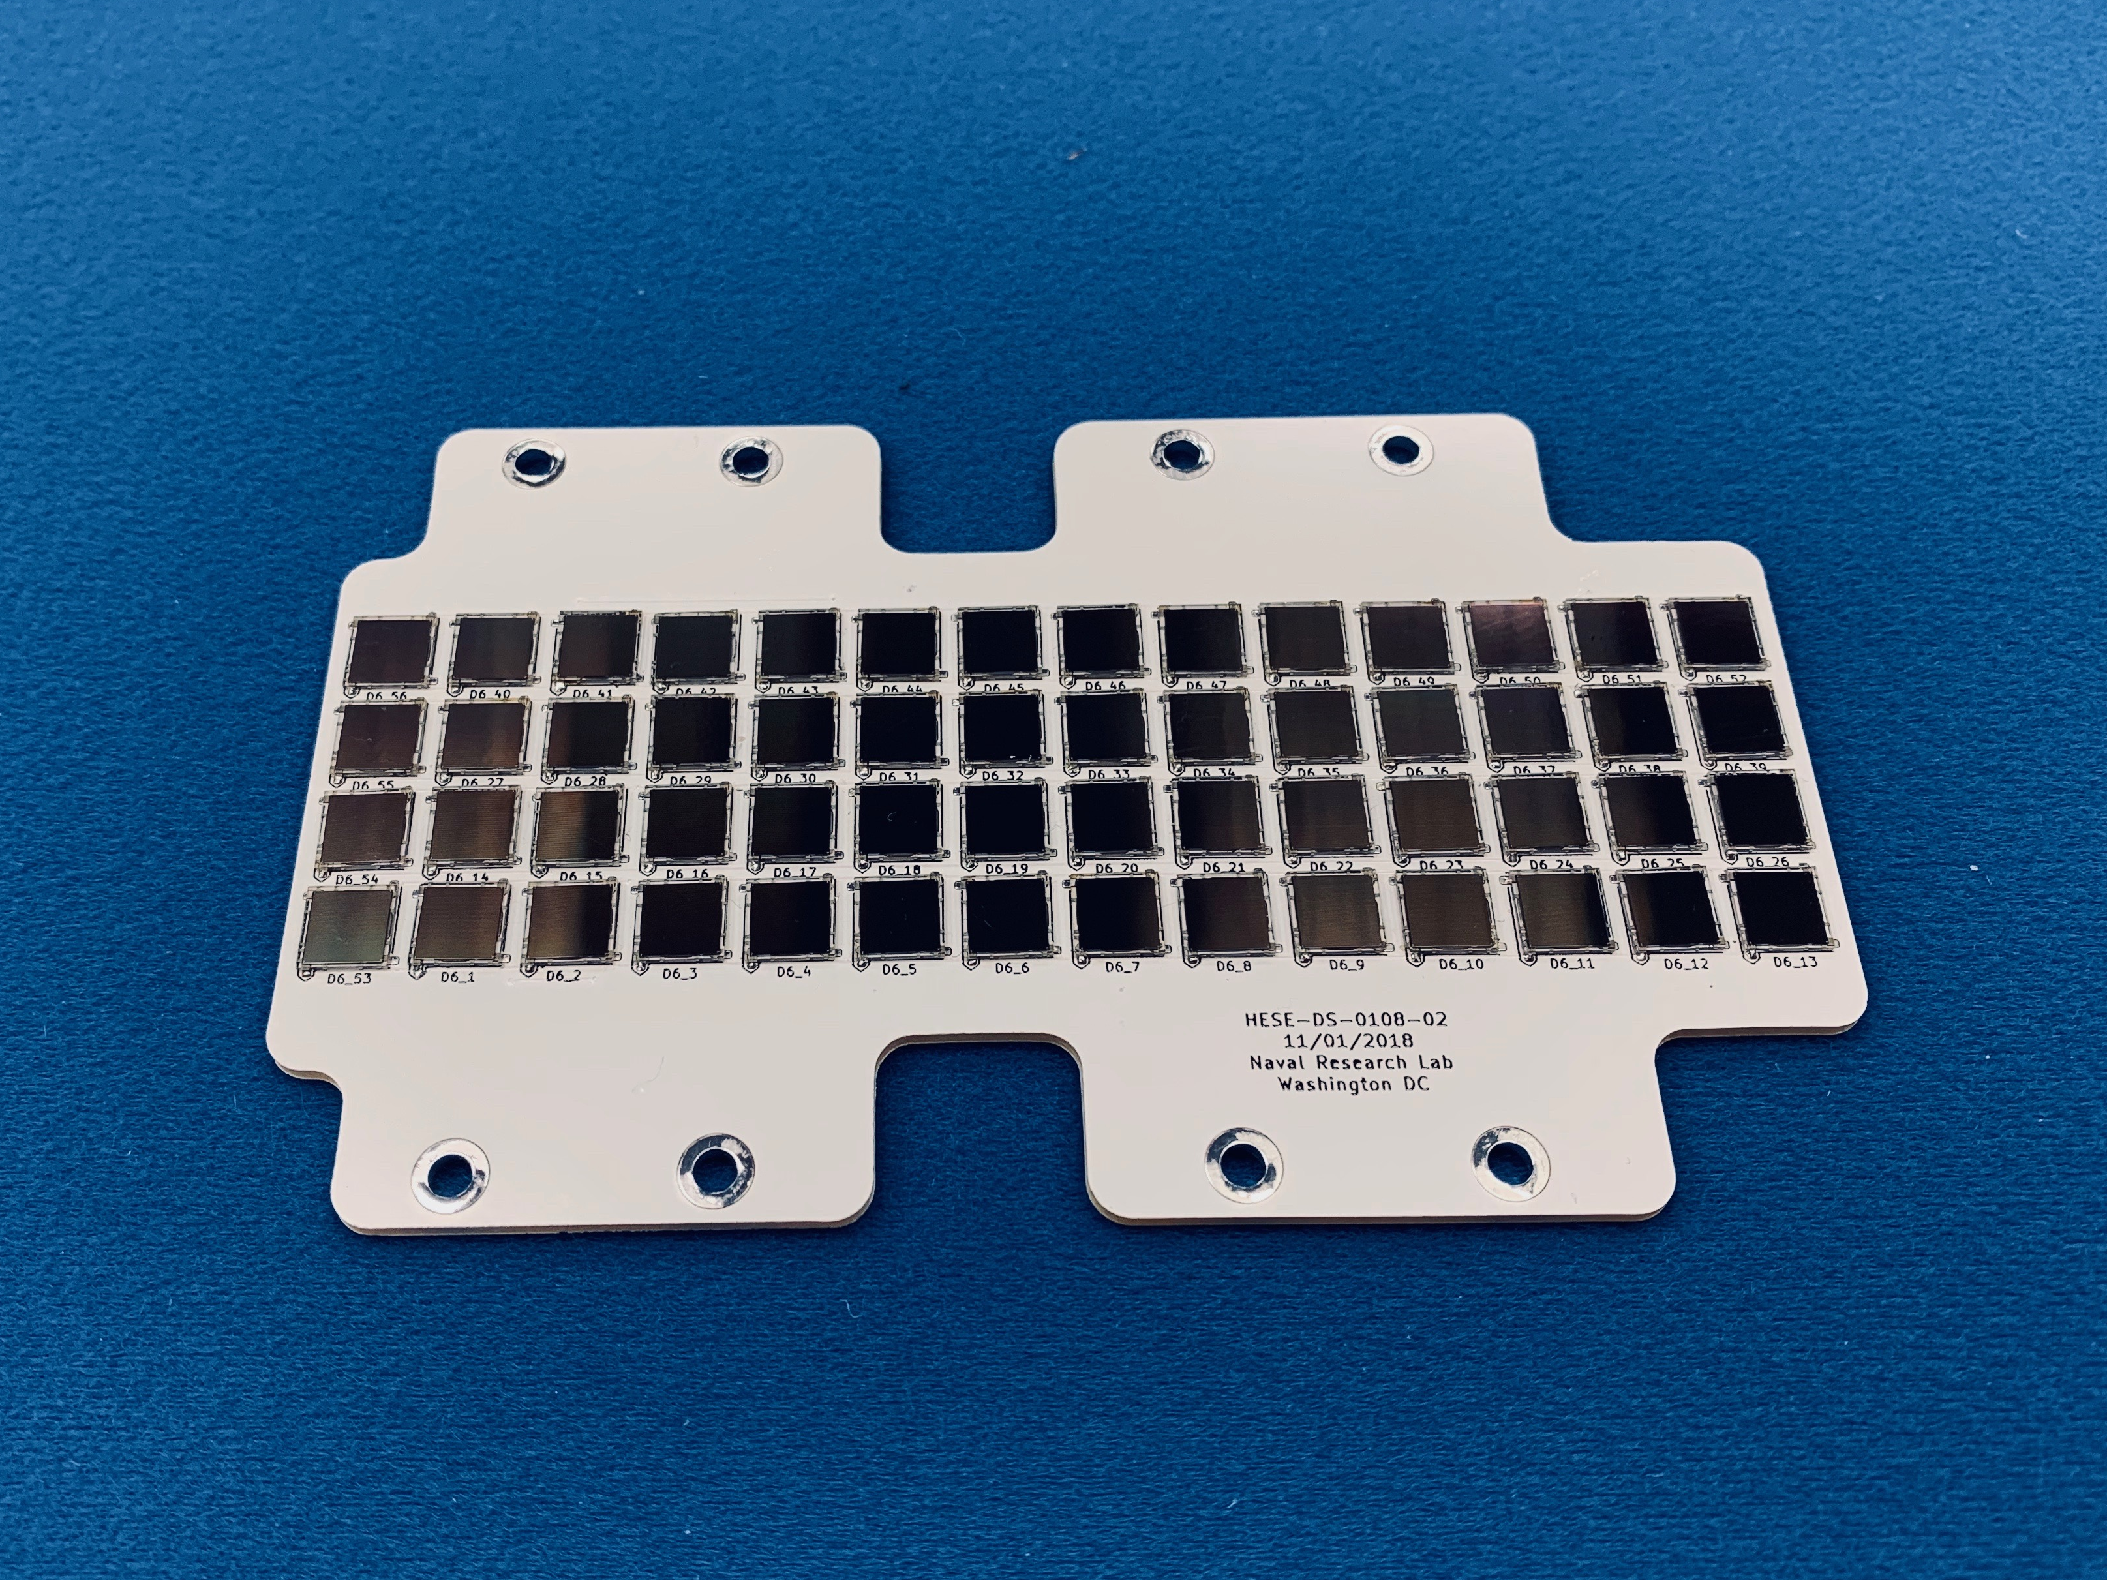
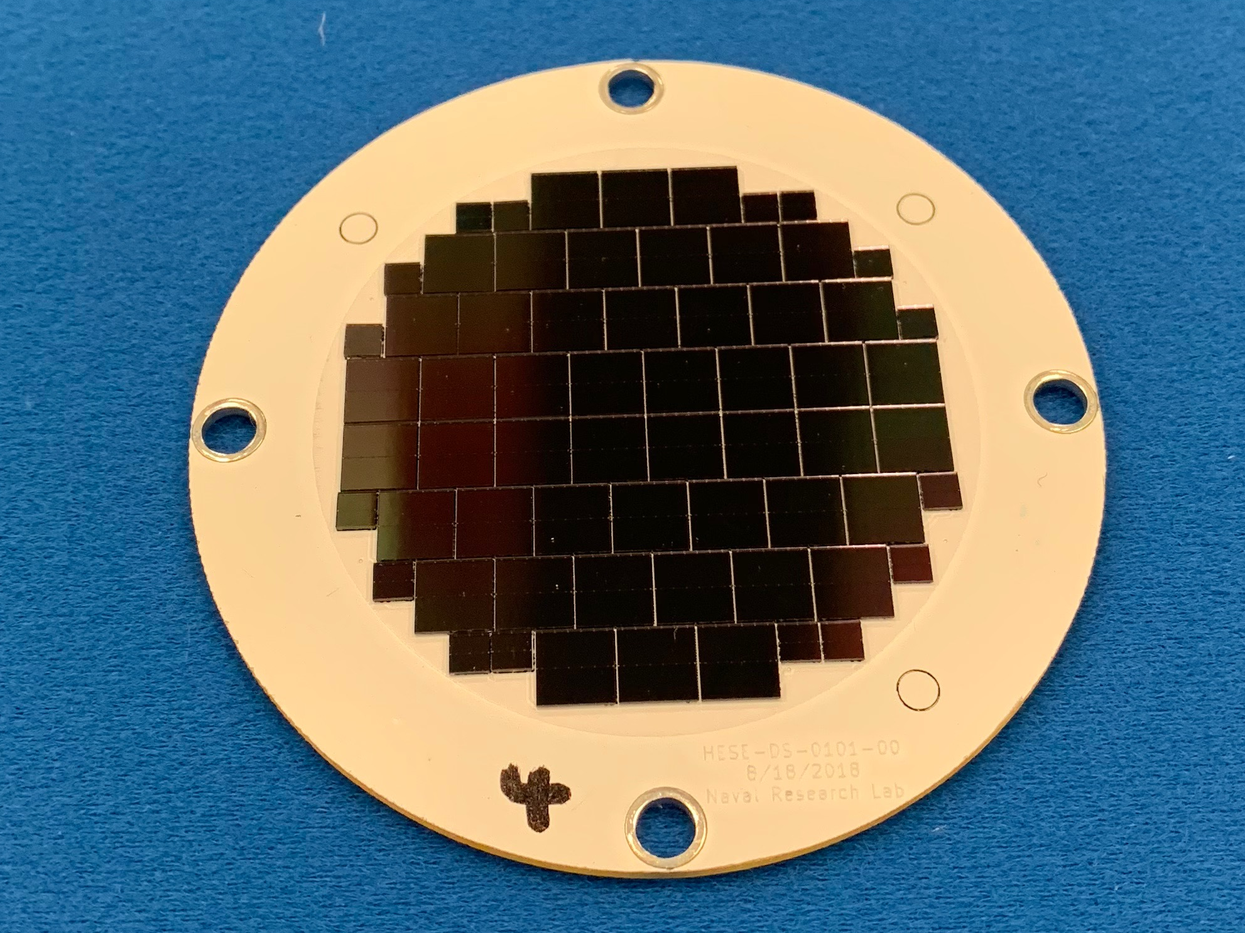
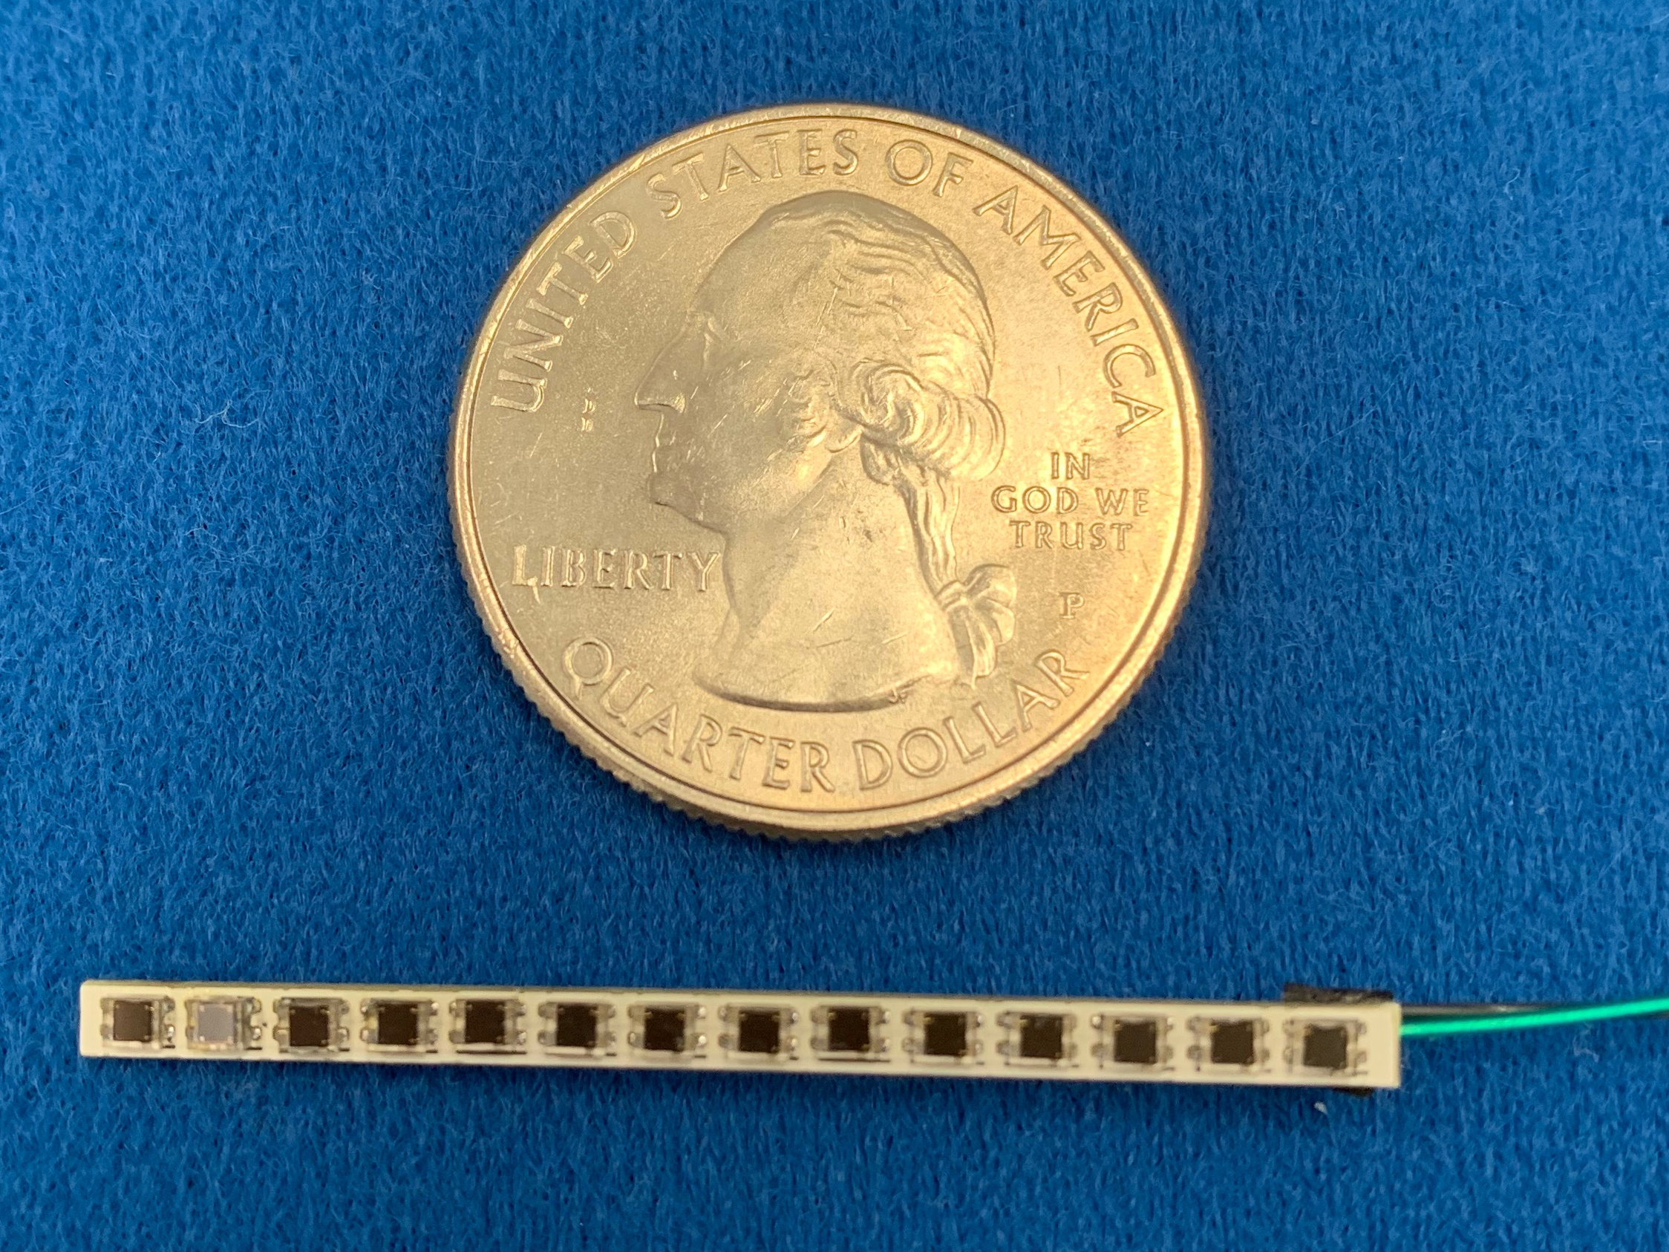
SiPM Instrumentation at NRL
Experience instrumenting SiPM arrays
Heritage of successful space- and ground-based systems
Applications
  Space-based
  Ground-based
  Science-focused
  Security-focused
Attractive Qualities of SiPMs
  Mechanical ruggedness
  Size
  Low voltage bias
  Relatively high quantum efficiency
Challenges with SiPMs
  Degraded performance at higher temperatures (> 30 °C)
  Large capacitance for arrays (sizes ≈ 6 cm² and greater)
Emphasis of this
presentation

Slide 4
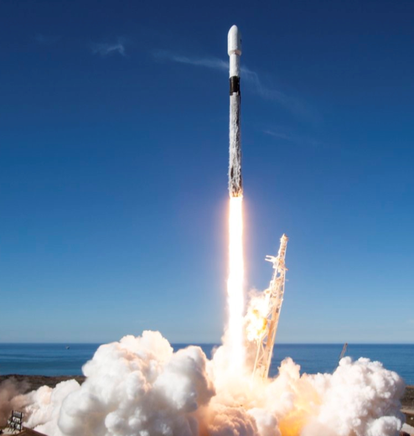
Space Test Program
U.S Department of Defense (DoD) Space Test Program (STP)
  Provides space flight to the DoD’s space science and technology community for experiments, new technologies and demonstrations.
  Mission: space qualify new technology for the DoD
  Available competitively to qualified and relevant investigations
  Service provided at no cost to the experimenter and includes
    Spacecraft
    Integration and testing (on spacecraft)
    Launch
    One year mission operations (e.g., spacecraft and instrument commanding, data handling and delivery)
  Experimenter covers the cost of
    Development and construction of the instrument
    Pre-ship environmental testing
    Analysis of data.
  A typical STP flight will host numerous experiments.

Slide 5
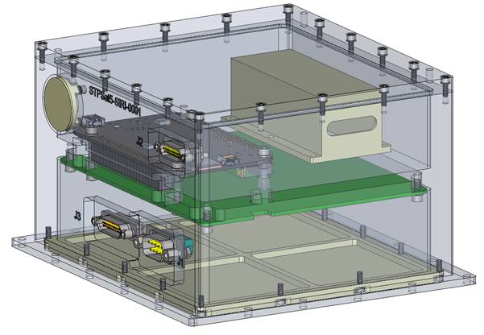
Strontium Iodide Radiation Instrument (SIRI-1)
Space qualification of SrI₂(Eu) and SiPMs
Launch: STPSat-5 (sun-synchronous LEO) – 03 Dec 2018
Goal
  Demonstrate and characterize this new technology for use as a component in larger space-based defense- or science-related missions
Design Overview
  Total SWaP
  Size: 8.9 cm (H) x 14 cm (D) x 15 cm (L)
  Mass: 1.620 kg
  Power: 1.5 W
  Detector
  Single SrI₂(Eu)
    17 x 17 x 40 mm³
    4% resolution at 662 keV
    Density: 4.55 g/cm³
  2 x 2 array of 6-mm SensL J-series SiPMs
PI: Dr. Lee J. Mitchell (NRL)
Detector Clamp
Vent
SBC
COM
Power
Currently successfully operating in orbit!
Custom PCB

Slide 6
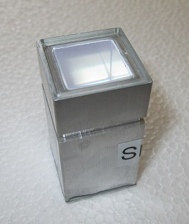
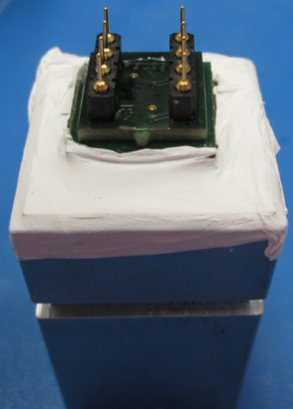
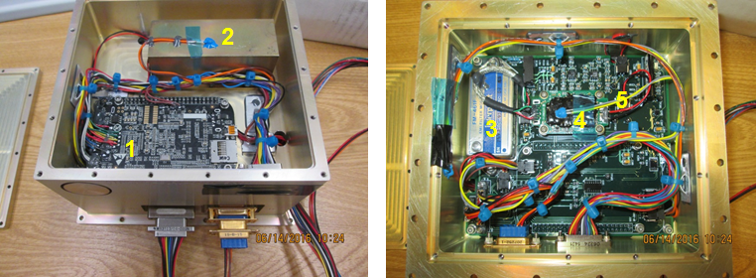
SIRI-1
Detector
  (Left) Packaged SrI₂(Eu) crystal purchased from Radiation Monitoring Devices, Inc.
  Opted for optical window to allow experimentation with different vendor-supplied SiPMs
  Optical window and SiPMs (right) result in ~1% resolution increase compared to ultra-bialkali PMT
    Measured resolution: 4% at 662 keV
System components
  Single-board computer: Beaglebone Black
  Detector clamp
  EMI filter
  Multichannel analyzer: Kromek K102
  Custom printed circuit board
    Includes power conditioning, temperature sensors, preamplifier, SiPM bias control

Slide 7
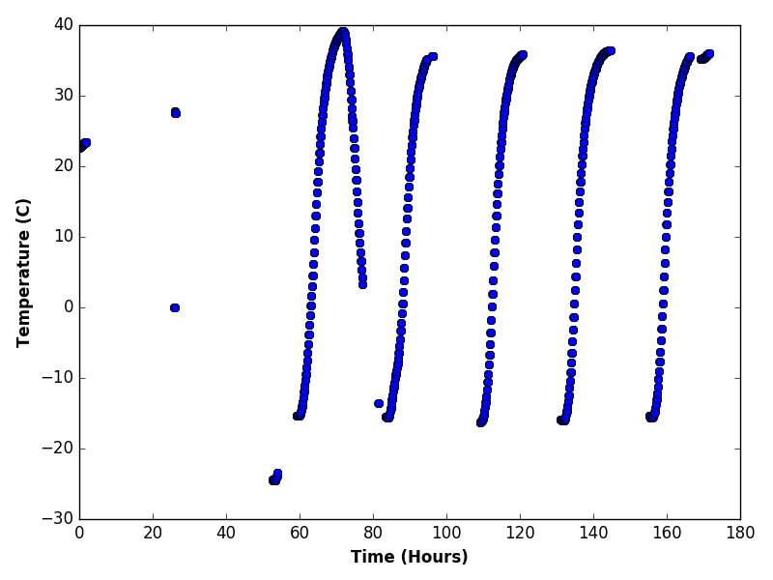
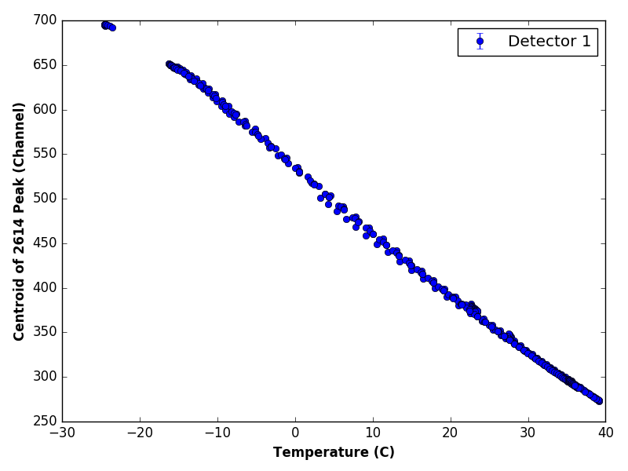
SIRI Pre-ship Testing
Pre-ship Temperature Testing
Max ramp
rate:12 °C/h

Slide 8
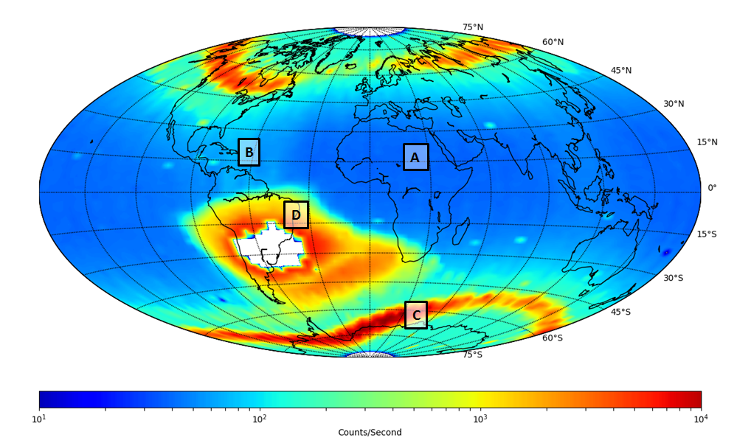
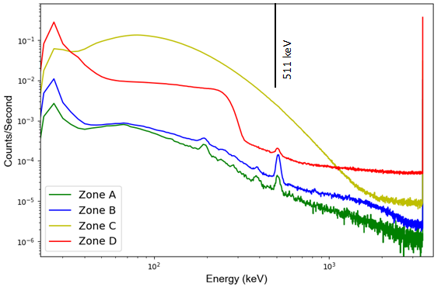
SIRI-1 Early Results
Gross gamma-ray count rate showing the elevated background as the instrument transitions through the various trapped particle regions. The four zones A, B, C and D were used generate the spectra shown in plot above right. No data is indicated by the white areas of the plot (when data acquisition is paused in the SAA).

Slide 9
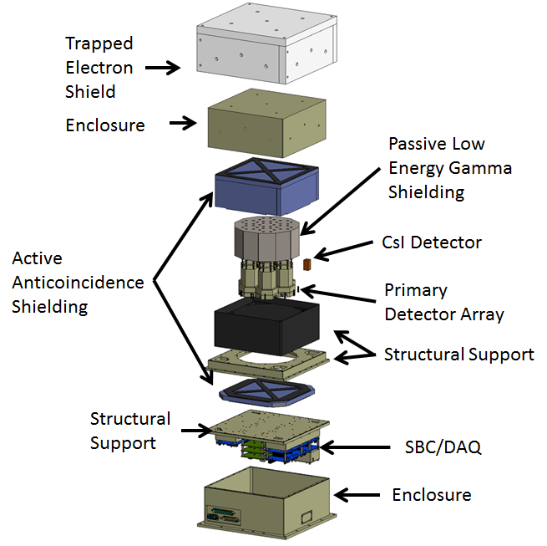
SIRI-2
Multi-crystal design improving upon SIRI-1
Solar gamma-ray spectrometer
Launch: STPSat-6 (GEO) – Aug 2020 (expected)
Design Overview
  Primary detectors
  Seven SrI₂(Eu)
    Hexagonal close-pack design
    38.1 mm diameter (19.05 mm per side) x 38.1 mm length
    SiPM readouts
      19 6-mm SensL J-series SiPMs in hexagonal array on PCB
  Active shield
    Six plastic detectors for approx. 4π coverage
    Anticoincidence rejects high energy cosmic-ray protons that pass through the detector and shielding.
  Passive shield
    Reduce low energy photons during solar events (prevent “swamping” of system)
    Reduce Bremsstrahlung produced by electrons interacting with enclosure
  Single CsI detector
    External to passive gamma shield
    Measure low-energy hard x-ray component of solar flare
PI: Dr. Lee J. Mitchell (NRL)

Slide 10
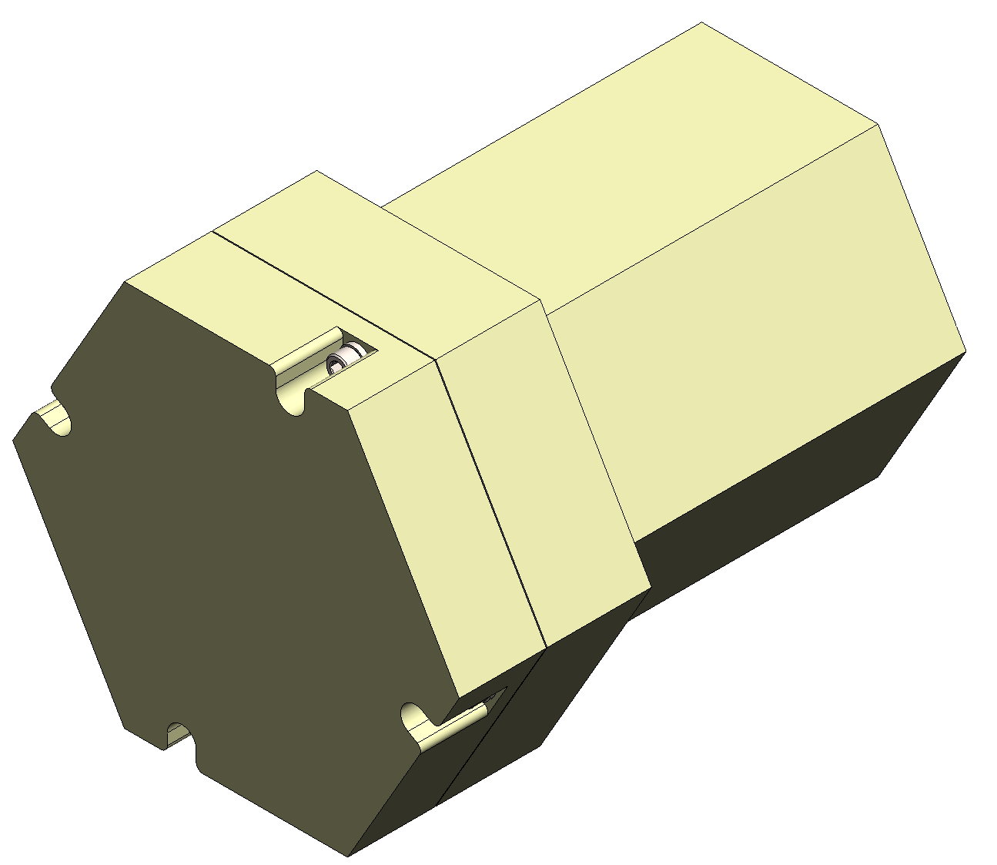
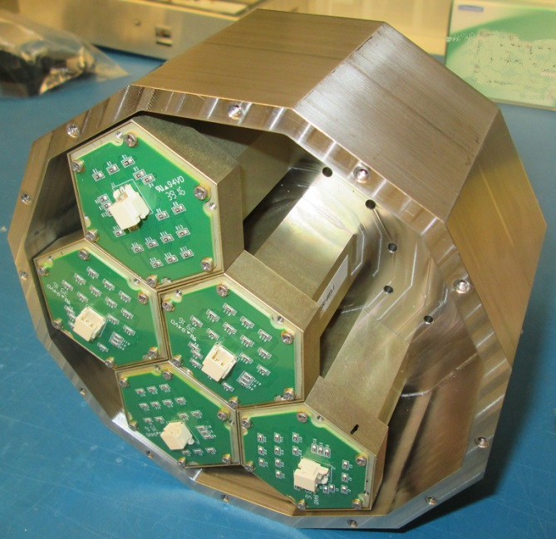
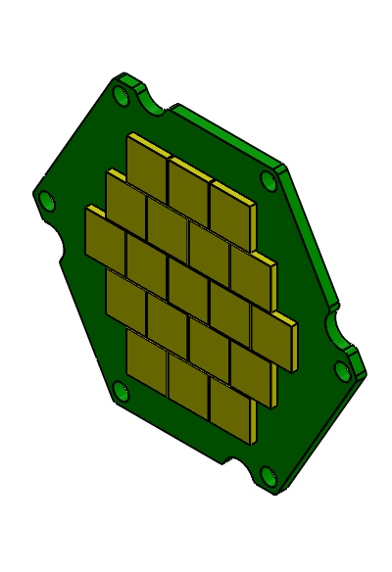
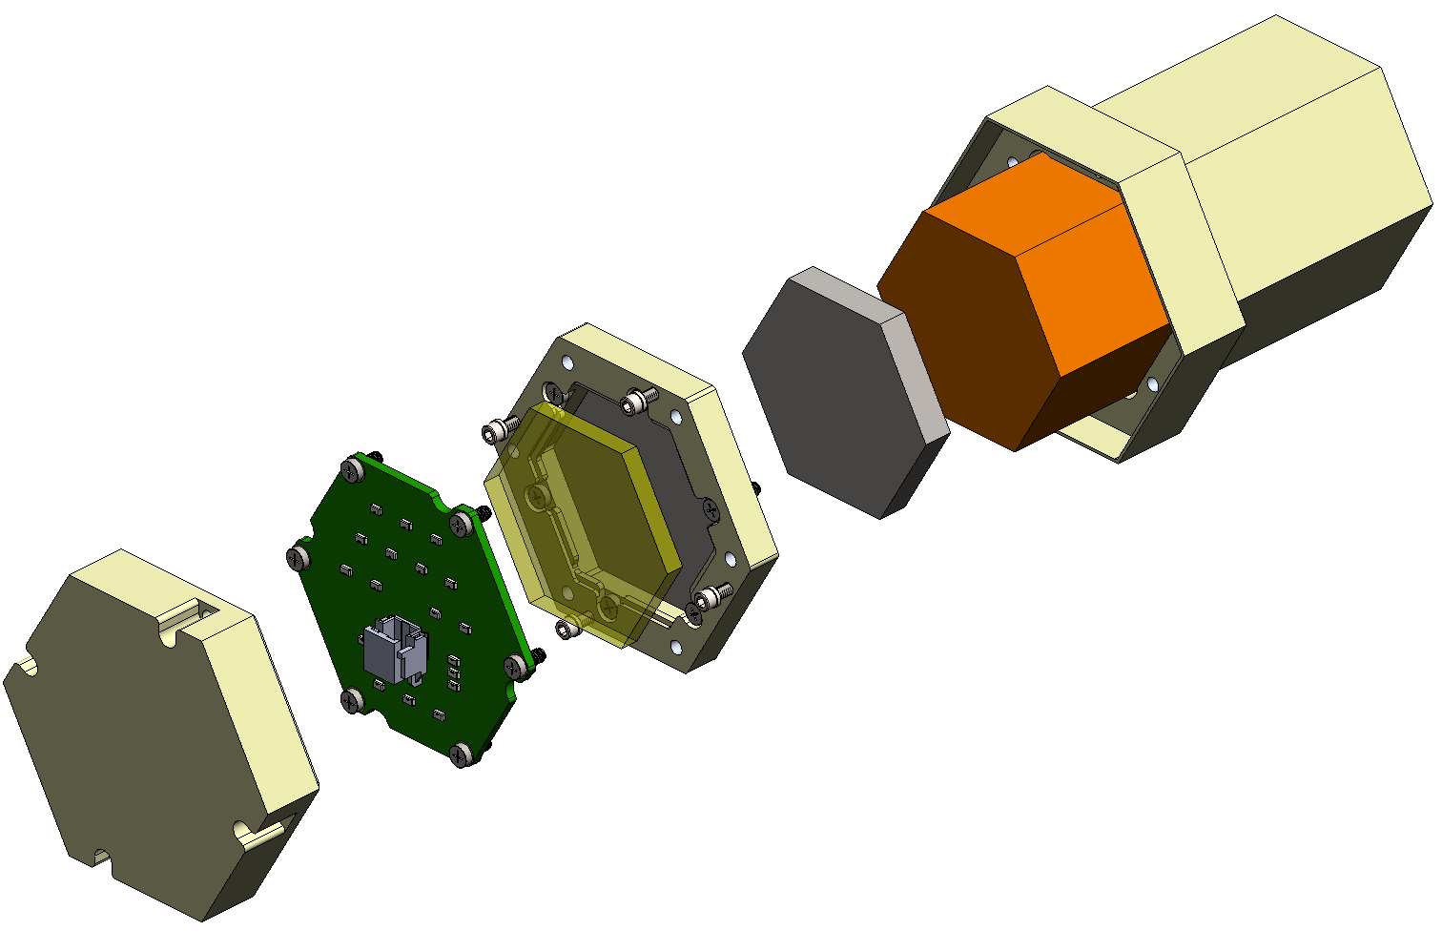
SIRI-2
SrI₂ detector assembly
Assembled
Exploded
Optical window
SiPM array
Aluminum housing
SrI₂(Eu) crystal
Silicone optical interface

Slide 11
GAGG Radiation Instrument (GARI)
Leveraging previous work on SIRI-1 to space qualify GAGG + SiPMs
Targeting manifest: STP-H7 – April 2022 launch (expected)
Goal
  Space qualify Gd₃(Al, Ga)₅O₁₂ (GAGG) scintillator with SiPM array
  Wherever possible, replicate SIRI-1 design
Design Overview
  Detector
  Single GAGG(Ce)
    30 x 30 x 30 mm³
    ~5% resolution at 662 keV
    Good mechanical properties
    Not hygroscopic
    Density: ~6.3 g/cm³
  4 x 4 array of 6-mm SensL J-series SiPMs
    Currently being fabricated
    3 x 3 array shown right used for testing
  Proposed for STP-H7
    Expected launch to International Space Station (ISS) in April 2022
PI: Dr. Lee J. Mitchell (NRL)

Slide 12
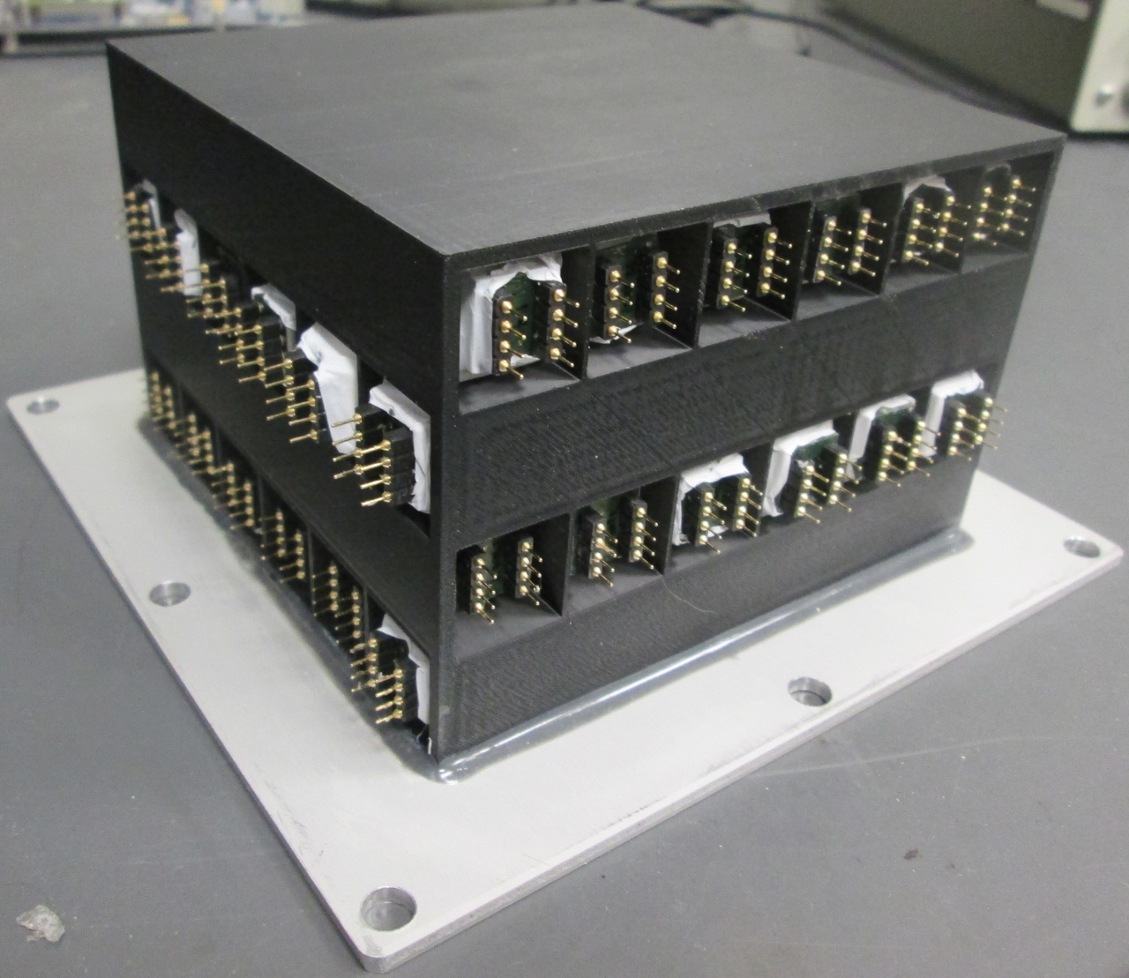
All-Sky Medium Energy γ-Ray Observatory (AMEGO)
Medium-energy γ-ray survey mission, NASA probe-class concept
Balloon flight (Ft. Sumner, NM) – Fall 2021
CsI Hodoscope with SiPM Readout
  Testing and balloon-flight prototype shown below
  17 x 17 x 100 mm³ CsI(Tl) crystals
  2 x 2 array of 6-mm J-series SiPM on each end of crystal
  DAQ: IDEAS ROSSPAD
    64-channel SiPM ASIC
    Four 16-channel SIPHRAs
PI: Dr. Richard S. Woolf (NRL)

Slide 13
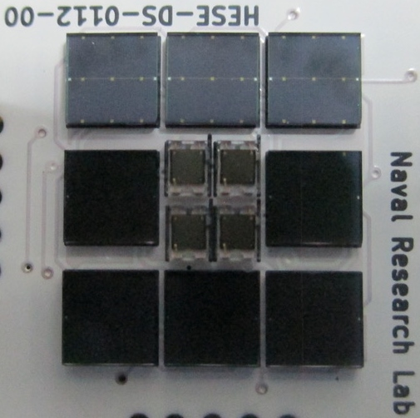
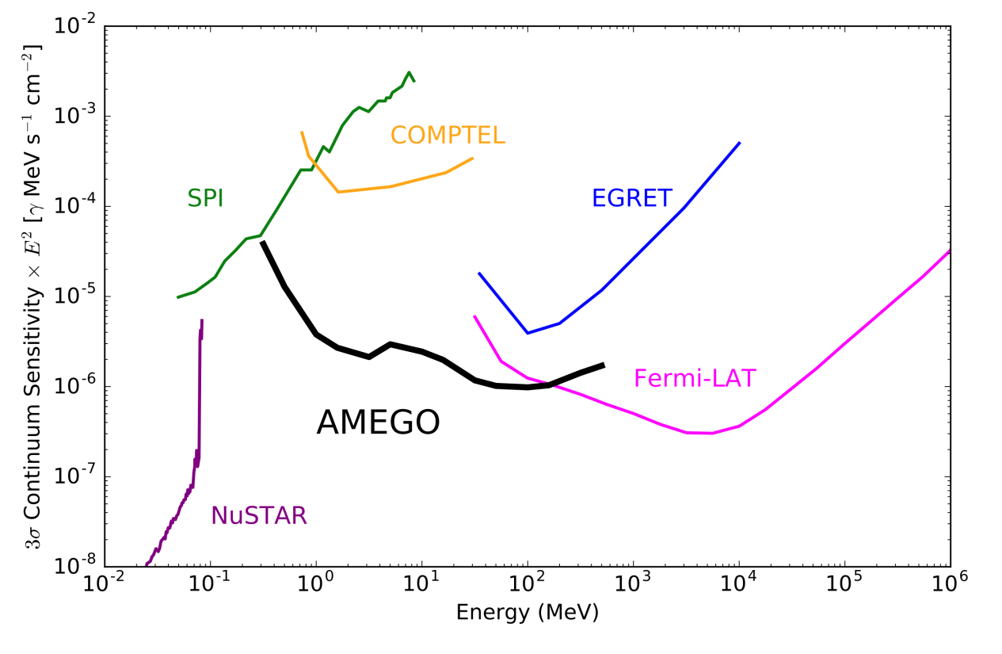
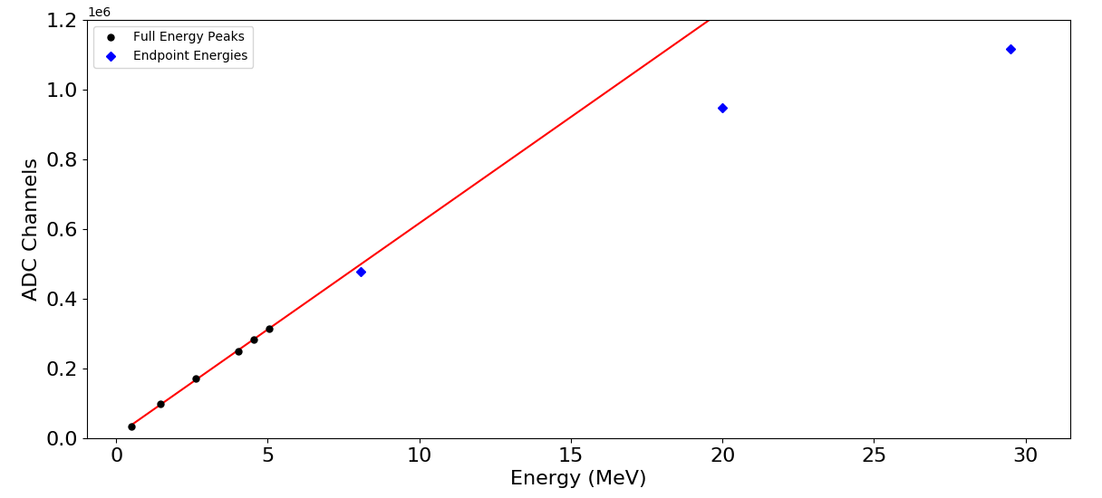
AMEGO
Dual Gain Range SiPM Arrays
Expand dynamic range
with small and large SiPM
(1 mm² to 36 mm²) readouts
Optimize microcell size
(10-50 µm) for individual
SiPMs to mitigate
high-energy non-linearity

Slide 14
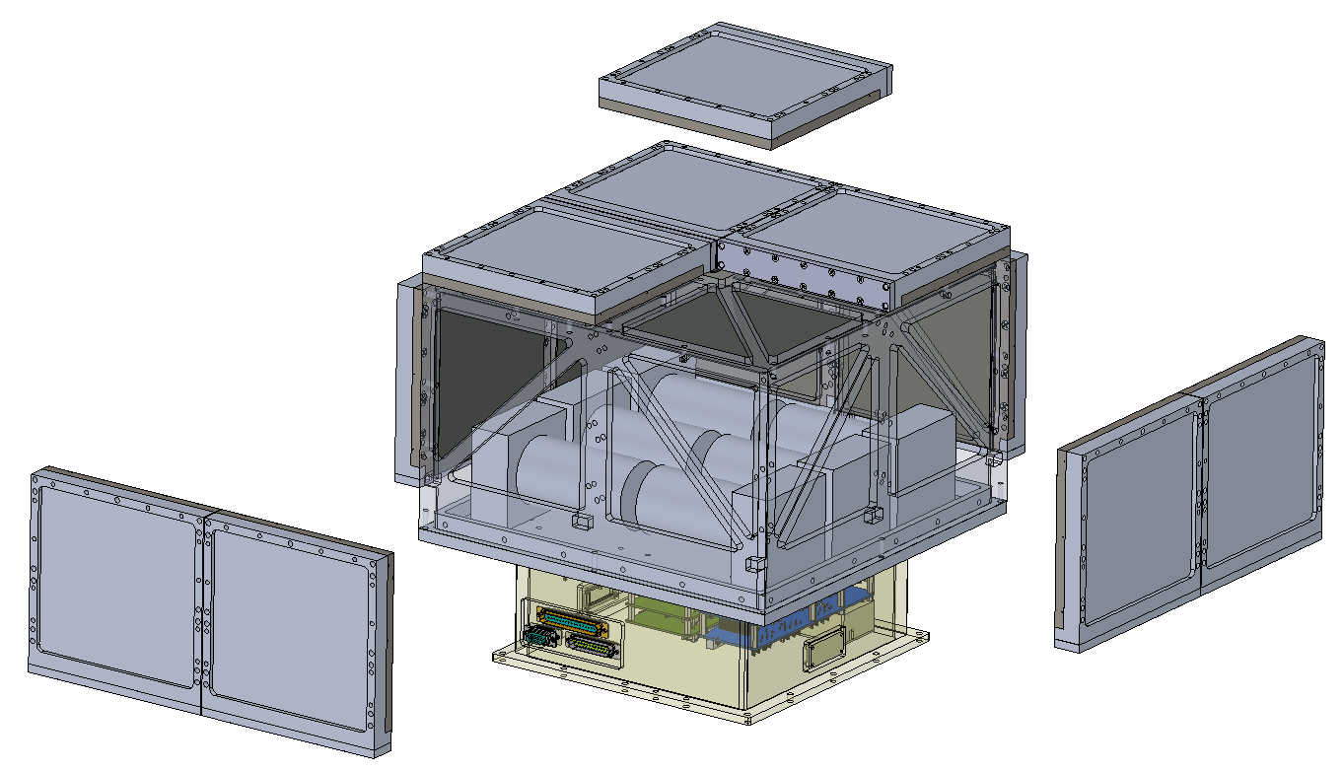
Glowbug
PI: Dr. J. Eric Grove (NRL)
All-sky 30 keV – 2 MeV band transient monitor optimized for GRBs
Targeting manifest: STP-H9 – early 2020s launch
Technology Demonstrator
Low-cost high-sensitivity GRB detector for gravitational wave era
  Large scintillator array
    CsI(Tl) + SiPM readout (12 detectors, each 15 x 15 x 1 cm³)
      Good stopping power; not hygroscopic
      Low size, weight, and power readout
    CLLB + SiPM readout (6 detectors, each Ø5 x 10 cm)
      Additional effective area above 1 MeV
      Sensitive to both photons and thermal neutrons
    Front end and DAQ from SIRI-2
      Low power, space qualified
  Selected by NASA APRA
    Funding began March 2019
  Proposed for STP-H9
    Launch to International Space Station (ISS) in early 2023
Glowbug
detector array
(exploded view)
34 cm
34 cm
6U CubeSat
detectors
20 cm

Slide 15
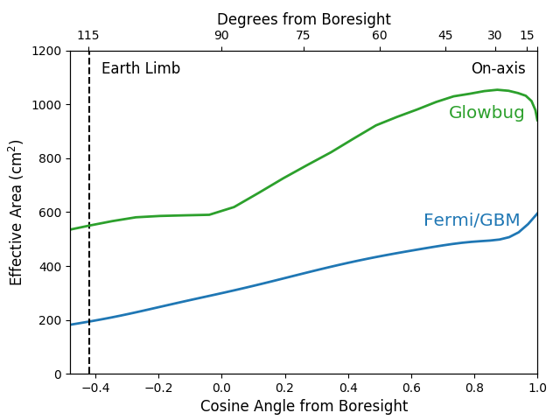
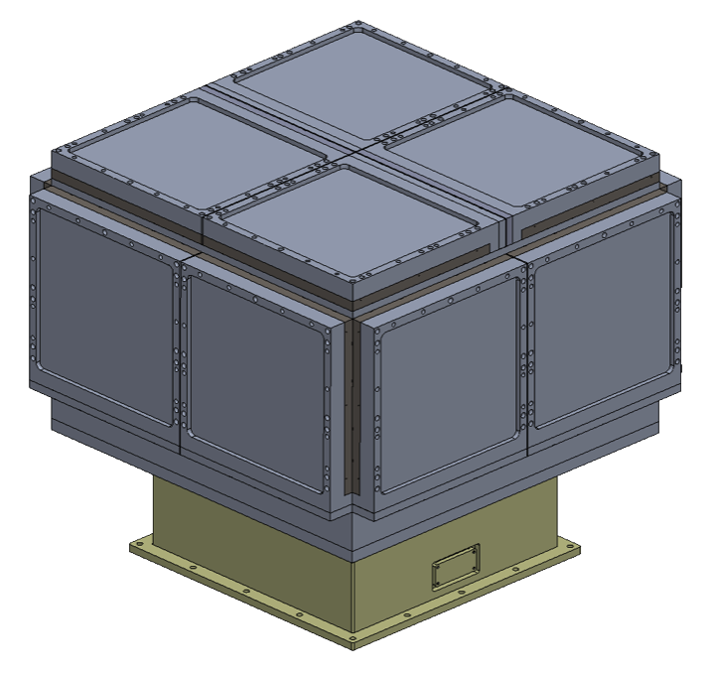
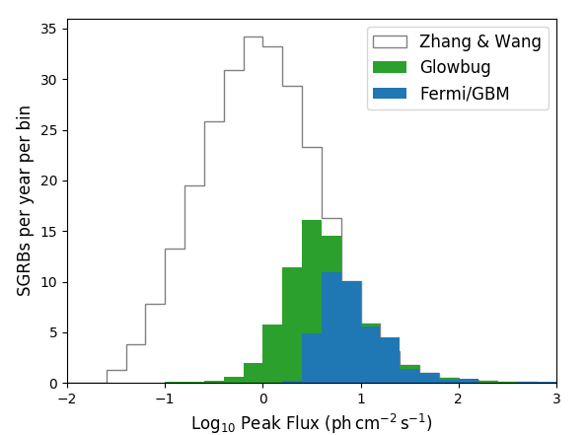
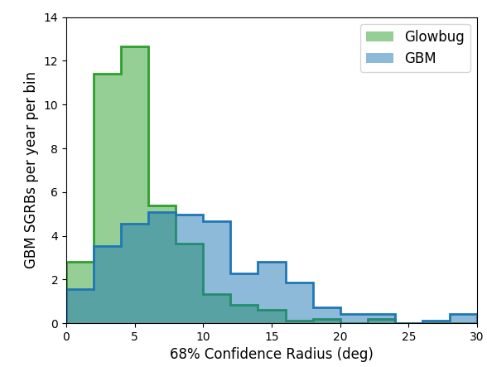
Glowbug
Good sensitivity at low cost
Large area scintillators
with SiPM readout
Effective area
~2 x Fermi GBM
Attached payload
instrument ~65 kg
High rate of
GRB detections
Modest localization ability
Rate ~ 70 short GRBs / year
Comparable to Fermi GBM

Slide 16
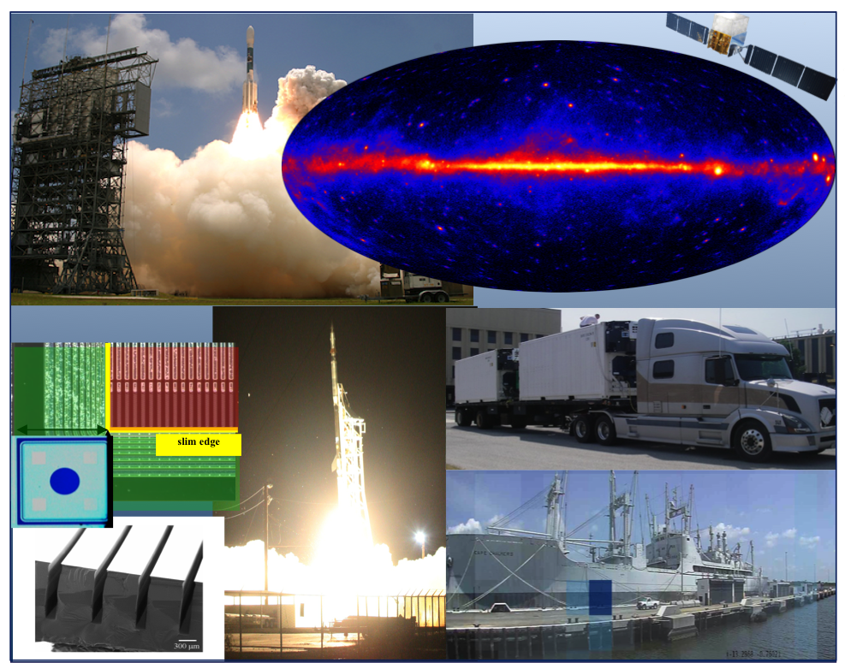
Conclusion
High Energy Space Environment Branch
  Active group with varied interests
  Experience designing, fabricating, and deploying instruments with SiPM arrays in space and terrestrial environments
  Heritage of success in cutting-edge instrumentation and scientific discovery in:
    high energy astrophysics
    high energy atmospheric physics
    security and nonproliferation applications
  We welcome collaboration (and postdocs)!

Slide 17
Conclusion
Instrument Principle Investigators
  Dr. Lee J. Mitchell – lee.mitchell@nrl.navy.mil
    SIRI-1
    SIRI-2
    GARI
  Dr. Richard S. Woolf – richard.woolf@nrl.navy.mil
    AMEGO CsI calorimeter
  Dr. J. Eric Grove – eric.grove@nrl.navy.mil
    Glowbug
Acknowledgments
  SIRI-1, SIRI-2, and GARI are supported by the Chief of Naval Research.
  AMEGO and Glowbug are supported by NASA.

