Slide 1


Status of Steering Module and Future Plans
Eric Raguzin and Sergio Rescia

Slide 2
Outline
Steering Module Design
Steering Module Future Improvements
Interconnections
Future R&D Items

Slide 3
Steering Module Overview
Feedthrough
Photodetector Module
Power
High voltage
SPI
Data output (fiber)
V_{CC}
Amplified Output
SiPM Bias
V_{EE}
µC
X25 OUTPUTS
HV3418
HV Switch
Enable
Control
SPI Out
HV5523
Amp Enable
Amp. Power
SPI In
Differential to Optical
Photodetector Module
Strip Motherboard
Steering Module
Optical
Steering Module

Slide 4












Block Diagram
VDDF
VDDF
P̅O̅L̅
HV5523
HV5523
HV_{OUT} 1-25
Connected to
SAMTEC
TIA_EN1
to
TIA_EN_25
VDDF
B̅L̅
LE
L̅E̅
^{HV}OUT¹
DATA INPUT
DATA INPUT
Latch
CLK
CLK
HV_{OUT}2
Latch
32-Bit
Shift
Register
(Outputs 3 to 30 not shown)
HV_{OUT}31
Latch
HV_{OUT}32
DATA OUTPUT
Latch
VDDF
VDDF
POL BL LE
HV3418
V_{HV}
VDDF
VPP
HV_{OUT}1
HV3418
HV_{OUT} 1-25
Connected to
SAMTEC
SIPM_01_VBIAS
to
SIPM_25_VBIAS
D_{IO}A
READ-BACK
CLK
HV_{OUT}2
100n
100V
•
•
•
60 Additional
Outputs
•
64 bit Static Shift Register
VDDF
64
Latches
DIR
HV_{OUT}63
D_{IO}B
HV_{OUT}64

Slide 5
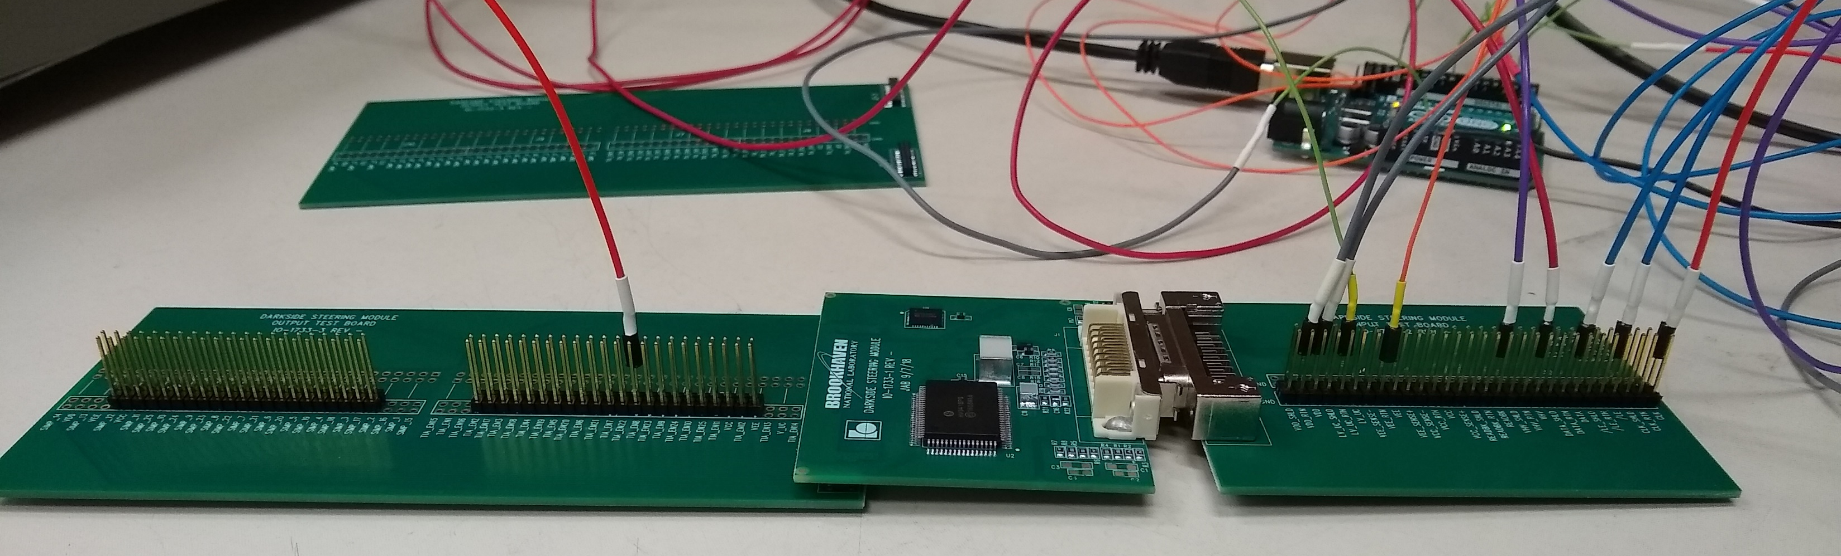
Steering Module
Test Output Board
Steering Module
Test Input board (takes HV, Amplifier bias, SPI Signals)
Steering Module designed, fabricated and tested
Fully functional at liquid nitrogen temperature

Slide 6
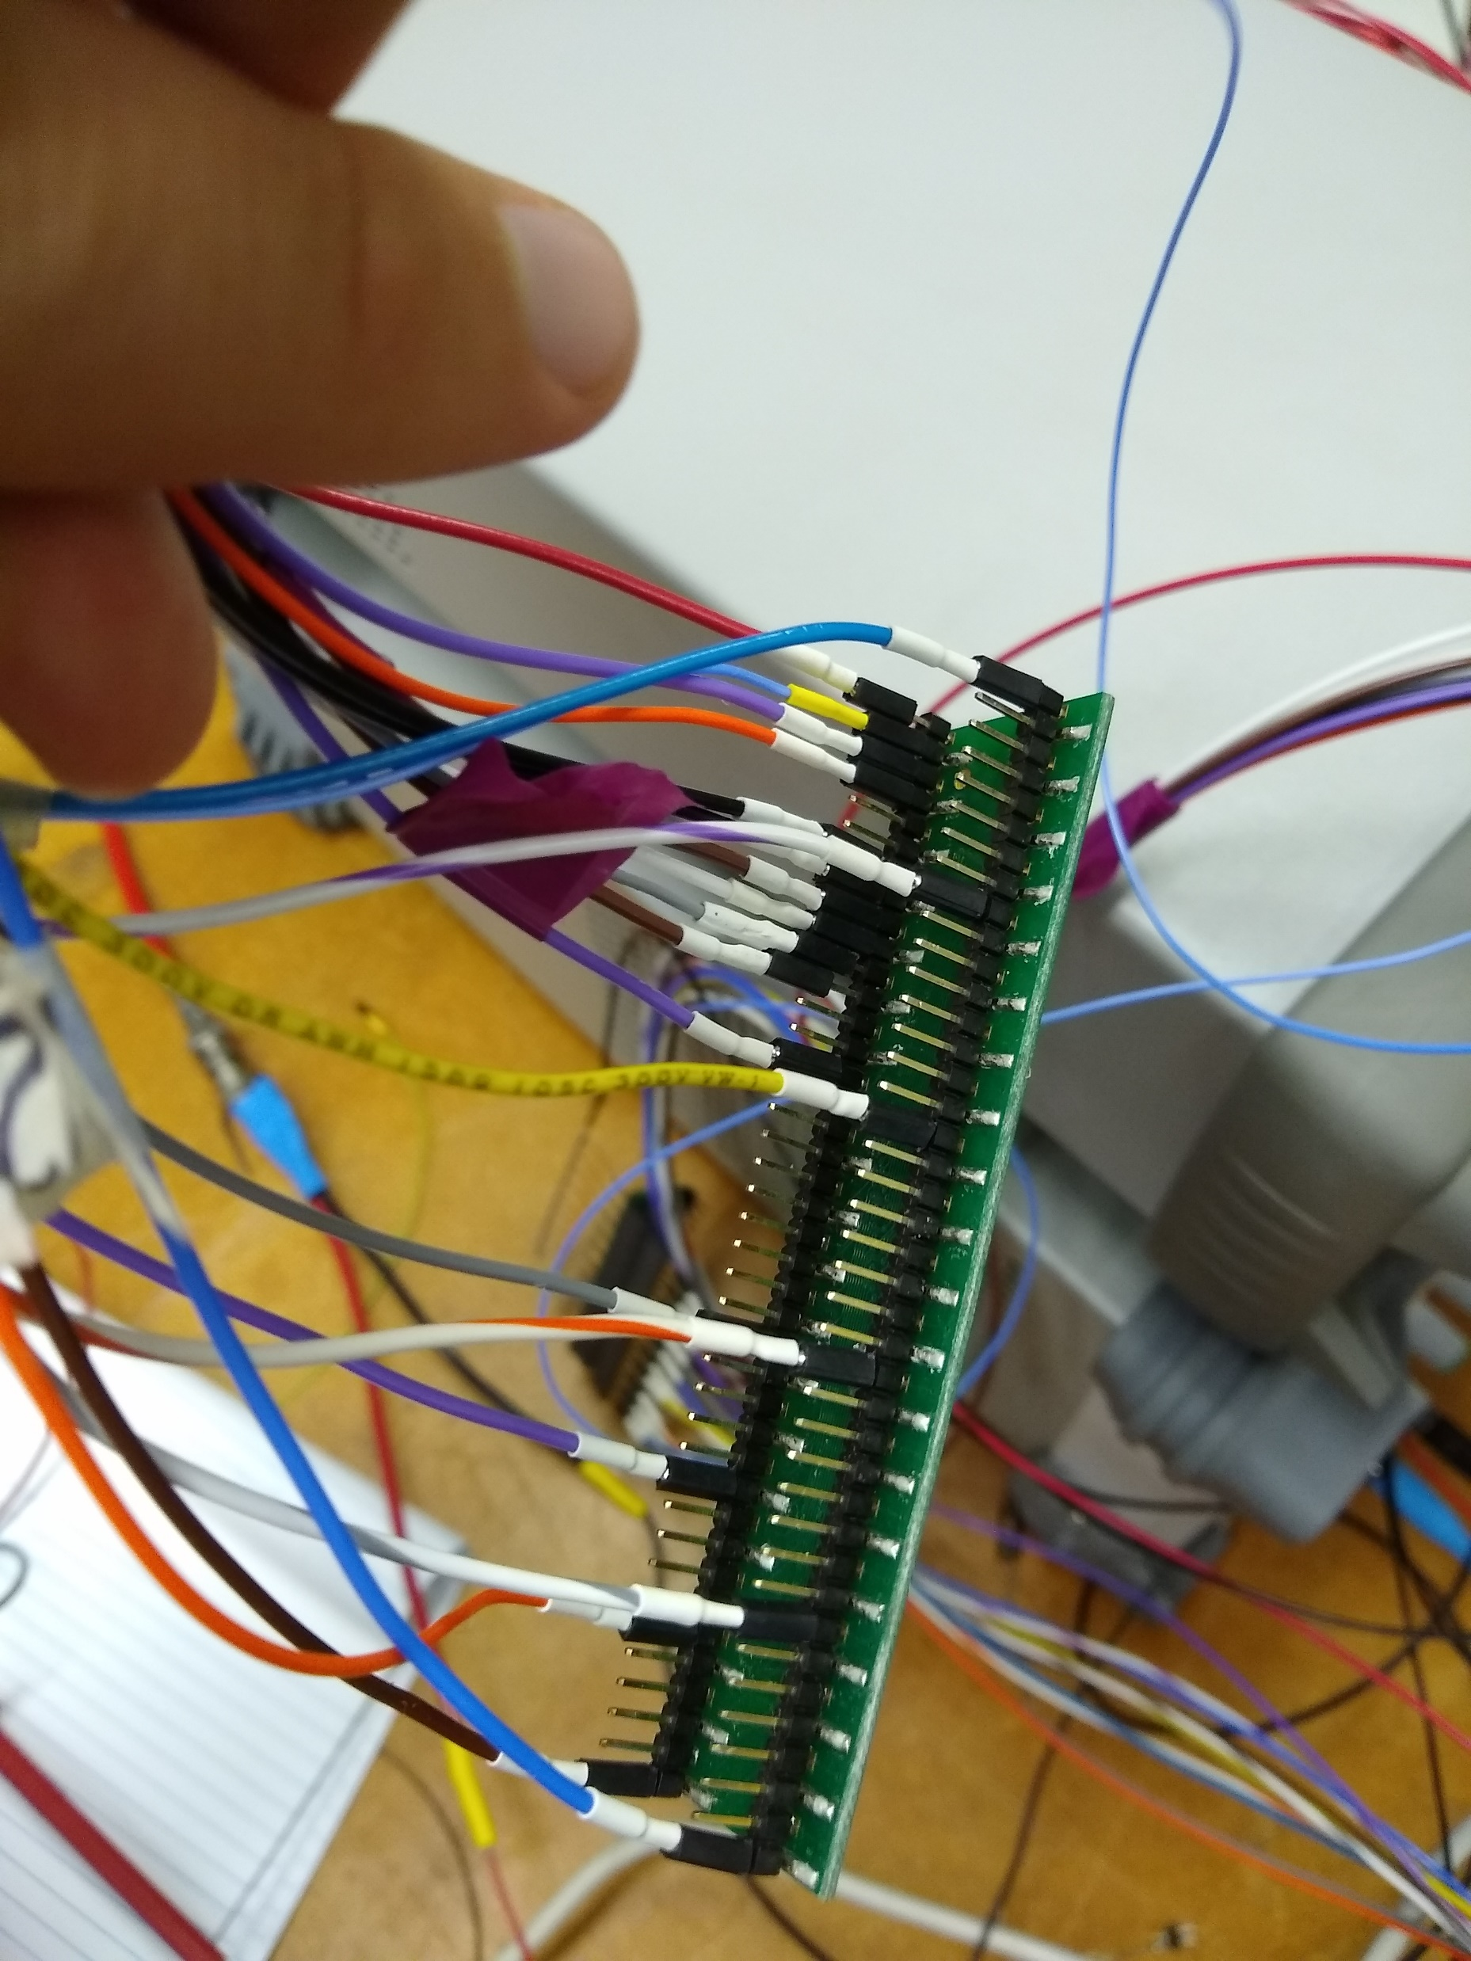
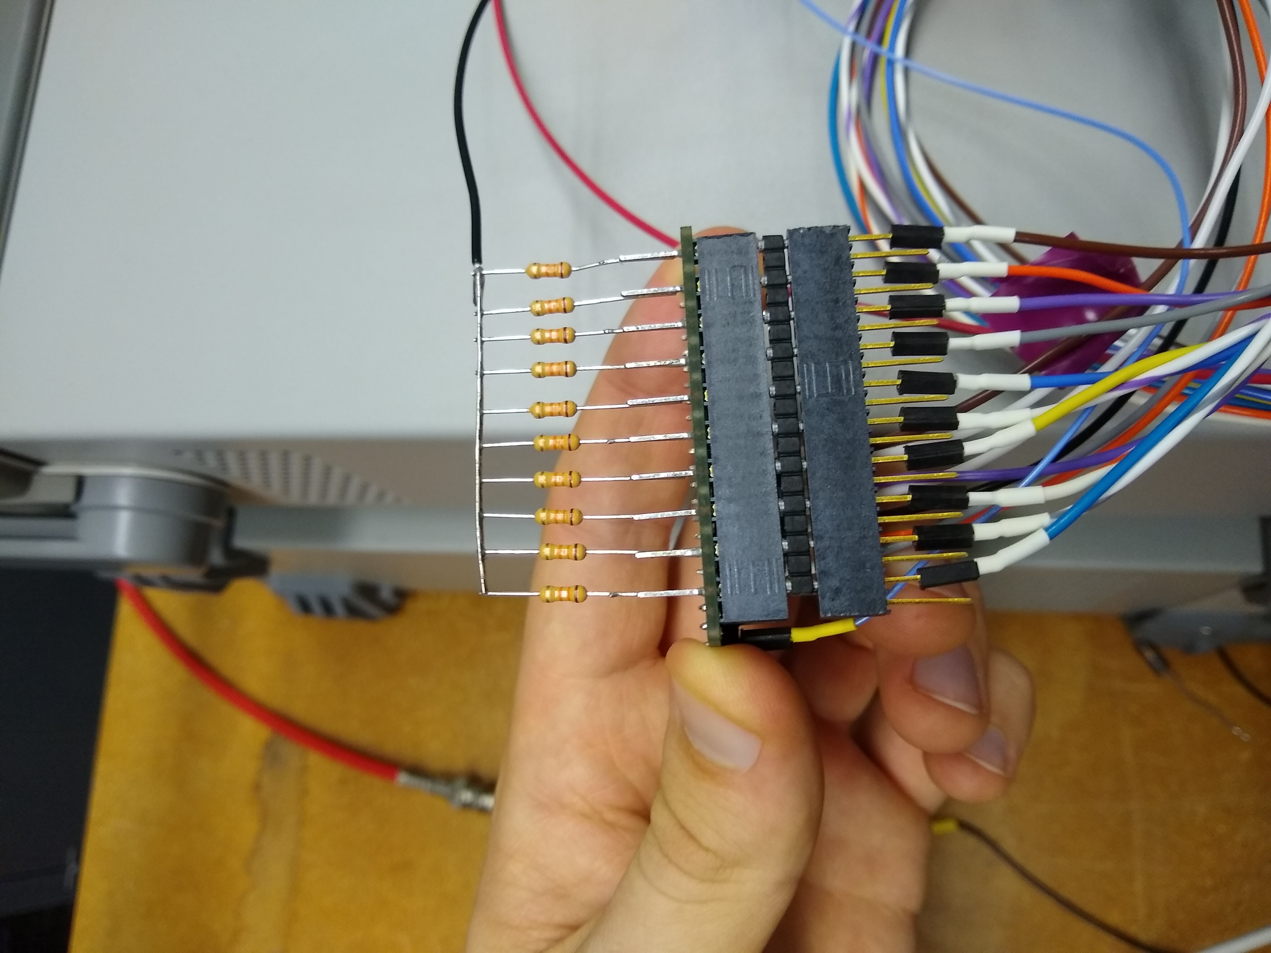
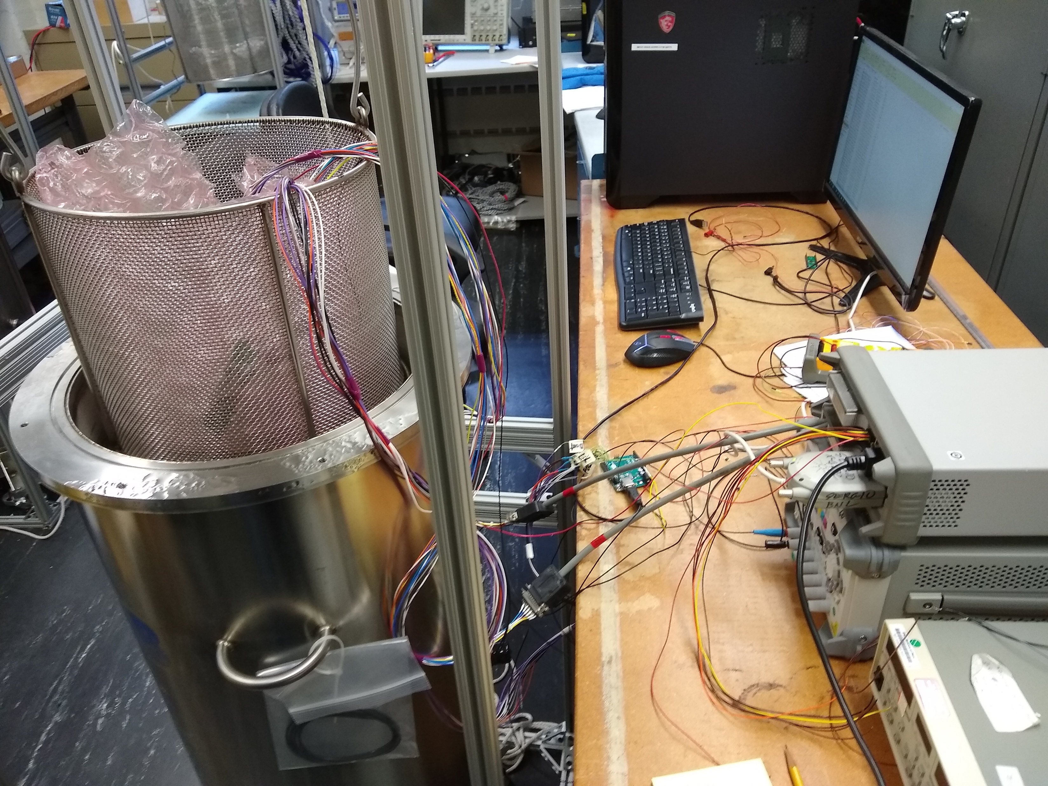
Switching Testing at Cryogenic Temperature
10 Channels from each chip were monitored in liquid nitrogen for 1 week
HV3418 alternated from 0V to 60V, HV 5523 from 0V to 5V

Slide 7
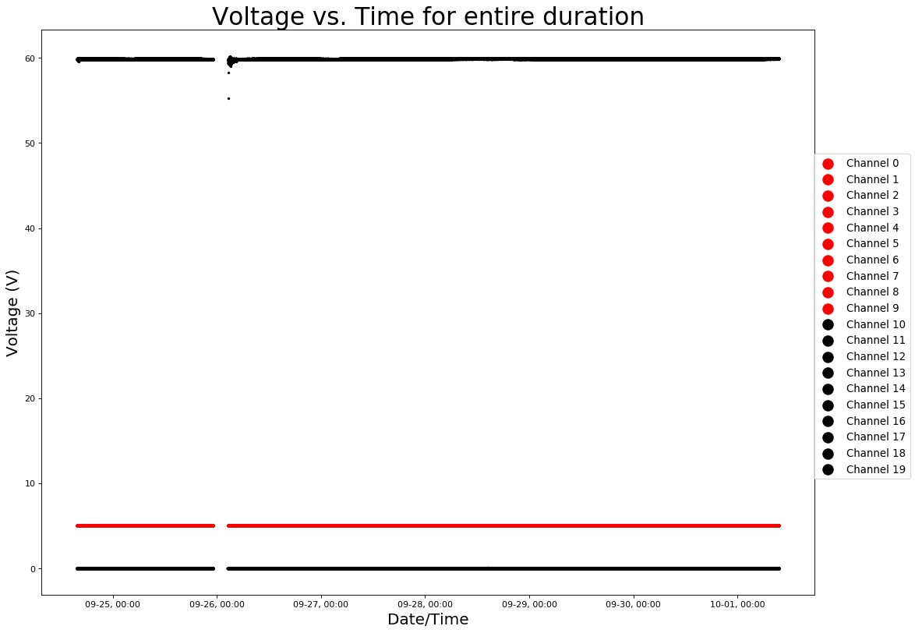
Switching Testing at Cryogenic Temperature
Channels were SPI written “on” and “off” every 3 seconds.
Data is as expected (besides gap due to connector).
No indication of long term issues at cryogenic temperatures

Slide 8
LIFETIME OF ELECTRONIC ACTIVE DEVICES
Processes that impact the lifetime of CMOS circuits:
  Electromigration
  Stress migration
  Time-dependent dielectric breakdown
  Thermal cycling
  Hot-Carrier Effect
First three are thermally activated processes (exponential dependence on temperature) and become negligible at cold temperatures.
The process that impacts the lifetime at cold is ONLY Hot-Carrier Effect.
One can perform accelerated lifetime tests on devices to understand the impact of this effect.

Slide 9
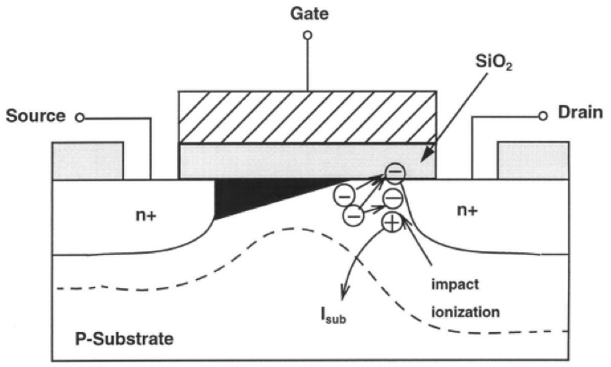
LIFETIME OF ELECTRONICS: HOT CARRIER EFFECT
Hot-Carried Effect deteriorates the performance of devices by creating interface states or trapping charge in the dielectric.
Some hot electrons exceed the energy required to create an electron-hole pair, resulting in impact ionization. Electrons proceed to the drain. The holes drift to the substrate yielding substrate current.
A very small fraction of hot electrons exceeds the energy required to create an interface state at the Si-SiO₂ interface: 3.7eV for electrons, ~4.6eV for holes.
Hot Carrier Effect primarily affects performance of NMOS transistors.
Electric field is the strongest near the drain

Slide 10
LIFETIME (AGING) OF THE ELECTRONICS
LIFETIME*CURRENT DENSITY vs 1/V_{DS}
EXTRACTED FROM THE STRESS MEASUREMENTS
For NMOS:
L=180nm
W=10um
It was found for 180nm, 130nm and 65nm technologies that reducing the V_{DS} at cryogenic temperature by ~6% makes the lifetime equal to that at 300K (x10 improvement).
Increasing the device length (thus decreasing electric field) also increases the lifetime.

Slide 11
Steering Module Lifetime: Assured by Design
HV3418 HV push-pull switch
■ HV_{max}= 180V ➝ V_{BIAS,max}≃70V
■ V_{logic,max}= 12V ➝ Operating Logic Voltage ≃4.5V
HV5223 open drain switch:
■ HVmax= 220V ➝ V_{EN,H}=2.5V
■ V_{logic,max}=5.5V ➝ Operating Logic Voltage ≃4.5V
HCE for switched logic happen only during transition (no current in steady state).
Minimal switching of SM logic, only during configuration

Slide 12
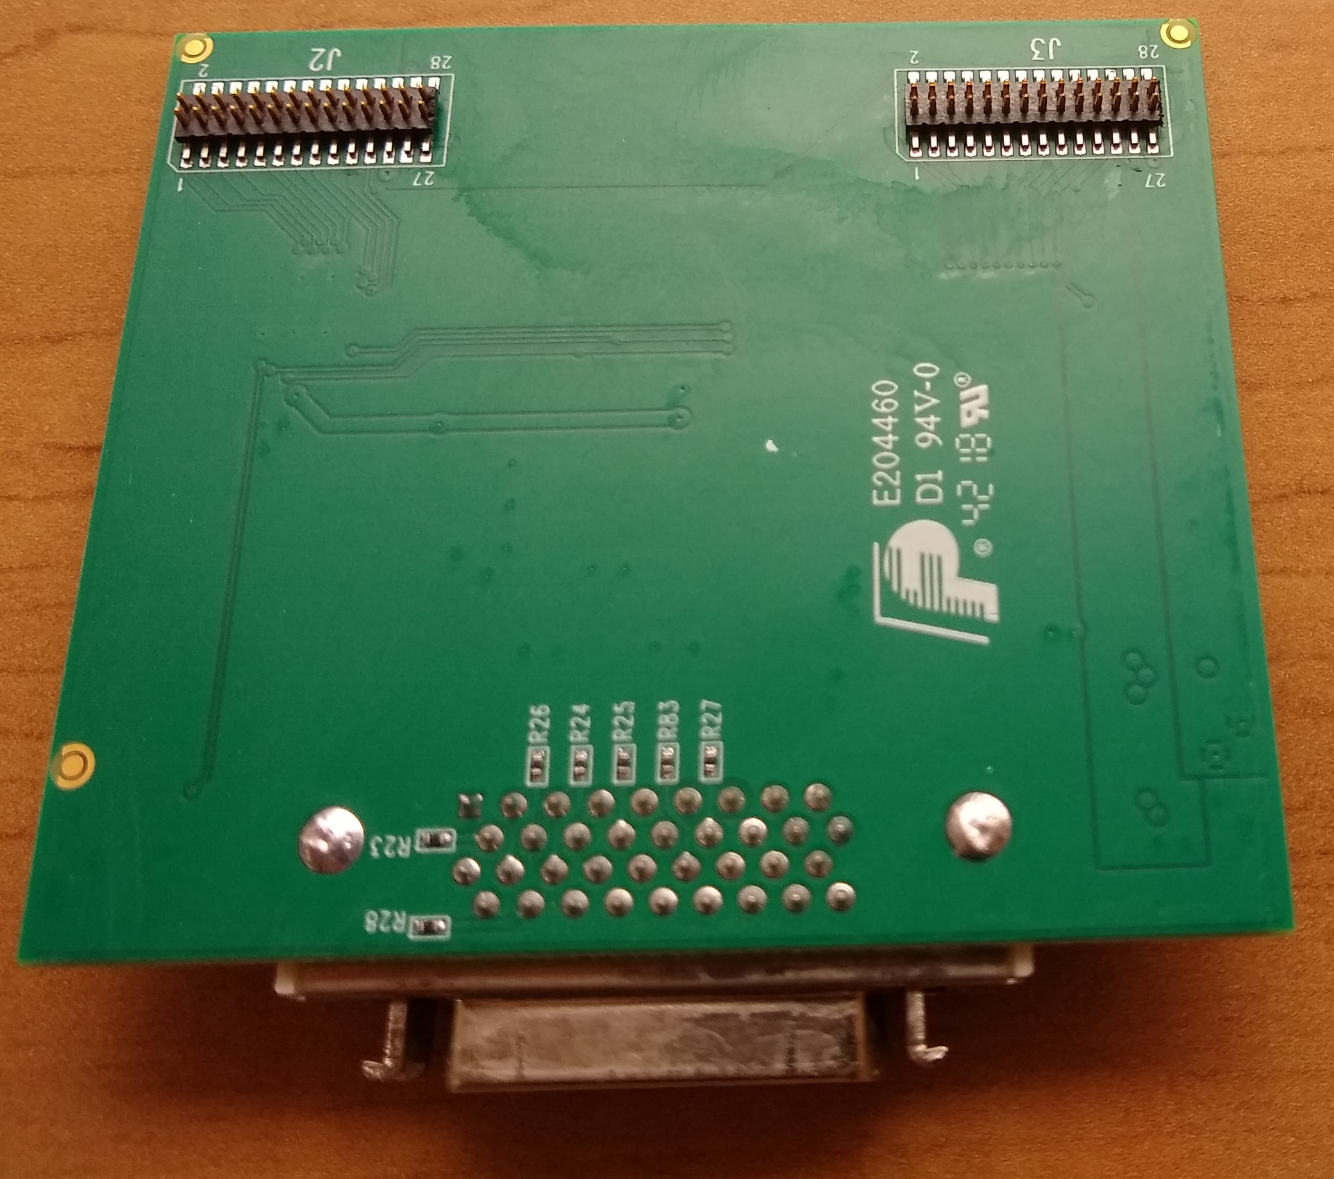
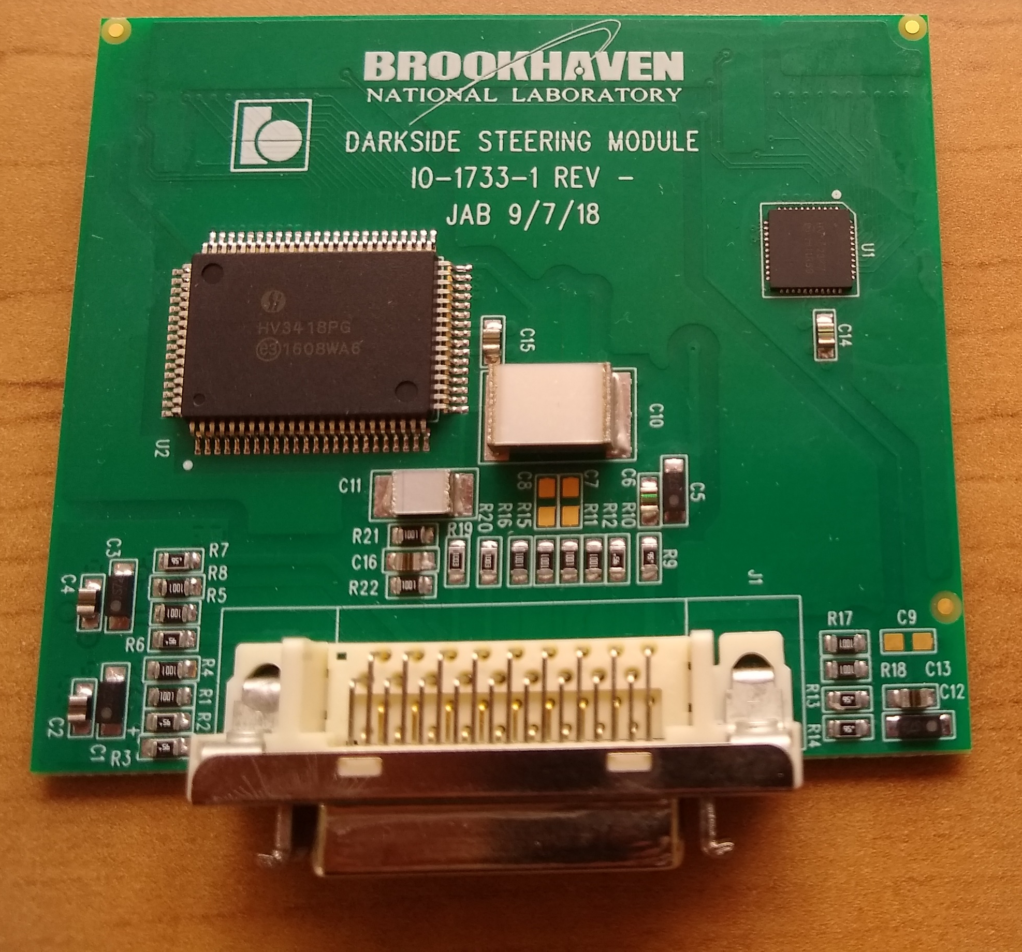
Steering Module Connectors
Back uses Samtec FTS connectors to mate with strip motherboard CLP (non radiopure)
Want to add ground pins.
Mix-up with connector orientation.
It will be fixed in next version
Input uses Mini-D connector for now.
Will look into radiopure connectors and minimizing number of signal lines

Slide 13
Future improvements (minimizing signal lines)
Signal
Return
Shield
Sense
All signals
Minimizing signals will lower mass of cable, help with radiopurity
29 total lines
★ 22 signal, power
★7 shields
HV
HV3418
SPI - CLK
SPI - DATA
HV5523
SPI - CS
SPI - Readback
V_{DD}
V_{CC}
V_{EE}
LV_UC

Slide 14
SAMI Cable for DarkSide (mates to MiniD on Steering Module Proto)
+2.5 V
RET +2.5 V
+ sense
- sense
- 2.5 V
RET -2.5 V
+ sense
- sense
HV
GND- HV
shield
LV- uController
RET - LV –uController
shield
VDD
VDD - RET
Shield
SM control 1 +
SM control 1 -
Shield
SM control 2 +
SM control 2 -
Shield
SM control 3 +
SM control 3 -
Shield
SM control 4 +
SM control 4 -
shield
total of 29 conductors
(22 signals, power & 7 shields )
Connector needs 23 positions min
(22 signals, 1 for shields together)

Slide 15
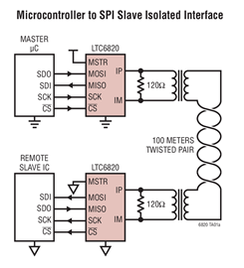
Future improvements (minimizing signal lines)
Linear LTC6820 – takes 4-pin SPI, encodes in bi-directional differential signal
With proper termination resistors, can be designed for up to 100 meters of twisted pair cabling
Low EMI susceptibility/High Noise immunity
For our application, slow data rate is OK

Slide 16
Future improvements (minimizing signal lines)
Signal
Return
Shield
Sense
LTC6820
SPI - CLK
HV5523
IP
SPI - DATA
Requires matching chip on the warm side of the flange
Would reduce to 19 signals
SPI - CS
IN
HV3418
SPI - Readback
HV
V_{DD}
V_{CC}
V_{EE}
LV_UC

Slide 17
SAMI Cable for DarkSide: Minimizing Number of Conductors (Cable Mass)
+2.5 V
RET +2.5 V
+ sense
- sense
- 2.5 V
RET -2.5 V
+ sense
- sense
HV
GND- HV
shield
VDD
RET - VDD
shield
LV- uController
RET - LV –uController
shield
SM control 1 +
SM control 1 -
Shield
SM control 2 +
SM control 2 -
Shield
SM control 3 +
SM control 3 -
Shield
SM control 4-ctrl +
SM control 5-ctrl -
shield
total of 11 conductors
(10 signals, power & 1 shields )
Connector needs 11 positions min

Slide 18
Future improvements (minimizing signal lines)
Signal
Return
Shield
Sense
FT232H
SPI - CLK
HV5523
DATA +
SPI - DATA
Can achieve similar reduction by using USB-to-Serial chip
Will use 4 pin USB - power and ground from existing lines
SPI - CS
DATA -
HV3418
SPI - Readback
HV
V_{DD}
V_{CC}
V_{EE}
LV_UC

Slide 19
Radiopurity
Next (final) version of Steering Module will be made with Pyralux.
Steering Module needs only two copper layers.
If solder mask cannot be used, an extra layer of Pyralux may be needed to insulate SM from strip motherboard (blind vias).
Need a radiopure connector between SM and strip motherboard and to connect to input power/signal cable

Slide 20
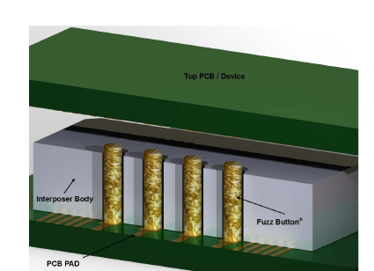
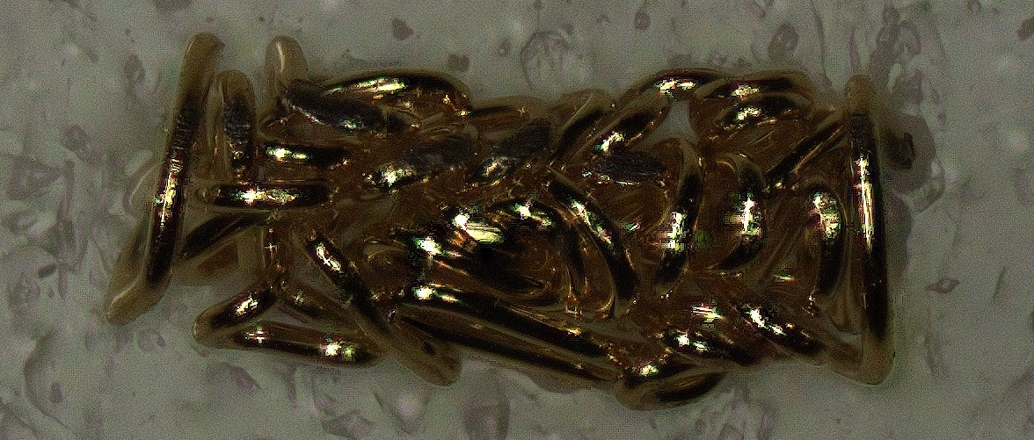
Radiopure SM to strip motherboard
An interposer with compression type contacts (eg “Fuzz Button”) allow reliable connectivity at low T with ~10mΩ resistance
Requires external pressure to hold two surfaces together (e.g. screws)
Flexibility with choice of interposer body material

Slide 21
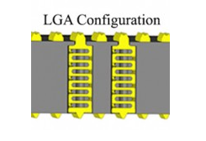
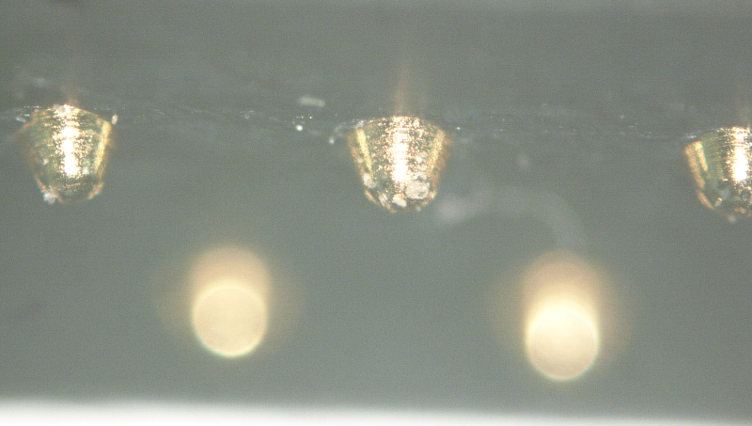
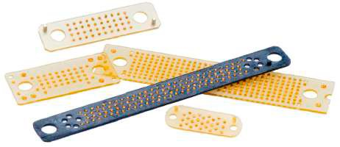
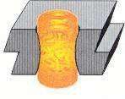
Radiopure SM to strip motherboard
Similar ideas:
■ Ardent Concepts’ “Stamped Contact”
■ Belfuse (Cinch) “CIN::APSE” contact
Are currently procuring samples, will test connectors/interposers for radiopurity
Ardent Concepts
“Stamped Contact”
CIN::APSE

Slide 22
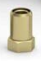

Radiopure SM to strip motherboard (backup)
Install thru-hole, open-ended metal receptacles on the SM and SMT metal pins on the Strip Motherboard
SM
Strip Motherboard
Steering
Module
Strip Motherboard

Slide 23
Backup Slides

Slide 24
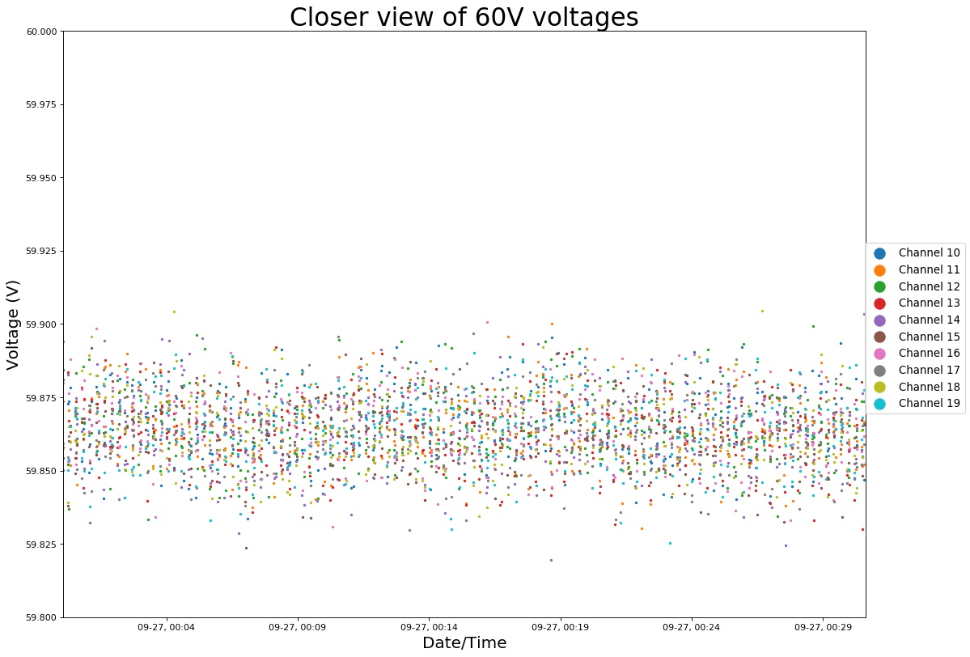
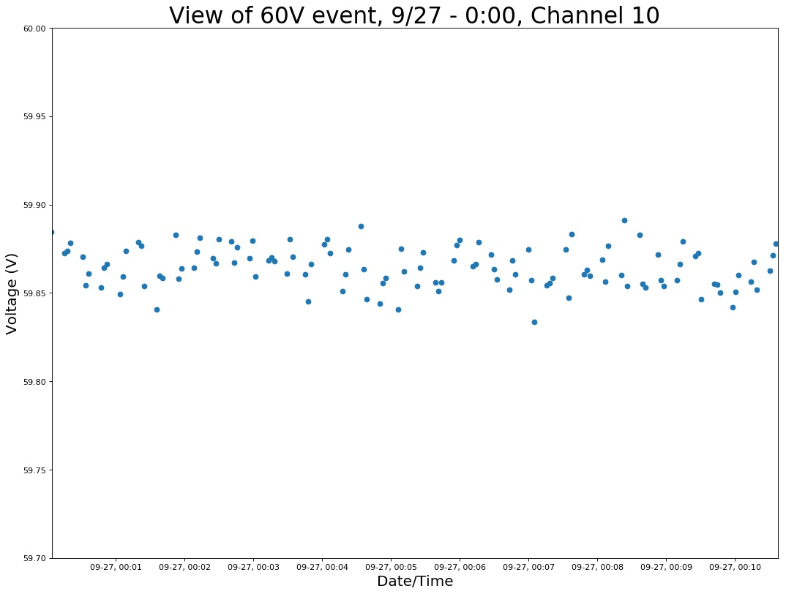
General spread of 60V readings

Slide 25
