Slide 1
A Preliminary Comparative Analysis of SuperB Backwards EMC
Abhiram Chivukula, David Doll, Bertrand Echenard, David Hitlin, Piti Ongmongkolkul, Frank Porter, Alexander Rakitin

Slide 2
Purpose
To compare the performance of SuperB Factory with and without the Backwards EMC
  139 cm Backwards EMC Detector Configuration
  Signal to Background Ratios
  Precision/Significance - S/sqrt(S+B)
    With Backwards EMC vs. No Backwards EMC
    In relation to BaBar
To decide whether the performance bonus given by Backwards EMC justifies the increased cost

Slide 3
Methods
Specify Tag B, Recoil B (Signal), and Background Decay
  Tag- B+ -> anti-D0 Pi, anti-D0 -> K+ Pi-
  Recoil- B- -> Tau- anti-tau neutrino
Major Background Decays (Relative B.F. >1)
  B- ->D0 Lep Nu (160) B- ->D*0 Lep Nu (406)
  B- ->D- Pi Lep Nu (30) B- ->D*- Pi Lep Nu (44)
  B- ->D**0 Lep Nu ( O(10^2)) *100 for purpose of analysis
Minor Background Decays (Relative B.F. <1)
  B- ->Pi0 Lep Nu (.55)
  B- ->Eta Lep Nu (.43) B- ->Eta’ Lep Nu (.12)
  B- ->Omega Lep Nu (.93)
  B- ->Rho0 Lep Nu (.91)

Slide 4
Methods (ctd.)
Reconstruct Tag B from signal MC
Apply same B reconstruction to background MC
Compare Precisions and Signal to Background Ratios for B’s when cut on Total Extra Energy
  BaBar
  SuperB with Backwards EMC
  SuperB without Backwards EMC
  Precisions meaningful only relative to each other based on arbitrary luminosity
Each MC Run Contained 50k events
  B.Fractions Normalized w.r.t B->Tau Nu running 1 MC Run

Slide 5
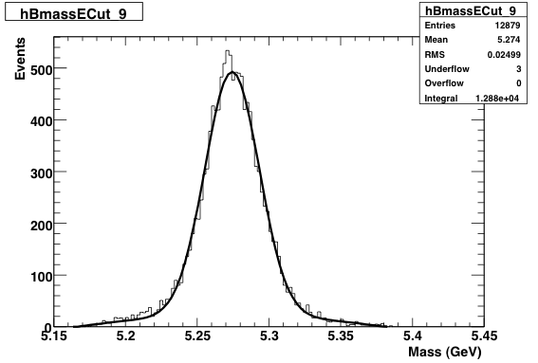
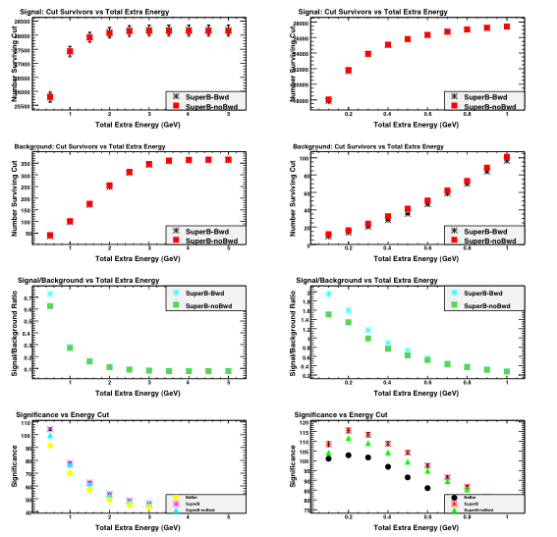
Total Extra Energy
We analyze B mass plots with cuts on the Total Extra Energy in the detector. We fit with a Gaussian+Bkg for each cut, record the integral, for both the Signal and Background decay (for both with and w/o bwd EMC), and plot the data to generate Signal and Background Decay plots. We then use those Signal and Background Plots to generate Signal/Background and Precision S/Sqrt(S+B) plots.

Slide 6
Tag B Reconstruction
In order to compensate for the huge branching fractions in the background, we cut on the mass of D0 to be around PDG mass
  Removes Combinatorial Background
Also Place an additional cut to have 4 tracks
  Makes Branching Fraction Comparable

Slide 7
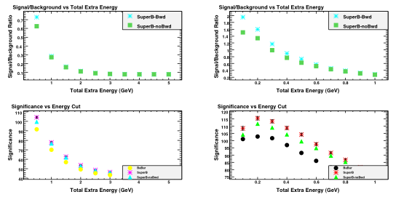
B->D0 Lep Nu
Background
Runs=8
Branching Fraction = 160
Improvement in S/B Ratios in .2 -.3 GeV Range: 17 % - 20%
Analysis with the 120 cm configuration resulted in 50-60% improvement vs SuperB no Bwd EMC

Slide 8
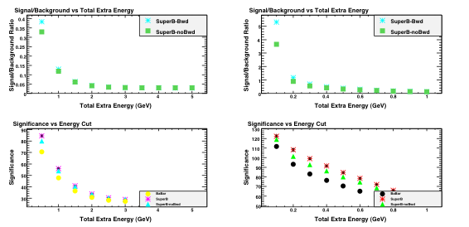
B->D*0 Lep Nu
Background
Runs = 20
Branching Fraction= 406
Improvement in S/B Ratios in .2 -.3 GeV Range: 24 % - 33%

Slide 9
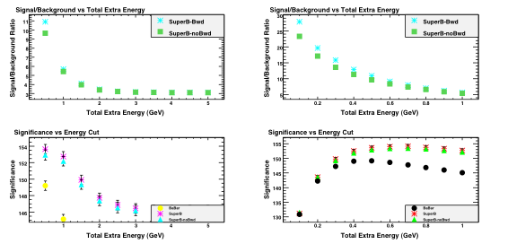
B->D Pi Lep Nu
Background
Runs = 50
Branching Fraction= 30
Improvement in S/B Ratios in .2 -.3 GeV Range: 15 % - 16%

Slide 10
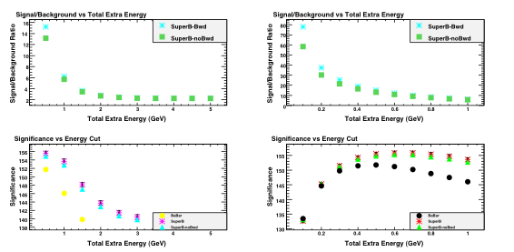
B->D*Pi Lep Nu
Background
Runs = 100
Branching Fraction= 44
Improvement in S/B Ratios in .2 -.3 GeV Range: 15 % - 17%

Slide 11
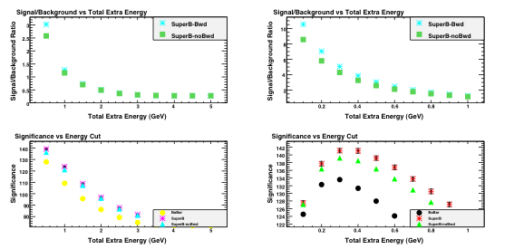
B->D**0 Lep Nu
Background
Runs = 200
Branching Fraction=100
Improvement in S/B Ratios in .2 -.3 GeV Range: 18 % - 19%

Slide 12
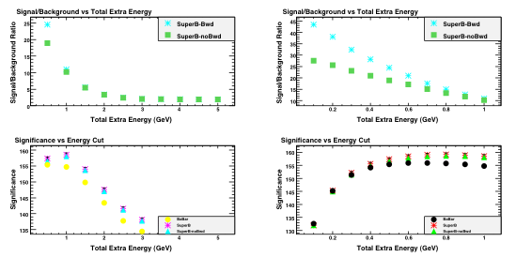
B->Pi0 Lep Nu
Background
Runs = 1
Branching Fraction= .55
Improvement in S/B Ratios in .2 -.3 GeV Range: 40 % - 50%
*This Analysis was also done on the 120 cm configuration and showed a 100% improvement over SuperB no Bwd EMC

Slide 13
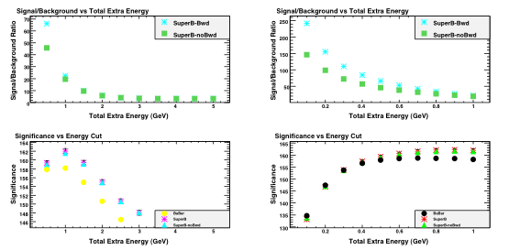
B->Eta Lep Nu
Background
Runs = 20
Branching Fraction=.43
Improvement in S/B Ratios in .2 -.3 GeV Range: 53 % - 58%

Slide 14
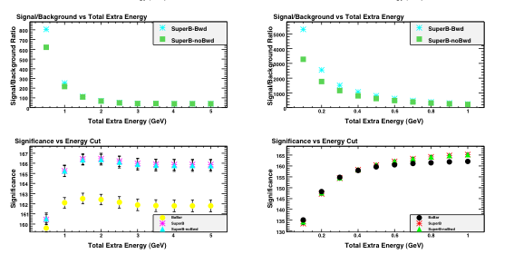
B->Eta’ Lep Nu
Background
Runs = 20
Branching Fraction= .12
Improvement in S/B Ratios in .2 -.3 GeV Range: 31 % - 32%

Slide 15
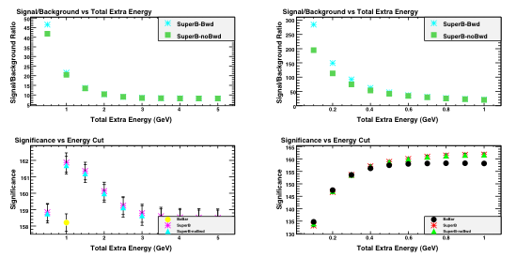
B->Omega Lep Nu
Background
Runs = 20
Branching Fraction=.93
Improvement in S/B Ratios in .2 -.3 GeV Range: 23 % - 33%

Slide 16
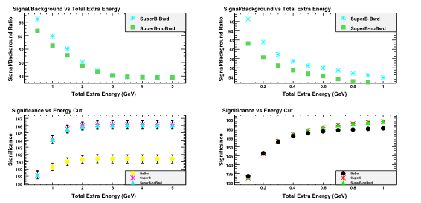
B->Rho 0 Lep Nu
Background
Runs = 20
Branching Fraction=.91
Improvement in S/B Ratios in .2 -.3 GeV Range: 4 % - 6%

Slide 17
Trends
Precision: .2 GeV to .3 GeV Range
  SuperB with + w/0 bwd EMC have distinct advantages over BaBar
  SuperB with bwd EMC has advantage vs SuperB w/o
    About 5% better with bwd EMC vs. SuperB w/o in Major Backgrounds
    No difference with bwd EMC vs SuperB in Minor Backgrounds
      Results may vary under analysis with different Tag and Recoil Signal Monte Carlos
Signal vs Background: .2 GeV to .3 GeV Range
  See distinct advantage with backwards EMC vs. without, but magnitude of the advantage varies from 15% to 60%
    Larger Branching Fraction -> Appreciable Improvement
    Smaller Branching Fraction ->Larger Improvement
  B.F. Weighted Average of % Increase ~ 24%
    Crude Estimate
Early hint that 120 cm configuration provides significantly better results than 139 cm configuration

Slide 18
Follow Up Analyses
Repeat Analysis for 120 cm detector configuration and compare results
Repeat Analysis while varying Tag and Recoil Decays
Combine Backgrounds together and repeat Precision and Signal/Background analysis from conglomerate Background

