Slide 1
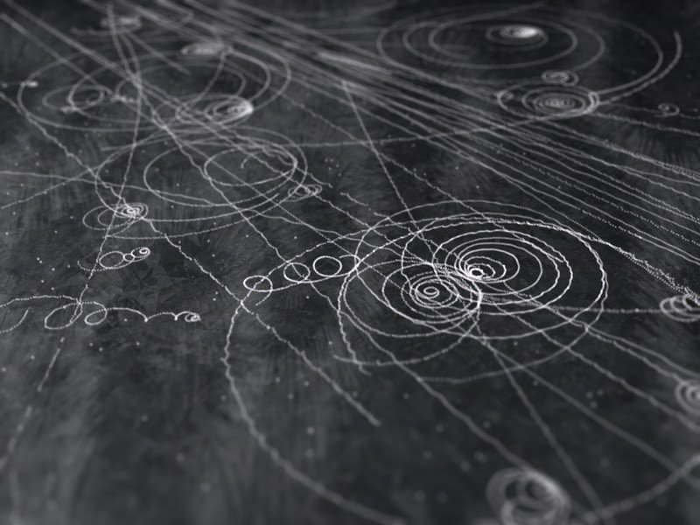
Valeria Di Felice
Valeria Di Felice
INFN Roma Tor Vergata

Slide 2
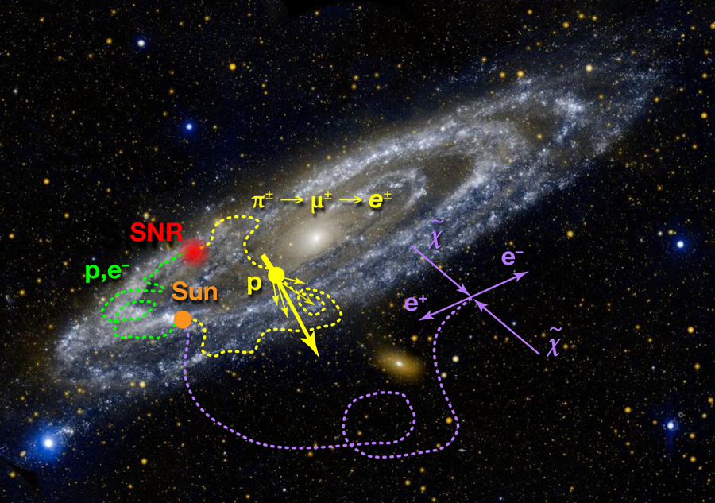
Image: GALEX, JPL-Caltech, NASA; Drawing: APS/Alan Stonebraker
Notes:
Figure 2: The flux of high-energy particles near Earth (cosmic rays) can come from many sources. “Primary” particles (green) come from the original cosmic-ray source (typically, a supernova remnant). “Secondaries” (yellow) come from these particles colliding with interstellar gas and producing pions and muons, which decay into electrons and positrons. A third, interesting possibility is that electrons and positrons (purple) are created by the annihilation of dark matter particles, denoted by χ˜ in the figure, in the Milky Way and its halo. Note that for illustrative purposes the background image used here is of Andromeda, a typical spiral galaxy, roughly similar to ours. [Credit: Image: GALEX, JPL-Caltech, NASA; Drawing: APS/Alan Stonebraker]
https://physics.aps.org/articles/v6/40

Slide 3
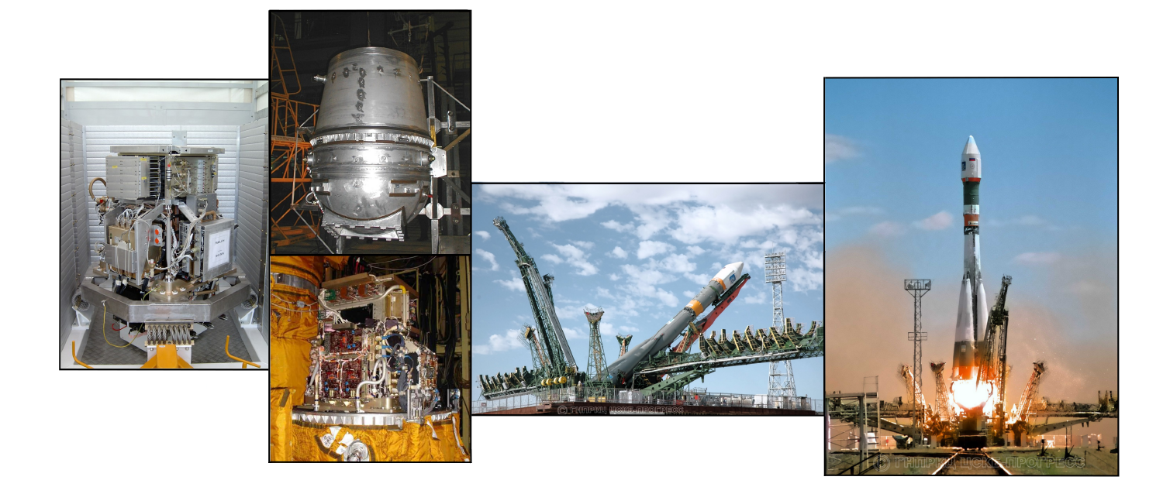
SCIENTIFIC INTERESTS (MAIN)
Cosmic ray physics
Indirect dark matter search
Antimatter-matter detection
Heliospheric and solar physics
PAMELA MISSION
Space-borne experiment for the precise measure of the matter and antimatter component in cosmic rays.
Launched on 15th June 2006. More than 10 years in flight!
Assembled and tested in Tor Vergata clean rooms.
[Prof. Picozza & R. Sparvoli group]
My story
PAMELA launch
(satellite)
PhD
INFN & Dip. Fis.
ToV
INFN ToV & ASI
PAMELA
AMS-02 launch (ISS)
CALET
CALET
launch (ISS)
ASN
II fascia
AMS-02

Slide 4
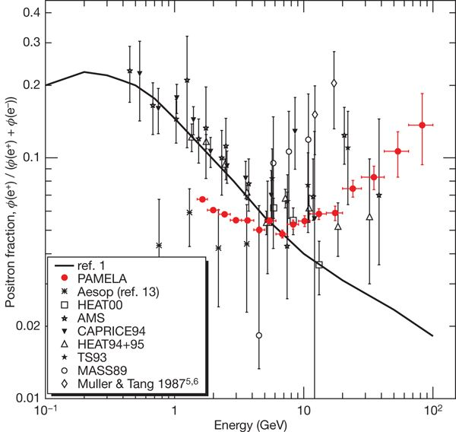
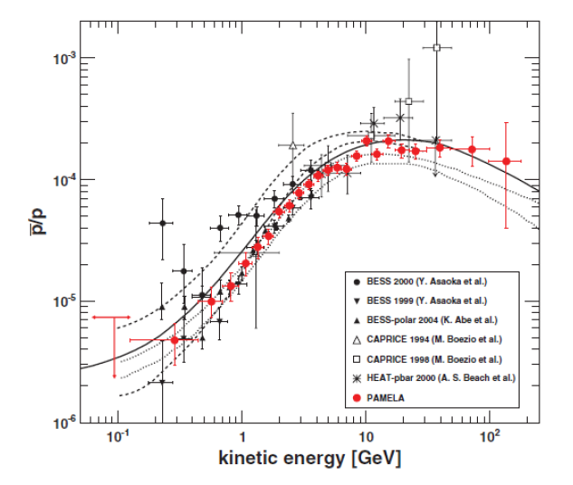
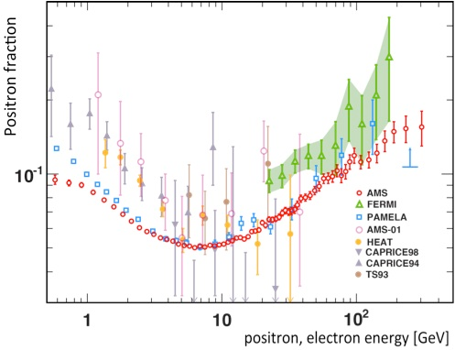
PAMELA positron excess
ANTIMATTER MEASUREMENTS
O. Adriani et al. , Nature 458 (2009) 607
O. Adriani et al., AP 34 (2010) 1
O. Adriani et al, Phys. Rep. 544 (2014) 323
O. Adrianiet al. , PRL 111 (2013) 081102
O. Adriani et al, PRL 105 (2010) 121101
O. Adriani et al, Phys. Rep. 544 (2014) 323
O. Adriani et al, PRL 102 (2009) 051101
……….
Interpretations:
Dark matter annihilation/decay (>1500 papers)
Astrophysical origin (~200 papers):
  SNR shocks
  Pulsars & pulsar wind nebulae
  Inhomogeneity of CR sources
AMS data
antiprotons
First Result from the Alpha Magnetic Spectrometer on the International Space Station: Precision Measurement of the Positron Fraction in Primary Cosmic Rays of 0.5–350 GeV, Phys. Rev. Lett. 110, 141102 (2013)
High Statistics Measurement of the Positron Fraction in Primary Cosmic Rays of 0.5–500 GeV with the Alpha Magnetic Spectrometer on the International Space Station, Phys. Rev. Lett. 113, 121101 (2014)
Phys. Rev. Lett. 110, 1411 (2013)
Phys. Rev. Lett. 113, 121101 (2014)
PAMELA launch
(satellite)
PhD
Nature

Slide 5
PAMELA positron excess
ANTIMATTER RESULTS
O. Adriani et al. , Nature 458 (2009) 607
O. Adriani et al., AP 34 (2010) 1
O. Adriani et al, Phys. Rep. 544 (2014) 323
O. Adrianiet al. , PRL 111 (2013) 081102
O. Adriani et al, PRL 105 (2010) 121101
O. Adriani et al, Phys. Rep. 544 (2014) 323
O. Adriani et al, PRL 102 (2009) 051101
………
Interpretations:
Dark matter annihilation/decay (>1500 papers)
Astrophysical origin (~200 papers):
  SNR shocks
  Pulsars & pulsar wind nebulae
  Inhomogeneity of CR sources
AMS data
antiprotons
First Result from the Alpha Magnetic Spectrometer on the International Space Station: Precision Measurement of the Positron Fraction in Primary Cosmic Rays of 0.5–350 GeV, Phys. Rev. Lett. 110, 141102 (2013)
High Statistics Measurement of the Positron Fraction in Primary Cosmic Rays of 0.5–500 GeV with the Alpha Magnetic Spectrometer on the International Space Station, Phys. Rev. Lett. 113, 121101 (2014)
Phys. Rev. Lett. 110, 1411 (2013)
Phys. Rev. Lett. 113, 121101 (2014)
PAMELA launch
(satellite)
PhD
Nature

Slide 6
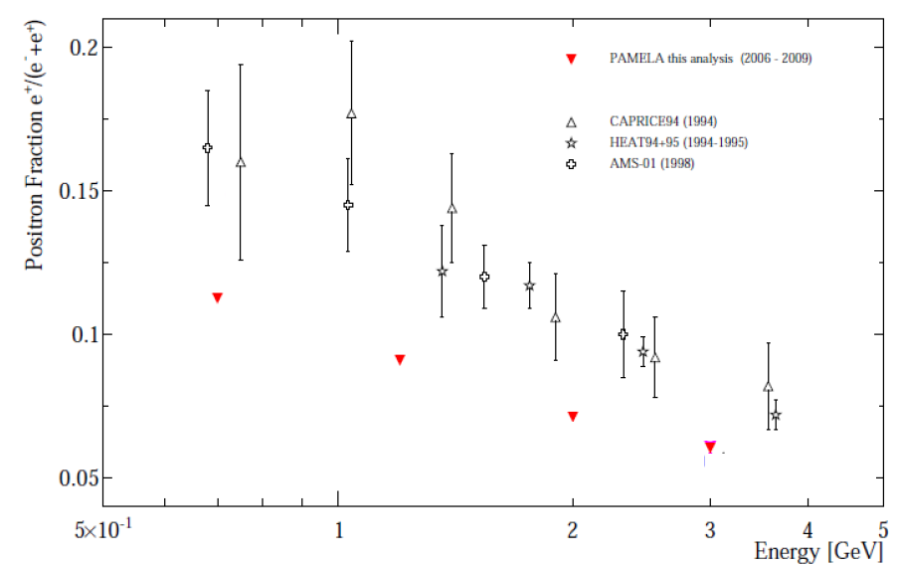

LOW ENERGY CR PARTICLES
(2006-2009) data

Slide 7
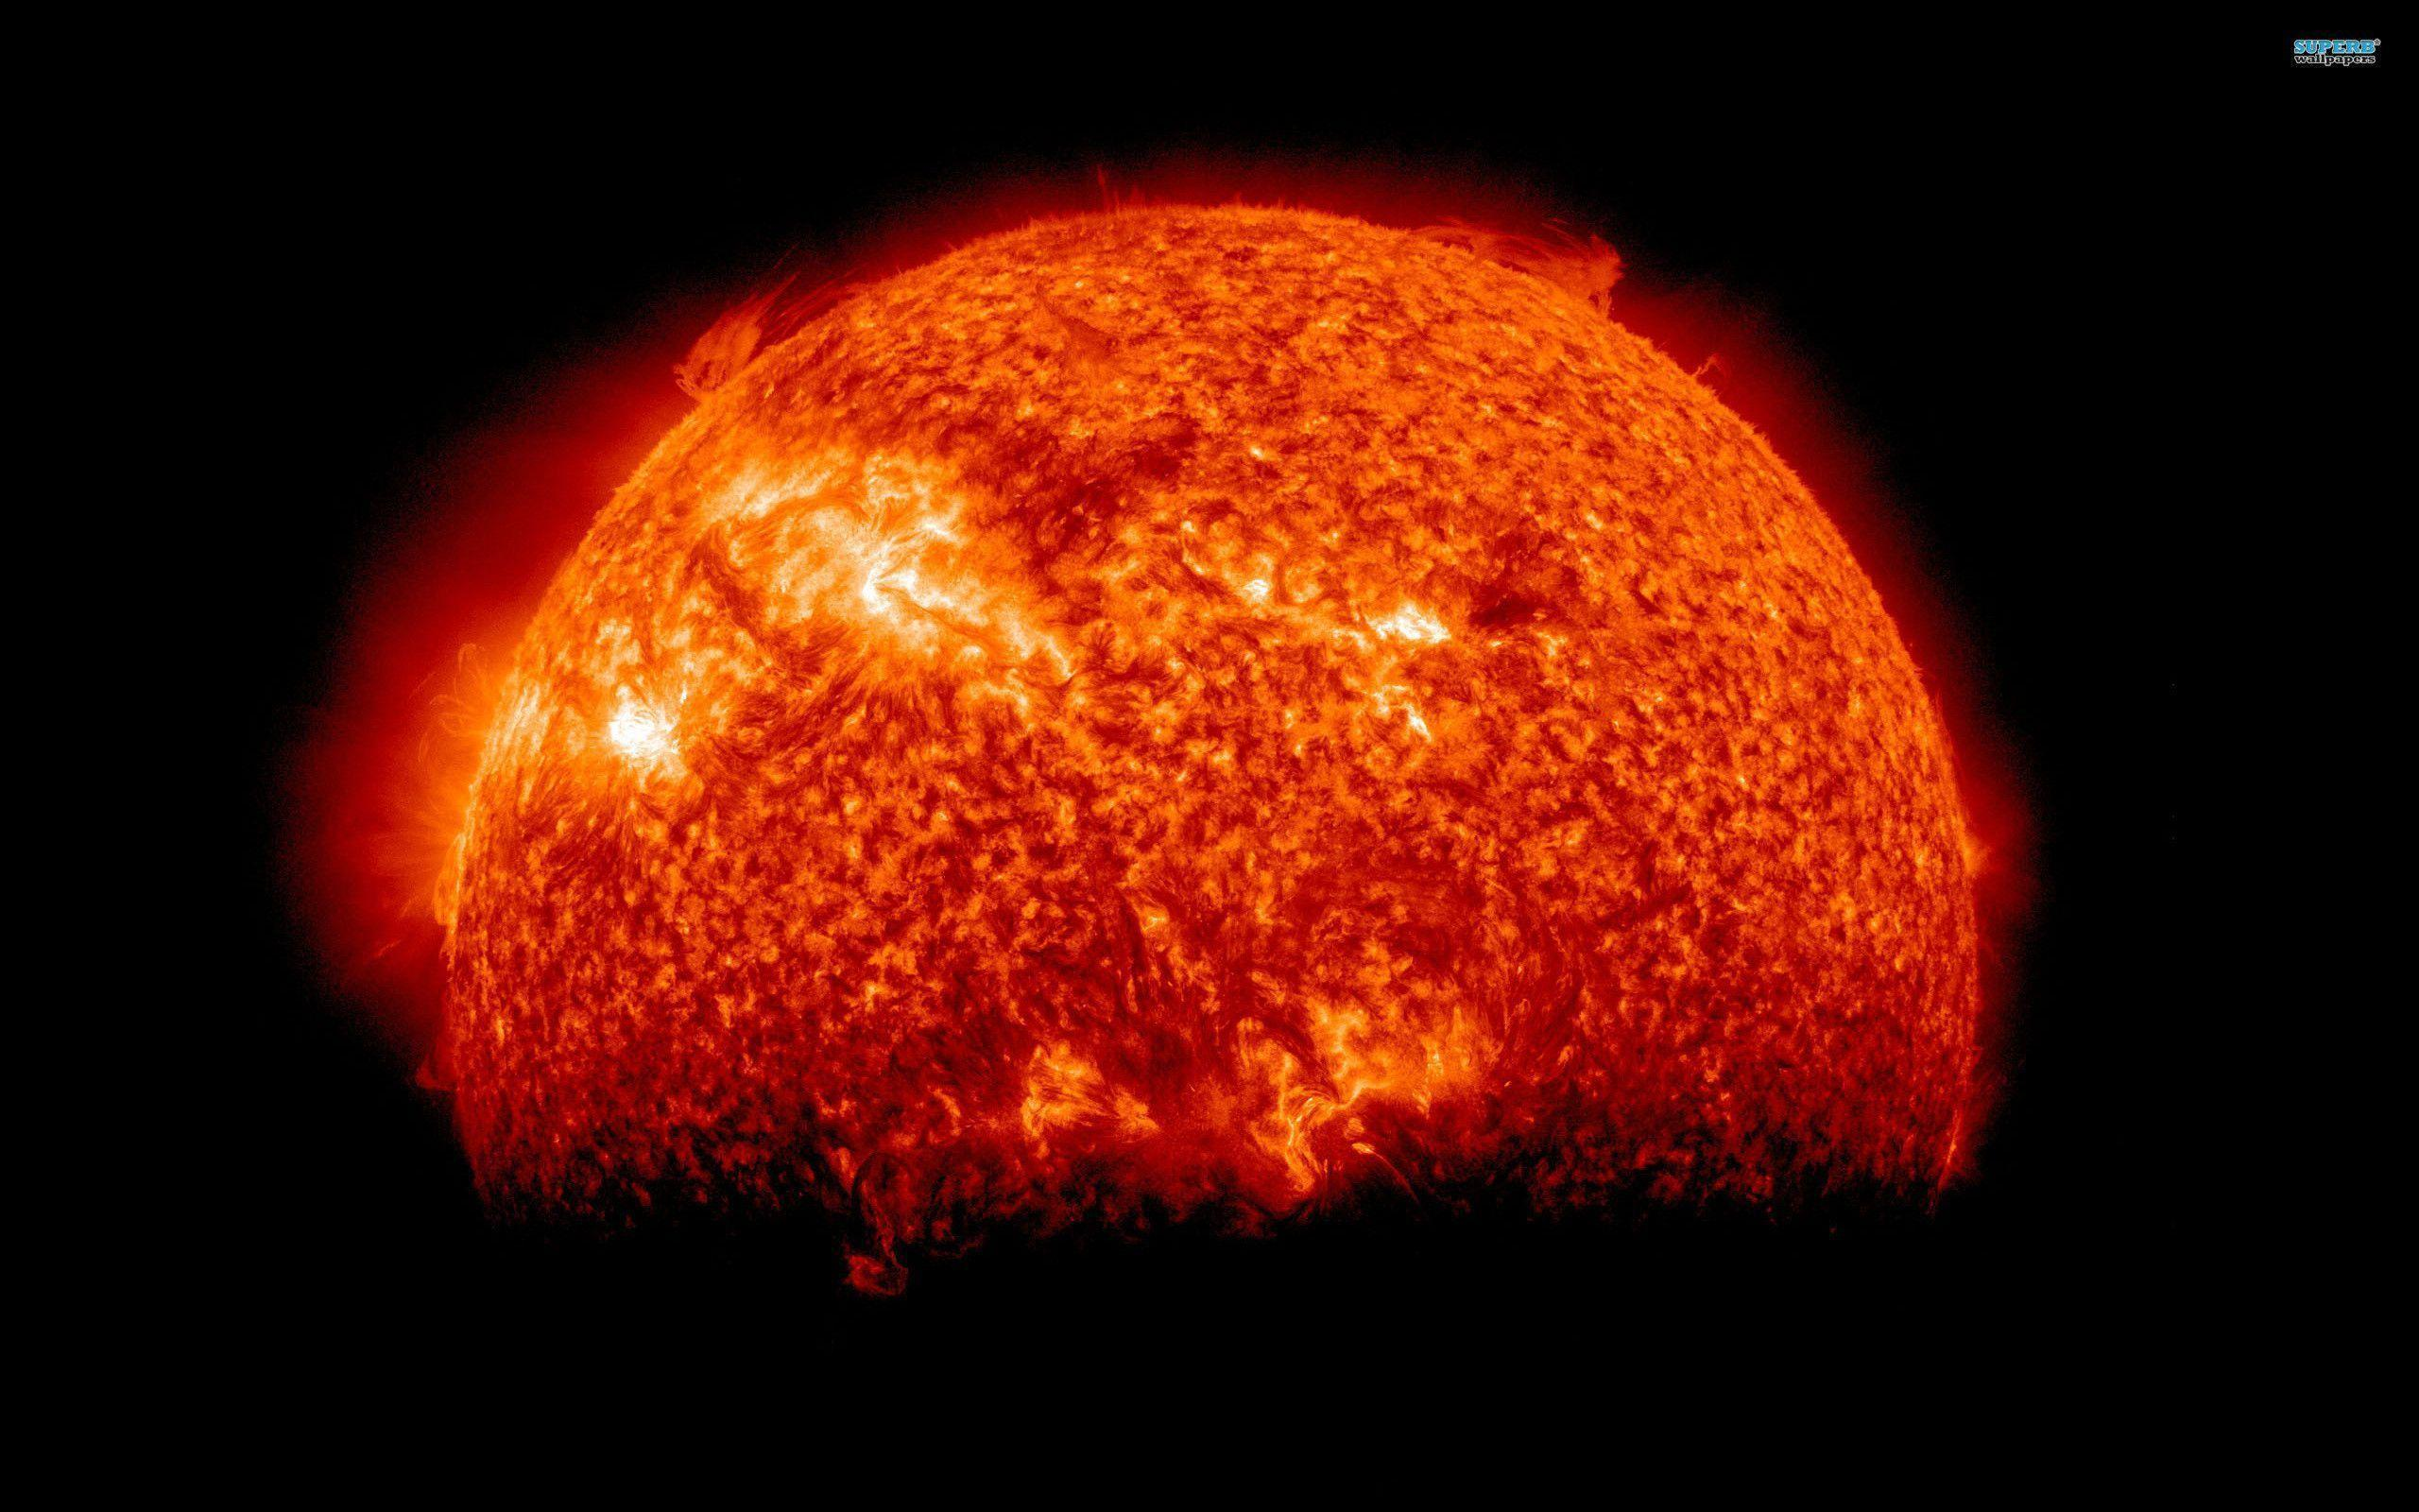

Slide 8
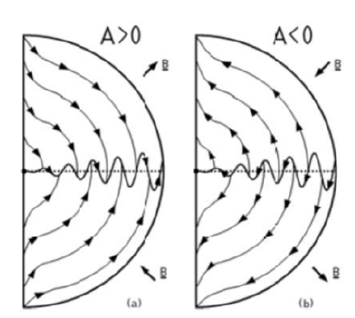
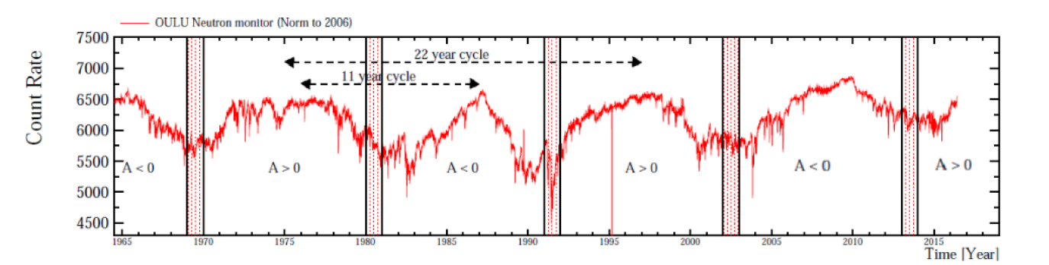
GALACTIC COSMIC RAY SOLAR MODULATION
Drift pattern positive particles
The solar activity cycle affects low energy cosmic rays.
Anticorrelation of Crs
Charge sign dependent effects due to drift effects in the heliospheric magnetic field
Observations:
Time dependence in low energy charged particles fluxes
e+/e- varying with time, according to solar activity evolution
For the same reason, galactic proton and electron fluxes evolve differently at the same rigidity
Positron fraction results not in tension

Slide 9
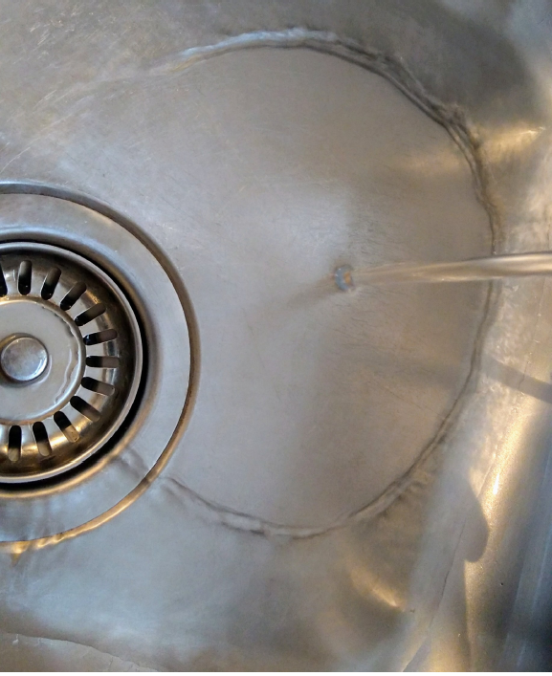
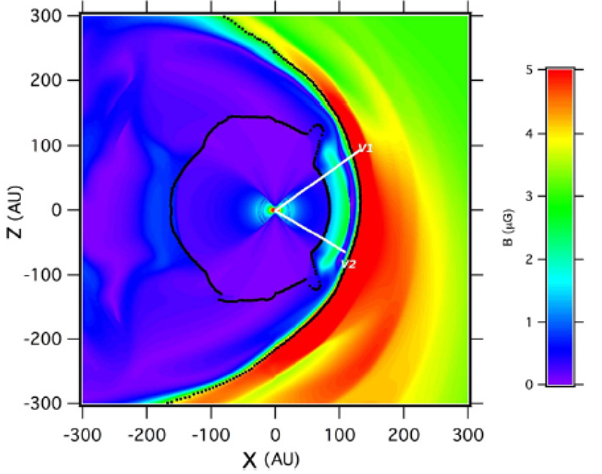
GALACTIC COSMIC RAY SOLAR MODULATION
Drift pattern positive particles
The solar activity cycle affects low energy cosmic rays.
Anticorrelation of Crs
Charge sign dependent effects due to drift effects in the heliospheric magnetic field
Observations:
Time dependence in low energy charged particles fluxes
e+/e- varying with time, according to solar activity evolution
For the same reason, galactic proton and electron fluxes evolve differently at the same rigidity
Positron fraction results not in tension

Slide 10
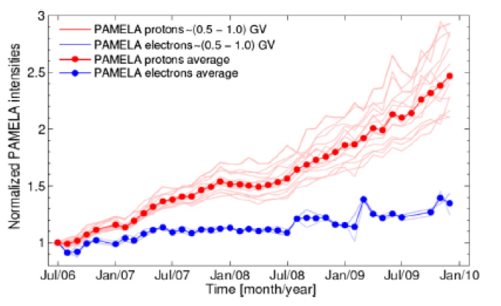
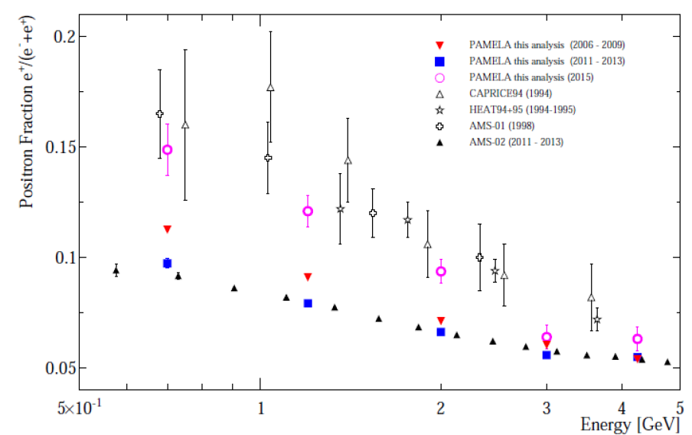
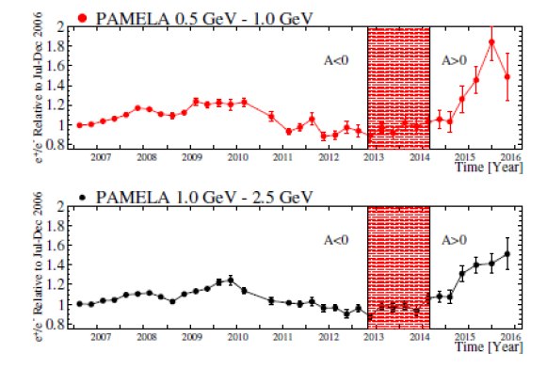
GALACTIC COSMIC RAY SOLAR MODULATION
Drift pattern positive particles
The solar activity cycle affects low energy cosmic rays.
Anticorrelation of Crs
Charge sign dependent effects due to drift effects in the heliospheric magnetic field
Observations:
Time dependence in low energy charged particles fluxes
e+/e- varying with time, according to solar activity evolution
For the same reason, galactic proton and electron fluxes evolve differently at the same rigidity
Positron fraction results not in tension
Di Felice V. et al., ApJ 834:1, 2017
O. Adriani et al., Phys. Rev. Lett. 116, (2016), 241105
O. Adriani et al., Phys. Rev. Lett. 116, (2016), 241105

Slide 11
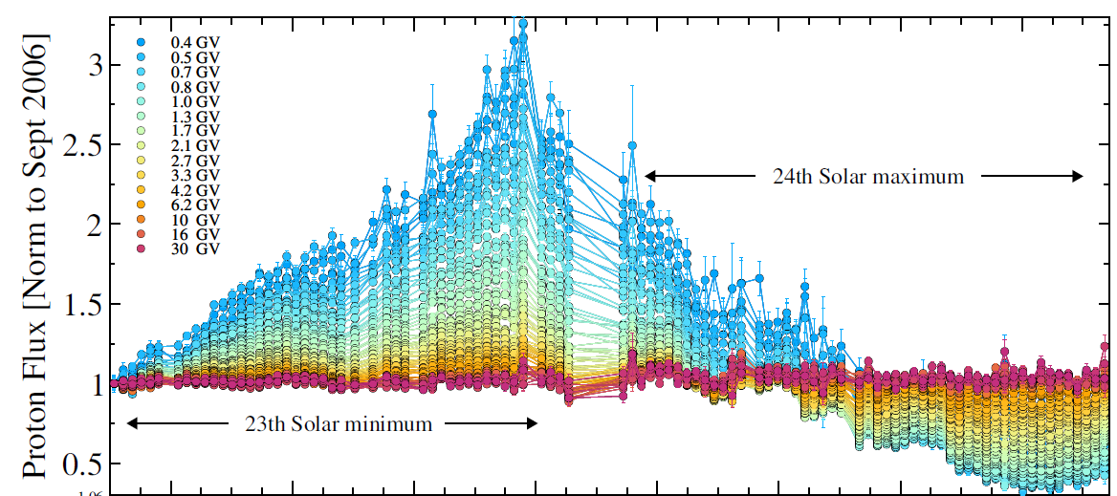

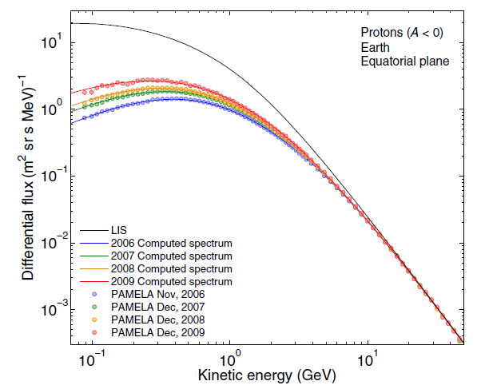
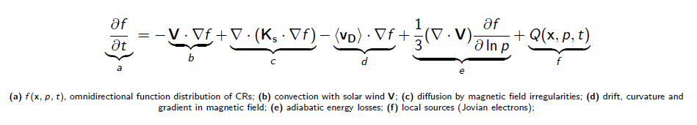
Kiel CAU
CERN
Selected papers
Martucci M. et al., ApJL 854 (2018) L2
Di Felice V. et al., ApJ 834:1 (2017)
Adriani O. et al, PRL 116 (2016) 241105
Adriani O. et al, ApJ 810 (2015) 142
Potgieter M. S. et al., Solar Phys. 289 (2014) 391
Adriani O. et al., ApJ 765 (2013) 91
Collaborations:
NWU South Africa
CAU Kiel Germany
NASA Goddard
Mephi Moscow …
North West
University
Premio INFN Bruno Rossi 2010
Premio ARAP 2010
AMS-02

Slide 12

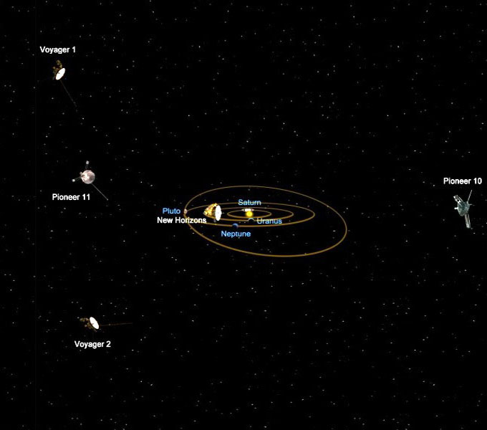
Uncertainties in heliospheric propagation
Geometry and physical boundaries of the Heliosphere
Solar activity parameters (time-varying)
Input Local Interstellar Spectrum (LIS)
Webber W. R. and F. B. McDonald, Geoph. Res. Lett., 40, 2013
Stone E. C. et al., Science, 341 (6142), 2013
Cummings A. C. et al., The Astrophysical Journal, 831:18, 2016
V1 in the interstellar space!
V2 almost there as well....

Slide 13
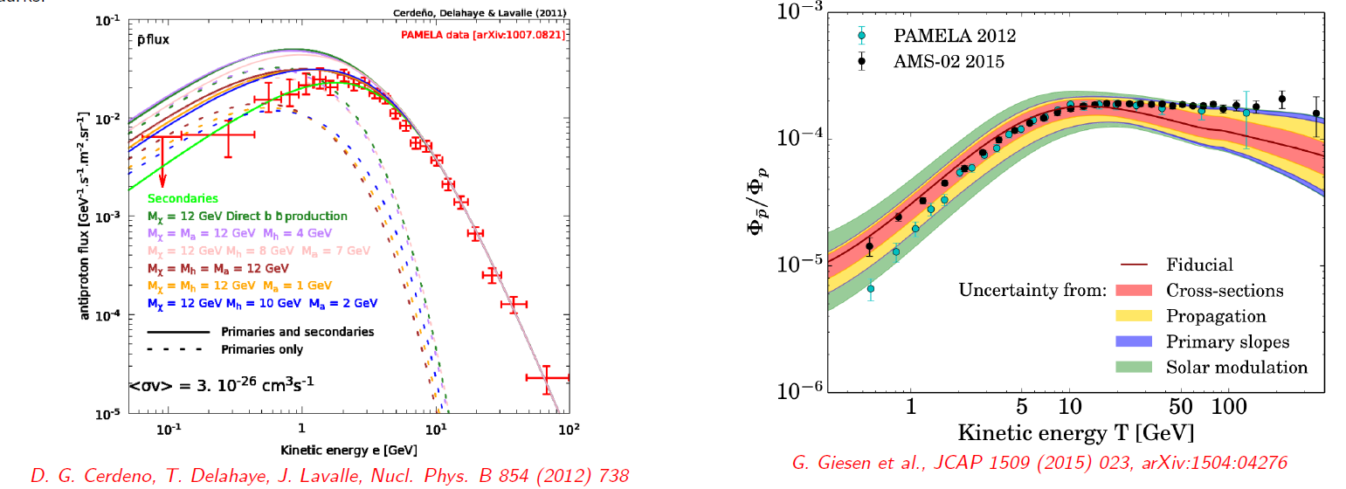
MOTIVATION
Precise measurements of the time-dependent GCRs spectra are important for:
● Understanding the propagation of GCRs in the heliosphere, and contribution from the various modulation mechanisms
● Refining models, reduce uncertainties on free parameters
● Constraining uncertainties on secondary CR prediction at low energy
● Useful in low energy dark matter indirect detection improving the evaluation of the secondary background.

Slide 14
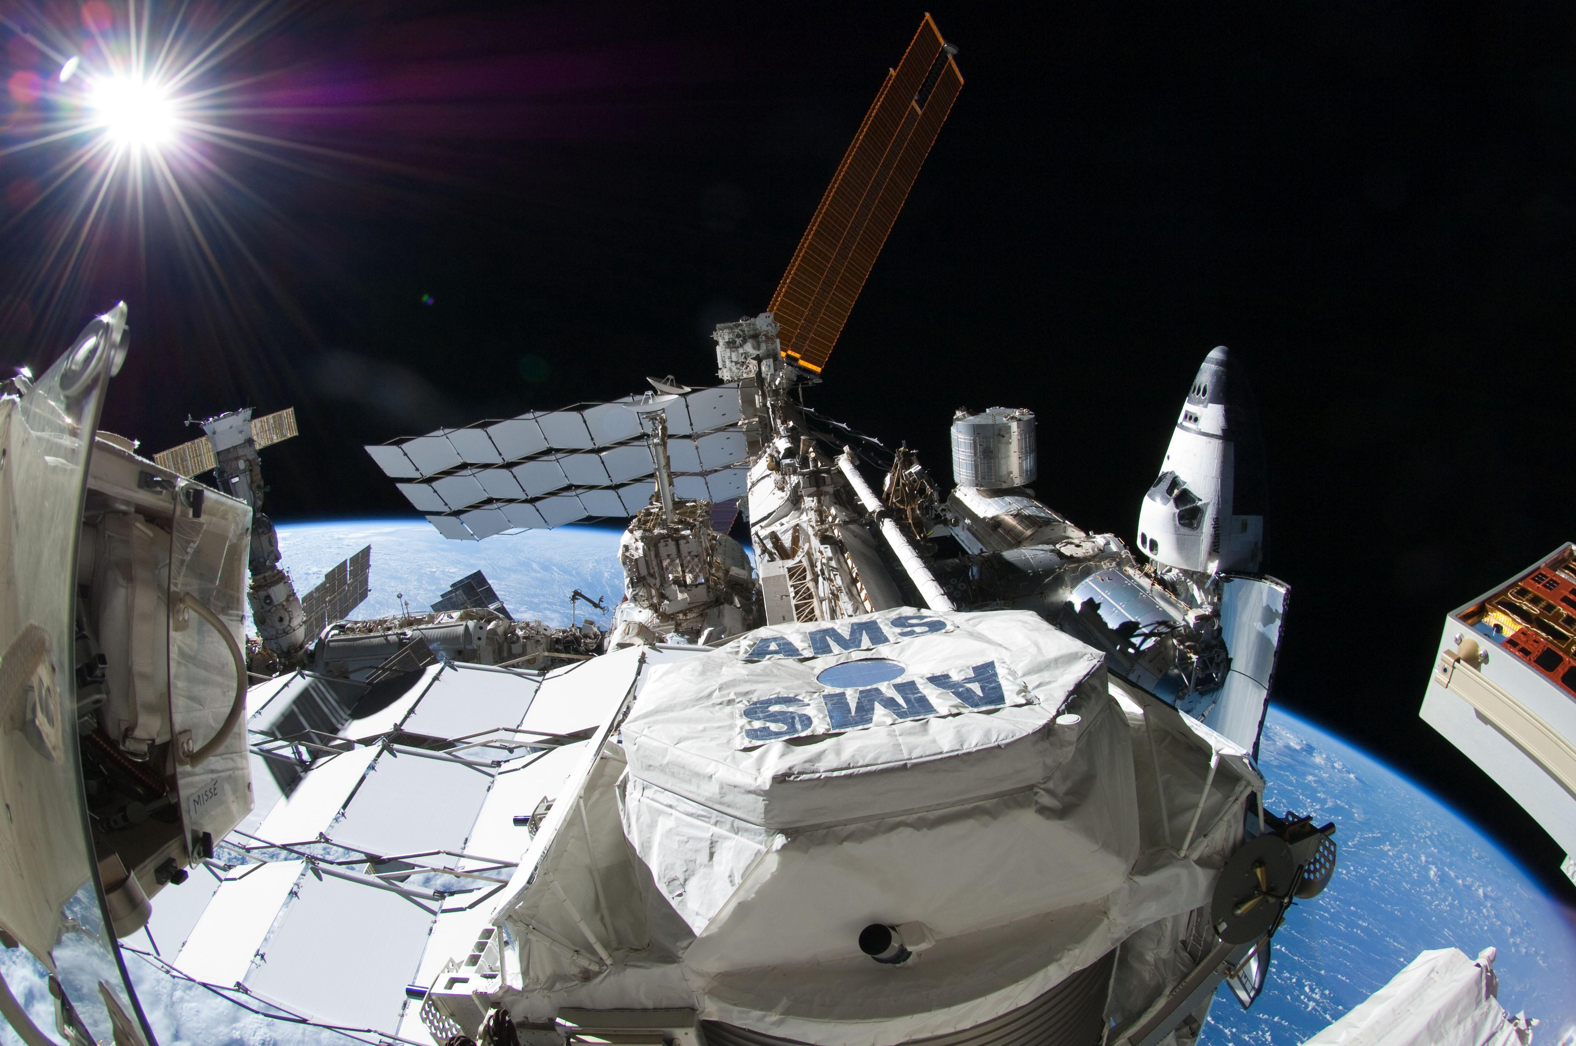
MOST RECENT ACTIVITY

Slide 15
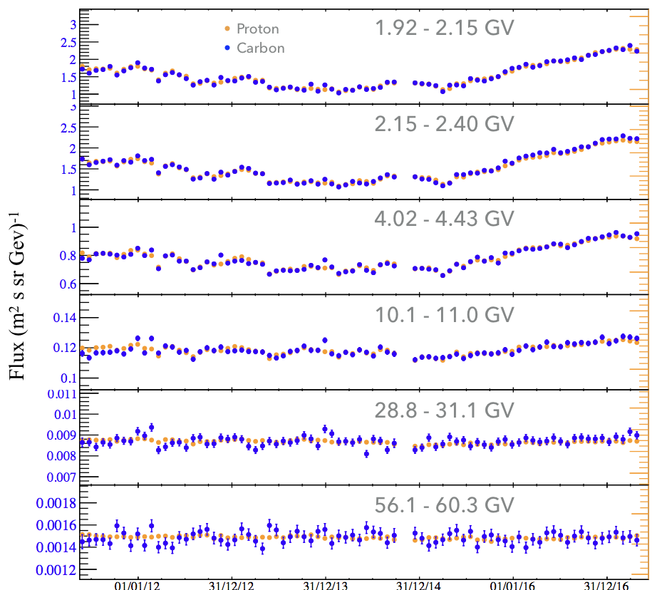
Many on-going analysis by instruments in space:
Precise antimatter-matter measurements in cosmic rays.
Indirect dark matter searches.
Cosmic ray physics
Connections with solar physics and space weather
Related to projects as Limadou, GAPS, LIDAL…
Preliminary data – low energy C
PostDocs: F. Donnini, B. Khiali

Slide 16
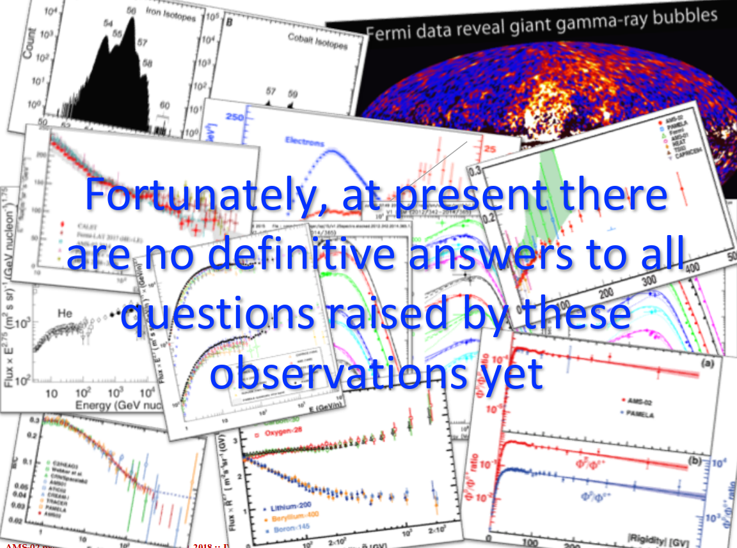
Prof. I. Moskalenko
November 2018

Slide 17
backup

Slide 18
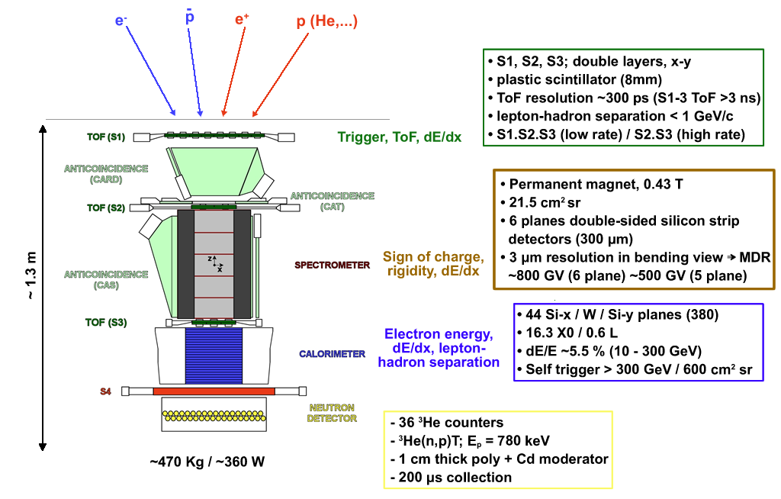
PAMELA INSTRUMENT

