Slide 1




Dr. Umberto De Sanctis

Slide 2
Outline
  Spent the whole career in the ATLAS Experiment
  Supersymmetry (SUSY)
    Searches in the dilepton channel
  Top Physics
    tt cross-section measurement in single lepton channel
    W+jets background estimation
    Top charge asymmetry measurement
      B-physics
        B⁰_{(d,s)} → μμ BR measurement
        Topological trigger studies
        ATLAS upgrade activities for HL-LHC
          L1Track project
          NPTEV-2020 Project

Slide 3
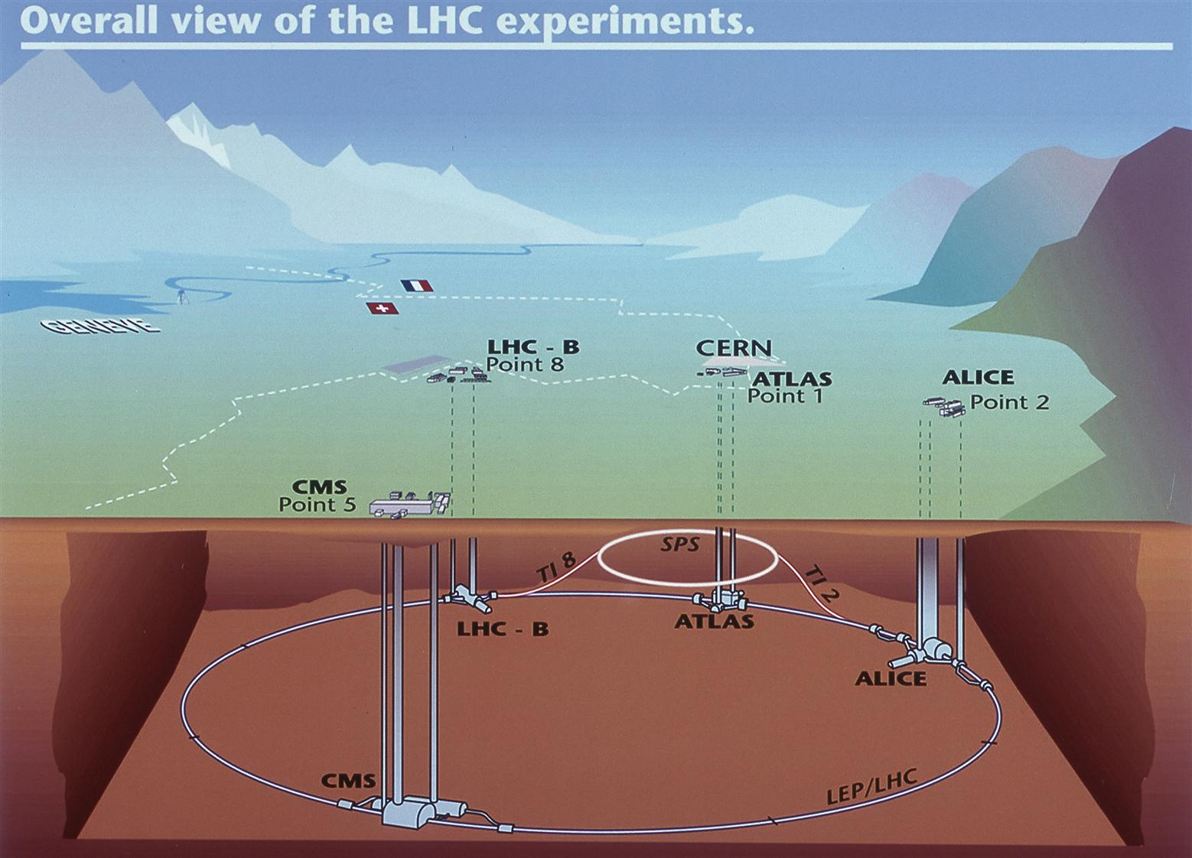
LHC & CERN
27 km circular collider
Up to 2800 bunches of 10¹¹ protons colliding in 4 points each 25 ns
Instantaneous luminosity up to 2.5 10³⁴ cm⁻²s⁻¹
Run1 (2010-2012) and Run2 (2015-2018) collected 25 fb⁻¹ and 150 fb⁻¹ at center-of-mass energies √s = 7, 8 and 13 TeV

Slide 4

The ATLAS Experiment
  Jets + Tranverse missing energy (EM + Hadronic Calo)
  Leptons (EM Calo + muon chambers + Inner Detector)
  b-jets (IBL and Pixel Vertex Detector).
Top physics needs high performance in reconstructing all these objects
B-physics mainly relies on muons and tracks will exploit at highest level its components.

Slide 5
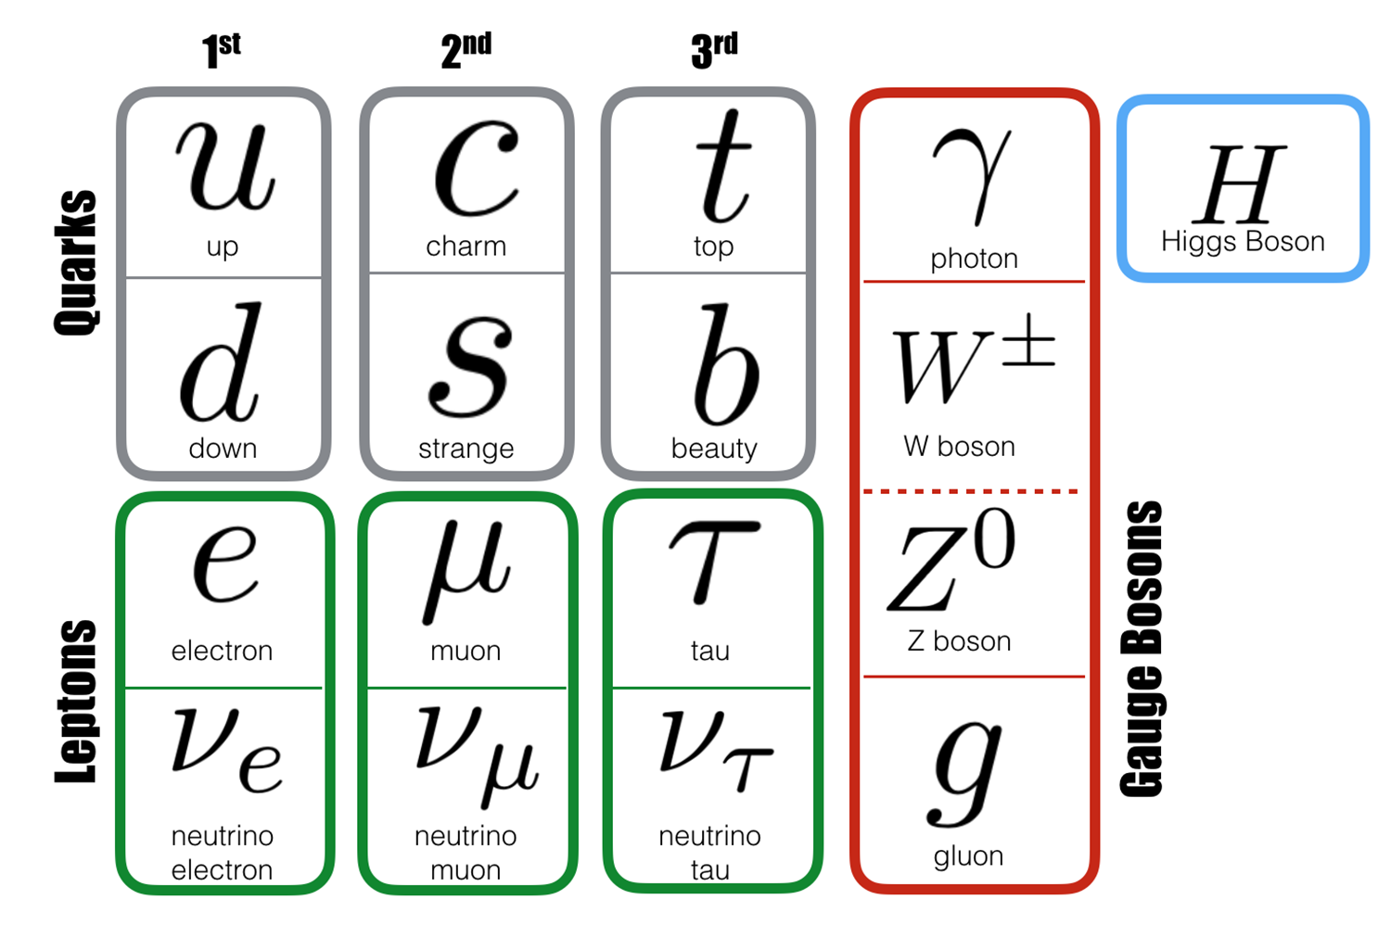
The Standard Model of Particle Physics
3 families of quarks and leptons: the fundamental “bricks”
4 types of mediators (gauge bosons) which describe the 3 fundamental interactions: strong, weak and electromagnetic
The “newcomer”: the Higgs Boson responsible for the masses of all particles in the Standard Model.

Slide 6
The Standard Model of Particle Physics
3 families of quarks and leptons
4 types of mediators (gauge bosons) which describe the 3 fundamental interactions: strong, weak and electromagnetic
The “newcomer”: the Higgs Boson responsible for the masses of all particles in the Standard Model.

Slide 7



Bs,d→μμ BR measurement
  Flavour physics: currently ATLAS B-physics convener
  Rare but clean decay suppressed by FCNC in the SM
  BR(Bs→µµ) = (3.65 ± 0.23)x10⁻⁹
  BR(Bd→µµ) = (1.06 ± 0.09) x10⁻¹⁰
  Sensitive to New Physics contributions through loops
  Measurements by CMS and LHCb (combined):
  BR(Bs→µµ) = ( ) x10⁻⁹
  BR(Bd→µµ) = ( ) x10⁻¹⁰
$${2.8}_{−0.6}^{+0.7}$$
$${3.0}_{−0.6}^{+0.7}$$
  x10⁻⁹
LHCb-only (Run2)
$${3.9}_{−1.4}^{+1.6}$$
< 3.4 x10⁻¹⁰

Slide 8



Bs,d→μμ BR measurement
  Rare but clean decay suppressed by FCNC in the SM
  BR(Bs→µµ) = (3.65 ± 0.23)x10⁻⁹
  BR(Bd→µµ) = (1.06 ± 0.09) x10⁻¹⁰
  Sensitive to New Physics contributions through loops
  Measurements by CMS and LHCb:
  BR(Bs→µµ) = ( ) x10⁻⁹
  BR(Bd→µµ) = ( ) x10⁻¹⁰
$${2.8}_{−0.6}^{+0.7}$$
  x10⁻⁹
(combined)
$${3.0}_{−0.6}^{+0.7}$$
LHCb (Run2)
  Analysis strategy:
$${3.9}_{−1.4}^{+1.6}$$
< 3.4 x10⁻¹⁰
Hadronisation probabilities
Number of Bs/Bd events from an unbinned ML fit to m(μμ) distribution
Trigger categories and luminosity prescales*
Reference channel: B±→J/ψK±
Extracted from an unbinned ML fit to m(μμK±) distribution
Acceptance and efficiencies from simulation

Slide 9
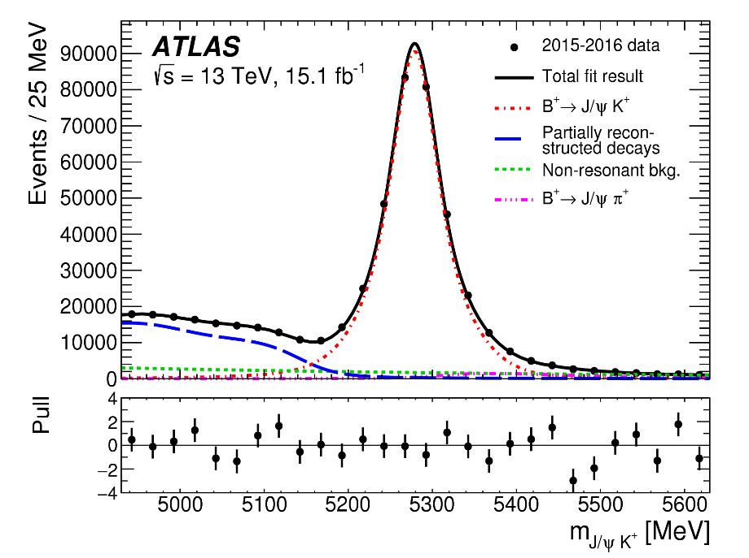
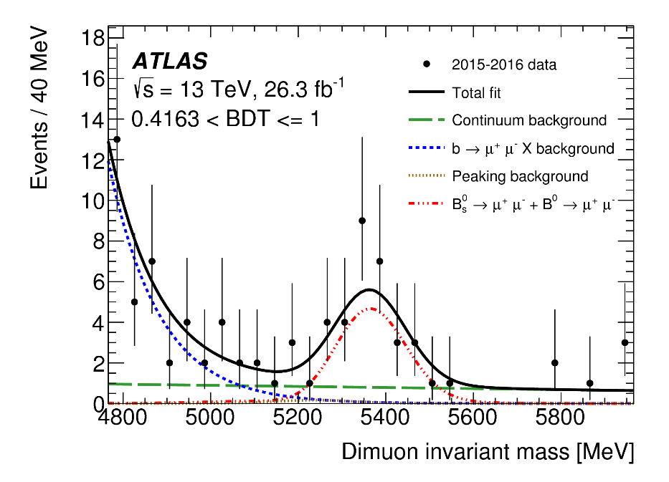
Bs,d→μμ BR measurement
    BR extracted w.r.t to a well know high statistics reference channel (B± → J/ψK±) → reduce systematics
    Blind analysis (e.g. the event selection and all the analysis is frozen before looking at data)
    Di-muon low-P_{T} triggers
    High reduction and control of the backgrounds (BDT for combinatorial)
    Main backgrounds:
      Combinatorial (i.e. 2 “random” muons forming a common vertex
      Semi-leptonic decays
        e.g. b → cμν → s(d)μμνν
        Hadrons identified as muons
          K/π decays in flight

Slide 10
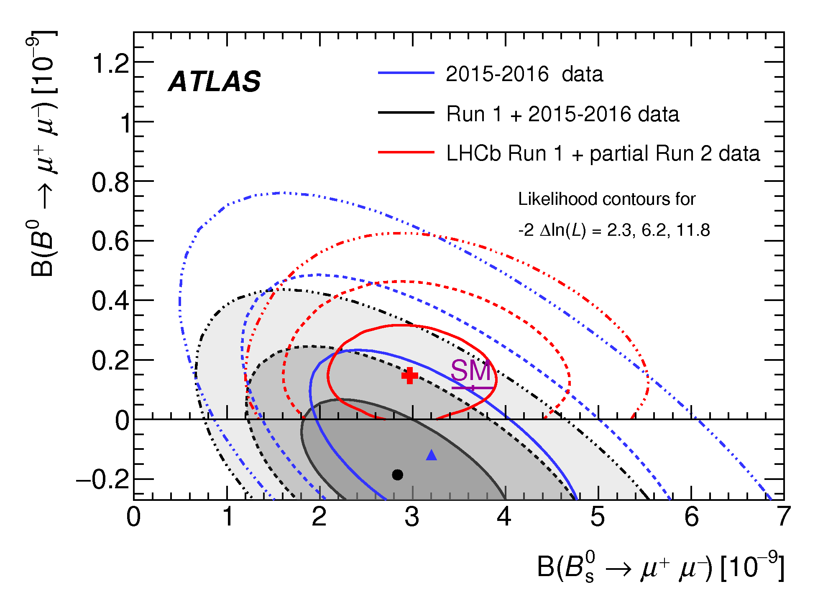
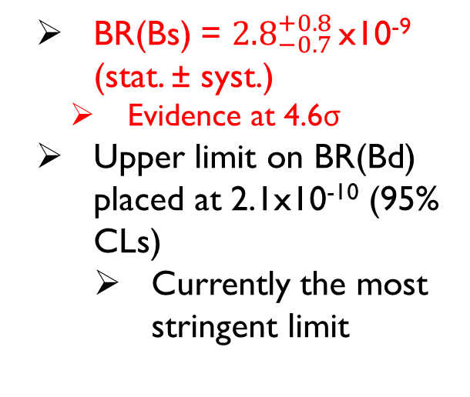
Bs,d→μμ BR measurement
  Results for full Run1+Partial Run2 dataset (25+26 fb⁻¹)
Simultaneous BR(Bs →μμ, Bd→μμ) extraction
Comparable precision w.r.t. CMS and LHCb despite their better m(μμ) resolution
BR(Bs) = ${2.8}_{−0.7 }^{+0.8}$x10⁻⁹ (stat. ± syst.)
  Evidence at 4.6σ
        Upper limit on BR(Bd) placed at 2.1x10⁻¹⁰ (95% CLs)
          Currently the most stringent limit

Slide 11
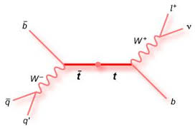
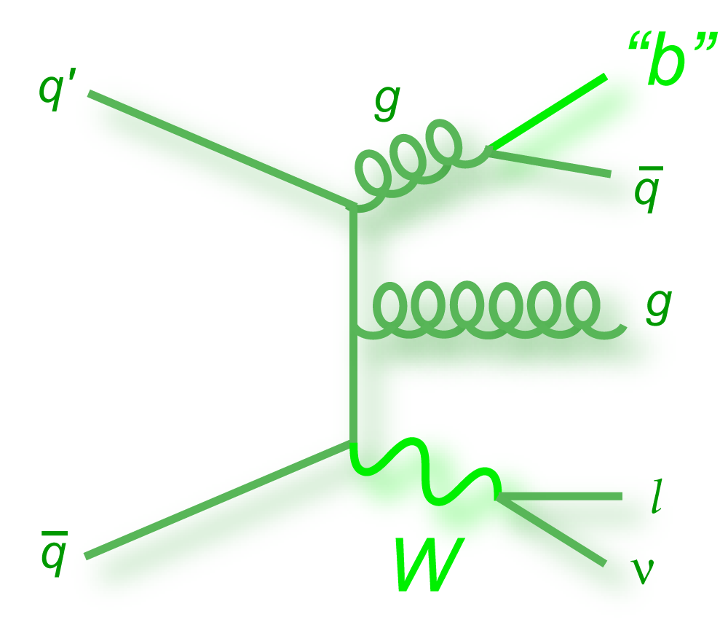
Top physics
Top quark is the heaviest particle in Nature
Its lifetime is shorter than 1/Λ_{QCD} → It doesn’t hadronise
Possibility to study the properties of a bare quark!
BR(t→Wb) ~ 99%
Experimental signatures:
  High-P_{T} jets with both light and heavy flavours HF (from b and c quark decays)
  High-P_{T} isolated lepton (e,µ)
  High missing transverse momentum E^{T}_{MISS}
tt signal
W+jets background

Slide 12
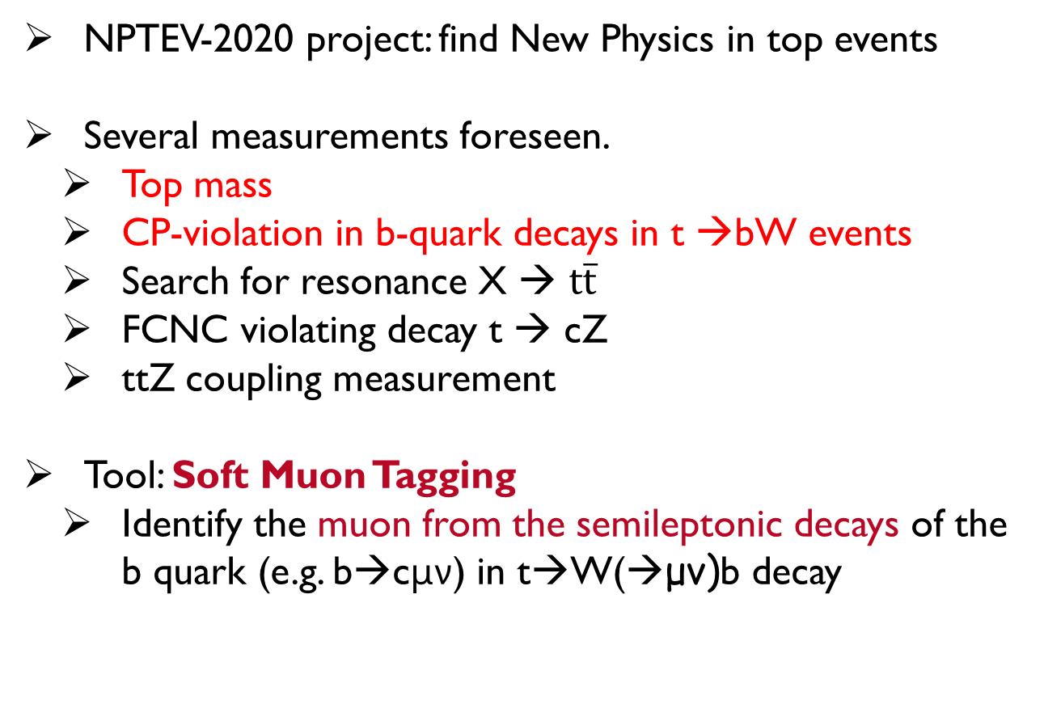
The NPTEV-2020 project
  NPTEV-2020 project: find New Physics in top events
    Several measurements foreseen.
      Top mass
      CP-violation in b-quark decays in t →bW events
      Search for resonance X → t$\overline{t}$
      FCNC violating decay t → cZ
      ttZ coupling measurement
  Tool: Soft Muon Tagging
    Identify the muon from the semileptonic decays of the b quark (e.g. b→cμν) in t→W(→μν)b decay

Slide 13
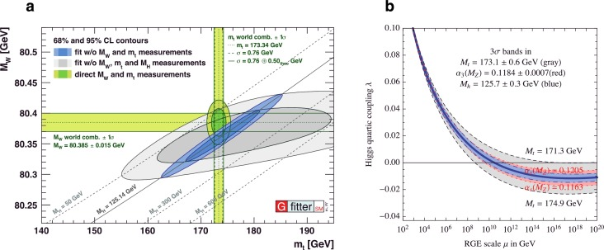
Top mass measurement
Accurate measurements of top quark mass (together with M_{W} and M_{H}) crucial to test the SM
  Compare EW fit and experimental measurements
  Vacuum stability (i.e. UV SM completion)

Slide 14
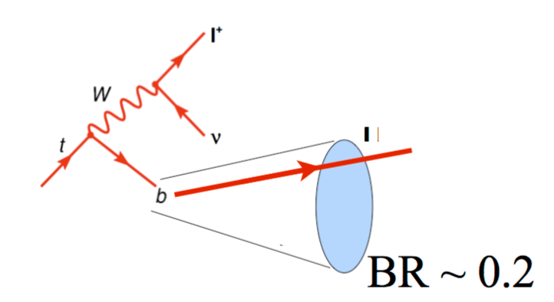
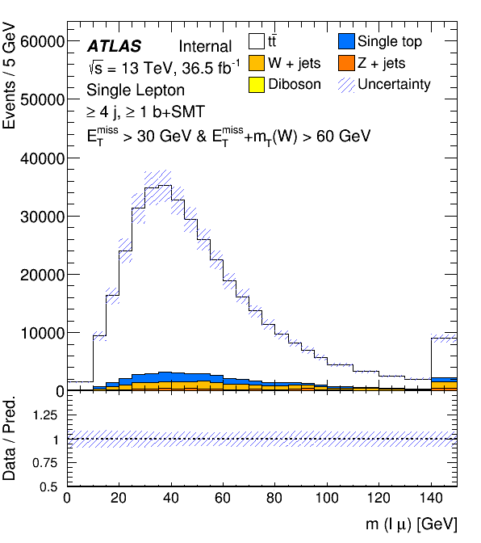
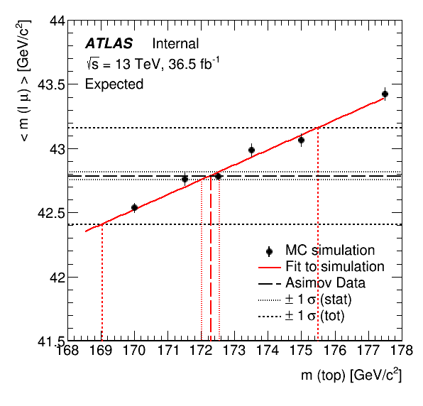
Top mass with soft-muons
Relate the top quark mass to the invariant mass constructed by the Soft Tagged μ with the e/μ from the W decay
Not sensitive to (b)- JES → gain in combination with other measurements
Non isolated muons → Need ad-hoc calibration with Z and J/ψ
b-fragmentation to be kept under control
  Constrained with LEP Z → bb data
μ
Reconstruct the invariant mass m(lμ)in data
Extract m(lμ) templates for several top mass points
Fit in data the m(lμ) curve
Find the best value of the top mass

Slide 15
CP-violation in b-decays
    Look for CP violation in b-semileptonic decays
    2 muons: one from W, one from the b-cascade
    Count the number of same-charge/opposite-charge muons N⁺⁺, N⁻⁻, N⁺⁻, N⁻⁺
      Build asymmetries sensible to CP violation both in B⁰-B⁰ mixing and direct b/c semileptonic decays
Run1 results:
  All asymmetries consistent with SM
  First limit on direct CPV in b→cX decay
Analysis on Run2 13TeV data just started

Slide 16


Slide 17
Backup

Slide 18
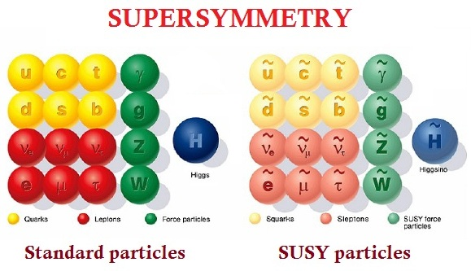
Supersymmetry (SUSY)
New symmetry that associates to every SM particle a partner with different spin
Solution to the “naturalness/hierarchy/fine-tuning” problem
Candidate for Dark Matter (called LSP) if R-parity conservation holds

Slide 19
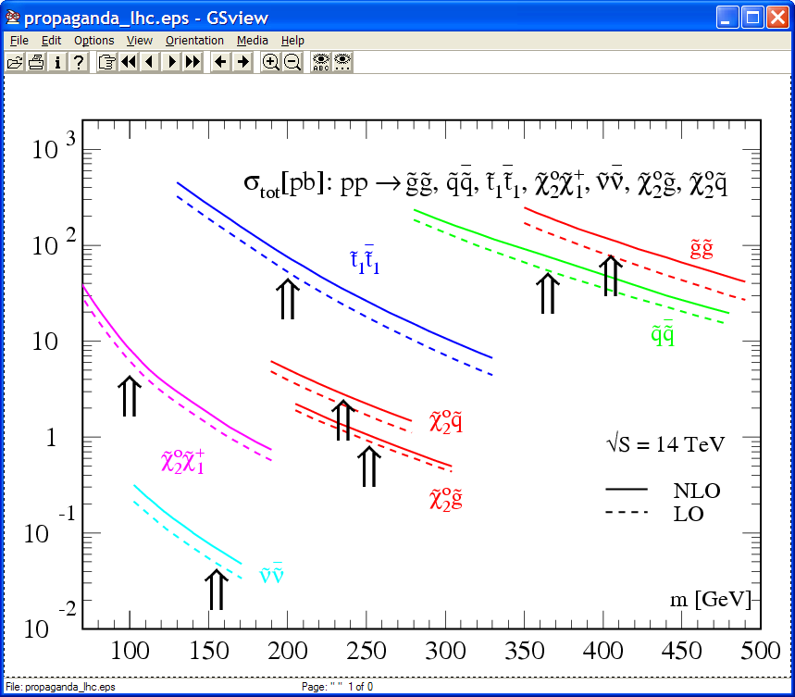
SUSY signatures at LHC
p
p
A typical decay chain:
Assuming R-parity conservation
Strongly interacting sparticles (squarks, gluinos) should dominate production unless very heavy.
Cascade decays to the stable, weakly interacting lightest neutralino follows.
Event topology:
  high p_{T} jets (from squark/gluino decay)
  Large E_{T}^{miss} signature (from LSP)
  High p_{T} leptons, b-jets, τ, jets (depending on model parameters).
~
~
~
χ⁰₁
~
q
χ⁰₂
~
g
l
q
q
l
l
Cross section (pb)
Particle mass (GeV)

Slide 20
SUSY activities
  2005-2008: Master and PhD theses at Milano University
    Inclusive and exclusive searches in final states with:
    2 Opposite Sign Same Flavour (OSSF) high-P_{T} leptons (e, μ)
    High-P_{T} jets + High missing transverse energy E^{T}_{MISS}
    Sensitive to SUSY scenarios with:
      R-Parity conservation
      Gluinos decay chains
      Interpreted within mSUGRA framework
      New method to estimate tt backgorund for these searches (dominant one)
      Results with 1 fb⁻¹ at √s=14 TeV:
        Significantly extend the discovery potential of the inclusive searches
        Reconstruct SUSY particles kinematic properties (e.g. mass differences) with a precision < 2%

Slide 21
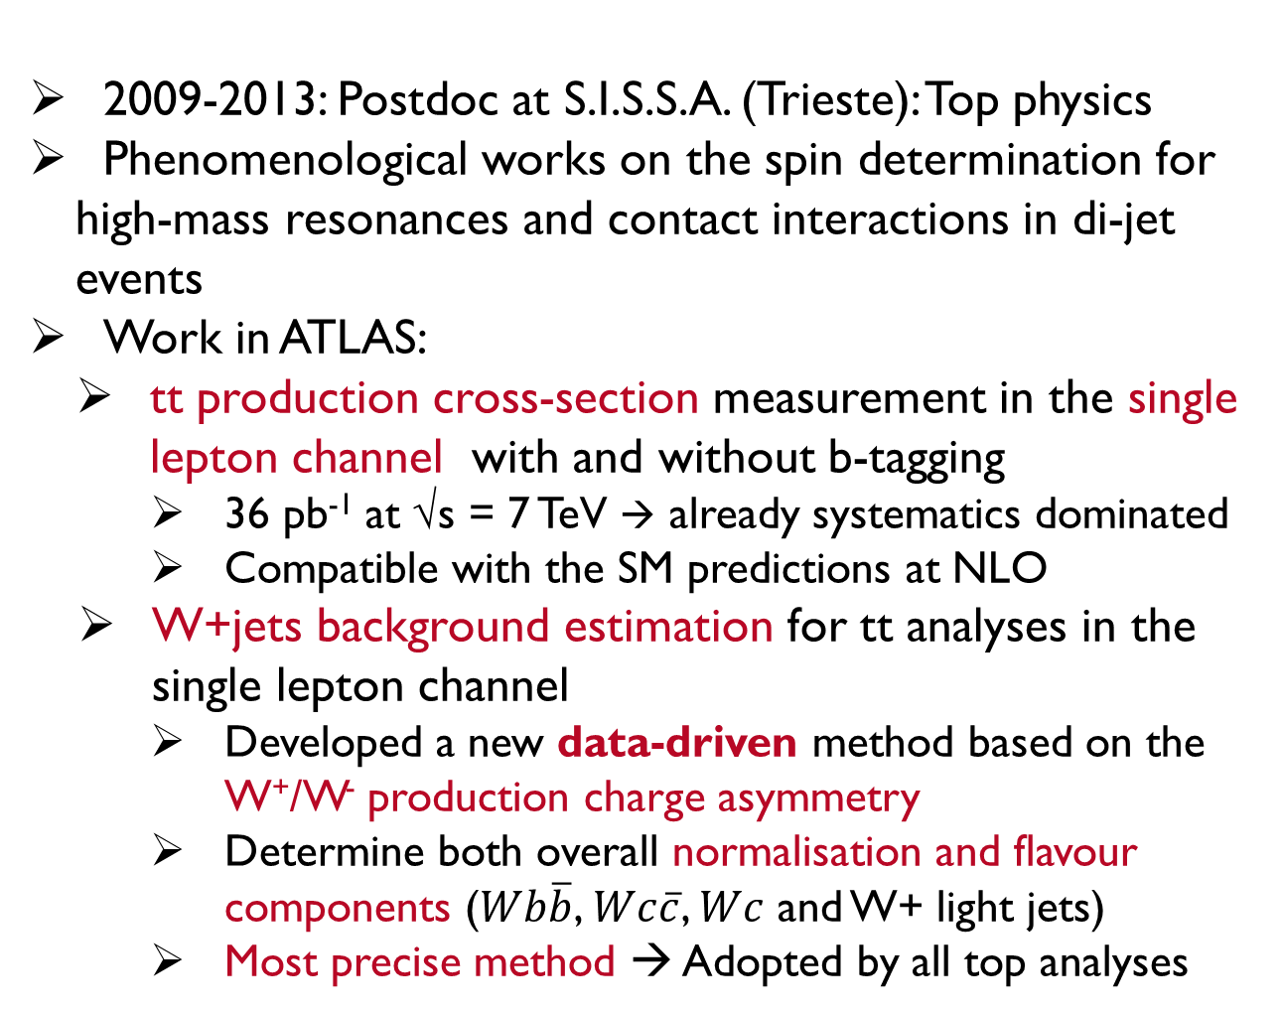
Top physics activities
  2009-2013: Postdoc at S.I.S.S.A. (Trieste): Top physics
  Phenomenological works on the spin determination for high-mass resonances and contact interactions in di-jet events
  Work in ATLAS:
    tt production cross-section measurement in the single lepton channel with and without b-tagging
      36 pb⁻¹ at √s = 7 TeV → already systematics dominated
      Compatible with the SM predictions at NLO
  W+jets background estimation for tt analyses in the single lepton channel
      Developed a new data-driven method based on the W⁺/W⁻ production charge asymmetry
      Determine both overall normalisation and flavour components ($Wb\overline{b}$, $Wc\overline{c}$, $Wc$ and W+ light jets)
      Most precise method → Adopted by all top analyses

Slide 22
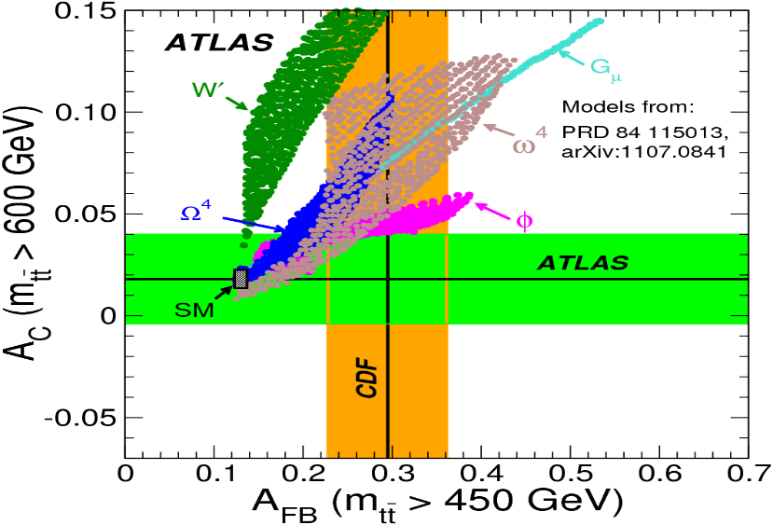
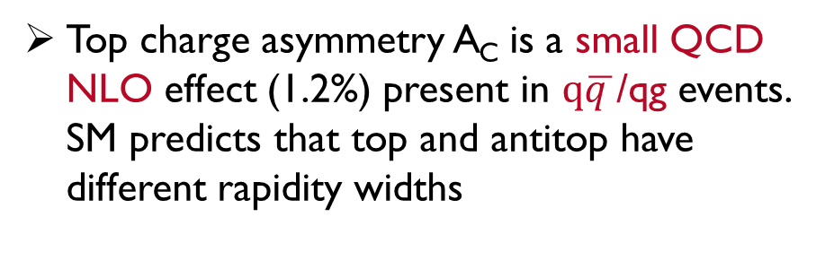
Top charge asymmetry
CDF reported a 3.4σ excess over SM → Started and led the activity for the two publication rounds
At LHC: less visible effect but much higher statistics
A_{C} measured after unfolding for detector/acceptance effects
Top charge asymmetry A_{C} is a small QCD NLO effect (1.2%) present in $q\overline{q }$/qg events. SM predicts that top and antitop have different rapidity widths
y
Most precise LHC measurement
Inclusive and differential ATLAS measurements compatible with SM
Comparison between ATLAS and CDF → Some model disfavoured
JHEP02(2014)107

Slide 23
Trigger & Upgrade activities
  Level-1 Topological trigger
    Optimised, supervising a PhD student, Run-2 trigger strategies for B-physics using Level-1 muon topological info
      x3 rejection improvement → Vital for B-physics in Run2!
  Level-1 Track Project for HL-LHC
    Goal: make a Level-1 trigger decision using ID info
      Low latency trigger (few μs)
      Pattern recognition and track fitting using Associative Memory and FPGA (à-la FTK)
      Add flexibility to the trigger system for HL-LHC
      Development of the track fitting algorithm based on Principal Component Analysis and tracking performance studies

