Slide 1






Un amplificatore SQUID per il segnale del rivelatore KLASH
Paolo Falferi FBK/TIFPA

Slide 2
The dc SQUID
The Superconducting Quantum Interference Device combines two phenomena
Flux Quantization
Josephson Tunneling
Φ=nΦ₀ (n=0, ±1, ±2...)
I
Superconductor
Th: F. London (1950)
Exp: Deaver and Fairbank (1961)
Th: Josephson (1962)
Exp: Anderson and Rowell (1963)
Josephson Equations
I=I₀sinδ δ=φ₁-φ₂
dδ/dt=2eV/h=2πV/Φ₀
Φ₀=h/2e ≈ 2×10⁻¹⁵ Wb
is the Flux Quantum
h ≈ 6.6x10⁻³⁴ Js is the Planck constant
e ≈ 1.6x10⁻¹⁹ C is the electron charge
I₀ is the Critical Current (maximum supercurrent)
φ is the phase of the macroscopic wave-function that describes the Cooper pair condensate
30/11/18
Klash kick-off meeting LNF
2

Slide 3
The dc SQUID
I
Two Josephson junctions connected in parallel on a superconducting loop
Each junction has a self-capacitance C and an added resistive shunt R
Provided that (I condition) the I-V characteristic is nonhysteretic
II condition:
R
C
V
β_{C}= 2πI₀ R²C/Φ₀ ≤ 1 .
2πk_{B}T/I₀Φ₀<<1
I-V Characteristic
V-Φ Characteristic
I
Max response to a δΦ_{a}<<Φ₀
at Φ_{a}= (2n+1)Φ₀/4
Φ = n Φ₀
V
I_{b}
2I₀
I₀
ΔV ~ 20-100 µV
I₀ ~ 10-20 µA
Φ = (n+1/2) Φ₀
V
1
2
3
Φ/Φ₀
For β_{c}<<1 V=R(I²-I₀²)^{1/2} ≈ RI for I>>I₀
30/11/18
Klash kick-off meeting LNF
3

Slide 4
The dc SQUID
From numerical simulation the SQUID response is optimized if
1) β_{C}= 2πI₀ R²C/Φ₀ <≈ 1 .
2) β_{L}= 2LI₀/Φ₀ = 1 where L=SQUID loop inductance
For these conditions
V
Slope V_{Φ} ≈ R/L
Transfer Function = V_{Φ} ≈ R/L ≈ 1/√(πLC)
Flux Noise S_{Φ}(ν) = S_{V}(ν)/V²_{Φ} ≈ 16k_{B}TL²/R
Energy Resolution = ε = S_{Φ}(ν)/2L ≈ 9k_{B}TL/R ≈ 16k_{B}T√LC
the Noise scales with the Temperature
Φ
ε ≈ 10⁻³³ J/Hz ≈ 10h for T=0.3K L=50pH R=2Ω
The white noise of low-Tc SQUIDs is in general in good agreement with these predictions.
30/11/18
Klash kick-off meeting LNF
4

Slide 5
The dc SQUID
Electronics - Flux-Locked Loop
For small signals (<0.1Φ₀) the SQUID can be operated in a linear range around the optimum working point W
Flux of the Earth's magnetic field
(50 μT) through 10μm×10μm is 2.5Φ₀
Flux-Locked Loop SQUID
For larger signals a linearization of the transfer function is realized with a flux-locked loop (FLL)
The deviation of the SQUID voltage V from that at the optimum working point is amplified, integrated, and fed back via a feedback resistor R_{f} and a feedback mutual inductance M_{f}
FLL SQUID transfer function = R_{f}/M_{f}
M_{i}
V_{out}
G
L_{i}
L_{SQ}
Preamp +
Integrator
M_{f}
R_{f}
30/11/18
Klash kick-off meeting LNF
5

Slide 6
The dc SQUID
Electronics - Methods to Suppress Preamplifier Noise
Two-stage SQUID amplifier
Sensor SQUID
Amplifier
SQUID
Matching
Network
I_{in}
V_{out}
Feedback Line
In principle the noise is thermal it scales with temperature
30/11/18
Klash kick-off meeting LNF
6

Slide 7
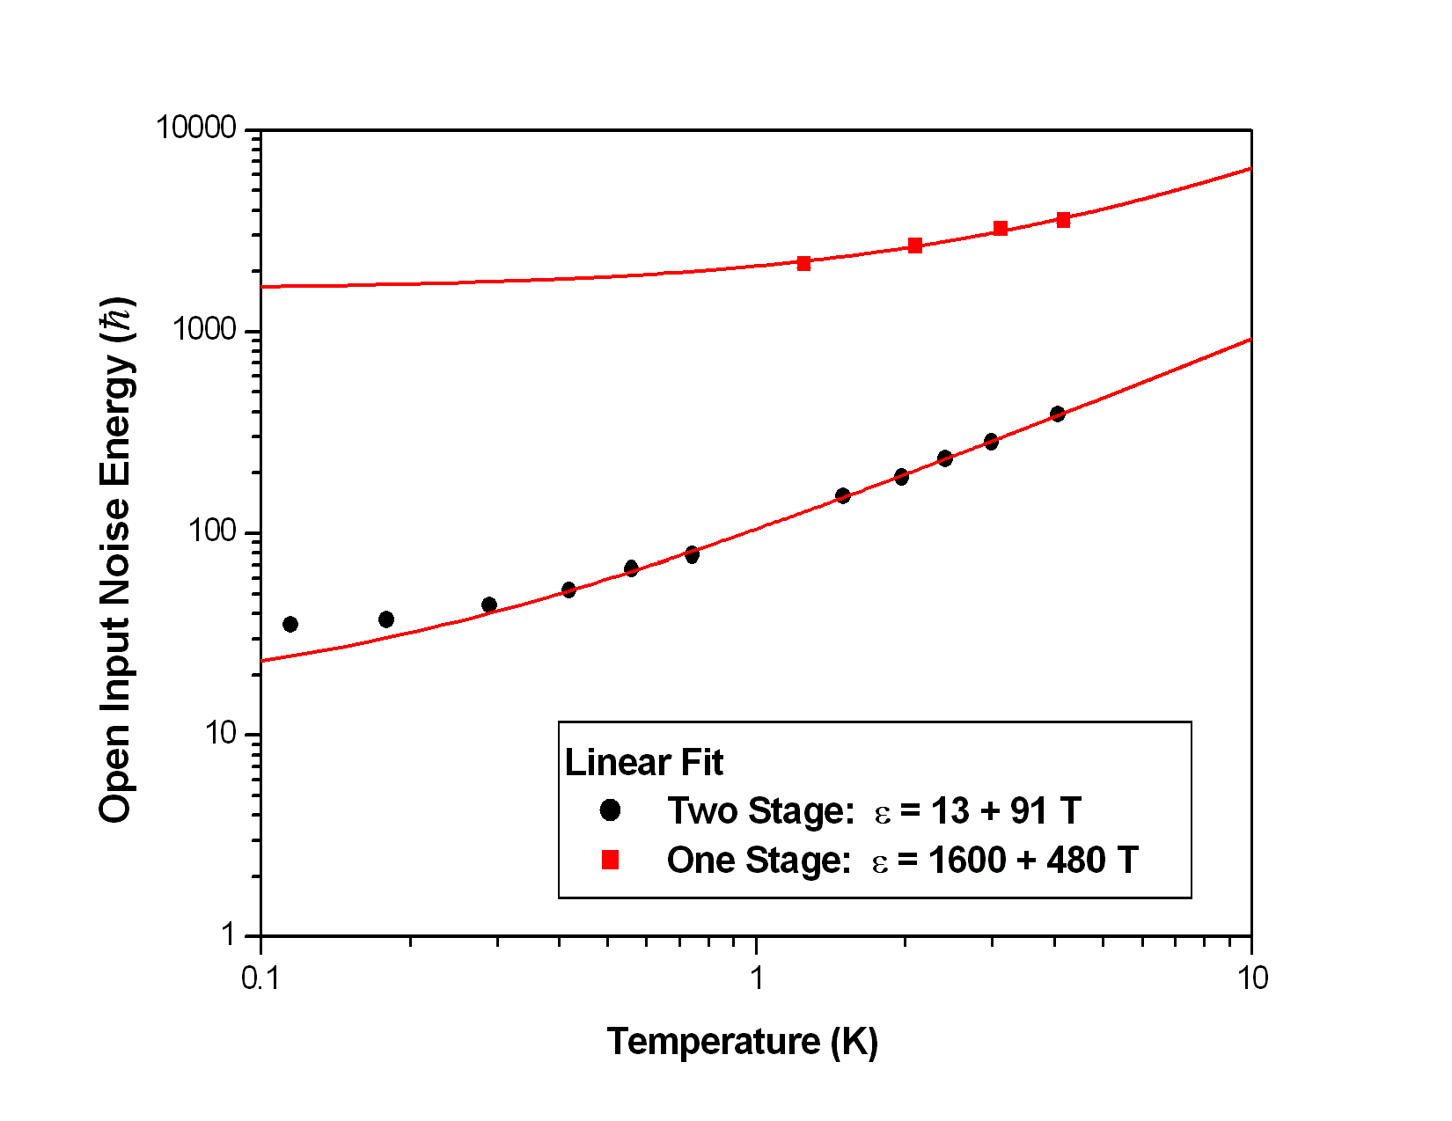
The dc SQUID
Electronics - Methods to Suppress Preamplifier Noise
Two-stage SQUID amplifier
Minimum Energy Resolution ε = 35 h
Saturation due to the Hot Electron Effect
30/11/18
Klash kick-off meeting LNF
7

Slide 8
The dc SQUID
Practical realization
Typical dc SQUID layout
Square Washer - L_{s}=80-300 pH
Fabrication Technology
Uncoupled SQUID
To improve the magnetic field resolution:
larger pickup loop
+
multi-turn spiral input coil
I
V
50-150 μm
R. Cantor and D. Koelle
Coupled SQUID
I
Flux Transformer
M_{i}
L_{p}
L_{i}
L_{s}
V
Input Coil
Wire-wound or
Thin-film
Pick-up
Tight coupling (M_{i}²≅L_{i}L_{s}) is obtained with multi-turn input coil integrated on top of the SQUID washer
30/11/18
Klash kick-off meeting LNF
8

Slide 9
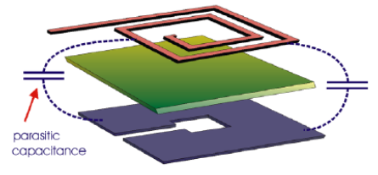
Lo SQUID per KLASH @ 70-250 MHz
Il Problema
dell’alta frequenza
The conventional square-washer SQUID can be operated as a low-noise amplifier up to about 100 MHz. At higher frequencies the parasitic capacitance between the input coil and the square washer lowers the gain to useless levels
30/11/18
Klash kick-off meeting LNF
9

Slide 10
Lo SQUID per KLASH @ 70-250 MHz
Il Problema
dell’alta frequenza
Sono stati sviluppati diversi metodi per estendere la freq di operazione.
M. A. Tarasov et al., IEEE Trans. Appl. Supercond. 2, 79 (1992)
L. Spietz et al., Appl. Phys. Lett. 95, 092505 (2009)
D. Drung et al., IEEE Trans. Appl. Supercond. 15, 777 (2005)
30/11/18
Klash kick-off meeting LNF
10

Slide 11
Lo SQUID per KLASH @ 70-250 MHz
Il Problema
dell’alta frequenza
Microstrip SQUID Amplifier (MSA)
In contrast to the conventional input scheme the signal is applied between one end of the coil and the washer (the other end of the coil is left open). The washer provides the groundplane for the resulting microstrip
Compared to cold semiconductor amplifiers, MSA offer lower noise (a factor 50 for ν < 1GHz) and much lower power dissipation.
Near-quantum-limited performance in the gigahertz range
The resonant frequency can be changed
by connecting a varactor diode
A MSA has recently replaced the HEMT amplifier of the Axion Dark Matter eXperiment that uses a microwave cavity at 800 MHz operating at ultracryogenic temperatures
M. Muck and R. McDermott
Quantum Noise Temperature
at 700 MHz: 33mK
Only one manufacturer of MSA: ez SQUID
30/11/18
Klash kick-off meeting LNF
11

Slide 12
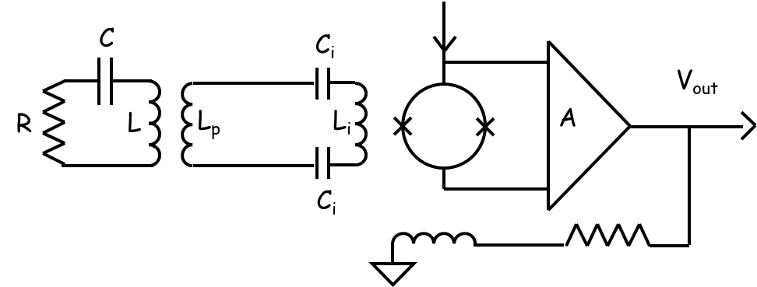
Lo SQUID per KLASH @ 70-250 MHz
Il Problema
dell’alta frequenza
Accoppiamento con cavità
Accoppiamento tipo ADMX cioè
“critically coupled antenna”
“MSA load-matched to 50 Ohm via a terminated Circulator”
Non sente i disturbi a basse frequenze
Su ADMX funziona
Funziona giù fino a 70 MHz?
MSA
Accoppiamento magnetico “tradizionale”
Per non sentire rumore vibrazionale ∗ ci deve essere un accoppiamento passa alto o banda ad alto Q
Va simulato e ottimizzato l’intero sistema cavità-pickup-squid
SQUID
cavità
accoppiamento
risonante
∗ ΔS = 1 μm² in 0.6 T => 300 Φ₀
SQUID
30/11/18
Klash kick-off meeting LNF
12

Slide 13
Lo SQUID per KLASH @ 70-250 MHz
Accoppiamento magnetico con cavità
Instabilità
Input Impedance of the dc SQUID Amplifier
The SQUID amplifier
its input impedance
I_{in}
M_{i}
G
V_{out}
L_{i}
L_{i} ∼ μH
M_{f}
Z
M_{i-f}
Z_{in}= iωL_{i} + Z(Φ, I_{bias}, ω, ….)
!
Usually negligible.
Important with high Q input load and at high frequency signals (~MHz)
30/11/18
Klash kick-off meeting LNF
13

Slide 14
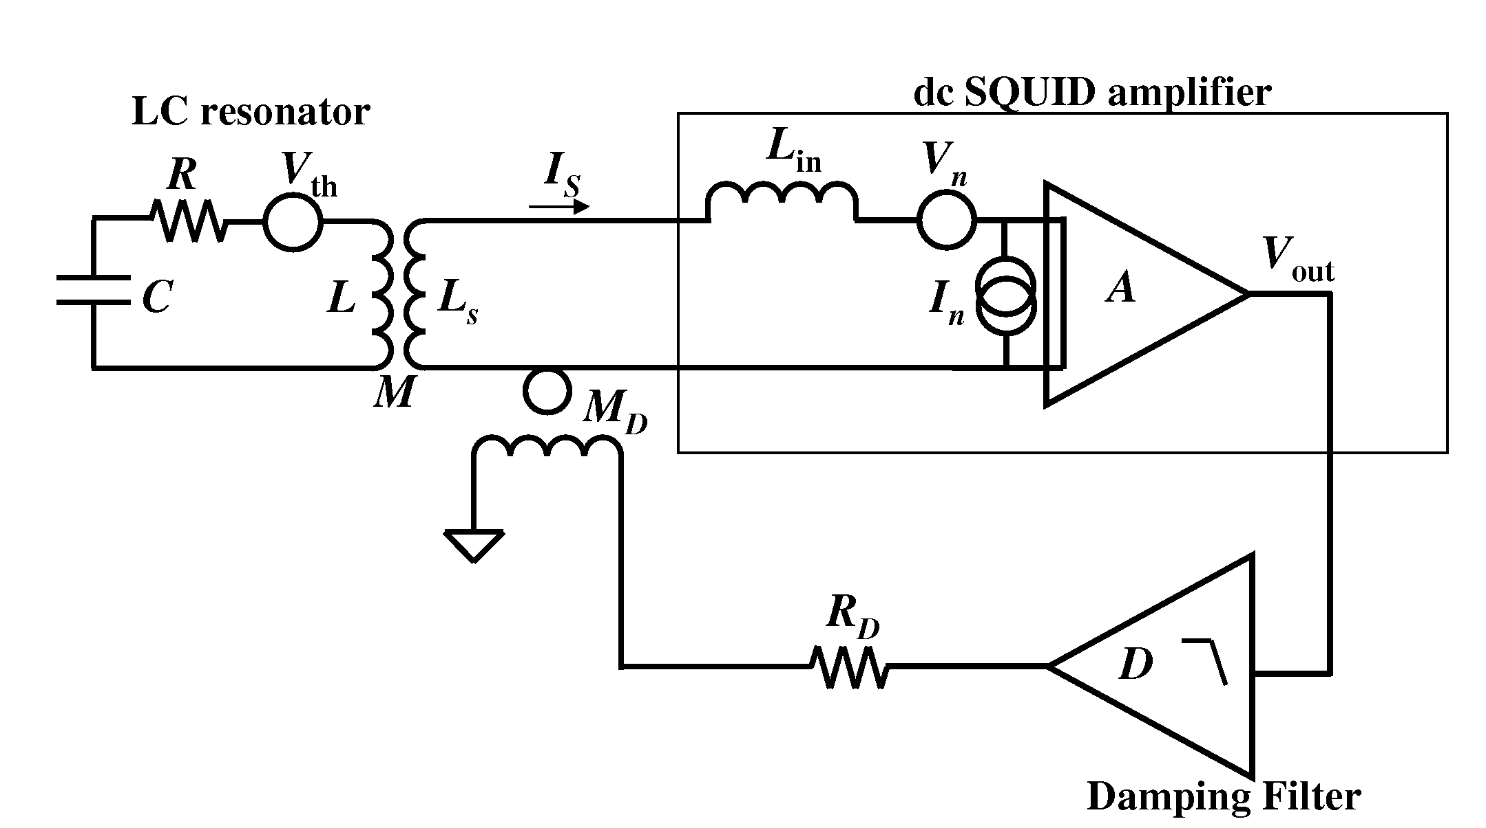
Lo SQUID per KLASH @ 70-250 MHz
Accoppiamento magnetico con cavità
Instabilità
Feedback
cooling
D(f) =D₀/(1+if/f_{D})
30/11/18
Klash kick-off meeting LNF
14

Slide 15
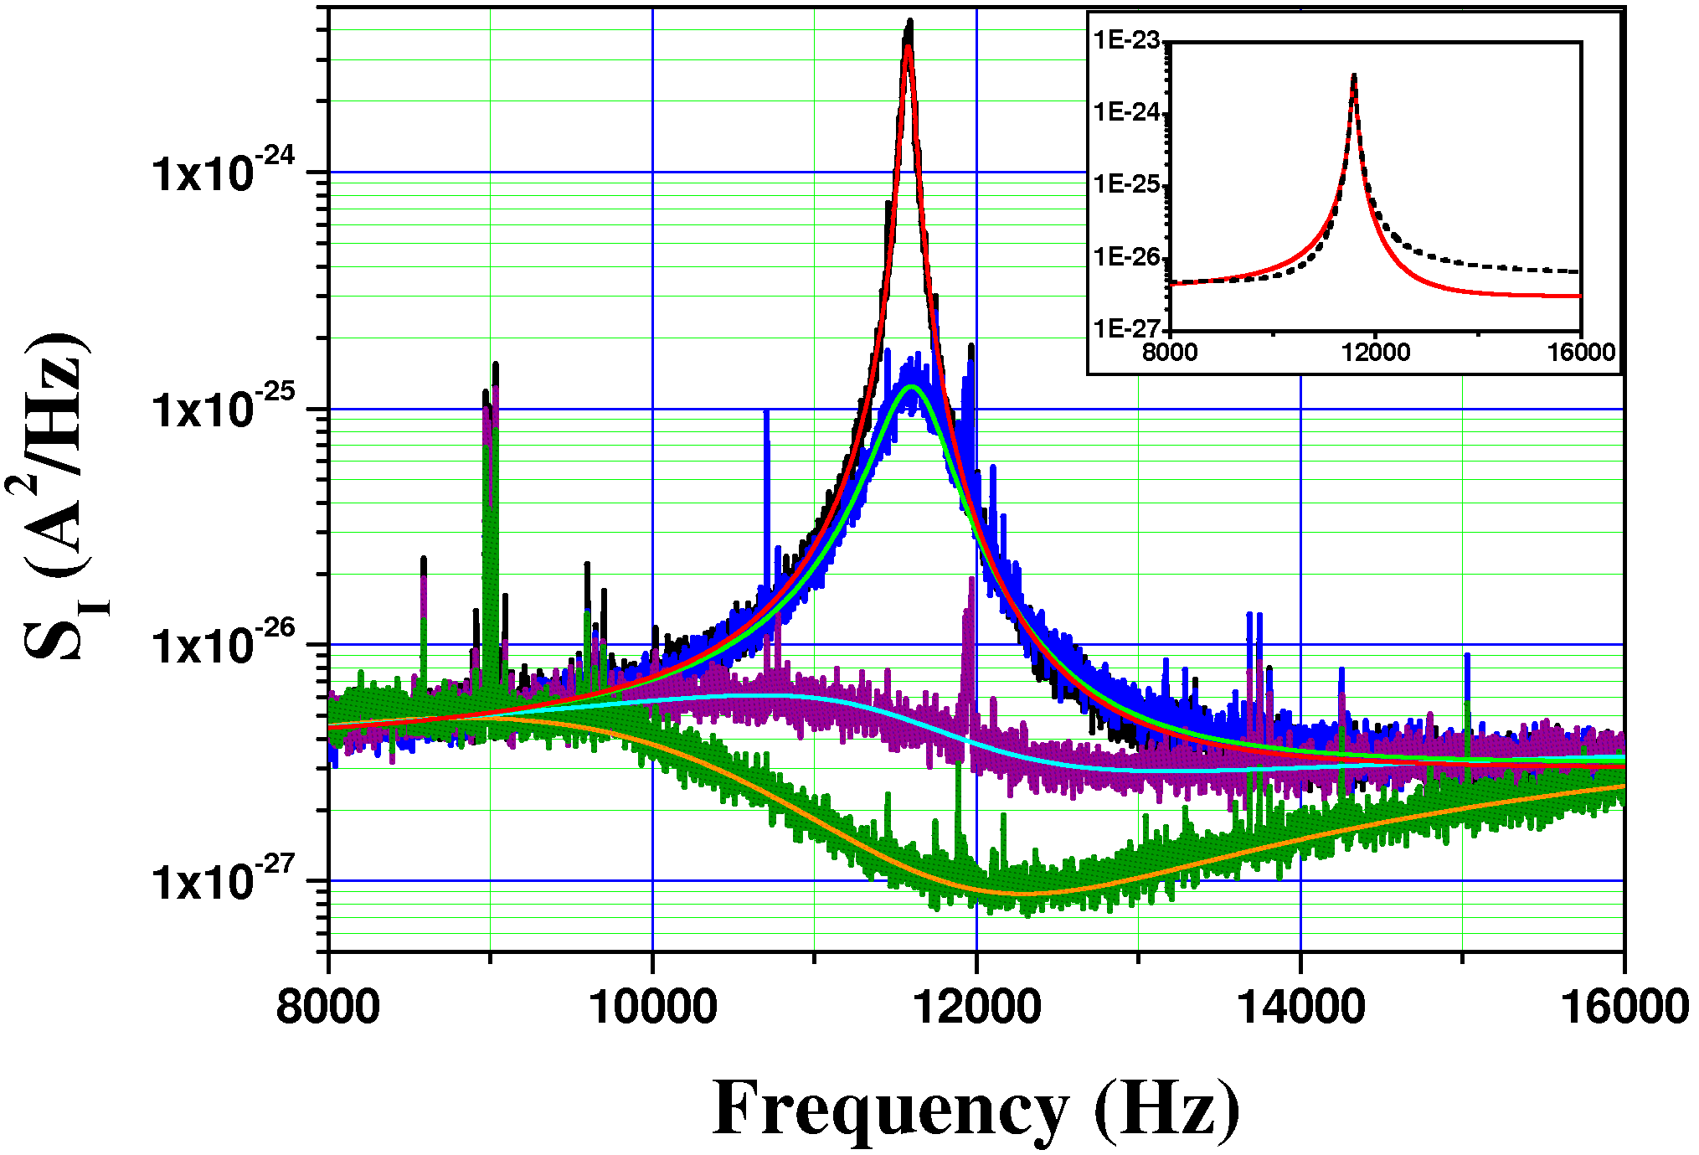
Lo SQUID per KLASH @ 70-250 MHz
Accoppiamento magnetico con cavità
Instabilità
Feedback
cooling
D₀=2
Resonance Frequency = 11.5 kHz
Operating Temperature = 135 mK
Minimum Effective Temperature = 14 μK
D₀=10
D₀=50
D₀=100
Power spectral density of the SQUID input current for four different values of the feedback amplifier gain D₀
30/11/18
Klash kick-off meeting LNF
15

Slide 16
Lo SQUID per KLASH @ 70-250 MHz
Accoppiamento magnetico con cavità
Back-action noise
FLL SQUID
Noise Model
M_{i}
L_{i}
V_{n}
L_{i}
L_{SQ}
G
I_{n}
Back-action Noise
Usually negligible.
Important with high Q input load
and at high frequency (~MHz)
!
Additive
Noise
30/11/18
Klash kick-off meeting LNF
16

Slide 17
Things to do list
Verificare la possibilità di utilizzo di un Microstrip SQUID Amplifier fino a 70 MHz e nel caso acquistarne uno (ezSQUID)
Costruzione di una test facility operante in LHe
Acquisire e testare sensori SQUID custom realizzati per alta frequenza (bassa capacità parassita fra input coil e SQUID loop) da Supracon? PTB/Magnicon? IBS/Corea?
Elettronica dedicata, veloce e a basso rumore, su modello di quella del PTB
Cavo criogenico speciale più corto possibile tra elettronica e sensore squid
Progettazione FEM del sistema cavità – pick-up – linea risonante – SQUID con ottimizzazione del rumore
Costruzione di una linea risonante a basse perdite tra pick-up e induttanza di ingresso dello SQUID
30/11/18
Klash kick-off meeting LNF
17

Slide 18
FINE

Slide 19
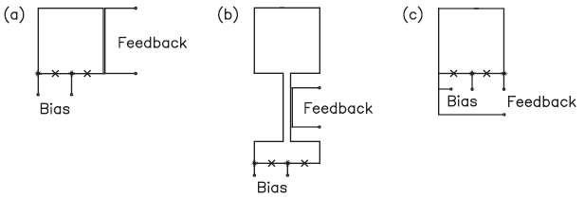
Magnetometers and Gradiometers
Magnetometers for High Spatial Resolution
(for scanning magnetic microscopes)
Magnetometers for High Field Resolution
High field resolution
large pickup loop
thin-film or wire-wound coil connected to a coupled SQUID
Best performance
S_{B} ^{1/2} = 0.9 fT/Hz^{1/2}
High spatial resolution
small pickup loop (Φ ≈ 10 μm)
SQUID loop as pickup
(uncoupled SQUID)
M_{i}
L_{p}
L_{i}
L_{s}
Flux
Transformer
Wire-wound or
Thin-film
Pickup

Slide 20
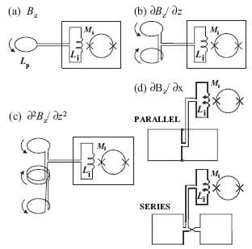
Magnetometers and Gradiometers
When
the magnetic field source is "distant" or
the environment is magnetically noisy
Magnetometer GRADIOMETER
(a) Magnetometer
(b) First-derivative axial gradiometer
(c) Second-derivative axial gradiometer
(d) Thin-film planar first-order gradiometer (parallel and series pick-up loops)
Thin-Film Planar Gradiometers
Two-dimensional film
Planar Gradiometers
(activity in brain or heart)
and
Miniature Susceptometers
(magnetic properties of particles down to 10 μm diam and magnetic calorimeter x-ray detectors )
Wire-Wound Axial Gradiometers
deep-lying sources
Long baseline axial gradiometers
wire-wound pickup coils transformer-coupled to the SQUID
A. Braginski and J. Clarke
pick-up balance up to 0.001% (with high-precision fabrication and post-assembly balancing)

Slide 21
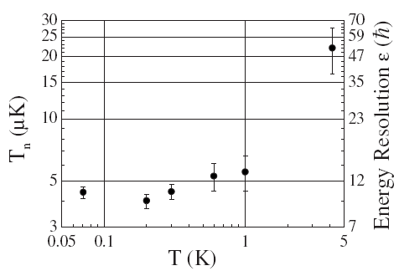
Noise Sources of the dc SQUID Amplifier
Noise Temperature
Quantum Magnetics two-stage SQUID
8.9 kHz
“True” Energy Resolution
Noise Impedance
Energy Resolution from additive noise is incomplete

Slide 22
C
C_{i}
V_{out}
R
L
L_{p}
L_{i}
A
C_{i}

