Slide 1
KLASH RF DESIGN
D. Alesini
(LNF-INFN)
On behalf of the RF klash designing team (D. Alesini, S. Tocci)

Slide 2
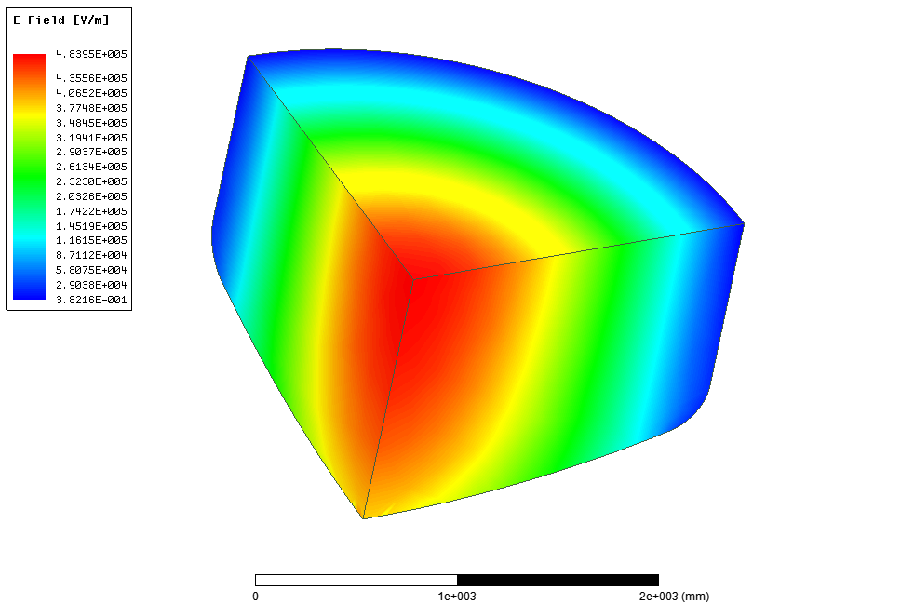
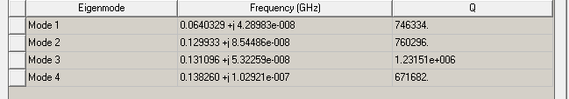
FROM KLASH PROPOSAL
tuning
Cu
coupling
Cu@300K

Slide 3
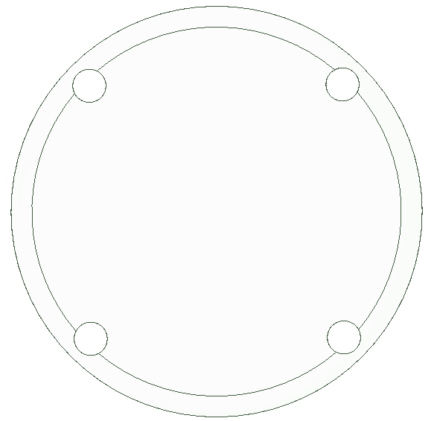
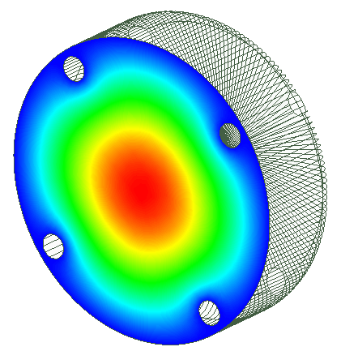

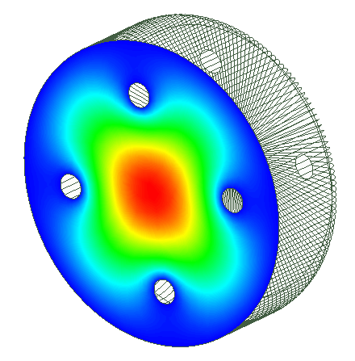
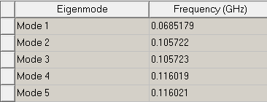
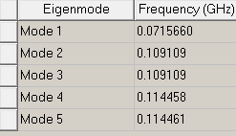
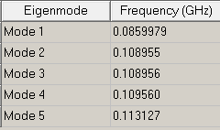
OTHER POSSIBLE TUNING SOLUTIONS

Slide 4
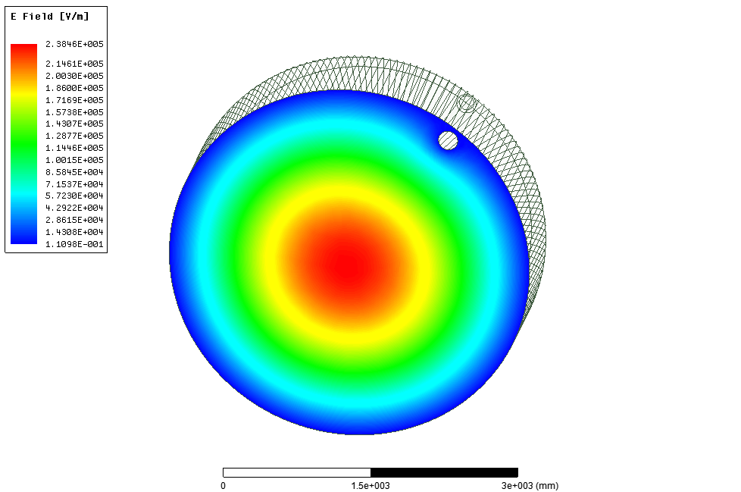
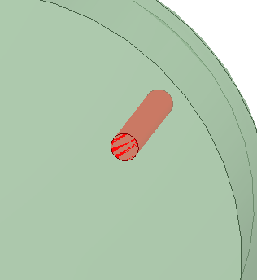
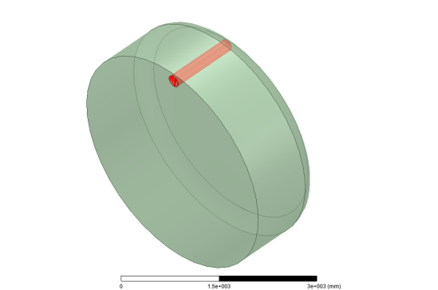
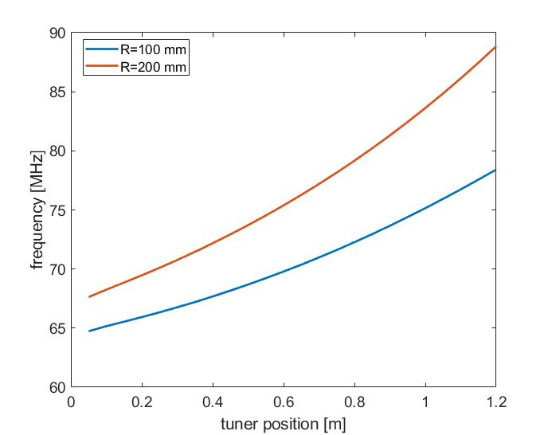
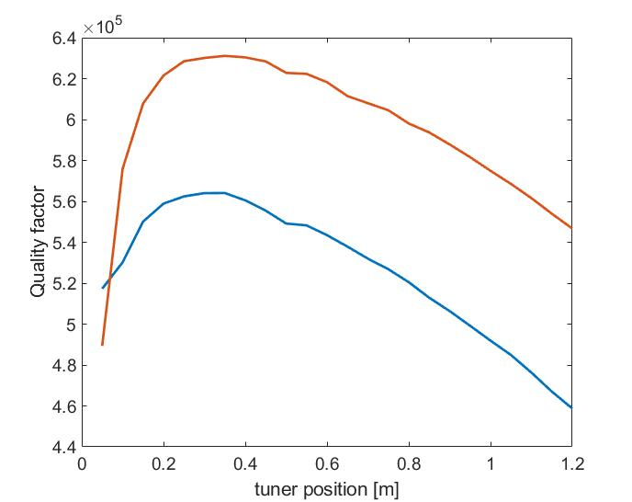
TUNING RESULTS: EXAMPLES (1/2)
Tuner position
R

Slide 5
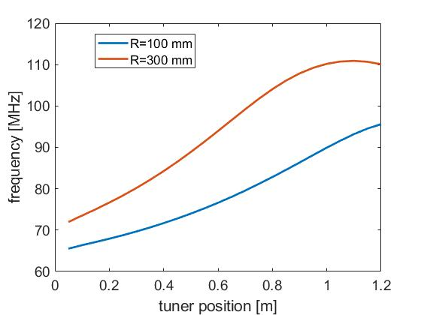
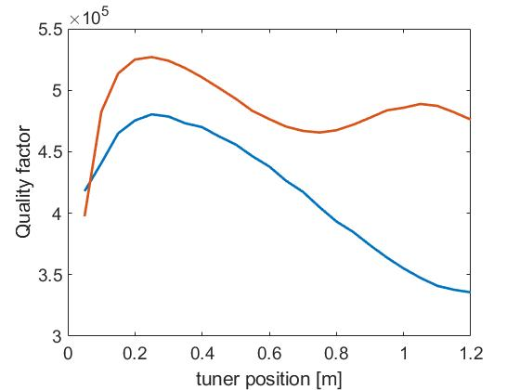
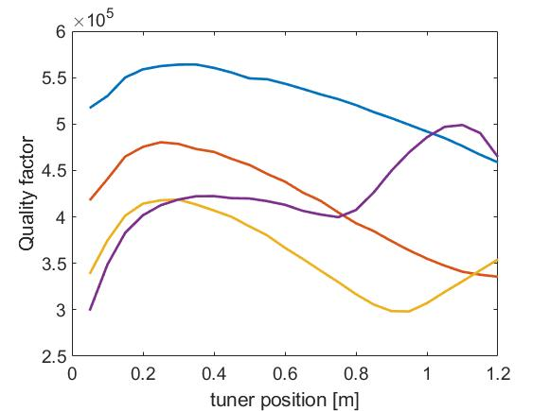
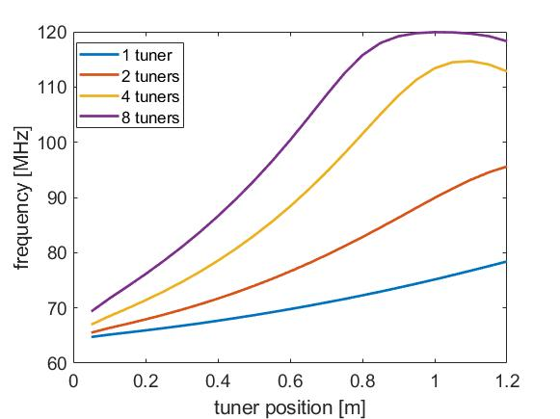
TUNING RESULTS: EXAMPLES (2/2)
Two tuners
R=100 mm

Slide 6
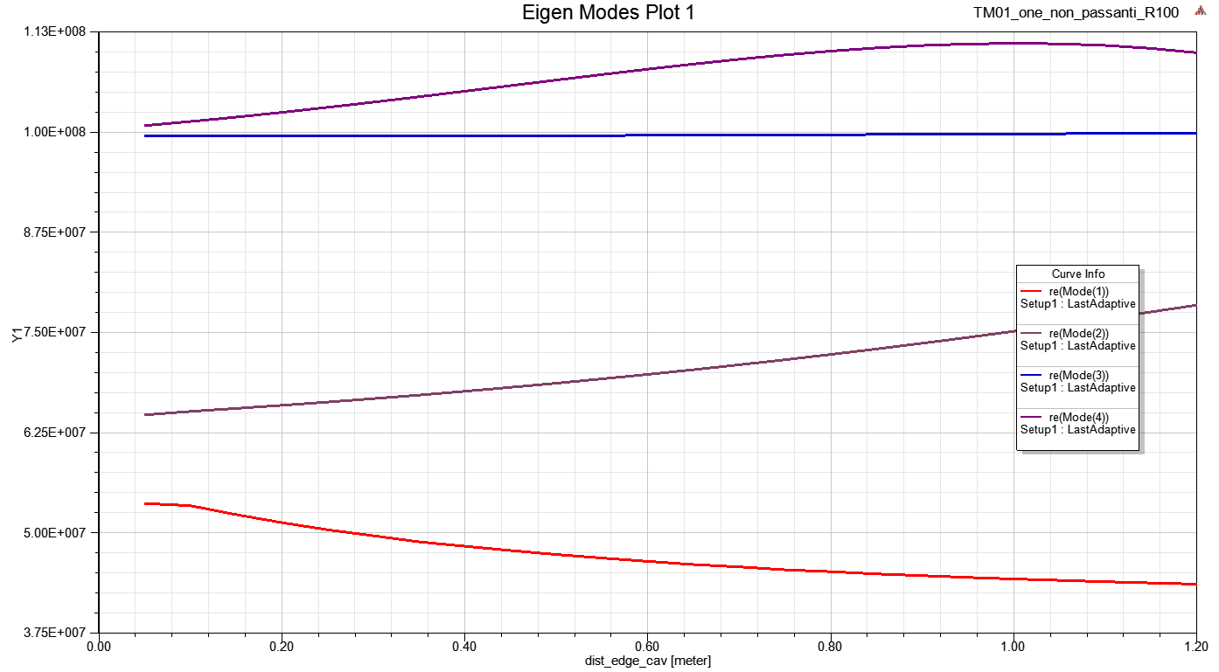
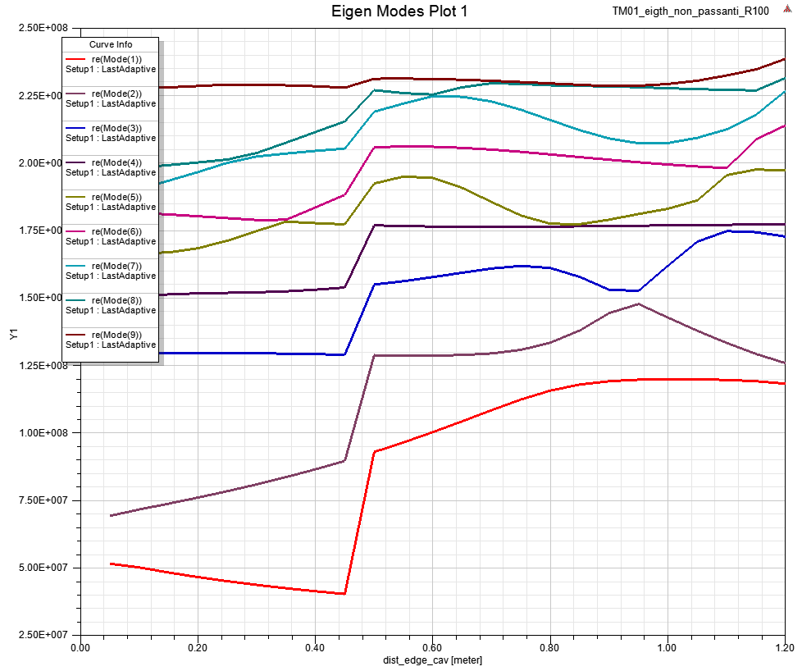
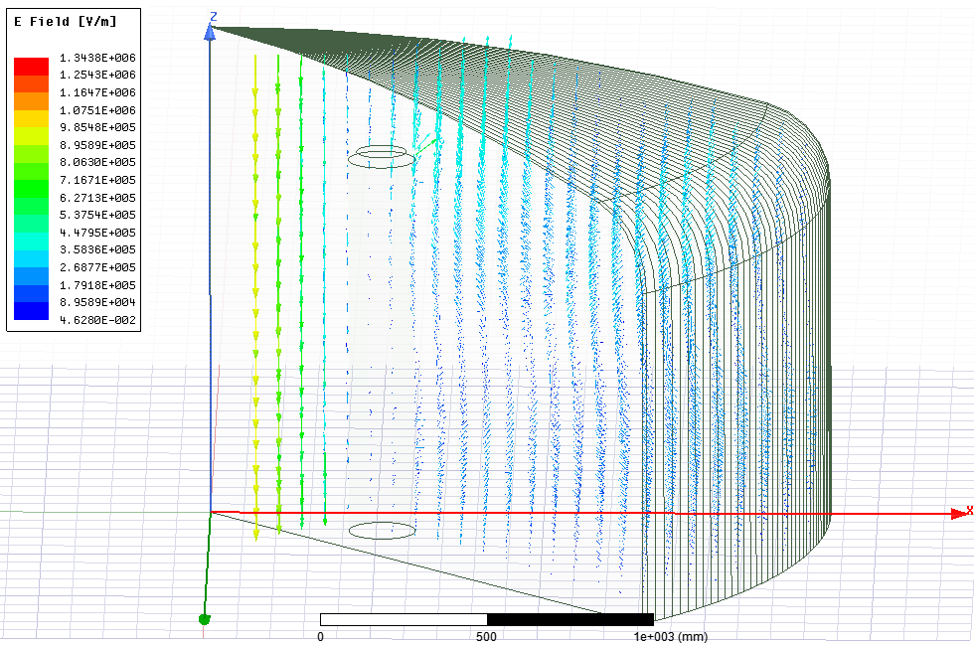
TUNING RESULTS: MODE MIXING
One tuner
Mode mixing
Eight tuners
f_{RF}=231 MHz Q=500000

Slide 7
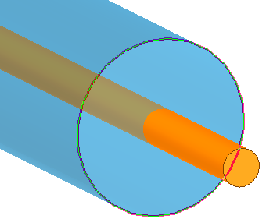
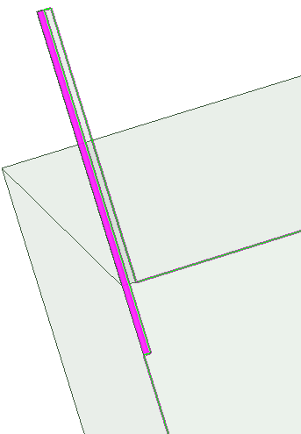
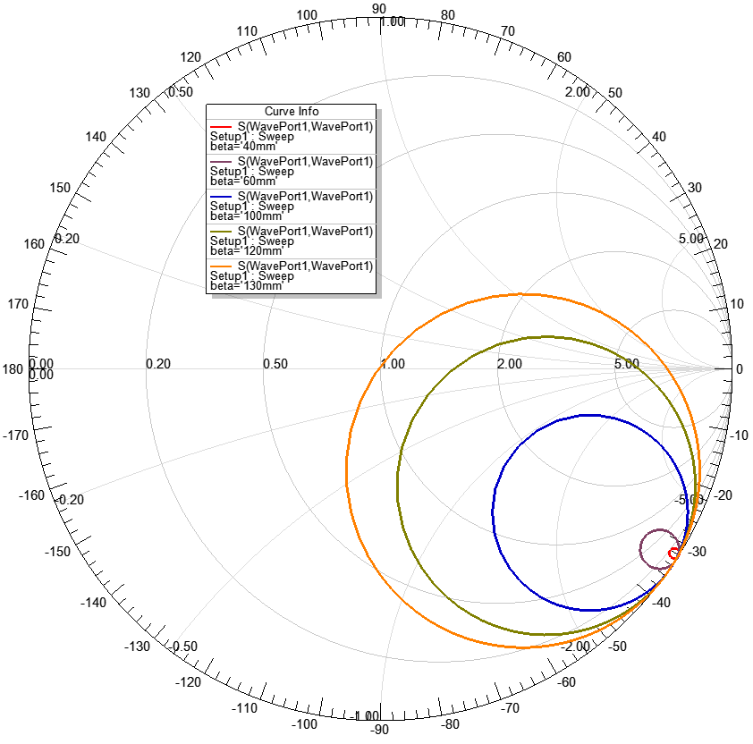
POSSIBLE COUPLING SOLUTIONS
KLASH: coaxial cable
Dipole
coaxial cable EZ_86_CU_TP_M17 (standard SMA; QUAX dipole)
R_in= 0.25 mm
R_out= 1.1 mm
2R_out
2R_in
Beta
R_in | K=1
0.25 mm | 130 mm
1 mm | 107 mm
2.5 mm | 111 mm
KLASH cavity

Slide 8
LIST OF ITEMS TO BE STUDIED FOR THE CDR
Tuning system final design studying the cavity mode mixing, the quality factor variation,… (1,2,4 tuners…) also considering non symmetric movements of the tuners
Design the coupler: antenna on axis or loop off axis and how to vary the probe coupling (needed to be always on critical coupling for different quality factors)
Define the components, at cryogenic temperatures, for the probe, how to sample the signal from the antenna itself (directional couplers, connections with the room temperature system etc…) and how to move the probe itself (penetration or rotation).
Study the effects of cuts in the cavity (to interrupts the induced currents in case of magnet quench)
Define (with the mechanical designing group) the system to allow the tuning rods rotation (RF contact, etc…)
Study possible upgrades of the cavity at higher frequencies (with cuts, pizza cavity etc…) and how the designed tuning/coupling system can be used…
Design a reduced size/room temperature prototype to test the tuning system, probe response, probe coupling variation, etc…

