Slide 1
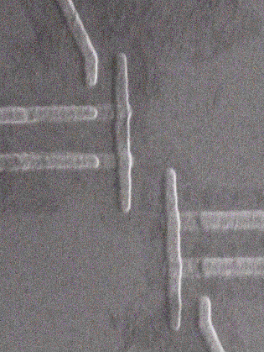
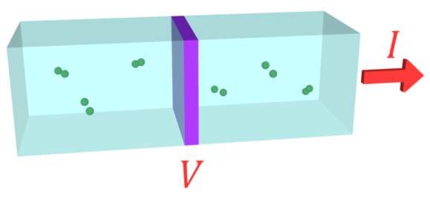
Josephson Junction Single Microwave Photon Detection
Fabio Chiarello
Francesco Mattioni
Guido Torrioli
Maria Gabriella Castellano
IFN-CNR Roma

Slide 2
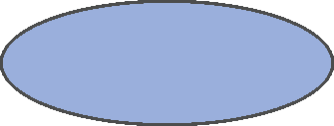
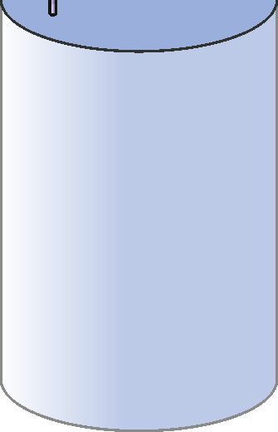

Axion detection
Detector
JJ: ideal detector for
$\sim 10 Ghz$range
Photon
B
Axion

Slide 3


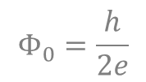

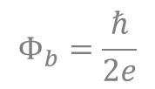

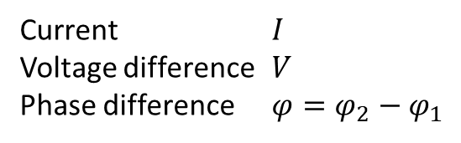


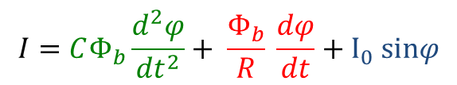
Josephson effect
$$Ψ_{1}=\sqrt{ρ_{1}}{ e}_{}^{iφ_{1}}$$
$$Ψ_{2}=\sqrt{ρ_{2}}{ e}_{}^{iφ_{2}}$$
Current $I$
Voltage difference $V$
Phase difference $φ=φ_{2}−φ_{1}$
Capacitance $C$
Critical current $I_{0}$
Dissipation $R$
$$V=Φ_{b}\frac{dφ}{dt}$$
$$Φ_{b}=\frac{ℏ}{2e}$$
$$I=CΦ_{b}\frac{d^{2}φ}{dt^{2}}+ \frac{Φ_{b}}{R} \frac{dφ}{dt}+I_{0} sinφ$$
$$Φ_{0}=\frac{h}{2e}$$

Slide 4

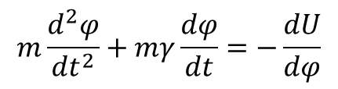
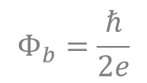
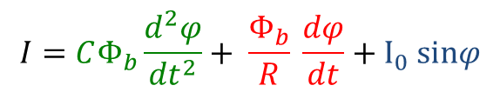

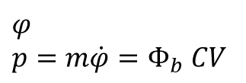

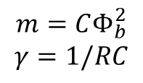

JJ Mechanical equivalent
$$Φ_{b}=\frac{ℏ}{2e}$$
$$I=CΦ_{b}\frac{d^{2}φ}{dt^{2}}+ \frac{Φ_{b}}{R} \frac{dφ}{dt}+I_{0} sinφ$$
$$V=Φ_{b}\frac{dφ}{dt}$$
$$m\frac{d^{2}φ}{dt^{2}}+mγ\frac{dφ}{dt}=−\frac{dU}{dφ}$$
Real pendulum
$$U(φ)$$
Mass:
Damping:
$$m=CΦ_{b}^{2}$$
$$γ=1/RC$$
ϕ
Position:
Momentum:
$$φ$$
$$p=m\dot{φ}=Φ_{b} CV$$
$$φ$$
Potential:
$$U=−Φ_{b}Iφ−Φ_{b}I_{0}\cos{φ}$$

Slide 5





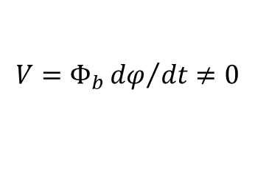

Quantum behavior
Classical mechanical equivalent
Quantum mechanical equivalent
Running state
$$V=Φ_{b}{dφ}/{dt}≠0$$
$$E_{2}$$
$$E_{1}$$
$$E_{0}$$
$$Γ_{1}$$
$$hν=E_{1}−E_{0}$$
$$Γ_{0}$$

Slide 6
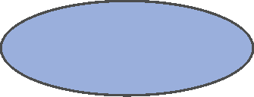
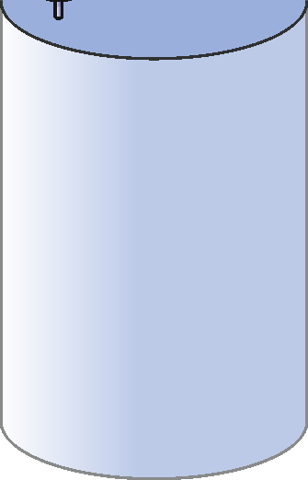





JJ detector
$$E_{2}$$
$$E_{1}$$
$$E_{0}$$
$$Γ_{1}$$
$$I_{bias}$$
$$hν=E_{1}−E_{0}$$
$$Γ_{0}$$
$$V_{out}$$
P
h
o
t
o
n
B

Slide 7
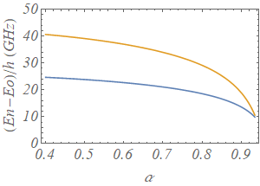
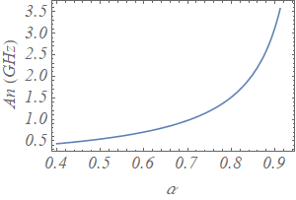
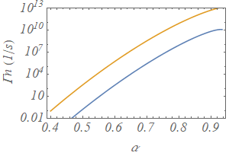
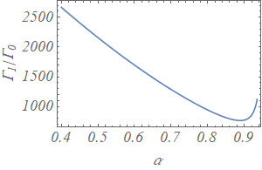






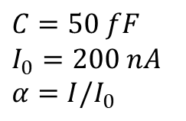





JJ parameter design
$$C=50 fF$$
$$I_{0}=200 nA$$
$$α=I/I_{0}$$
$$E_{2}$$
$$E_{1}$$
$$E_{0}$$
$$Γ_{1}$$
$$Γ_{0}$$
$$A_{n}=ΔE_{01}−ΔE_{12}$$
$$E_{2}−E_{0}$$
$$E_{1}−E_{0}$$
$$Γ_{1}$$
$$Γ_{1}/Γ_{0}$$
$$Γ_{0}$$

Slide 8
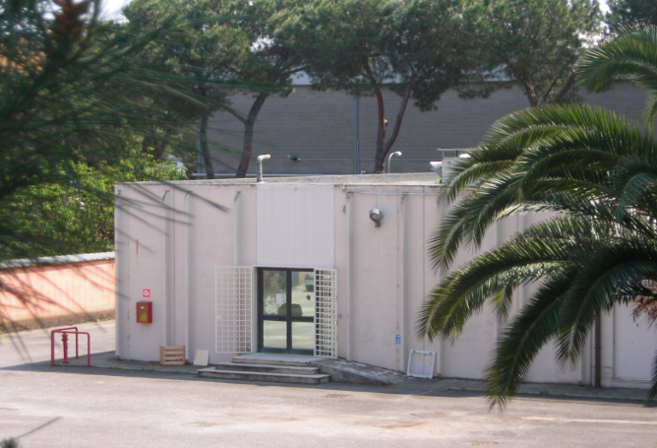
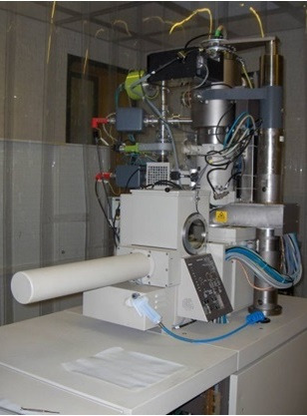
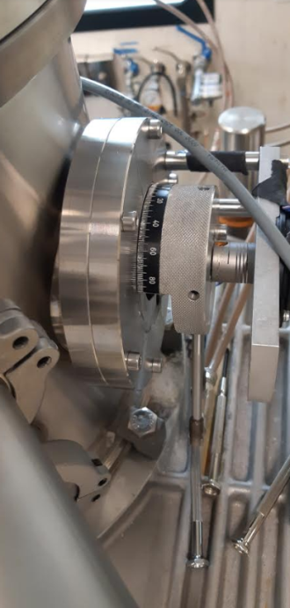
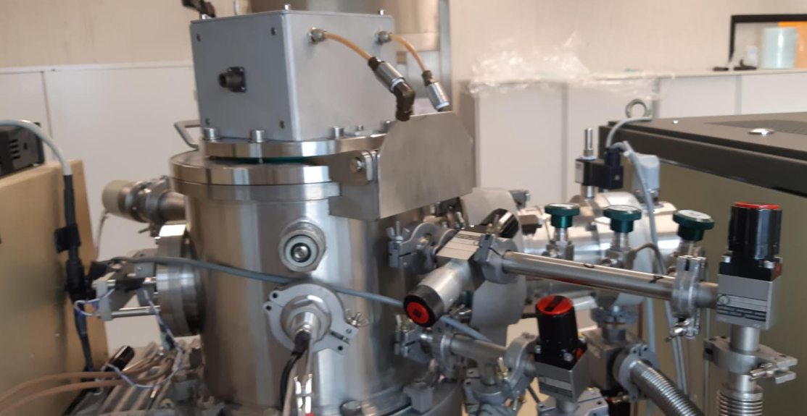
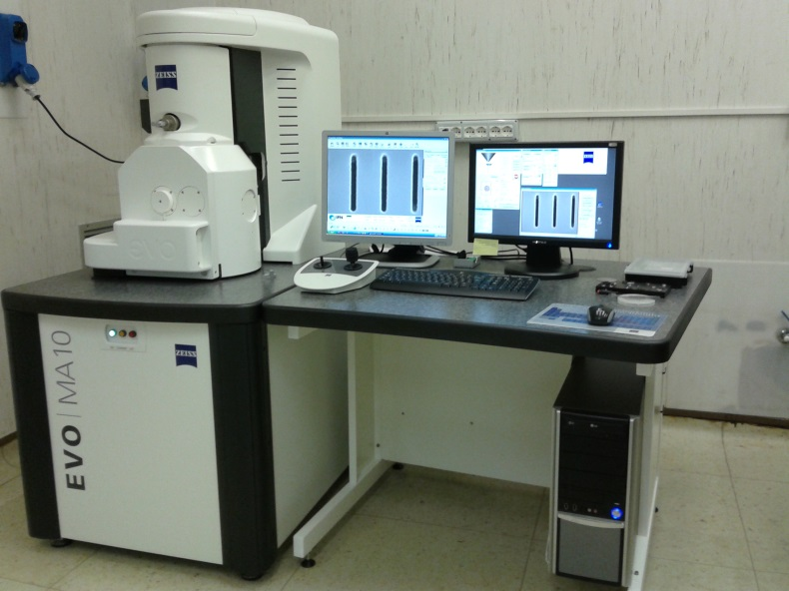
Fabrication

Slide 9
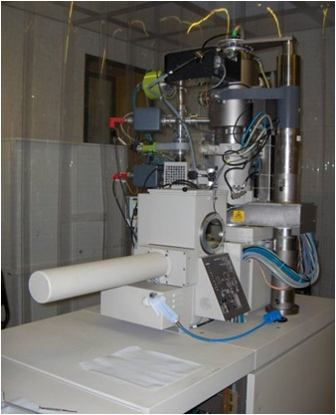
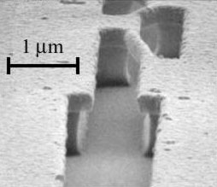
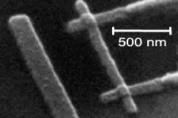

AlOxAl junctions - Shadow evaporation
Layers
Suspended bridges
Devices
Mask
PMMA
Copolymer
Silicon
1
2
3
4
5
6
e-beam
litography
Development
Al evaporation
Oxidation
Al evaporation
Lift off

Slide 10
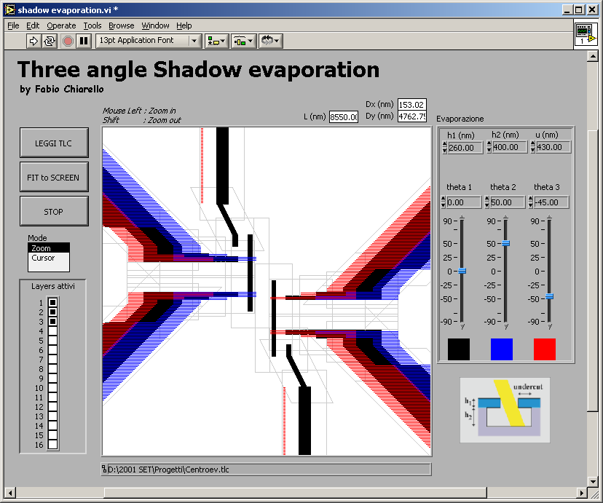
Design
500 nm

Slide 11
Thank you!
fabio.chiarello@ifn.cnr.it
francesco.mattioli@ifn.cnr.it
www.roma.ifn.cnr.it

