Slide 1
FOOT
Collaboration Meeting
Mechanical Layout
3rd Dec 2018

Slide 2
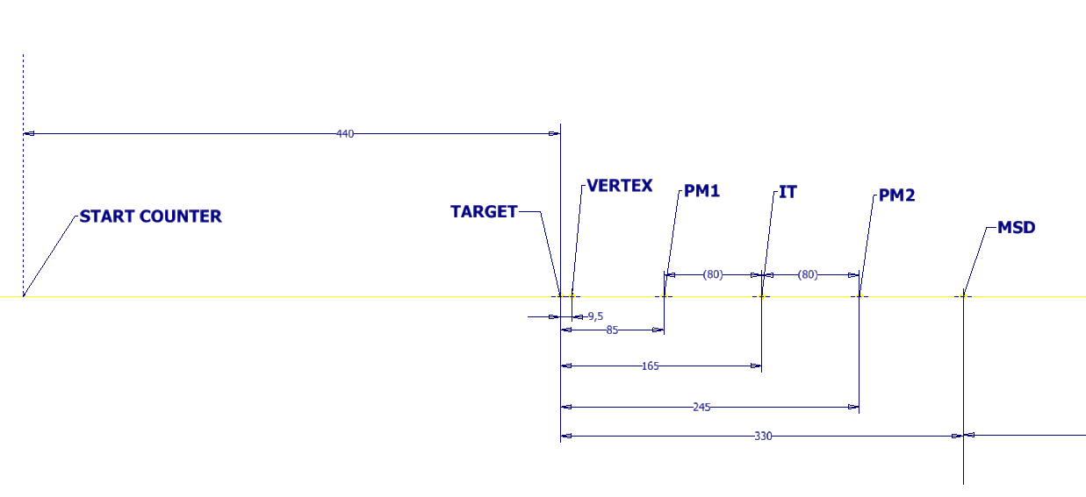
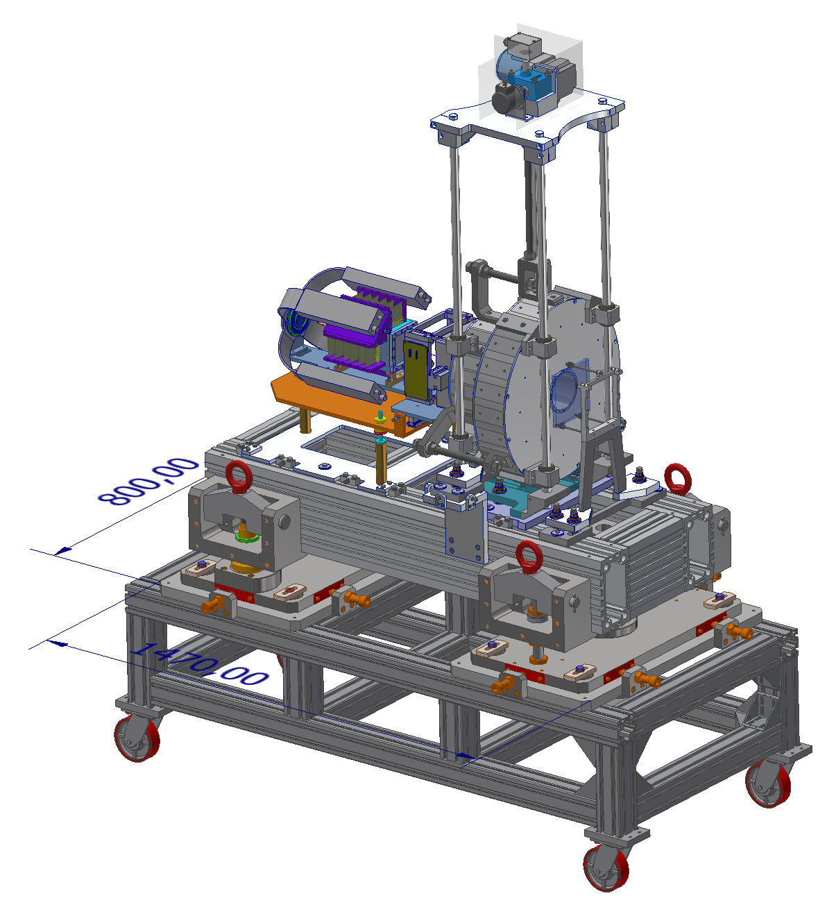
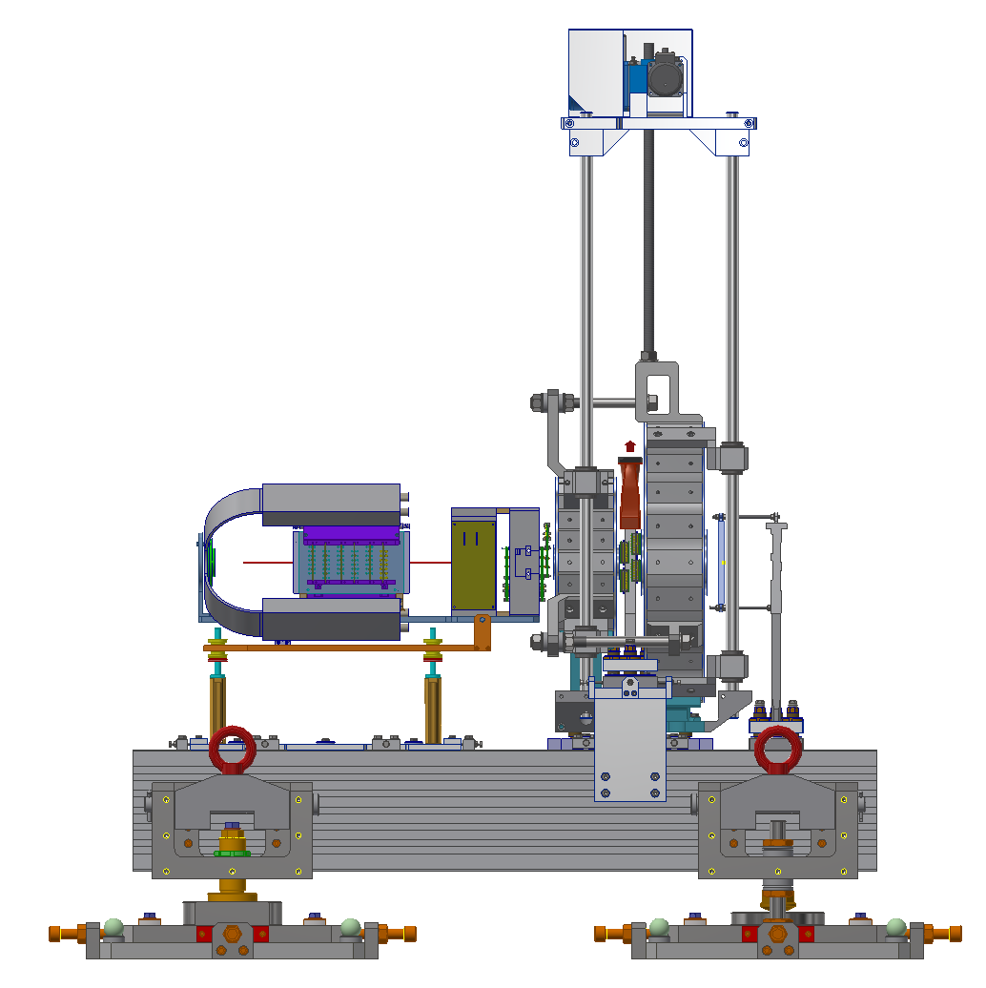
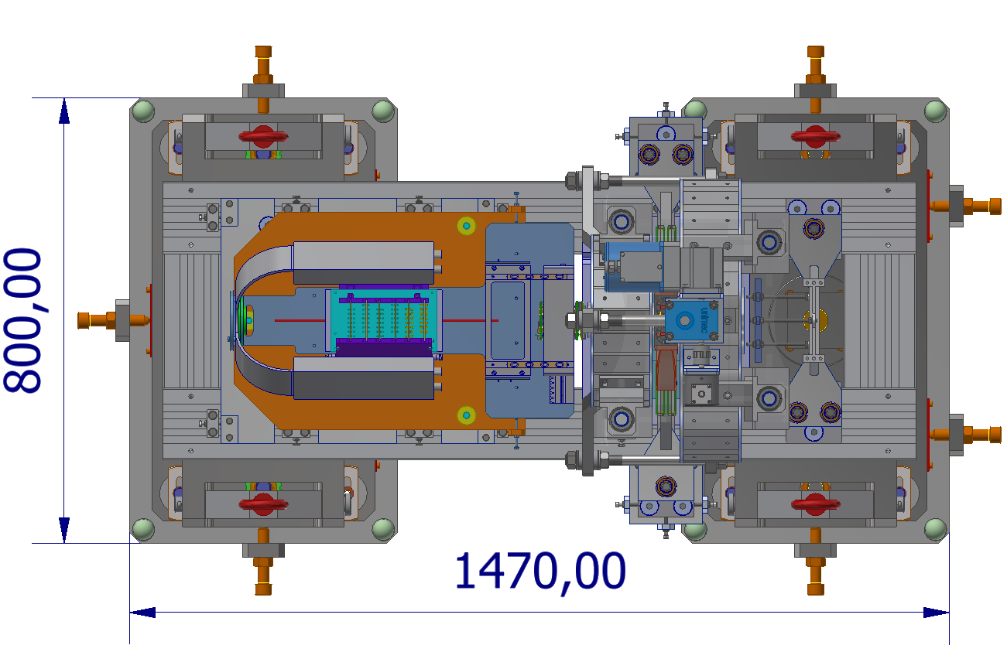
Mechanical Layout

Slide 3
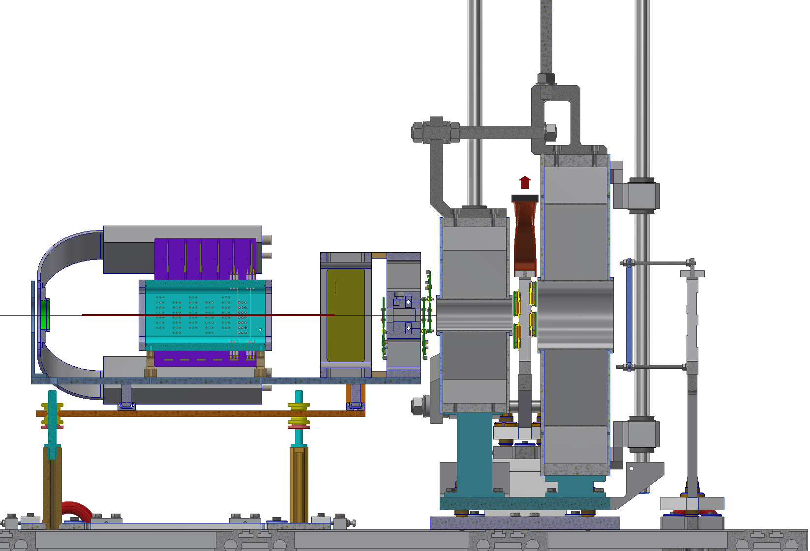
Mechanical Layout
 | Z [mm]
TARGET | 0
VERTEX | 9.5
PM1 | 85
IT | 165
PM2 | 245
MSD | 330
S. COUNTER | - 440
Vertex

Slide 4
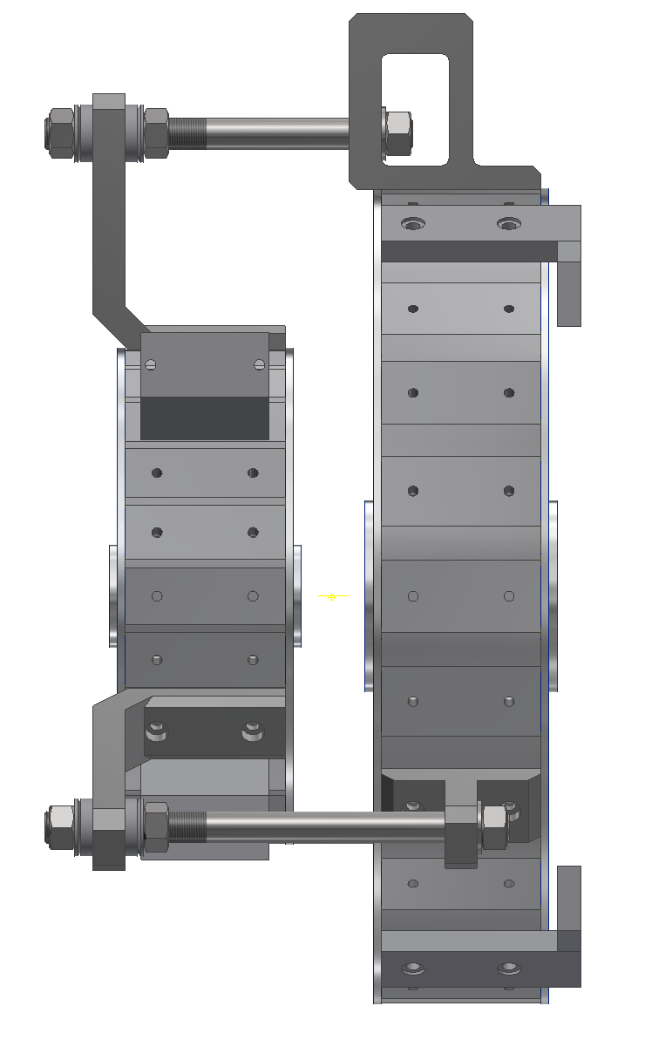
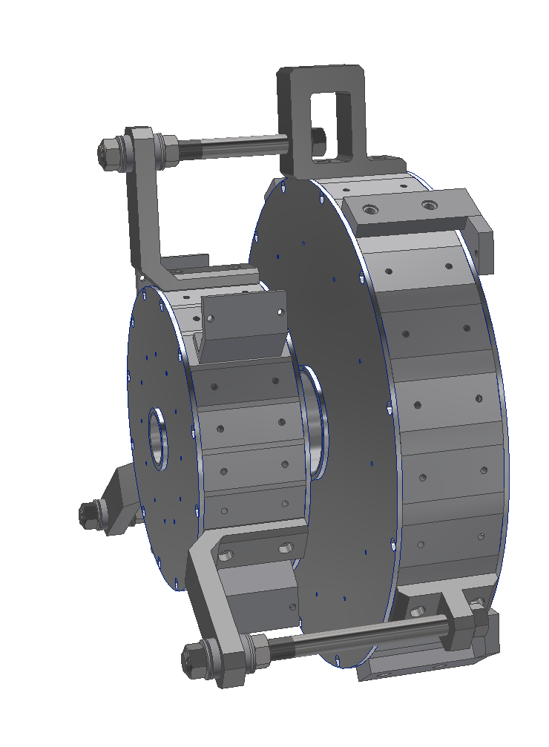
PM Dipole: assembly
Two Permanent Magnet Dipoles in one assembly to avoid handling issues (special toolings required for safe handling)
Repulsion force: 2000 N @ 50 mm gap
Weight: 180 kg
Magnetic field aligned at the vendor
Magnetic map to be checked
at LNF after delivery

Slide 5
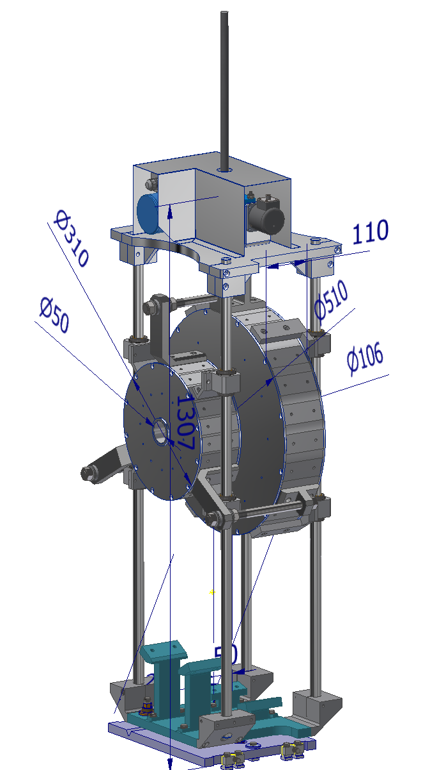
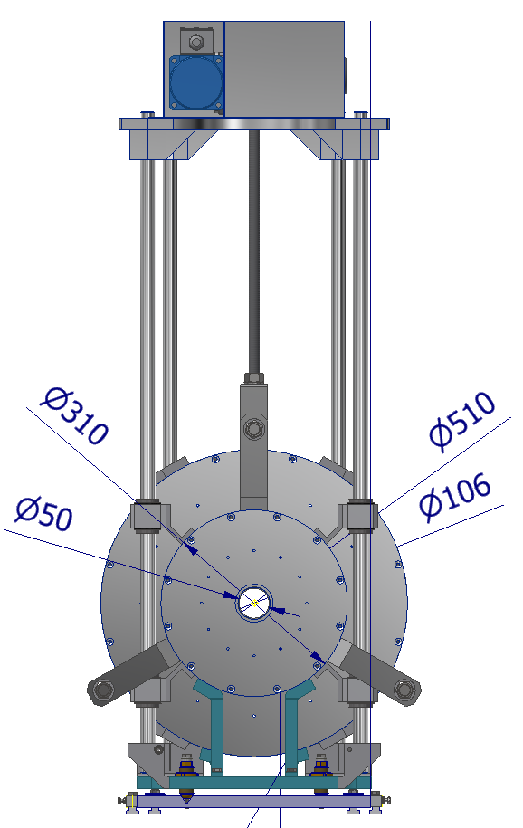
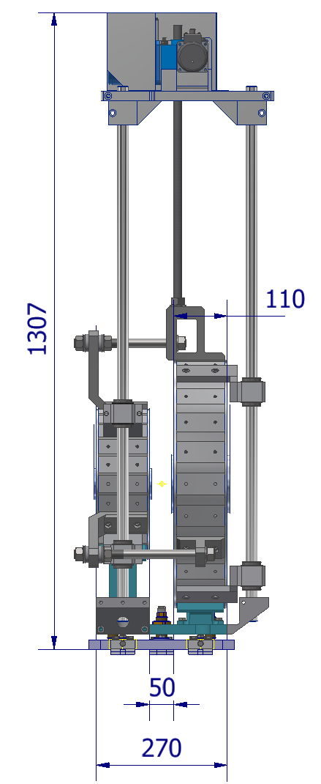
PM Dipole: support
Capability to vertically offset the assembly of about 400 mm

Slide 6
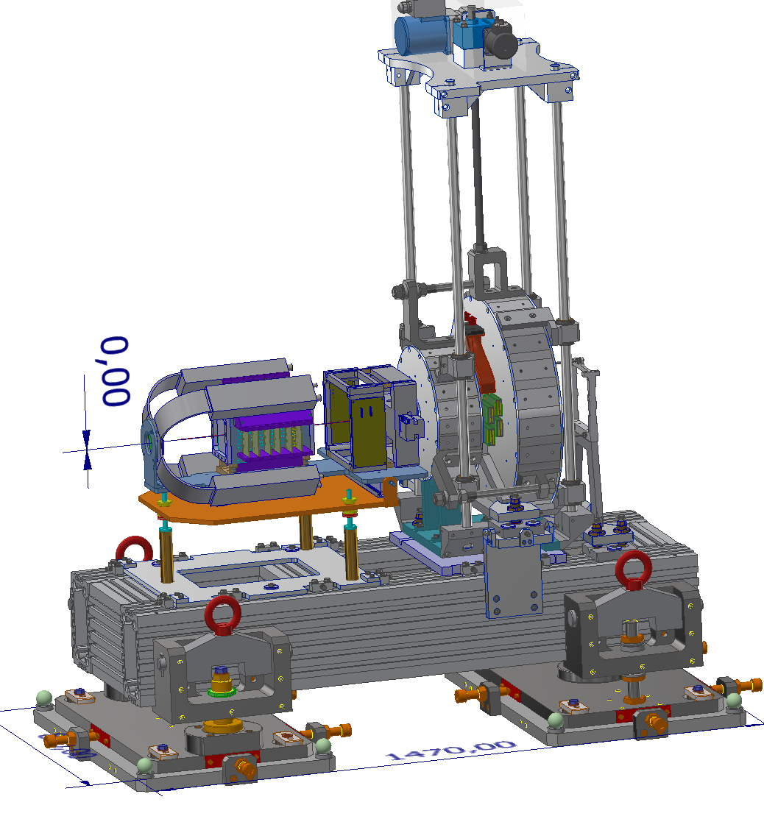
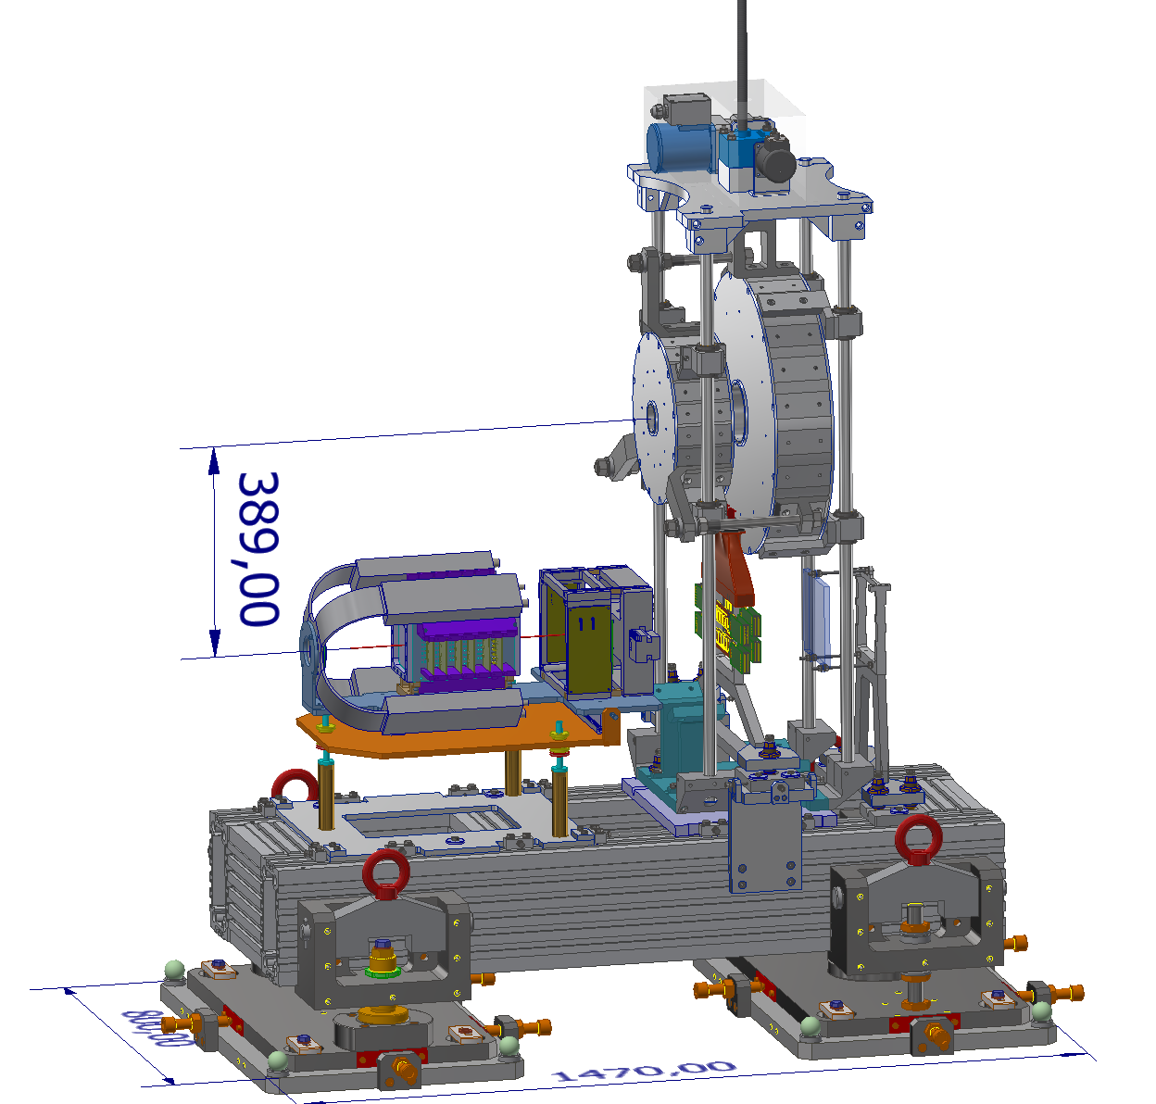
Calibration with straight tracks
Magnet offset compatible with detector cabling

Slide 7
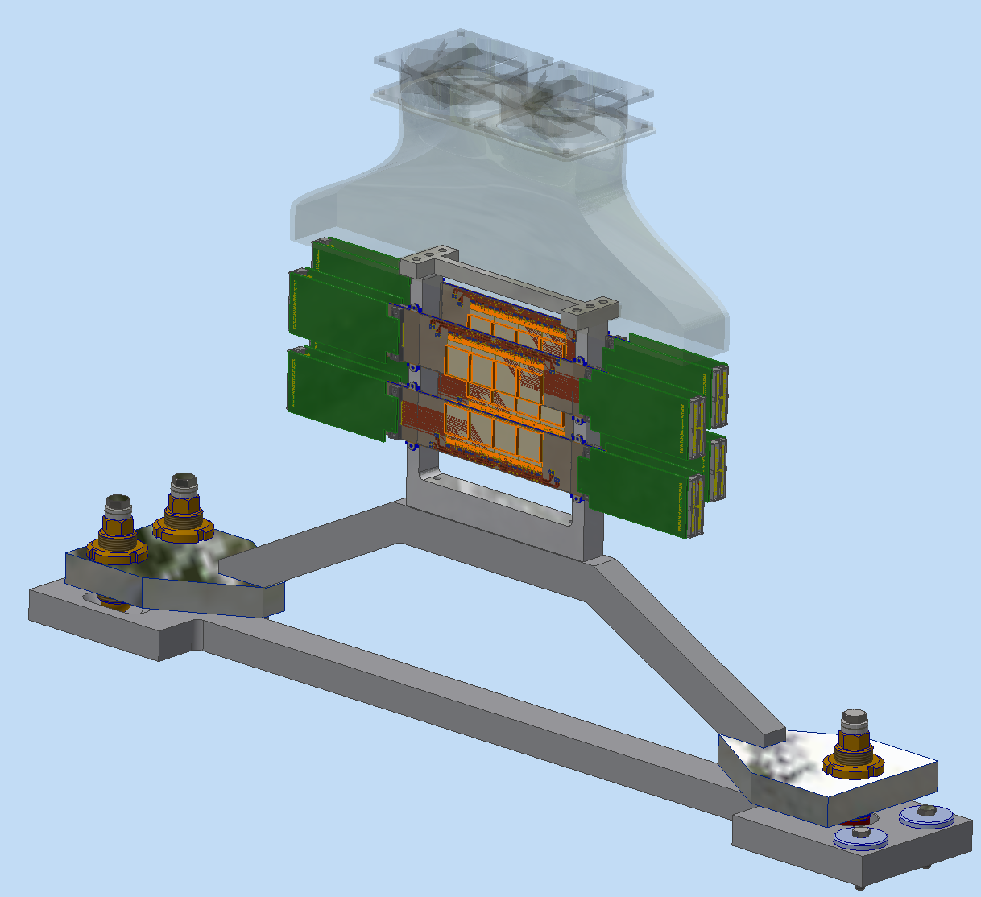
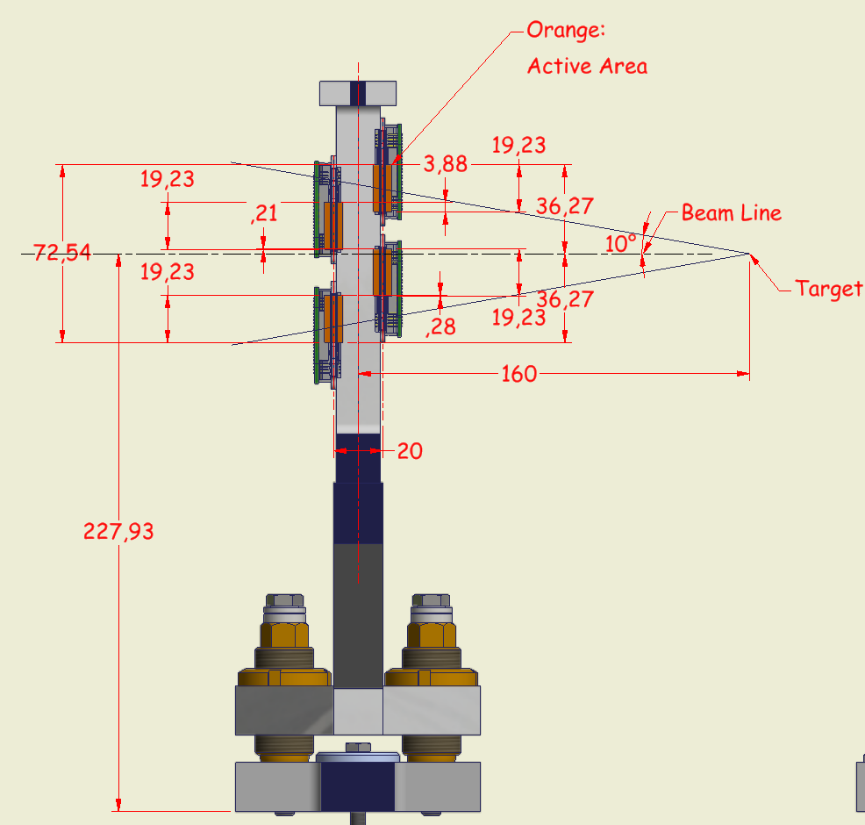
IT 1/2

Slide 8
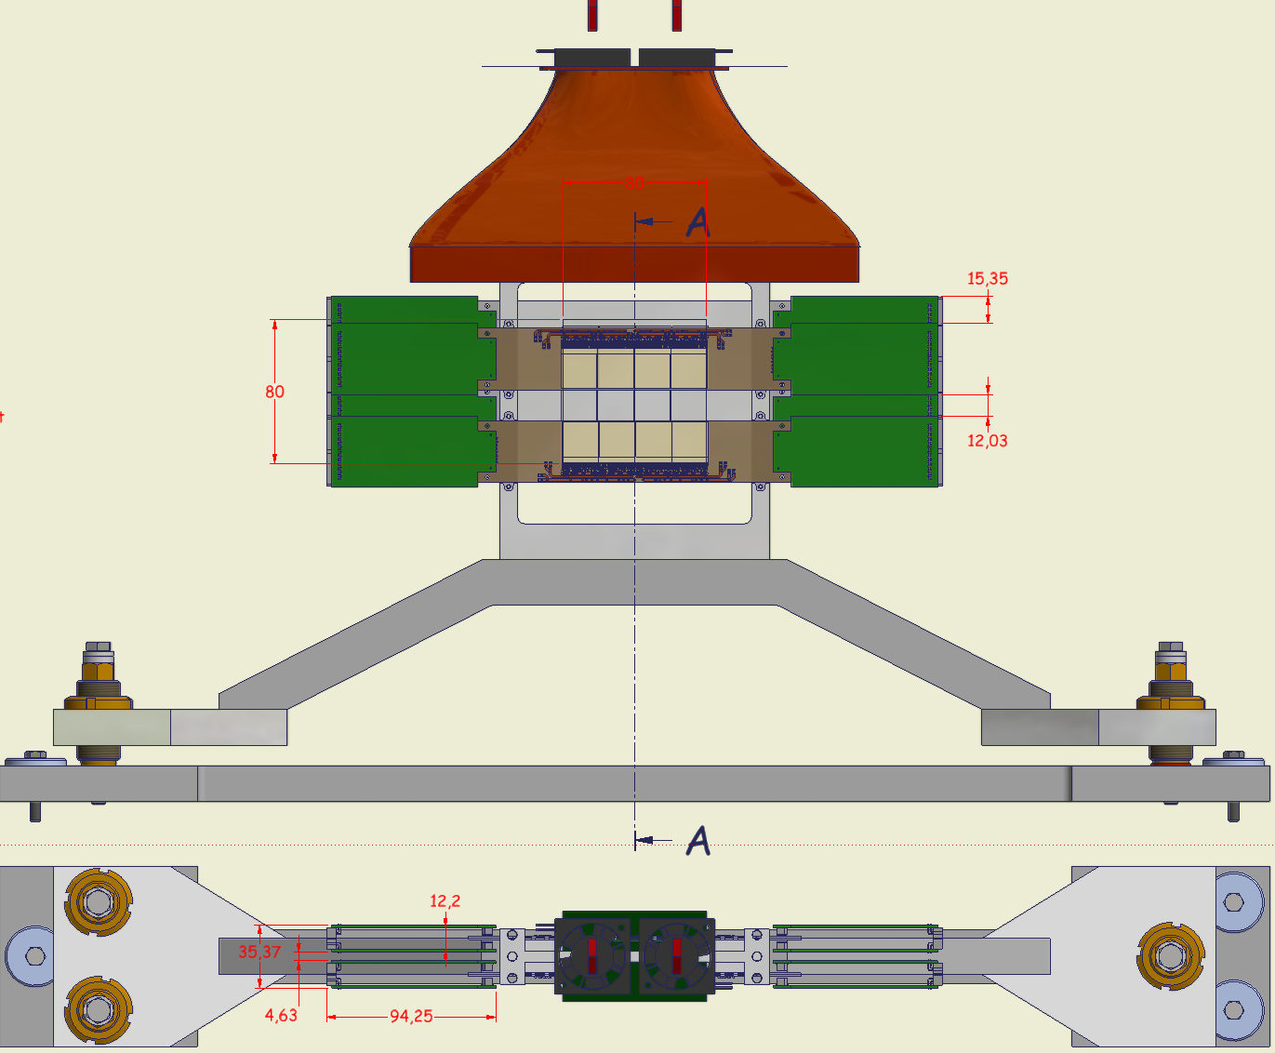
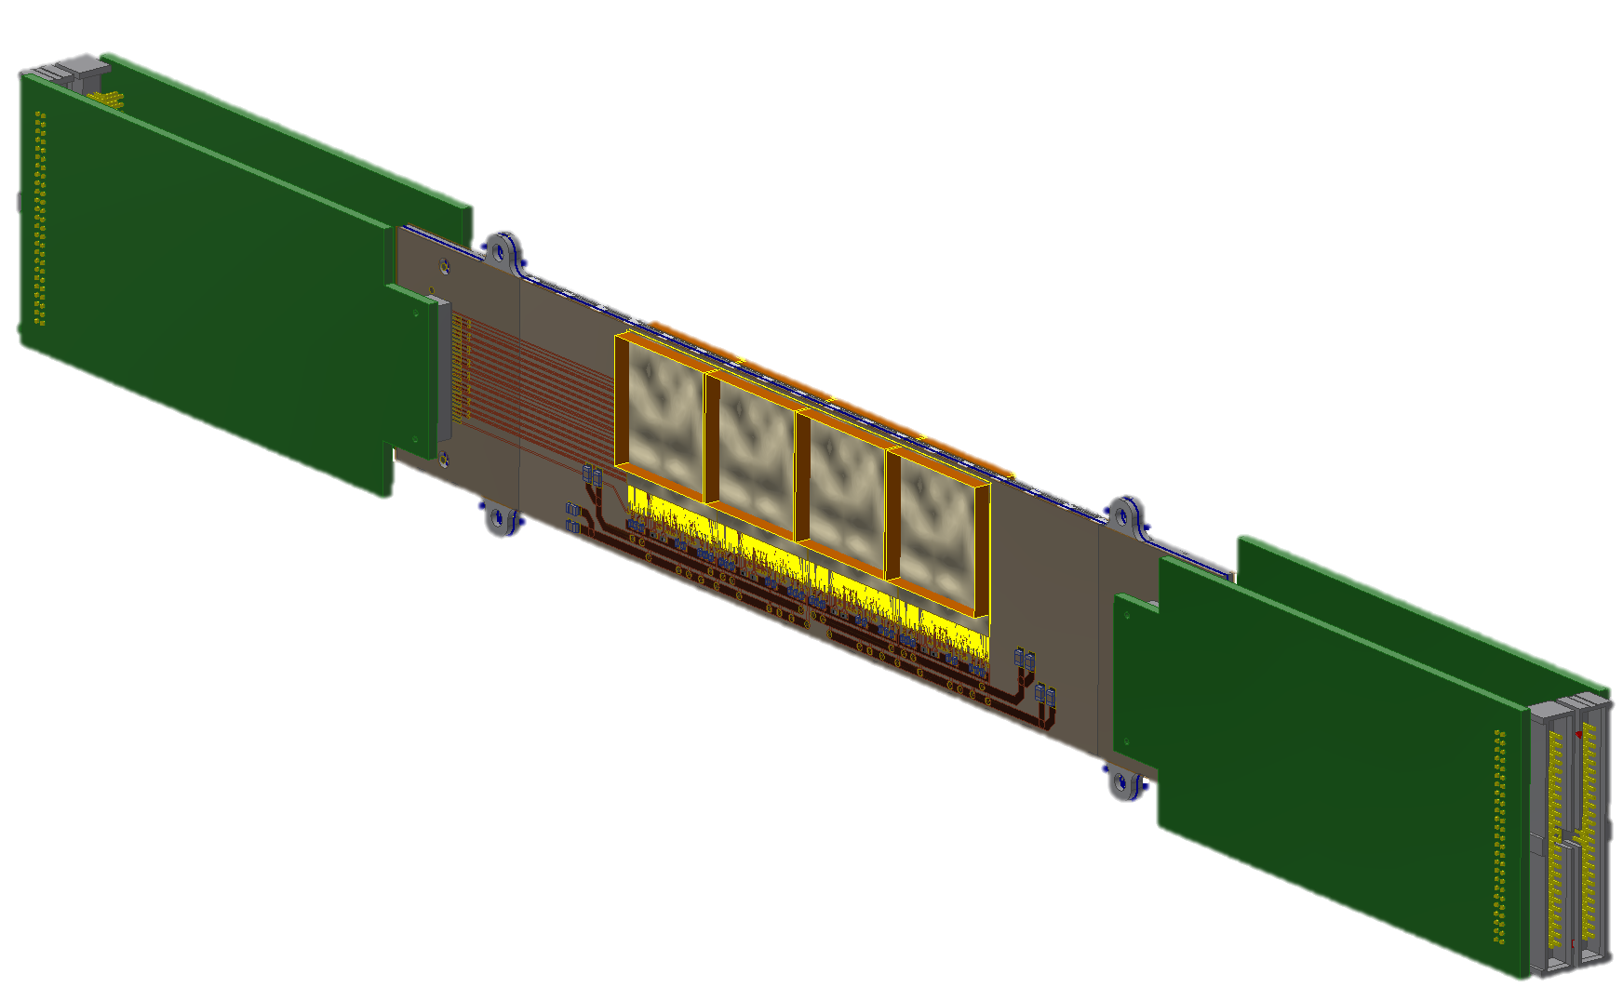
IT 2/2
Ladder

Slide 9
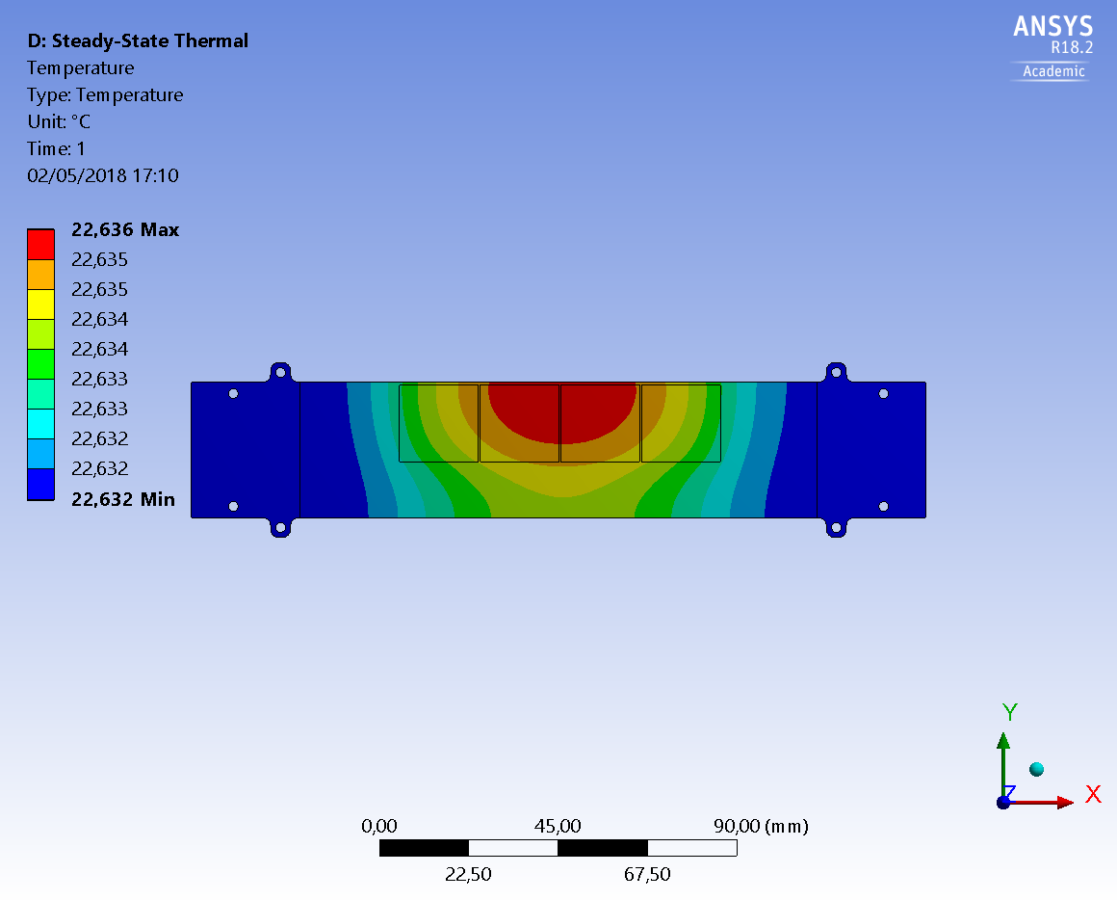
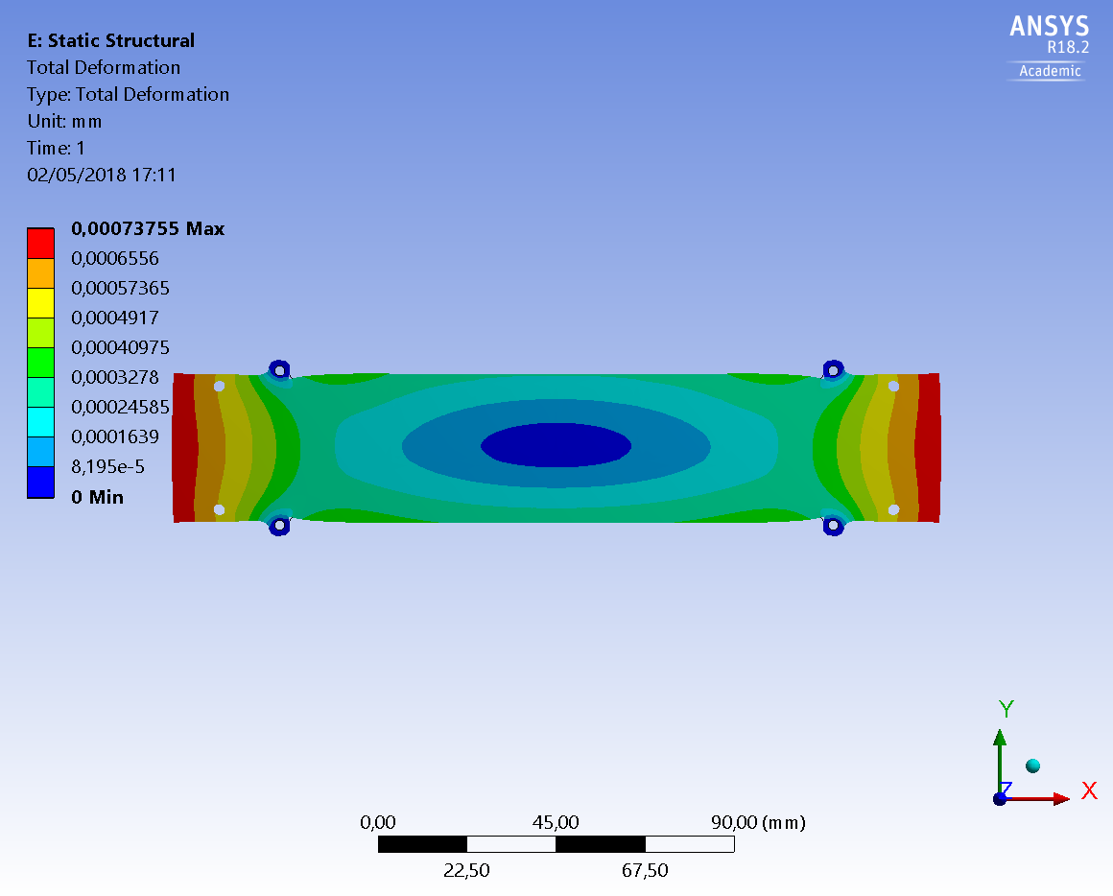
IT: FEA Preliminary
P=0.7 W / Sensor
h= 1 W/m^2 K (Natural Convection)
Room Temp= 22 °C
ΔT max= 0.6 °C
ΔL max= 0.8 µm
Results are conservative because:
No radiation
No forced convection
No conduction

Slide 10
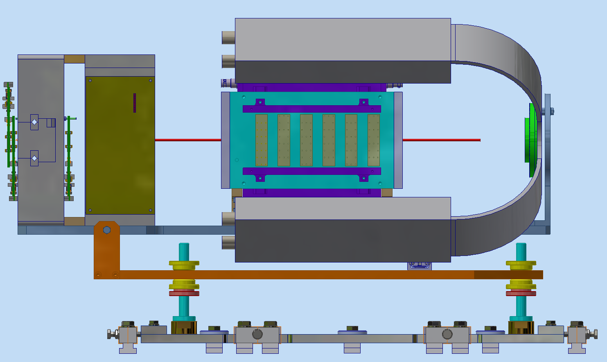
Drift chamber / Start counter
MIMOSA

Slide 11
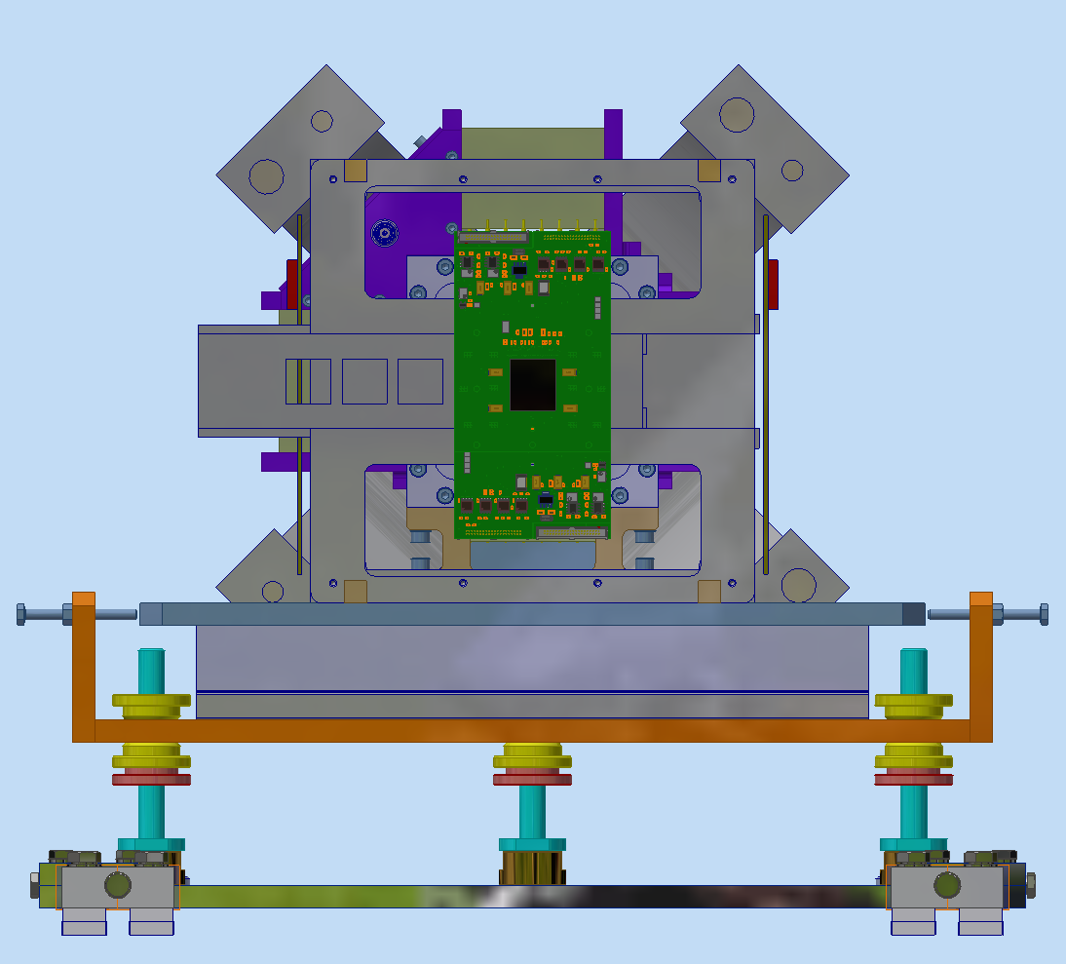
Drift chamber / Start counter

Slide 12
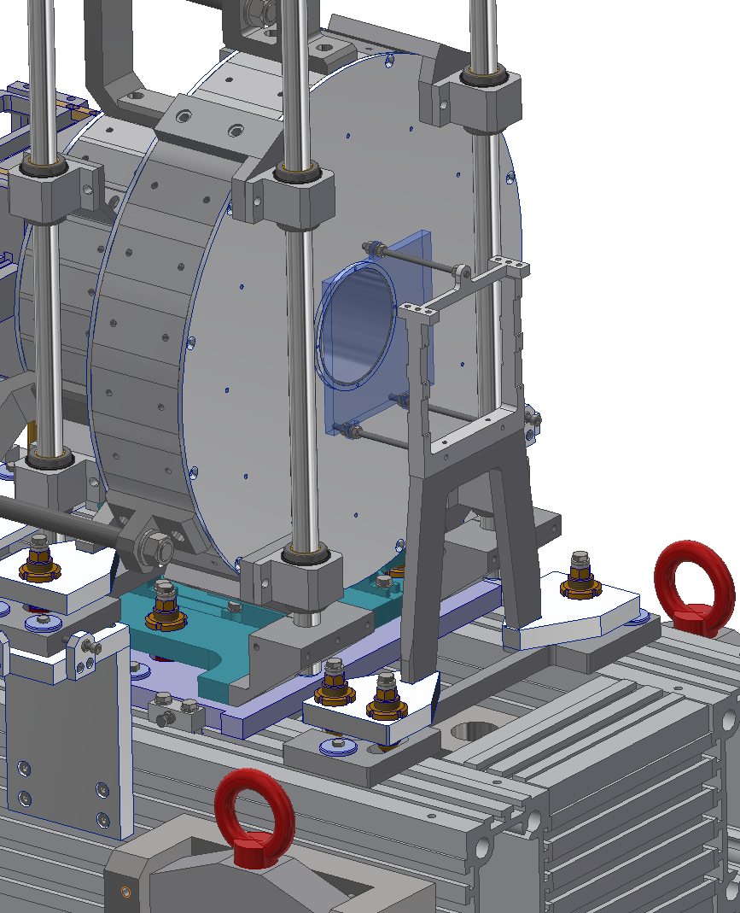
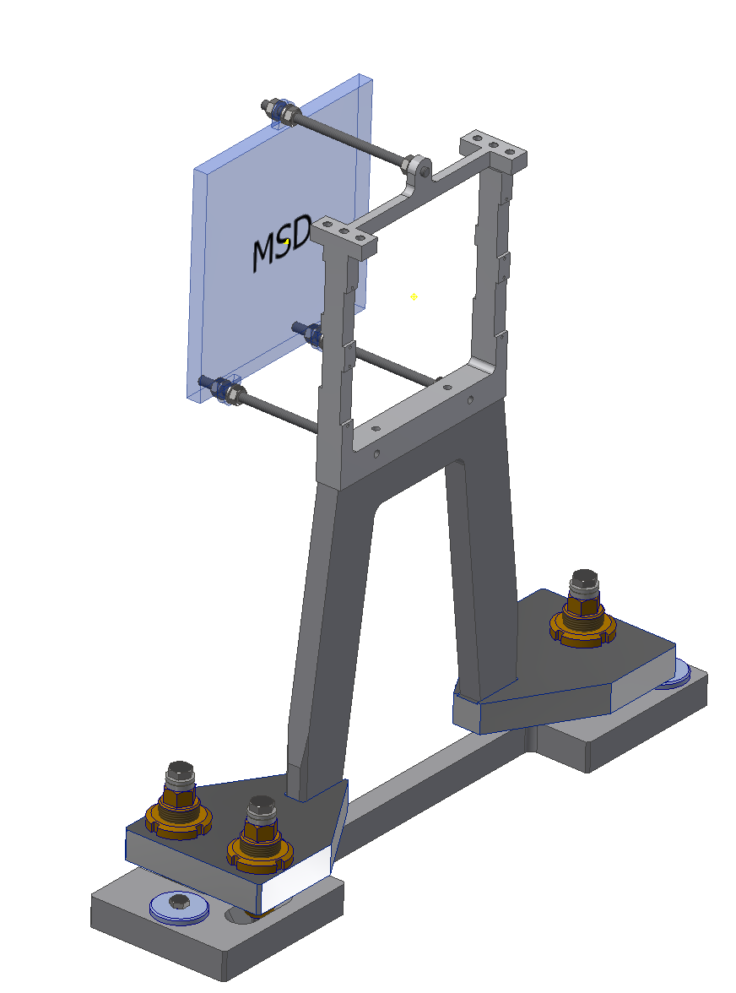
MSD: envelope
150x150x10 mm
Cables

Slide 13
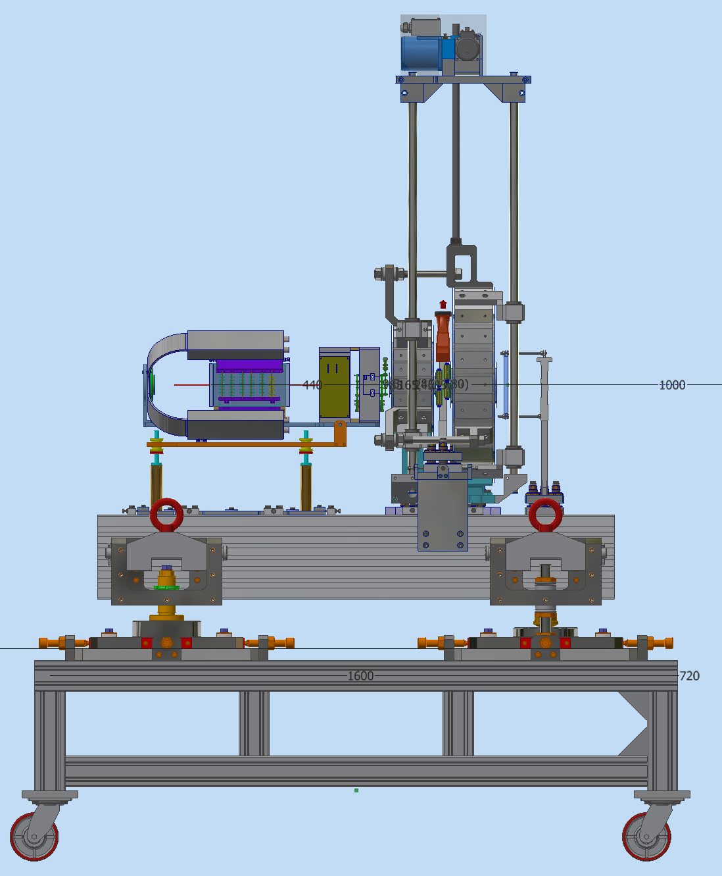
BEAM LINE: FLOOR HEIGHT
1200?
CNAO
1200?
GSI
1300
MAX
1200
BTF
1000
MIN
FLOOR
Manual Jacks to match the beam height in different sites

