Slide 1

BTF/LINAC upgrade status
P. Valente
Acc. Div. Meeting, 14 Dec. 2018
Update since Oct. 15
Plans for BTF-2 installation and commissiong
PADME run status
More future activities

Slide 2
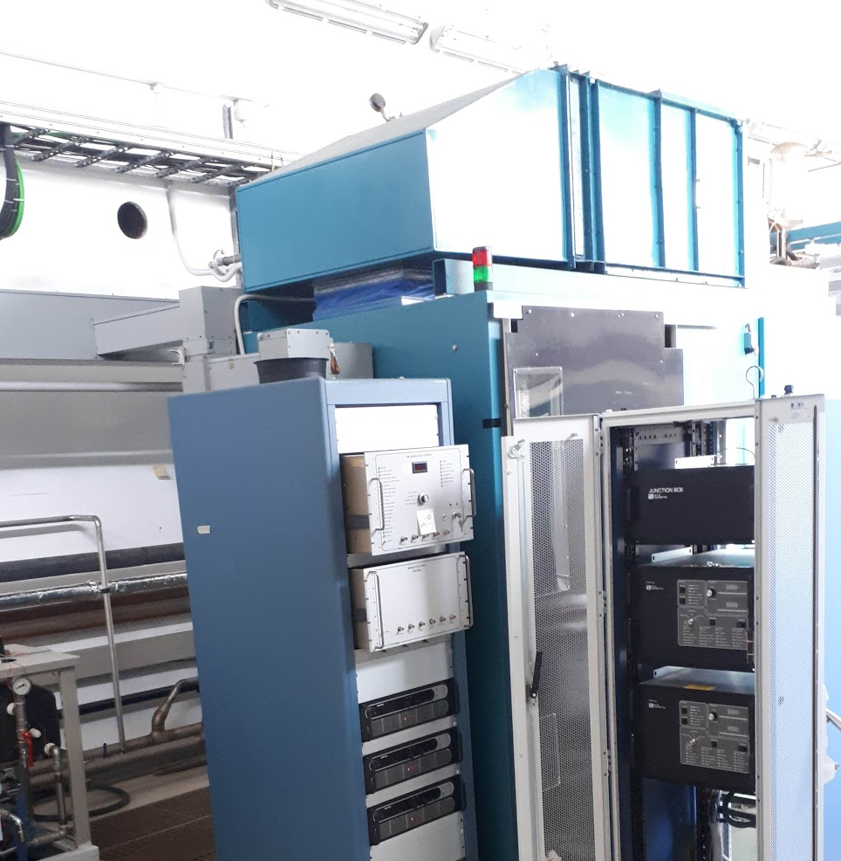
Modulators upgrade

Slide 3
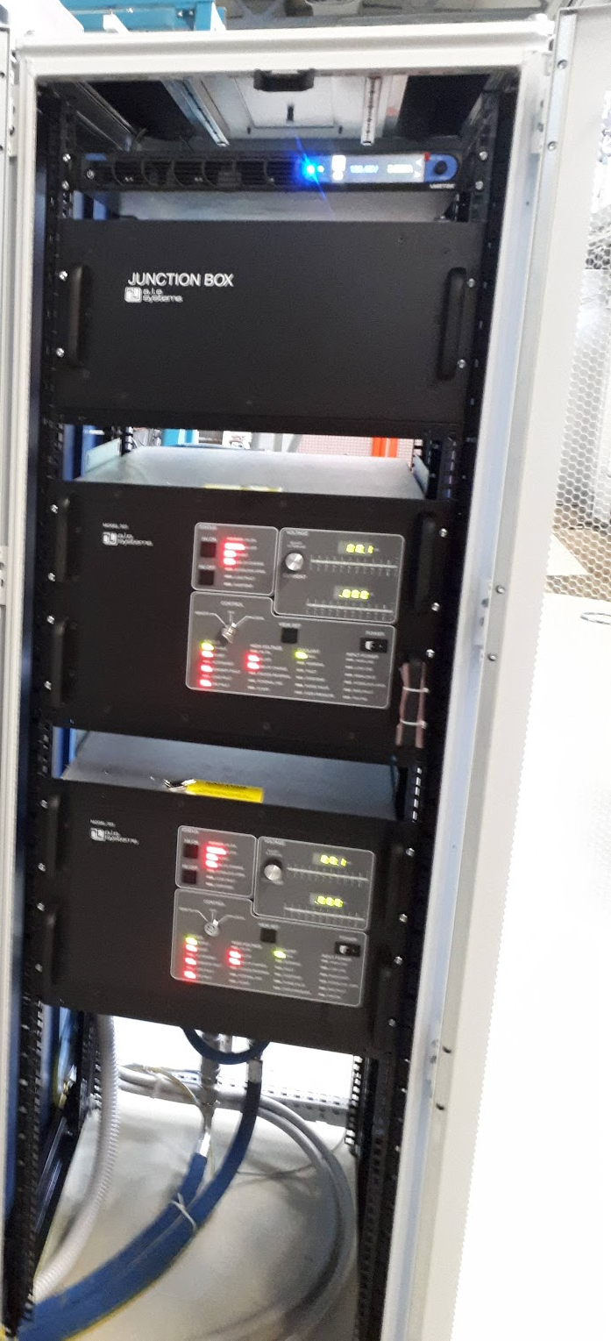
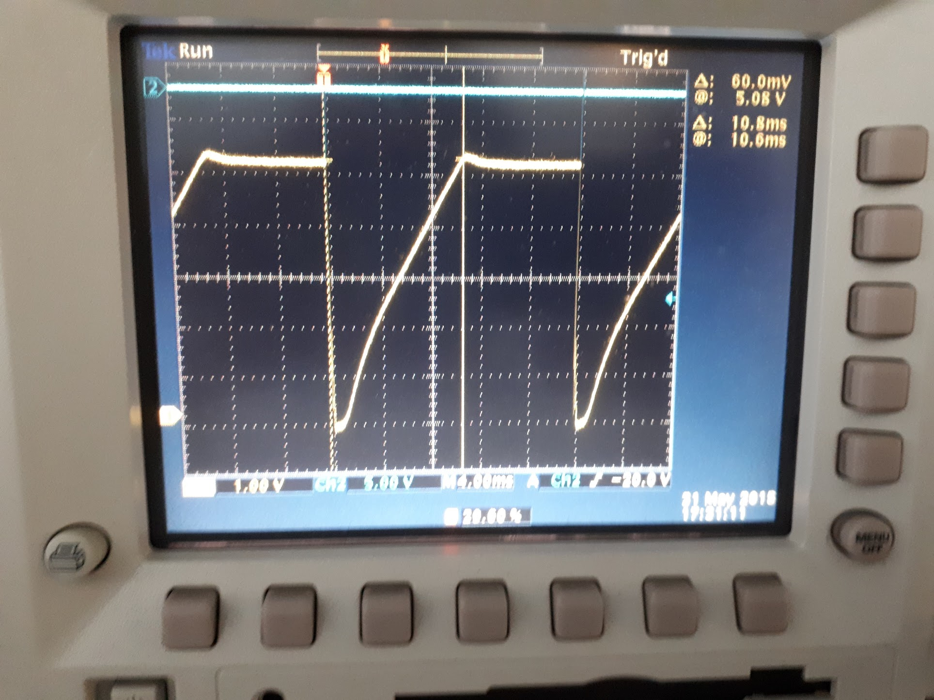
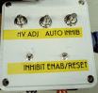

Modulators upgrade: PFN charging supplies
New filament power supply
New TDK-Lambda
junction box
and charging power supplies
PFN Charging Time 10 ms, 40kV $→$ 320A
Self-made cooling system
Test of Simulated Remote control and local control

Slide 4
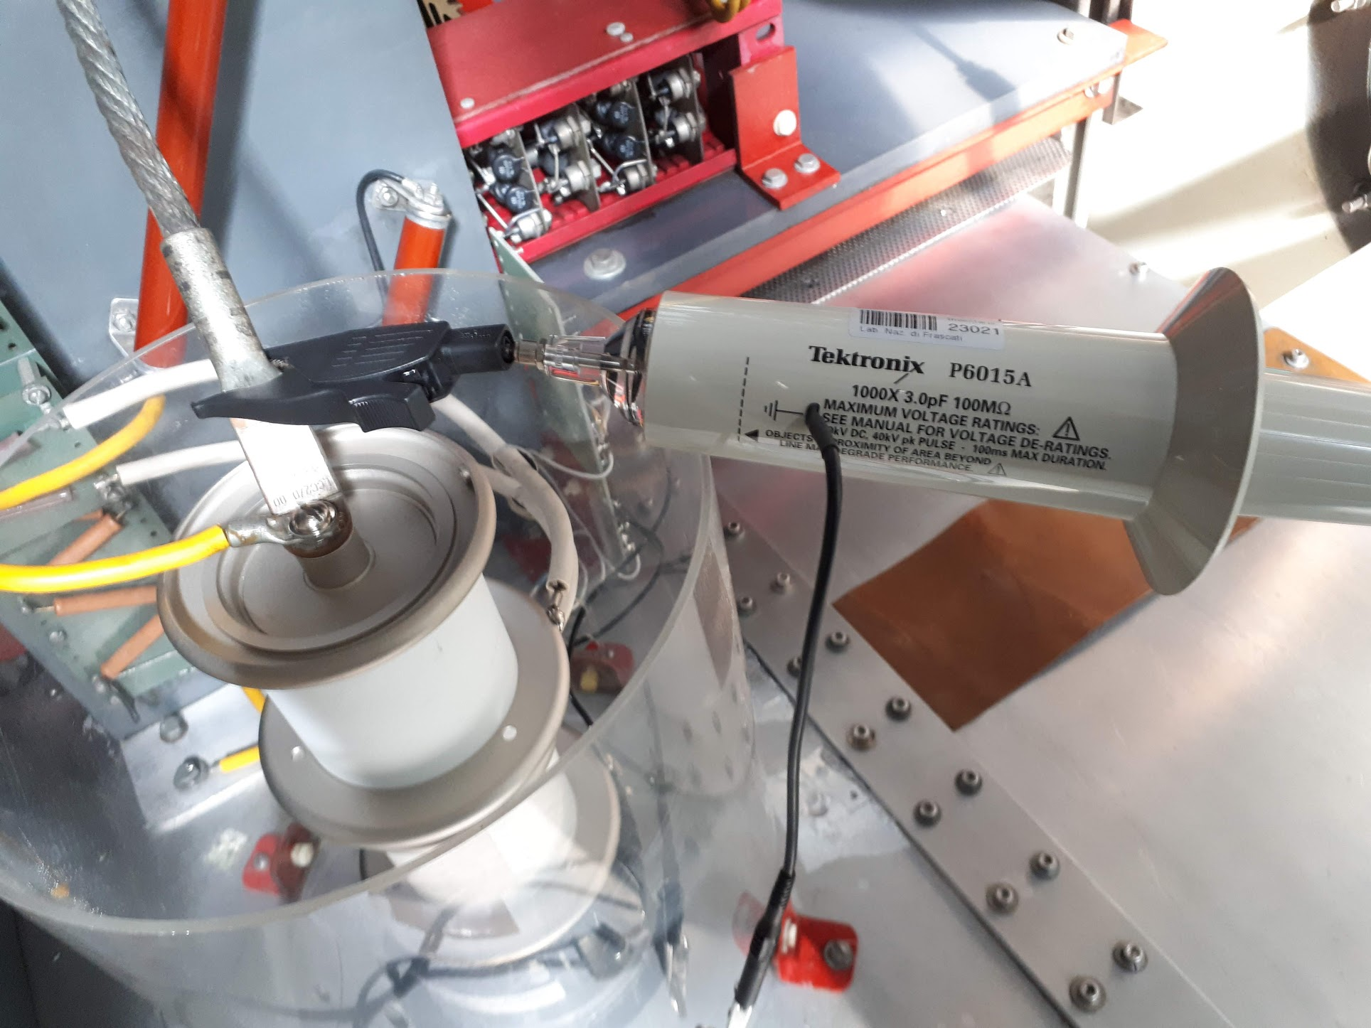
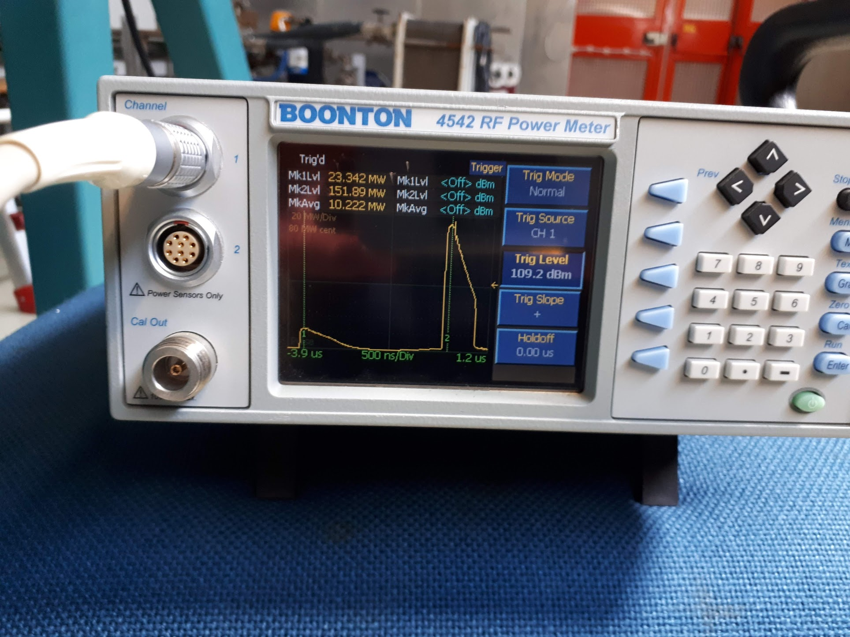
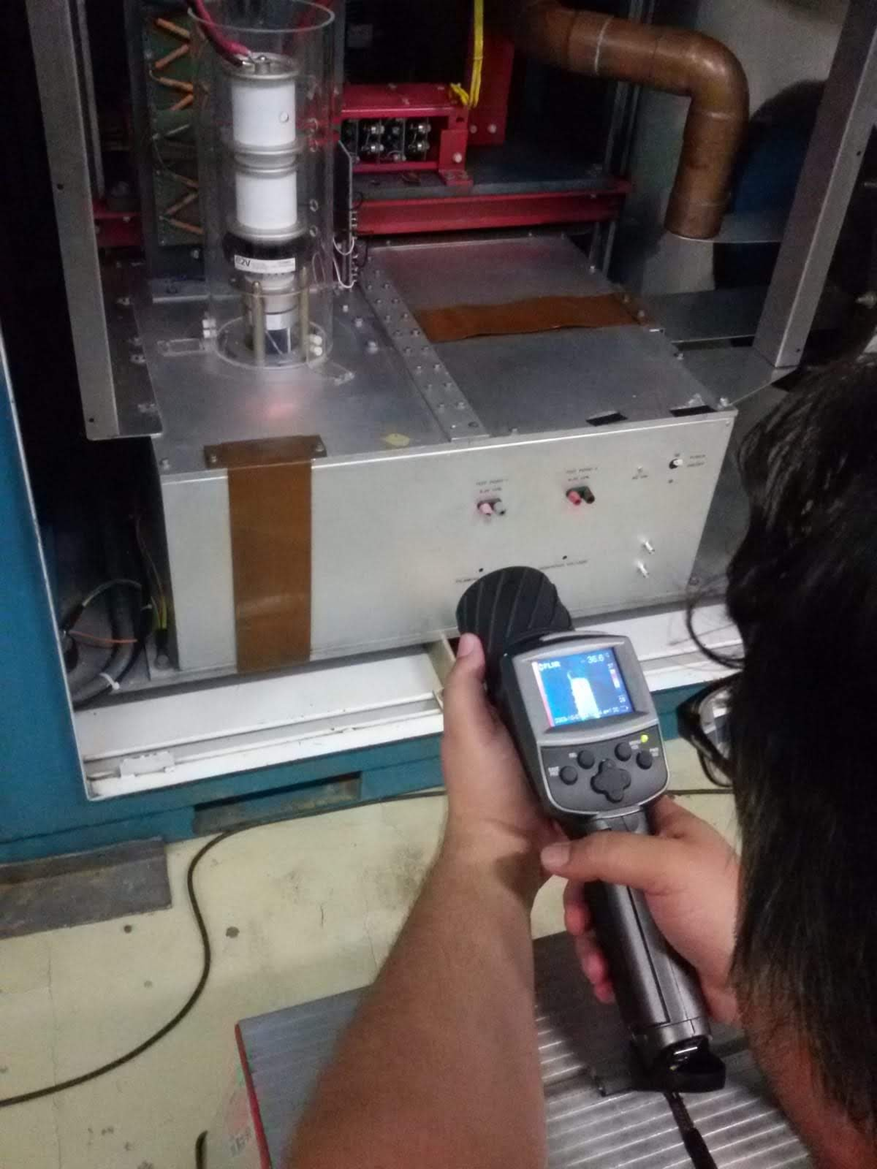
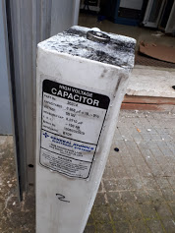
Modulators upgrade: PFN charging supplies
New TDK-Lambda power supplies tests OK
(Mod. D)
Up to 150 MW at SLED output
New Thyratron setup
(Mod. B)
Faulty capacitors
(Mod. D and C)

Slide 5
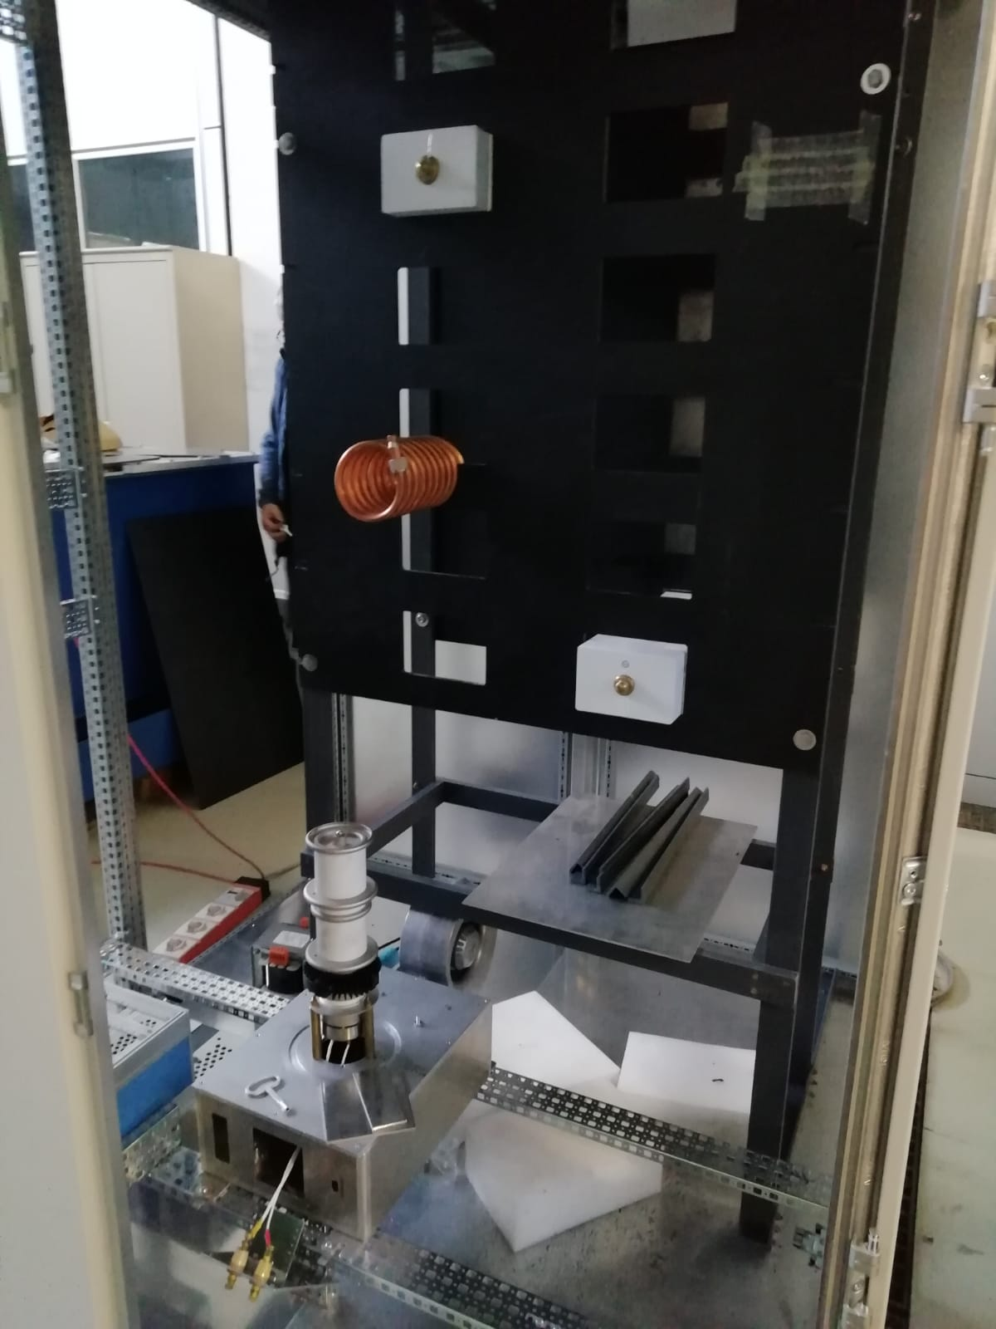
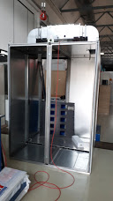
New modulator construction ongoing

Slide 6
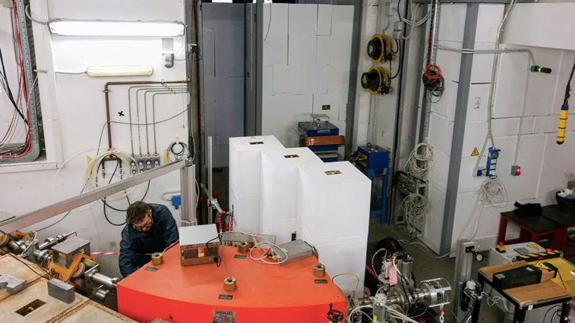
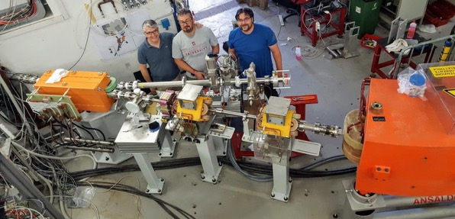
BTF line splitting

Slide 7
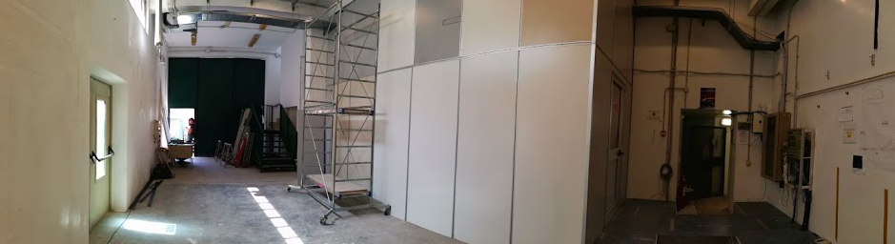
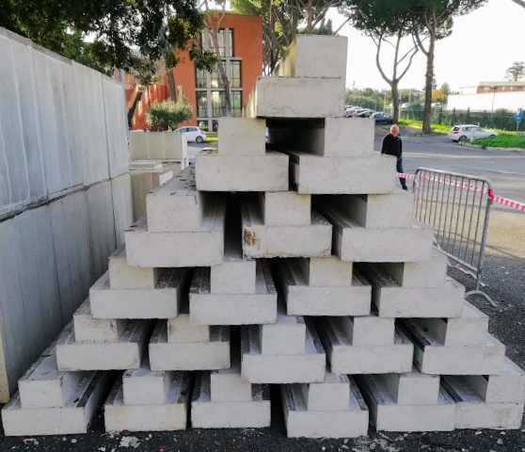
Experimental hall 2 – new bunker
All concrete blocks delivered
Lateral shielding installed
Bins to be tested under load (January)
Bunker to be completed (January)

Slide 8
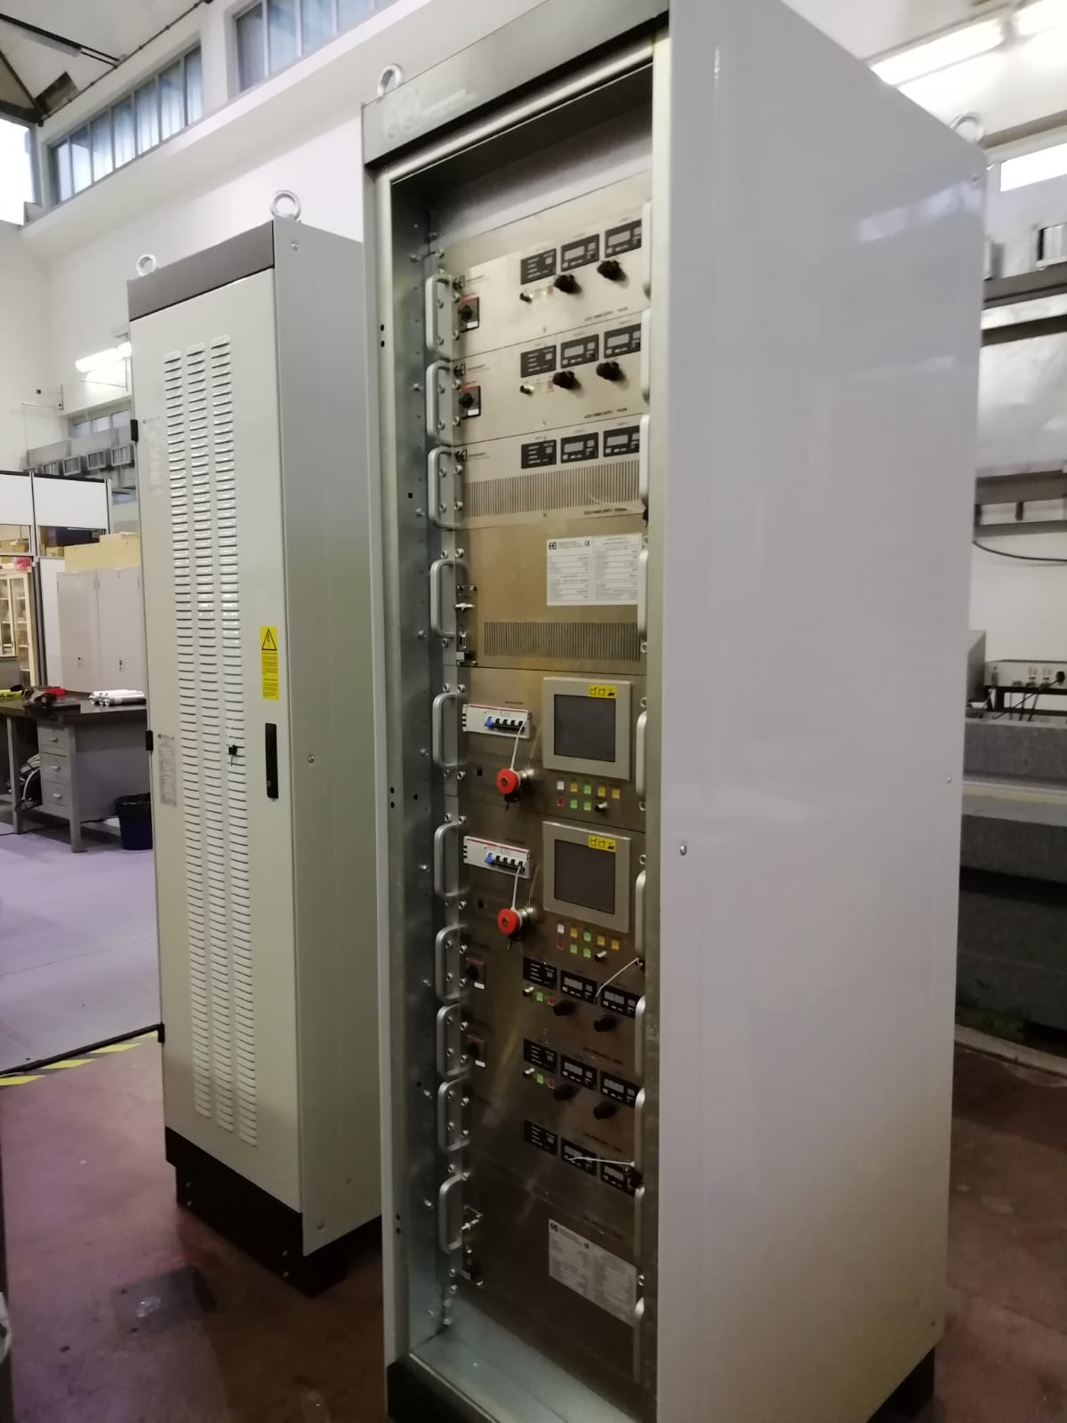
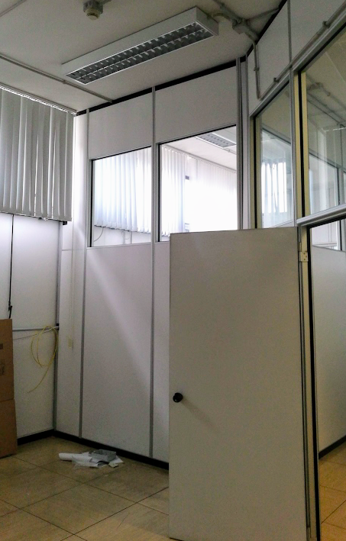
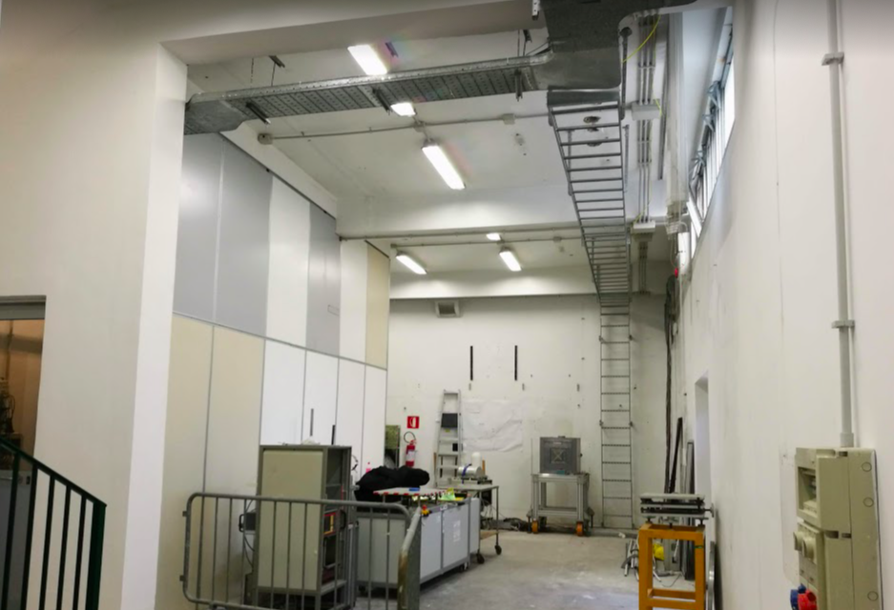
Power supplies
New BTF PS room
  Room 17 and 18 available
  Electricity, conditioning and cooling preparation starting from Dec. 20 (Christmas stop for LINAC/PADME)
  Cable tray ready
  Power cables to be laid down during shutdown
Power supplies
  All power supplies of new magnets delivered yesterday
  Now at MEA
  Quadrupoles PS to be installed in one of our racks
  DHPTB102/DCSTB200 rack to be moved in the new BTF PS room in January
Control test program available
  SAT tests as soon as connected to load

Slide 9
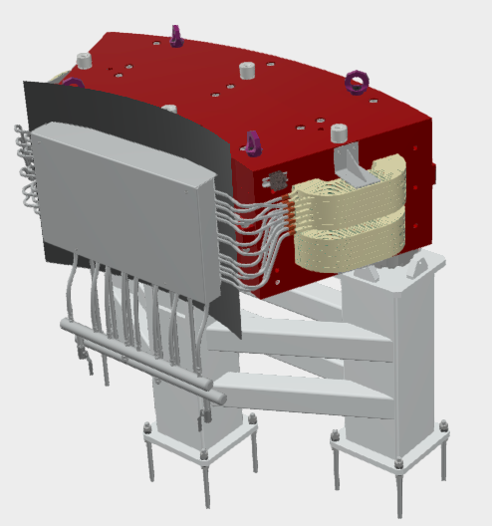
New magnets

Slide 10
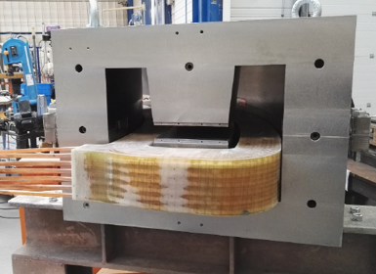
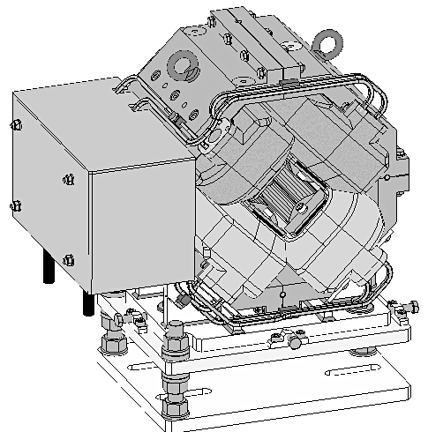
Construction drawing
Sigmaphi has practically completed the construction of DH dipoles
  Working on manifolds
  Delivery expected in January
Delivery of new quadrupoles due in February

Slide 11
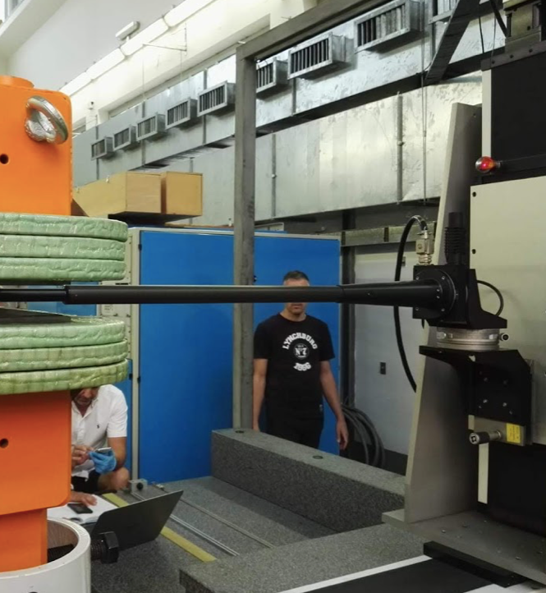
To do list: new magnets
Magnetic field characterization of:
  2 DC dipoles (delivery Jan. 2019)
  7 quadrupoles (delivery Feb. 2019)

Slide 12
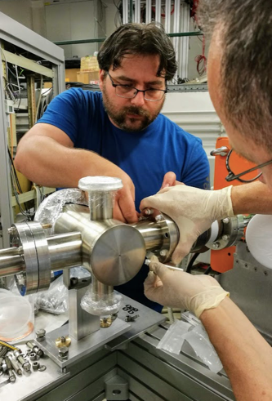
BTF-2 installation

Slide 13
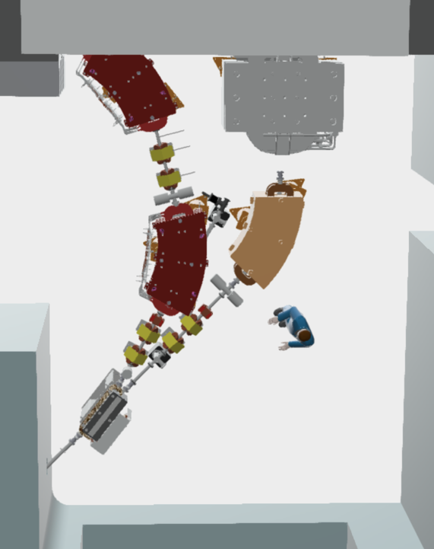
To do list
New cooling plant
  Not ready (Order issued)
  Some power can be added using the existing (revised) circuit
  External work can be done with BTF in operation
  Final connection of water pipes requires the facility to be stopped (for a few days)
Installation and alignment of:
  Supports
  2 DC dipoles
  6 quadrupoles
Vacuum
  Pipes (Order issued)
  Valves and pumps
  Scrapers: delivered, being tested
Cabling:
  Power cables, control cables available in Jan. ‘19.
  New iron staircase for passing over the beam-lines: to be designed and ordered
All components should be ready for installation by Mar. 2019
  Time set by the end of PADME run/beginning of DAFNE recommissioning
  Switch on DHPTB102 as soon as possible, validate beam-splitting scheme and timing modifications
  This would allow driving the beam on BTF-2, at least up to the first DH dipole
2-way pipes for DHSTB201 and DHSTB202:
3D designed finalized in May
Detailed drawings to be done

Slide 14
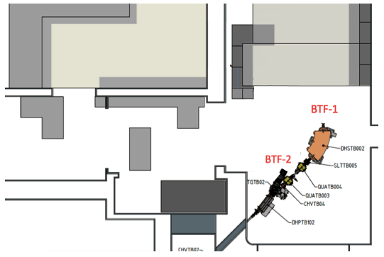
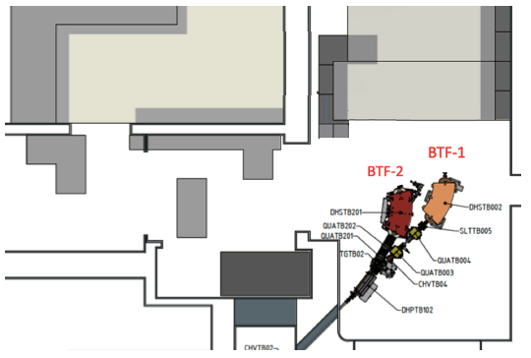
Open points
Dis-installation procedure of PADME setup, without and with BTF-2 beam-line has to be studied
Authorization for beam in the BTF-2 branch needed also for the commissioning of the partial line staying inside BTF-EH1;
  At least it has to be cleared by RPO (EQ)
  This, together with the PADME setup dis-installation, sets the time scale for re-opening the BTF to the standard users
Option B would drive the beam practically with the same dump configuration as in the original BTF authorization
A: partial BTF-2 installation (now)
B: partial BTF-2 installation with one DH only

Slide 15
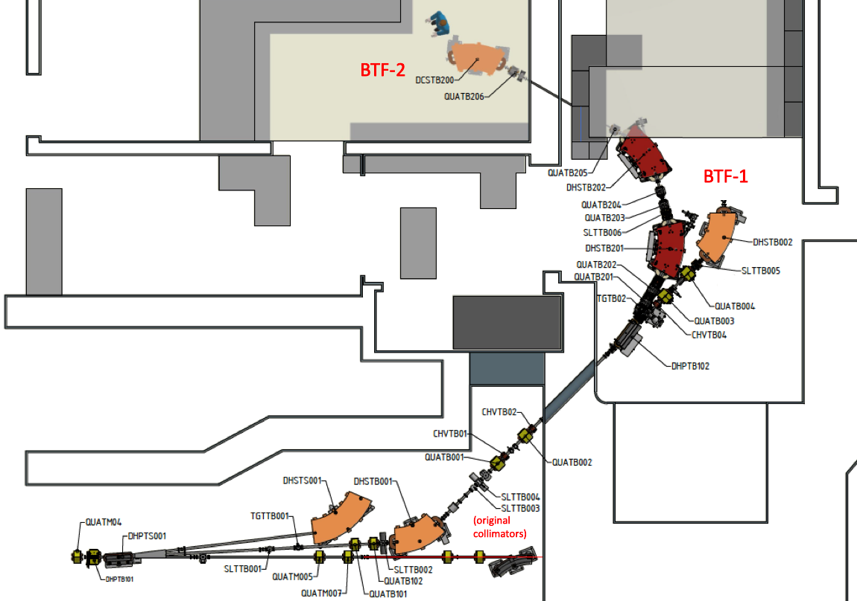

Slide 16
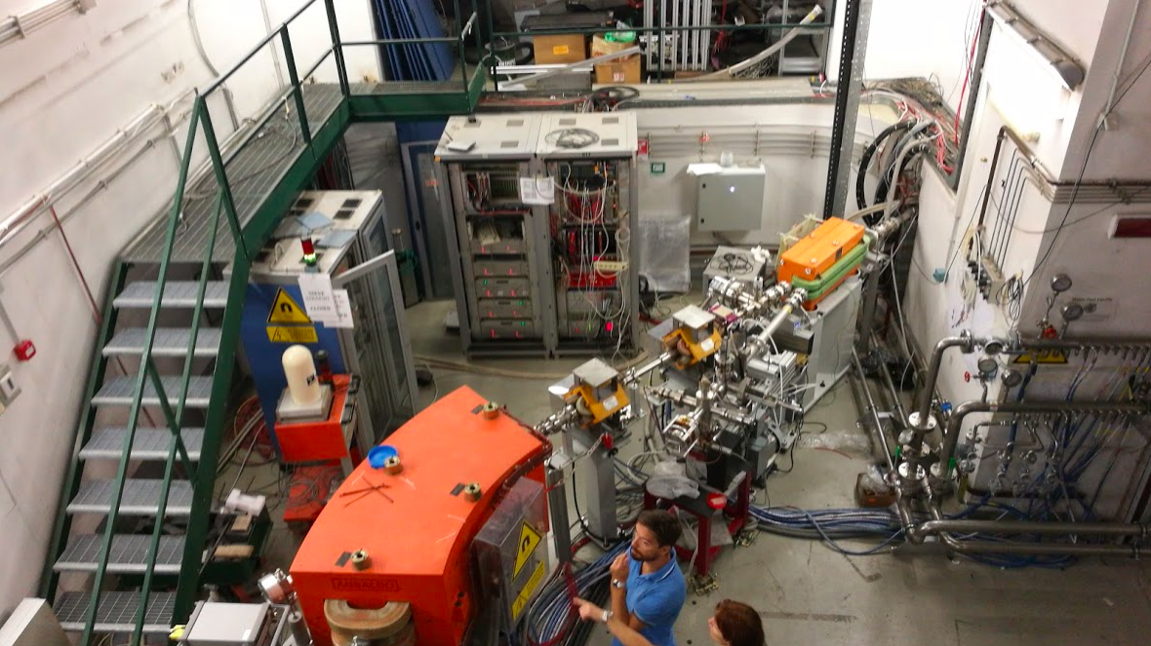

Slide 17
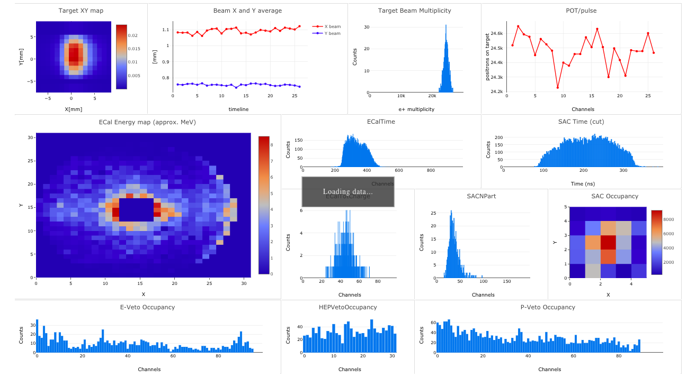
PADME run status

Slide 18
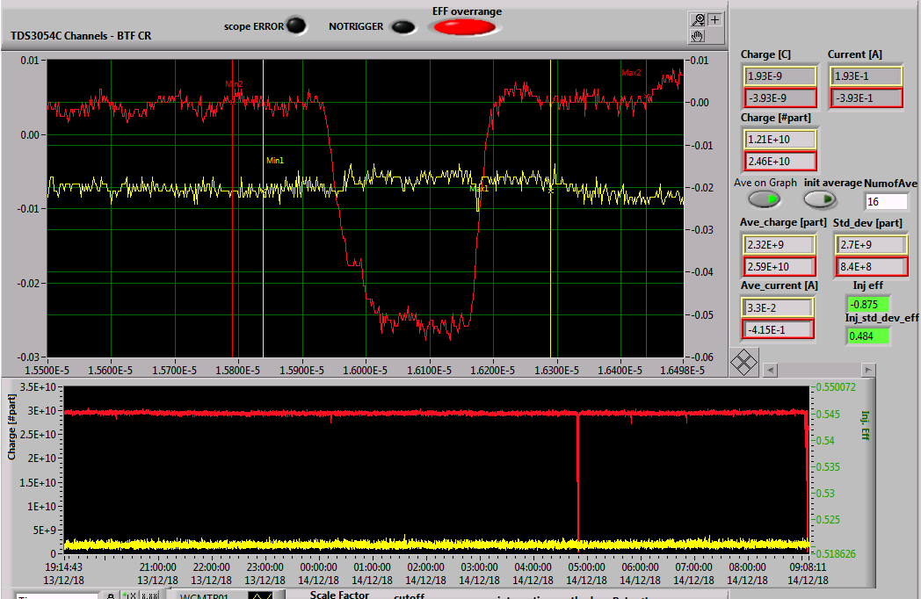
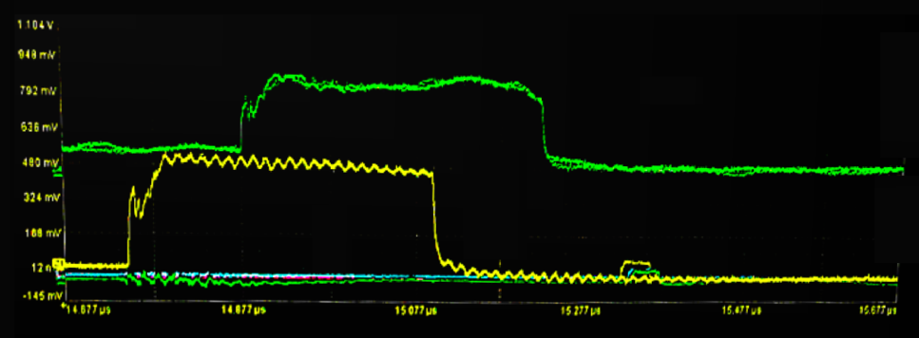
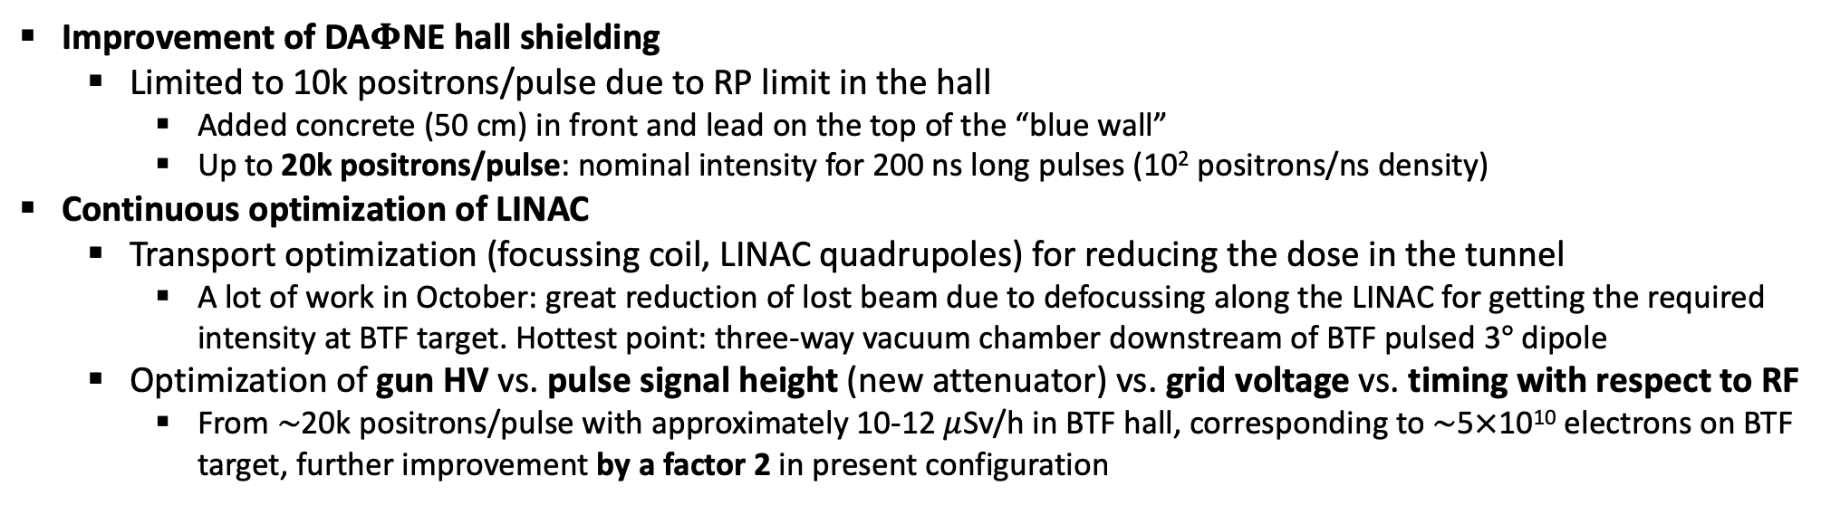
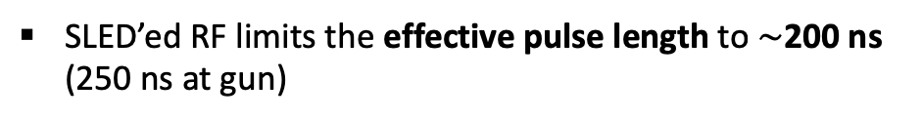
Long beam-pulse optimization
At LINAC end
At gun exit
At BTF target
SLED’ed RF limits the effective pulse length to $\sim$200 ns (250 ns at gun)
Improvement of DA$Φ$NE hall shielding
  Limited to 10k positrons/pulse due to RP limit in the hall
    Added concrete (50 cm) in front and lead on the top of the “blue wall”
    Up to 20k positrons/pulse: nominal intensity for 200 ns long pulses (10² positrons/ns density)
Continuous optimization of LINAC
  Transport optimization (focussing coil, LINAC quadrupoles) for reducing the dose in the tunnel
    A lot of work in October: great reduction of lost beam due to defocussing along the LINAC for getting the required intensity at BTF target. Hottest point: three-way vacuum chamber downstream of BTF pulsed 3$°$ dipole
  Optimization of gun HV vs. pulse signal height (new attenuator) vs. grid voltage vs. timing with respect to RF
    From $\sim$20k positrons/pulse with approximately 10-12 $μ$Sv/h in BTF hall, corresponding to $\sim$5$×$10¹⁰ electrons on BTF target, further improvement by a factor 2 in present configuration

Slide 19
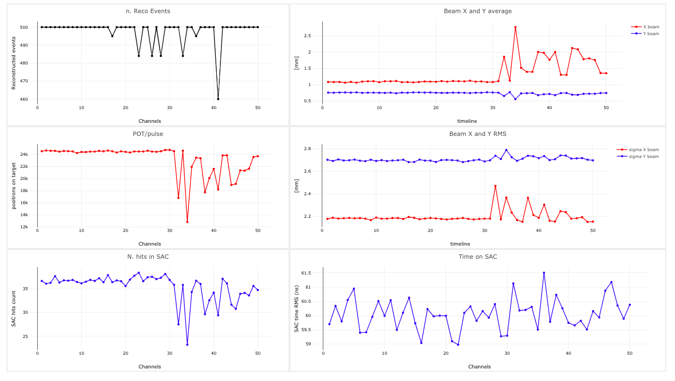
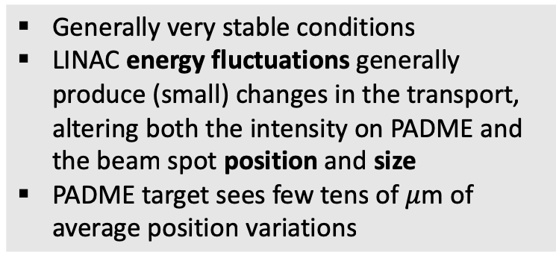


Run stability
Generally very stable conditions
LINAC energy fluctuations generally produce (small) changes in the transport, altering both the intensity on PADME and the beam spot position and size
PADME target sees few tens of $μ$m of average position variations
Target $x$ and $y$ average
Target $x$ and $y$ size
Intensity at target
Photons in SAC

Slide 20
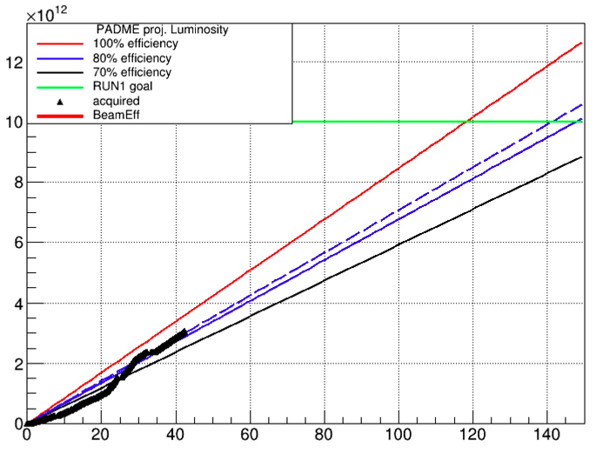
PADME integrated luminosity
Jan. 2019
Feb. 2019
Nov. 2018
Dec. 2018
Positrons on traget
Trigger board fault
Days
From 10k positrons/pulse to 20k positron/pulse
(shielding)
Good physics data since Nov. 1st, 2018

Slide 21
ASIF phase 2

Slide 22
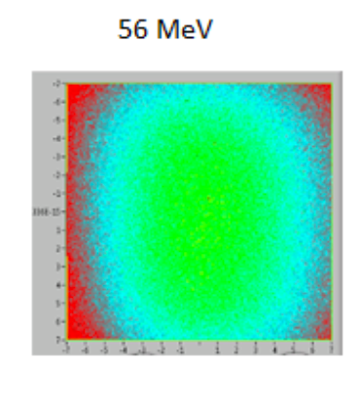
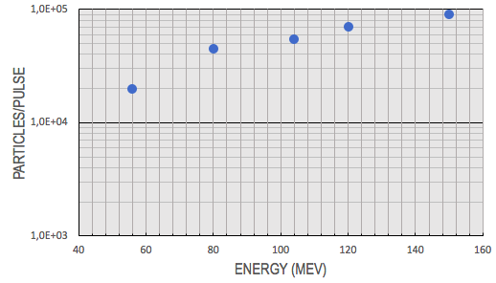
Premesse
ASIF: Progetto sulle infrastrutture per irraggiamento di interesse spaziale di ASI con ENEA e INFN (LNF e LNS, LNL, TIFPA)
Fase 1 (1 anno) completata, circa 1.5M, di cui 60k per LNF
  Adeguamento alle direttive ESA per irraggiamenti (ESCC)
  Attività di studio e caratterizzazione che hanno portato a un vero e proprio run di irraggiamento con un proto-cliente (TRAD)
  Si è dimostrato:
    La fattibilità e la capacità di controllare la dose e l’uniformità
    La necessità di aumentare il flusso a bassa energia e quindi – di fatto – la scarsa utilizzabilità del fascio secondario del linac
Dopo la fase di studio, una fase 2 più operativa
  Possibilità di un maggiore coinvolgimento (e finanziamento) per LNF

Slide 23
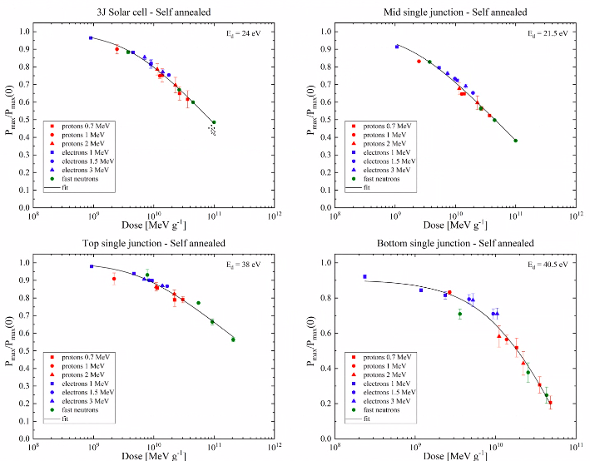
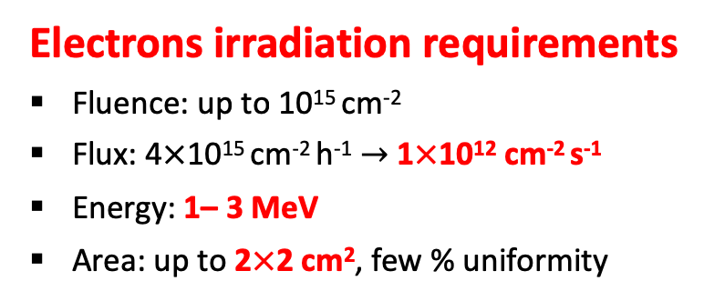
Tempi e taglia del progetto
Definizione del Work Package di LNF nell’ambito di ASIF-2 entro il 15 gennaio ‘19
Firma dell’accordo e partenza del finanziamento e del progetto: marzo-aprile ‘19
Durata: 2 anni
Ordine di grandezza del finanziamento: 0.5M
Electrons irradiation requirements
Fluence: up to 10¹⁵ cm⁻²
Flux: 4$×$10¹⁵ cm⁻² h⁻¹ $→$ 1$×$10¹² cm⁻² s⁻¹
Energy: 1– 3 MeV
Area: up to 2$×$2 cm², few % uniformity

