Slide 1
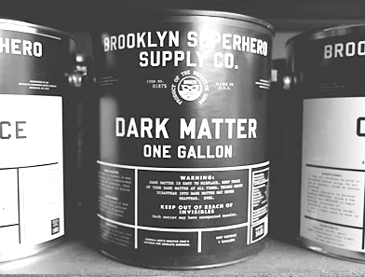
Light dark matter searches at fixed-target experiments
Outline
Why searching for LDM? Dark sector, dark forces and LDM
Searching for LDM at accelerators: why fixed-target?
Invisible decays experimental status
Present: PADME
Future perspectives
Paolo Valente
INFN Roma Tre mini-workshop
December 3rd, 2018

Slide 2
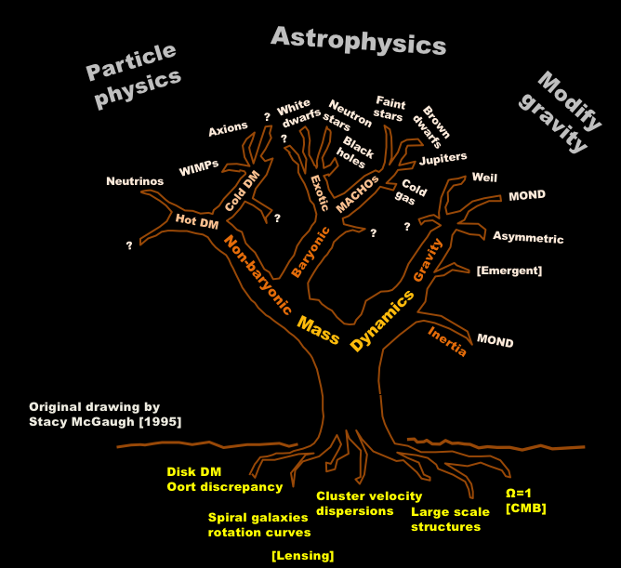
There is a growing set of experimental pieces of evidence, indicating that a large fraction of the gravitational force in the Universe come from components that do not emit electromagnetic radiation: dark energy and dark matter
We (particle physicists) are eagerly looking for dark matter particles since quite a while…
But this is not the only possibility:
Lensing:
micro-lensing
Bullet cluster
CMB

Slide 3
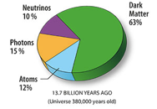
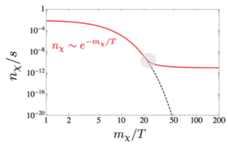
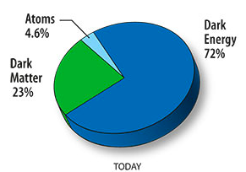
Relic density and WIMP’s
The dark matter relic density is determined by the thermodynamic evolution of the Universe and by the DM$↔$SM particles interaction cross-section
If the coupling is through the weak interaction the mass scale has to be $\sim O$(TeV), but no candidate for WIMP dark matter so far (DAMA-LIBRA still un-confirmed)
But this is not the only possibility:
Not exclusively «thermic» production
A new (and weaker) fundamental interaction

Slide 4
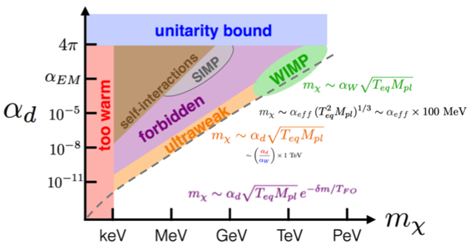
Why LDM? Dark sector and new interactions
WIMP
SIMP
ultraweak
forbidden
Josh Ruderman
DM particles ($χ$) interact among them through a dark force (or more than one) with coupling constant $α_{d}\sim$1
An entire, new dark sector could exist, containing a number of DM particles that could be completely decoupled from ordinary matter except a mediator particle (or more than one)
The DM to SM coupling can be very weak: parametrized by a reduced strength interaction ($ε$ times the electro-weak one)

Slide 5
Dark matter, dark sector, and dark forces
What kind of mediator?
Vector (dark photon)
Scalar (dark Higgs)
Axion (or ALP)
Fermion (sterile neutrino, HNL)
More advantages of the dark sector paradigm:
Can solve other problems, e.g. ${(g−2)}_{μ}$ anomaly, strong CP, etc.
The dark mediator not required to be itself the necessary CDM
The allowed mass range is greatly extended
A weak but not vanishing coupling to ordinary matter allows producing the mediator at accelerators
Concentrating on the dark photon ($U$ boson or $A’$)
Simple model, described by a new $U(1)’$ symmetry, and with just two parameters:
The dark photon mass $m_{A’}$
The coupling to the e.m. field $ε$: $ℒ=\frac{ε}{2}{ F}^{μν }{F′}_{μν}$

Slide 6
Why LDM? Mass scales for DM and anomalies
arXiv:1707.04591
Strong interest in the MeV – GeV region

Slide 7
… all things, visible and invisible
Kinetic mixing
Invisible coupling
Visible coupling

Slide 8
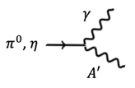
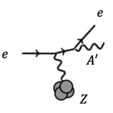
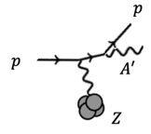
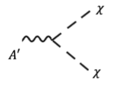
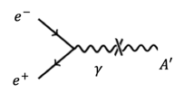
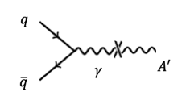
Dark photon production and decays
Electron accelerators
Proton accelerators
Meson decay
Electron Bremsstrahlung
Proton Bremsstrahlung
Visible
Invisible
Electron-positron annihilation
Drell-Yan
Dominant if $m_{A’}>2m_{χ}$

Slide 9
What kind of experiment?
Visible decays
Invisible decays
Recoil
Parametri aggiuntivi:
$α_{d}$e $m_{χ}$
$$e^{+}e^{−} γ A’$$
$$A’\text{→}χ\overline{χ}$$
$$e^{−}Z { e}^{−}Z A’$$
$$e^{−}Z { e}^{−}Z A’$$
$$A’\text{→}{ e}^{+}e^{−}$$
$$A’\text{→}χ\overline{χ}$$
Dump
Dump + recoil
Positive evidence
E-137, E-141, E-774, Orsay, …
(BDX)
Missing mass
BaBar, KLOE-2, Belle-II
Positive evidence
(bump hunt, displaced vertex)
E₁ + E₂ << E_{beam}
p₂ << p_{beam}
$A’$→ $e^{+}e^{−}$
Exclusion only
$$A’\text{→}χ\overline{χ}$$
$$A’\text{→}χ\overline{χ}$$
Thin target
APEX, HPS, A1
Missing energy
NA64
Missing momentum
(LDMX)

Slide 10
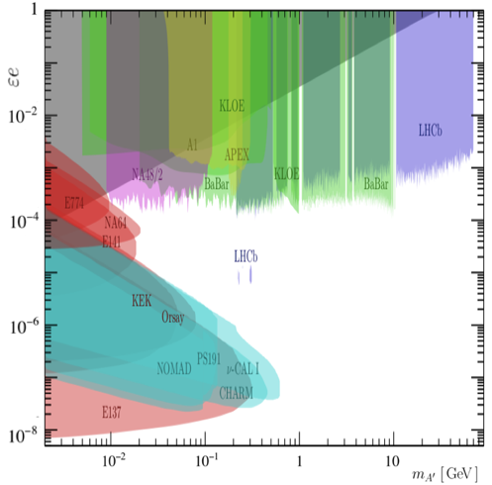
Visible decays status
Putting all limits together (different experiments with different production mechanisms):
[E137] electron beam dumps
[CHARM] proton beam dumps
[BaBar] $e^{+}e^{−}$ colliders
[LHCb] $pp$ collisions
[NA48] meson decays
[APEX] electron fixed target
Basic assumptions:
Kinetic mixing with ordinary photon (universal coupling)
Decay to visible final state i.e.: BR(A’$→e^{+}e^{−}$)$\sim$1
Band favoured by ${(g−2)}_{μ}$ excluded
Still running:
LHCb
HPS at JLAB
arXiv:1801.04847

Slide 11
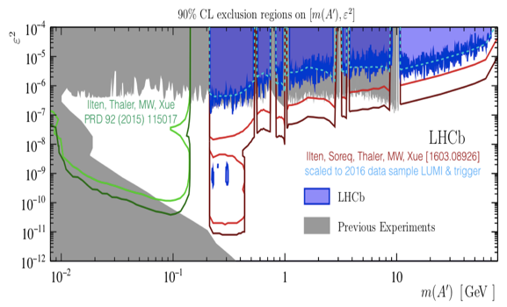
LHCb Run-3 predictions (2021-2023)

Slide 12
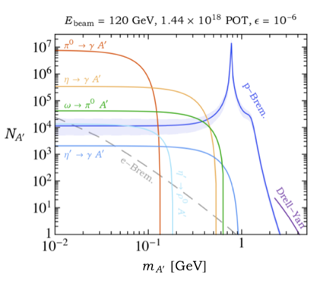
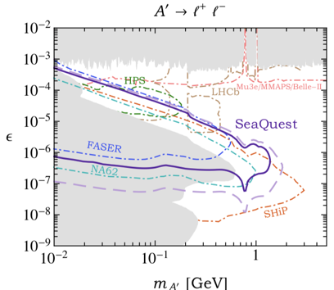
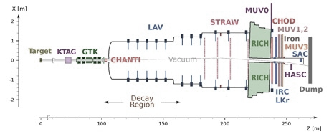
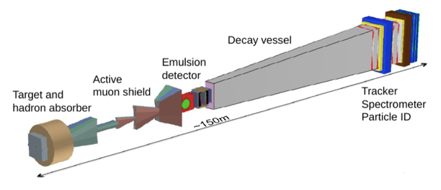
What kind of experiment? Proton beam dump
arXiv:1804.00661
NA62
SeaQuest
SHiP

Slide 13
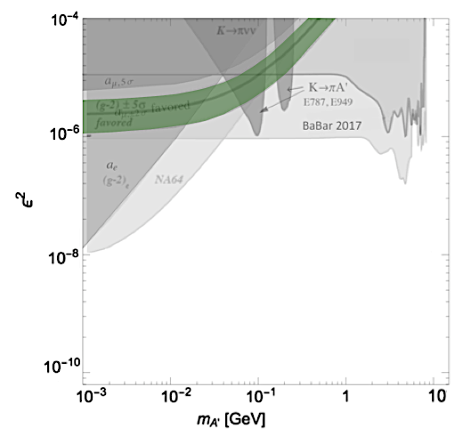
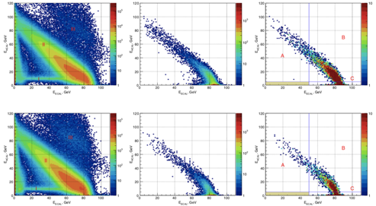
Invisible decays status
Missing energy: NA64 at H4, 100 GeV electron beam
Corresponding to 4.3 ×10¹⁰ electrons on target
Thermal relic
E_{HCAL} (GeV)
GUT
E_{ECAL} (GeV)
Phys. Rev. D97 (2017) 072002

Slide 14
Invisible decays status
BaBar: 53 fb⁻¹ near $Υ(2S)$, $Υ(3S)$, $Υ(4S)$ with mono-photon trigger, missing mass with boosted decision tree
Background fit with $ϵ$=0
Belle-II 20 fb⁻¹, statistics only
Phys. Rev. Lett. 119 (2017) no.13, 131804
Thermal relic
GUT
Belle-II just started taking data, will soon improve
$ε^{2}\sim$10⁻⁷ reachable with 20 fb⁻¹ (statistics only)

Slide 15
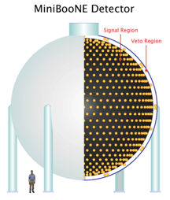
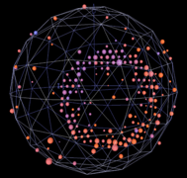
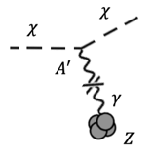
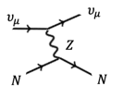
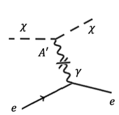
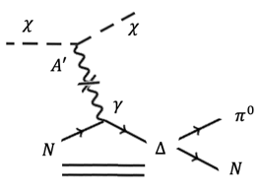
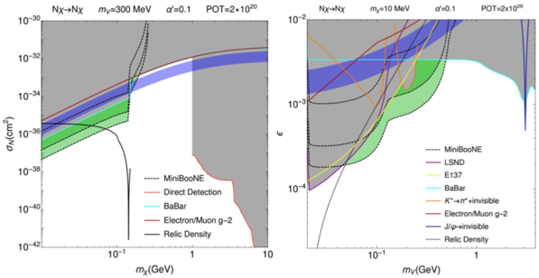
LDM at neutrino experiments
MiniBooNE run with booster neutrino beam in off-target mode (2014)
1.86$∙$10²⁰ POT in 10 months run (8 GeV protons)
Nuclear scattering
Similar to neutrino neutral-current elastic scattering
Cherenkov in mineral oil (CH₂)
Nuclear scattering sensitivity
Electron scattering
1 event
1000 events
$π^{0}$ channel
10 events
10 events
Further improvement form CE$υ$NS:
COHERENT@SNS Oak Ridge
CENNS@Fermilab

Slide 16
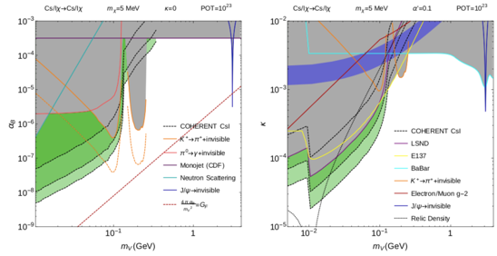
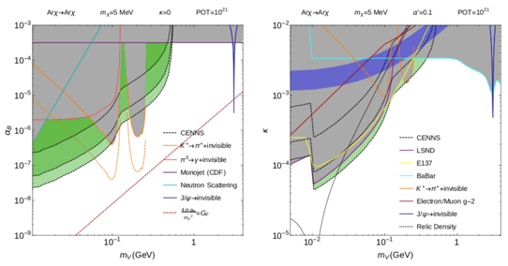
LDM at neutrino experiments
${U\left(1\right)}_{B}$ model
Dark photon
COHERENT@SNS Oak Ridge
1 ton CsI
1000 events
10 events
1 event
CENNS@Fermilab
1 ton ³⁹Ar
Phys. Rev. D 92, 095005 (2015)

Slide 17
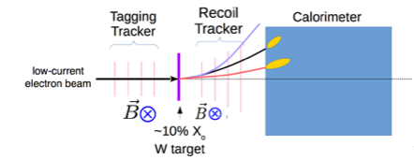
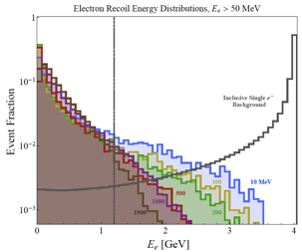
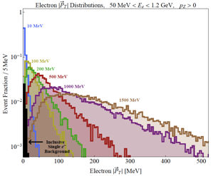
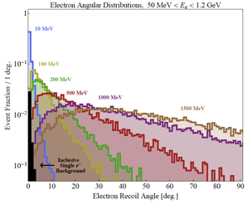
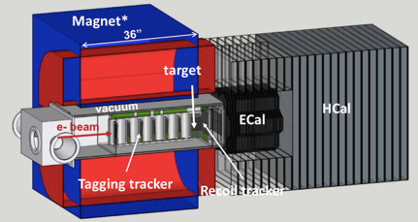
Future experiments: LDMX
4 GeV electron beam on 0.1 $X_{0}$ target
Missing momentum
A multi-GeV, low-current, high repetition rate (10¹⁶ EOT/year ≈ 1e/3 ns) beam with a large beam spot to spread out the occupancy/radiation dose.
DASEL@SLAC (4/8 GeV) or CEBAF@JLab (up to 12 GeV)
First phase (10¹⁴ EOT) $\sim$2022, full intensity of DASEL beam $\sim$2026
Electron recoil energy [GeV]
Electron transverse momentum [MeV]
Electron recoil angle [deg.]

Slide 18
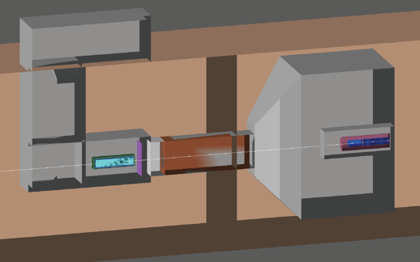
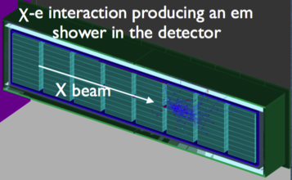
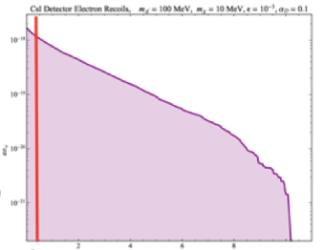
Future experiments: BDX
Dump+recoil
BDX@JLAB
10²² EOT = 1 beam-year at Hall-A
3 beam-years at Hall-C?
800 Cs(Tl) crystals, total interaction volume $\sim$ 0.5 m³
Rate
0. 2. 4. 6. 8. 10.
Shower energy [GeV]

Slide 19
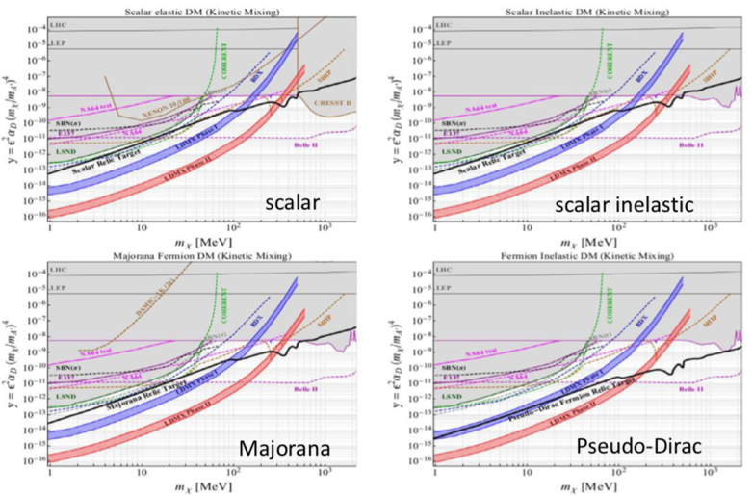
Future experiments sensitivity
$α_{D}=$ 0.5
$m_{A′}/m_{χ}=$ 3

Slide 20
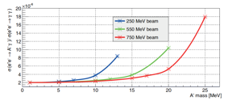
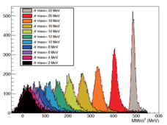
Missing mass in fixed target positron annihilations: the PADME concept
Larger luminosity: $N_{e^{−}} \sim N_{A}$
Smaller accessible mass: $\sqrt{s}=\sqrt{2m_{e}E_{e^{+}}}$
$$e^{+}e^{−} γ A’$$
$$e^{+}e^{−} γ A’$$
$$A’→χ\overline{χ}$$
Missing mass (fixed target)
(PADME, VEPP-3, MMAPS)
Missing mass (collider)
(BaBar, KLOE-2, Belle-II)
Invariant mass $\sqrt{s}$ can be changed easily by changing the positron beam energy: take advantage of increasing cross-section when $\sqrt{s}\sim M_{A′}$
Limited possibility of changing $\sqrt{s}$ (radiative return)
Positive evidence: search for a peak in the missing mass distribution; a few MeV$/c^{2}$ resolution is needed
At higher energies, worse missing mass resolution for small masses (e.g. BaBar $\sim$GeV$/c^{2}$)

Slide 21
Signal vs. backgrounds
Signal: invisible decay of $A’$
Background: Bremsstrahlung + lost $e^{+}$
Background: 2 or 3 photons, 1 detected
$$γ$$
$$γ$$
$$γ$$
$$χ$$
$$A′$$
$$γ$$
$$\overline{χ}$$
Bremsstrahlung background:
Detect the irradiating positron
Cut on the photon energy
2+ photons background:
Ermeticity
Granularity
Energy resolution
For cleaning away positron beam (not interacting with the target):
Central hole
Sweeping magnetic field

Slide 22
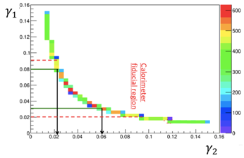
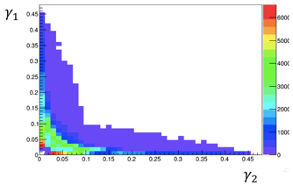
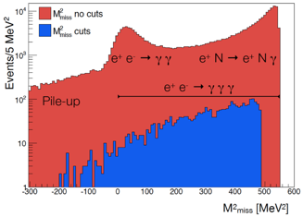
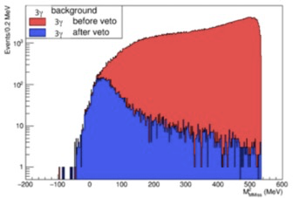
PADME: fighting the background
For $γγ$ events: given one photon in the fiducial region, the second is always in the acceptance
For $γγ(γ)$ events: given one photon in the fiducial region, the small angle region is crucial
Regione fiduciale
Calorimetro
Residual background dominated by Bremsstrahlung with the positron escaping detection in the scintillating bars veto

Slide 23
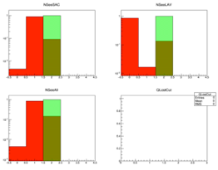
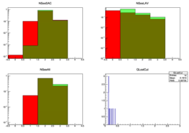
PADME: fighting the background
The probability of losing 1 or 2 photons (given the first cluster) critically depends on the cluster definition and calorimeter angular acceptance
Recoil γ definition:
10 MeV < E < 400 MeV
30 mrad < θ < 65 mrad
2$γ$ events
1+2
2+3
Region 1: θ < 20 mrad
Region 2: 20 < θ < 75 mrad
Region 3: 75 < θ < 100 mrad
1+2+3
Lost
Lost: θ >100 mrad
Where is the cluster without and with recoil photon selection
3$γ$ events
1+2
2+3
Need a veto detector covering the calorimeter hole:
Fast (pile-up translates in over-veto)
Moderate energy resolution
1+2+3
Lost

Slide 24
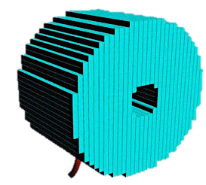
PADME final layout
Si pixel detector
Veto Bremsstrahlung (very soft)
Beam monitor
Large area, timing (TimePIX3)
Small-angle calorimeter
Veto Bremsstrahlung (hard)
Recover 3 photons events acceptance
Fast (Cherenkov)
Good light yield: PbF₂
Scintillators
Veto Bremsstrahlung (soft)
WLS fiber + SiPM
Design choices
Beam intensity $×$ target thickness = luminosity, it is limited by the maximum tolerable occupancy and veto probability: pile-up
Driven by the distribution and rate of photons + by the timing resolution of detectors
$M_{miss}$ resolution determined by spatial (Moliére radius) and energetic resolution of main calorimeter + lever-arm (calorimeter-to-target distance)
Aim at 4-5 MeV/$c^{2}$
Distance + magnet gap fix the photon acceptance
Hole in the main calorimeter (BGO)
To limit the Bremsstrahlung rate
Covered by fast, small-angle calorimeter (PbF₂)
Everything in vacuum: avoid parasitic interactions of positrons (other than in target), losing photons, showering, etc.
Scintillators
Veto Bremsstrahlung (hard)
WLS fiber + SiPM
$$γ$$
$$γ$$
Main calorimeter
Very good energy resolution
Highly segmented
Compact
BGO crystals, readout by PMT’s
Magnetic field
(dipole)
Large gap
Uniformity
$e^{+}$ beam
Scintillators ($e^{−}$ side)
Beam-induced background rejection
Detect visible decays: $A′→e^{+}e^{−}$
Active target
100 $μ$m diamond
Graphitic strips

Slide 25
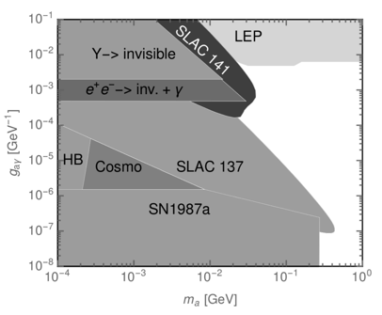
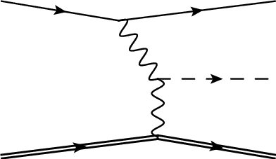
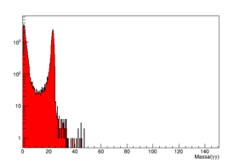
ALPs at PADME
For axion-like particles different production mechanisms: annihilation, Primakov and photon fusion
$$a$$
$$gaγγ$$
$$a$$
$$a$$
Region of interest
Final states observable at PADME:
Visible ALP decays ($a→γγ$):$γγγ$, $e^{+}γγ$, $e^{+}e^{−}γγ$
Invisible ALP decays: $γ$ + missing mass
Main background is $γγ$, but limited by invariant mass (24 MeV)
To be studied in details, but promising (good granularity and resolution of calorimeters)
arXiv:1512.03069

Slide 26
OK, let’s build it

Slide 27
PADME squad
Electronics, DAQ, trigger, mechanics, vacuum,
Beam, infrastructure, …
Scintillating bars veto and electronics, DCS, analysis
Small angle calorimeter, X boson analysis
Simulations, physics, analysis
Software, calibrations, calorimeter, analysis
Simulations
BGO calorimeter
Small angle calorimeter R&D
Analysis
Diamond target, analysis

Slide 28
Getting the positrons: BTF beam
BTF-2 branch
BTF-1 branch
(PADME)
Beam spot at target
Beam parameters:
electrons/positrons from DA$Φ$NE Linac at 50 Hz
Up to 750/550 MeV
Intercepted by Cu target, energy-selected by dipole+slits
Collimated and focussed on BTF beam-line
Variable length pulses, 1.5 up to $\sim$350 ns
$\sim$10⁴ positrons/pulse
$σ_{xy}\sim$1 mm; $σ_{θ}\sim$1 mrad
Beam pulse length (SAC)

Slide 29
PADME components
Main calorimeter (BGO crystals)
All detectors sampled by waveform digitizers at 1 or 2.5 GS/s
Beam trigger at 50 Hz
On-line zero suppression
L0-L1 $→$ data recording
Dipole magnet
C-fiber window
in front of the main calorimeter
TE/MSC-MNC
Active target
diamond with graphitic strips
Fast calorimeter (PbF₂ crystals)
In-vacuum veto scintillators
TimePIX

Slide 30
PADME installed and commissioned
Oct. 4th, 2018: data taking start

Slide 31
PADME: active target
CVD diamond, detector grade
1 mm graphitic strips (laser-burning)
$x$ and $y$ views
Pre-amplified analog signals sampled by waveform digitizer
Gives beam spot position, size and intensity pulse by pulse
Charge-weighted strips
Average $x$ and $y$ coordinates
Intensity/pulse
Average intensity vs. time

Slide 32
PADME: BGO calorimeter
BGO crystal signal
No beam, cosmics trigger
Beam on target
GeV
GeV (1000 events)
Readout side
sample #

Slide 33
PADME: small angle calorimeter
1 crystal
sample #
5$×$5 PbF₂ crystals, 30$×$30 mm², fast 1’’ PMT’s
Cumulative time distribution
BGO calorimeter
ns

Slide 34
PADME: scintillating bar veto
Low-energy positrons
TimePIX
Beam core
Radiative tail
High-energy positrons

Slide 35
PADME: TimePIX
BTF single TimePIX
3.5 m upstream
Monte Carlo
1% energy spread
$θ_{x}$=1 mrad, $θ_{y}$=1 mrad
Chip side
Data 5$×$2 array
Readout side

Slide 36
PADME expected sensitivity
Maximum beam intensity limited by pile-up
Given the 50 Hz repetition rate, advantage in diluting the positron beam in long pulses:
10¹³ $e^{+}$ on target = 2$∙$10⁴ $e^{+}$/pulse$×$49 pulses/s$×$10⁷ s effective running time ($\sim$200 ns long pulses)
In the DA$Φ$NE case, the Linac was optimized for 10 ns pulses
10¹³
4$∙$10¹³
Belle-II
stat only, 20 fb⁻¹
0-background

Slide 37
Acquired statistics
November ’18:
$\sim$1.5$∙$10¹² positrons on target
Estimate of positrons on target from diamond target charge signal
Calibrated wrt FitPIX
Based on online reconstruction

Slide 38
Beryllium-8 anomaly
Anomalous bump in the $e^{+}e^{−}$ opening angle, in radiative transitions with Internal Pair Conversion of ⁸Be* excited nuclei
Anomaly shows up only if the excited energy level is above $\sim$17 MeV
A new boson (not the «classical» dark photon) advocated, with coupling to quarks suppressed wrt leptons: proto-phobic boson
PRL 116, 042501 (2016)
E_{p}=0.8 MeV
E_{p}=1.04 MeV
E_{p}=1.10 MeV

Slide 39
Resonant production at PADME
Exploit knowledge of the mass $\sim$17 MeV$/c^{2}$
Exploit the possibility of tuning the beam energy at BTF for sitting on the resonance: $E_{e^{+}}=$282.7 MeV
Produced on-shell throught the direct annihilation diagram
Parametric enhancement of cross section wrt $e^{+}e^{−}→X γ$
Effect of threshold crossing can provide solid evidence (if the boson does exist…)
The electro-magnetic shower background must be absorbed
Optimization of the target (thickness, material)
Number of $X$
10¹⁸ positrons on target
Energy of positron beam (MeV)
E. Nardi et al. Phys.Rev. D97 (2018) no.9, 095004
39

Slide 40
ALP’s at PADME
In the case of axion-like particles different production mechanisms are at work: annihilation, Primakov production and photon fusion
$$a$$
$$gaγγ$$
$$a$$
$$a$$
PADME region of interest
Final states accessible at PADME:
Visible decays ($a→γγ$):$γγγ$, $e^{+}γγ$, $e^{+}e^{−}γγ$
Invisible decays: $γ$ + missing mass
Main background is $γγ$: limited to $\sim$24 MeV/c² invariant mass!
To be studied in details, but promising (good calorimeters granularity and resolution)
arXiv:1512.03069

Slide 41
Think bigger
Increase luminosity, i.e. extend the beam pulse length
and/or
increase the positron beam energy:
PADME at DA$Φ$NE
PADME at Cornell
PADME at JLAB
To be compared with future invisible dark photon experiments, in particular Belle-II and LDMX

Slide 42
Positron extraction from DA$Φ$NE
Create two regions in the phase space: an island of stability (a triangle, for $n+\frac{1}{3}$ ) and an unstable region outside
Change the betatron tune to drive particles outside the stable region, towards a septum
In the DA$Φ$NE case, exploit the synchrotron radiation energy loss (through cromaticity)
The extracted beam spill length will depend on the energy spread of injected beam: 0.2 to 0.4 ms for $δE\sim$1% and with – without wigglers.
Two candidate extraction regions: dispersion $\sim 0$, $β\sim$ maximum)
arXiv:1711.06877,
IPAC2018-THPAK023
S. Guiducci
Maximum positron energy limited to 500-550 MeV (RF, dipoles, etc.)
Same PADME setup with some modifications to trigger and readout for coping with much longer beam pulses
Moderate cost for extraction line and operations
Gain factor in luminosity huge: 0.4 ms/200 ns = 2000

Slide 43
PADME at Cornell
150 MeV positrons from Linac
Injected into the synchrotron and accelerated
Up to 5.3 GeV, now 6.0 GeV
Transferred and accumulated into the CESR storage ring
Synchrotron radiation in the CHESS facility (South, Wilson Hall)
Detailed study of ($n+\frac{1}{3}$) resonant extraction performed
Up to 2 ms long spills (variable energy)
Background studies (MMAPS proposal, very similar to PADME)
PADME Monte Carlo for 6 GeV positron beam
Variable energy could actually improve sensitivity at lower dark photon masses
Higher energy and larger target-to-calorimeter distance should actually improve the missing mass resolution
To do: detailed studies of pile-up and a completely new trigger
D. Rubin

Slide 44
PADME-next sensitivity
Poseydon: rescaled PADME@BTF only for statistics
Cornell: essentially the same setup of PADME@BTF
Monte Carlo at 6 GeV (fixed energy)
Beryllium target (thicker)
JLAB: letter of intent for PADME-like experiment using the proposed 11 GeV positron beam extracted from CEBAF
Monte Carlo at 11 GeV
Sensitivity for lower current (10 nA), up to 100 nA possible
Same PADME setup and target simulated
https://wiki.jlab.org/pwgwiki/images/7/74/PAC46-LOI.pdf

Slide 45
PADME status summary
All detectors installed and working
BTF-1 commissioning and optimization for long beam pulse done
Stable data taking since Oct. 2018
Aim at 10¹³ positrons on target for Run-1
Future perpectives
Run-2 before the end of 2019?
Increase statistics by a factor $\sim$10³: resonant extraction from DA$Φ$NE
Further increase of statistics (one order of magnitude at least) and increase mass sensitivity to $\sim$78 MeV: positron beam from Cornell synchrotron (6 GeV)

Slide 47
Freeze-in
Thermal equilibrium: $χ\overline{χ} ↔f\overline{f}$
Universe cools: $χ\overline{χ}→f\overline{f}$ and not $χ\overline{χ}←f\overline{f}$
Universe expands: neither $χ\overline{χ}→χ\overline{χ}$ nor $χ\overline{χ}←f\overline{f}$

Slide 48
Choosing a portal
Patrick deNiverville

Slide 49
Choosing a portal
Maxim Pospelov

Slide 50
Simple dark matter model with dark photon and dark Higgs
Luc Darmé
$$A’$$
Kinetic mixing with photon + scalar potential
After $U(1)’$is broken $→$ massive light dark photon $A’$and light dark Higgs $S$
Introduce a Dirac fermion DM with Yukawa couplings to the dark Higgs
After $U(1)’$is broken $→$ DM acquires a Majorana mass
After diagonalization $→$ 2 Majorana fermions with variable mass splitting:
$χ_{1}$ is the lightest, the dark matter candidate
$χ_{2}$ will decay to lighter dark sector fields

Slide 51
Simple dark matter model with dark photon and dark Higgs
Luc Darmé

Slide 52
Current constraints
Toro, Krnjaic

Slide 53
More physics

Slide 54
Semi-visible decays of dark photon
Missing energy approach assuming $A’$brings away all four-momentum in a totally invisible way: $A’→χχ$
In case of a non-minimal dark sector: semi-visible decays: $A’→χ_{1}χ_{2}$ with the heavier state decaying in: $χ_{2}→χ_{1}e^{+}e^{−}$
Co-annihilation
Missing mass approach more general, but $e^{+}e^{−}$ can veto single photons
Also electron beam dump experiments affected through up-scattering
Gopolang Mohlabeng

Slide 55
BDX inelastic DM scattering and decay

Slide 56
HPS
Look for displaced vertex
$θ$ of the decay is small:
put detectors as close as possible, good forward coverage
Aim at minimum $θ$_{A’} ≈ 15 mrad
Bump hunting needs good momentum/mass resolution
Good tracking and analyzing magnet
Aim at $Δm/m ≈$1% and $Δz ≈$1 mm
Trigger with a high rate ECAL
Magnet+ECAL to select $e^{+}$and $e^{−}$
Magnet+muon detector to select $μ^{+}$ and $μ^{−}$

Slide 57
BGO calorimeter
700 BGO crystals extracted from L3 e.m. calorimeter endcap
Calibration: 511 keV (²²Na);
Calibration: 18 MeV (cosmics)
Glue PMT;
Optical paint
Assembly and installation
Beam-testing:
2% resolution at 1 GeV
Remove photosensor;
Anneale; Machine; Polish

Slide 58
PADME trigger e DAQ
Trigger is produced using two boards
CPU trigger Board
2 Trigger distribution boards (32 channels each)
The CPU Trigger Board generates the trigger signal based on 3 different trigger sources (up to 6 possible)
Physics (BTF bunch trigger)
Cosmic (Ecal calibration trigger)
Random (Ecal pedestal trigger)
Data collected by two level readout system
L0 PCs perform data collection from single boards and zero suppression
L1 PCs perform event merging and eventually further selection based on full event information
Everything is already assembled and tested first real full data stream this week.
Test with the full system performed with empty events
Data transfer Ok and boards pedestal measured for calibration purpose
No noisy or faulty channels identified in the system so far

Slide 59
PADME TimePIX3
Imaging of the beam at the end of the setup to capture beam images
Provides measurements of beam divergence, beam time structure and beam intensity bunch by bunch
2x6 array of 14x14 mm² Si sensors readout by CERN TimePix3 chip.
256x256 55mm pixels with 1.6ns time resolution
256x256x12 ~ 800K pixels
Biggest array of Timepix3 detector ever build so far!
Construction in collaboration with ADVACAM
Readout by 12 credit card PC+merger PC

Slide 60
PADME small angle calorimeter
Detector made of 25 PbF₂ crystals
30x30x140 mm³
Very dense Cherenkov radiators
Crystal wrapped with black tedlar to avoid reflections and obtain shorter signals
Detector coupled to very fast Hamamatsu PMT (~1ns rise and fall time)
Photon energy in SAC (MC)

Slide 61
PADME vacuum system

Slide 62
Beryllium-8

Slide 63
PADME@Cornell

Slide 64
PADME@Cornell

Slide 65
Beam-Test Facility
 | electrons | positrons
Maximum beam energy | 50-750 MeV | 50-650 MeV
Energy spread [$δp/p$] | 0.5% | 1%
Typical Charge | 2 nC | 0.85 nC
Bunch length | 1.5 – 200 ns
Linac Repetition rate | 1-50 Hz | 1-50 Hz
Typical emittance [mm mrad] | 1 | ~1.5
Beam spot s | <1 mm
Beam divergence | 1-1.5 mrad
2 possible positron production targets can be used:
Positron converter, electrons at 220 MeV on 2 $X_{0},$W-Re target: limited energy $\sim$500 MeV, maximum intensity
BTF target, highest possible electrons on 1.7 $X_{0},$ Cu target, higher maximum energy $\sim$650 MeV

