Slide 1


Welcome to Varese industries
Visit to CERN
Marcello Losasso CERN /KT- 01.03.2019
Marcello.Losasso@cern.ch
Notes:
1

Slide 2
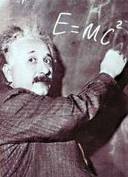



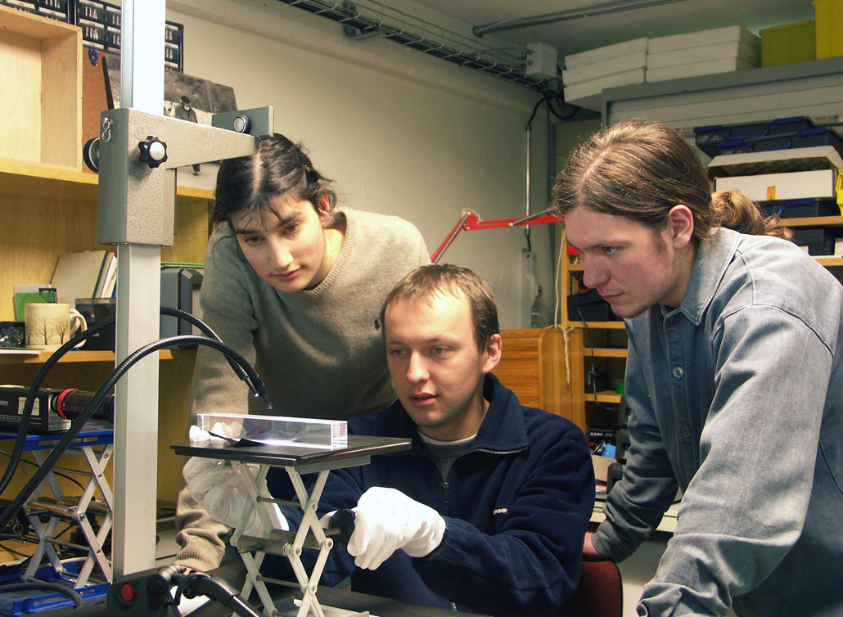
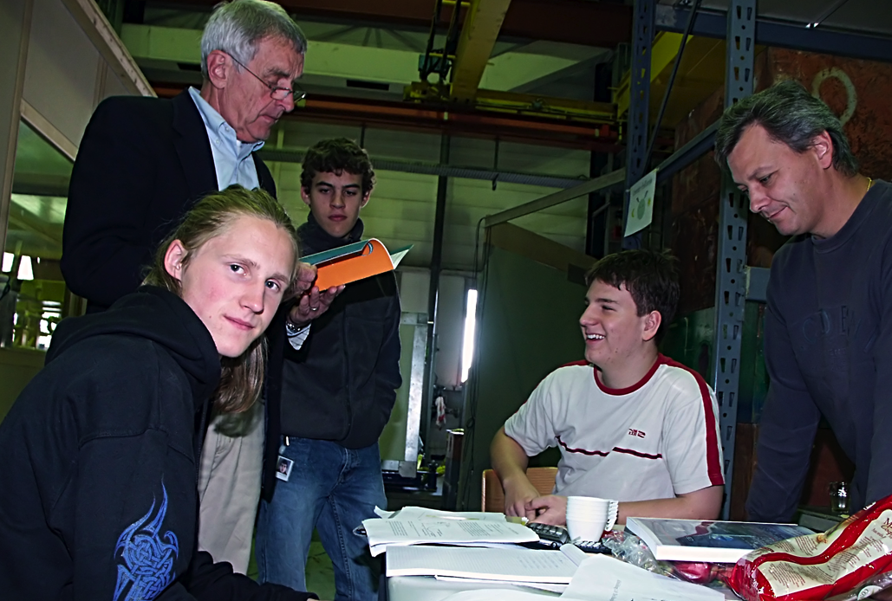
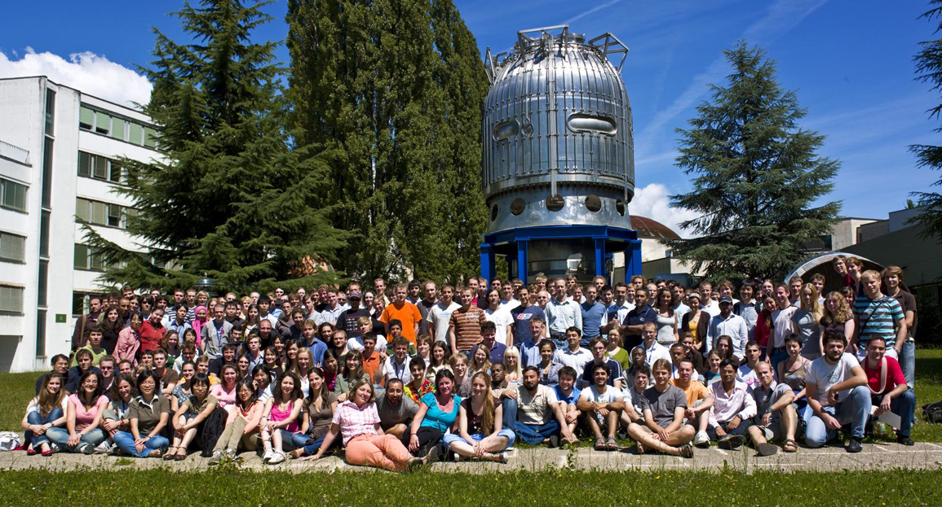
The Mission of CERN
Push back the frontiers of knowledge
E.g. the secrets of the Big Bang …what was the matter like within the first moments of the Universe’s existence?
Develop new technologies for accelerators and detectors
Information technology - the Web and the GRID
Medicine - diagnosis and therapy
Train scientists and engineers of tomorrow
Unite people from different countries and cultures
Notes:
2

Slide 3
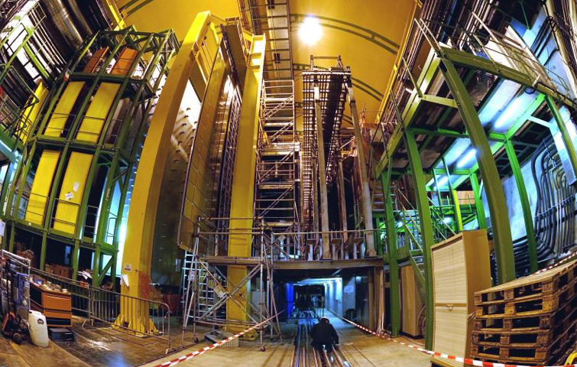


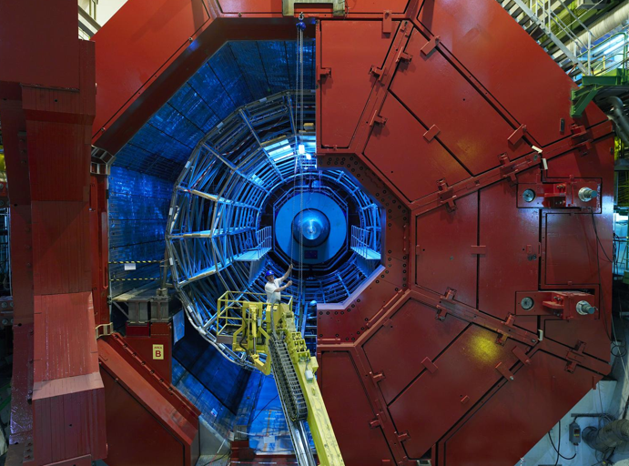


LHCb
CMS
ATLAS
Exploration of a new energy frontier
in p-p and Pb-Pb collisions
ALICE
LHC ring:
27 km circumference
Notes:
3

Slide 4
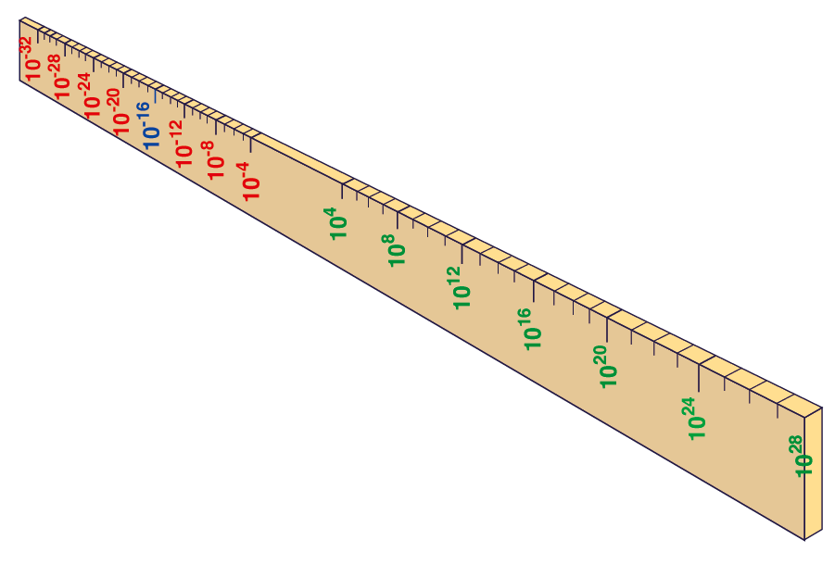
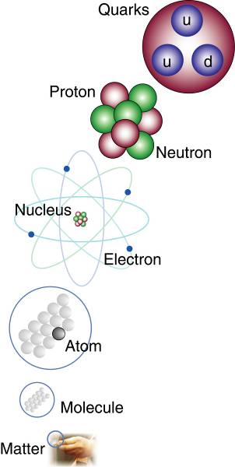
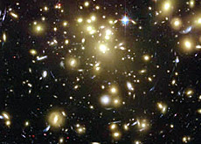
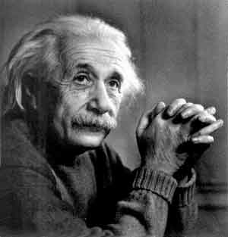

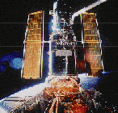
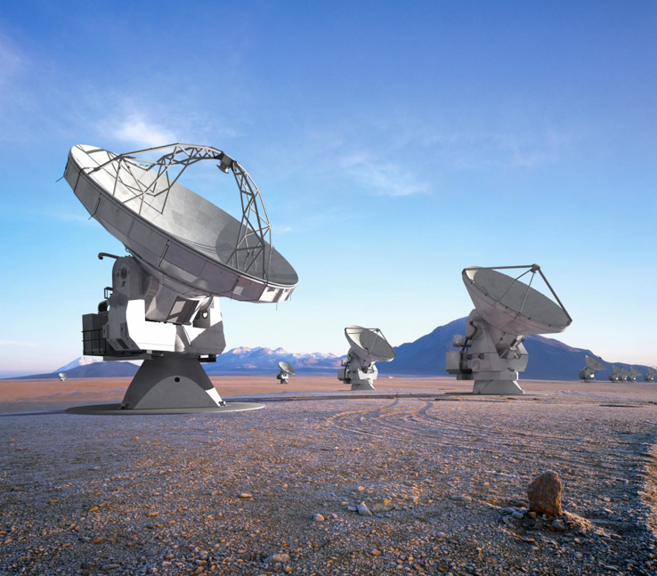
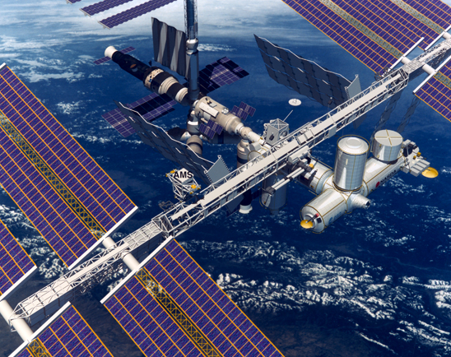
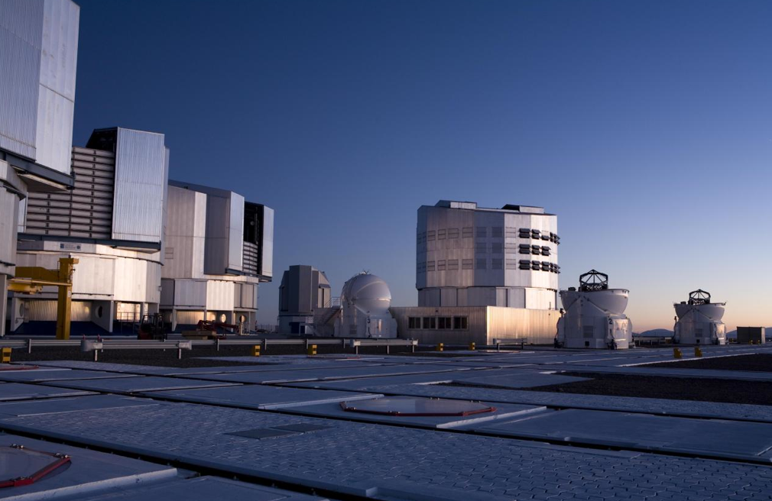
Big Bang
Proton
Atom
Radius of Earth
Earth to Sun
Radius of Galaxies
Universe
LHC
Super-Microscope
Hubble
ALMA
cm
Study physics laws of first moments after Big Bang
increasing Symbiosis between Particle Physics,
Astrophysics and Cosmology
AMS
VLT
Notes:
4

Slide 5
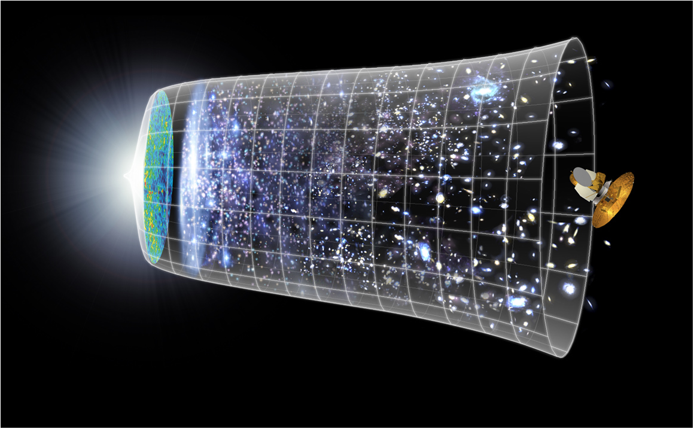
Next Scientific Challenge:
to understand the very first moments of our Universe after the Big Bang
Big Bang
WMAP
13.8 Billion Years
Today
10²⁸ cm

Slide 6
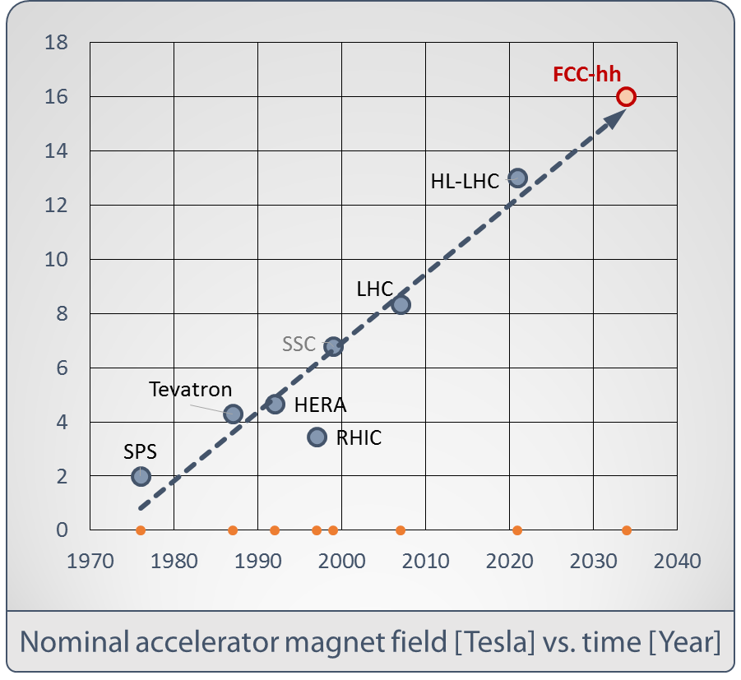
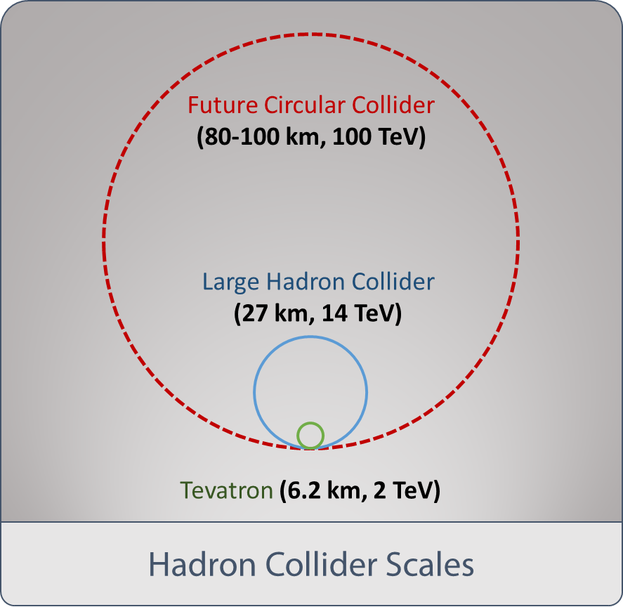

Slide 7
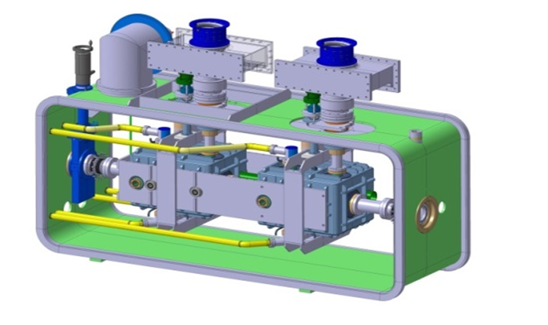
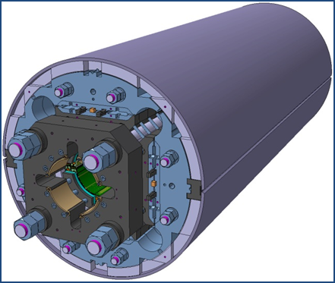
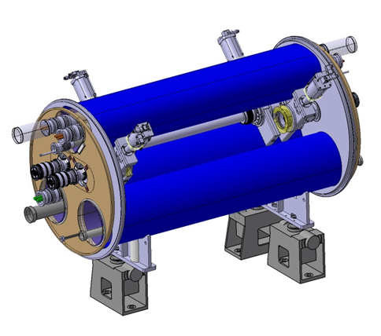
The largest HEP accelerator in construction
ATLAS
CMS
Dispersion Suppressor (DS)
Matching Section (MS)
Interaction Region (ITR)

Slide 8

KT Mission
Maximize the technological and knowledge return to Society, specially in the Member States
Promote CERN’s image as a center of excellence for technology
Demonstrate the importance and impact of fundamental research investments
Key words:
Dissemination,
Impact!

Slide 9
Technology areas
CERN has mapped about 70 technology area of interests. There has been a steady growing number of new technologies at a rate of 1 new technology/year
The reference technology landscape is dominated, by size, connections to other areas and impact, by technologies embedded by accelerators, with thousands of patents.
HL-LHC, the current CERN flagship project, is involved in all of the main mapped technological areas. Namely, NbTi, Nb3Sn, HTSC, cryogenics, vacuum. Of these many are showing a growing trend in the last years. Among these 3D printing and HTSC

Slide 10
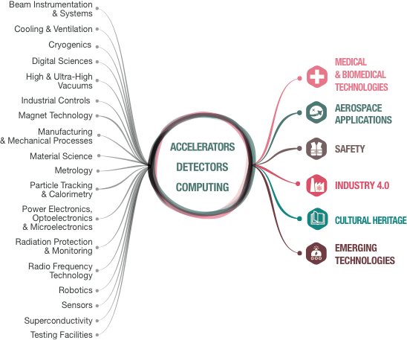
Notes:
Advances in accelerator technologies advance the energy level by factor 10 every 6 y

Slide 11
accelerators in Science, Industry and Society
High Energy Physics
Medical Applications
Particle acclerators
more than 30000 accelerator installed in the world - 1100 new systems deployed every year for about US$ 3.2B.
Industrial processes
...not yet fully exploited areas
Notes:
Advances in accelerator technologies advance the energy level by factor 10 every 6 y

Slide 12

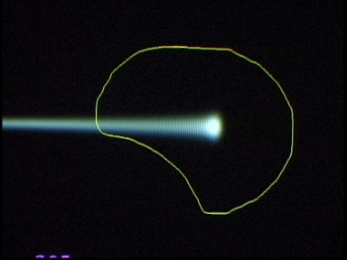
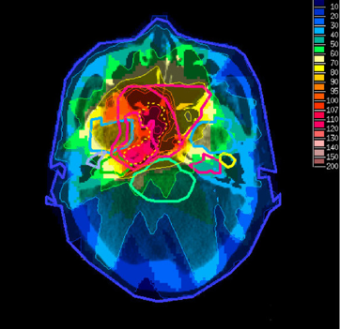
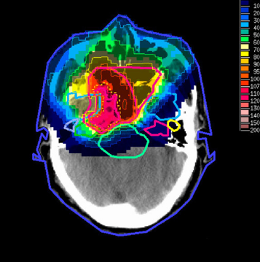
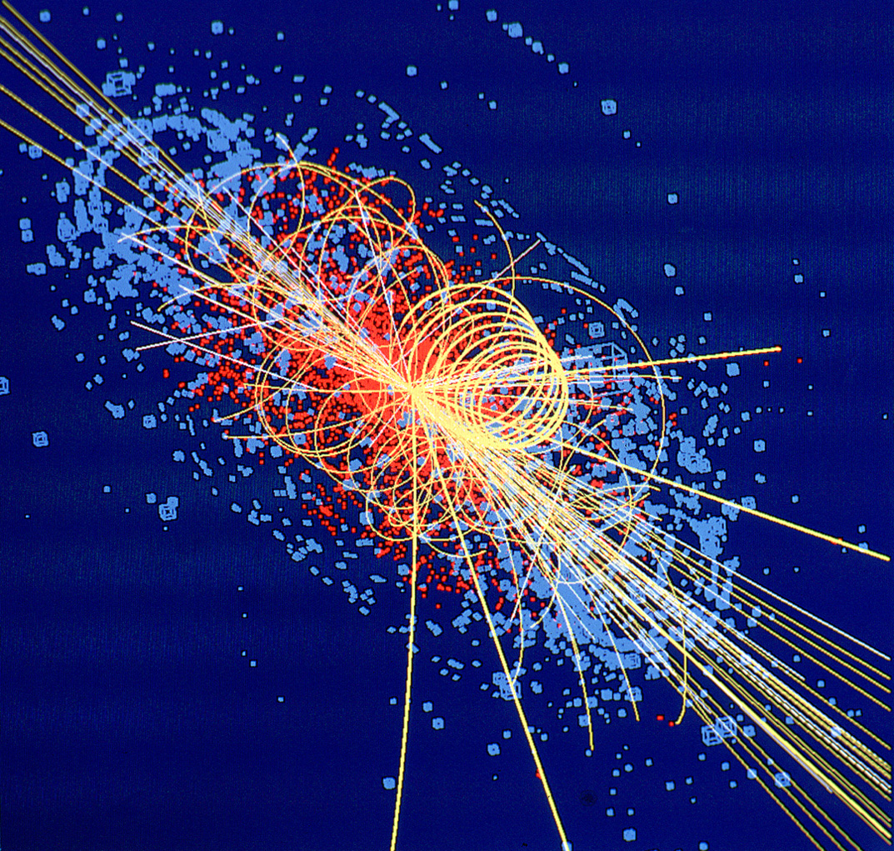
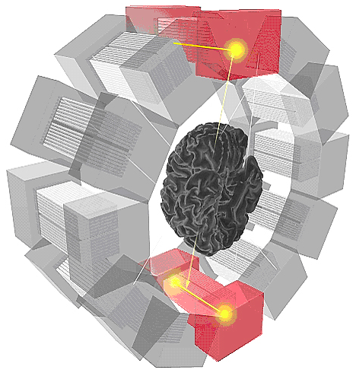
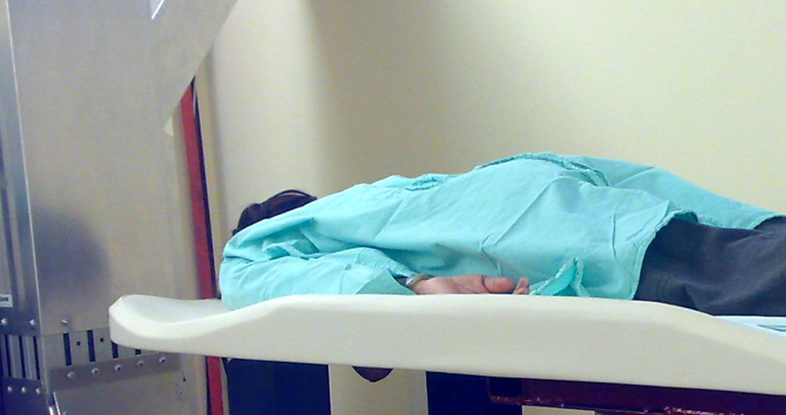
Medical Application as an Example of Particle Physics Spin-off
Combining Physics, ICT, Biology and Medicine to fight cancer
Hadron Therapy
Tumour Target
Leadership in Ion Beam Therapy now in Europe and Japan
Protons
light ions
Accelerating particle beams
~30’000 accelerators worldwide
~17’000 used for medicine
X-ray
protons
>100’000 patients treated worldwide (45 facilities)
>50’000 patients treated in Europe (14 facilities)
Imaging
PET Scanner
Clinical trial in Portugal, France and Italy for new breast imaging system (ClearPEM)
Detecting particles
Notes:
12

Slide 13
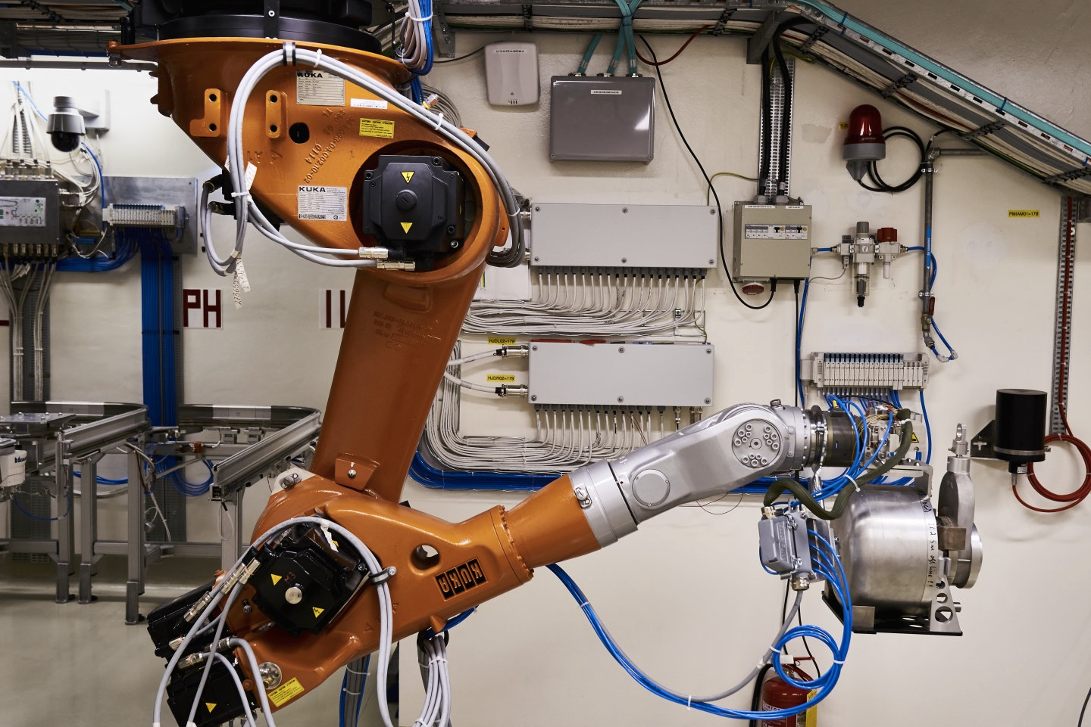
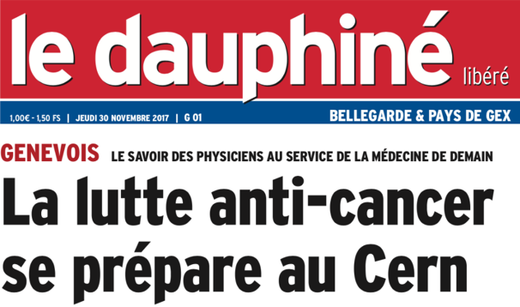
CERN-MEDICIS
First medical isotopes produced

Slide 14
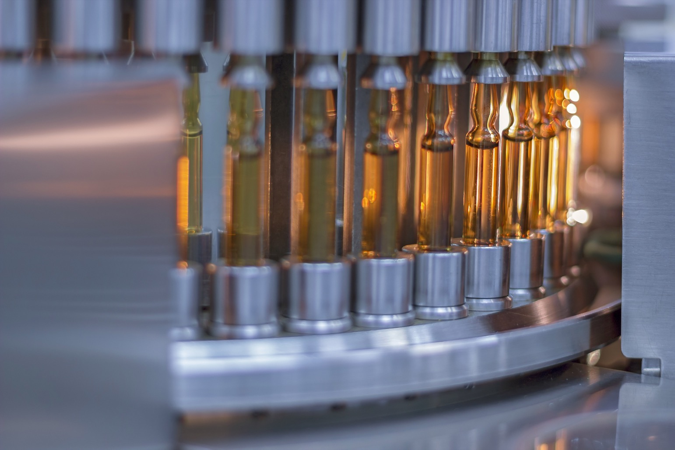
“How can machine learning improve vaccine production?”
CERN - Sanofi
Notes:
Example 1 - Medtech
CERN experts train Sanofi in machine learning - potential application in their vaccine production
Training was in 2017

Slide 15
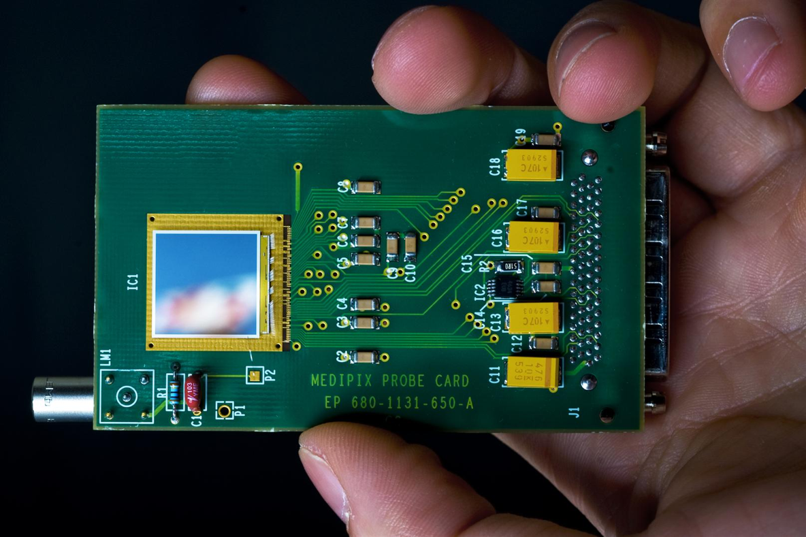

Slide 16
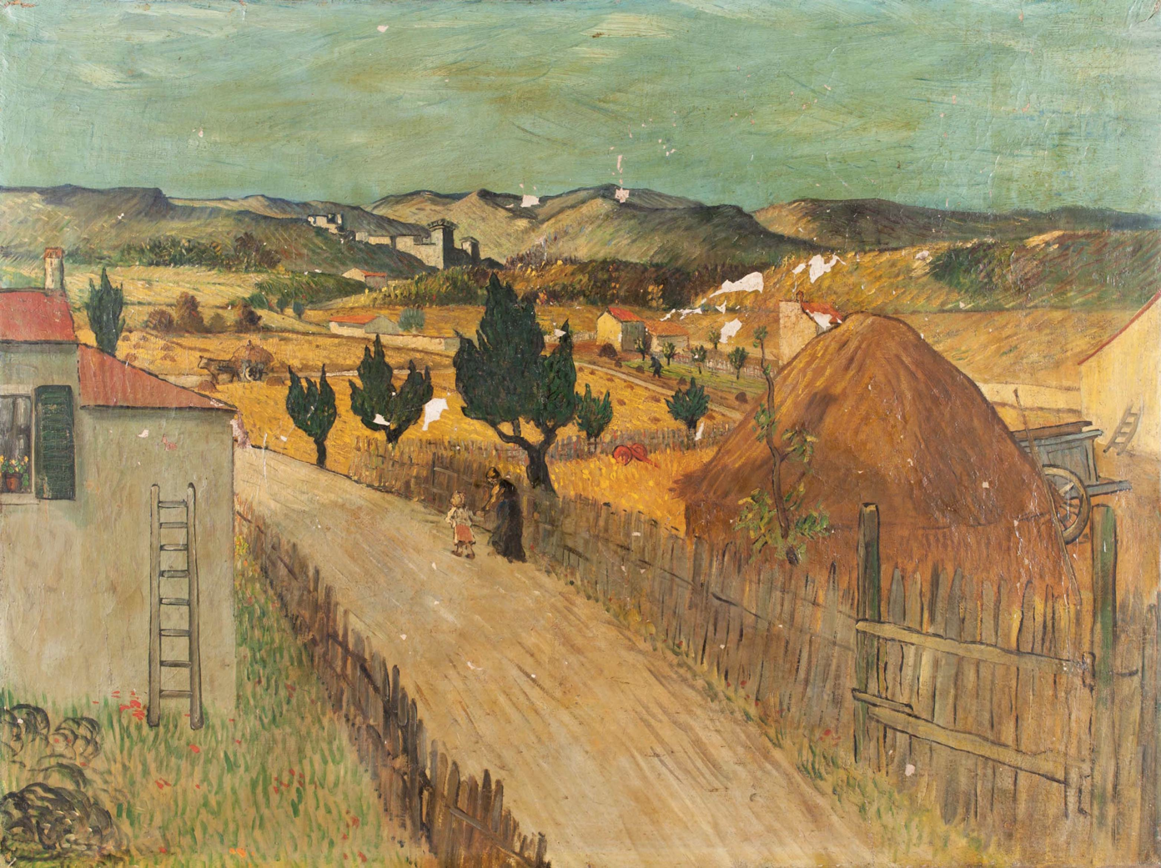
X-ray eyes for cultural heritage - Medipix chip
Notes:
#EuropeForCulture = because 2018 is the European Year for Cultural Heritage.
Note: Cultural Heritage is defined as: “Cultural heritage takes many forms: from the tangible legacy of monuments, artwork and books, to digital resources, either newly created or used to ensure cultural preservation. The concept also includes intangible (such as language and oral traditions) and natural elements (such as flora and fauna). This heritage may seem remotely connected to CERN's technological advances, yet the opposite is true: in 2018, several projects related to art restoration and digital preservation are using CERN technology.”

Slide 17
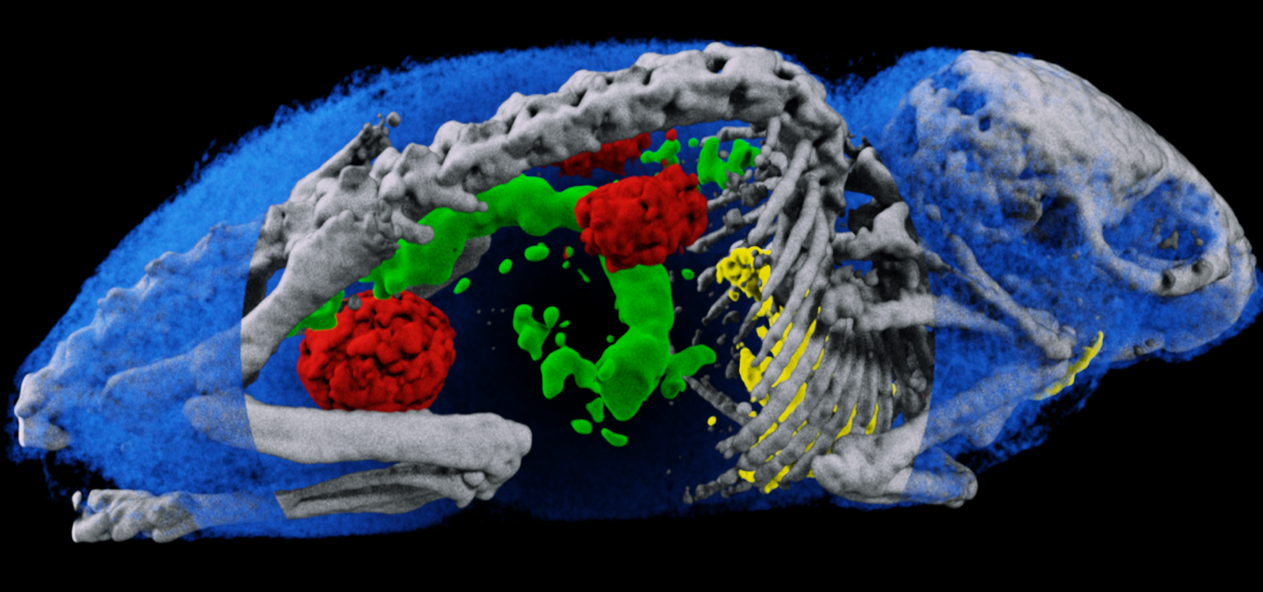
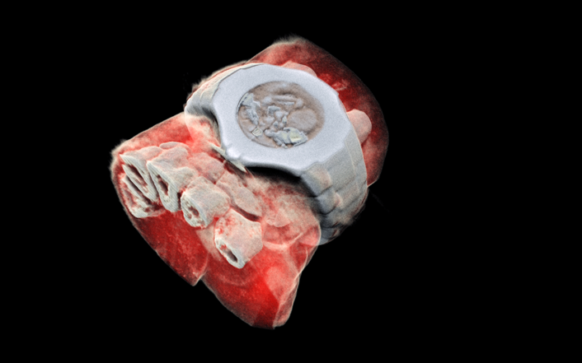
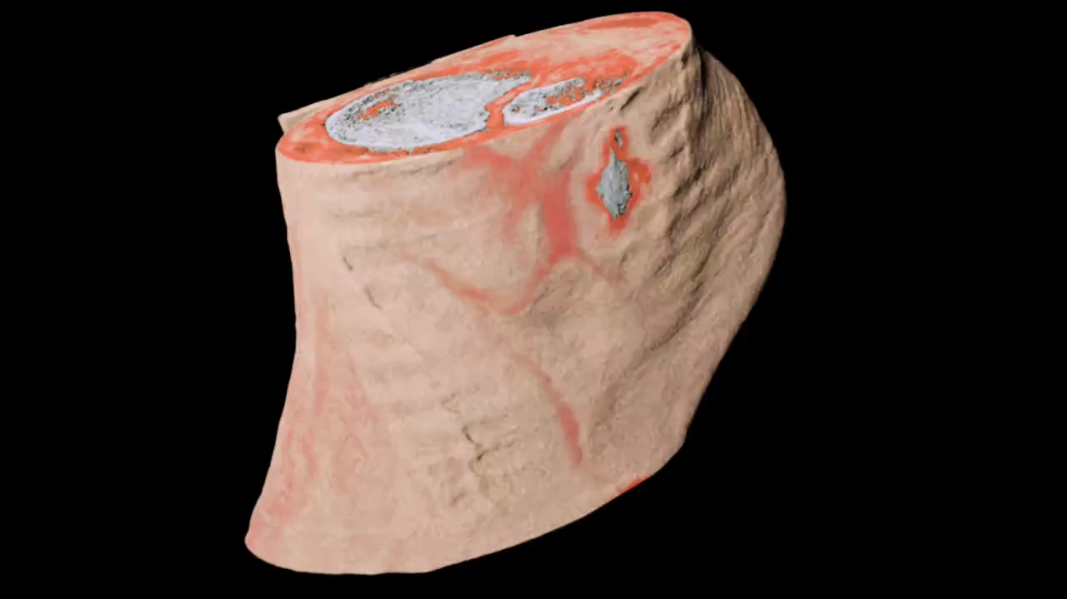
(courtesy of MARS Bioimaging Ltd)

Slide 18
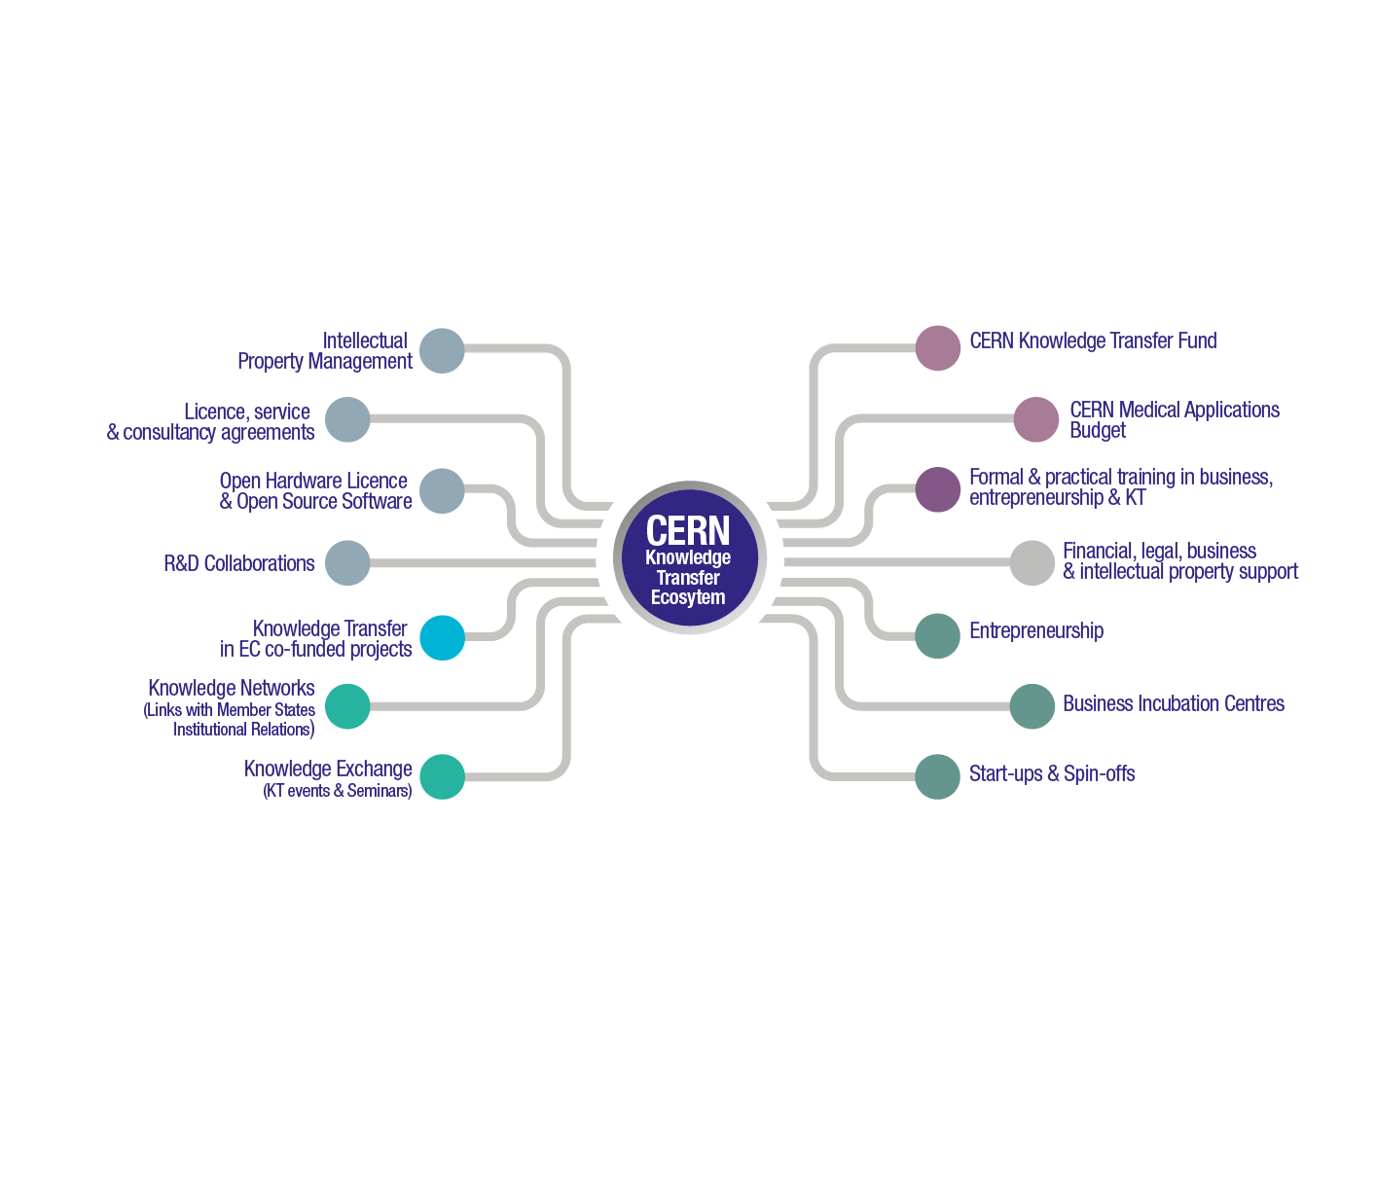
Notes:
This slide needs to be updated

Slide 19
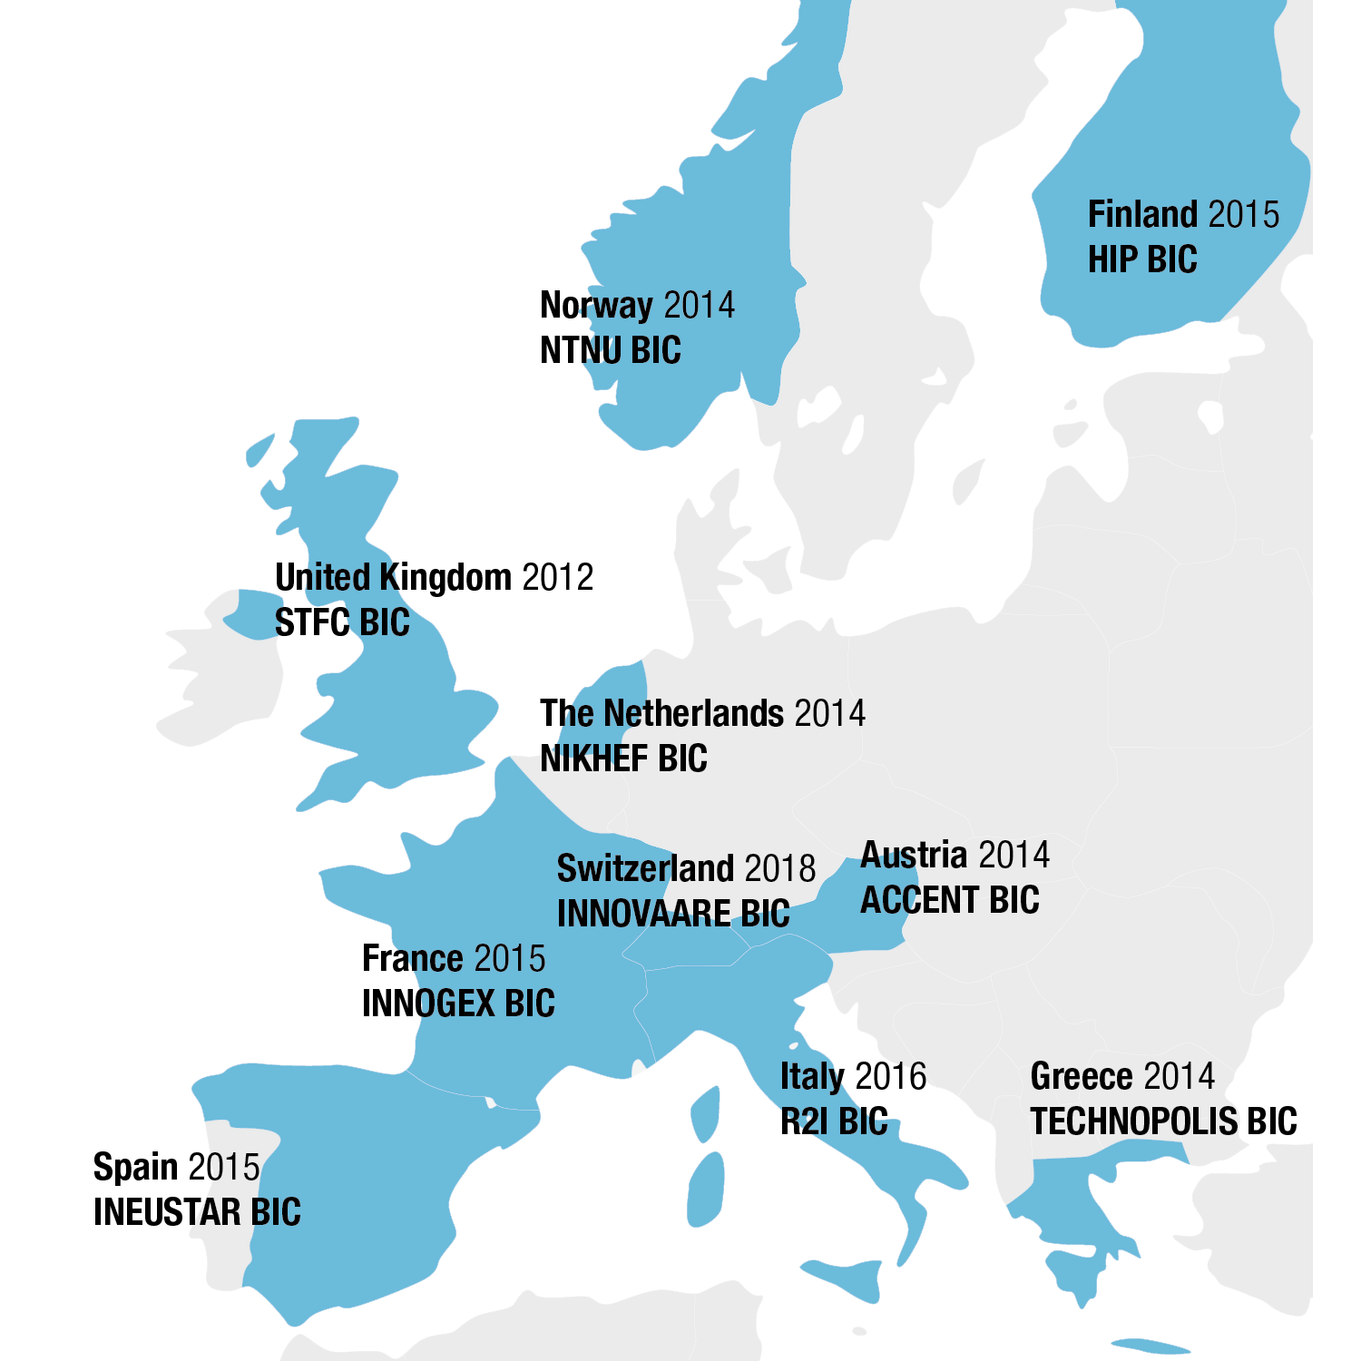
CERN BICs
CERN Network of 10 Member State Business Incubation Centres

Slide 20
KT participates / coordinates the submission of H2020 Call for Proposal
KT currently engaged in coordinating, or participating in different H2020 projects (AIDA-2020, ARIES, QUACO, CYCLADS,…)
  Advanced Infrastructure for Detectors Accelerator
  Accelerator technology
  Nuclear technology
KT coordinates a Proof-of-Concept funds
It means:
- identification of projects potentially entitled for funding
- selection & award for the Proof – of – Concept fund
- management of the fund.

Slide 21
  KT promotes CERN currently used technologies for commercial exploitation.
        But, more interestingly,
  KT promotes, jointly with industrial partners and academia, technologies originated in CERN that are not yet applied in societal context
Few examples follow:

Slide 22
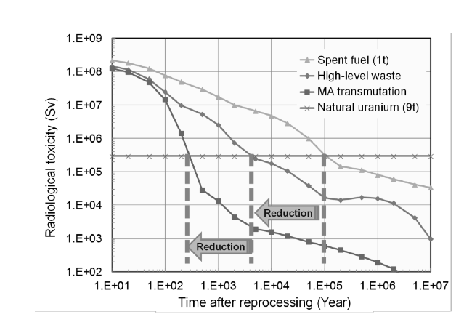
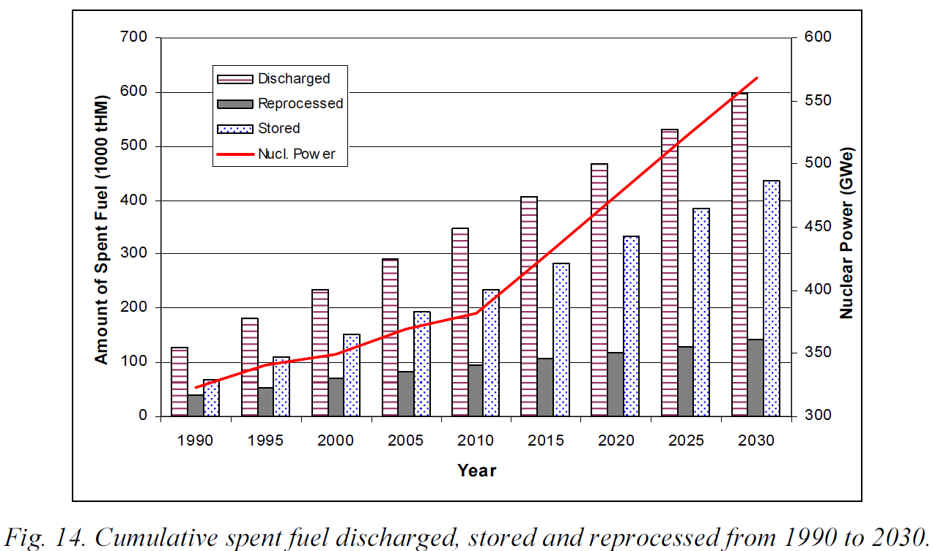
ADS & waste transmutation
According to the World Energy Council, global energy demand is expected to increase between 30% - 60% by 2050. This means a surge in electricity production of 120% to 150%. Replacing fossils will bring the value of the market to at least 10 trillion US$/y. Nuclear power potentiality is limited with present PWR technology (because of limited U reserves and because of public opposition to the expansion of nuclear).
High intensity beams from accelerators can provide neutrons able to:
“drive” a subcritical reactor to produce nuclear energy (Accelerator Driven System)
transmute radioactive waste into less dangerous elements
the world still would need to address the safe, economic and definitive management of all the waste produced in the last 60 years.
It is possible to reduce the lifetime of most dangerous waste from ≈200,000 y to ≈500 y

Slide 23
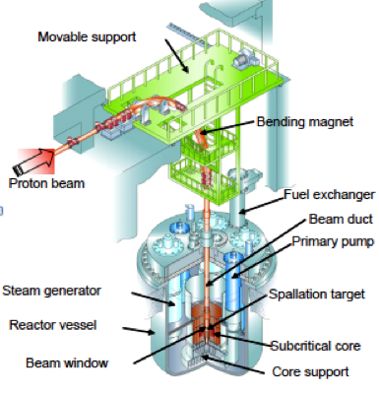
It is possible to achieve nuclear waste transmutation and/or nuclear energy generation using a high energetic proton beam hitting a target. The generated intense flux of spallation neutrons will be used to transmute in stable or short-lived isotopes the long-lived nuclear waste, or even to produce energy.
Great potential to eliminate criticality (K<1) accidents by making the system subcritical
Ex.:the CERN LHC beam can be switched off in 270µs
Great potential to minimize long-lived waste and recycling of long-lived transuranic actinides (TRU). Th/U-233 long term fuel activity has only trace quantities of transuranics and therefore lower radiotoxicity after 500 years
Great potential to control military proliferation because thorium fuel can only have small Pu production and 233U very difficult mixture

Slide 24
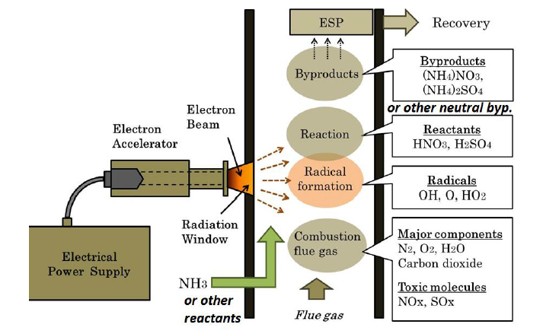
Exhaust gas cleaning
Combustion of fossil fuel produces SO_{x} and No_{x .} Deposition of these pollutants leads to acidification of the environment.
Electron Beam can simultaneously remove SO₂ and No_{x} in exhaust gas
Conventional technique only transfer the contaminant from gas (or liquid) to solid phase. The remains of the conventional processes still need to be stored/decontaminated.
Instead the only by-product of EB can be used for production of commercial agricultural fertilizer
Technology can be applied to cargo
ship, to municipal waste incinerators,
to power plants working with coal,
lignite, and heavy fuels. Plants are
efficiently in operation in Takahama
Clean Center (Jp), in Pomorzany (P)

Slide 25
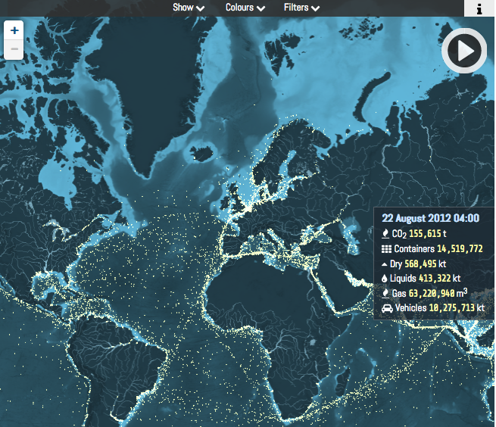
About 90% of world
trade is involving
sea transportation.
Shipping trades
produces a measurable negative impact on the environment
https://www.shipmap.org/
CERN currently promotes a research action with industries, regulators, academia, EC, to address this societal challenge with solutions involving EB accelerators.

Slide 26
Conclusion
Accelerator technology provides important applications for society. KT promotes its transfer for societal benefit.
Medicine, Imaging, Wastewater and exhaust gas cleaning, sterilization, energy production from biomass, energy production and nuclear waste treatment are potential areas mature for deployment using accelerator technologies.
CERN is ready to exploit possibilities of collaborations with industries to help the adoption of accelerator technologies for societal benefit.

Slide 27
Thank You!
M.Losasso CERN/KT ---- Marcello.Losasso@cern.ch
Notes:
27

