Slide 1

Material science and accelerator R&D: Reflectivity and Photo Yield measurements of vacuum chamber technical surfaces
Relatore interno: prof. M. Migliorati
Relatore esterno: dott. R. Cimino
Eliana La Francesca
Dottorato in fisica degli acceleratori
(XXXI ciclo)

Slide 2
Outline
Synchrotron radiation detrimental effects
Reflectivity and Photo Yield
Bessy II measurements
Conclusions
Eliana La Francesca
Roma, 19 November 2018

Slide 3
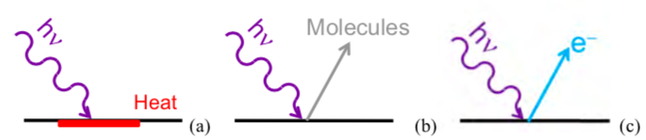
Synchrotron Radiation detrimental effects
Heat load on the accelerator walls
Gas load
Production of photo emitted electrons (e⁻ cloud effect)
Beam instability
Eliana La Francesca
Roma, 19 November 2018

Slide 4
Synchrotron Radiation interaction with Matter
Reflected + Absorbed + Transmitted
Specular reflected
Scattered
Eliana La Francesca
Roma, 19 November 2018

Slide 5
Synchrotron Radiation interaction with Matter
Reflected + Absorbed + Transmitted
Photo-electrons
generation
Electron cloud effect
Eliana La Francesca
Roma, 19 November 2018

Slide 6
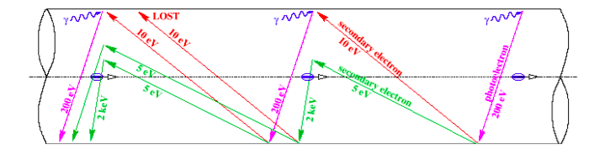
SR and electron cloud generation
Photo-emitted electrons can be:
Produced directly by SR (dipoles): emitted in the orbit plane (not participate to electron cloud build up).
Produced by the reflected or scattered light (dipoles and free field zone): emitted perpendicularly to the orbit plane (generate secondary electrons)
To model the generation of photoelectrons in PyECLOUD build- up simulations are needed paramters like PY and R
Beam instability
Original representation F. Ruggero
Eliana La Francesca
Roma, 19 November 2018

Slide 7
Synchrotron Radiation interaction with Matter
Reflected + Absorbed + Transmitted
Photo-electrons
generation
Heat Load
Electron cloud effect
Eliana La Francesca
Roma, 19 November 2018

Slide 8

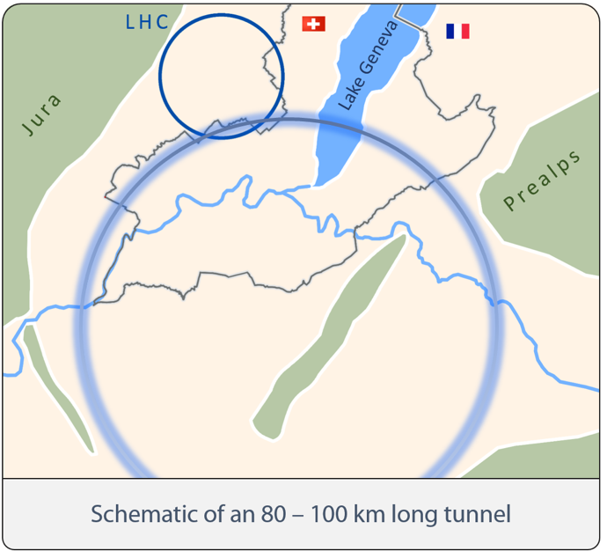
FCC Parameters
http://tlep.web.cern.ch/content/fcc-hh
Version 1.0 (2014-02-11)
Parameters LHC H-L LHC FCC-hh
FCC-hh SR incidence angle: 0.077 deg
(0.62 mrad)
Dipoles at
1.9 K
Total Power to dissipate such HL at cold bore temperature: 3 GW
Eliana La Francesca
Roma, 19 November 2018

Slide 9
Synchrotron Radiation interaction with Matter
Arc SR Heat Load = 28.4 (44.3) W/m/aperture
Reflected + Absorbed + Transmitted
Specular reflected
To be increased in high temperature parts
Scattered
To be increased in cold parts (Superconductor Magnets)
R. Cimino, V. Baglin and F. Schäfers, PRL. 115 (2015) 264804
Eliana La Francesca
Roma, 19 November 2018

Slide 10
Reflectivity
X-Ray Reflectivity depends on a limited number of parameters:
Photon energy and light polarization
Angle of incidence
Surface roughness
Material
Eliana La Francesca
Roma, 19 November 2018

Slide 11
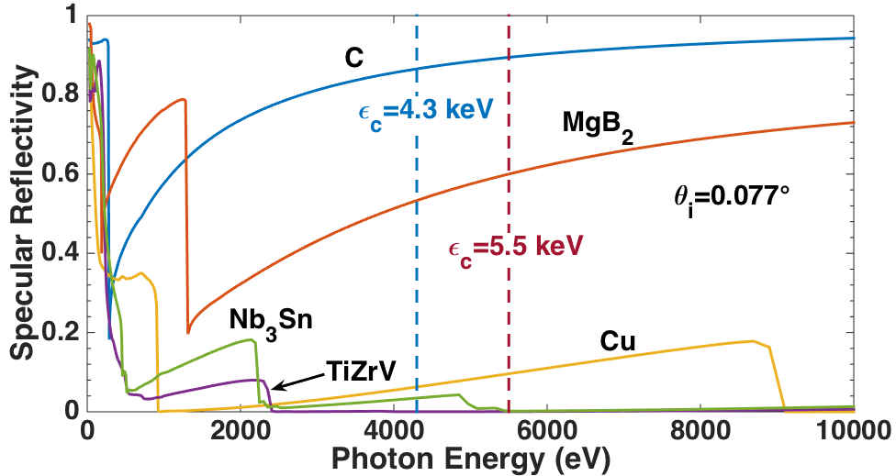
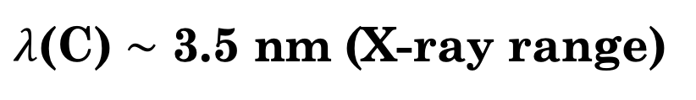
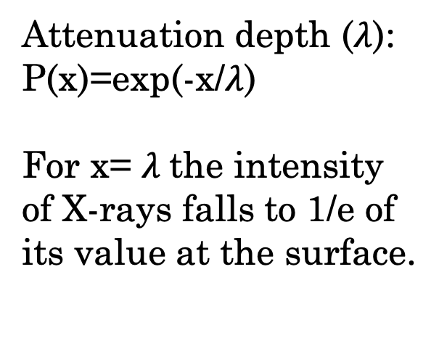
Specular Reflectivity: the case of Carbon
REFLEC simulations
FCC-hh SR incidence angle: 0.077 deg
(0.62 mrad)
R_{a}=50 nm
Attenuation depth ($λ$):
P(x)=exp(-x/$λ$)
For x= $λ$the intensity of X-rays falls to 1/e of its value at the surface.
R. Cimino, V. Baglin and F. Schäfers, PRL. 115 (2015) 264804
20 nm of C can reflect all photons
$λ$(C) $\sim$ 3.5 nm (X-ray range)
Eliana La Francesca
Roma, 19 November 2018

Slide 12
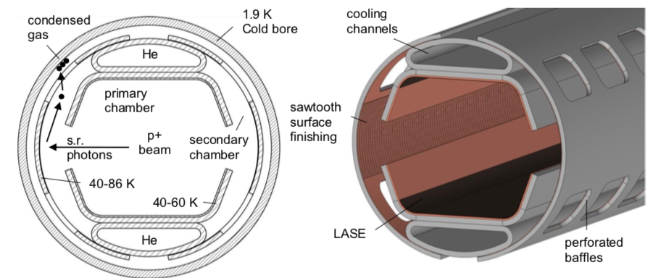
FCC-hh Beam Screen
Eliana La Francesca
Roma, 19 November 2018

Slide 13
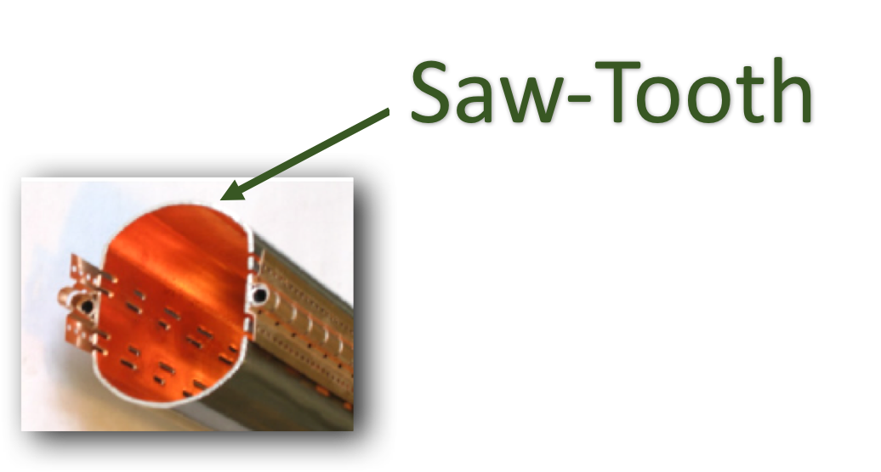
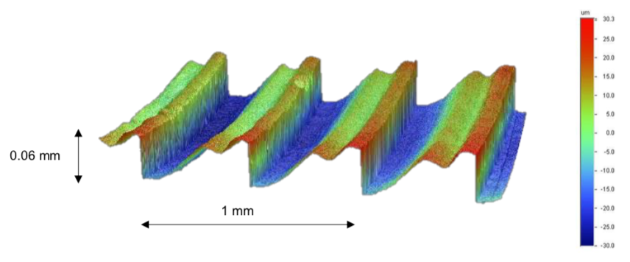
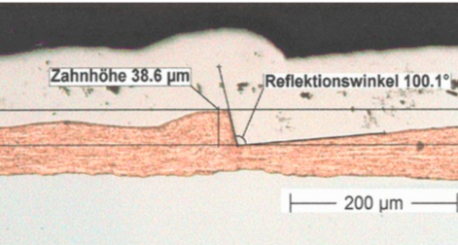
FCC-hh Beam Screen
Eliana La Francesca
Roma, 19 November 2018

Slide 14
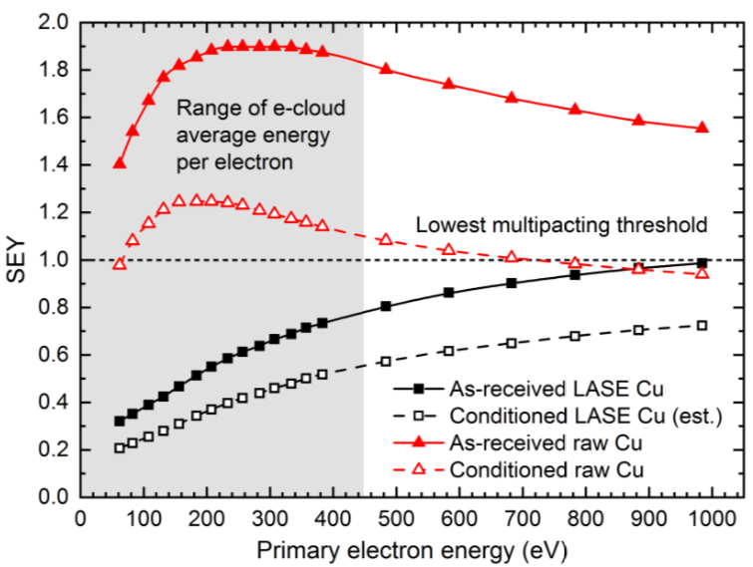
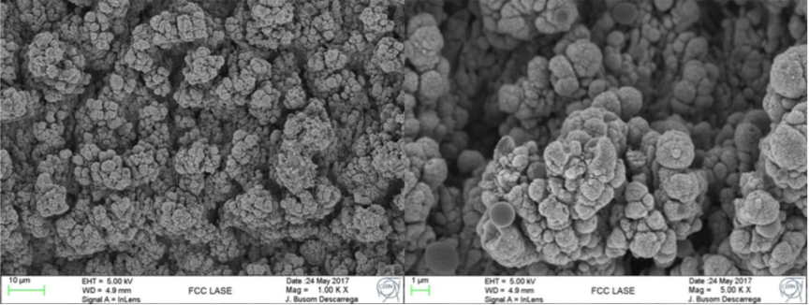
FCC-hh Beam Screen
The Science & Technology Facility Council (STFC)
Eliana La Francesca
Roma, 19 November 2018

Slide 15
Samples
two copper sample polished, Cu 1A and Cu 2A (10 cm long), with and without a-C coating;
two copper sample lapped, Cu 1B and Cu 2B (10 cm long), with and without a-C coating;
LHC Beam Screen (BS), flat zone (30 cm long), with and without a-C coating;
LHC Beam Screen (BS), Saw-Tooth zone (30 cm long);
Cu sample treated by Laser Ablation Surface Engineering (LASE, made by the Science & Technology Facility Council (STFC))(30 cm long).
Eliana La Francesca
Roma, 19 November 2018

Slide 16

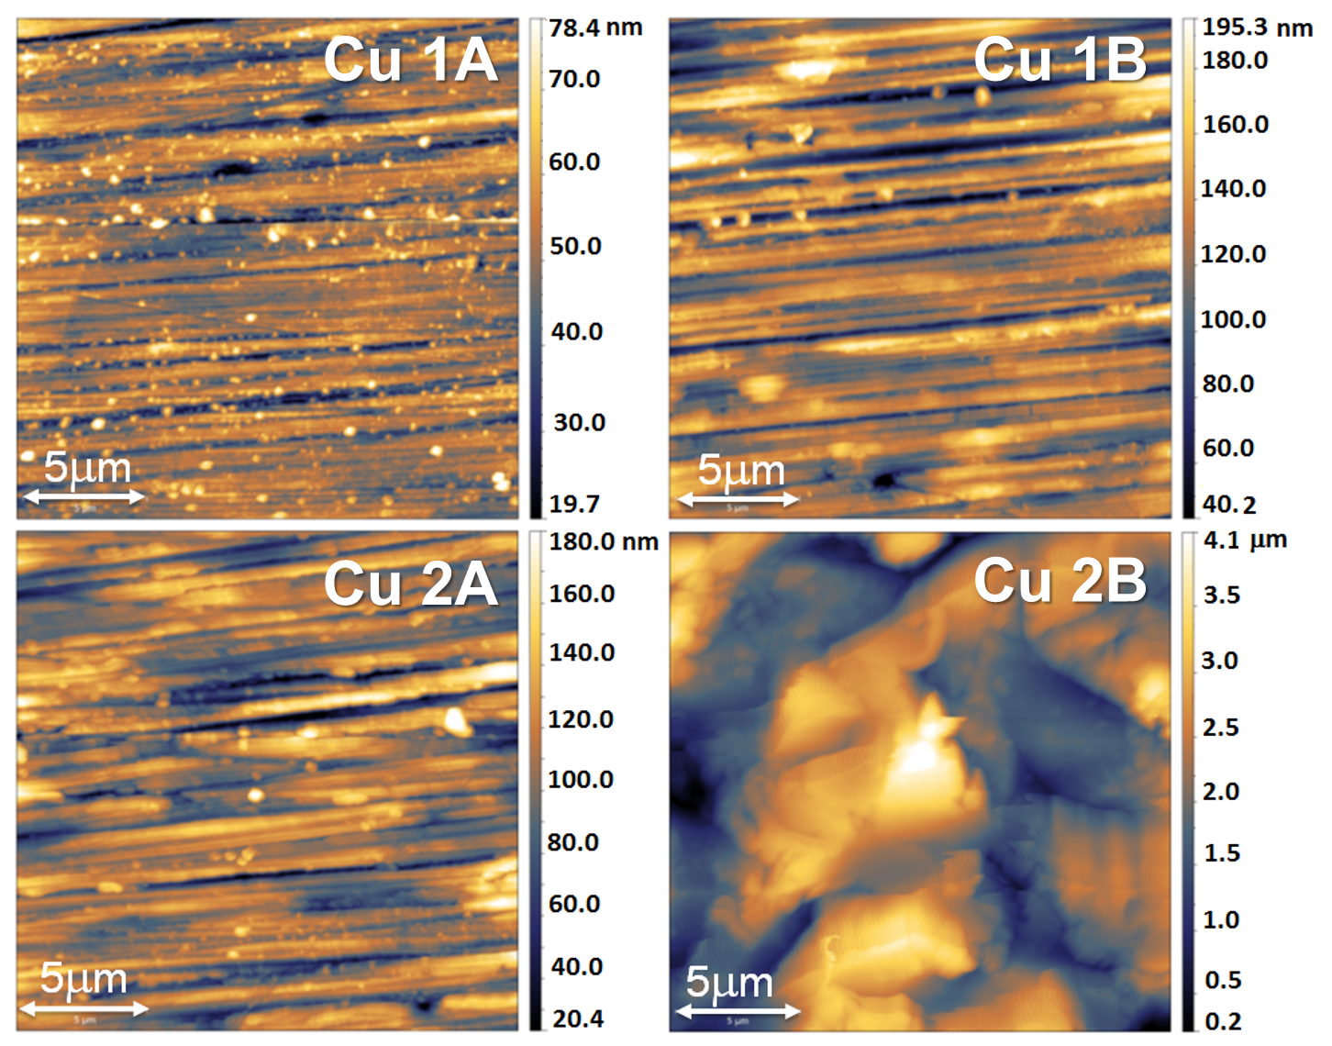
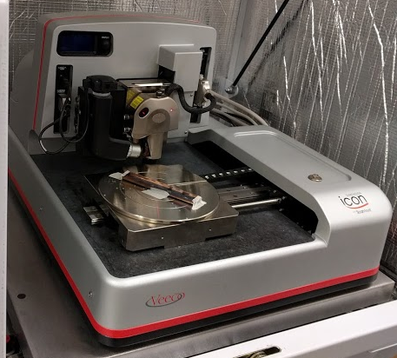
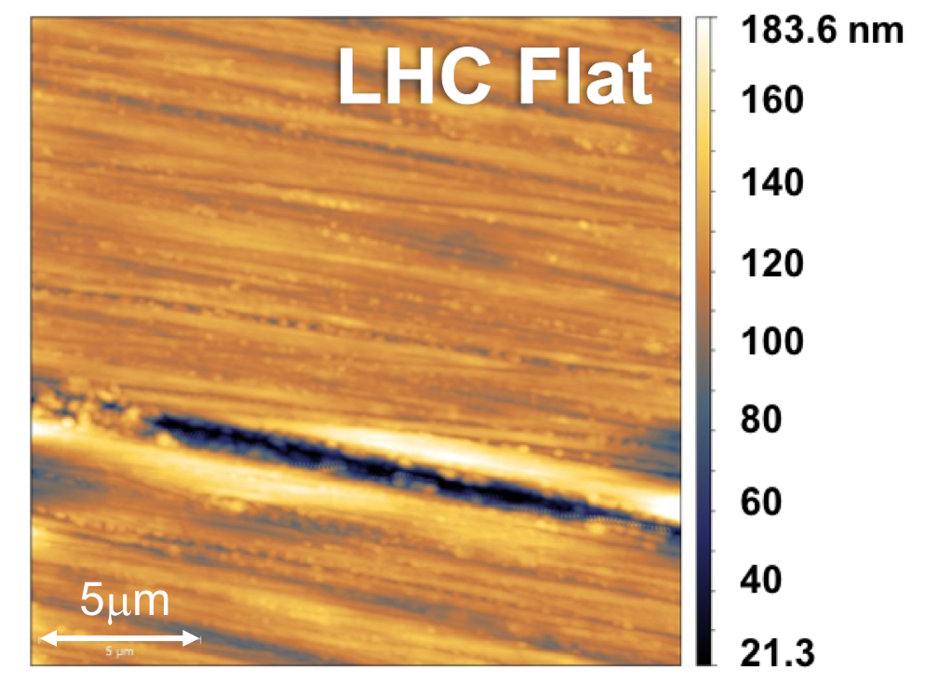
AFM measurements
AFM (20x20µm²)

Slide 17
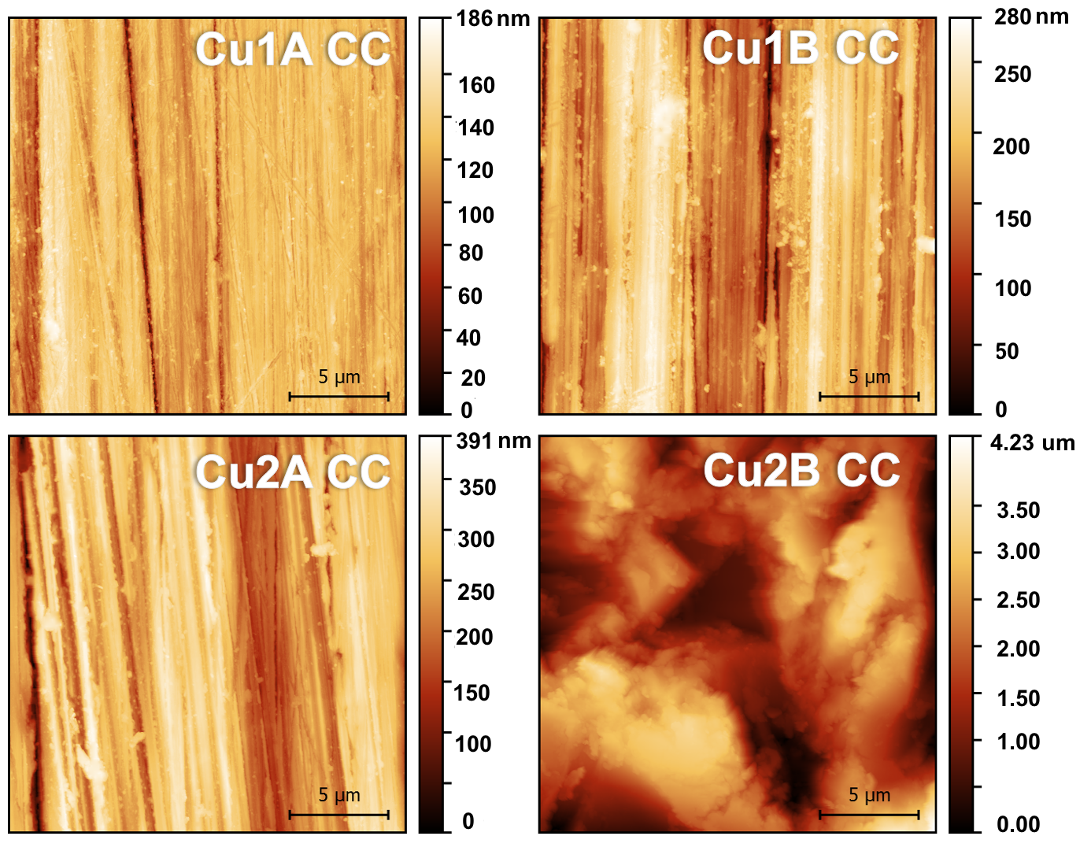
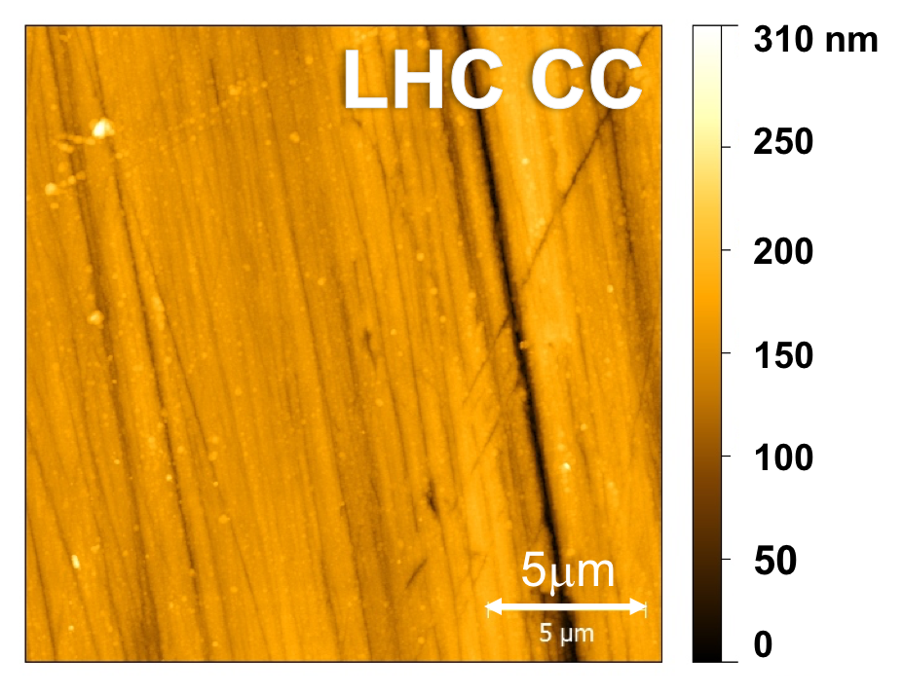
AFM measurements
AFM (20x20µm²)

Slide 18
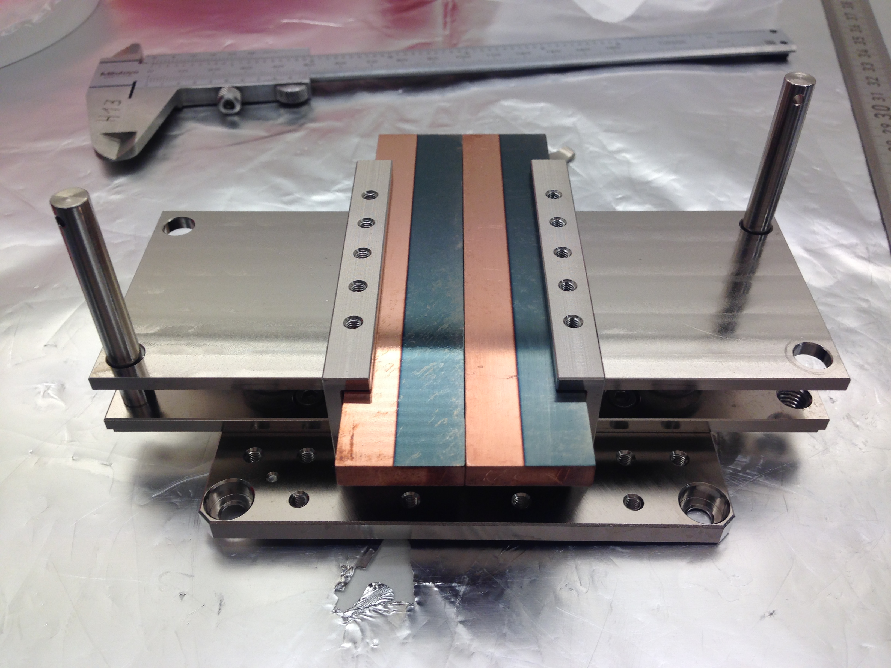
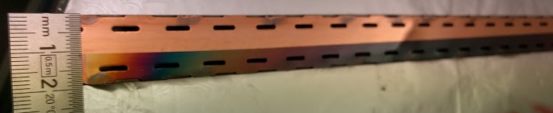
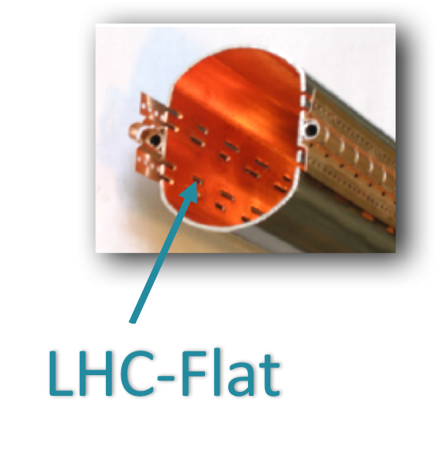
Measured roughness
Sample | RMS Roughness (R_{a}) | RMS Roughness (R_{a}) (Carbon Coating)
Cu 1A | 9.6 nm | 13.4 nm
Cu 1B | 25 nm | 31.3 nm
Cu 2A | 27 nm | 28.6 nm
Cu 2B | 643 nm | 648 nm
LHC-Flat | 14.9 nm | 20.1 nm
Cu 1A
Cu 2A
Side A – means polished
Side B – means lapped
50 nm CC made by
Magneto-sputtering
Eliana La Francesca
Roma, 19 November 2018

Slide 19
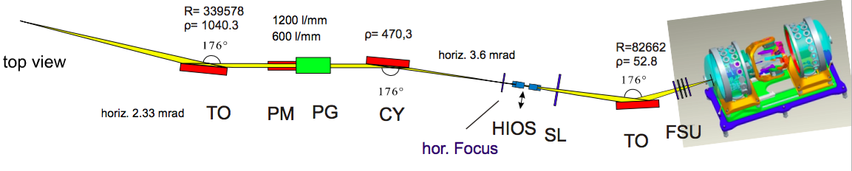

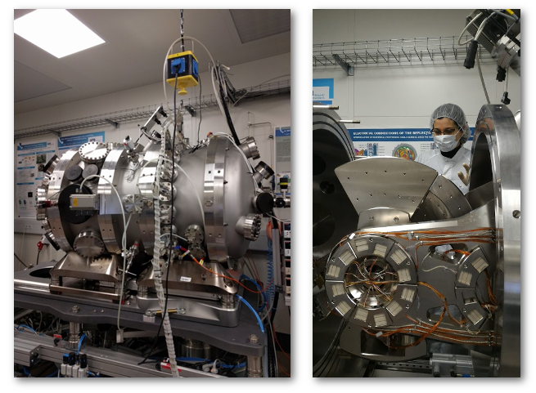
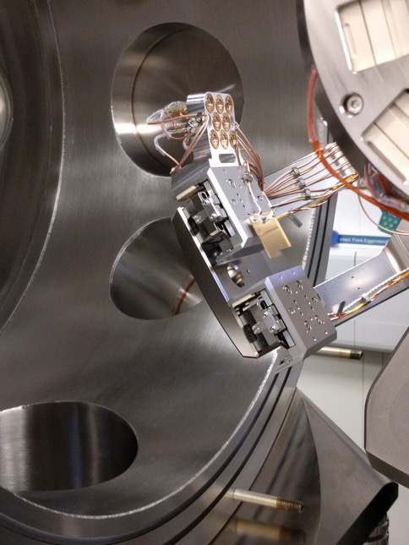
BESSY-II Optic Beamline and Reflectometer
A.A.Sokolov,et al,Proc.of SPIE92060J-1-13(2014)
Eliana La Francesca
Roma, 19 November 2018

Slide 20
BESSY-II Optic Beamline and Reflectometer
Incidence angle θ: -90° – 90°
Detector in-plane 2θ: -180° – 180°
Detector off-plane χ : -4° – 4°
Sample – detector: 310 mm
Six axes sample positioning
Sample current measurement
GaAsP-Photodiodes
Detector slits, pinholes
A.A.Sokolov,et al,Proc.of SPIE92060J-1-13(2014)
Eliana La Francesca
Roma, 19 November 2018

Slide 21
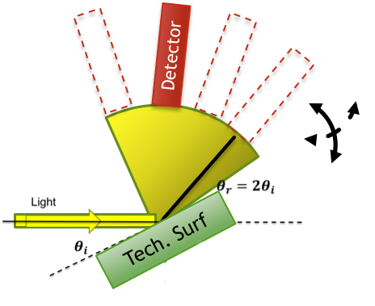
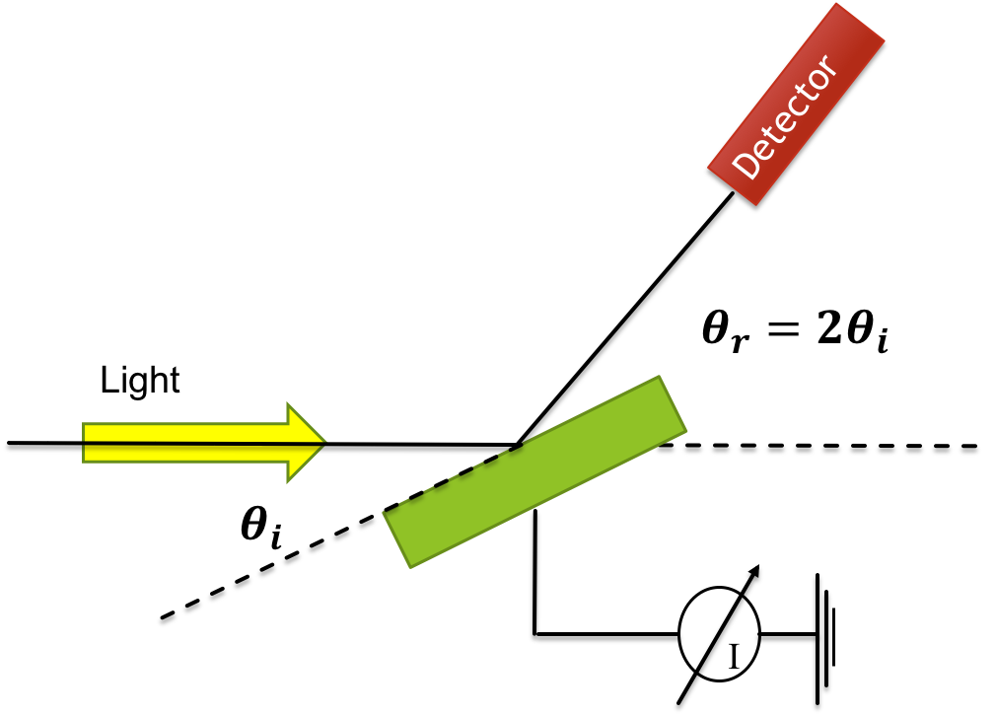
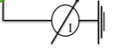
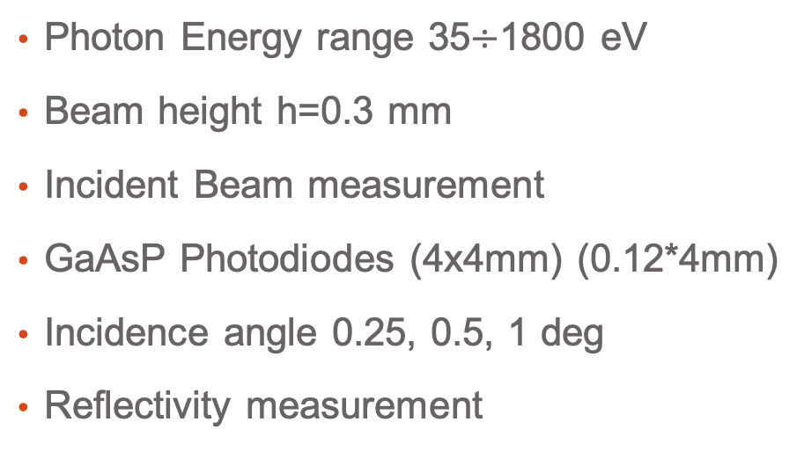




Bessy II Measurements
Photon Energy range 35$÷$1800 eV
Beam height h=0.3 mm
Incident Beam measurement
GaAsP Photodiodes (4x4mm) (0.12*4mm)
Incidence angle 0.25, 0.5, 1 deg
Reflectivity measurement
Photo Yield:
PY= N_{e}/N$γ$
Specular Reflectivity
Scattered Light
Specular
Total
Detector
$$θ_{r}=2θ_{i}$$
$$θ_{i}$$
Mirror
$$θ_{i}$$
Eliana La Francesca
Roma, 19 November 2018

Slide 22
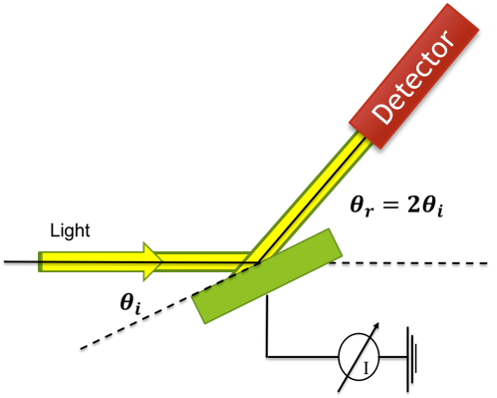
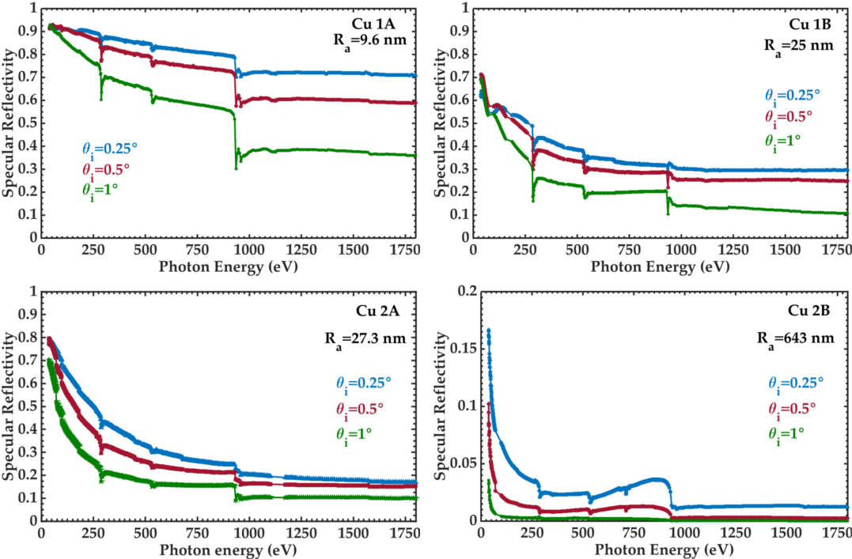

Flat Copper Samples
$$θ$$
$$θ_{r}=2θ$$
Tech. Surf
At grazing incidence angle contaminants are influencing Cu Reflectivity
Eliana La Francesca
Roma, 19 November 2018

Slide 23
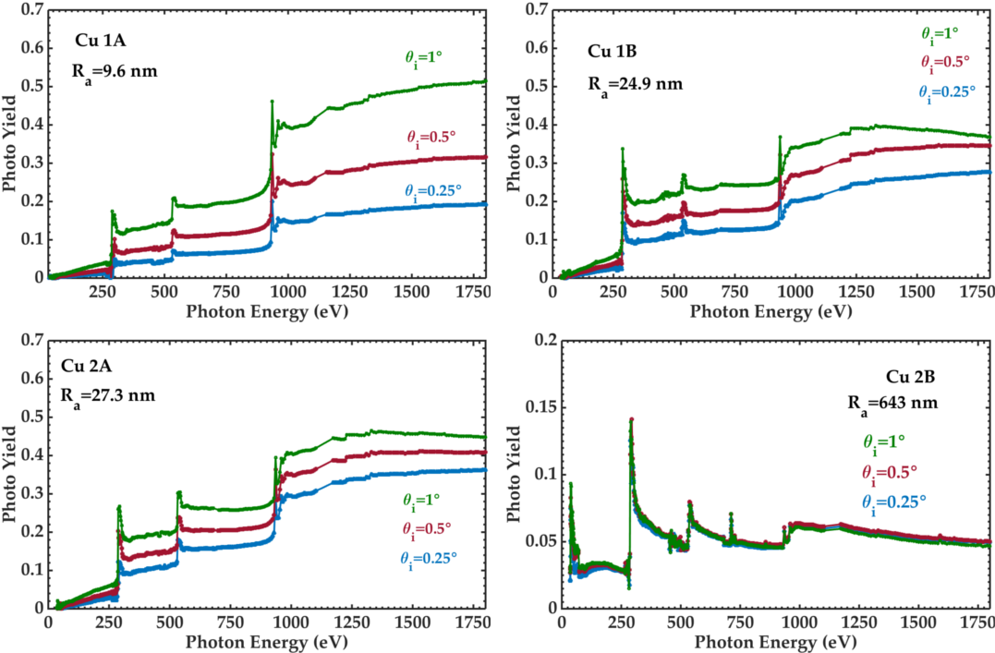
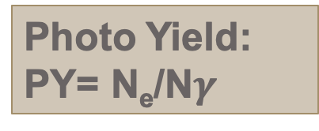
Flat Copper Samples
$$θ$$
$$θ_{r}=2θ$$
Tech. Surf
Photo Yield:
PY= N_{e}/N$γ$
Peaks correspond to absorption edge
Eliana La Francesca
Roma, 19 November 2018

Slide 24
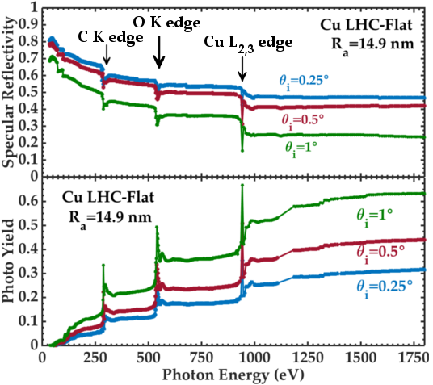
LHC-Flat
$$θ$$
$$θ_{r}=2θ$$
Tech. Surf
Photo Yield:
PY= N_{e}/N$γ$
At grazing incidence angle contaminants are influencing Cu Reflectivity
Peaks correspond to absorption edges
Eliana La Francesca
Roma, 19 November 2018

Slide 25
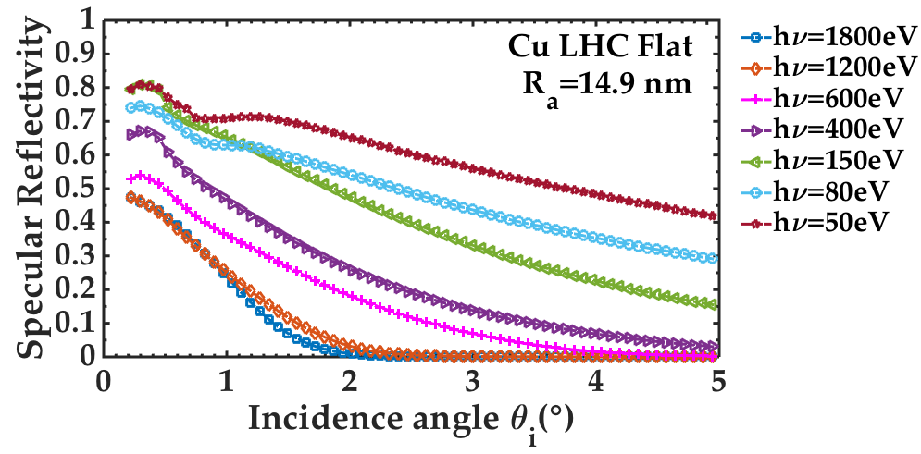
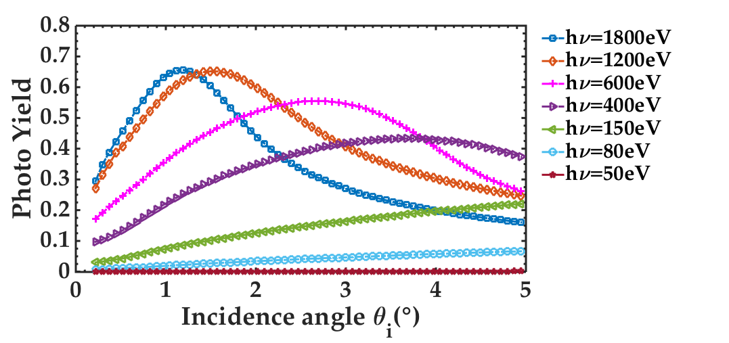
LHC-Flat
$$θ$$
$$θ_{r}=2θ$$
Tech. Surf
Photo Yield:
PY= N_{e}/N$γ$
Low energy photons can be reflected even at high incidence angles
Eliana La Francesca
Roma, 19 November 2018

Slide 26
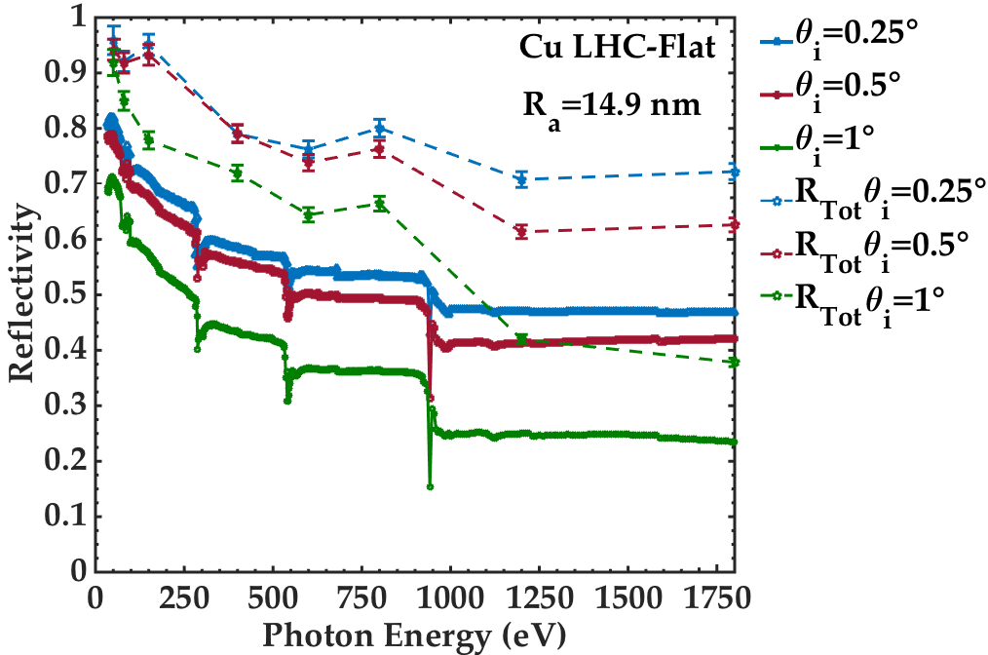
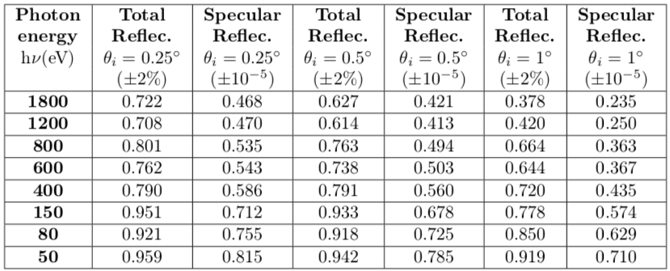
Specular and Total Reflectivity
Eliana La Francesca
Roma, 19 November 2018

Slide 27
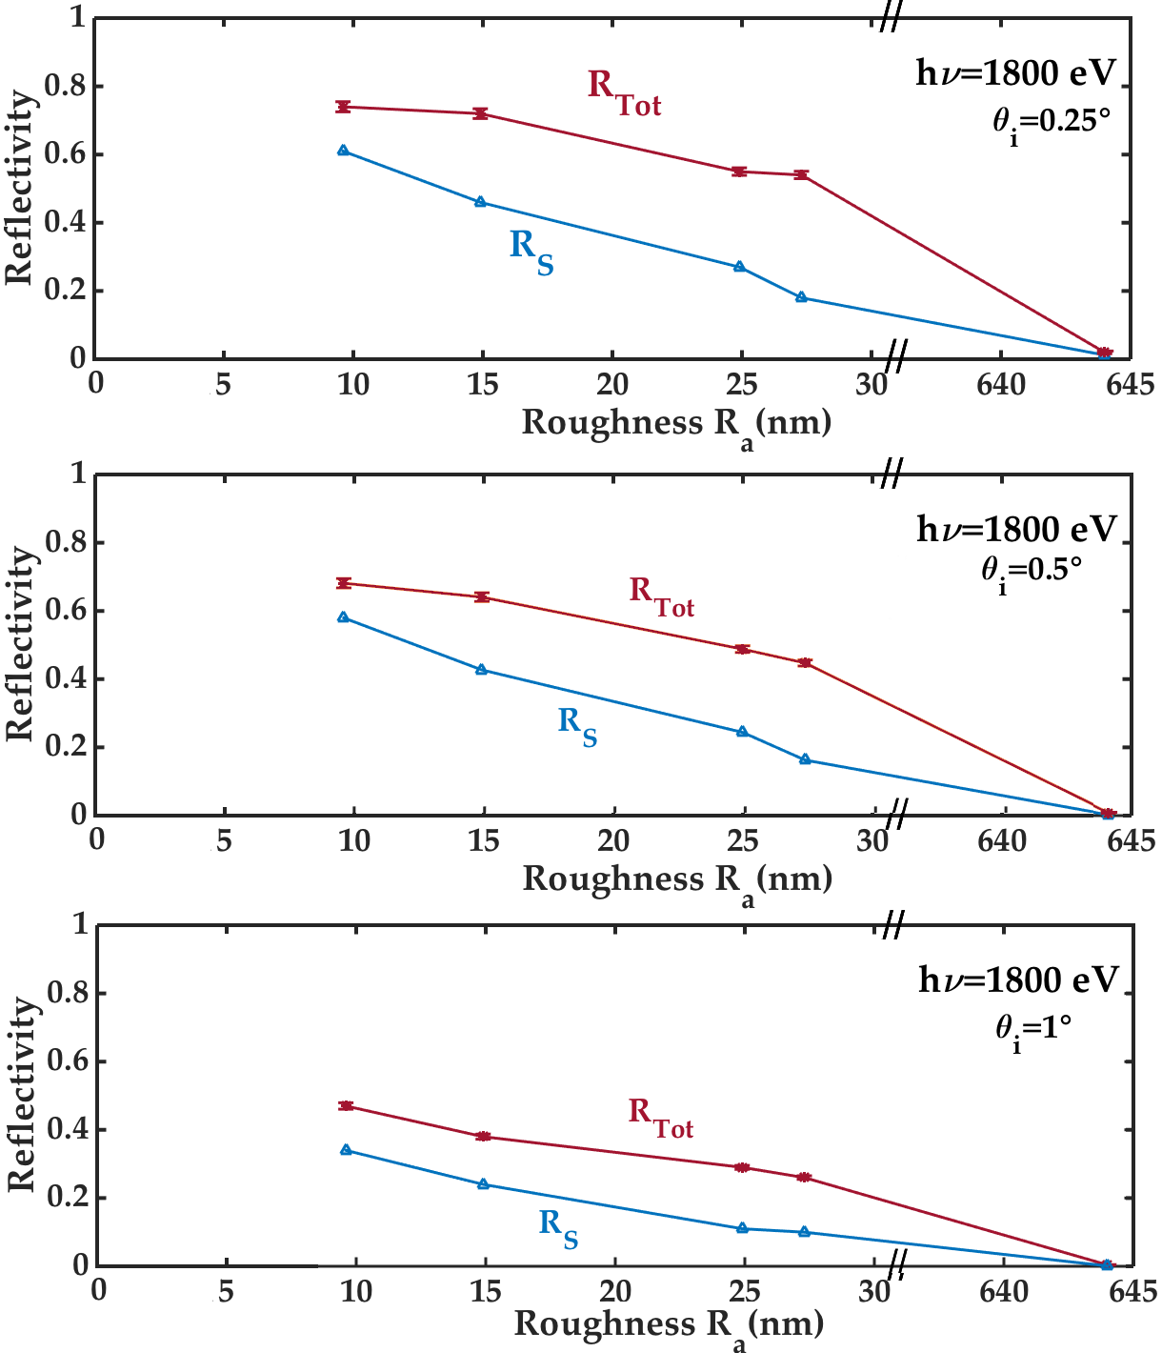
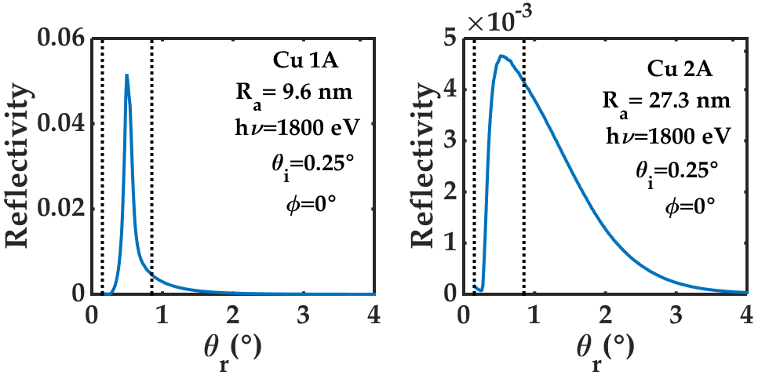
Specular and Total Reflectivity
Eliana La Francesca
Roma, 19 November 2018

Slide 28
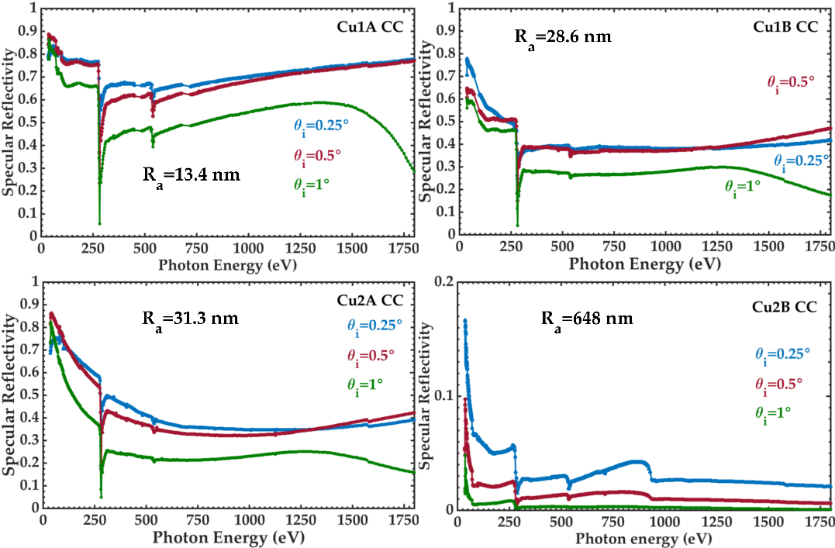
Cu Samples with C Coating
$$θ$$
$$θ_{r}=2θ$$
Tech. Surf
Coating process increased roughness
Eliana La Francesca
Roma, 19 November 2018

Slide 29
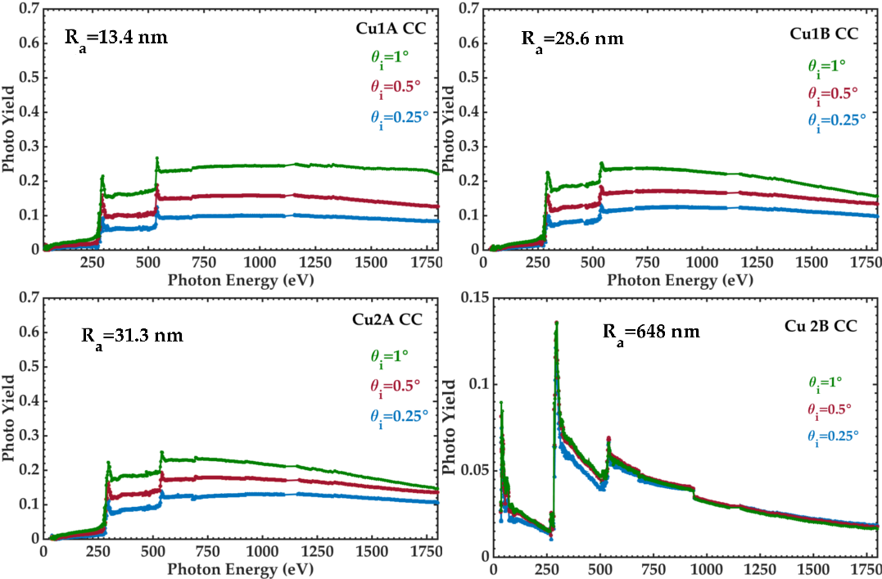
Cu Samples with C Coating
$$θ$$
$$θ_{r}=2θ$$
Tech. Surf
Peaks correspond to absorption edges
Carbon coating reduces
Photo Yield at high energy
Eliana La Francesca
Roma, 19 November 2018

Slide 30
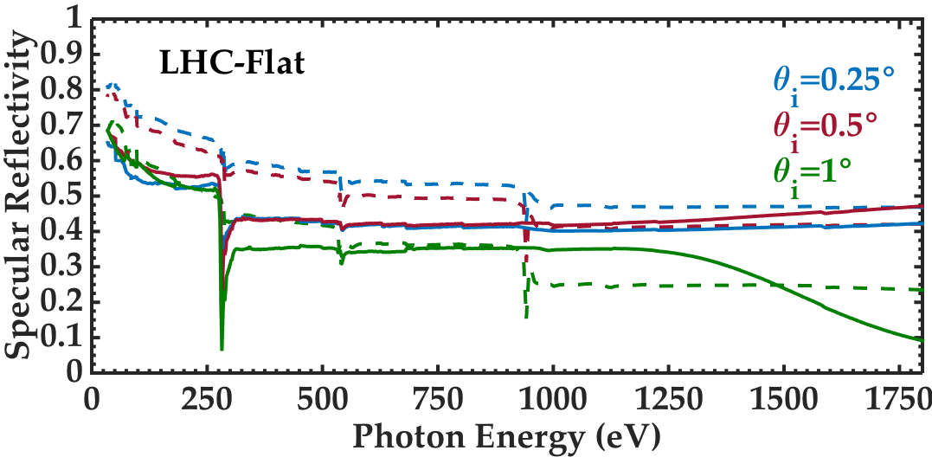
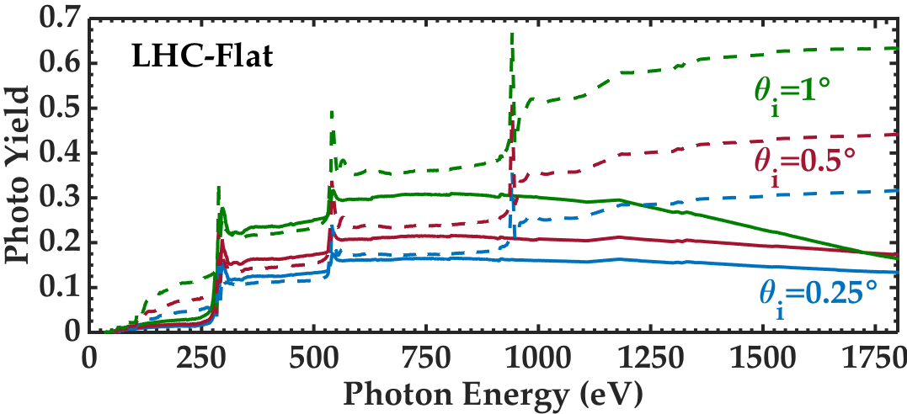
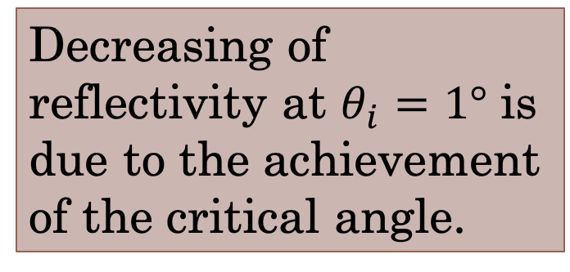
LHC-Flat with C Coating
$$θ$$
$$θ_{r}=2θ$$
Tech. Surf
Decreasing of reflectivity at $θ_{i}=1°$ is due to the achievement of the critical angle.
Peaks correspond to absorption edges
Eliana La Francesca
Roma, 19 November 2018

Slide 31
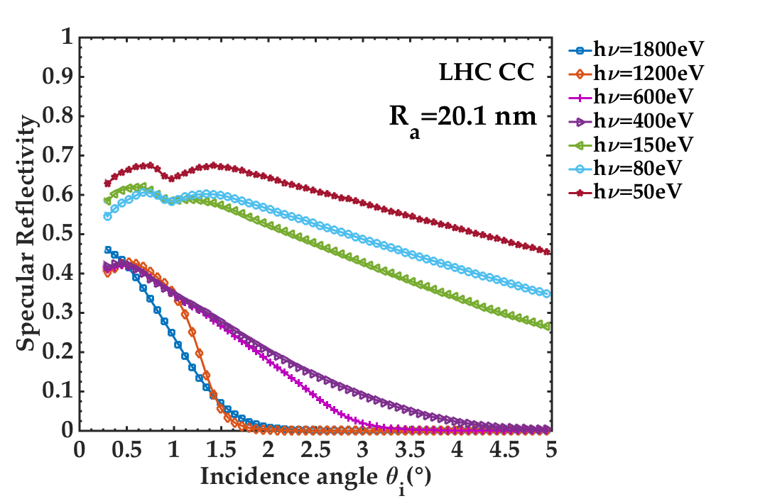
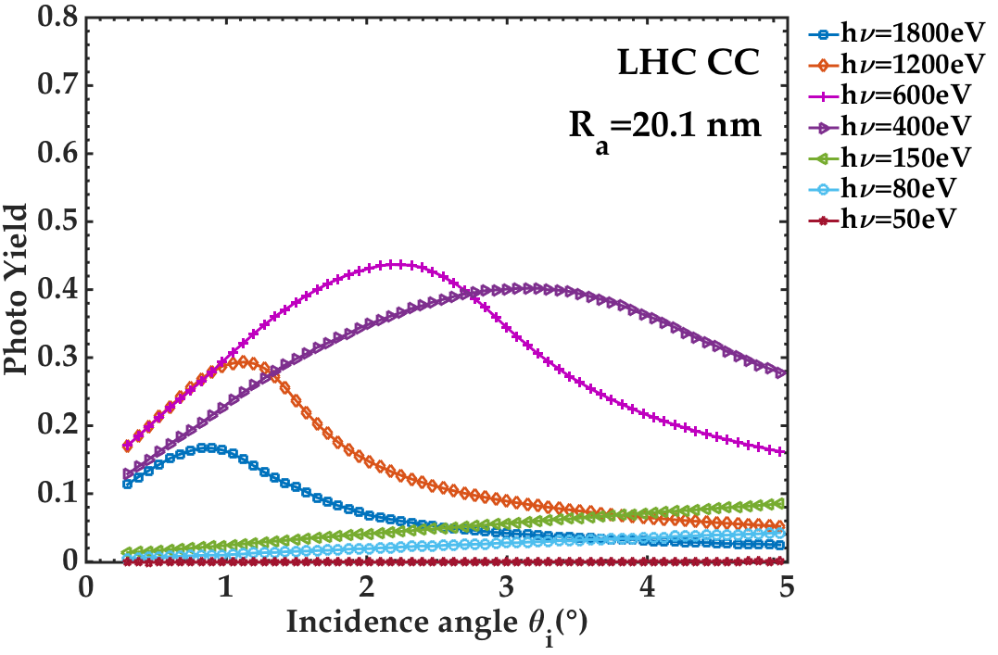
LHC-Flat with C Coating
Photo Yield:
PY= N_{e}/N$γ$
$$θ$$
$$θ_{r}=2θ$$
Tech. Surf
Eliana La Francesca
Roma, 19 November 2018

Slide 32
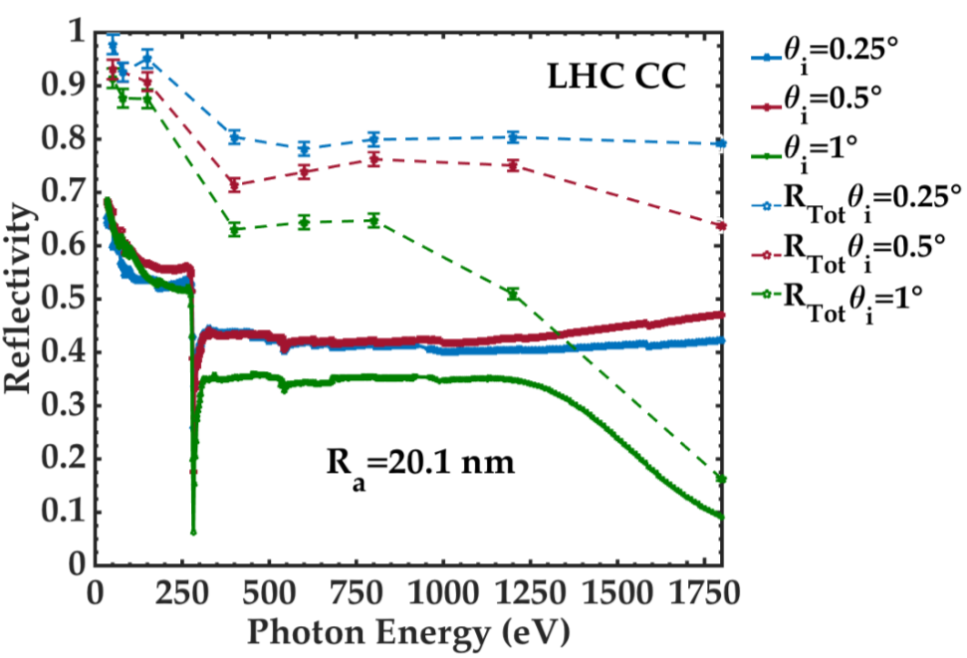
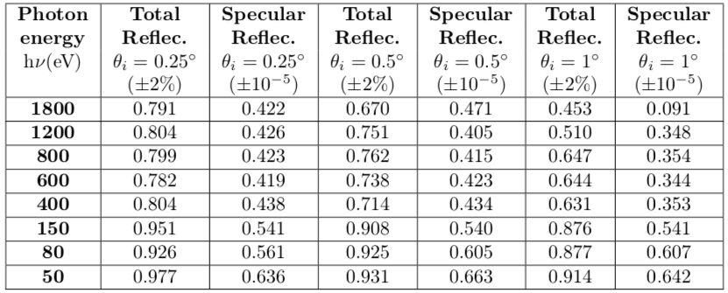
Specular and Total Reflectivity
Total Reflectivity higher than Specular Reflectivity
Eliana La Francesca
Roma, 19 November 2018

Slide 33
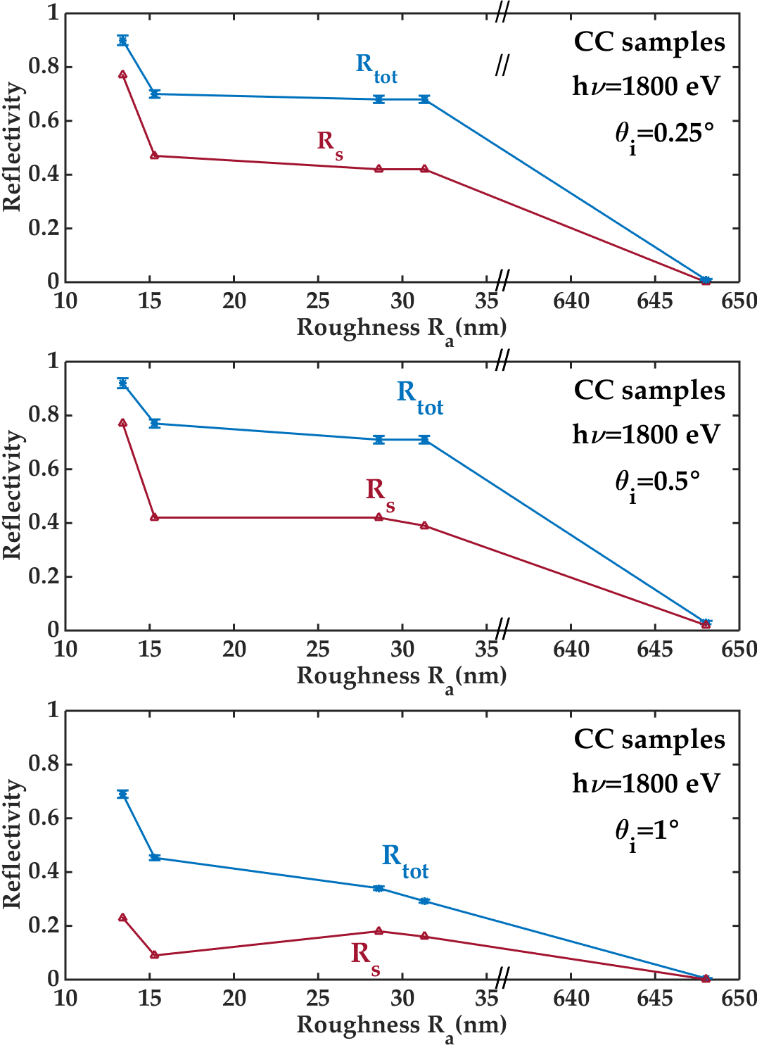
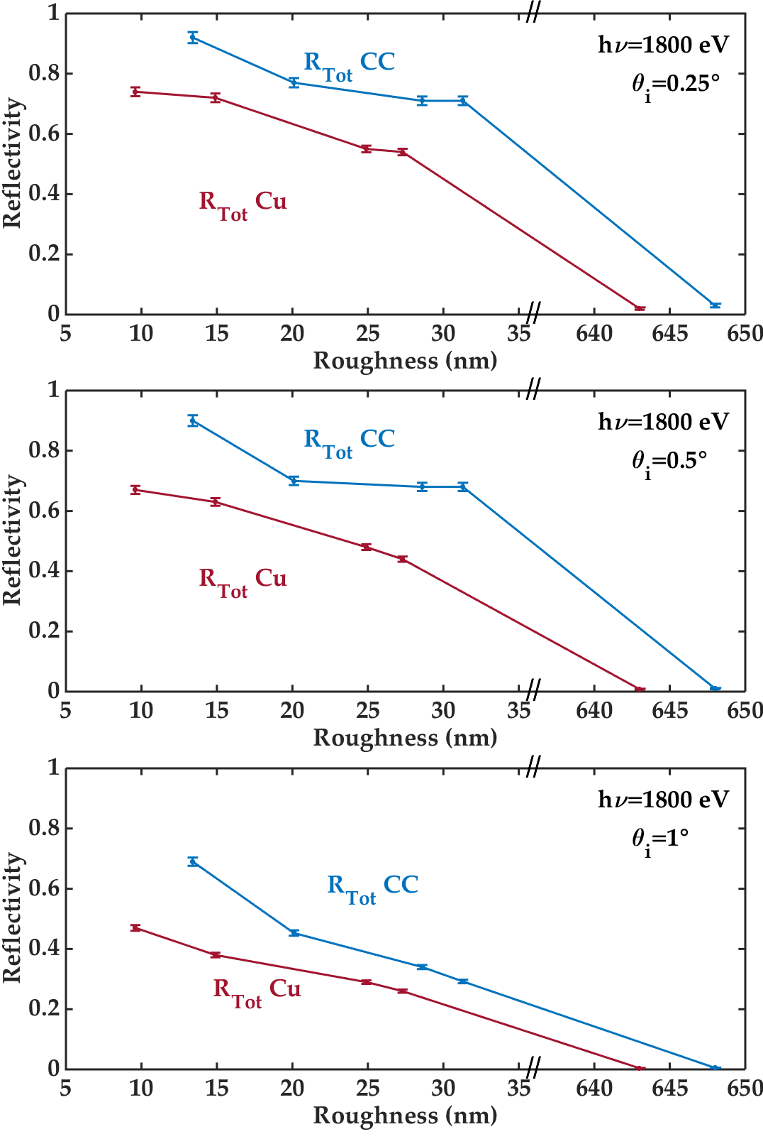
Specular and Total Reflectivity
CC increases Total Reflectivity and reduce absorption and related Heat Load.
Eliana La Francesca
Roma, 19 November 2018

Slide 34
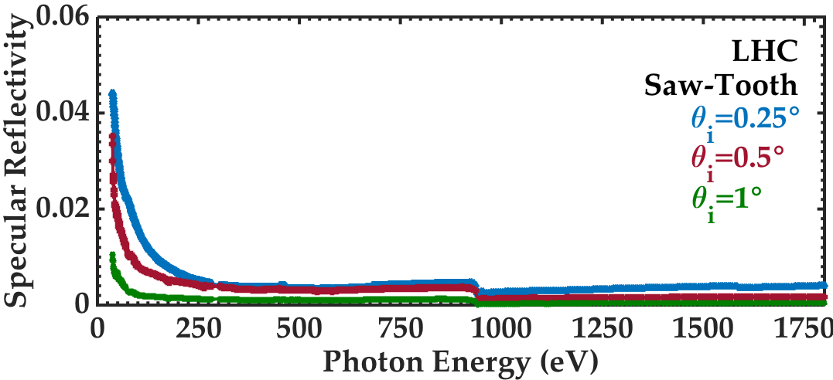

LHC Saw-Tooth
$$θ$$
$$θ_{r}=2θ$$
Tech. Surf
PY peaks confirm the contaminants presence
Little difference in PY for the three incidence angle
Eliana La Francesca
Roma, 19 November 2018

Slide 35


LHC Saw-Tooth
$$θ$$
$$θ_{r}=2θ$$
Tech. Surf
Total Reflectivity higher than Specular Reflectivity
Eliana La Francesca
Roma, 19 November 2018

Slide 36


LASE
$$θ$$
$$θ_{r}=2θ$$
Tech. Surf
No difference in PY for the three incidence angle
No carbon evidence
Eliana La Francesca
Roma, 19 November 2018

Slide 37


LASE
$$θ$$
$$θ_{r}=2θ$$
Tech. Surf
Total Reflectivity higher than Specular Reflectivity
Eliana La Francesca
Roma, 19 November 2018

Slide 38


Surface modification effects
LHC S-T Specular Reflectiviy is one order of magnitude lower than LASE.
Photo Yield of LHC S-T and LASE are the same
Eliana La Francesca
Roma, 19 November 2018

Slide 39
Conclusions
At grazing incidence angle air contaminants deeply influence Reflectivity.
For technical surfaces scattered light cannot be neglected.
Photo Yield does not significantly depend on roughness.
Carbon coating increases Total Reflectivity and reduce absorption and related Heat Load (as long as incidence angle is below its critical angle).
Cu LASE Reflectivity is substantially lower than for untreated copper and for LHC Saw-Tooth sample.
The Photo Yield of Saw-Toothed copper and LASE are the same.
Experimental data are important to characterize SR behaviour and HL for all materials to be used in FCC-hh dipoles and IP.
Eliana La Francesca
Roma, 19 November 2018

Slide 40
Thank you for your attention.
Eliana La Francesca
Roma, 19 November 2018

