Slide 1
CHALLENGES IN THE DESIGN OF A LASER DRIVER FOR A PLASMA ACCELERATOR
European Advanced Accelerator Concepts Workshop (EAAC2019), 15-21 September 2019 Hotel Hermitage, La Biodola Bay, Isola d'Elba, Italy
Leonida Antonio GIZZI
Intense Laser irradiation laboratory
Istituto Nazionale di Ottica, CNR, Pisa, Italy
and
INFN, Sezione di Pisa, Italy
In collaboration with:
L. Labate
ILIL, CNR-INO, Pisa, Italy
F. Mathieu
LULI, CNRS, Ecole Polytechnique, 91128 Palaiseau, France
G. Toci
CNR-INO, Sesto Fiorentino, Italy

Slide 2
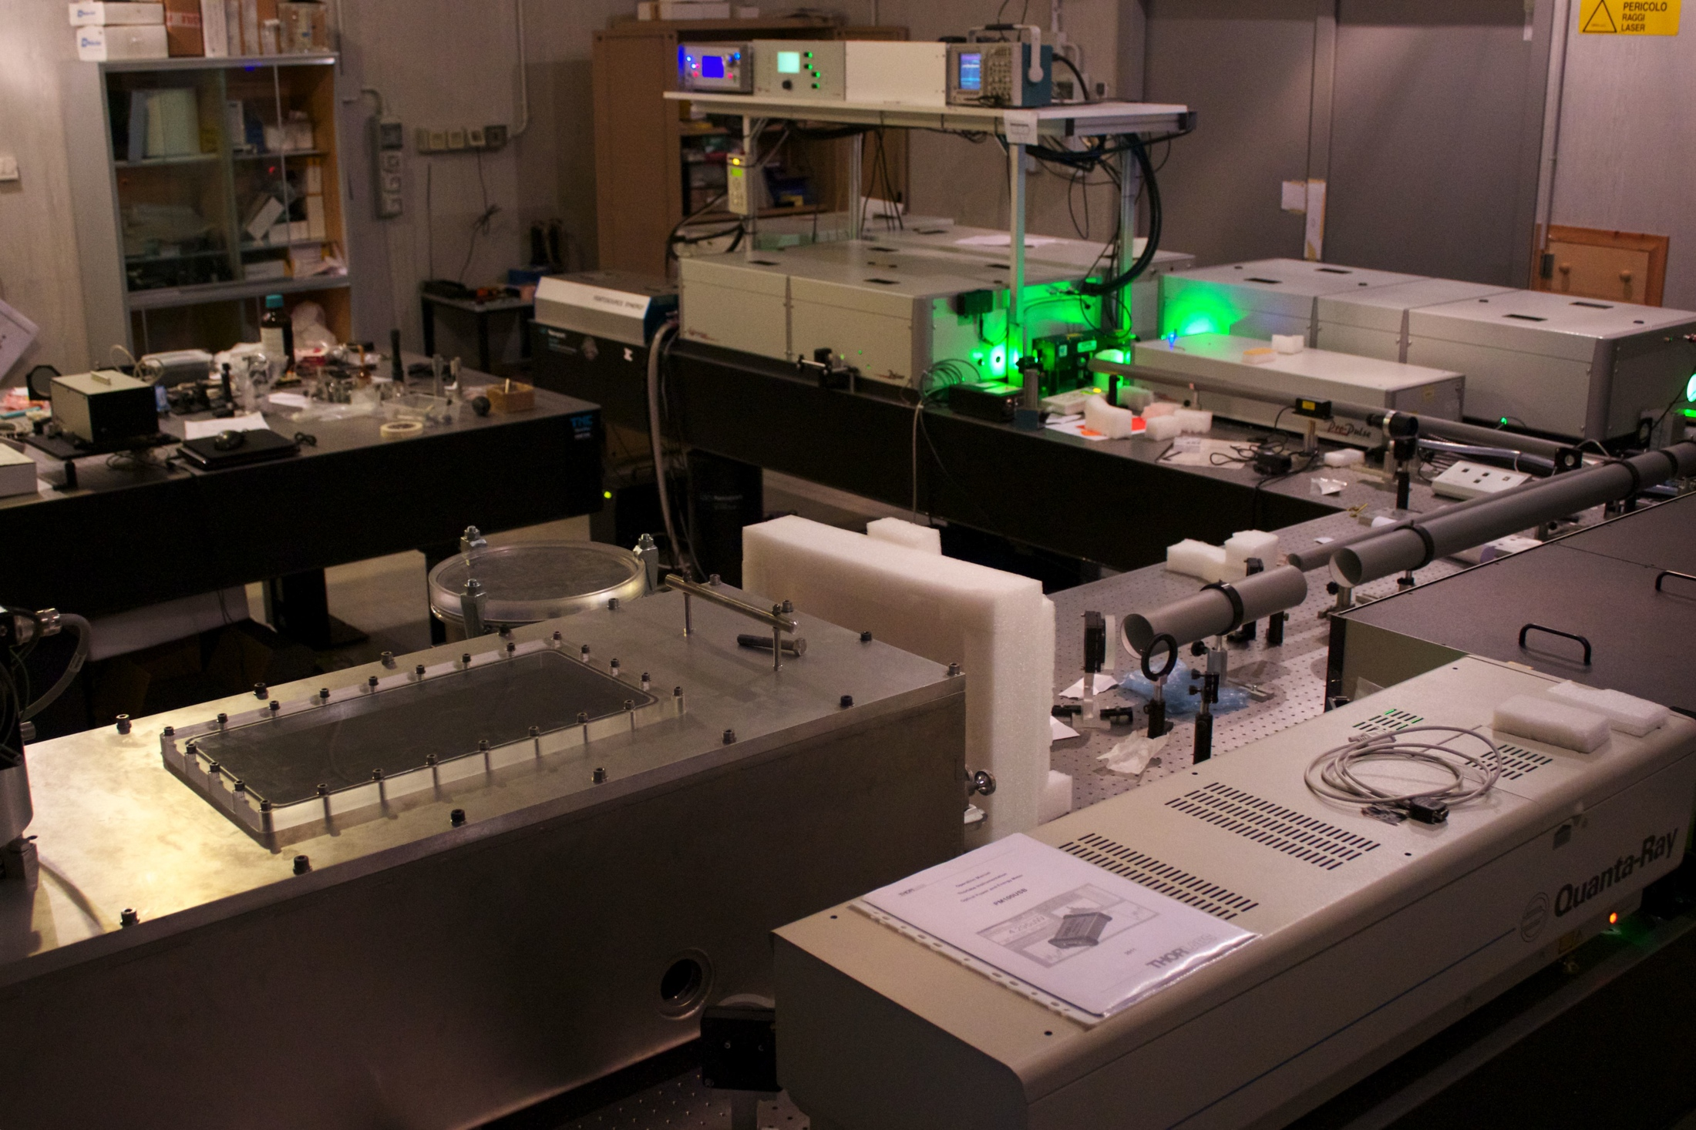
CNR-INO
Intense Laser Irradiation Lab
Pisa, Italy
A node of the Italian ELI Network
A founding member of the EuPRAXIA infrastructure project
http://www.ilil.ino.it
Intense Laser Irradiation Laboratory
LNS-INFN, Catania

Slide 3
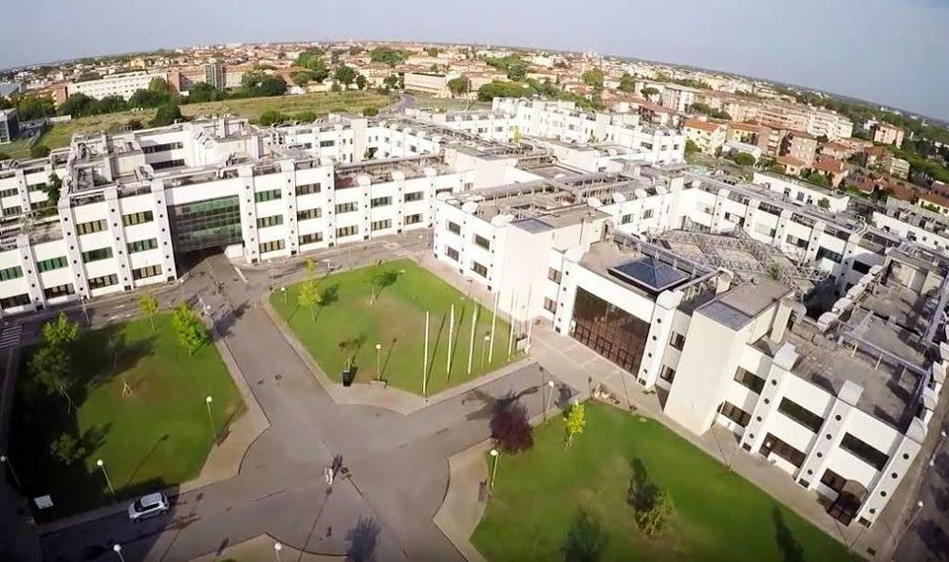
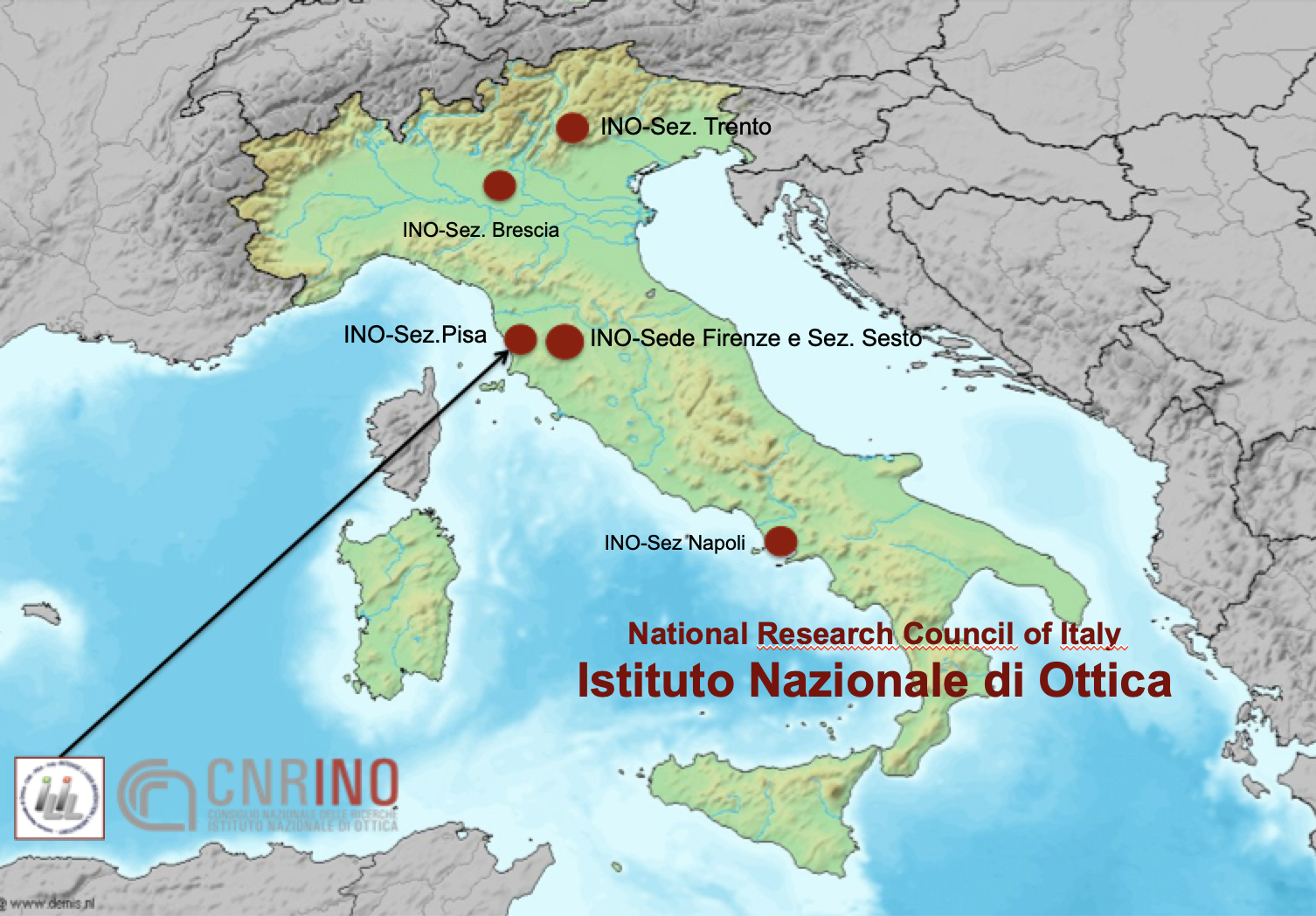
CNR Campus in Pisa
LNS-INFN, Catania

Slide 4
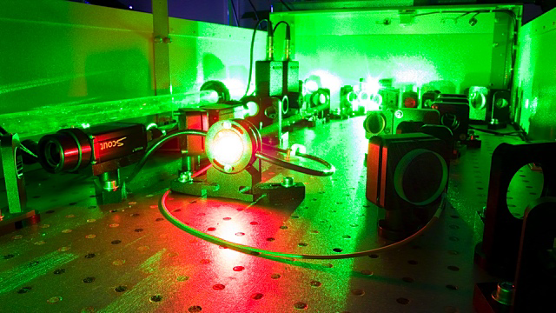
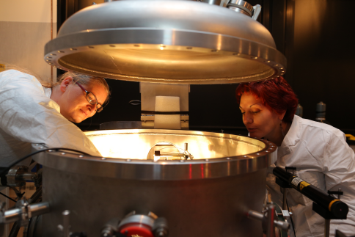
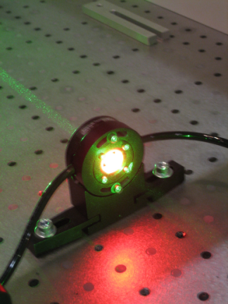
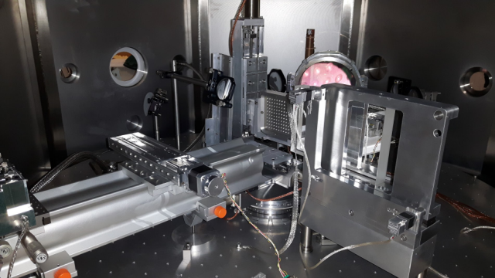
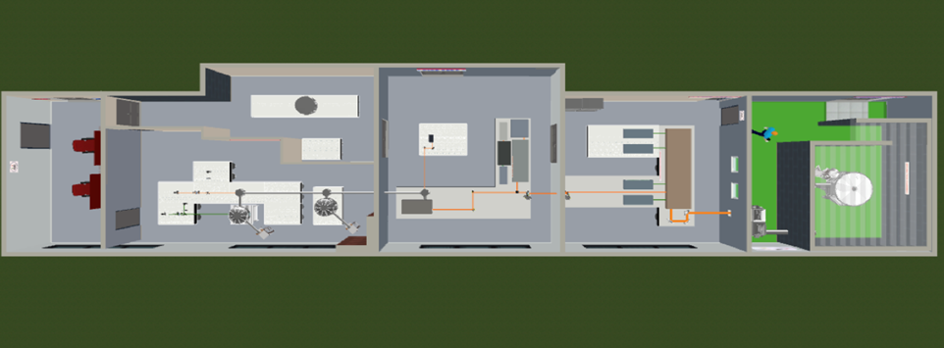
PEOPLE
  Leonida A. GIZZI
  Fernando BRANDI
Gabriele CRISTOFORETTI
Petra KOESTER
Luca LABATE
Federica BAFFIGI
Lorenzo FULGENTINI
Paolo TOMASSINI
Daniele PALLA
Davide TERZANI
Antonio GIULIETTI
Sanjeev KUMAR
Federico AVELLA
The Intense Laser Irradiation Lab
Contributions to this workshop
L. Labate, WG4, Mon. 16.40
L.A. Gizzi, WG7, Mon, 18.20
D. Terzani, WG6, Wed, 18.40
P. Tomassini, Poster, Wed, 19.00
L.A. Gizzi, Poster, Wed, 19.00
F. Brandi, Plenary, Fri, 9am
Sub-PW Experimental Laser Facility
Control Room
Radiobiology
Laser-Driven
Particles and Radiation
Laser Front End
10 TW, 10 Hz
Power Amplifier
Up to 250 TW
Shielded target Area LWFA, TNSA, Thomson Scattering, γ-rays …

Slide 5


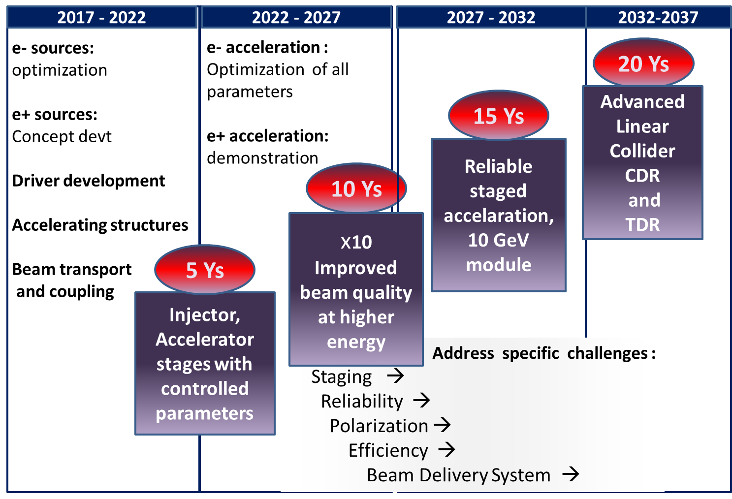

Roadmap of Advanced and Novel Accelerators

Slide 6

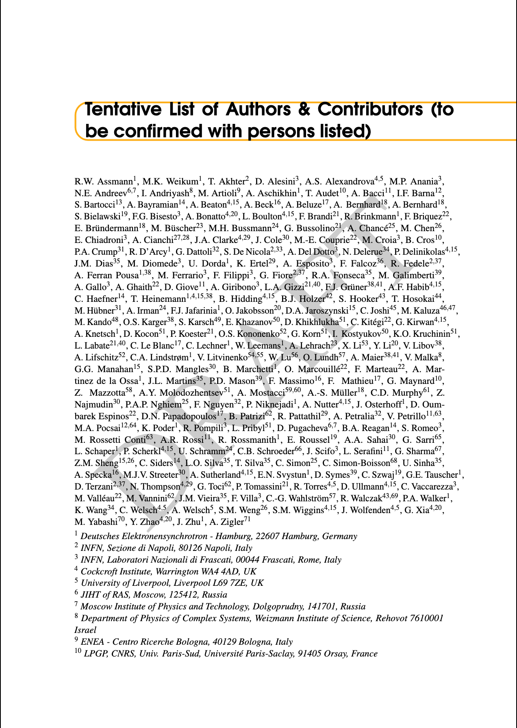
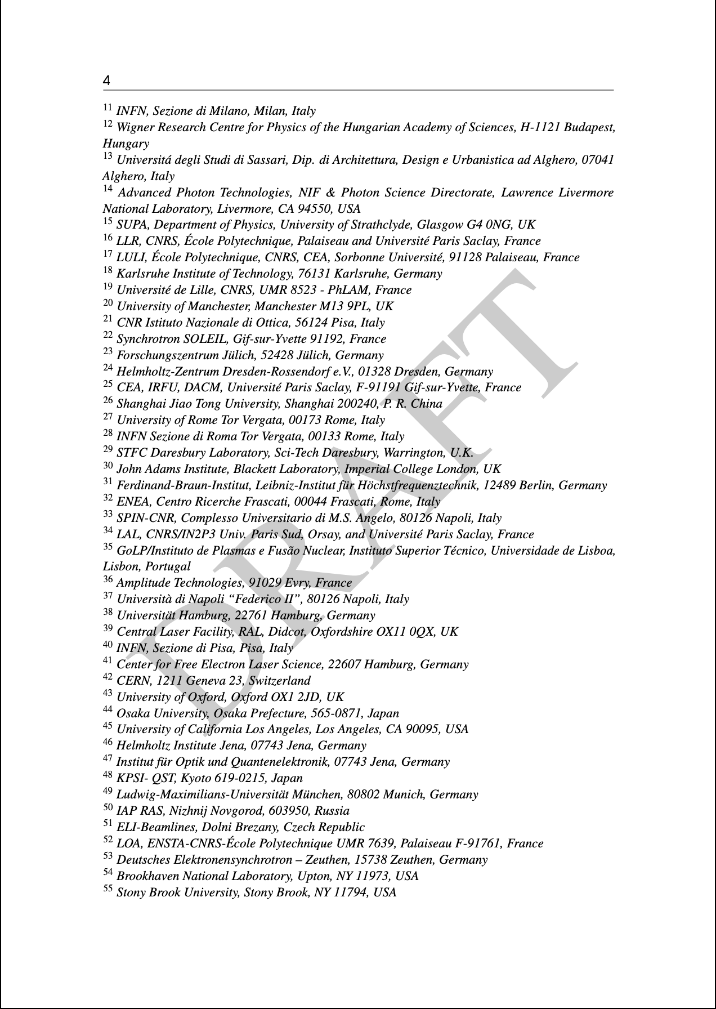
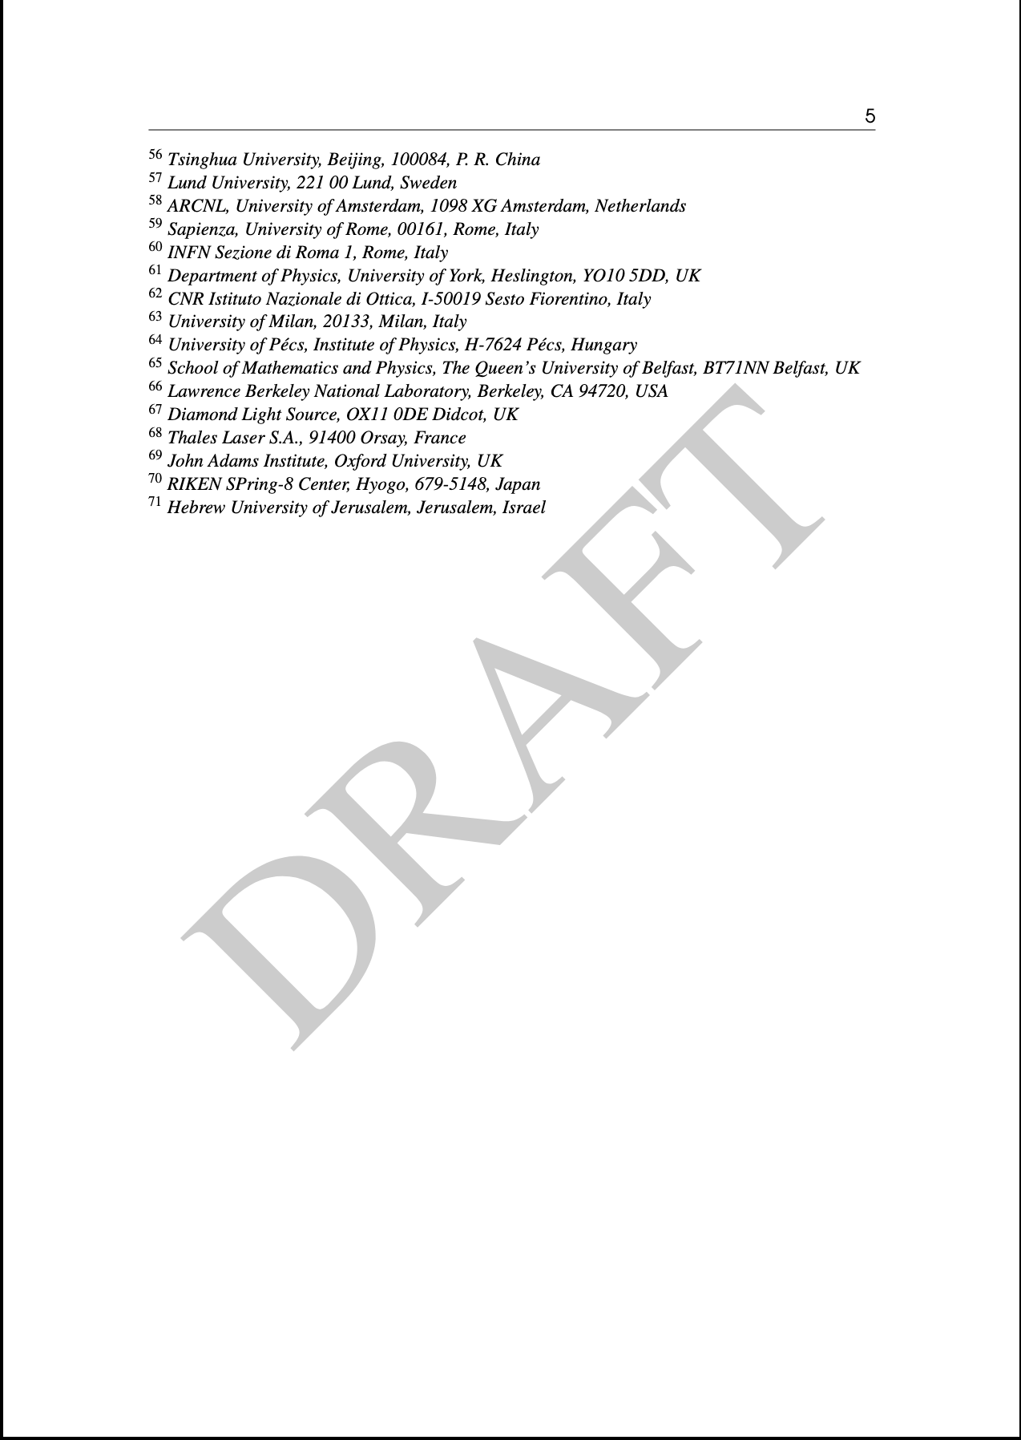
HOW TO ASSESS DRIVER NEEDS?
A three years extensive conceptual design work from international leading groups
Detailed concept from lasers to applications

Slide 7
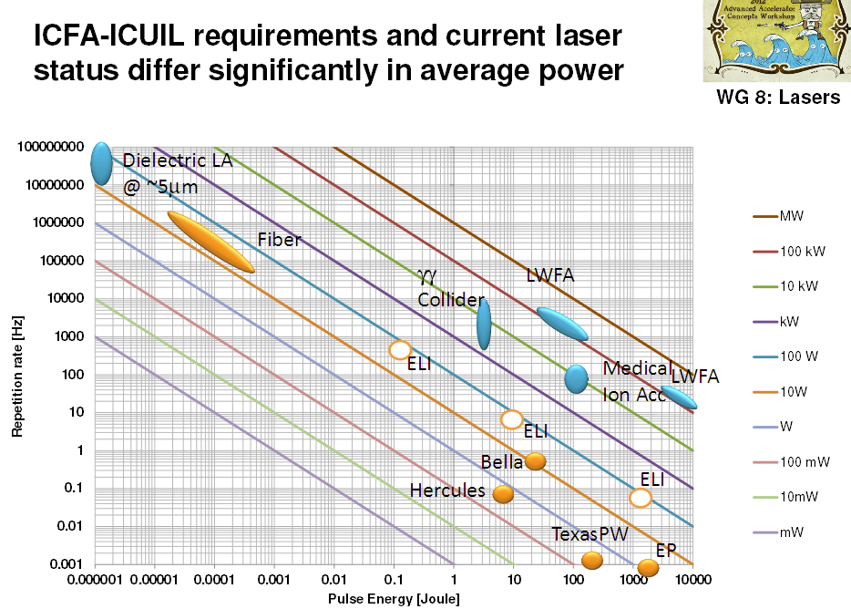
High power laser REQUIREMENTS
PW-class system, with high repetition rate (≈kHz) and demanding high average power
Machine drivers
Major effort required to fill the gap between existing and required laser technology

Slide 8
KEY REQUIRED LASER FEATURES
    Short pulse PW-kW laser technology (CPA, diode pumping);
    High repetition rate to allow user operation while enabling active stabilization via feedback loops;
    Average power ranging from 1kW to 10 kW;
    Controlled beam transport, focusing, diagnostics.
    Main issues: pump lasers, amplifiers heat management and compressor gratings at high rep-rate.

Slide 9
DRIVER: STRATEGY 1/2
up to ten kW average laser power with PW peak power and high(est possible) repetition rate;
Ti:Sa technology pumped by diode-pumped solid state (DPSSL) lasers provides a relatively safe ground, with major industrial and research endeavour in place;
Recent developments, with DPSSL prototype pump lasers offer kW performances at the required Ti:Sa pumping wavelength of 0.5 µm;

Slide 10
DRIVER: STRATEGY 2/2
Other technologies are developing aiming at >kW, higher rep. rates, higher average power levels and even more efficient configurations (k-BELLA@LBNL, Kaldera@Desy, LEAP@CELIA …);
Fiber laser technology offers the best WPE >50% in CW mode and coherent combination is being developed (FSU Jena-Fraunhofer IOF and Ecole Polytechnique-Thales in France). Suited for lower energy per pulse >10 kHz or for future upgrades; see anso XCAN project;
Direct Chirped Pulse Amplification with lasing media pumped directly by diodes is ideal for higher efficiency and higher rep-rate;

Slide 11
Relevant BLOCKS of a laser DRIVER
Plasma
Cooling
Pump (Energy)
Transport and focusing
Optical Compressor
Gain medium/stages
Transport
Cooling

Slide 12
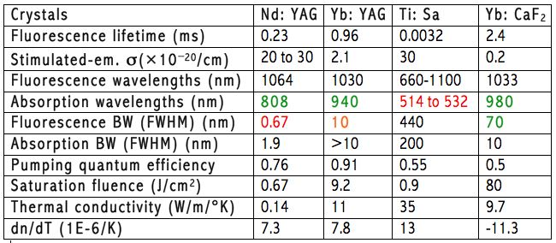
Key parameters of lasing media
Main parameters governing laser amplifiers:
  Spectral gain bandwidth: short pulse duration
  Thermal conductivity: limits repetition rate
  Abs. and emis. cross sections: gain, pump absorption and saturation
  Fluorescence lifetime: sets conditions on pumping
  dn/dT: limits beam quality

Slide 13
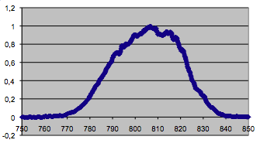
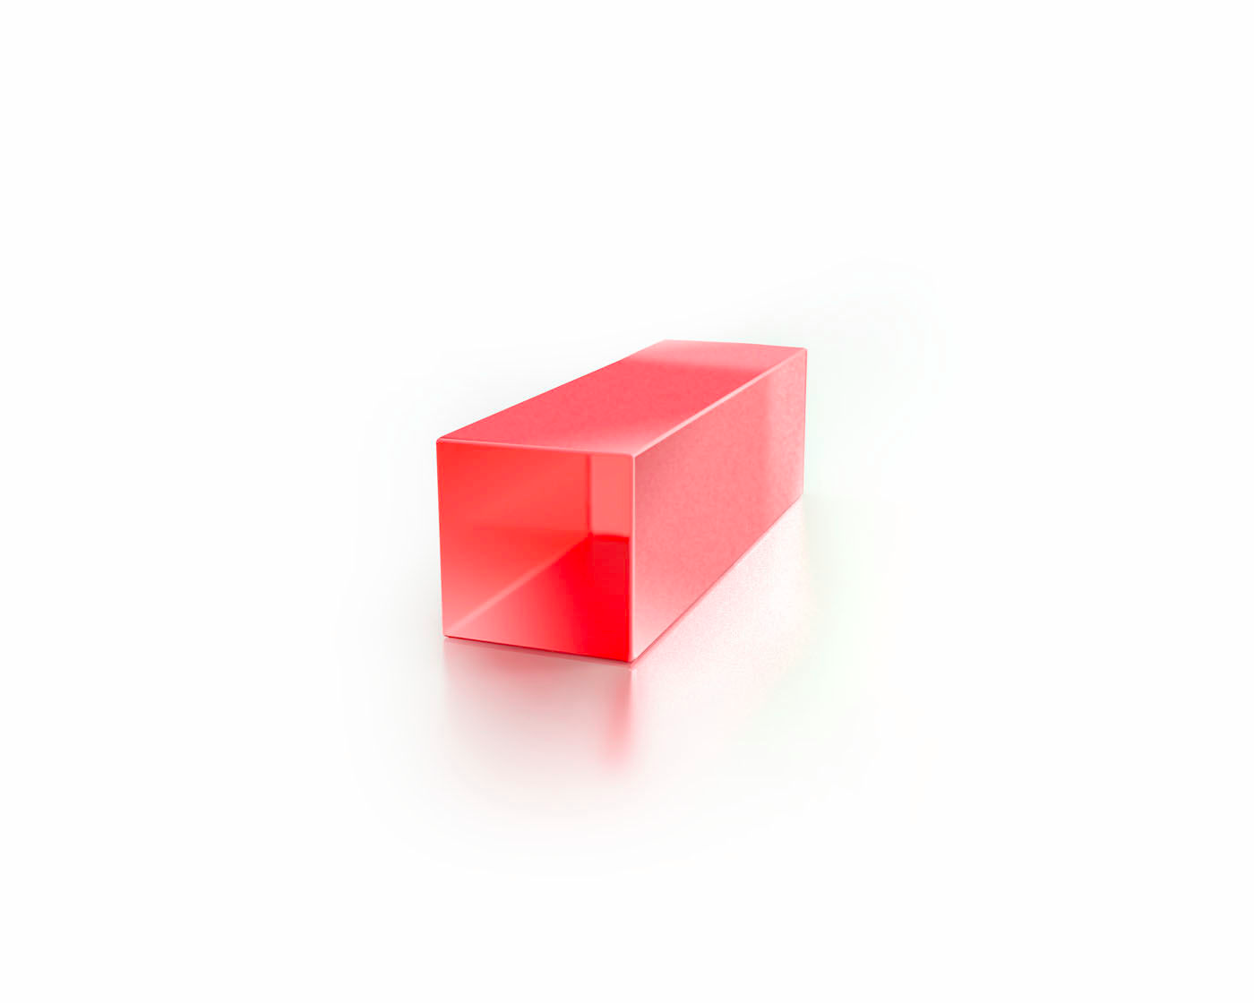
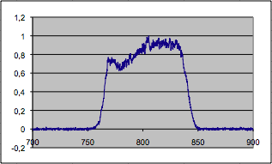
GAIN MATERIAL: Titanium Sapphire
Currently, most PW-scale CPA lasers are based on Ti:Sapphire pumped by frequency doubled Nd:YAG lasers
Ti:Sa native spectrum
Ti:Al₂O₃
Ti:Sa with BW active control
Large gain bandwidth (680 nm – 1080 nm)
• High quantum efficiency
• Long lifetime: 3 μs
• Thermal conductivity: 35 WK⁻¹m⁻¹
• Pumped in the green
Active bandwitdth control crucial to
overcome gain narrowing and enable sub-50 fs pulses

Slide 14
The EuPRAXIA Project:
COMPACT EUROPEAN PLASMA ACCELERATOR WITH SUPERIOR BEAM QUALITY
http://eupraxia-project.eu

Slide 15
Goals and challenges
EuPRAXIA is a conceptual design study for a 5 GeV electron plasma accelerator as a European research infrastructure.
P. Tomassini on “FEL-quality 5GeV e-bunches with the Resonant Multi Pulse Ionization injection scheme (ReMPI).
Poster on Wed
FEL requires low (total) energy spread (<1%) and low emittance (<1mm mrad):
  Validate technical components and schemes in plasma accelerator concepts producing already GeV class beams:
  Establish laser driver technology
  Combine efforts with laser industry and laser institutes to improve rep. rate & efficiency (incorporate all viable laser technologies with higher efficiency).

Slide 16
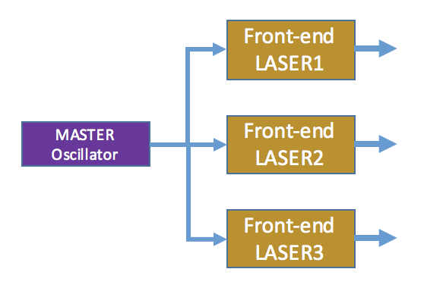
The EuPRAXIA approach
Three independent front-end sections seeded by the same laser oscillator
Amp Chain 1
Compr
150 MeV Inj
Amp Chain 2
Compr
1 GeV Inj
Amp Chain 3
Compr.
5 GeV

Slide 17
5GeV: Driver Specifications

Slide 18
Detailed scheme
FRONTEND
MASTER Oscillator
FRONTEND
AMP1
FRONTEND
37( 65) J, 0.5µm
20(25)J, 0.5µm
AMP1
Power amplifiers
AMP1
9 (13) J, 0.8 µm
AMP2
PROPAGATION
AMP2
19 (37) J, 0.8 µm
Photocathode and diagnostics
AMP3
62 (126) J, 0.8 µm
105 J / 197 J, 0.5µm
PROPAGATION
COMPRESSION
PROPAGATION
COMPRESSION
COMPRESSION
5(7)J, 30(20)fs, 20(100)Hz
15(30)J, 30(20)fs, 20(100)Hz
50(100)J, 60(50)fs, 20(100)Hz
TO FOCUSING
TO FOCUSING
TO FOCUSING
LASER1
LASER2
LASER3
Average Output Power
1.3 kW
3.7 kW
12.6 kW
150 MeV
1 GeV
5 GeV

Slide 19
Amplifiers design strategy
Design guidelines
Modularity: same amplification stages in the different laser chains;
Scalability: upgrade “simply” by increasing pump energy and rep rate
High extraction efficiency (esp. at P1) to reduce pump energy requirements
Thermal management issues
Design methodology
Evaluation of the amplification parameters (energy, spectrum, beam size, stability, parasitic lasing) with numerical simulations (MIRO – CEA);
Validation of modelling with existing systems up to multi-J level;
Preliminary thermomechanical evaluation by means of FEA simulations (LAS-CAD);
Results
- Main parameters for each stage: pump energy, extracted energy, beam size, spectral shift, parasitic gain …
Energy stability vs pump and seed energy fluctuations
Evaluation of thermal aberrations
Cooling strategies: liquid flow cooling
ASE/PL mitigation strategies: Extraction during pumping

Slide 20
Thermal management
Transmission vs. “active mirror” configuration is currently being evaluated to account for thermal management
“Active mirror” geometry
Transmission geometry
Pro: Well established concept with no propagation through cooling fluid
Con: limited cooling (single face), to be modelled
Gain comparison (AMP3)
Pro: More efficient (double-side) cooling and reduced complexity;
Con: propagation through flowing cooling liquid
*) Water cooled Ti:Sa amplifier (“Active Mirror” configuration) under development at ELI-HU (After V. Cvhykov et al. , Opt. Lett, 41, 3017, 2016)
**) Fluid (D₂O ) cooled Nd:YAG laser, 20 kW CW pump power, D₂O (After X. Fu et al. , Opt. Express, 22, 18421 (2014)
***) Fluid (Siloxane ) cooled Nd:YLF laser, 5 kW CW pump power (After Z. Ye et al. , Opt. Express, 24, 1758 (2016)

Slide 21
Detailed scheme
FRONTEND
MASTER Oscillator
FRONTEND
AMP1
FRONTEND
37( 65) J, 0.5µm
20(25)J, 0.5µm
AMP1
AMP1
9 (13) J, 0.8 µm
AMP2
PROPAGATION
AMP2
19 (37) J, 0.8 µm
Photocathode and diagnostics
AMP3
62 (126) J, 0.8 µm
105 J / 197 J, 0.5µm
PROPAGATION
COMPRESSION
PROPAGATION
PUMP LASERS
COMPRESSION
COMPRESSION
5(7)J, 30(20)fs, 20(100)Hz
15(30)J, 30(20)fs, 20(100)Hz
50(100)J, 60(50)fs, 20(100)Hz
TO FOCUSING
TO FOCUSING
TO FOCUSING
LASER1
LASER2
LASER3
Average Output Power
1.3 kW
3.7 kW
12.6 kW
150 MeV
1 GeV
5 GeV

Slide 22
PUMP LASERS: STRATEGY
Industrial developments of high average power pump lasers;
DPSSL implementation on currently available industrial flash-lamp pumped systems for 20-50 Hz performance;
Link to available effort in prototyping from industry and research labs for enhanced performance;
High power diode developments for future 100 Hz / 1 kHz upgrade.

Slide 23
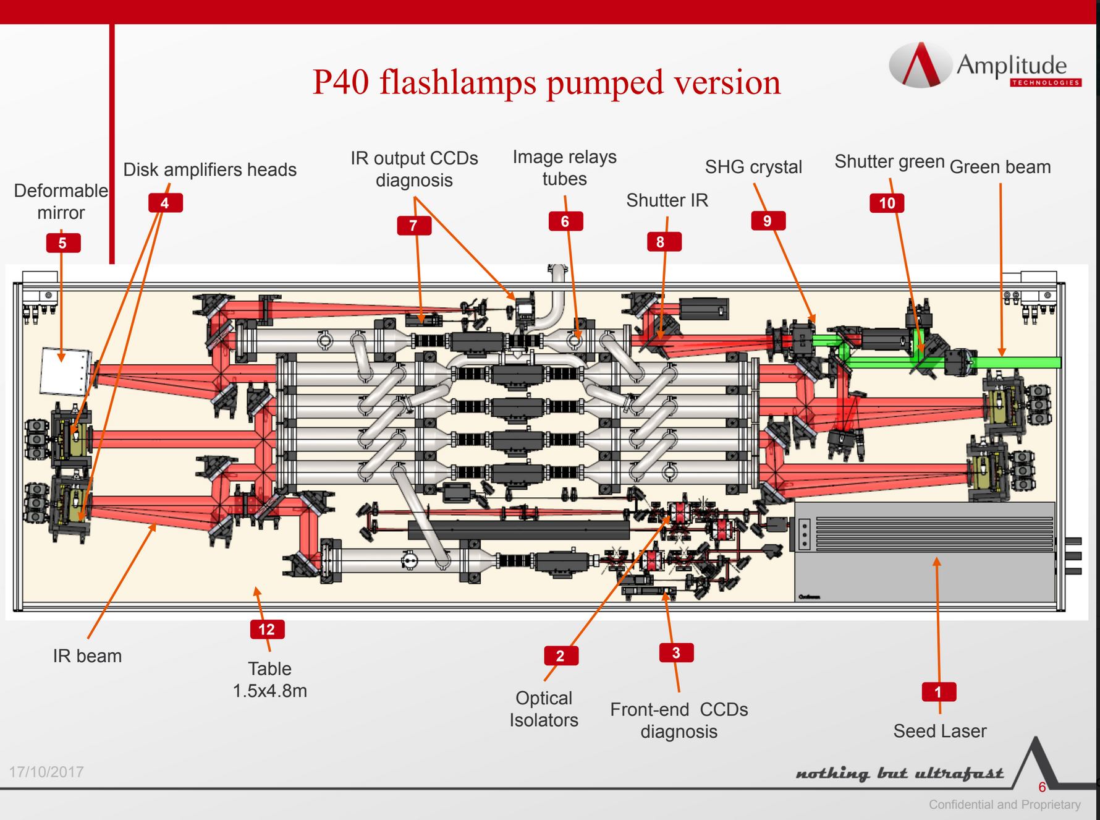
INDUSTRIAL SUBSYSTEMS: PUMP LASERS
Industrial unit (P60): conversion to diode pumping fully designed
Flashlamp pumped Nd:YAG/ DPSSL possible
80 J output energy demonstrated @ 10 Hz, 1064 nm
60 J SHG energy @ 532 nm : design target (40 J demonstrated)
Cost of diode still an issue – currently 5x total (including operational) costs compared to flashlamps.
Expected to decrease in 5-10 yrs.
Maintenance free operation for 25-30 yrs.

Slide 24
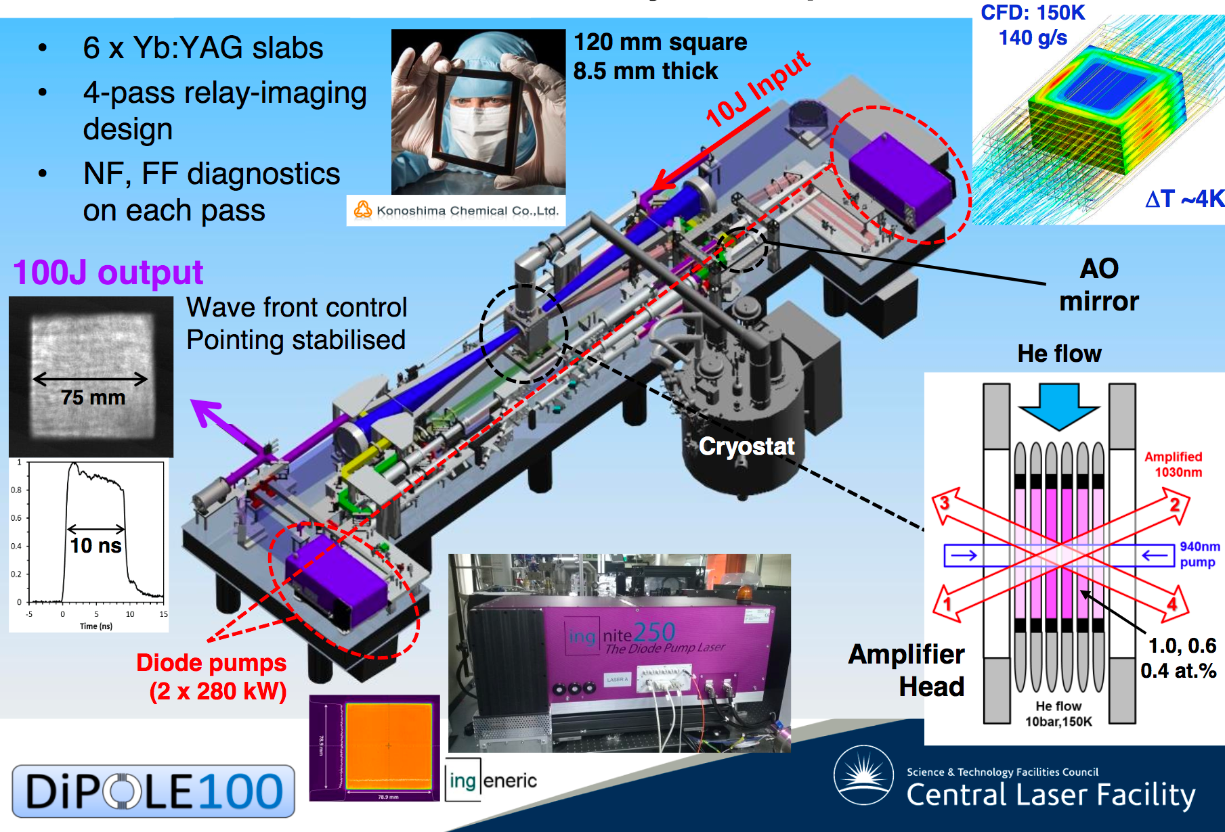
DiPOLE 100

Slide 25
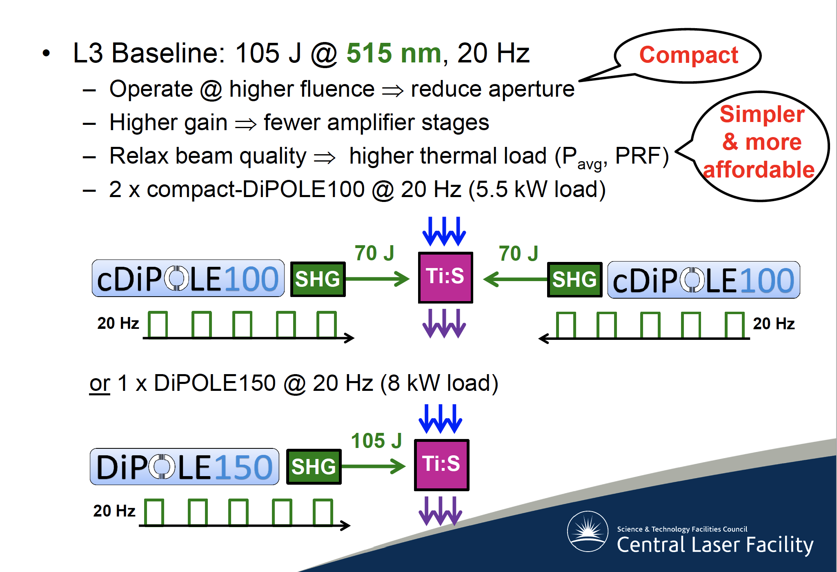
VIABLE CONFIGURATION
Convergence with EPAC Project (UK)

Slide 26
Detailed scheme
FRONTEND
MASTER Oscillator
FRONTEND
AMP1
FRONTEND
37( 65) J, 0.5µm
20(25)J, 0.5µm
AMP1
PROPAGATION AND COMPRESSION
AMP1
9 (13) J, 0.8 µm
AMP2
PROPAGATION
AMP2
19 (37) J, 0.8 µm
Photocathode and diagnostics
AMP3
62 (126) J, 0.8 µm
105 J / 197 J, 0.5µm
PROPAGATION
COMPRESSION
PROPAGATION
COMPRESSION
COMPRESSION
5(7)J, 30(20)fs, 20(100)Hz
15(30)J, 30(20)fs, 20(100)Hz
50(100)J, 60(50)fs, 20(100)Hz
TO FOCUSING
TO FOCUSING
TO FOCUSING
LASER1
LASER2
LASER3
Average Output Power
1.3 kW
3.7 kW
12.6 kW
150 MeV
1 GeV
5 GeV

Slide 27
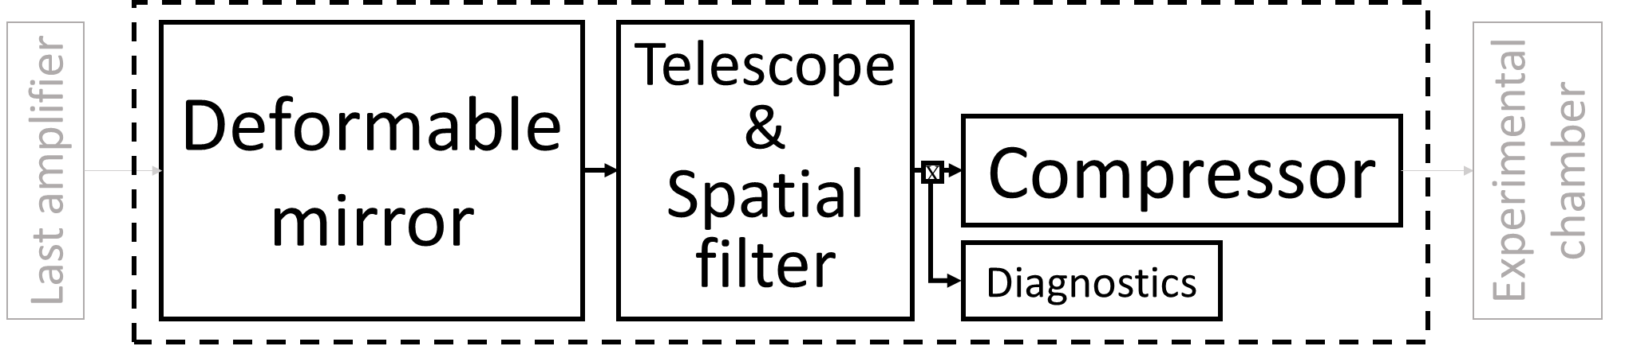
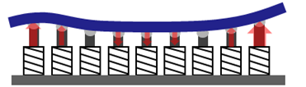
TRANSPORT TO TARGET
Main challenges: large optics, mechanical stability, cooling of gratings, beam quality control, beam pointing stability …
R&D at existing laser labs (APOLLON(FR), RAL(UK), ILIL(IT) etc …)

Slide 28
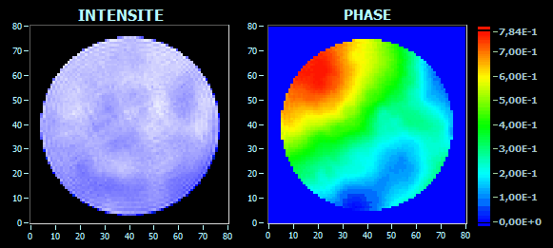
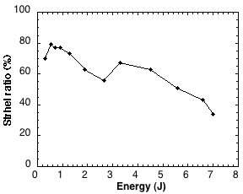
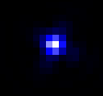
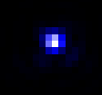


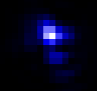
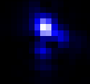
FOCAL SPOT BEAM QUALITY
As larger gain media and optics are used, optical aberrations become important and limit the focusability of laser pulses
Energy in the focal spot
Energy in the pulse
S_{r}=
STREHL RATIO
PHASE FRONT DISTORTIONS
Strehl ratio vs. energy
FLAME Laser System, 2013
Amplification
Also: need of Gaussian profile

Slide 29
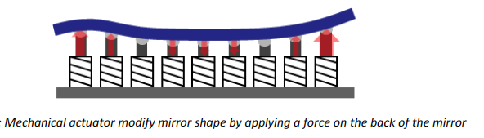
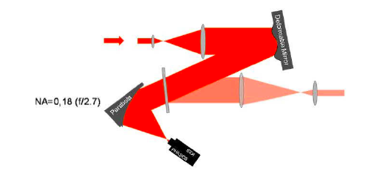
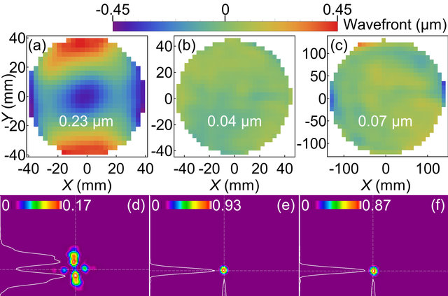
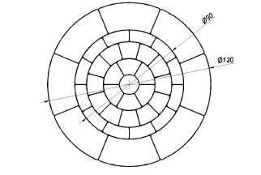
ADAPTIVE OPTICS for high power lasers
Active spatial phase control technique can be used to correct severe to moderate phase distortions;
Sensors are used to measure intensity and phase map of the beam;
Deformable mirrors are used to correct the measured wave front distortions in a closed loop;
S.-W. Bahk et al., Optics Letters 29, 2837 (2004)
A. PIROZHKOV et al., Optics Express 25, 17 (2017)
Key enabling component to reach high intensity

Slide 30
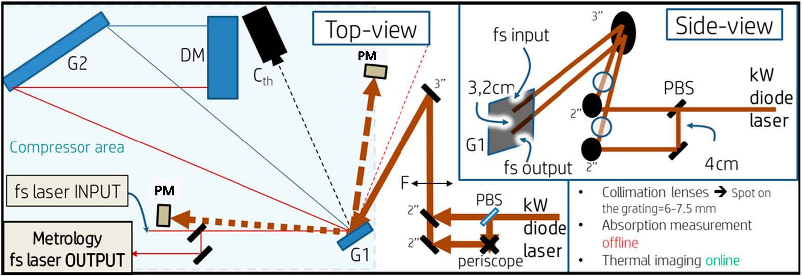
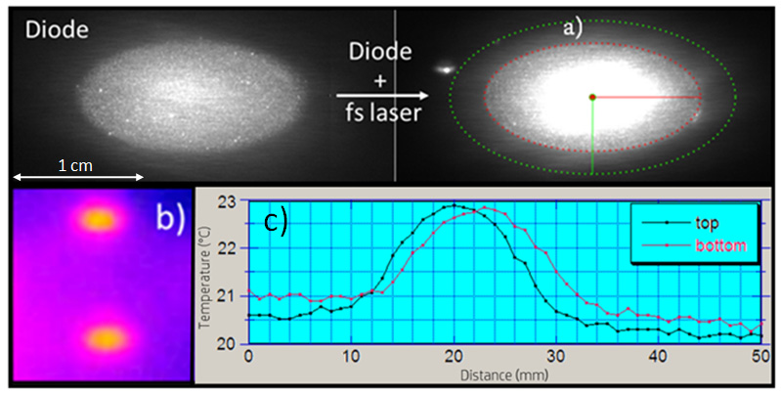
Grating heating experiment*
Compressor Area: PM = power meter; Cth = Thermal camera; G1 = first compressor grating; G2 = second compressor grating (gold, 56°,1480l/mm); DM = Dihedral Mirror. Diode Area: F = imaging lens; PBS = Polarizing Beam Splitter.
Image of the heating diode laser beam and of the fs laser beam on G1. The laser diode beam has a top hat profile, with a spot size of 0.82 mm x 1.63 mm (surface ~ 1 cm2). (b) G1 thermal image for 130 W sent on each spot. (c) Temperature profiles for the beam spots (b); left profile: input spot; right profile: output spot.
*using Apollon front-end test compressor
G. Toci et al. Instruments, 3, 40 (2019)

Slide 31
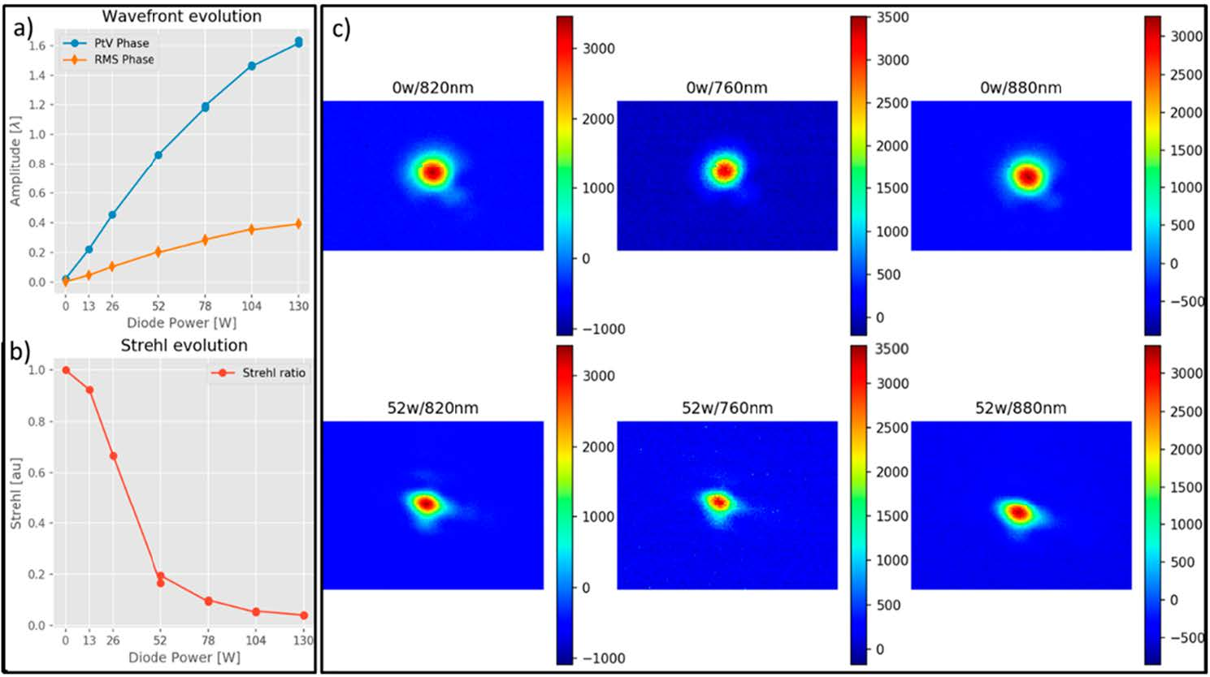
Strehl ratio degradation
First measurements of phase front distortion by HAP heating of compressor grating
Upper line: far field at 760 nm, 820 nm, 880 nm for 0 W heating power.
Lower line: far field at 760 nm, 820 nm, 880 nm for 52 W heating power.
G. Toci et al. Instruments, 3, 40 (2019)

Slide 32
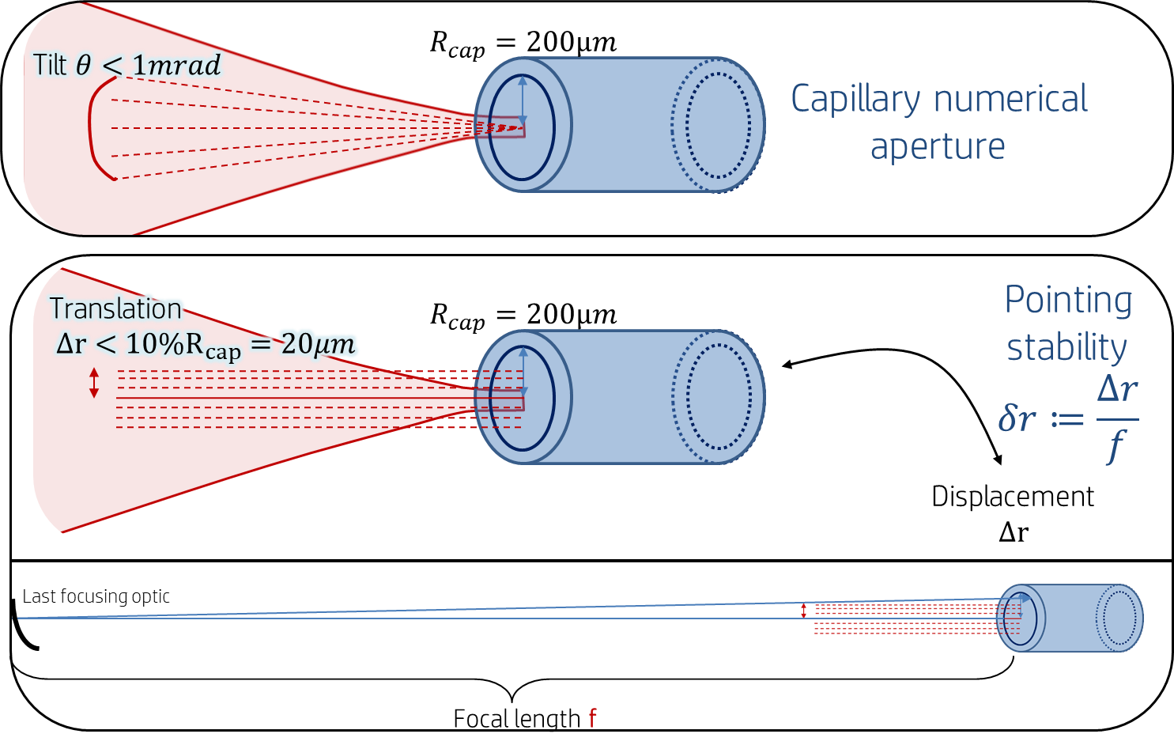
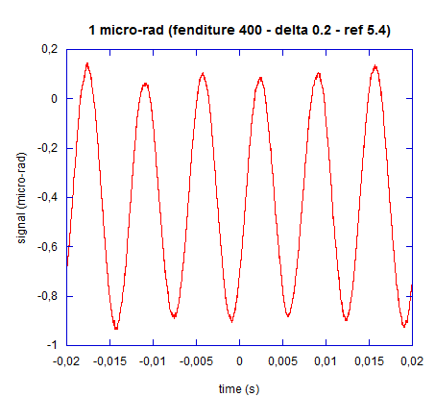
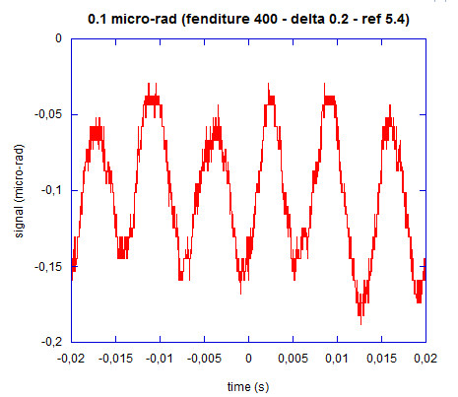
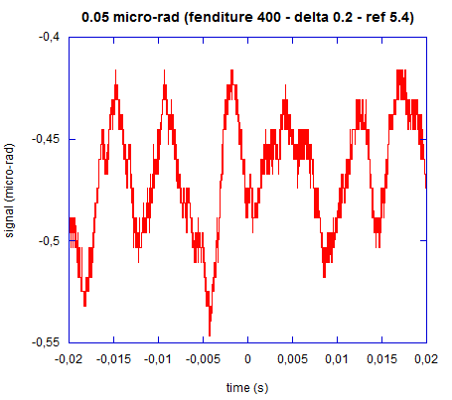
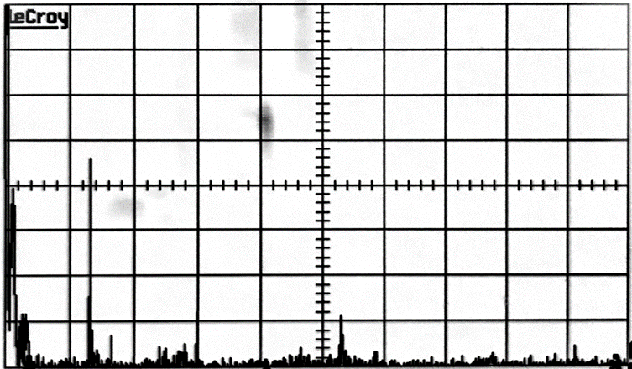
POINTING STABILITY
Requirements for beam pointing stability are extremely demanding (1-5 µrad). Both passive and active control will be required. Prior to the implementation of control strategies, tools are being developed to measure pointing stability performances at EuPRAXIA facilities and labs.
1 µrad
0,1 µrad
Laser angular fluctuations footprints at 150 Hz
50 nrad
Environmental angular noise of about 30 nano-rad
We already detect
<100nrad fluctuations
Z. Mazzotta, F. Mathieu
in collaboration with
S. Cialdi, D. Cipriani, S. Capra
of Università degli studi di Milano.
up to the MHz regime and more
64
~40nrad
48
~10nrad
32
Angular fluctuation (nrad)
16
Spectral analysis of the laser fluctuation.
0
100
200
300
400
500
Frequency (Hz)
B. Canuel et al., Sub-nanoradiant beam pointing monitoring […], Appl. Opt. 2014, 53, 2906-2916

Slide 33
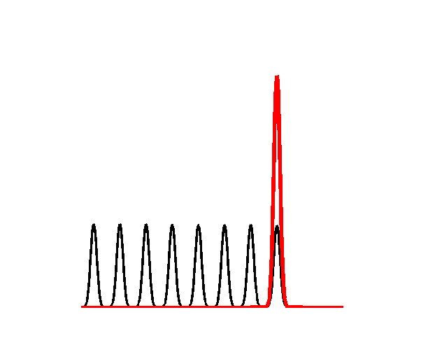
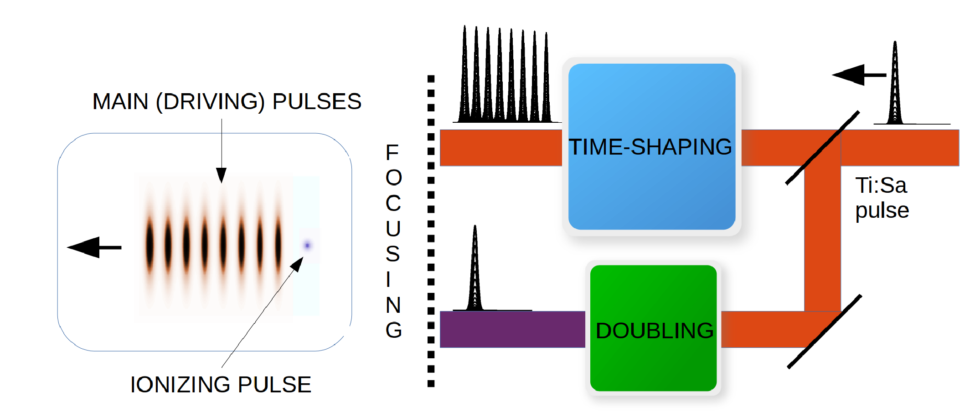


The Resonant Multi-Pulse Ionization Injection*
The Resonant Multi-Pulse Ionization injection [P. Tomassini et al., Phys. Plasmas 24 (2017) ] is a new bunch injection scheme aiming at generating extremely low-emittance bunches [as low as 0.06 mm mrad]
ReMPI requires ONE short-pulse 100-TW class (e.g Ti:Sa) laser system. Since a unique very large-amplitude Ti:Sa pulse would fully ionize the atoms (N5+ or Ar8+ ), the pulse is shaped as a resonant sequence of sub-threshold amplitude pulses.
P. Tomassini on “FEL-quality 5GeV e-bunches with the Resonant Multi Pulse Ionization injection scheme (ReMPI).
Poster on Wed
ReMPI
Ionization Threshold
A new scheme to generate the train of pulse in a stable, efficient and feasible way « Quasi Lossless Pulse Train generation by Early Amplitude division »
has been recently proposed by L. Labate et al. (submitted)
*P. Tomassini et al., Physics of Plasmas 24, 103120 (2017), PPCF, 2019 in press

Slide 34

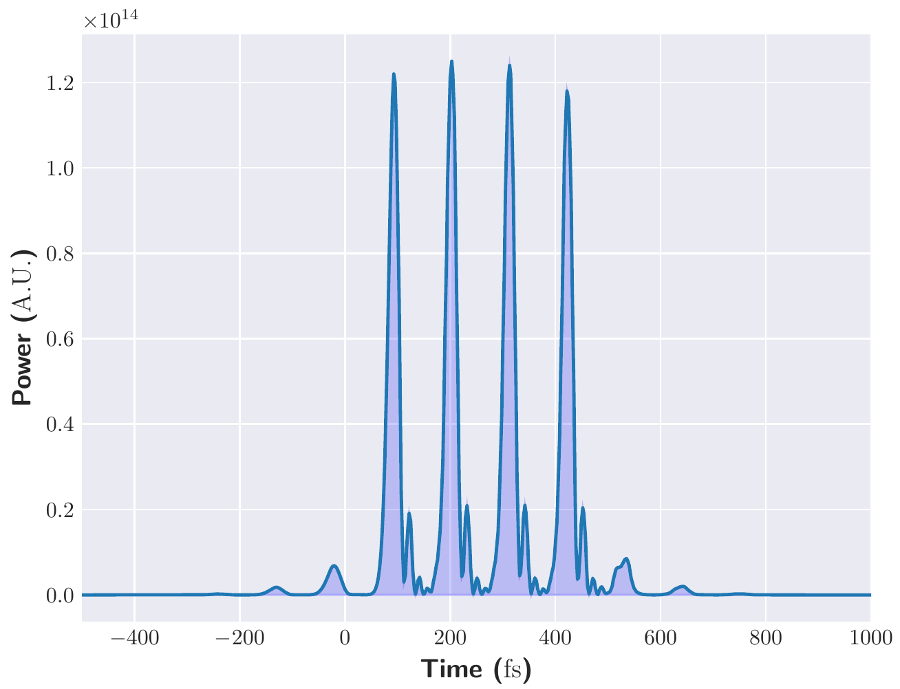
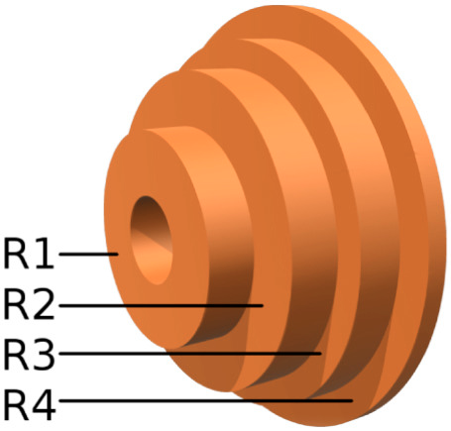
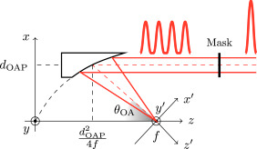

Pulse train for resonant wakefield
Michelson interferometer approach [1] as a baseline, but needs large optics and leads to significant losses
Use birefringent plates of increasing (doubling) thicknesses and crossed polarization [2].
Complex setup, to be implemented on the compressed (large) beam
  Intensity homogeneity issues among the different pulses of the same train
  Possibly leading to very high energy losses (up to 50%) ← relevant for the EuPRAXIA laser design
Our approach: quasi lossless Train gEneration by an early aMplitude dIvision (TEMPI) [3,4]:Splitting occurs upstream in the laser chain. Small aperture and negligible energy losses. Effects due to pulse interference manageable.
Alternative scheme: delay mask [5]
Simulation carried out using the MIRO code
Test experiment in progress at CNR ILIL laboratory
[1] C. W. Siders et al., Appl. Opt, 37, 5302–5305 (1998)
[2] B. Dromey et al., Appl. Opt. 46, 5142 (2007)
[3] L. Labate, G. Toci, P. Tomassini, L.A. Gizzi, submitted
[4] G. Toci et al. Instruments, 3, 40 (2019)
[5] G. Vantaggiato et al., NIM-A, 909, 114, (2018)
Energy losses negligible as compared to the overall pump energy
Compact and simple setup [4]

Slide 35
TECHNOLOGY READINESS
Laser driver for a plasma accelerator designed to seamlessly drive a user laser-plasma accelerator;
Current required drivers, 100-1kHz Hz, 10-100J, is beyond existing technologies;
Conceptual design relies on the latest industrial and lab components of high power lasers;
20 Hz operation relies on demonstrated components (TRL 5 to TRL 7);
100 Hz operation (TRL2 to TRL3) is evolving along with diode pumping developments (prototyping);
Heat management of amplifier head (TRL3-TRL4) requires validation at the relevant component scale.

Slide 36
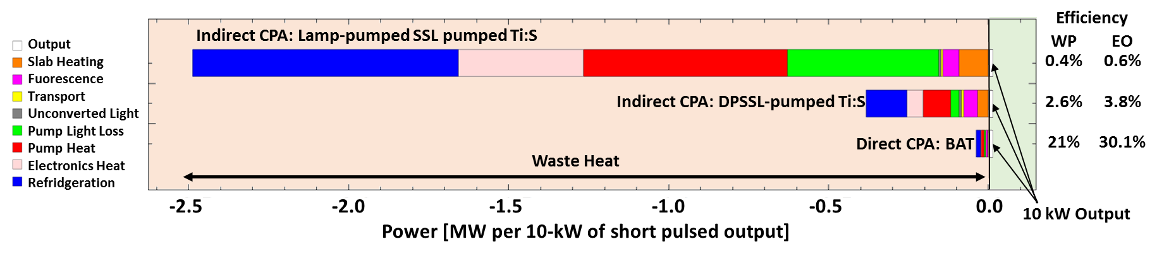
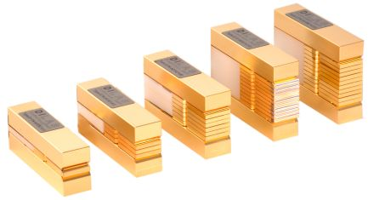
>kHz repetition rate ?
Plasma accelerators will require higher and higher repetition lasers with high efficiency. Direct pumping of lasing medium with diodes is most efficient:
Direct CPA may become a solution for >100Hz due to wall-plug efficiency limitations.
C. Siders et al., EAAC 2017
We need a gain medium that can support amplification on a large bandwidth and can be pumped directly with diode lasers.

Slide 37
Direct diode pumping
Available direct CPA concepts (Yb:CaF₂, Yb:YAG …) limited in pulse duration, heat extraction and scaling;
Developments in progress also with Tm:YLF

Slide 38
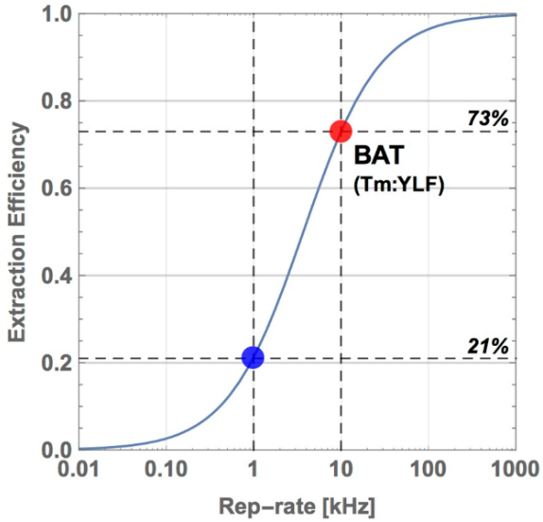
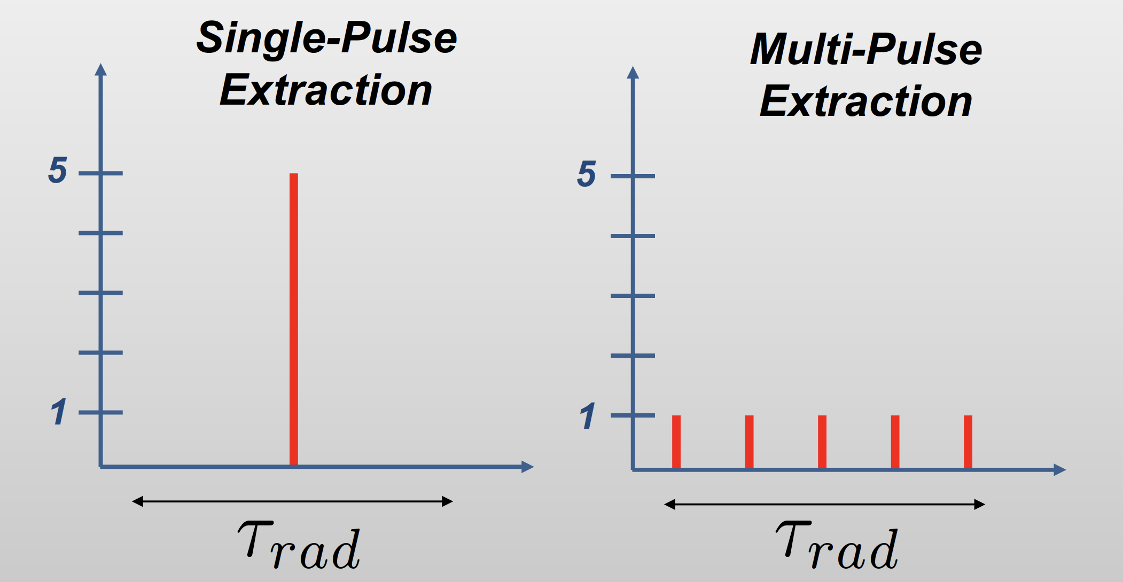
A possible solution: Tm:YLF
Currently under investigation[1]: Tm:YLF
  Emission at 1,9 µm, eye safe;
  Ultrashort pulse (<100 fs;
  High peak power ≈ PW;
  High average power(scalable from kW to 300 kW);
  Direct pumping at 808 nm, using diodes operating in CW mode (available and scalable);
  Multi-pulse extraction at high repetition rate > 10 kHz; Ideal for accelerator technology;
  High efficiency;
  Mature material technology (crystal growth);
Ti:Sa
Tm:YLF
T.C. Galvin et al., Proc . of SPIE Voi. 11033 1103303 (2019)
Tm: YLF Full specifications
Absorption peak wavelength 792 nm
Absorption cross-section at peak 0.55×10-20 cm2
Absorption bandwidth at peak wavelength 16 nm
Laser wavelength 1900 nm
Lifetime of 3F4 thulium energy level 16 ms
Emission cross-section @1900 nm 0.4×10-20 cm2
Refractive index @1064 nm no=1.448, ne=1.470
Crystal structure tetragonal
Density 3.95 g/cm3
Mohs’ hardness 5
Thermal conductivity 6 Wm-1K-1
dn/dT -4.6×10-6 (//c) K-1
Thermal expansion coefficient 10.1×10-6 (//c) K-1
Typical doping level 2-4 at.%
High Efficiency enabled by multipulse extraction
Relatively new approach for short pulse operation: needs R&D in progress
(1)C. Haefner et al., EAAC 2017

Slide 39





Broader view on driver R&D
Laser driver relies on industrial development in:
Pumping technology: diode (direct or indirect) pumping;
Gain media: material should be industrially available at laser quality, scalable in size and capable of supporting large bandwidth and efficient cooling;
Grating technology to improve for higher damage threshold and smaller beam size
Optics Damage threshold
Thermal load, management, dissipation
Vacuum technology
Mechanical stabilization (active and passive);
Major R&D and technology transfer to embed in final systems

Slide 40
Cluster approach
Cluster on laser technology (EuP-LASTECH):
Main Scientific and Technical issues
Amplifier configuration:
  Prototyping of Ti:Sa amplifiers
  Build a test amplifier to test Thermal load, Cooling;
Pumping technology:
  Scaled 100 Hz rep rep. rate, high energy pumping;
  Addressing 100 Hz pump lasers developments
Optical compressor technology:
  Thermal management of compressor gratings
  Run high average power illumination tests at existing facilities, to make assessments on LIDT, Thermal load, Cooling. Lifetime;
Pointing stability :
  Stability (pointing & more) and active control
  Build tools and run tests at existing facilities; define route for active stabilization;
Temporal and Spatial Shaping:
  Synchronization
  Develop efficient pulse train, temporal contrast, AO control and measurements.

Slide 41

Cluster approach
Cluster on laser technology (EuP-LASTECH):
High Repetition Rate Developments
The current layout of the EuPRAXIA laser foresees up to 100 Hz configuration. Beyond this, totally alternative systems based on direct diode pumping of different gain media are being explored like Yb:YAG and Yb:CaF₂ Tm:YLF. Cluster coordination will foster these explorations.
Exploring funding opportunities. Two proposals submitted to TIARA-ARIES.

Slide 42

SUMMARY
Ti:Sa as a viable options for first generation laser driver
Addressing open issues
  Thermal management of
    Amplifiers
    Compressor gratings
Stability (pointing & more) and active control
Synchronization
Driver pulse temporal shaping (multi-pulse)
Longer term solutions with direct diode pumping
Major need of R&D -> Cluster approach

Slide 43
Contributors
CNR – Italy
Leonida A. GIZZI, Istituto Nazionale di Ottica-CNR, Pisa
Petra KOESTER INO-CNR, (EuPRAXIA contract), Pisa
Luca LABATE, INO-CNR, Pisa
Fernando BRANDI, INO-CNR, Pisa
Gian Carlo BUSSOLINO, INO-CNR, Pisa
Barbara PATRIZI, INO-CNR, Firenze
Guido TOCI, INO-CNR, Firenze
Matteo VANNINI, INO-CNR, Firenze
CNRS – France
François MATHIEU, CNRS, Ecole Polytechnique
Zeudi MAZZOTTA, CNRS, Ecole Polytechnique (Eupraxia contract)
Dimitrios PAPADOPOULOS, CNRS, Ecole Polytechnique
Catherine LE BLANC, CNRS, Ecole Polytechnique
Bruno LE GARREC, CNRS, Ecole Polytechnique
Audrey BELUZE, CNRS, Ecole Polytechnique
Jean-Luc PAILLARD, CNRS, Ecole Polytechnique
Collaborators
Franck FALCOZ
Rajeev PATTATHIL
Klaus ERTEL
Paul MASON
Marco GALIMBERTI
Amplitude Technologies
STFC Rutherford Appleton Laboratory
Christophe SIMON BOISSON
Sandrine RICAUD
Sebastien LAUX
Thales Group
Andy BAYRAMIAN
Constantin HAEFNER
Craig W. SIDERS
Tom SPINKA
K. CHESTNUT
E. ERLANDSON
T. GALVIN
K. SHAFFERS
E. SISTRUNK
Hamburg University
Oliver KARGER
Alexander KNETSCH
Ferdinand-Braun-Institut, Germany
Lawrence Livermore
National Laboratory
Paul CRUMP
Maria Pia ANANIA
Fabrizio BISESTO
Dario GIOVE
M. BELLAVEGLIA
S. GALLO
INFN
LNF
industries
laboratories
shaded major contributors/collaborators
43

Slide 44

THANK YOU FOR YOUR ATTENTION

