Slide 1
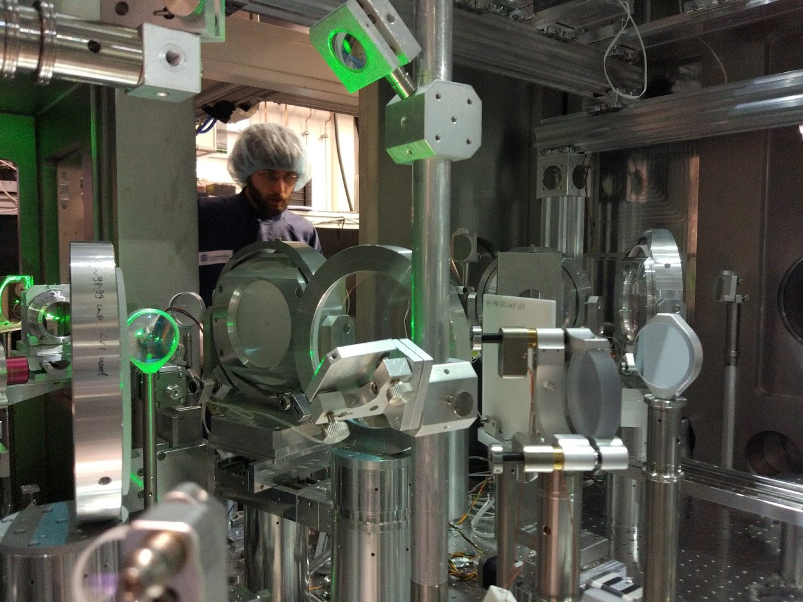
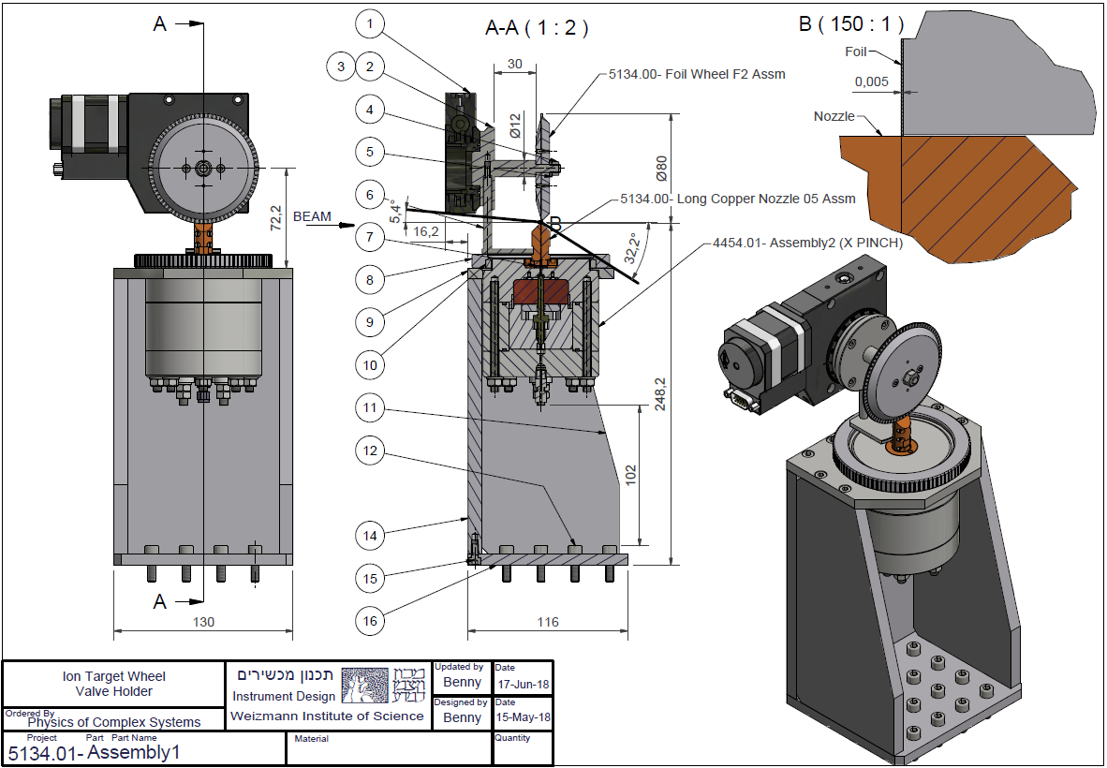
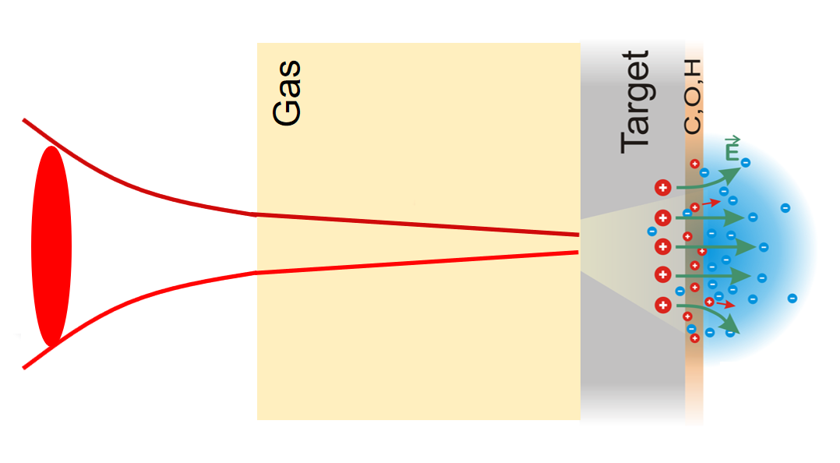
Gas-foil target for Ion acceleration
Dan Levy EAAC 19/9/2019

Slide 2
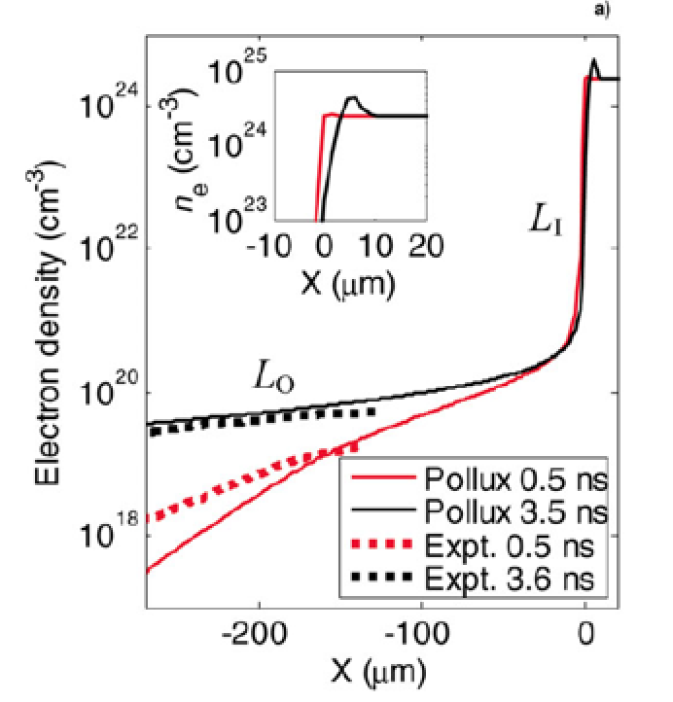
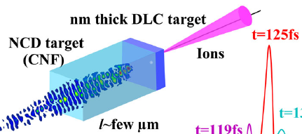
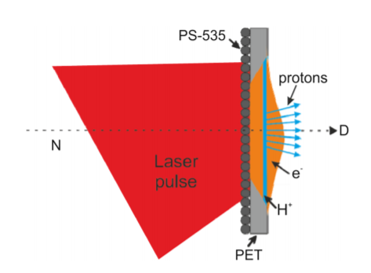
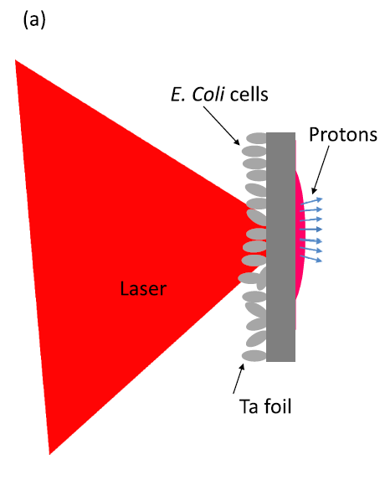
The quest for the optimal density profile
Bin, J. H., et al. PRL 115.6 (2015): 064801.
McKenna, P., et al. Laser and Particle Beams 26.4 (2008):591-596.
Margarone, D., et al. PRL 109.23 (2012): 234801.
Dalui, Malay, et al. AIP Advances 7.9 (2017): 095018.
18/6/2019

Slide 3
The Idea

Slide 4
A novel target: underdense gas followed by foil
Foil
Foil holder
Underdense gas hundreds of microns thick
Interaction conditions can be probed
Tunable target
Very rich playground: things happen before the pulse hits the foil
Gas
Ions
Laser
Ions
EAAC 2019

Slide 5
We expect: increased intensity on foil due to Relativistic Self Focusing and pulse compression
Gas
Ions
$$E_{ion}^{(max)}∝T_{hot electrons}\left(I\right){∝φ}_{pond.}\left(I\right)=$$
$$=mc^{2}\left(<γ_{osc}(I)>−1\right)=mc^{2}\left[{\left(1+\frac{Iλ_{um}^{2}}{1.3×10^{18}}\right)}^{1/2}−1\right]$$
$Maximum ion energy∝ I^{\sim 1/2}$
EAAC 2019

Slide 6
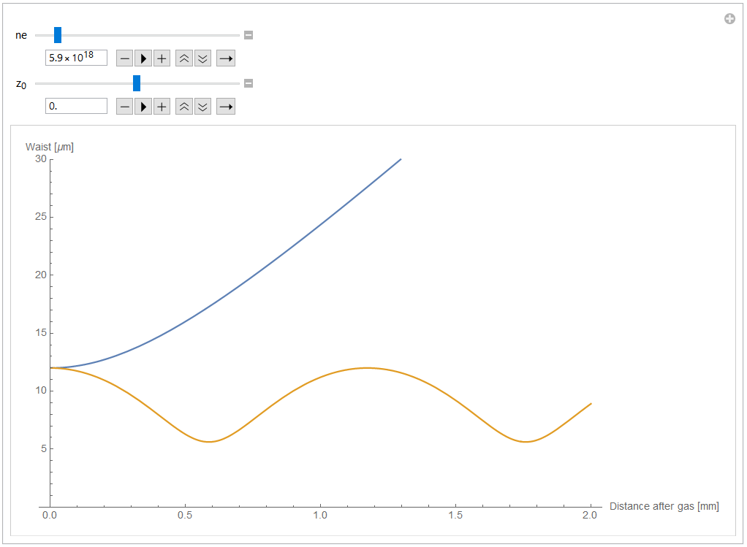
Numerical estimations look promising
Waist [um]
Free-space waist
Sprangle et al.,
IEEE Transactions on Plasma Science (1987).
Waist with plasma
$$12$$
$$5$$
Z [mm]
EAAC 2019

Slide 7
Target development

Slide 8
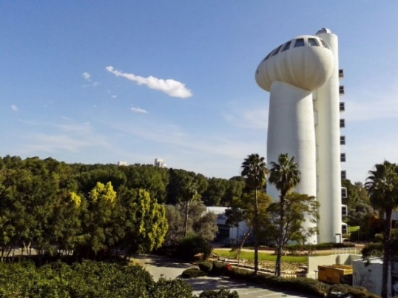
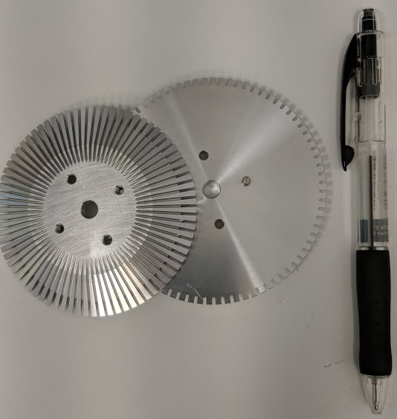
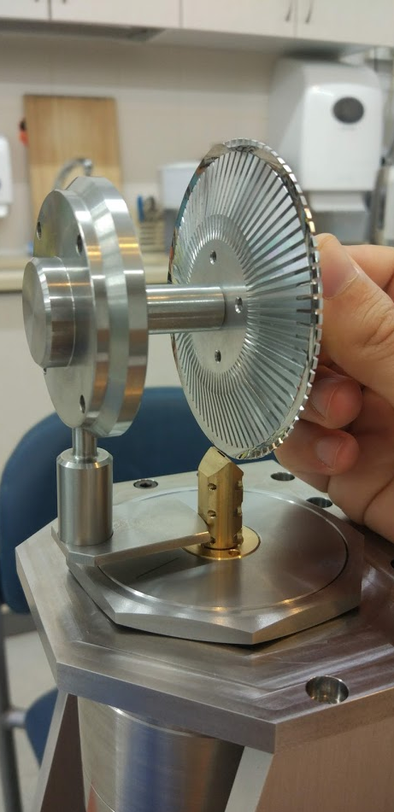
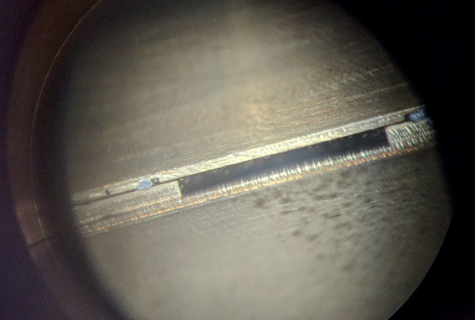
Design and fabrication
Precisely cut (<0.05 mm tolerance) 5 micron thick stainless steel foils
Foil
Foil holder
Gas
Ions
Laser
Ions
EAAC 2019

Slide 9
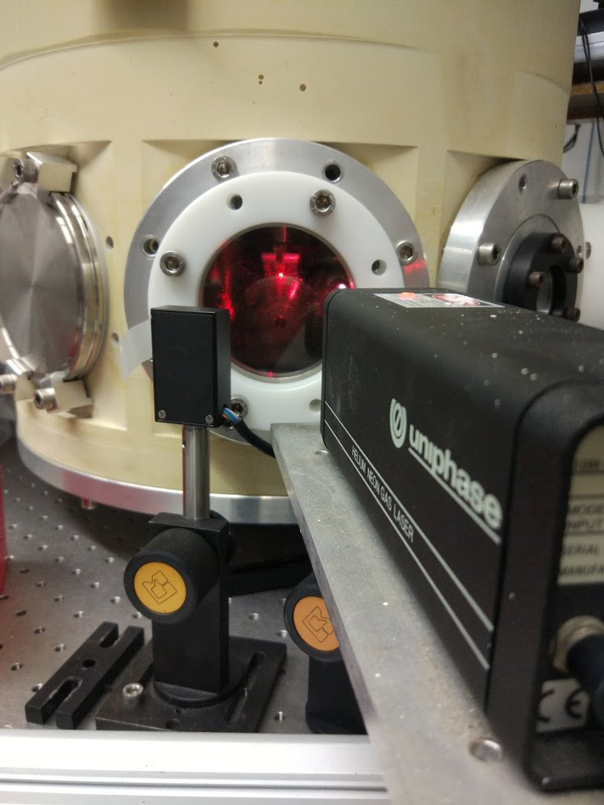
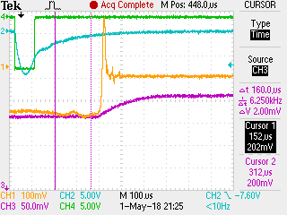
Foil does not move when gas flows
Foil
Foil holder
Gas
Ions
Laser
Ions
Foil does not move at steady state flow
EAAC 2019

Slide 10
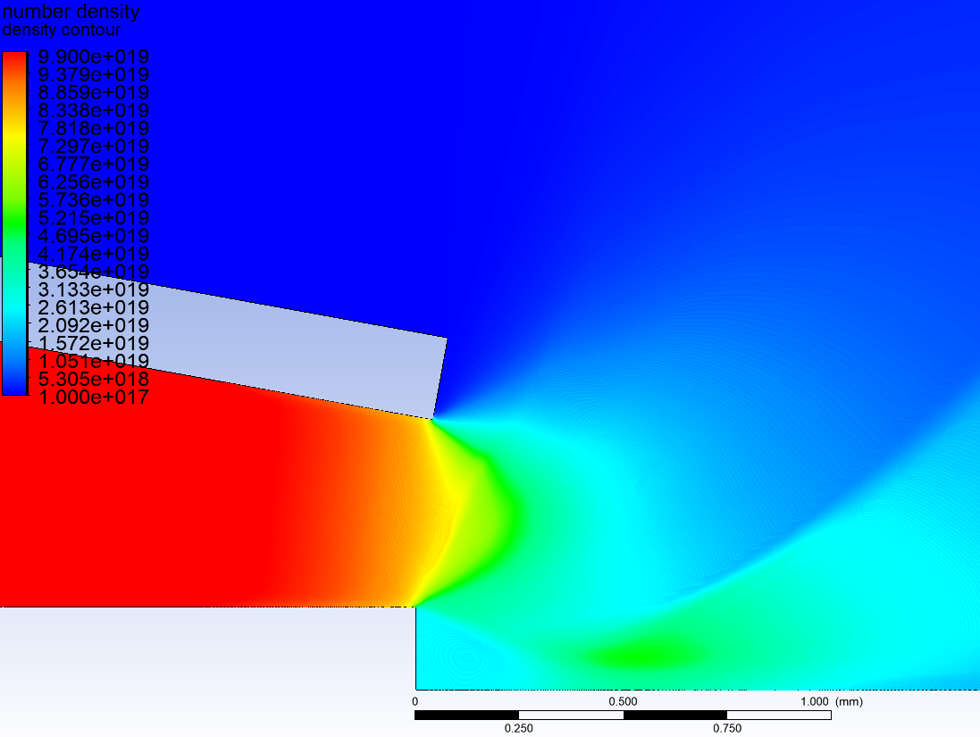
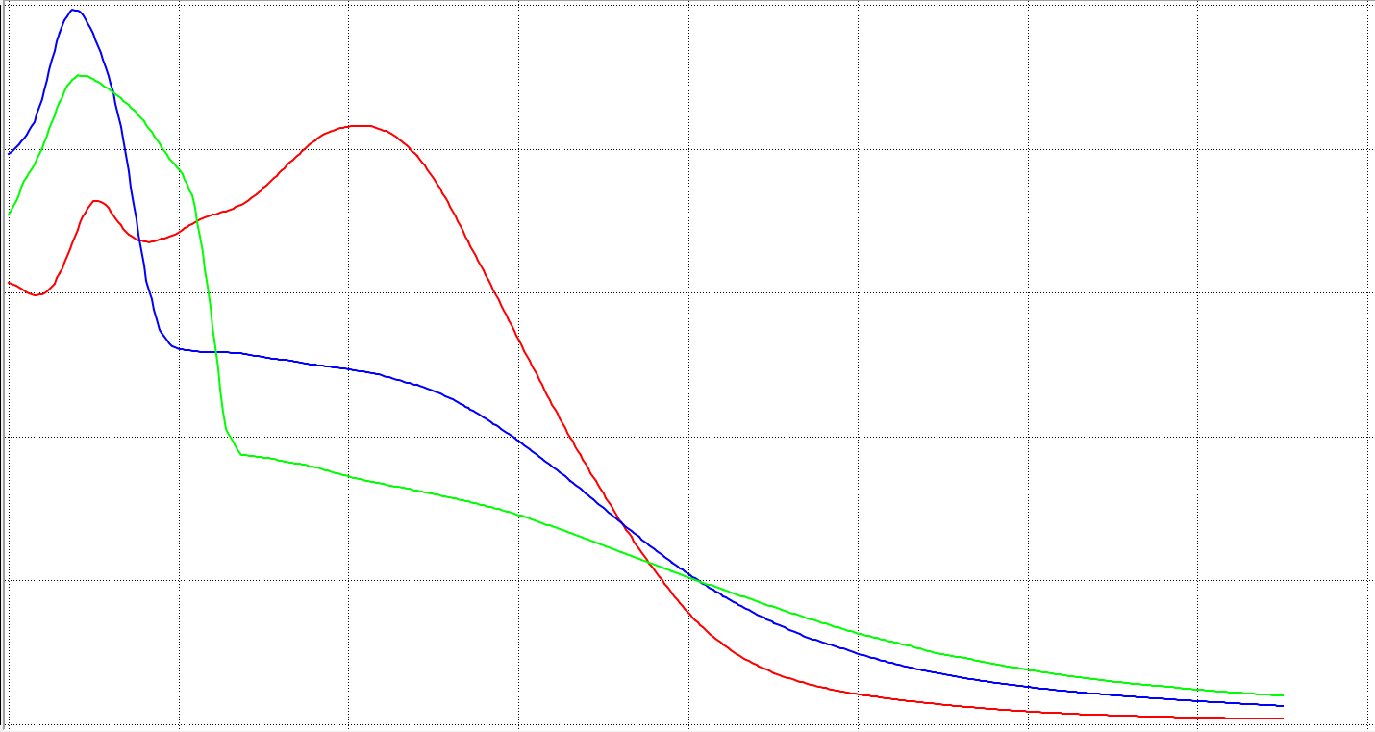
Density profile: CFD simulations close to measurements
$${(10}^{19} cm^{−3})$$
5
0.3 mm
4
0.5 mm
0.8 mm
3
Number density
2
1
0
0.2
0.4
0.6
0.8
1.0
1.2
Distance along line
1.4
EAAC 2019

Slide 11
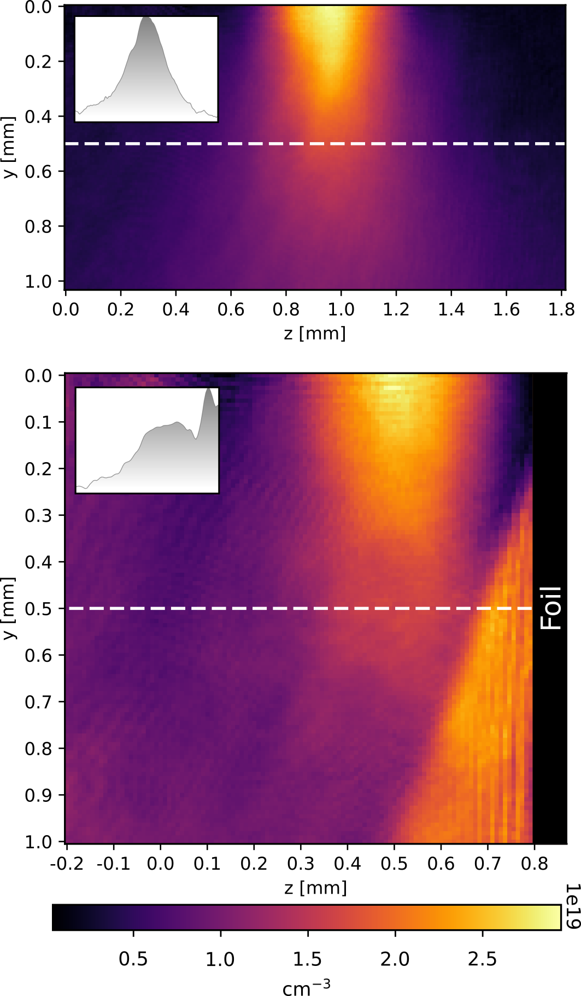
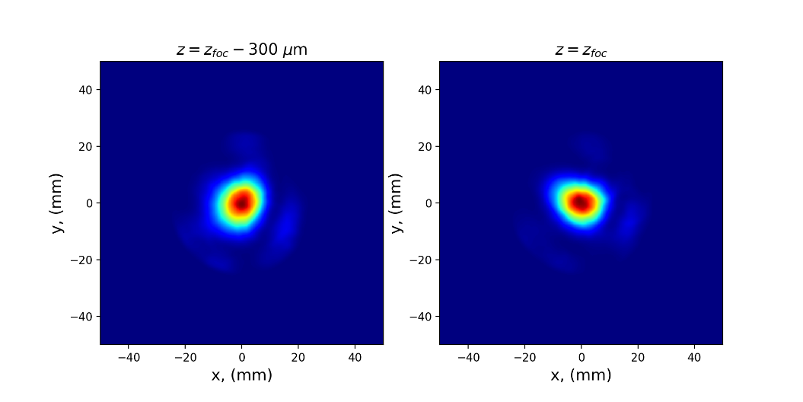
FBPIC simulations with measured focal spot and density profile: still looks promising
No gas
$$4×{10}^{18} cm^{−3}$$
$$8×{10}^{18} cm^{−3}$$
$$1.6×{10}^{19} cm^{−3}$$
$$3.2×{10}^{19} cm^{−3}$$
$$6.4×{10}^{18} cm^{−3}$$
EAAC 2019

Slide 12
Experimental results

Slide 13
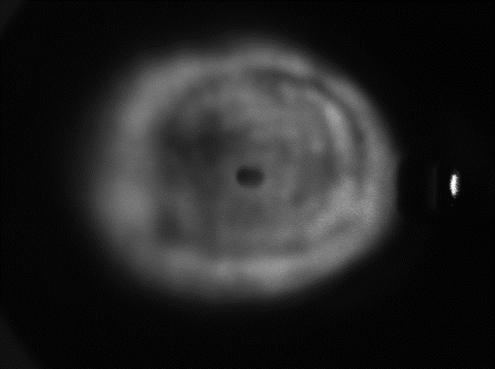
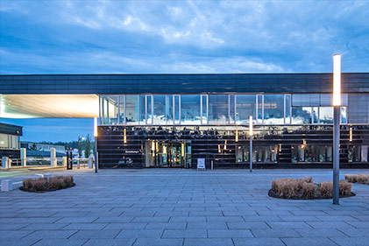
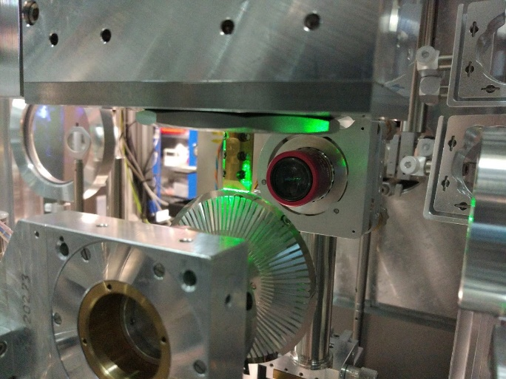
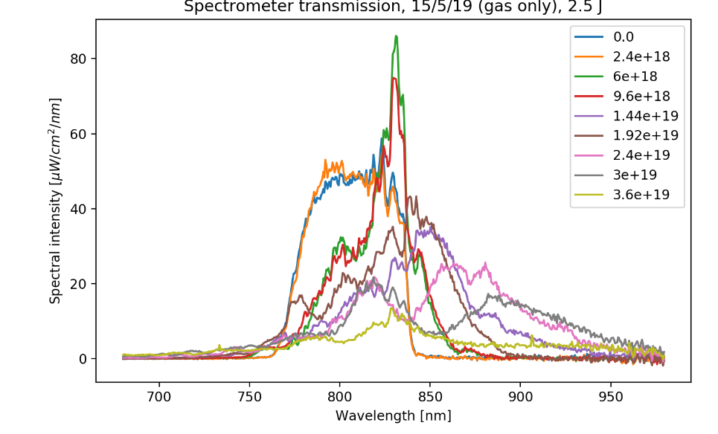
Experiment at HZDR
Laser transmission profile
Self-emission @ $2ω$
Thomson Parabola Spectrometer
Shot spectrum
EAAC 2019

Slide 14
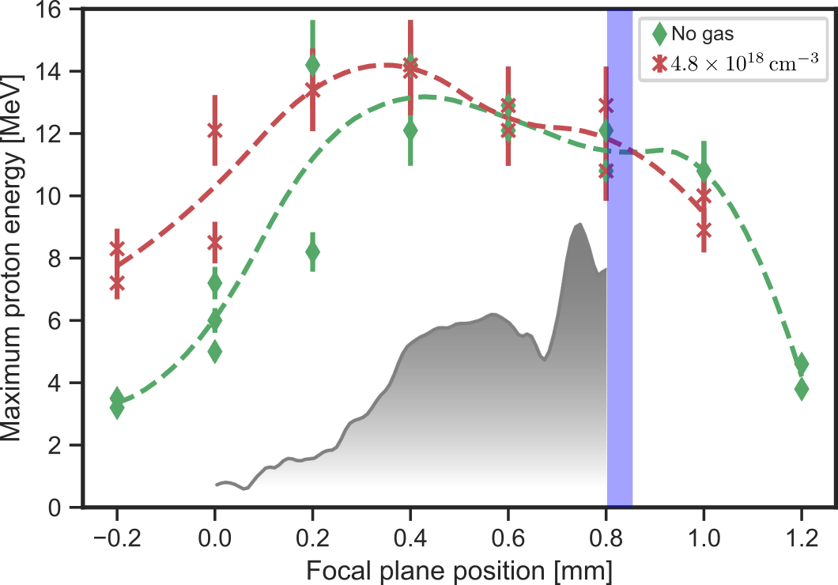
Focal plane scan: evidence for self focusing at low densities, - but not as high as expected
EAAC 2019

Slide 15
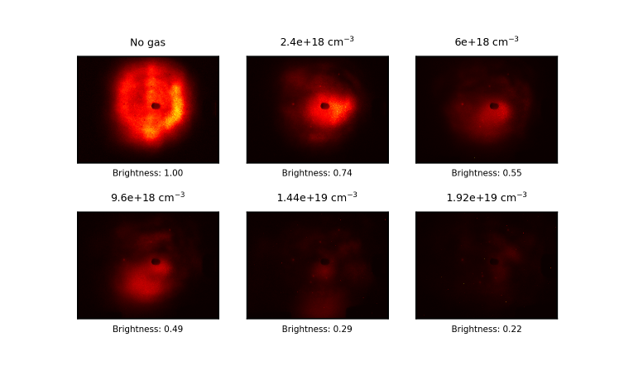
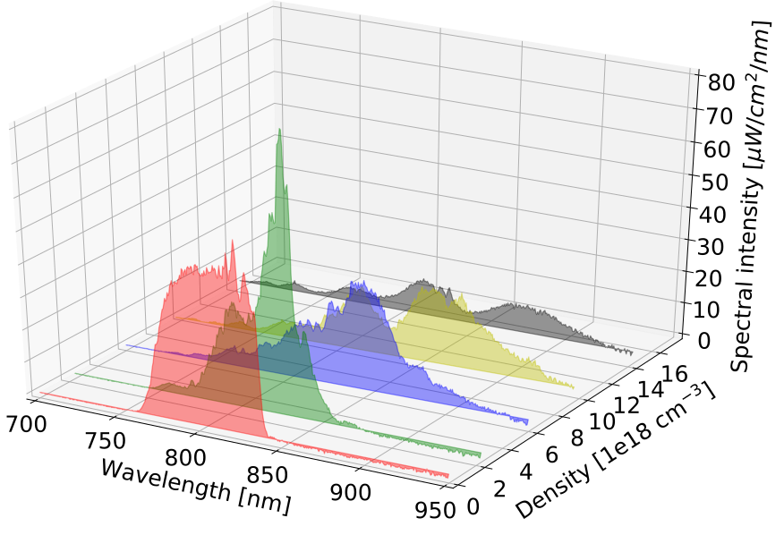
Transmission diagnostics: spectrometer and screen
EAAC 2019

Slide 16
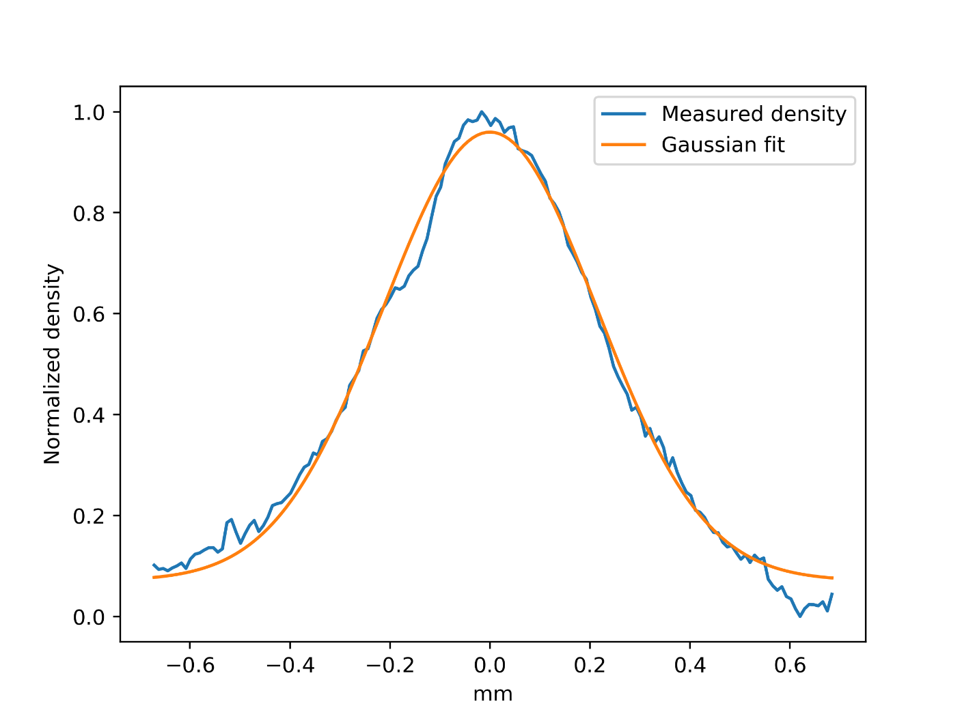
Measured transmission: a drop at medium-high densities
$$L_{depletion}≅\frac{ω_{0}^{2}}{ω_{p}^{2}}cτ=\frac{n_{c}}{n_{e}}cτ, (∗)$$
$$T=1−\frac{L_{plasma}}{L_{depletion}}=1−\left(\frac{1}{n_{c}cτ}\right)\int_{−∞}^{∞}{n_{e}\left(z\right)dz}.$$
$$1−0.025⋅n_{e0}$$
$$2L_{plasma}$$
$n_{e}\left(z\right)≈n_{e0}exp⁡(−z^{2}/L_{plasma}^{2}$)
$$T(n_{e0})=1−\left(\frac{\sqrt{π}L_{plasma}}{n_{c}cτ}\right)n_{e0},$$
(*) Lu, Wei, et al. PRSTAB 10.6 (2007): 061301.
EAAC 2019

Slide 17
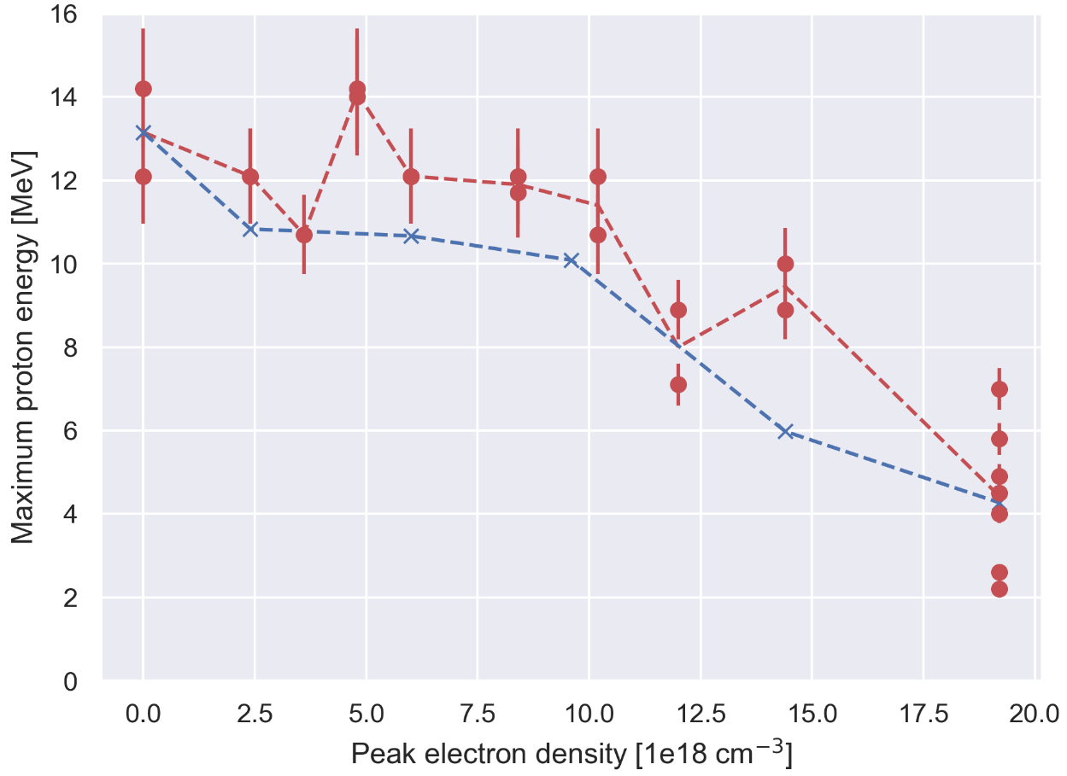
Density scan: proton energies just follow pulse transmission. No increase due to self-focusing/compression.
Expectations
from intensity increase seen in simulations
Expectation assuming just
linear scaling with pulse energy
Measurement
EAAC 2019

Slide 18
Exit-mode imaging: Beam breaks down at medium-high densities
EAAC 2019

Slide 19
Summary
Proton energies are not higher with gas. Why?
Pulse does not propagate well at medium-high densities;
Depletes and breaks down.
Picture is clear thanks to probe-ability (vs. probability…)
Simulations suggested otherwise. Why?
A possibility: input to simulation does not carry
all information, beam spatial phase information is missing.
What can we do next?
Optimize beam quality.
Fully-functioning experimental system: pursue other ideas.
Already at $1.5×{10}^{19} cm^{−3}$
What is the phase?
More to come
EAAC 2019

Slide 20
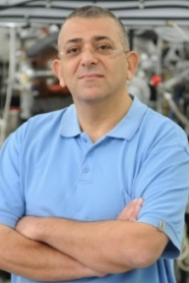
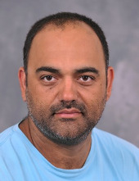
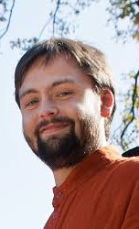
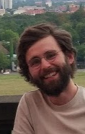
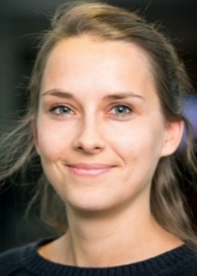
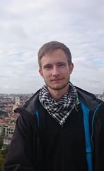
A real collaboration
Igor
Andriyash
Ulrich
Schramm
Martin
Rehwald
Constantin
Bernert
Victor Malka
Eyal Kroupp
Tal Queller
Karl Zeil
David Naimark
Benny
Pasmantirer
Haim Sade
Pesy Meiri
Lotti Obst
Tim Ziegler
Stefan Assenbaum
Josefine Metzkes-Ng
EAAC 2019

Slide 21
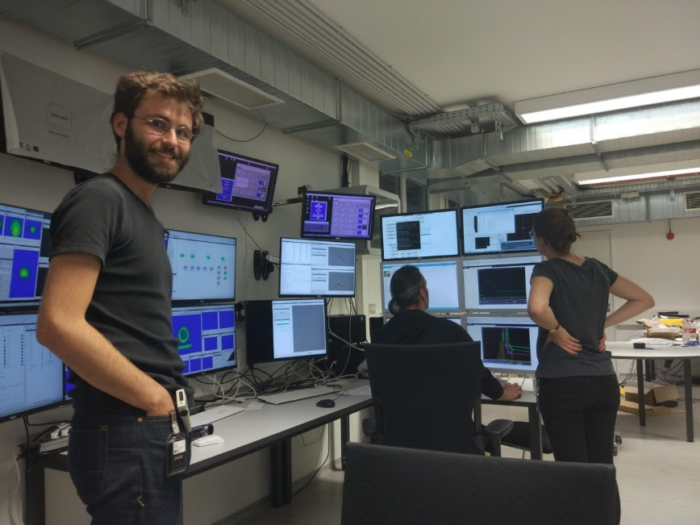
A real collaboration
Thank you for your attention

Slide 22
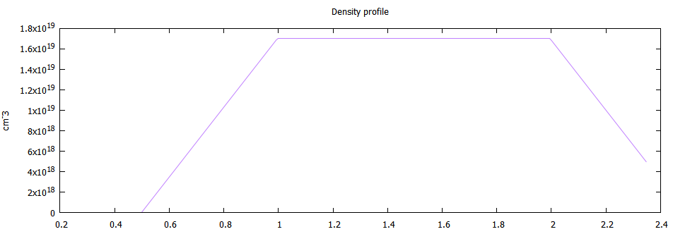
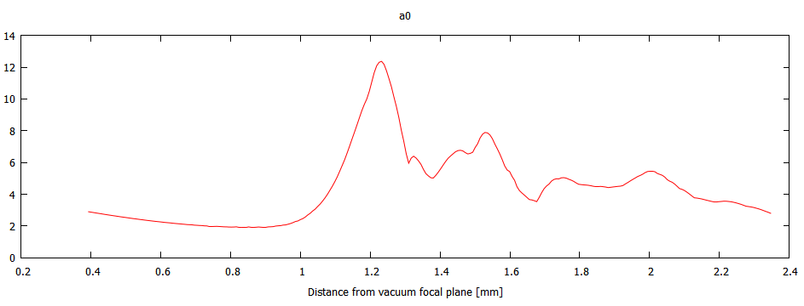
Preliminary simulations: increase in intensity by up to 10 times
Gas density with respect to distance from vacuum focal plane
$$1.7⋅{10}^{19}$$
Density
$$0.01 n_{c}$$
$$1⋅{10}^{19}$$
$$[cm^{−3}]$$
0
12
$$a_{0}$$
4
0
1
2
Distance from vacuum focal plane [mm]
EAAC 2019

Slide 23
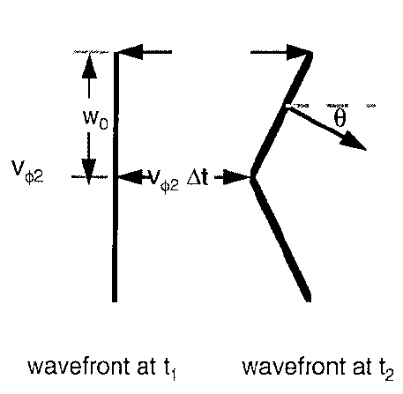
Relativistic Self Focusing: Wavefront bends due to increased effective electron mass at center
$$v_{φ}(r)=c/η(r)$$
$η\left(r\right)=\sqrt{1−\frac{ω^{2}}{γ(r)ω^{2}}}$,
$\frac{dv_{φ}\left(r\right)}{dr}>0$.
$γ\left(r\right)=\sqrt{1+a_{0}^{2}\left(r\right)/2}$,
Condition: $\frac{P}{P_{c}}>1$
$$P_{c}=\frac{n_{c}}{n_{e}}17 GW$$
Mori, W. B. IEEE Journal of Quantum Electronics 33.11 (1997): 1942-1953.

