Slide 1
Characterization of the Electron Beam in the ACHIP Chamber in SwissFEL
Rasmus Ischebeck, Simona Bettoni, Simona Borrelli, Marco Calvi, Eugenio Ferrari, Franziska Frei, Vitaliy Guzenko, Dominique Hauenstein, Benedikt Hermann, Peter Hommelhoff, Orell Hürzeler, Adrian Kirchner, Csaba Lombosi, Eduard Prat, Sven Reiche, Leonid Rivkin, Dominique Zehnder

Slide 2
The Accelerator-on-a-Chip International Program
Rasmus Ischebeck — EAAC 2019 — Characterization of the Electron Beam in the ACHIP Chamber in SwissFEL

Slide 3
ACHIP Collaboration
students and guest scientists from Los Alamos National Laboratory, and National Tsing Hua University
Rasmus Ischebeck — EAAC 2019 — Characterization of the Electron Beam in the ACHIP Chamber in SwissFEL

Slide 4
Interaction Chamber in SwissFEL
Rasmus Ischebeck — EAAC 2019 — Characterization of the Electron Beam in the ACHIP Chamber in SwissFEL

Slide 5
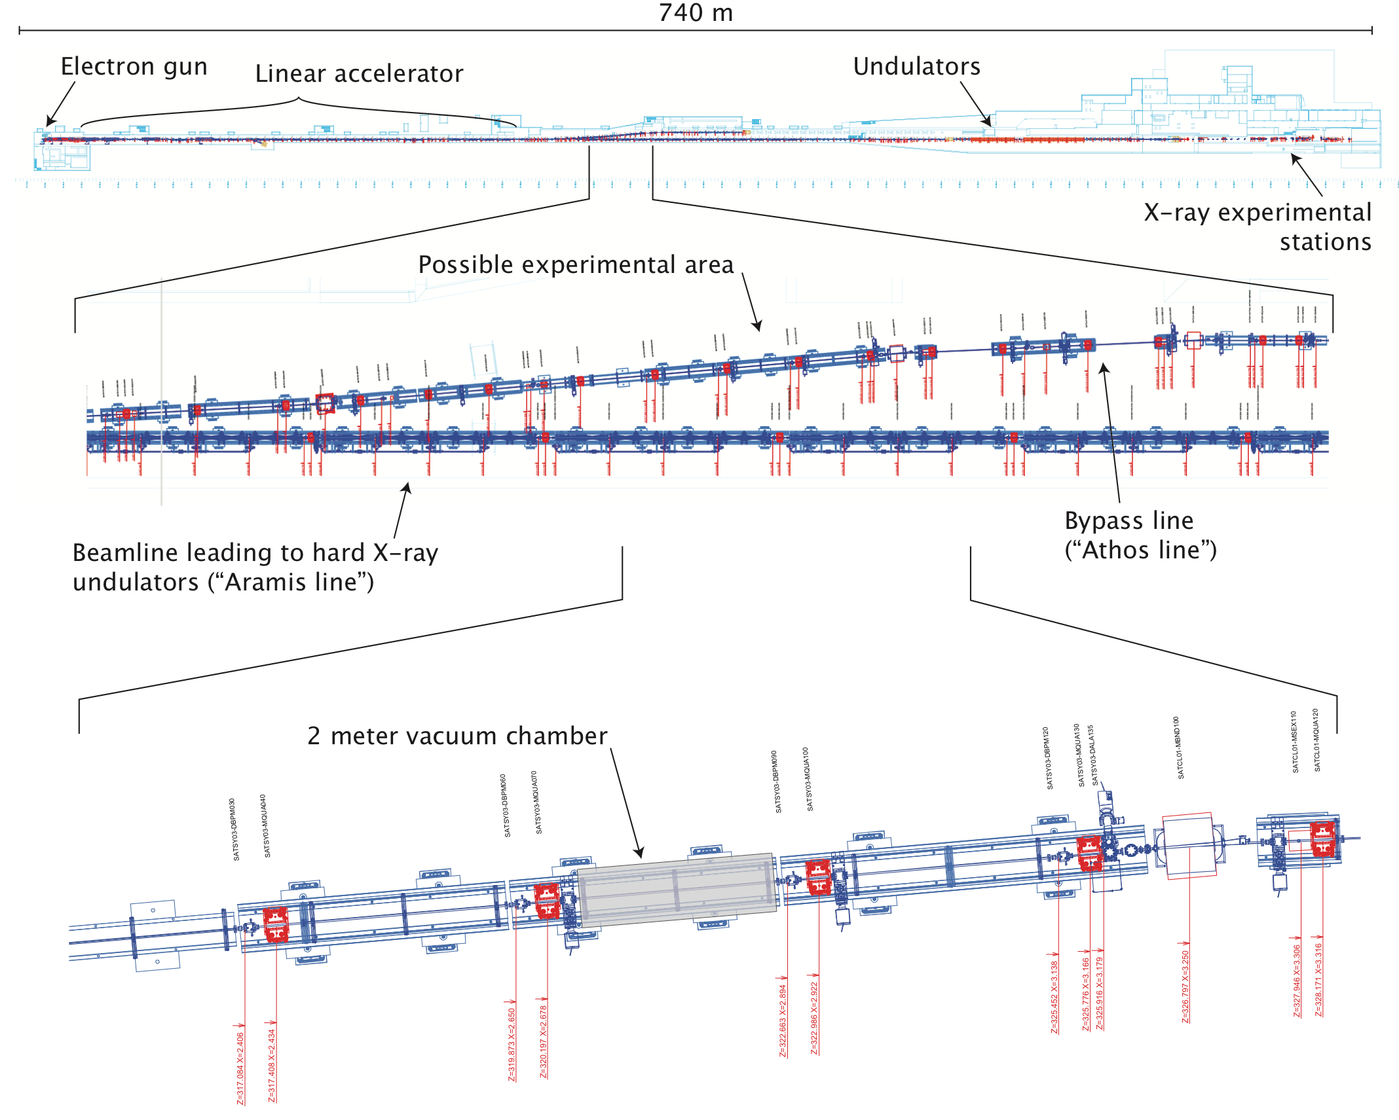
Experimental Setup in SwissFEL
Goals:
Acceleration by 1 MeV
Bunch shaping
Rasmus Ischebeck — EAAC 2019 — Characterization of the Electron Beam in the ACHIP Chamber in SwissFEL

Slide 6
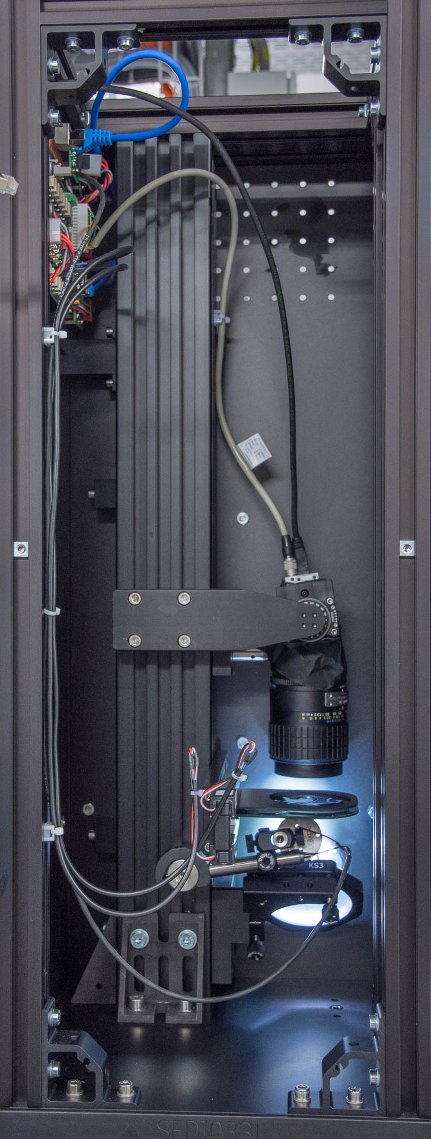
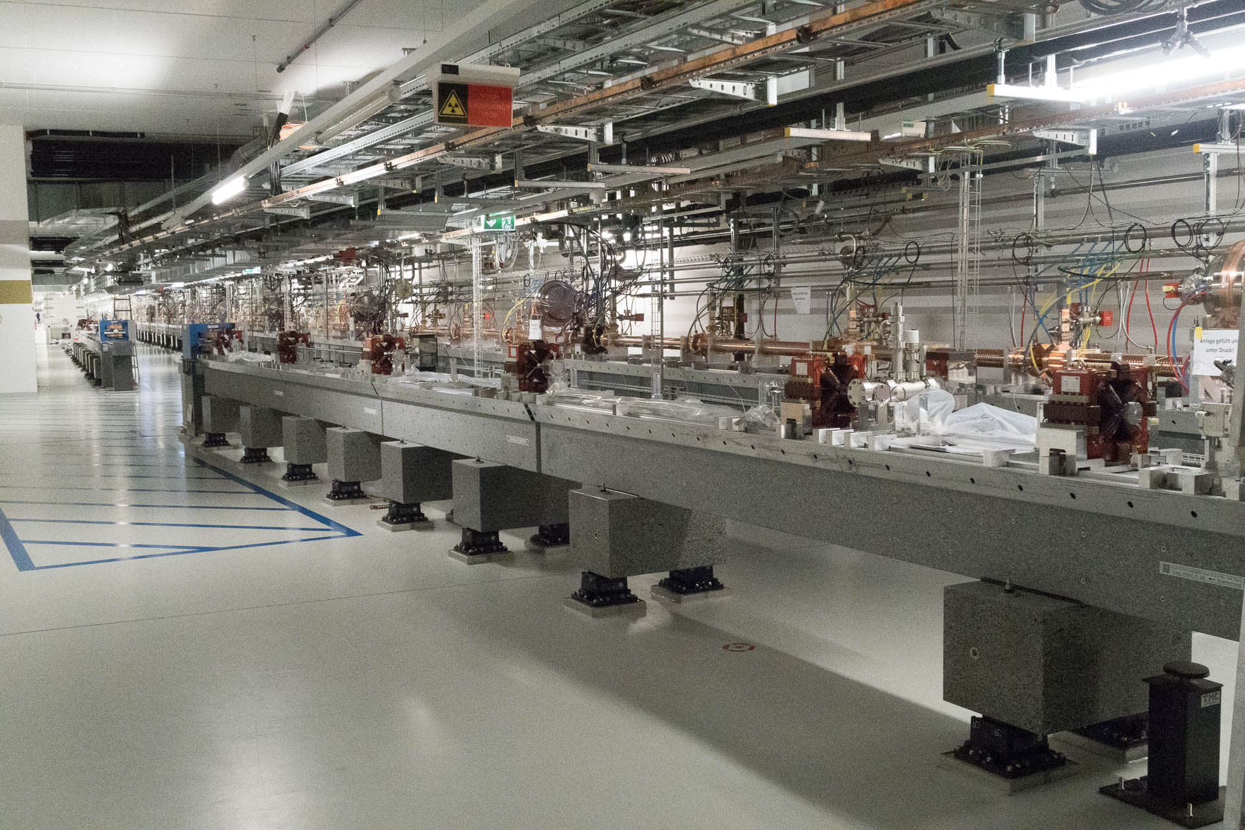
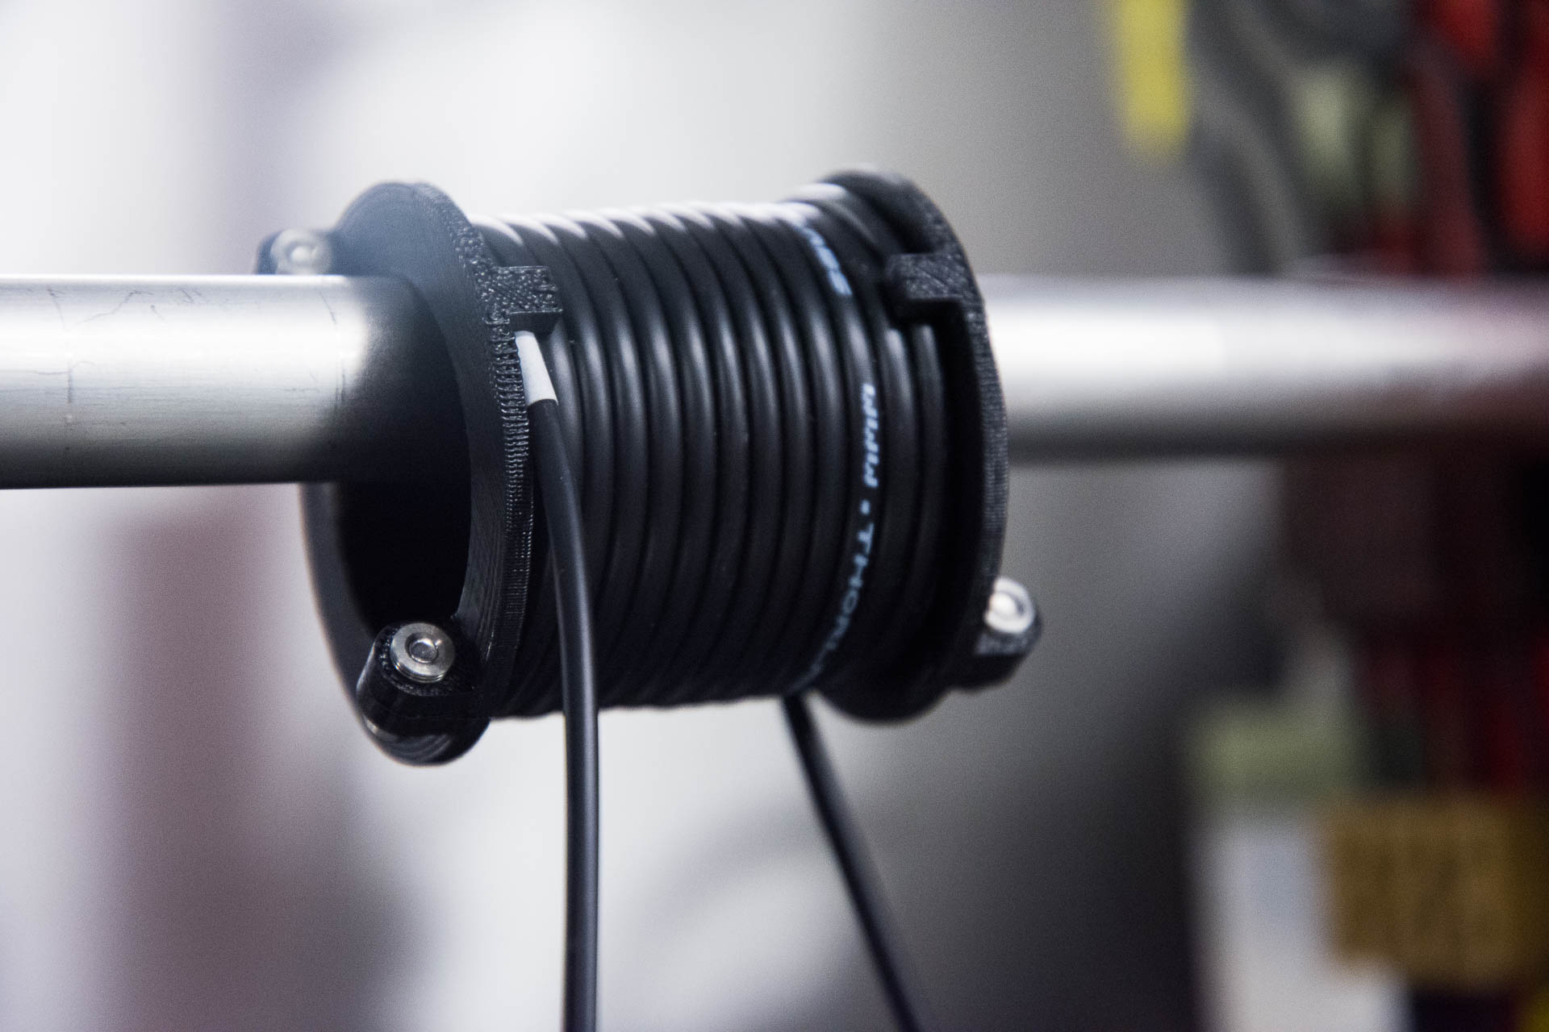
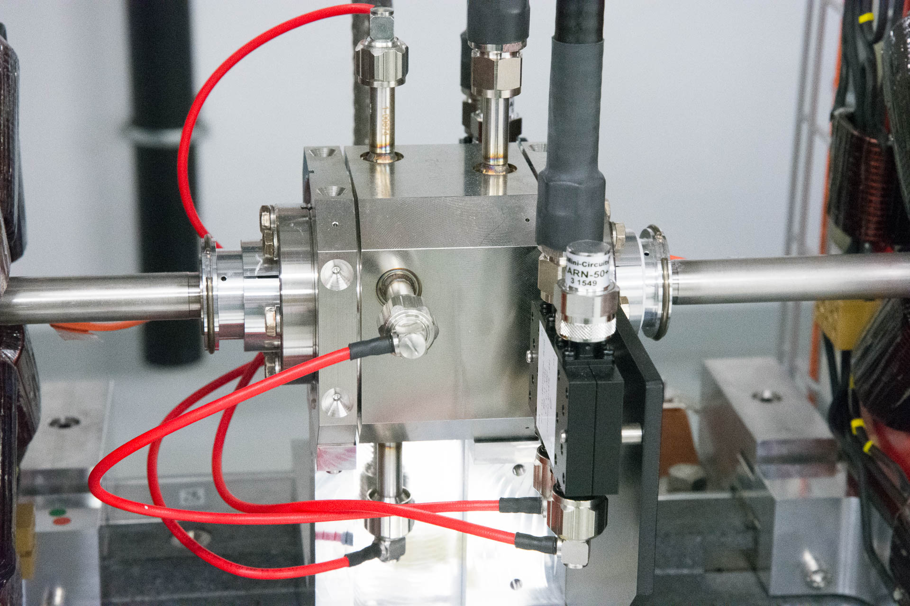
Electron Beam Instrumentation
Charge
Profile
Beam Losses
Energy spectrum
Rasmus Ischebeck — EAAC 2019 — Characterization of the Electron Beam in the ACHIP Chamber in SwissFEL

Slide 7
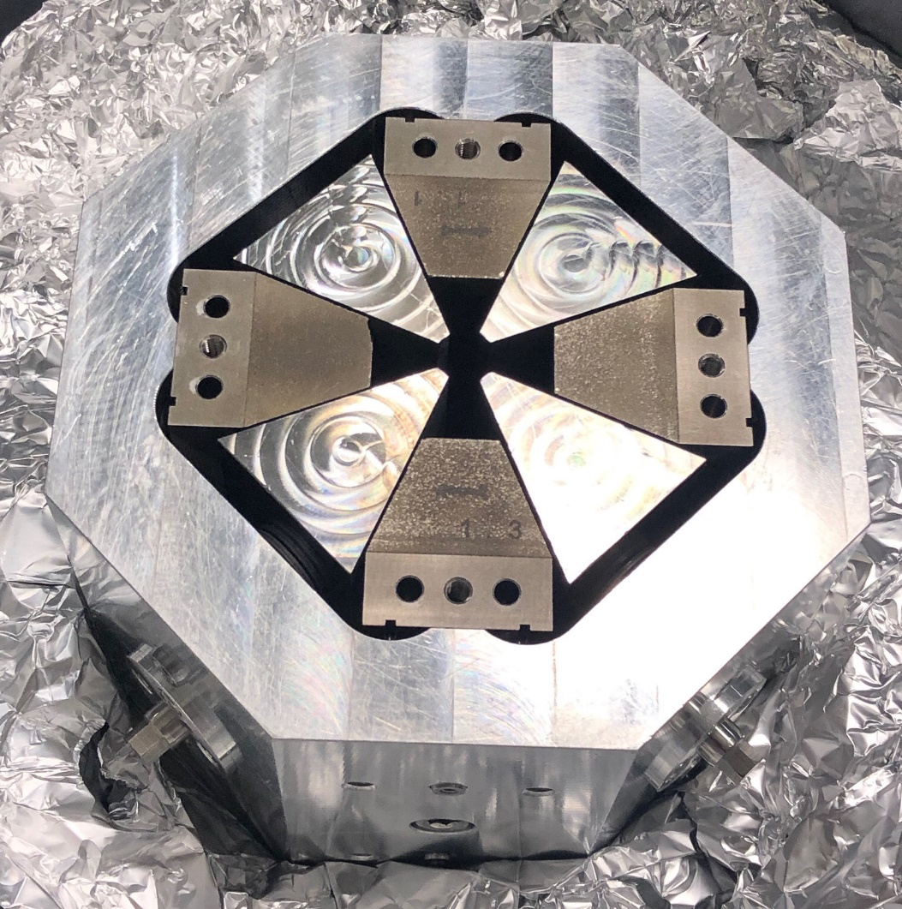
Quadrupoles for Beam Focusing
6 Permanent magnet quadrupoles (PMQs) calibrated (Marco Calvi)
K-Value: 25.9 m-2, 38.8 m-2 (error < 0.2%)
L = 0.1 m → f = 1/KL = 0.39 m, 0.26 m (at 3 GeV)
Vacuum < 1e-7 mbar after 24 hours
→ Chamber access for sample installation during short shutdowns (1.5 day, every month) is feasible
Rasmus Ischebeck — EAAC 2019 — Characterization of the Electron Beam in the ACHIP Chamber in SwissFEL

Slide 8
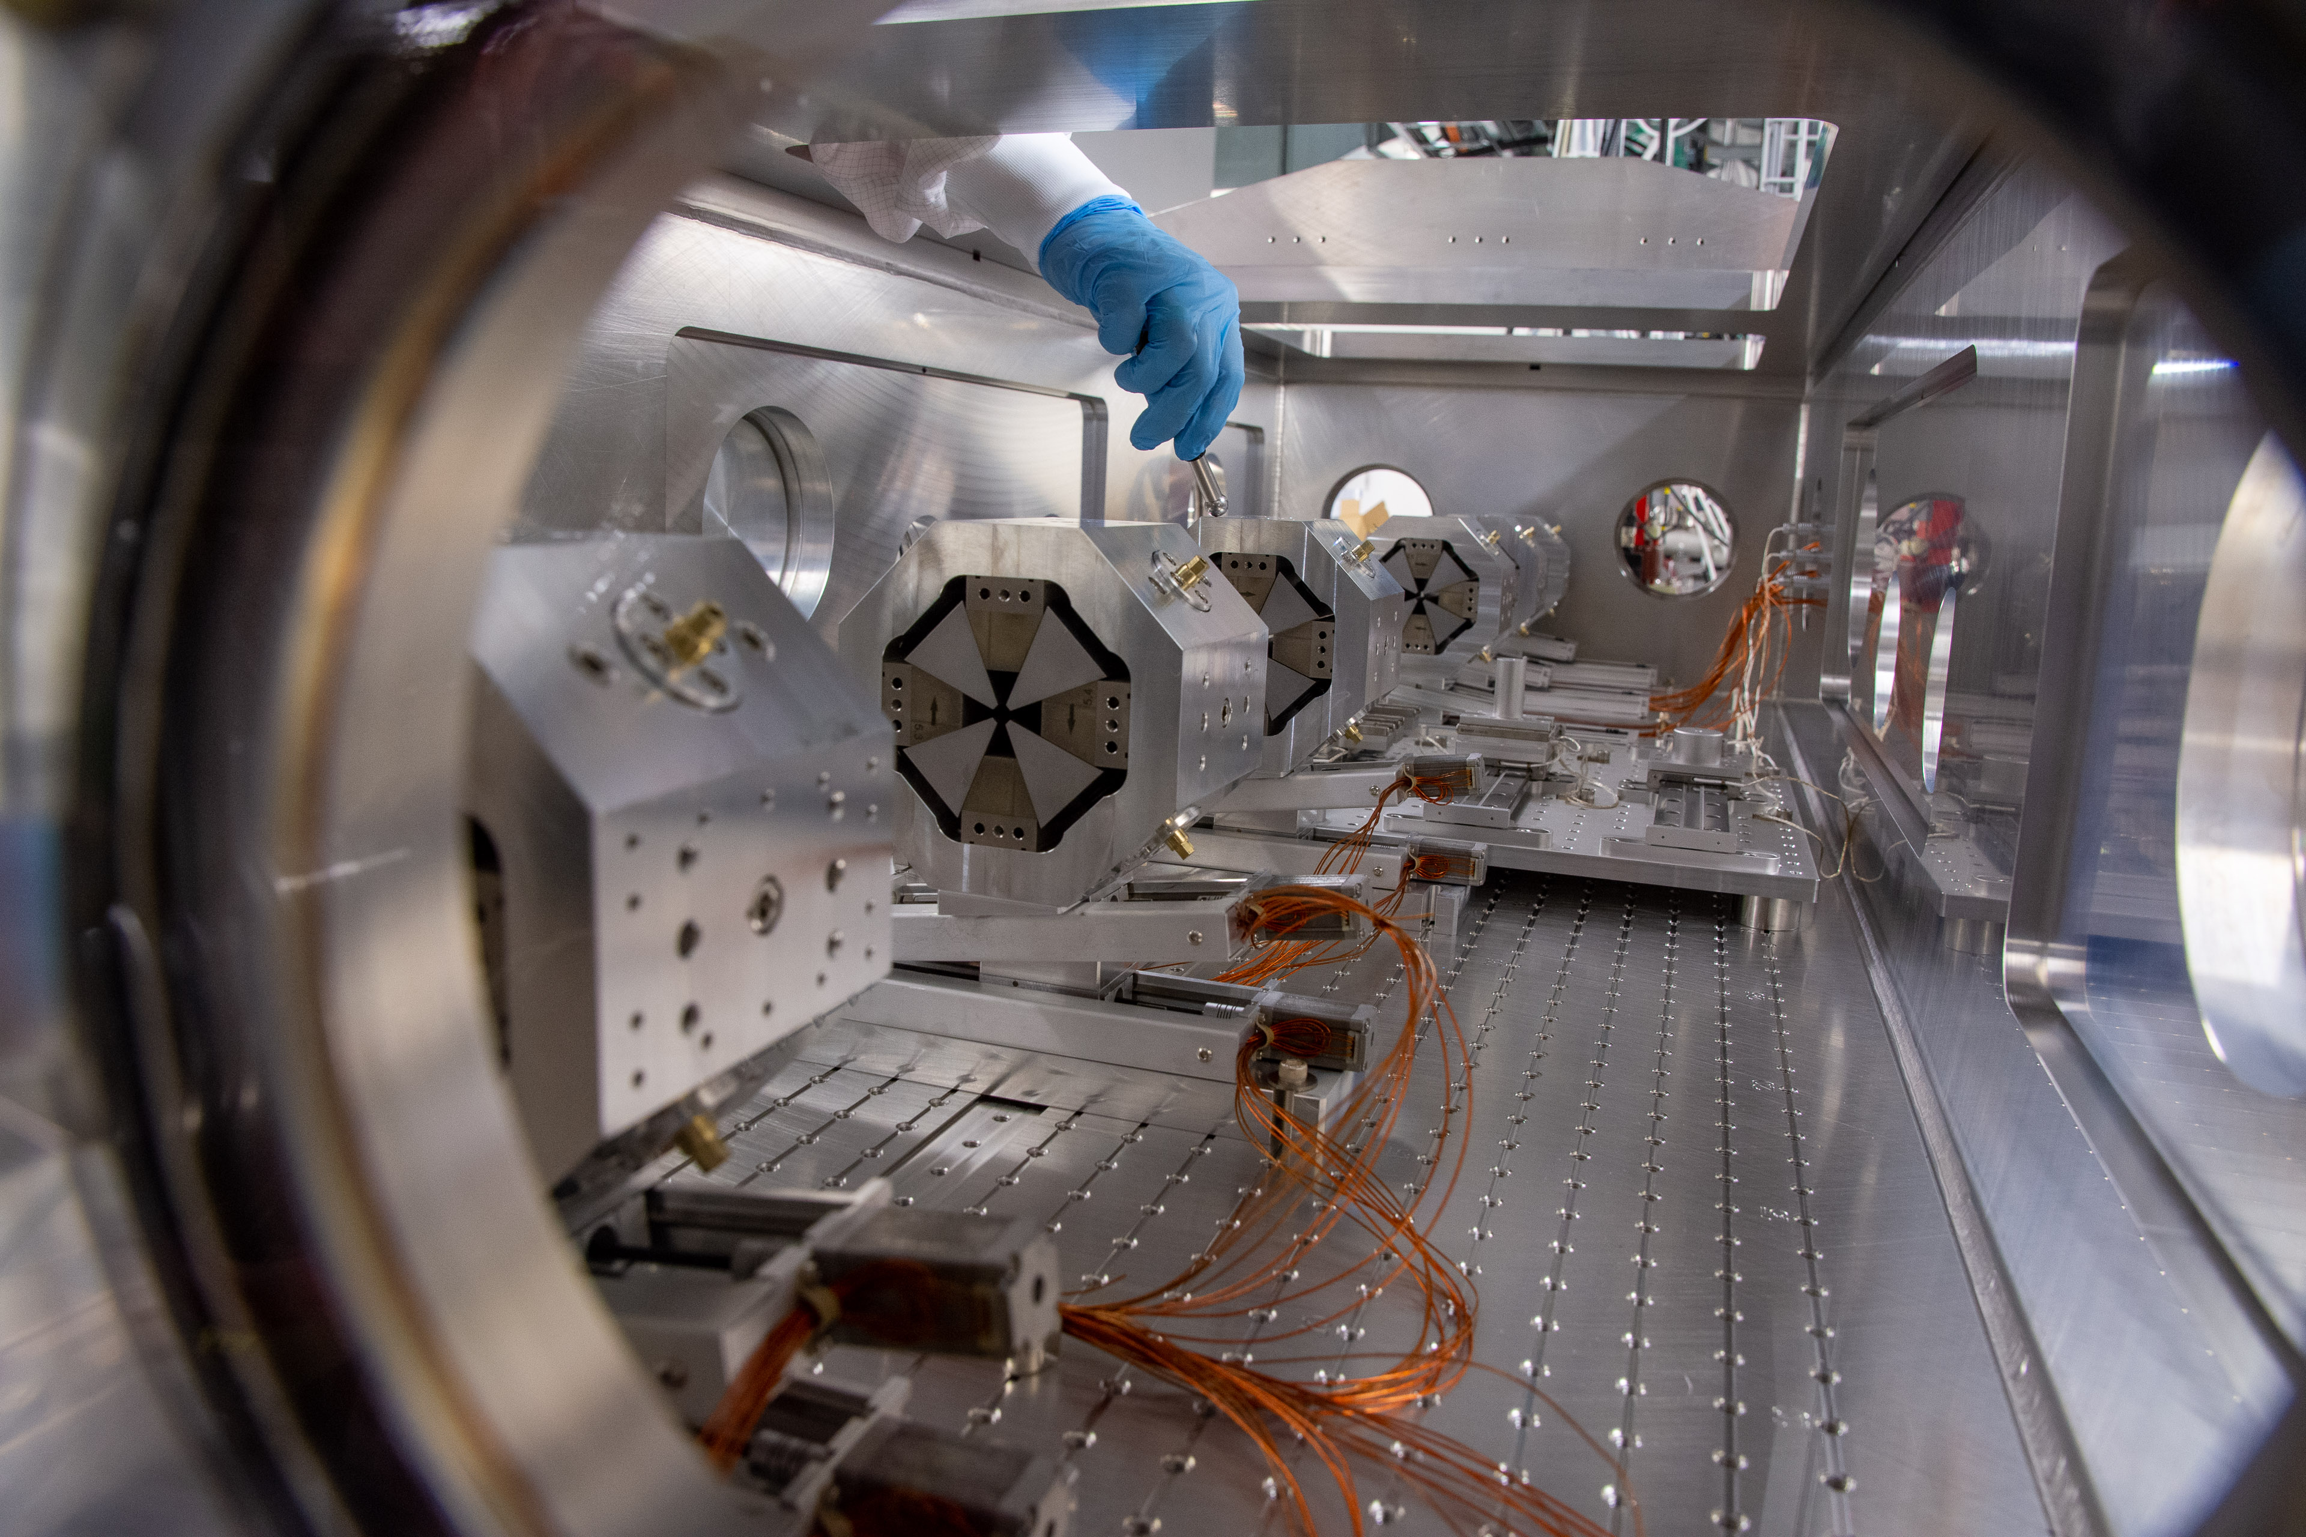
Quadrupole Alignment
Rasmus Ischebeck — EAAC 2019 — Characterization of the Electron Beam in the ACHIP Chamber in SwissFEL

Slide 9
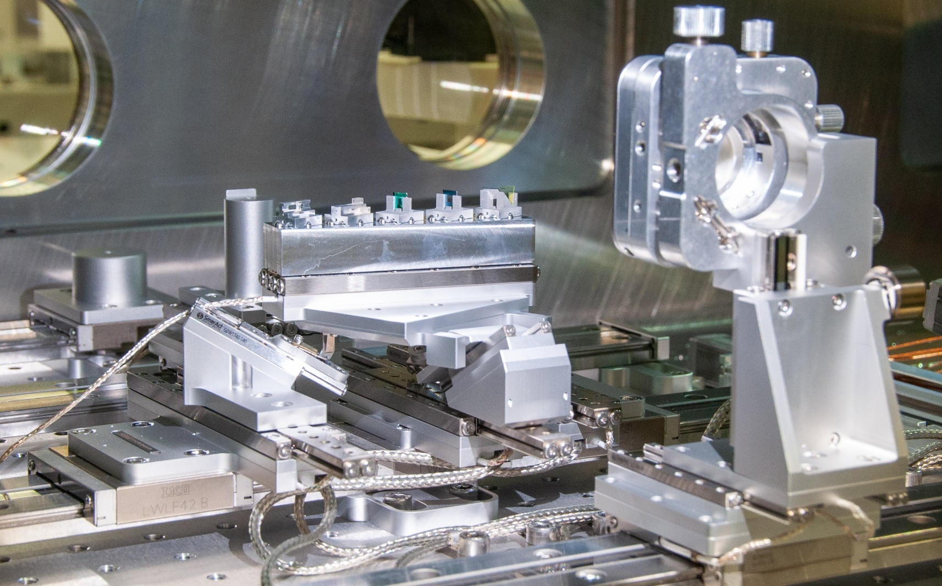
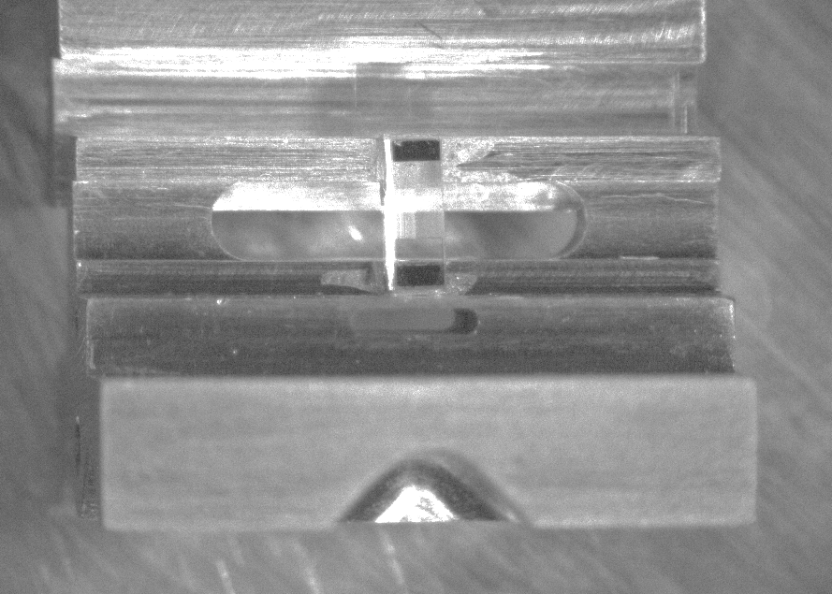
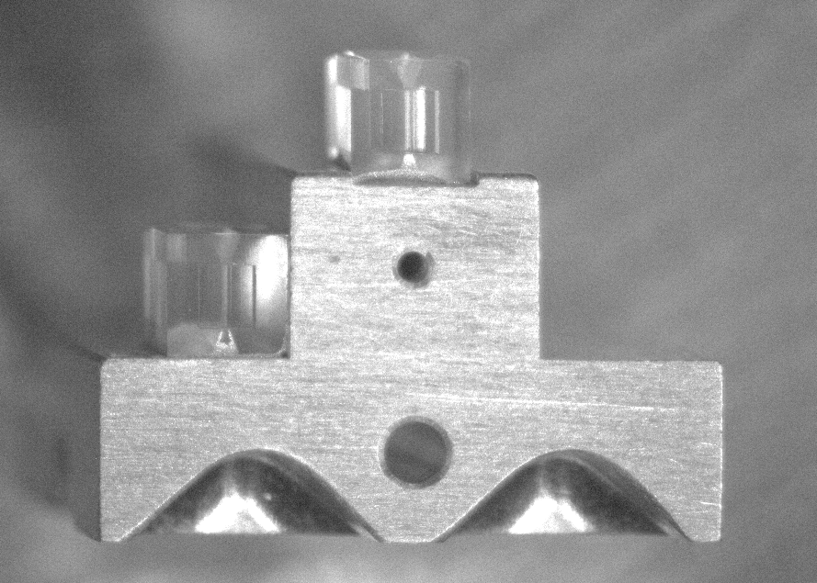
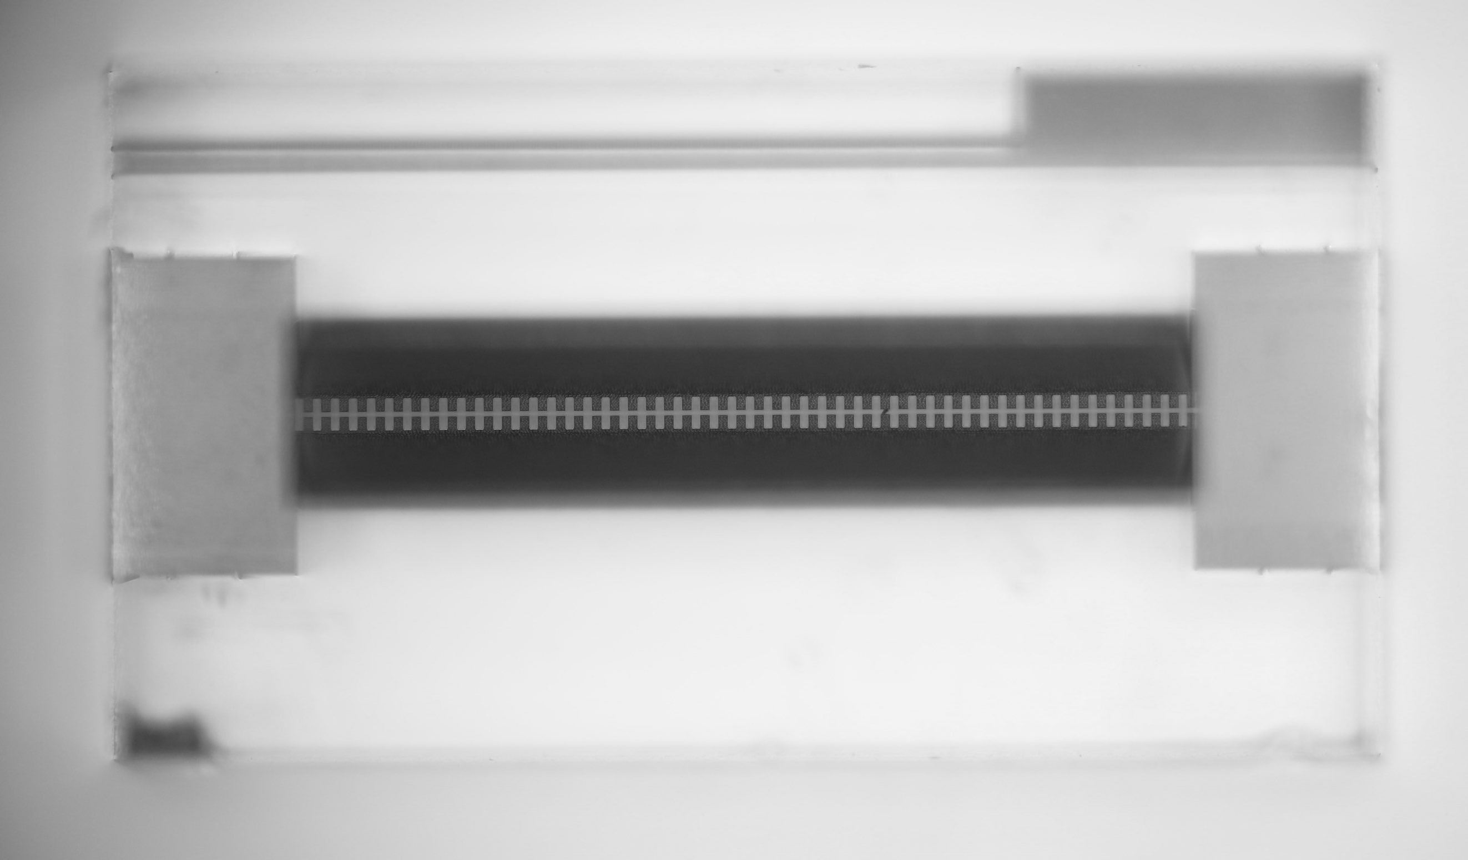
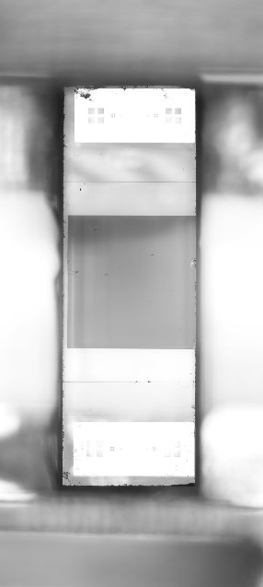
Sample Alignment
Micro Wire Scanners (2x)
YAG Screen
Dielectric Gratings
2 µm period
50 µm period
2 um dual grating, SiO2, Yu Miao, Stanford
DLA modulation experiments
50 um dual grating, SiO2, Femtoprint, Wake field and radiation generation
Rasmus Ischebeck — EAAC 2019 — Characterization of the Electron Beam in the ACHIP Chamber in SwissFEL

Slide 10
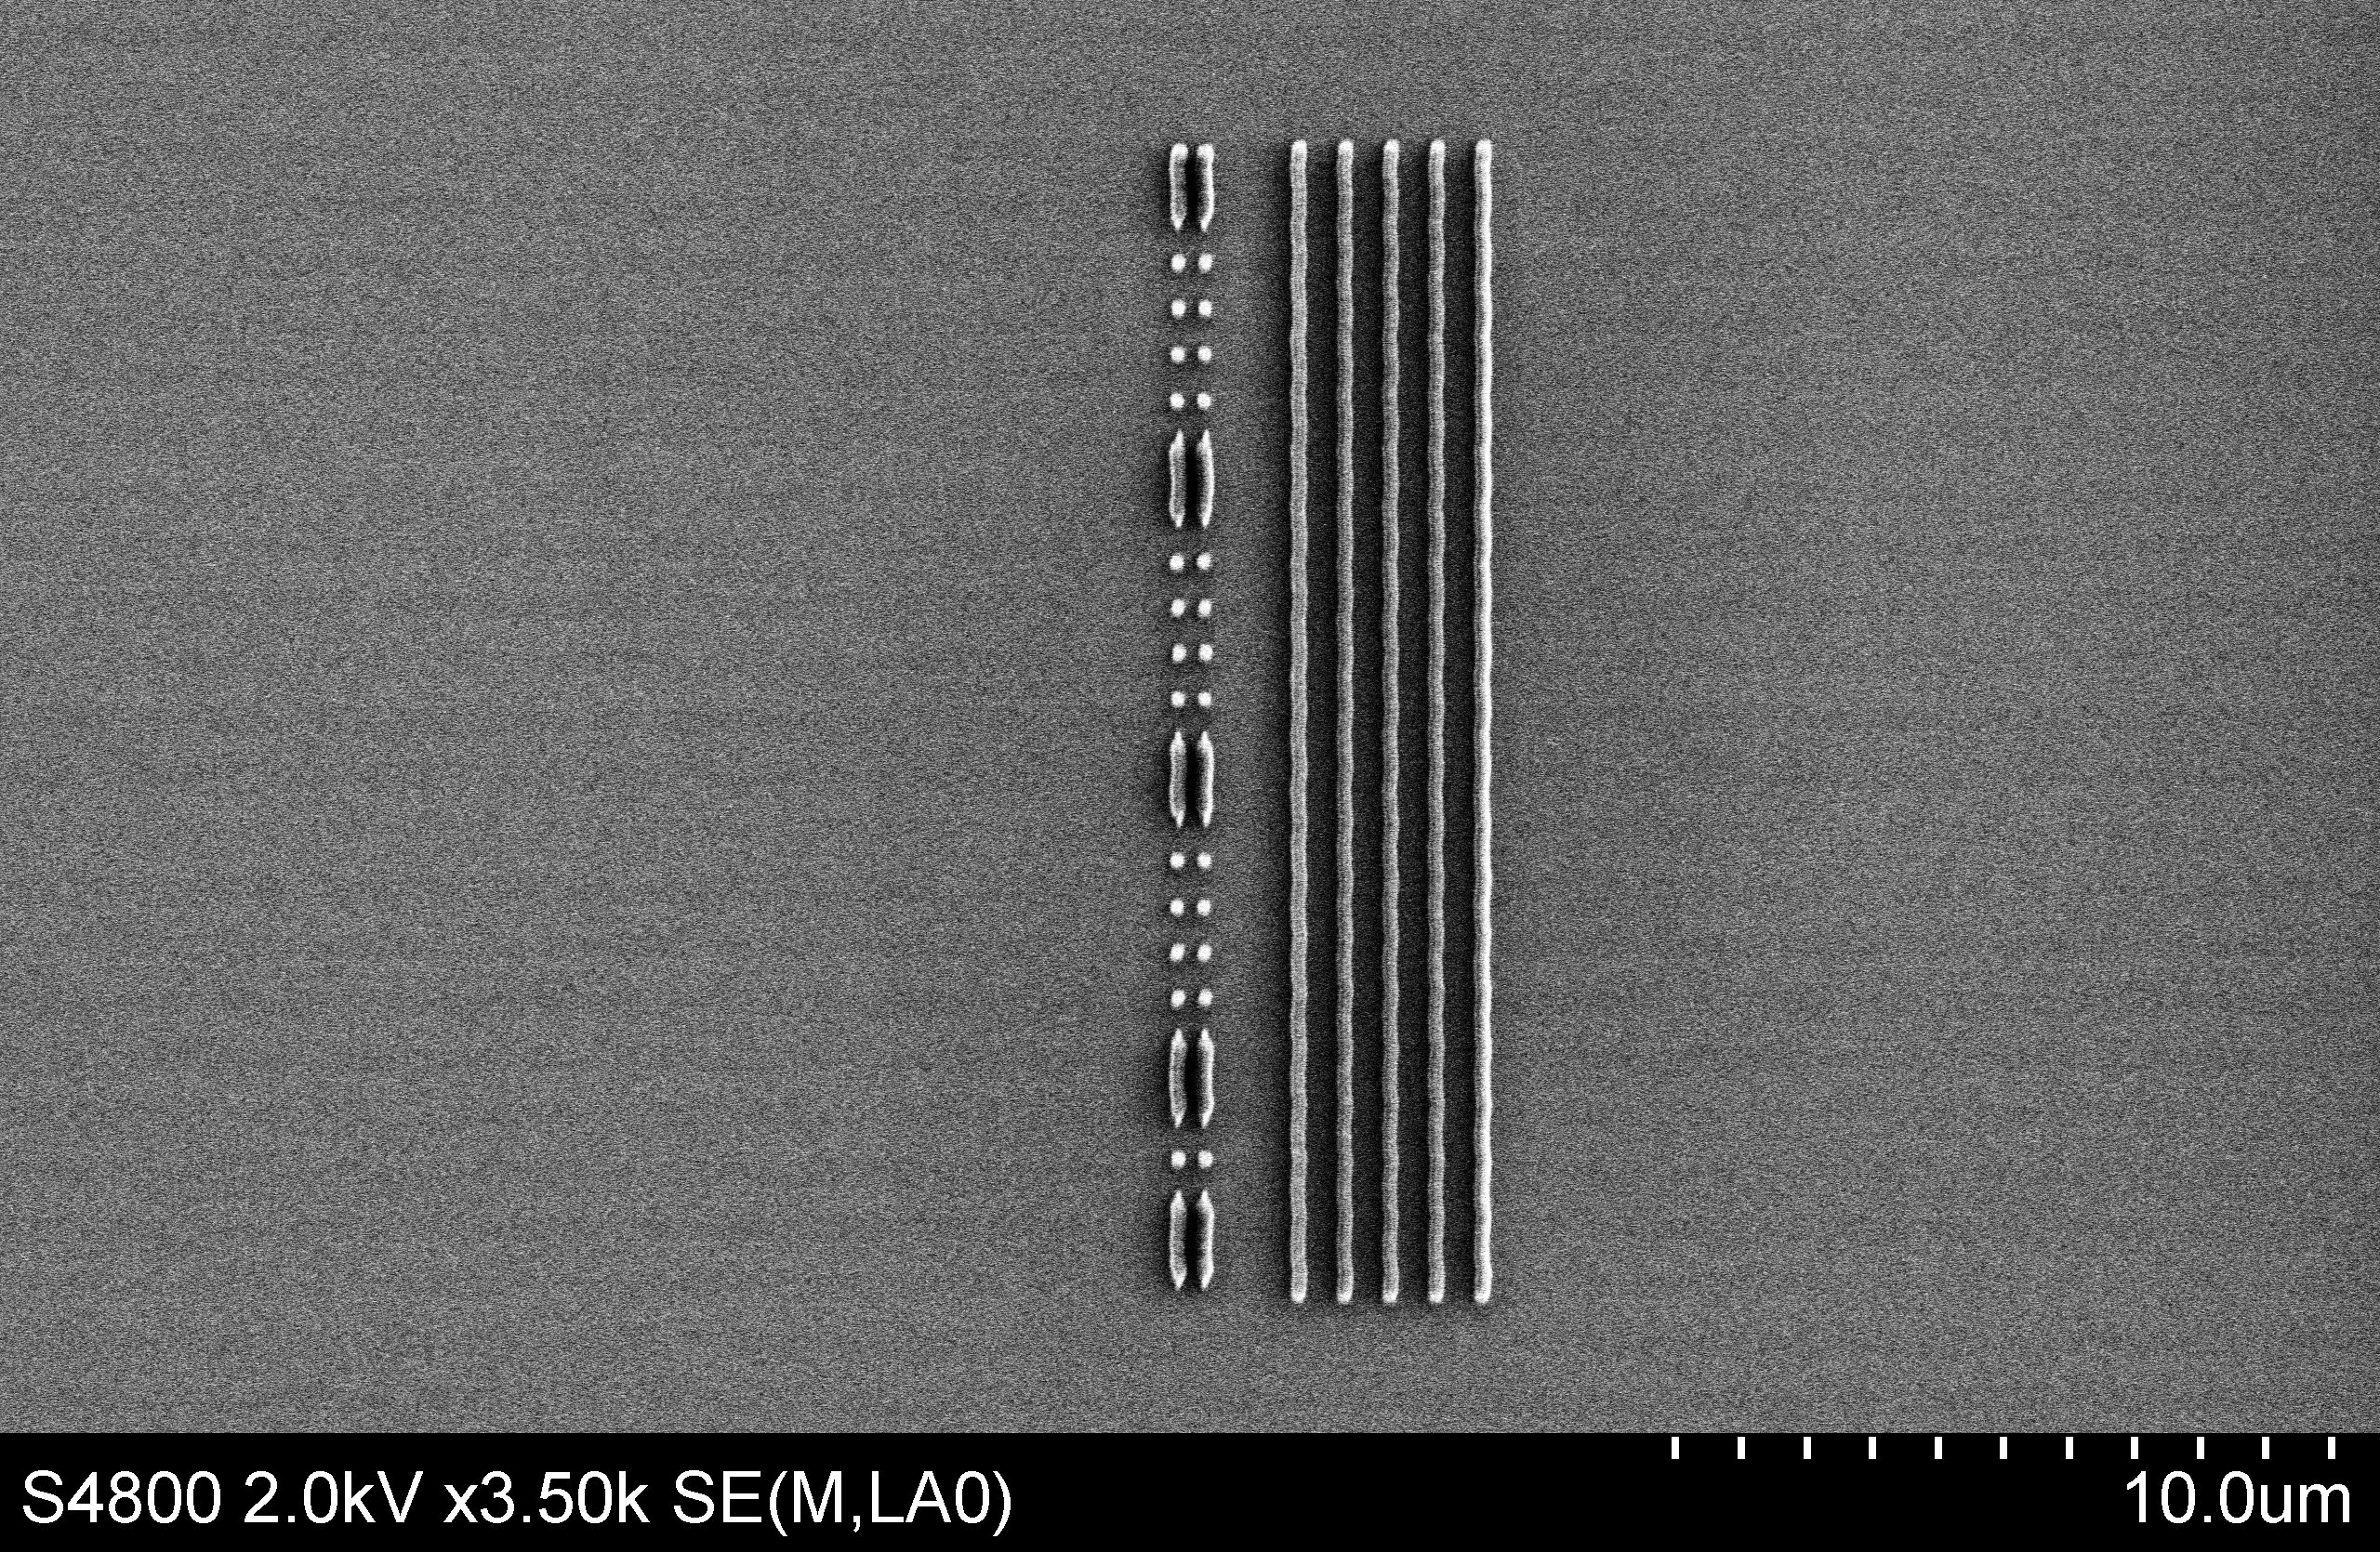
2 µm structures
DLA structure
Structure type | Double pillar
Charge | 1 pC
Accelerating length | 1 mm
Accelerating gradient | 1 MeV
Structure diameter | 1.2 – 7.0 µm
Laser wavelength | 2 µm
Laser pulse energy | 400 µJ
Laser pulse length | 100 fs
Rasmus Ischebeck — EAAC 2019 — Characterization of the Electron Beam in the ACHIP Chamber in SwissFEL

Slide 11
Characterization of the Electron Beam
Rasmus Ischebeck — EAAC 2019 — Characterization of the Electron Beam in the ACHIP Chamber in SwissFEL

Slide 12
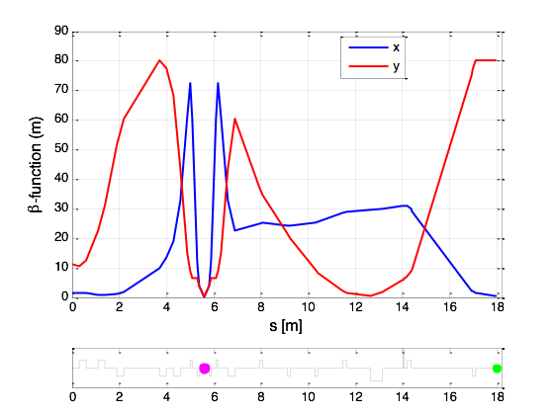
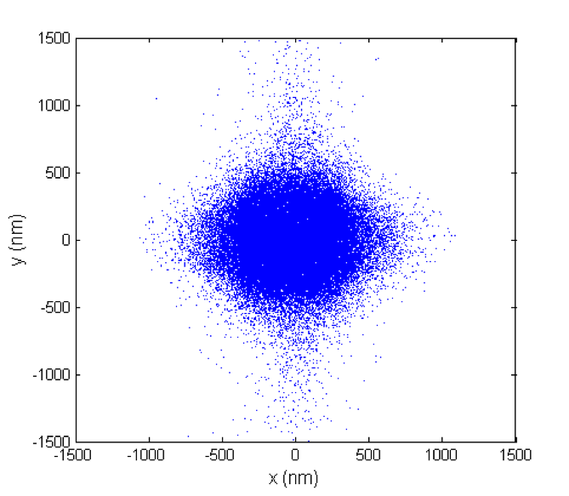
Design Optics
Eduard Prat
Rasmus Ischebeck — EAAC 2019 — Characterization of the Electron Beam in the ACHIP Chamber in SwissFEL
Eduard Prat

Slide 13
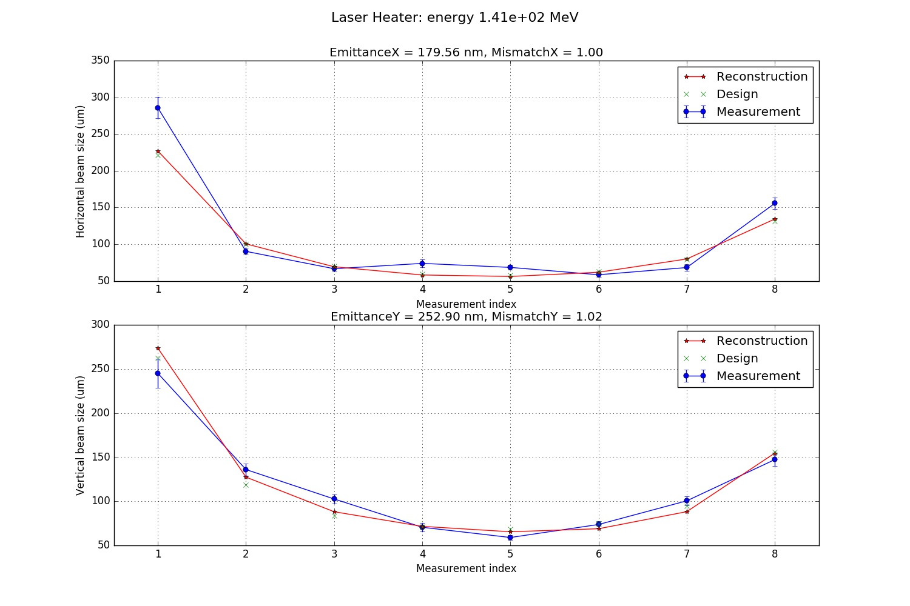
Emittance Measurement
Emittance at the Injector: 180 · 250 nm
Beam matched to design optics
Rasmus Ischebeck — EAAC 2019 — Characterization of the Electron Beam in the ACHIP Chamber in SwissFEL

Slide 14
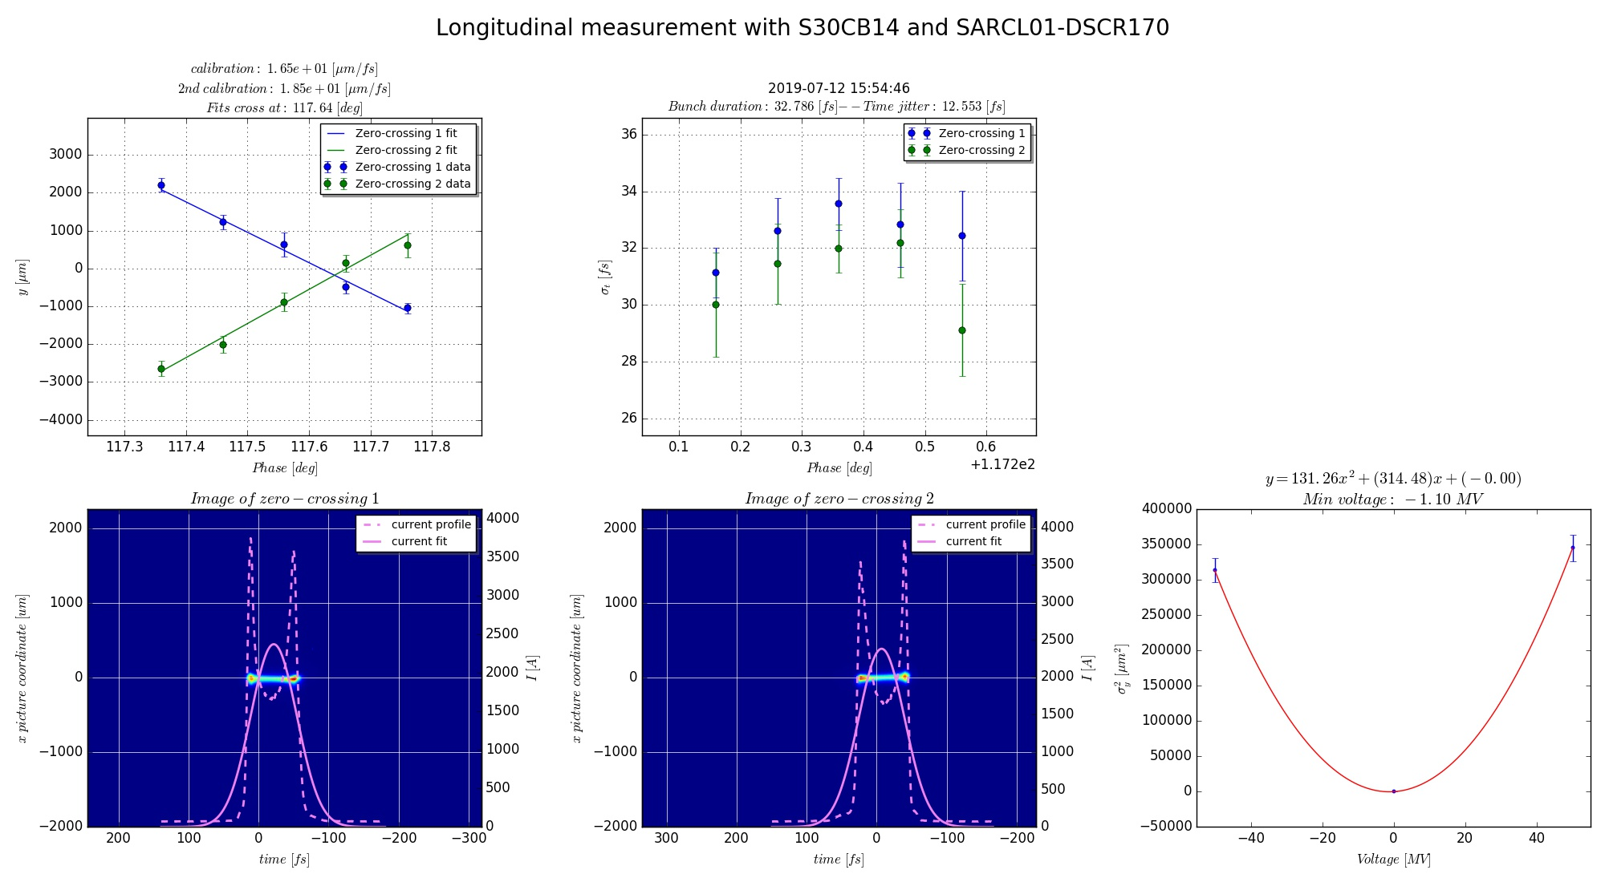
Measurement of Bunch Length and Peak Current
Rasmus Ischebeck — EAAC 2019 — Characterization of the Electron Beam in the ACHIP Chamber in SwissFEL

Slide 15
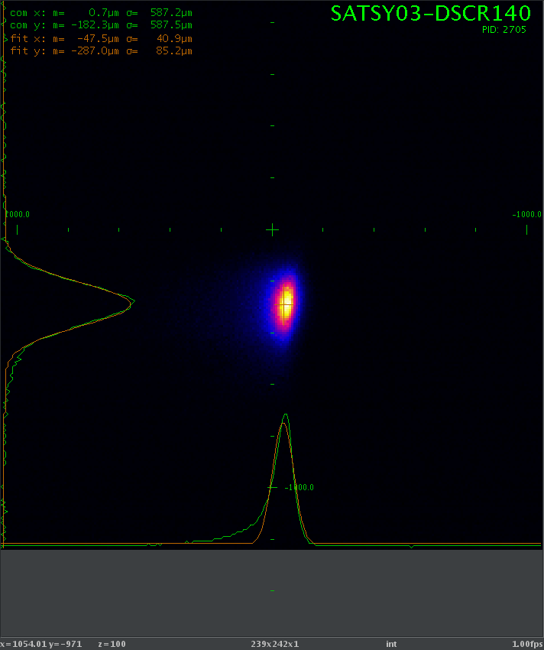
Beam Upstream of Interaction Chamber
Measured profile in switchyard
Rasmus Ischebeck — EAAC 2019 — Characterization of the Electron Beam in the ACHIP Chamber in SwissFEL

Slide 16
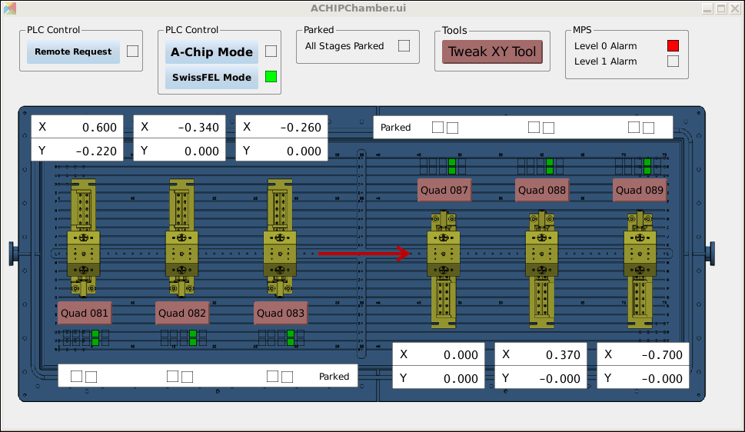
Quadrupole Alignment
Quadrupole settings for minimum losses
Rasmus Ischebeck — EAAC 2019 — Characterization of the Electron Beam in the ACHIP Chamber in SwissFEL

Slide 17
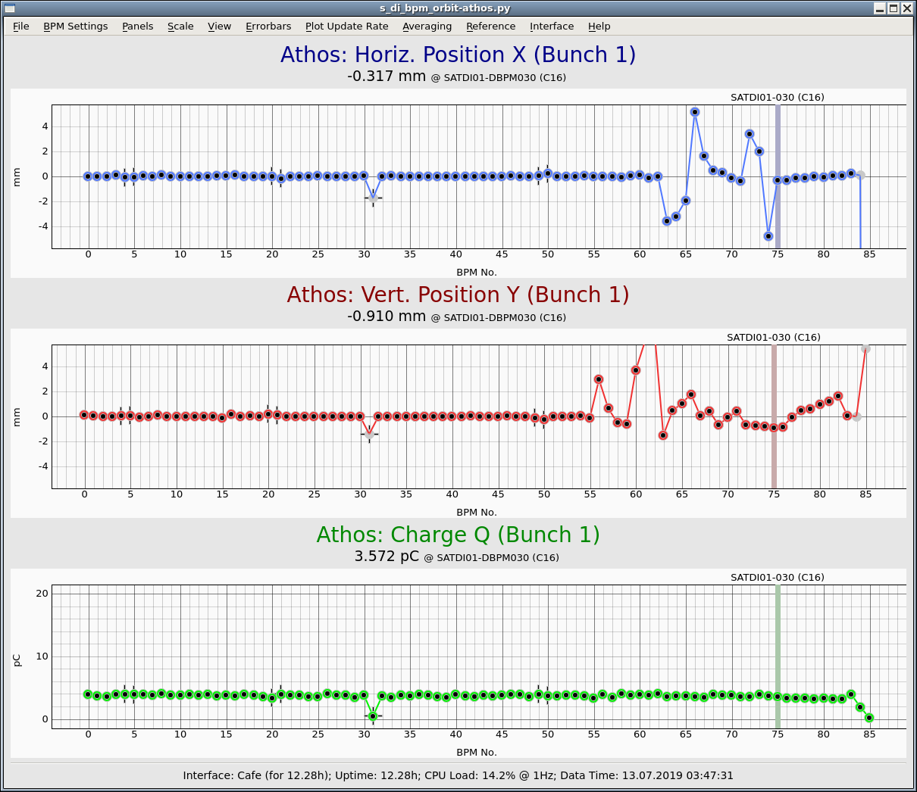
BunCh Charge and Transmission
Measured with cavity beam position monitors
Rasmus Ischebeck — EAAC 2019 — Characterization of the Electron Beam in the ACHIP Chamber in SwissFEL

Slide 18
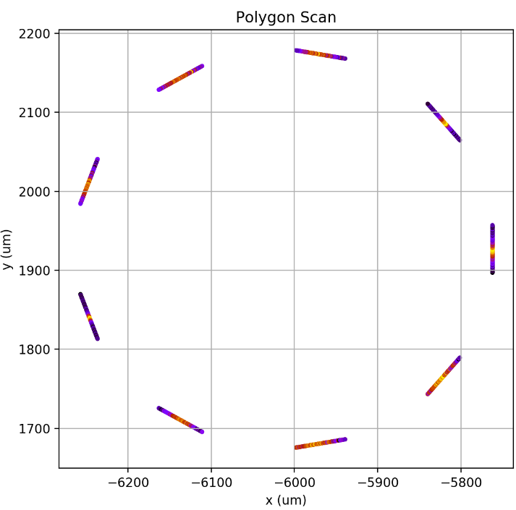
V
2x 8h shifts for alignment and transport through chamber with quadrupoles
Beam profile characterization started with wire scanner (wire width: ~1 um)
Collect beam loss signal w.r.t. wire position
Total scan duration
9 wires * 100 shots\wire \ 1 Hz = 15 min
Rasmus Ischebeck — EAAC 2019 — Characterization of the Electron Beam in the ACHIP Chamber in SwissFEL
Vitaliy Guzenko, Benedikt Hermann

Slide 19
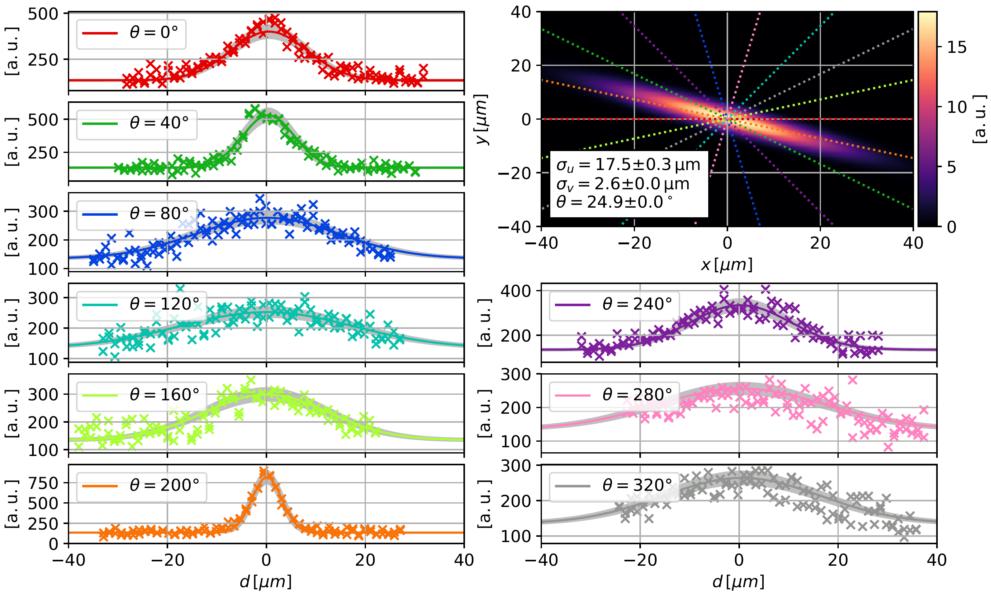
Beam Size Measurement: 2D Gaussian Fit
Preliminary
Rasmus Ischebeck — EAAC 2019 — Characterization of the Electron Beam in the ACHIP Chamber in SwissFEL
Data Analysis: Adrian Kirchner, visiting student from FAU Erlangen

Slide 20
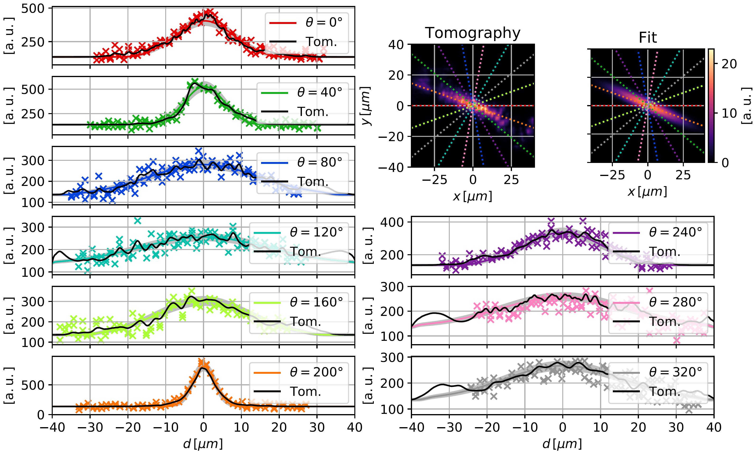
Beam Size Measurement: Tomography
Preliminary
Rasmus Ischebeck — EAAC 2019 — Characterization of the Electron Beam in the ACHIP Chamber in SwissFEL
Benedikt Hermann, Adrian Kirchner

Slide 21
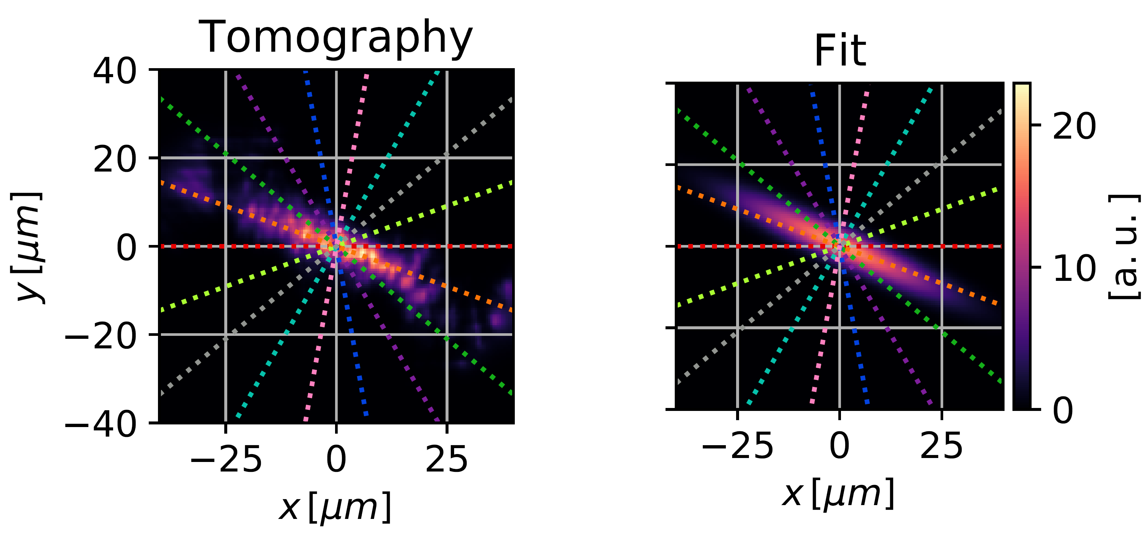
Beam Size Analysis
Preliminary
+ No assumption on distribution
+ Feature reconstruction
– Prone to noise, smoothing kernel
– Assumption: Gaussian shape
+ Fast
+ Stable even with fewer wires
and poor SNR
Rasmus Ischebeck — EAAC 2019 — Characterization of the Electron Beam in the ACHIP Chamber in SwissFEL
Benedikt Hermann, Adrian Kirchner

Slide 22
Beam characterization, wire scan tomography
First Measurement
$$σ_{min}=2.6μm,σ_{max}=17.5μm$$
X-Y tilt: ~ 25 deg
Next steps:
Reduce emittance at Injector
Improve matching
Minimize dispersion
Optimize alignment
Improve detector position (beam loss monitor) for better SNR
→ sub-µm beam size in x and y
Rasmus Ischebeck — EAAC 2019 — Characterization of the Electron Beam in the ACHIP Chamber in SwissFEL
Benedikt Hermann

Slide 23
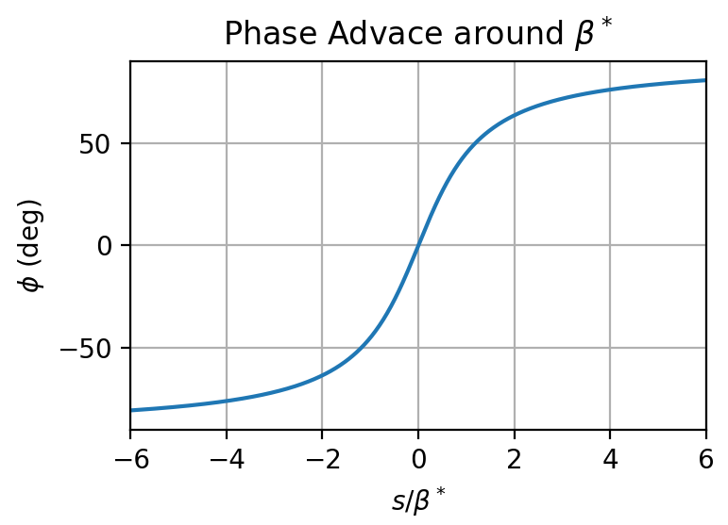
Emittance Measurement with Wire Scanner
Measure beam profile at different phase advances
Instead of quad-scan, move hexapod along z (range: +/- 5 cm)
At center: $β^{∗}=1$ cm
Evolution of $β$ around focus: $β\left(z\right)=β^{∗}+\frac{z^{2}}{β^{∗}}$
Phase advance: $φ\left(s\right)=\int_{0}^{s}{\frac{ⅆz}{β\left(z\right)}}=\frac{1}{β^{∗}}\int_{0}^{s}{\frac{ⅆz}{1+{(z/β^{∗})}^{2}}}=\arctan\left(\frac{s}{β^{∗}}\right)$
Rapid phase advance around small focus
For +/- 5 cm: $φ=2∗\arctan\left(5\right)=$ 157 deg
→ 4D (x, y, x’, y’) Phase space tomography
Rasmus Ischebeck — EAAC 2019 — Characterization of the Electron Beam in the ACHIP Chamber in SwissFEL
Benedikt Hermann

Slide 24
The Accelerator on a Chip International Program
Leonid Rivkin
Yves Bellouard
Peter Hommelhoff
Johannes Illmer
Stefanie Kraus
Ang Li
Anna Mittelbach
Yuya Morimoto
Norbert Schönenberger
Roy Shiloh
Alexander Tafel
Peyman Yousefi
Franziska Frei
Rasmus Ischebeck
Andreas Adelmann
Simona Bettoni
Marco Calvi
Micha Dehler
Vitaliy Guzenko
Benedikt Hermann
Nicole Hiller
Csaba Lombosi
Eduard Prat
Sven Reiche
Minghao Qi
Yun Jo Lee
Gary Greenburg
Robert Kirshner
Lloyd Lee
Scientific Advisors
Reinhard Brinkmann
Chan Joshi
Tor Raubenheimer
Guest Scientists
Heather Andrews
Tomohiko HIrano
Yeng-Chieh Huang
Ido Kaminer
John Lewellen
Evgenya Simakov
Eric Weis
Ralph Aßmann
Ingmar Hartl
Franz Kärtner
Florian Burkart
Huseyin Cankaya
Ulrich Dorda
Luca Genovese
Sonja Jaster-Merz
Willi Kuropka
François Lemery
Christoph Mahnke
Barbara Marchetti
Frank Mayet
Axel Rühl
Hongwen Xuan
Hong Ye
Jun Zhu
Robert Byer
James Harris
Olav Solgaard
Jelena Vuckovic
Dylan Savage Black
Payton Nash Broaddus
Sergio Carbajo
Andrew Ceballos
Huiyang Deng
Tyler Hughes
Tom Langenstein
Chunghun Lee
Kenneth Leedle
Yu Miao
Alexander Piggott
Dries Vercruysse
Ian Williamson
Si Tan
Pietro Musumeci
Jamie Rosenzweig
Sophie Crisp
Eric Cropp
Krish Kabra
Xinglai Shen
Joel England
Zhirong Huang
Ziran Wu
Oliver Boine-Frankenheim
Thilo Egenolf
Uwe Niedermayer
Benjamin Cowan
Notes:
Will not replace existing accelerators!

