Slide 1


Terahertz Driven
Particle Acceleration of relativistic beams
S.P Jamison
Department of Physics, Lancaster University, U.K.
Cockcroft Institute for Accelerator Science, Daresbury, U.K.
S.P. Jamison, EAAC 2019, September 2019

Slide 2





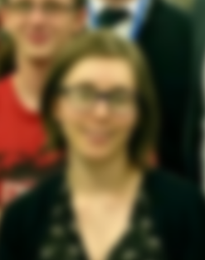


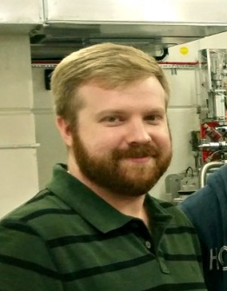






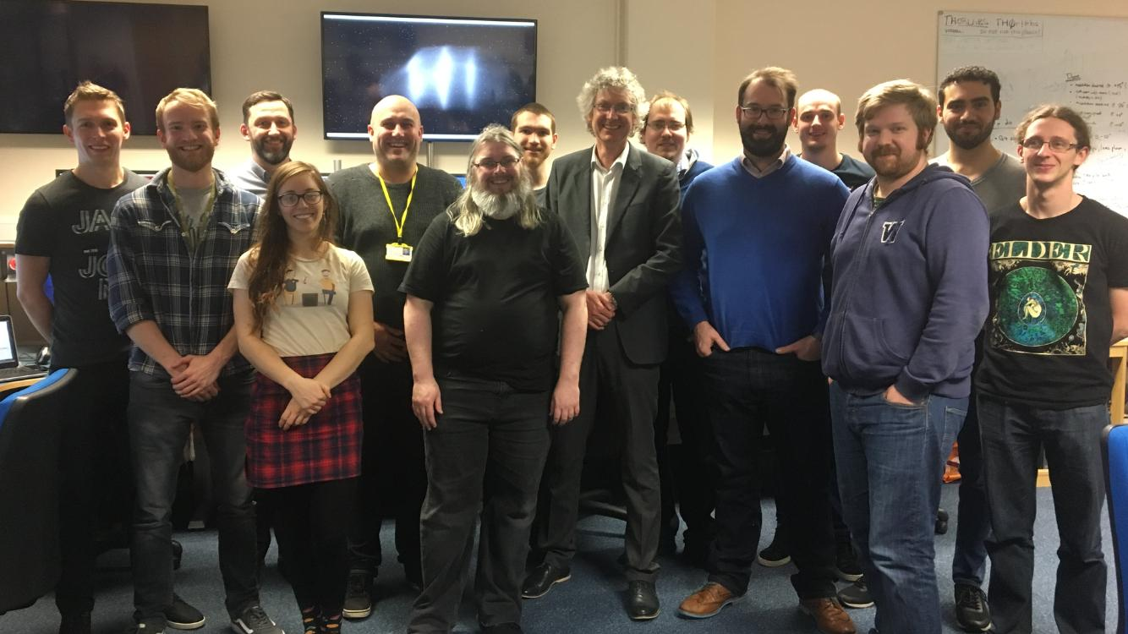
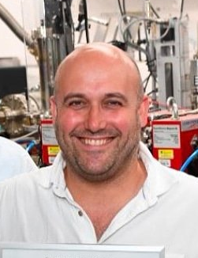
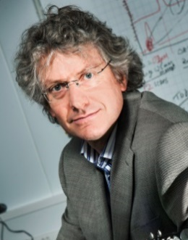
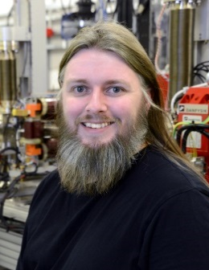


The Cockcroft Institute: Terahertz acceleration group
Terahertz acceleration group
Vasileios Georgiadis
Elliott Smith
Oliver Finlay
Alisa Healy
Dr. David Walsh
Dr. Edward Snedden
Dr. Morgan Hibberd
Dr. Daniel Lake
Dr Yuri Saveliev
Dr James Jones
Tom Pacey
Dr. Darren Graham
Dr. Robert Appleby
Prof. Steven Jamison
Prof. Graeme Burt
S.P. Jamison, EAAC 2019, September 2019

Slide 3
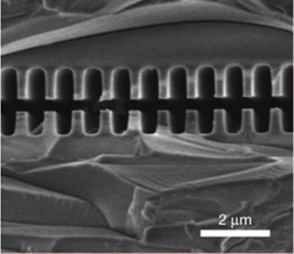
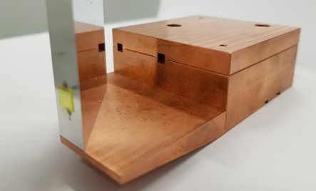
Why THz radiation for particle acceleration?
Radio frequencies
THz frequencies
Optical frequencies
Frequency ≈3 GHz
period ≈ 300 ps,
λ ≈ 10 cm
Cavity aperture ~ 2 cm
E_{acc} ~ 10 - 100 MV m⁻¹
Pulse length: 5 ms (superconducting)
5 μs (normal conducting)
Frequency ≈1 THz
period ≈ 1 ps,
λ ≈ 300 μm – 1 mm
Cavity aperture ≈ 1 mm
E_{acc} ≈ 100 MV/m to > GV/m
Pulse length 1-5 ps
Frequency ≈300 THz
period ≈ 3 fs,
λ ≈ 0.8 – 1 μm
Cavity aperture ≈ 1 μm
E_{acc} ≈ 100 MV m⁻¹ to >> GV/m
Pulse length 20 fs – 1 ps
THz advantages:
50um silica
Oscillation period short, and well matched to the bunch duration
High field strengths possible.
Wavelength allows for easy fabrication of structures.
THz challenges:
Obtaining sub-luminal phase velocities
Broadband pulses – controlling dispersion
High field THz sources still challenging
[2] E.A Peralta et al., Nature,
503.7474 (2013): 91-94
S.P. Jamison, EAAC 2019, September 2019
Notes:
There are several points to consider; (1) phase matching of electrons and THz pulse over a wide bandwidth,
(2) accelerating gradient, (3) shunt impedance, and (4) ease of fabrication.
(5) Other issues include charging of the dielectric and electron bunch injection into a small aperture.
waveguide dispersion typically results in an unmatched group velocity and so the pulse envelope of a short THz pulse changes along the length of the structure. This reduces field amplitude and therefore accelerating gradient as the envelope propagates at a different velocity to the electron

Slide 4
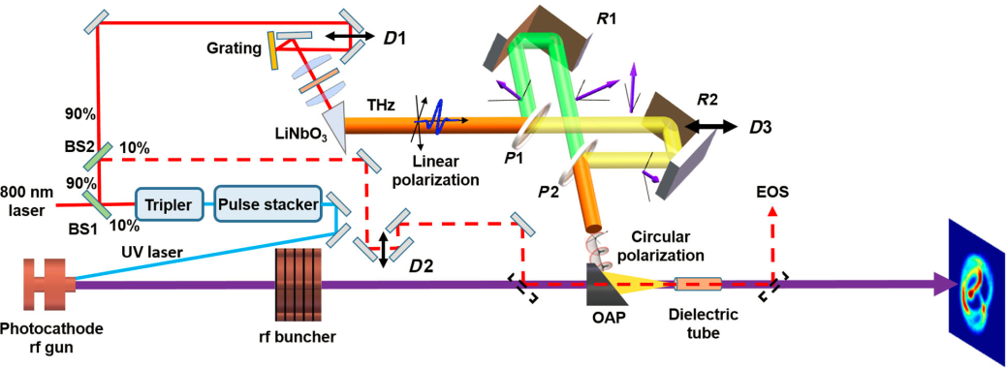
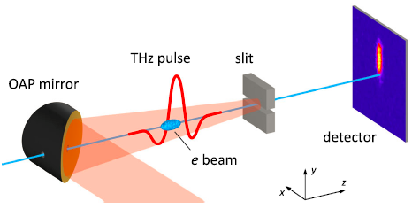
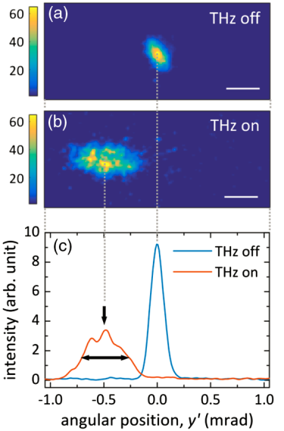
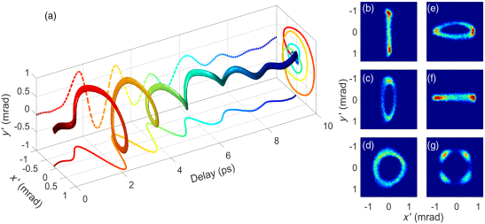
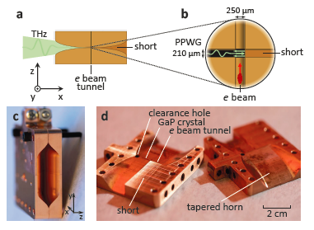
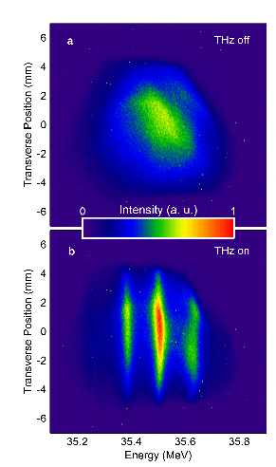
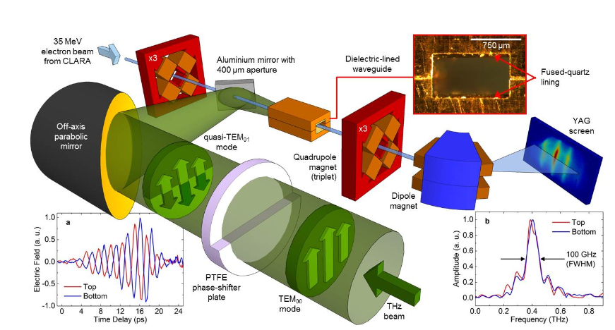
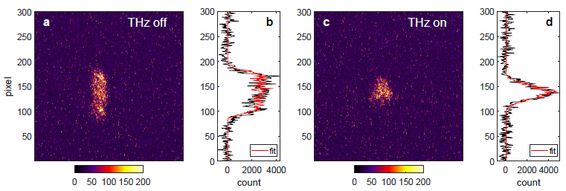
Terahertz-driven interactions: Relativistic electrons
THz-driven streaking
THz-driven streaking
Dielectric tube, helical deflection for 50-fold longitudinal compression
of 3.4 MeV beam
Streaking of a 3.1 MeV electron beam using a parallel-plate waveguide
L. Zhao et al. Phys. Rev. Lett. 122, 144801 (2019)
R. K. Li et al. Phys. Rev. Accel. Beams 22, 012803 (2019)
THz-driven compression
THz-driven acceleration
2.5 MeV electron beam
x3 compression
x2 timing jitter reduction
E. C. Snively et al. arXiv:1906.03358 (2019)
Dielectric lined waveguide
Quasi-monochromatic THz
Energy modulation &
acceleration on 35MeV beam
M.T. Hibberd et al,
arXiv 1908.04055 (2019)

Slide 5
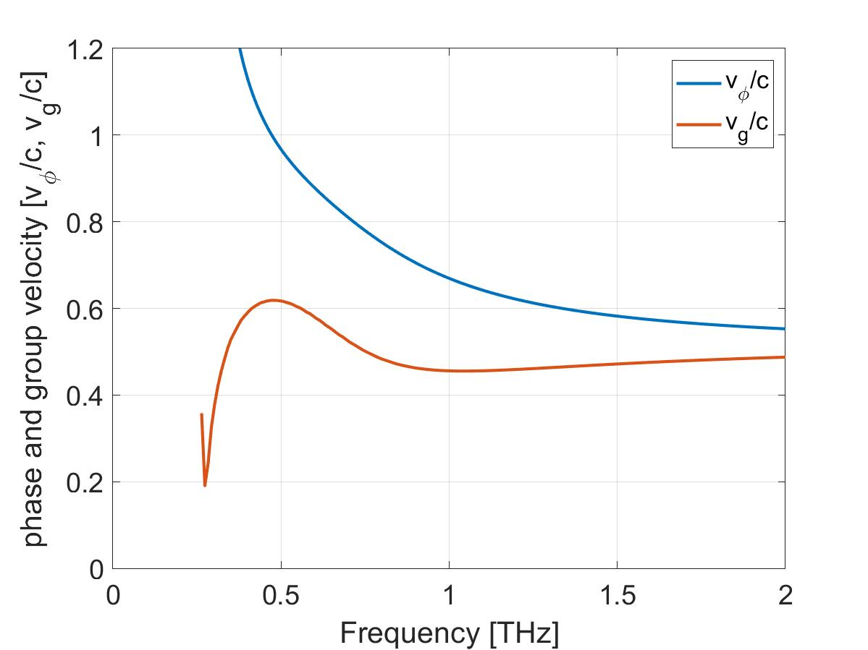
Dielectric lined waveguides
for particle beam acceleration
Mode patterns in waveguide can support longitudinal electric field
Dielectric layers enable velocity matching of carrier-frequency to particle beam
Longitudinal Cross-section
field pattern
propagation
Phase-velocity matching
v_{g} ~ 0.6c
LSE₁₁ mode
S.P. Jamison, EAAC 2019, September 2019

Slide 6
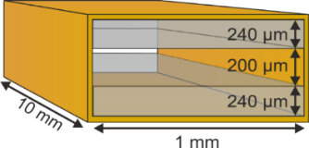
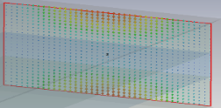
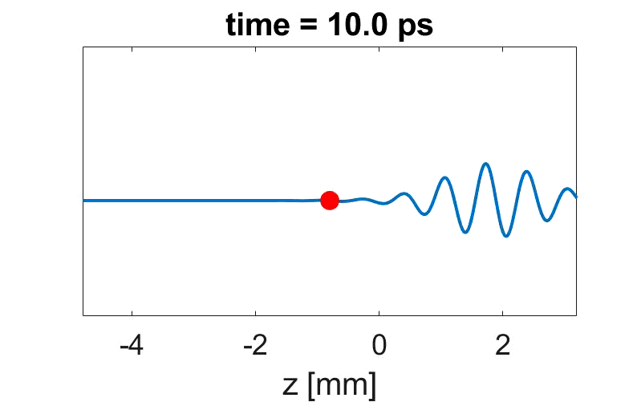
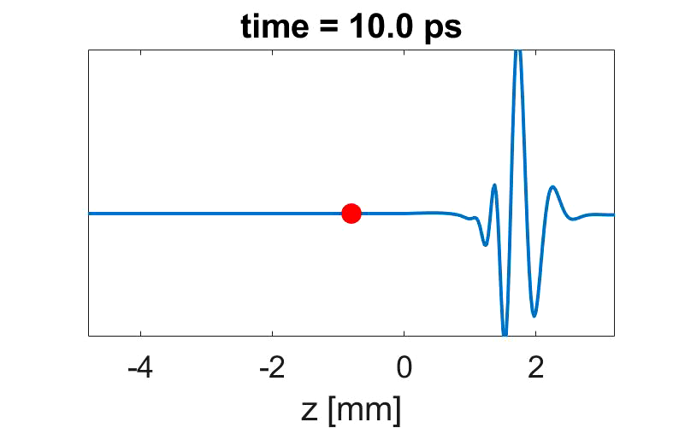
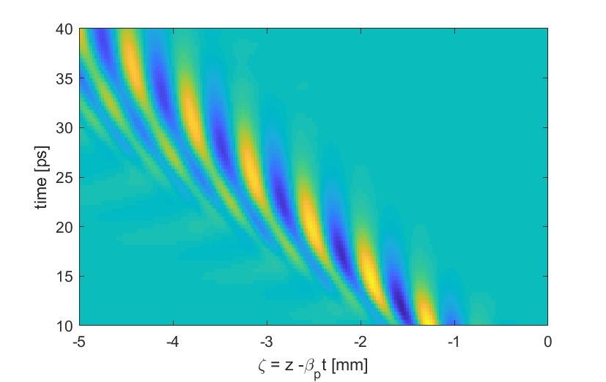
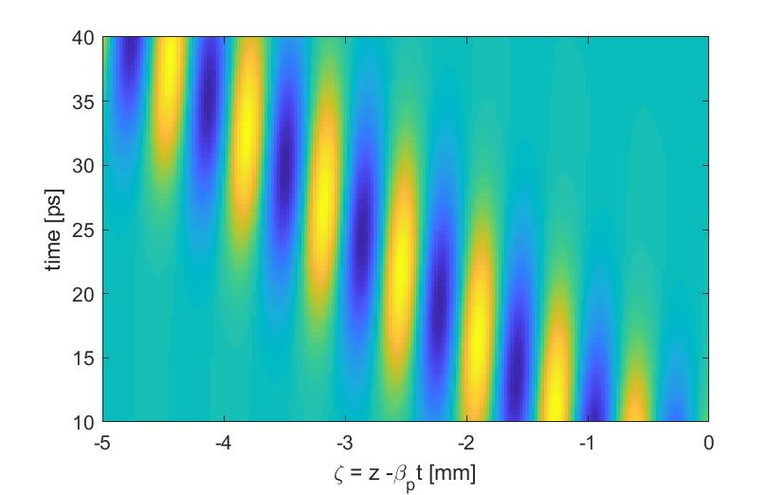
Dielectric lined waveguides
for relativistic particle beam acceleration
Phase velocity matching, v_{φ} = β c
Group velocity v_{g} << v_{φ}
few-cycle THz input
(quasi-monochromatic)
Single-cycle THz input
Field in frame of 50MeV
electron beam (v = 0.9995 c)
Particle
trajectory
Particle
trajectory
Particle see constant electric field phase (accelerator or decelerating)
S.P. Jamison, EAAC 2019, September 2019

Slide 7
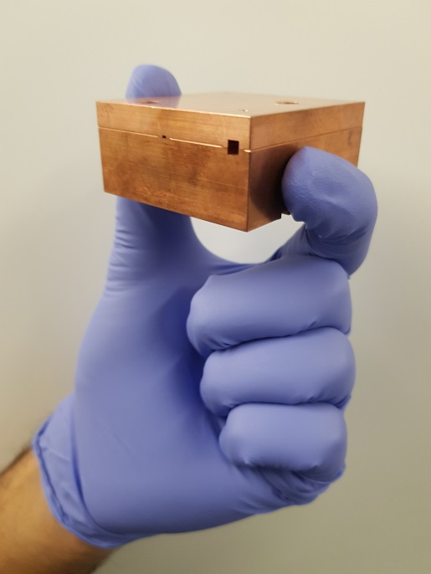
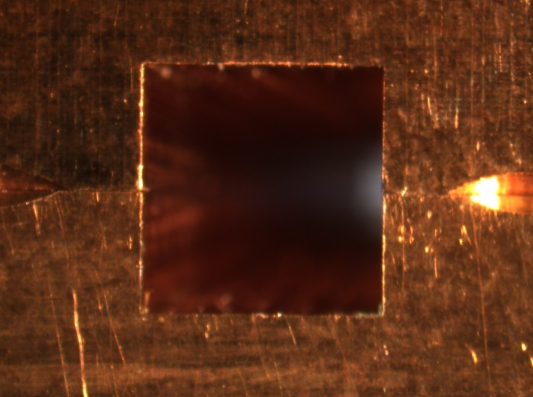
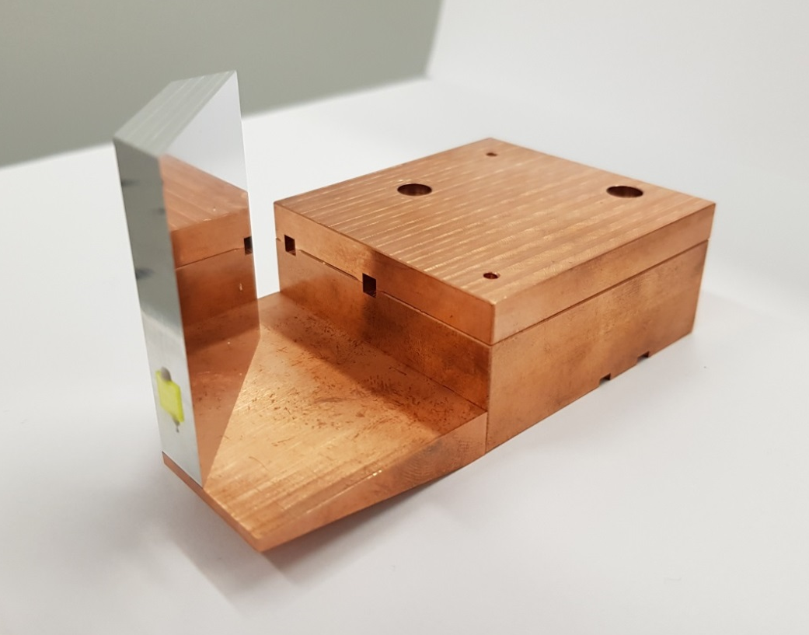
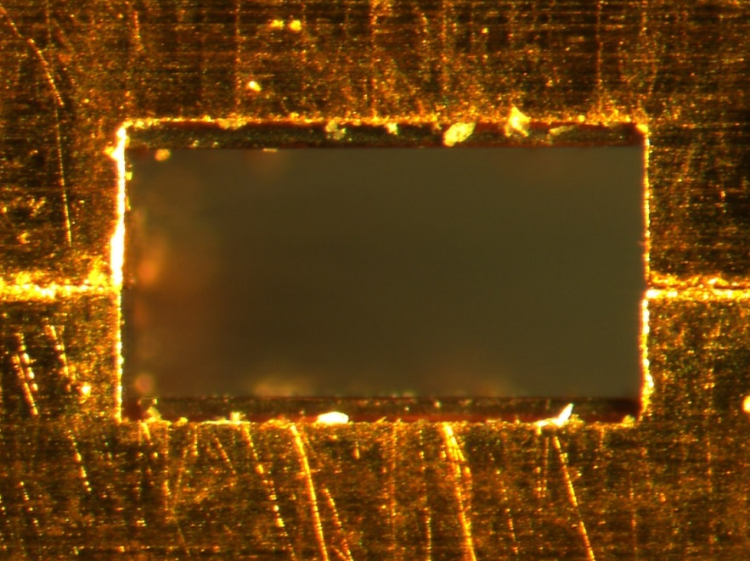
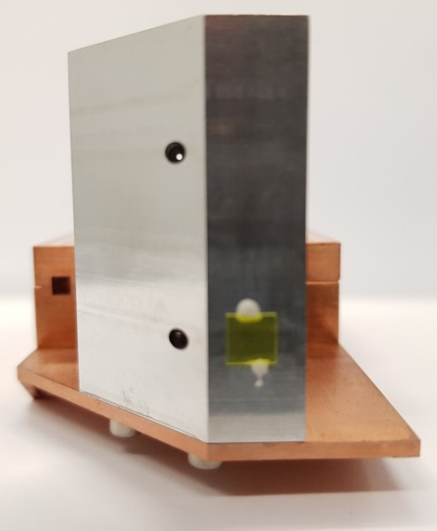
Our approach: Rectangular dielectric-lined waveguide
DLW side
Coupler entrance
DLW assembly
3.25 mm
3.18 mm
DLW exit
575 μm
695 μm
Dielectric lining results in:
Longitudinal Section Magnetic modes
LSM₁₁ for acceleration
Designed for velocity-matching to the 35 MeV electron beam
1200 μm
Mirror side
S.P. Jamison, EAAC 2019, September 2019

Slide 8
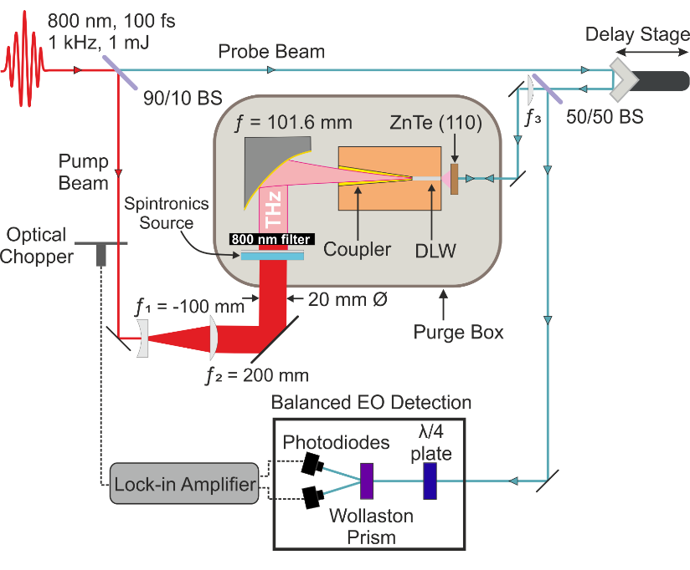
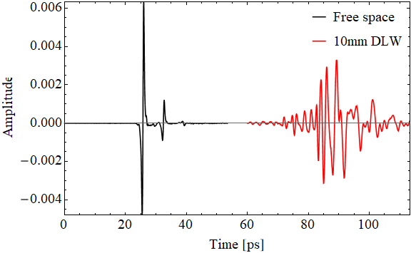
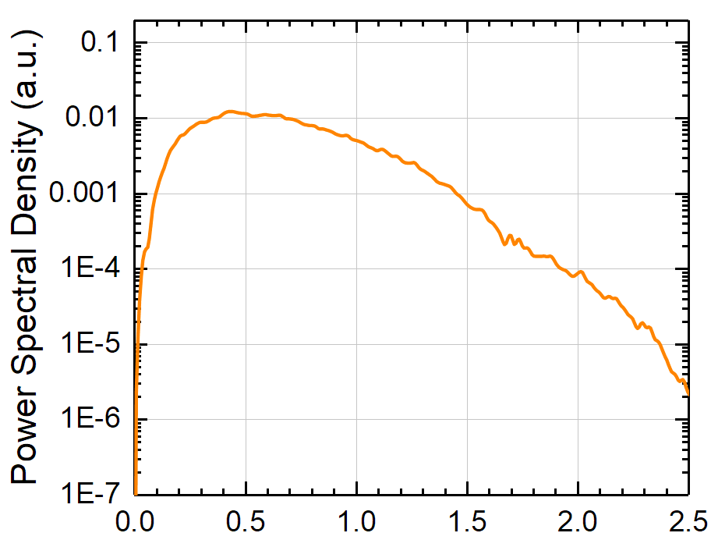
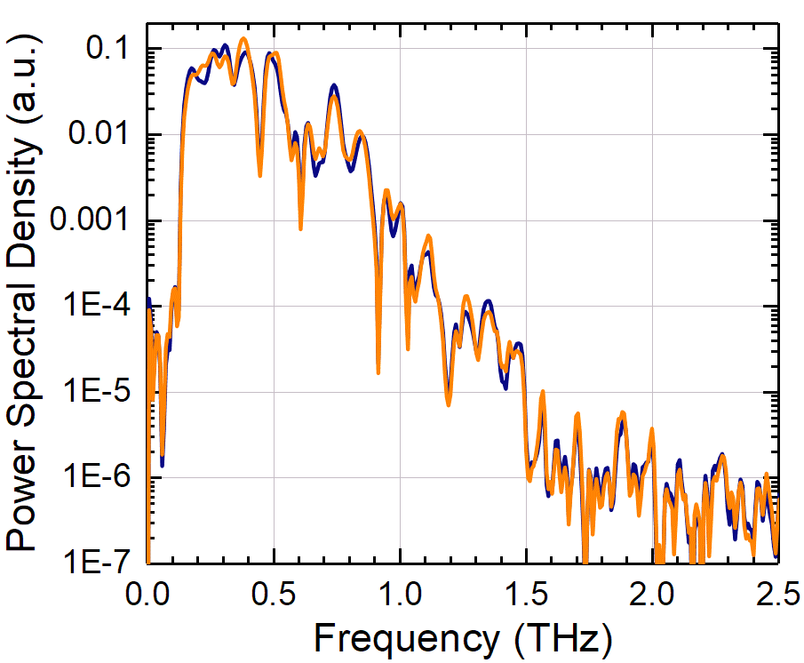
THz network analyser for waveguides
structure characterization with electro-optic time-domain sampling
Power spectra
plus
phase
spectra
S.P. Jamison, EAAC 2019, September 2019

Slide 9
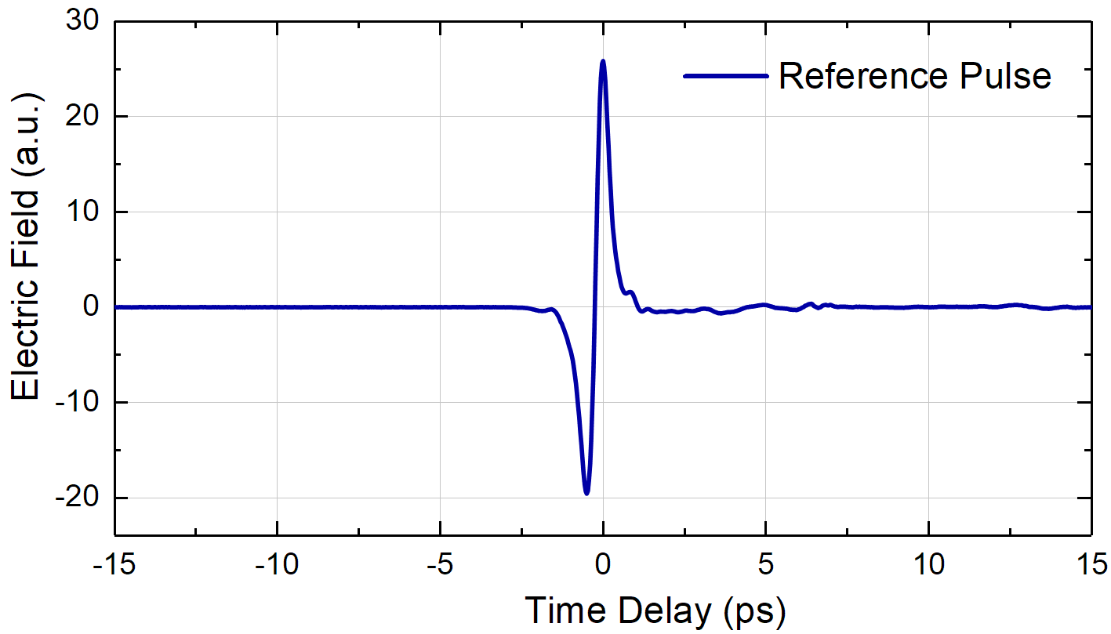
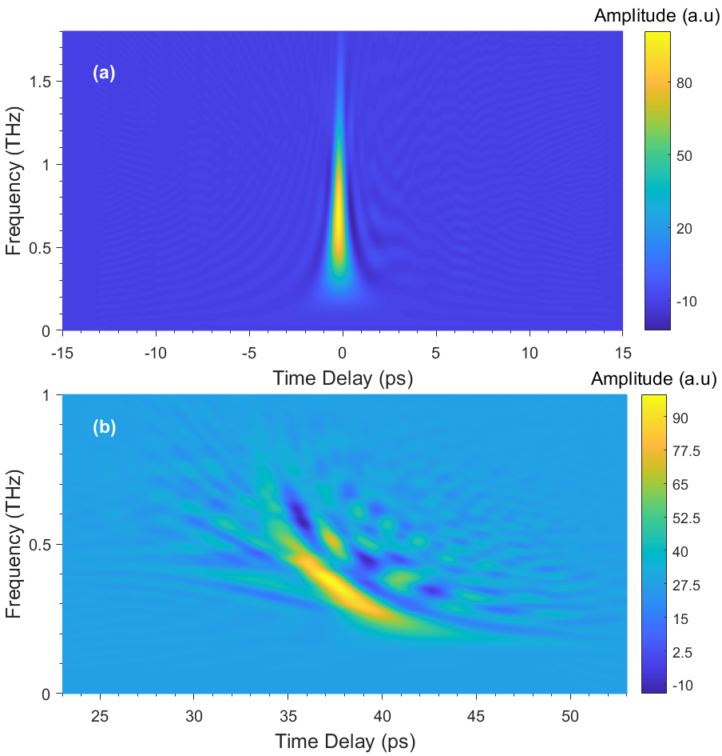
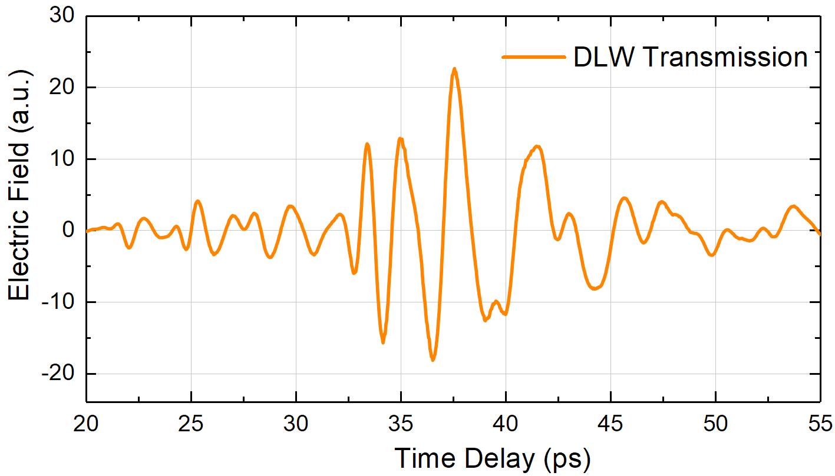
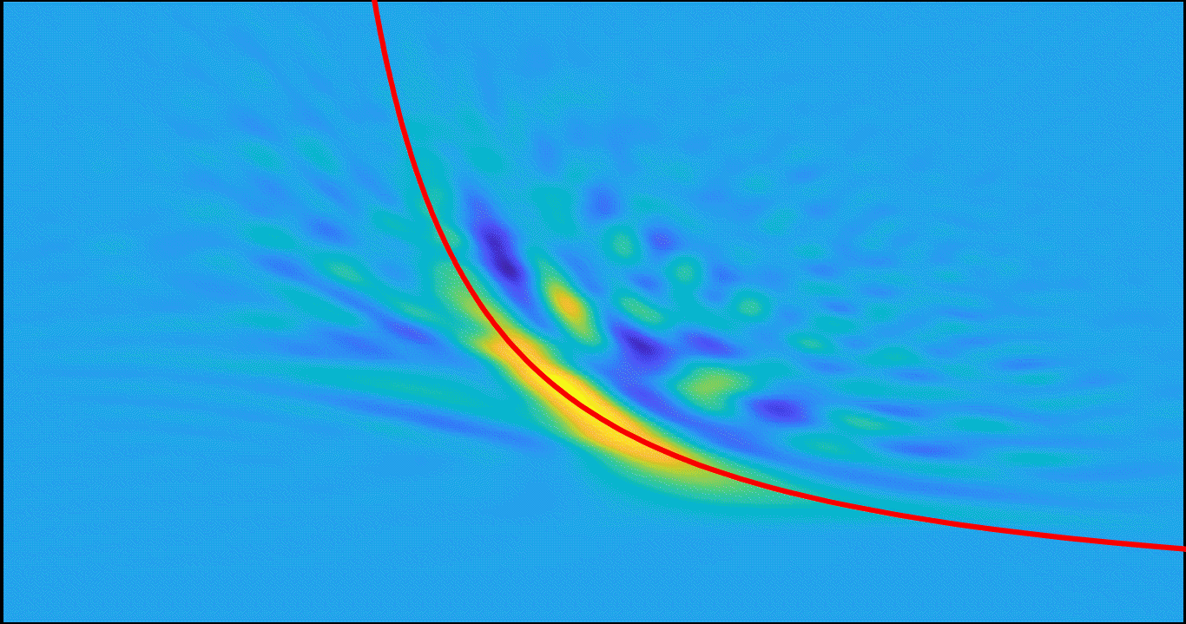
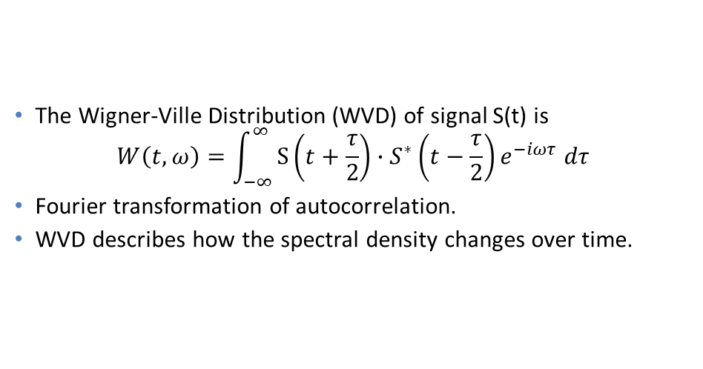
THz network analyser for waveguides
structure characterization with electro-optic time-domain sampling
The Wigner-Ville Distribution (WVD) of signal S(t) is
$$W\left(t,ω\right)=\int_{−∞}^{∞}{S\left(t+\frac{τ}{2}\right)}∙S^{∗}\left(t−\frac{τ}{2}\right)e^{−iωτ }dτ$$
Fourier transformation of autocorrelation.
WVD describes how the spectral density changes over time.
S.P. Jamison, EAAC 2019, September 2019
Notes:
Having now the corrected, free of reflections waveforms, we proceed with time-frequency analysis. We can see how the frequency content changes over time.
although this model did not consider the influence the effect of the coupler.

Slide 10
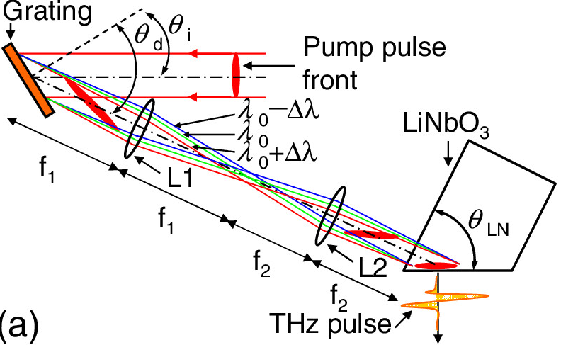
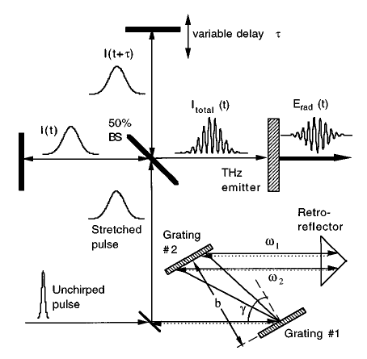
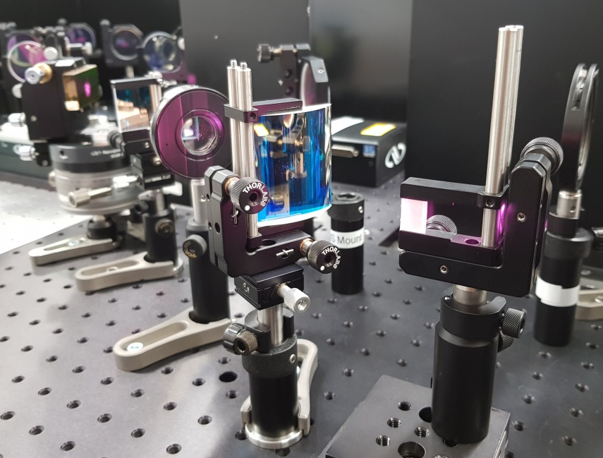
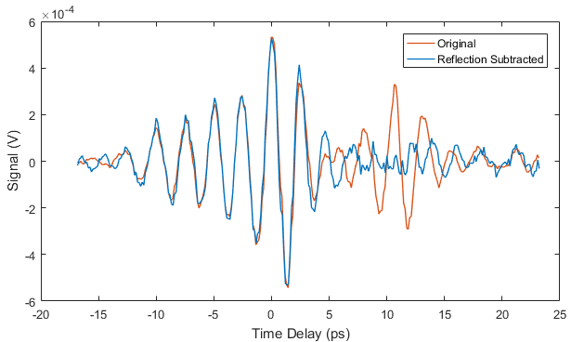
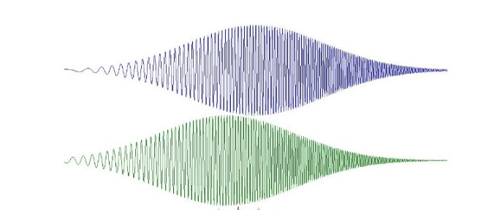
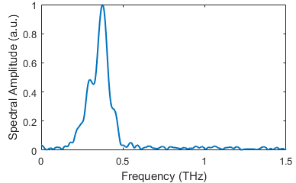
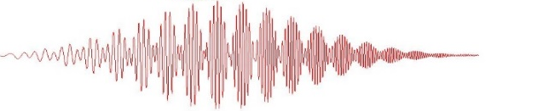
Narrowband terahertz source
Tilted-pulse-front pumping in LiNbO₃
Chirped-pulse beating for narrowband THz generation
First demonstrated using a Michelson interferometer with a photoconductive antenna
A.S. Weling & D.H. Auston, J. Opt. Soc. Am. B 13, 2783 (1996)
J. Hebling et al. Opt. Express 10, 1161-1166 (2002)
Diagram from:
H. Hirori et al. Appl. Phys. Lett. 98, 091106 (2011)
Our tilted-pulse-front setup
S.P. Jamison, EAAC 2019, September 2019

Slide 11
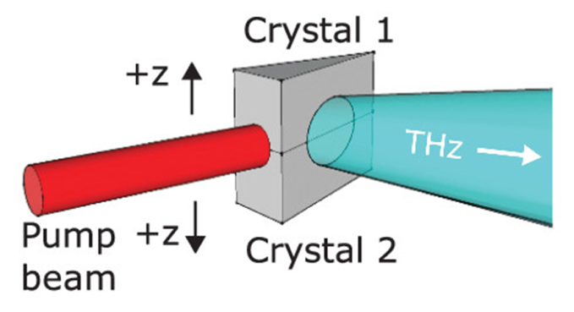
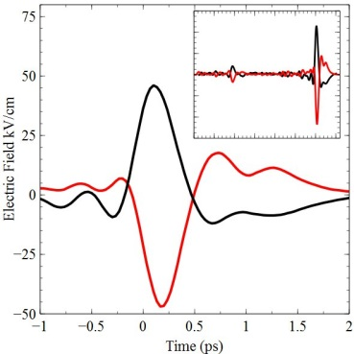
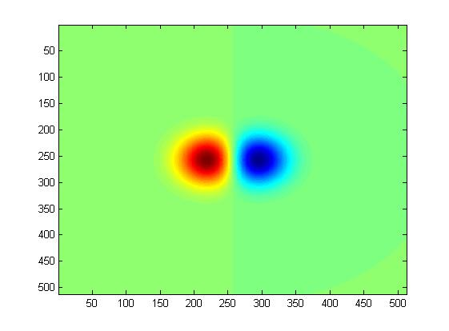
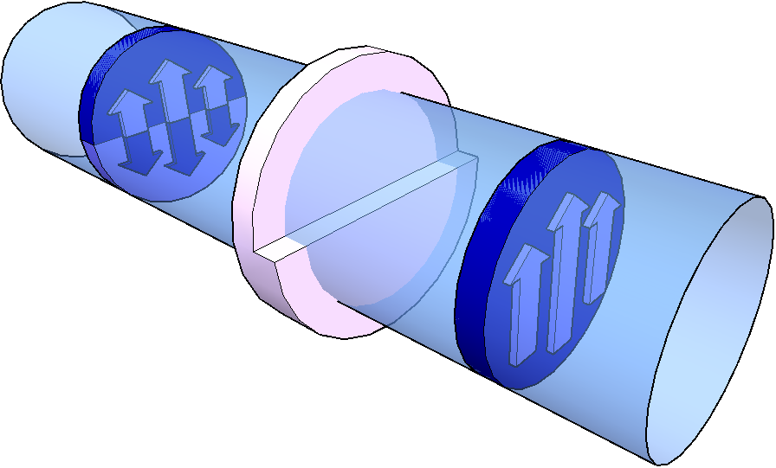
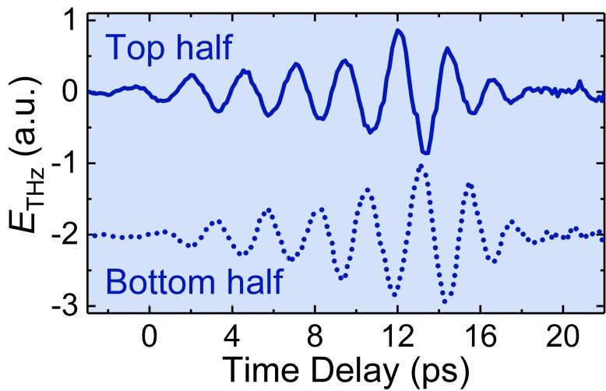
Polarisation of the terahertz beam
To excite the accelerating mode of the DLW
→ THz beam with a TEM₀₁ mode is required
TEM₀₁ mode
Previously demonstrated using the interferometric recombination of two polarity-inverted, linearly polarised THz beams
M. Cliffe et al. Appl. Phys. Lett. 108, 221102 (2016)
quasi-TEM₀₁
PTFE
phase-shifter plate
Phase-shifter plate
Achieve effective polarity inversion by using a phase delay
TEM₀₀
THz beam
Half-cycle phase delay difference between top and bottom halves of the THz pulse
S.P. Jamison, EAAC 2019, September 2019

Slide 12
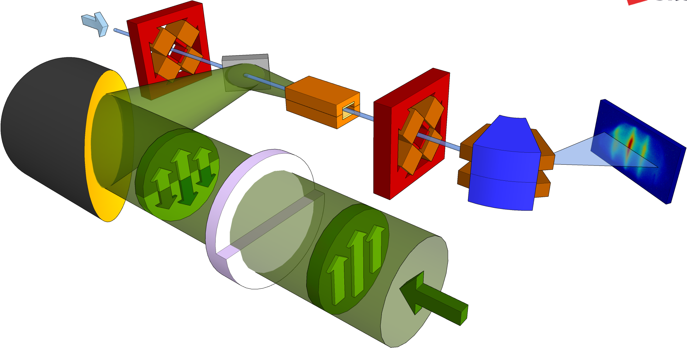


Experimental approach
35 MeV
CLARA electron beam
Mirror with
400 µm aperture
x3
Dielectric-lined
waveguide
Off-axis parabolic mirror
x3
Quadrupole
magnet (triplet)
YAG screen
Dipole
magnet
quasi-TEM₀₁
mode
PTFE
phase-shifter
plate
TEM₀₀
mode
THz
beam
S.P. Jamison, EAAC 2019, September 2019

Slide 13





Daresbury Laboratory: CLARA test facility
CLARA
≈ 50 MeV
Compact Linear Accelerator for Research and Applications
≈ 5 MeV
Bunch parameters
Energy: ≈ 50 MeV
Charge: 20 – 100 pC
Duration: 0.3 – 6 ps
Spot size: 100 µm
Rep. rate: 10 Hz
S.P. Jamison, EAAC 2019, September 2019

Slide 14



Experimental user area
Electron beam
Flexible end-station for rapid
reconfiguration of experiments on an
optical breadboard inside vacuum chamber
Electron beam
Quadrupole magnets
Interaction chamber
Dipole magnet
to YAG screen
Optical breadboard
S.P. Jamison, EAAC 2019, September 2019

Slide 15




Experimental setup
S.P. Jamison, EAAC 2019, September 2019

Slide 16



Experimental setup
S.P. Jamison, EAAC 2019, September 2019

Slide 17





Results: Chirped electron bunch
Image on electron energy spectrometer
CLARA operated in a long electron bunch configuration
Bunch duration of 6 ps FWHM
Linear (approx.) chirp of 53 keV/ps
High-charge: 60pC through structure
Estimated from beam dynamics simulations
6 ps
Electron bunch
f = 0.4 THz
Δf = 100 GHz
THz pulse
Intensity (arb. units)
THz off
THz on
2.5 ps
Energy
Energy
Longitudinal phase space
Time
Time
S.P. Jamison, EAAC 2019, September 2019

Slide 18

Results: Chirped electron bunch
CLARA operated in a long electron bunch configuration
Bunch duration of 6 ps FWHM
Linear (approx.) chirp of 53 keV/ps
Determining the peak terahertz-driven acceleration
Calculation imposing a sinusoidal THz-driven modulation on to a model electron bunch, including:
→ Bunch emittance, energy spread and chirp
Estimated from beam dynamics simulations
6 ps
Electron bunch
δE_{THz} = 8.8 keV
Linear chirp = 47.3 keV/ps
f = 0.4 THz
Δf = 100 GHz
THz pulse
THz off
THz on
2.5 ps
Energy
Energy
Longitudinal phase space
Time
Time
S.P. Jamison, EAAC 2019, September 2019

Slide 19



Results: Chirped electron bunch
CLARA operated in a long electron bunch configuration
Bunch duration of 6 ps FWHM
Linear (approx.) chirp of 53 keV/ps
Determining the peak terahertz-driven acceleration
Calculation imposing a sinusoidal THz-driven modulation on to a model electron bunch, including:
→ Bunch emittance, energy spread and chirp
Estimated from beam dynamics simulations
Measured longitudinal phase-space distribution
Obtained from 100 single-shot spectra with varying THz-electron bunch timing, using:
The measured energy modulation period δE(E)
The known THz period τ = 2.5 ps (0.4 THz)
δE_{THz} = 8.8 keV
Linear chirp = 47.3 keV/ps
100 shots
2.5 ps
2.5 ps
Linear chirp 47.5 keV/ps
S.P. Jamison, EAAC 2019, September 2019

Slide 20



Results: Chirped electron bunch
CLARA operated in a long electron bunch configuration
Bunch duration of 6 ps FWHM
Linear (approx.) chirp of 53 keV/ps
Determining the peak terahertz-driven acceleration
Calculation imposing a sinusoidal THz-driven modulation on to a model electron bunch, including:
→ Bunch emittance, energy spread and chirp
Estimated from beam dynamics simulations
Waveguide resonance and velocity-matching
δE_{THz} = 8.8 keV
Linear chirp = 47.3 keV/ps
Terahertz frequency varied from 0.32 – 0.55 THz
→ Peak in modulation strength at 0.40 THz
Constant modulation period observed
→ Interaction dominated by velocity-matched frequency
S.P. Jamison, EAAC 2019, September 2019

Slide 21





Results: Short electron bunch
CLARA operated in a short electron bunch configuration
Bunch duration of 2 ps FWHM
Residual linear chirp of <10 keV/ps
“Single-bucket” acceleration
Estimated from beam dynamics simulations
2 ps
Electron bunch
f = 0.4 THz
Δf = 100 GHz
THz pulse
THz off
THz on
Energy
2.5 ps
Energy
Longitudinal phase space
Time
Time
Modelled
Modelled
S.P. Jamison, EAAC 2019, September 2019

Slide 22

Relativistic electron beam acceleration
THz-induced energy and timing stabilization
Energy jitter in electron beam injected into THz structure
Energy modulation more stable – dependent on THz timing,
not incoming electron energy.
S.P. Jamison, EAAC 2019, September 2019

Slide 23



THz-induced energy and timing stabilization
Approximately linear chirp ⇒ E_{central} proportional to t_{arrival}
S.P. Jamison, EAAC 2019, September 2019

Slide 24



THz-induced energy and timing stabilization
Addition of R56 for compression
Compression : sub-10fs for realistic parameters
Active timing stabilization
Micro-bunches locked to THz timing &
THz timing locked to laser envelope
S.P. Jamison, EAAC 2019, September 2019

Slide 25

Summary
Demonstrated THz-driven linear acceleration of a 35 MeV relativistic electron beam
  Measurements performed at the CLARA test facility, Daresbury Laboratory
  Generation of narrowband THz pulses with required polarity-inversion
  Dielectric-lined waveguide designed for velocity-matching
  Energy spectra modulation of chirped electron beams,
  Near-singleAcceleration/deceleration of short bunches
M.T. Hibberd et al. Acceleration of relativistic beams using laser-generated terahertz pulses. arXiv:1908.04055 (2019)
Other research areas: From 100keV to MeV with a THz-driven injector
Poster today. Oliver Finlay
Terahertz-Driven Velocity Bunching Experiment
S.P. Jamison, EAAC 2019, September 2019

Slide 26
With thanks to Cockcroft Institute THz Acceleration Group
& STFC Daresbury Laboratory CLARA team
Postdoc positions available: - THz driven acceleration
(Lancaster University) - Ultrafast electro-optic diagnostics for AWAKE
PhD positions available : THz driven acceleration. (laser/accelerator/simulations)
        Contact: s.jamison@Lancaster.ac.uk
S.P. Jamison, EAAC 2019, September 2019

