Slide 1

Initial Studies on a Compact High-Gradient Ka-Band Accelerating Structure for Medical and Industrial Applications
Luigi Faillace
@INFN-Milan
EAAC2019 15-21 September 2019 Hotel Hermitage, La Biodola Bay, Isola d'Elba, Italy

Slide 2
Outline
Linacs for industrial and medical applications
Compact High-Gradient Ka-Band linac
RF Design
Beam Dynamics
Conclusions and future plans
EAAC2019 15-21 September 2019 Hotel Hermitage, La Biodola Bay, Isola d'Elba, Italy

Slide 3
Compact High-Gradient Ka-Band linac
Electron linear accelerators (linacs) are used for numerous applications in many different areas;
Both direct electron beams or X-rays from target (e-γ conversion);
In research, high accelerating gradients are sought for producing ultra-bright and high-energy (>GeV) electron beams for linear colliders as well as FELs, Compton sources, etc.
Thousands of linacs are sold every year, mainly for industrial and medical applications, these structures mostly operate either in S-Band (~3 GHz) or in X-Band (9.3 GHz) → these structures can be very bulky and large robotic systems are needed for operation, representing a crucial issue especially for medical applications.
We propose here a compact linear accelerating structure in Ka-Band (~36 GHz) able to achieve ultra-high accelerating gradients (up to 150 MV/m) and therefore it allows to obtain high beam energies in ultra-compact foot prints.
The proposed Ka-Band accelerator can be either operated, depending on the specific application, either in Standing-wave (SW) or Traveling-wave (TW) mode, is a table-top and inexpensive solution as accelerator for medical and industrial applications. Due to the small geometric dimensions, the maximum average electron current in Ka-Band is lower than lower frequencies and it is therefore suitable for low average power applications;
The Ka-Band accelerator is also designed as a higher harmonics linac for the linearization of the electron beam for the CompactLight project (see Bruno Spataro’s Talk on Thursday)
EAAC2019 15-21 September 2019 Hotel Hermitage, La Biodola Bay, Isola d'Elba, Italy

Slide 4
Applications
 | Application | Beam energy | Average Current
Research | High-Energy Physics | >1GeV | 10’s µA - 10’s mA
Medical Area | Diagnostics |  | > 1 µA
 | Radiotherapy | 4-25 MeV | 10 nA – 1 µA (X-rays of 200-500 cGy/min@1m, flux of 10⁷⁻⁸ photons/s/mm²)
 | Radioisotopes Production | Up to 70-90 MeV | Up to 10 mA
 | FLAH therapy | Up to 7 MeV | >10’s µA
 | Blood Irradiation | 1-2 MeV | >10’s µA
Industry | Material Processing | < 10 MeV | 10-150 mA
 | Sterilization | < 10 MeV | Up to 10 mA
 | Non-Destructive Testing (NDT) |  | > 1 mA
Security | Cargo Scanning | < 10 MeV | 0.1 mA – 1 mA
Environmental Area | Water, flue gas treatment, etc. | 0.7-5 MeV | 5-10 mA
EAAC2019 15-21 September 2019 Hotel Hermitage, La Biodola Bay, Isola d'Elba, Italy

Slide 5
Basic linac accelerator system layout
target
Gun driver
X-rays
e-gun
linac
e-
RF
windows
Cooling system
Directional Coupler
Modulator
RF power source
circulator
load
Vacuum system
EAAC2019 15-21 September 2019 Hotel Hermitage, La Biodola Bay, Isola d'Elba, Italy

Slide 6
Different frequencies for different applications
The choice depends on:
  Requirements of the application
  Availability of the commercial microwave power source
  Knowledge and technology
L-Band
  High beam power ~1MW (e.g. food irradiation)
S-Band is the most common:
  Power source commonly available
  Medium size/weight
  Technology is well established
X-Band
  More compact and lighter → mini-system and portable systems
  More stable and easier to manage (e.g. Radiotherapy)
  Mobile and transportable systems (e.g. Cargo Inspection)
Ka-Band
  Ultra compact → suitable for industrial and medical applications?
EAAC2019 15-21 September 2019 Hotel Hermitage, La Biodola Bay, Isola d'Elba, Italy

Slide 7
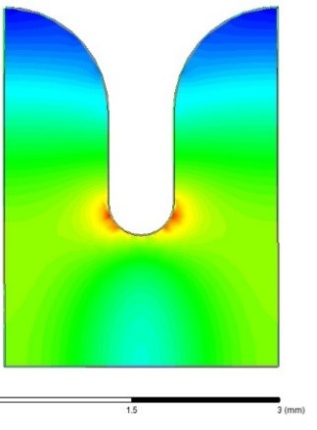
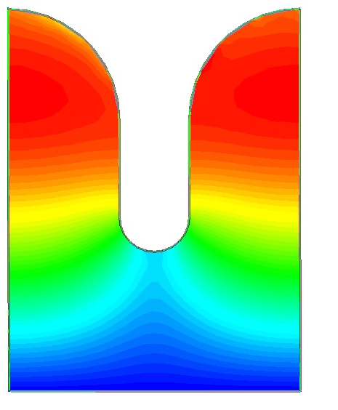
Main RF parameters for Ka-Band accelerating cell
E-field
H-field
Main RF Parameters | Value
Frequency | 35.982 GHz
Accelerating Gradient | Up to 150 MV/m 125 MV/m (safe value)
Eff. Shunt Impedance | 158 MΩ/m
Quality Factor Q₀ | 4110
Cell length L_{c} | 2.9 mm
2.9 mm
Max E_{surface} = 250 MV/m
Max H_{surface} = 0.33 MA/m
RF Pulsed Heating
ΔT = 16.5 °C
(below 50 °C safety threshold)
2D field plots of the main accelerating cell, electrically coupled, operating in the TM₀₁₀-like mode.
T_{RF} = 50 ns, flat top
→ Accelerating gradients are usually lower in industrial linacs due to the particular high shunt impedance cavity geometries.
Modified Poynting Vector
Sc ~ 8 MW/mm²
From Bruno Spataro’s Talk
EAAC2019 15-21 September 2019 Hotel Hermitage, La Biodola Bay, Isola d'Elba, Italy

Slide 8
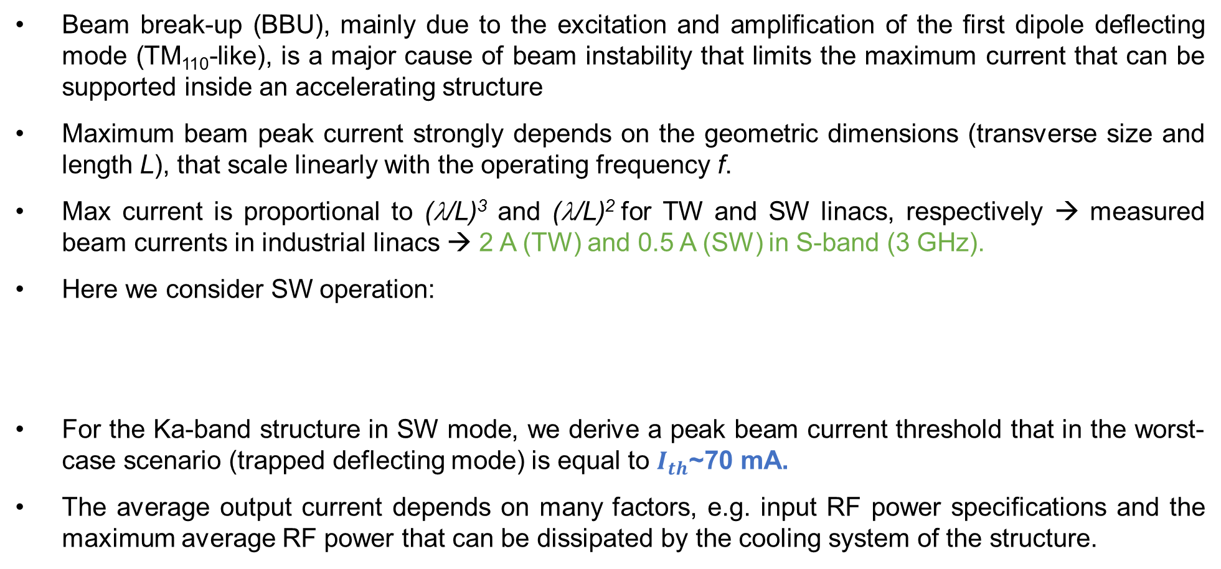

Estimation of maximum available beam current in Ka-Band
Beam break-up (BBU), mainly due to the excitation and amplification of the first dipole deflecting mode (TM₁₁₀-like), is a major cause of beam instability that limits the maximum current that can be supported inside an accelerating structure
Maximum beam peak current strongly depends on the geometric dimensions (transverse size and length L), that scale linearly with the operating frequency f.
Max current is proportional to (λ/L)³ and (λ/L)² for TW and SW linacs, respectively → measured beam currents in industrial linacs → 2 A (TW) and 0.5 A (SW) in S-band (3 GHz).
Here we consider SW operation:
For the Ka-band structure in SW mode, we derive a peak beam current threshold that in the worst-case scenario (trapped deflecting mode) is equal to $I_{th}$~70 mA.
The average output current depends on many factors, e.g. input RF power specifications and the maximum average RF power that can be dissipated by the cooling system of the structure.
$$I_{th}≈{\left(\frac{π}{L}\right)}^{2}\frac{\left.λ_{d}βγ(m{c^{2}}/e\right)}{4Q_{L}{r_{⊥}}/Q}f\left(x\right)$$
SW linac
[T. Wangler, “RF Linear Accelerators”]
EAAC2019 15-21 September 2019 Hotel Hermitage, La Biodola Bay, Isola d'Elba, Italy

Slide 9
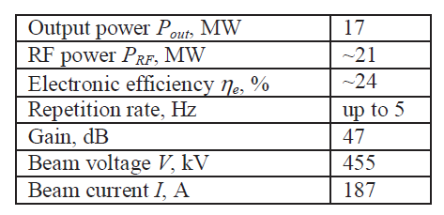
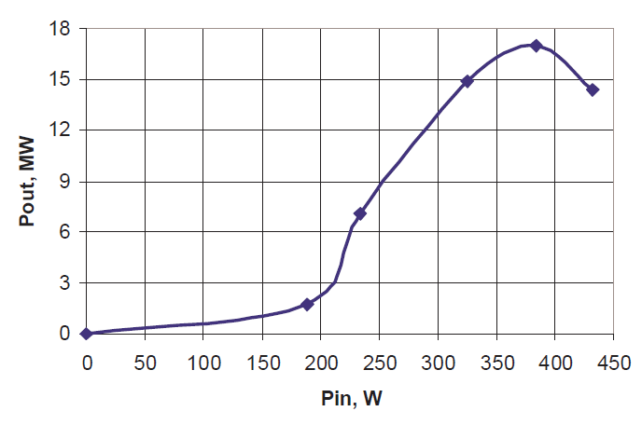
Ka-Band RF Power Source
RF power supply at ~36 GHz was demonstrated at Yale University more than a decade ago, the Magnicon.
Research activity on the re-design of the old Magnicon in order to improve the output power and the repetition rate at least up to 100 Hz → Klystron version with 3rd harmonic output!
Operation in Ka-band requires relatively low RF power (~5 MW) for industrial and medical applications.
Research activity on the electron gun:
  High energy physics: 500 kV for a beam current of about 200 A and beam power up to 100 MW.
  Industrial/Medical field: 15-30 kV voltage (or higher to increase the beam capture inside the Ka-Band linac).
Collaboration: Pending Memorandum Of Understanding between Yale and INFN-LNF.
Hirshfield et al., Proceedings of 2005 Particle Accelerator Conference, Knoxville, Tennessee
EAAC2019 15-21 September 2019 Hotel Hermitage, La Biodola Bay, Isola d'Elba, Italy

Slide 10
Ka-Band RF Power Source for low-energy linacs
The availability of input RF peak power (5MW) with repetition rates between 10 and 100 HZ allows to obtain an average beam current of 1-10 μA, which makes the accelerating structure suitable for medium-energy, low current/power applications like medical diagnosis and therapy of tumors as well as intra-operative radiotherapy.
Pulse lengths of the order of 1μs, as needed in medical and industrial applications, are compatible with an accelerating gradient of 80 MV/m, since the estimation of the breakdown rate (BDR), that is a major cause of failure of an accelerating structure, is below the safety threshold.
The breakdown limit to the max accelerating gradient is not an issue in this case, since we envision operation below 10 MeV for industrial and medical applications.
Main RF Parameters | Value
Frequency | 35.982 GHz
Accelerating Gradient | ~ 80 MV/m
Linac Length | ~ 10 cm
Peak RF power | ~ 5 MW
Pulse Length | Up to 1.5 μs
Repetition Rate | Up to 100 Hz
Duty Cycle | 1.5*10⁻⁴
EAAC2019 15-21 September 2019 Hotel Hermitage, La Biodola Bay, Isola d'Elba, Italy

Slide 11
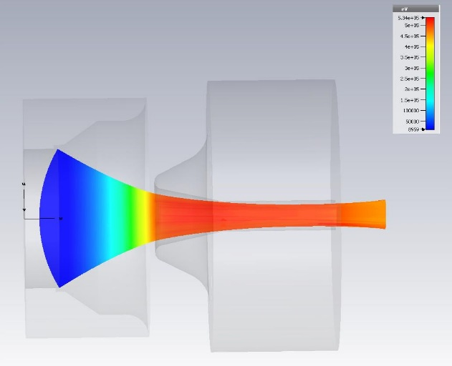
Electron gun and Linac Design
Main RF Parameters | Value
Frequency | 35.982 GHz
Accelerating Gradient | ~ 80 MV/m
Linac Length | ~ 10 cm
Peak RF power | ~ 5 MW
Pulse Length | Up to 1.5 μs
Repetition Rate | Up to 100 Hz
Duty Cycle | 1.5*10⁻⁴
Lanthanum-based Thermionic cathode 100 A/cm² → 1A/mm²
DC diode gun, 15 kV and 250 mA beam current
1mm
200 um
Various types of linac configurations are currently used:
Standing Wave
Pi-mode operation (On-axis electrically coupled linac)
Pi/2-mode (Off-axis/On-axis resonant coupling biperiodic linac)
Traveling Wave
2pi/3 mode (On-axis electrically coupled linac)
5pi/6 mode (Off-axis magnetically coupled linac)
The choice depends on the application and required beam quality (current, spot size, emittance, energy spread…).
Beam Loading Curve
Energy [eV]
70 mA, 7.5 MeV
beam current [A]
EAAC2019 15-21 September 2019 Hotel Hermitage, La Biodola Bay, Isola d'Elba, Italy

Slide 12
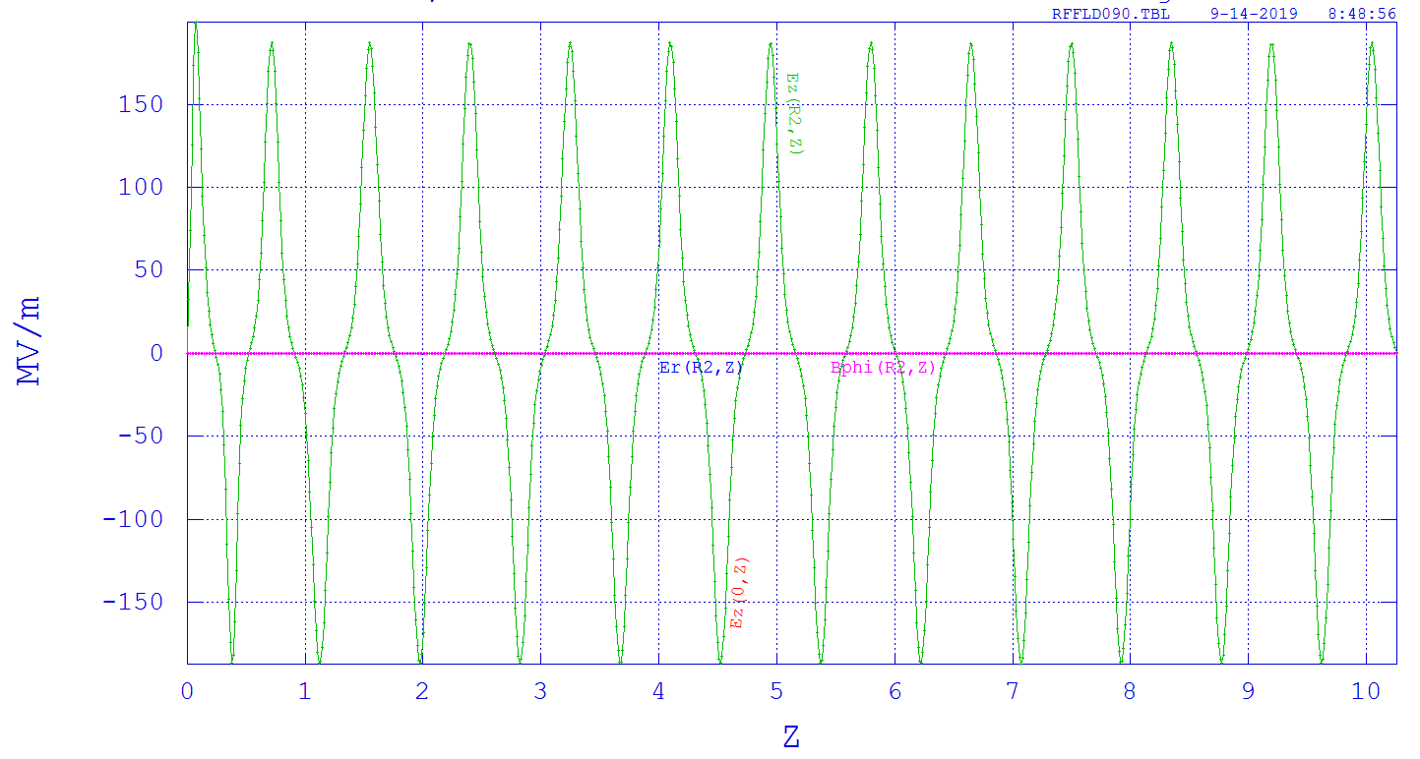
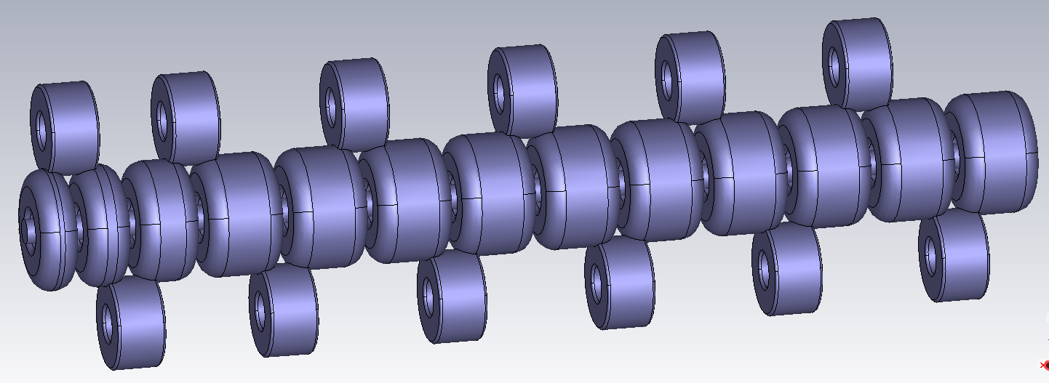
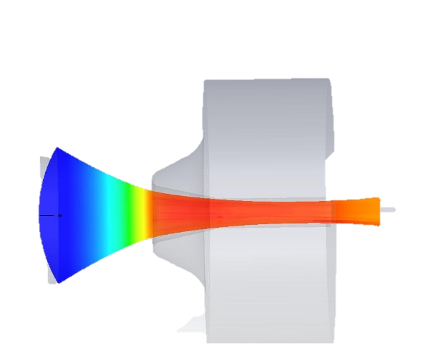
Initial Beam Dynamics, Input Parameters
On-axis Electric Field (MV/m)
PARMELA simulations
15kV DC e-gun (DC electron beam), 250 mA e-beam
DC Input electron beam with gaussian transverse profile (spot size = 0.2 mm diameter, hard edge)
Side-coupled biperiodic accelerating structure (24 cells, L~10cm)
Cell iris diameter = 2mm
No focusing solenoid
Low-beta bunching section
Beam capture ~ 30 % (typically)
(cm)
Side-coupled biperiodic linac
Beam
path
cathode
EM energy
EAAC2019 15-21 September 2019 Hotel Hermitage, La Biodola Bay, Isola d'Elba, Italy

Slide 13
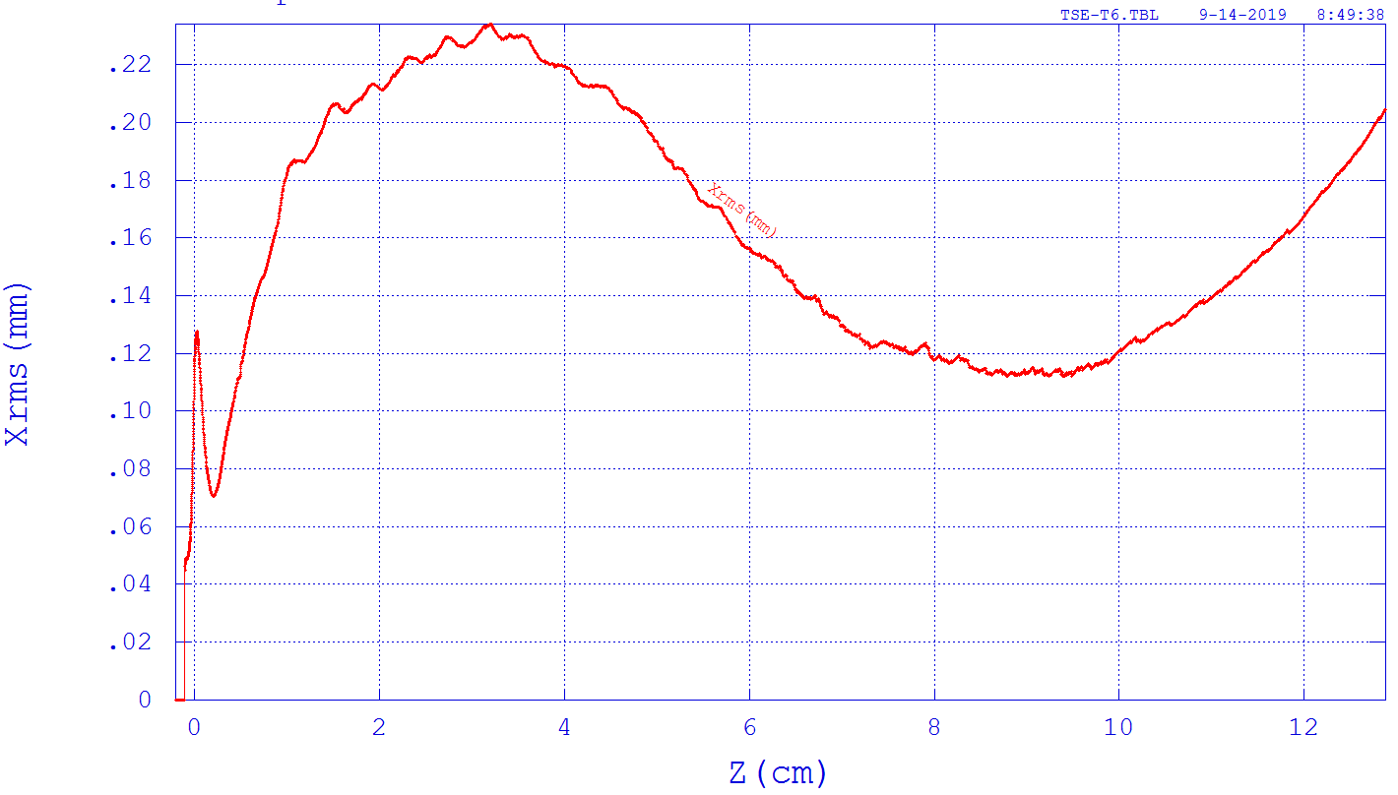
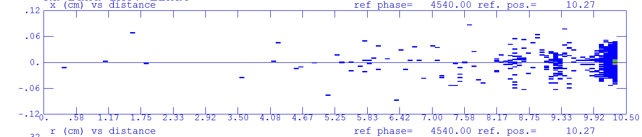
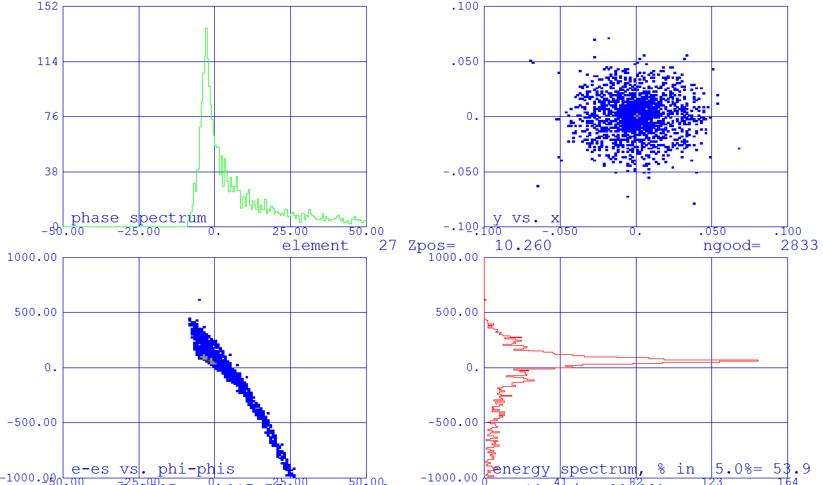
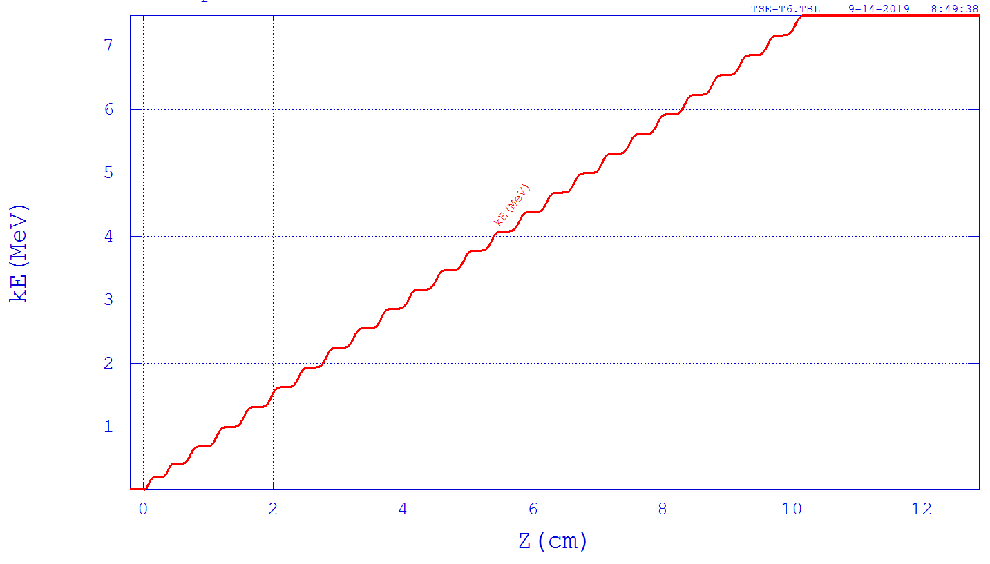
Initial Beam Dynamics Output Results
Beam Transverse Profile
e-beam
Linac exit
Linac axis
Output current 71 mA
~1 ps
Energy Gain
Energy spread <10%
EAAC2019 15-21 September 2019 Hotel Hermitage, La Biodola Bay, Isola d'Elba, Italy

Slide 14
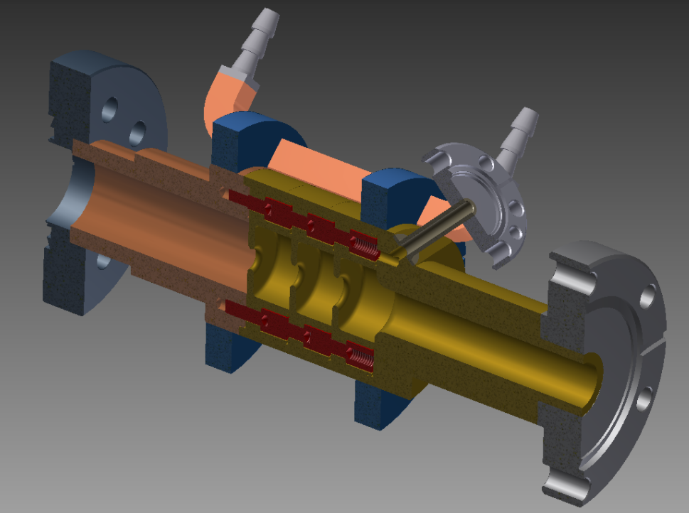
Conclusions and Future Work
We have presented the preliminary design of a compact linear accelerator in Ka-Band (~36 GHz) which is well suited for industrial and medical applications where a low-medium energy and low average current electron beam is required (from a few MeV’s up to a few tens of MeV’s with average beam currents up to few tens of μA’s).
These applications cover the diagnosis and therapy of tumors (both direct electrons or X-rays from e-beam conversion through a target), as well as any other type of diagnostics.
We plan to machine the Ka-Band linac for high gradient applications in two halves with TIG welding of the outer surfaces. As for medium-low energy industrial/medical applications, we plan to apply the same approach but we are also considering an alternative approach like novel clamping techniques (D.A. Dolgashev, L. Faillace, B. Spataro and R. Bonifazi, “Innovative compact braze-free accelerating cavity”, Journal of Instrumentation JINST 13, no. 09 (2018): P09017.)
RF and Beam dynamics Optimization (cavity geometry, focusing solenoid,…)
Braze-free cavity
Thanks for your attention!!!
EAAC2019 15-21 September 2019 Hotel Hermitage, La Biodola Bay, Isola d'Elba, Italy

