Slide 1
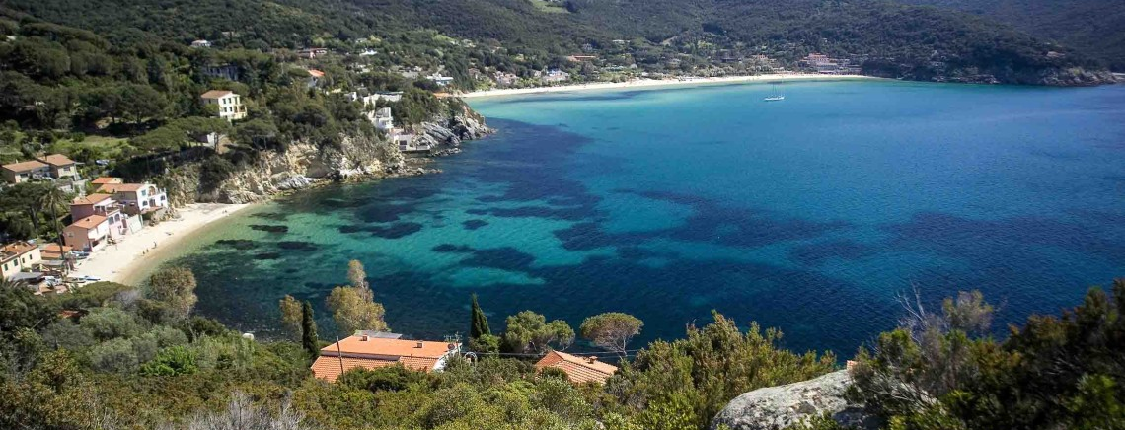
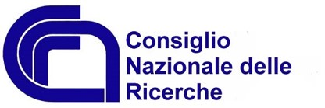
Numerical implementation of a hybrid PIC-fluid framework in laser-envelope approximation
D. Terzani¹, P. Londrillo², L. Labate^{1,3}, P. Tomassini¹, L. A. Gizzi^{1,3}
¹ INO – CNR, Section of Pisa
² INAF
³ INFN, Section of Pisa
4th European Advanced Accelerator Concepts Workshop
La Biodola Bay, Isola d'Elba

Slide 2
Outline
ALaDyn: envelope and fluid solvers
Explicit envelope solver
Second order Envelope Boris pusher
Plasma equations in fluid approximation
High quality injection scheme
REMPI
Outcomes of the optimized injection scheme

Slide 3
Outline
ALaDyn: envelope and fluid solvers
Explicit envelope solver
Second order Envelope Boris pusher
Plasma equations in fluid approximation
High quality injection scheme
REMPI
Outcomes of the optimized injection scheme

Slide 4
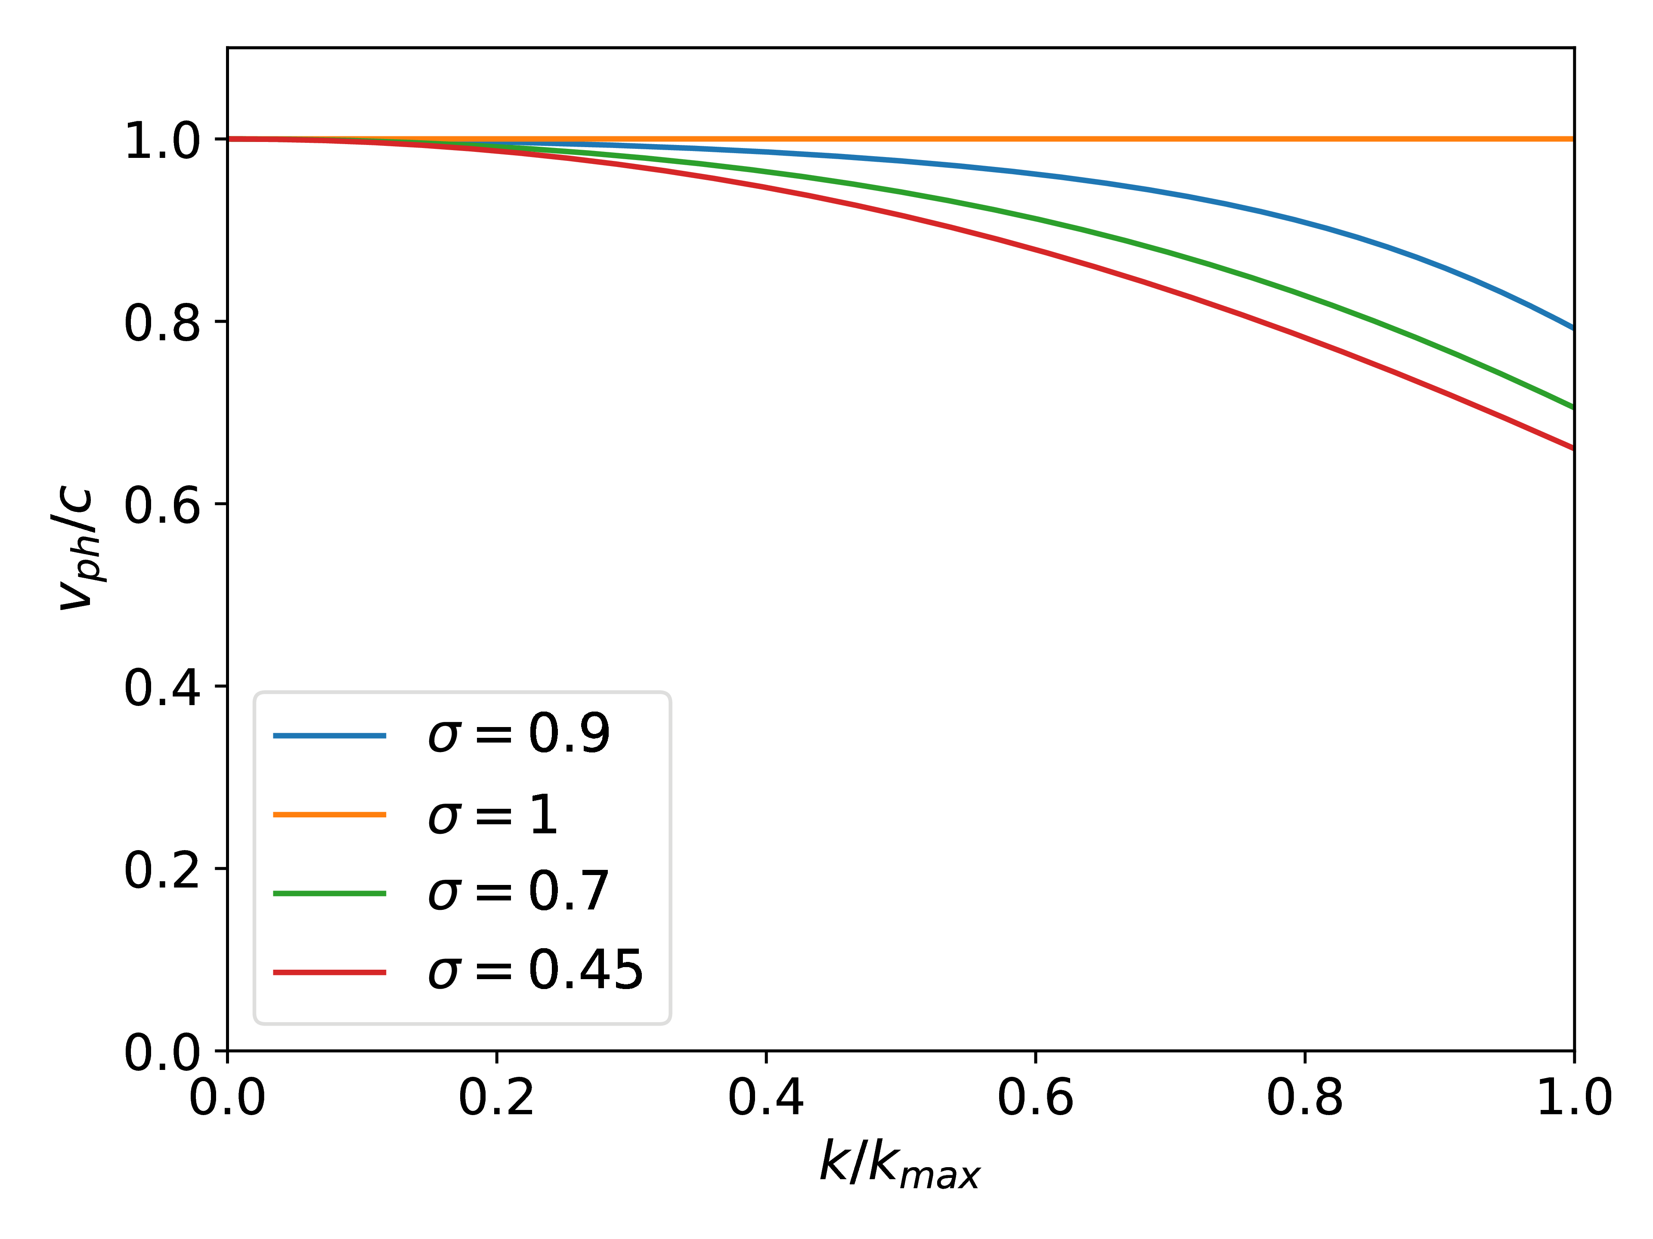
Particle-In-Cell limitations
Even though they are powerful, PIC codes present some limitations
Numerical dispersion of electromagnetic waves
High computational cost due to the number of particles
Nonlinear electron oscillations must be resolved: high resolution
High number of particles needed for statistical reasons:
better sampling and smoothing
∆t/ ∆x
PIC retain all motion scales: disadvantageous on multi-scale systems or very long simulations
Typical computational cost
Computational time

Slide 5
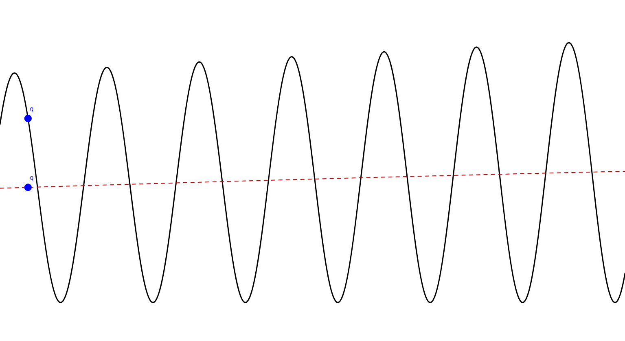
Reduced model: envelope approximation
Relevant scales much longer than the laser wavelength: no need to resolve wavelength, because the motion is coupled to the laser envelope length scales
We look for a way to describe a laser pulse evolution without resolving its wavelength
Reduced resolution in simulations equals a lot of time saving!
Laser envelope
Electric potential
Density waves
Electrostatic field
Resonant with plasma frequency: macroscopic motion
Consistent theory to:
Adequately describe pulse envelope evolution
Move particles retaining their averaged motion (no oscillations)
Include the effects of the laser oscillation in the evolution equations
System quickly damps fast oscillations outside laser pulse

Slide 6
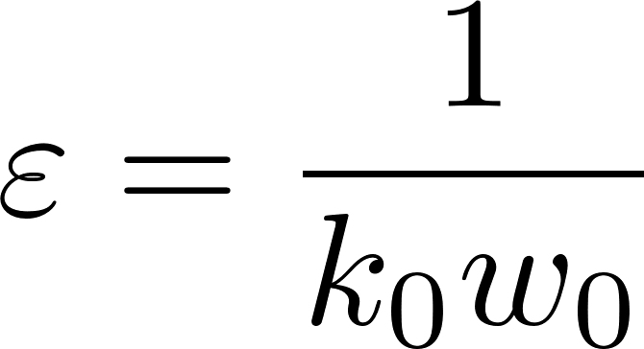
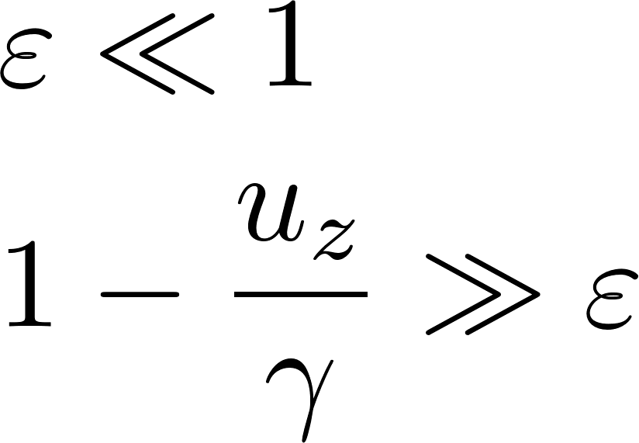
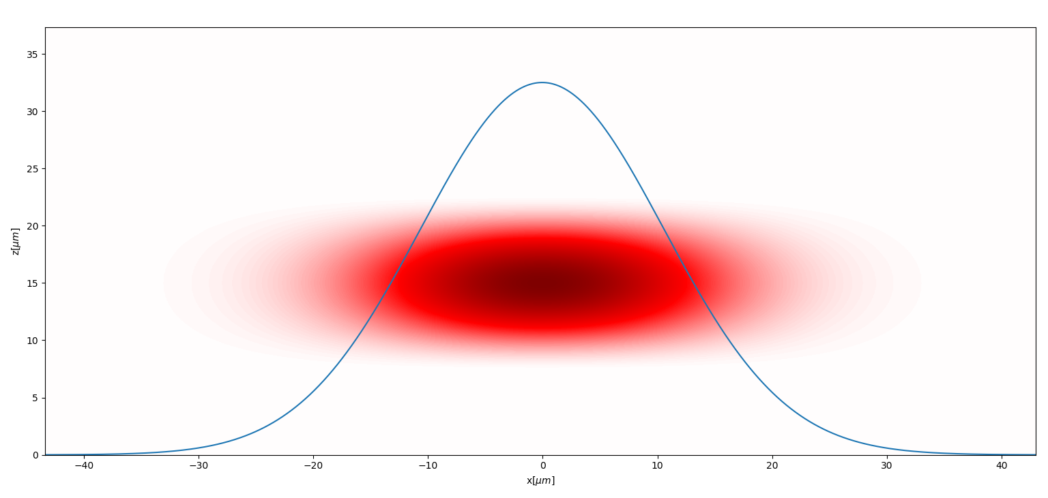
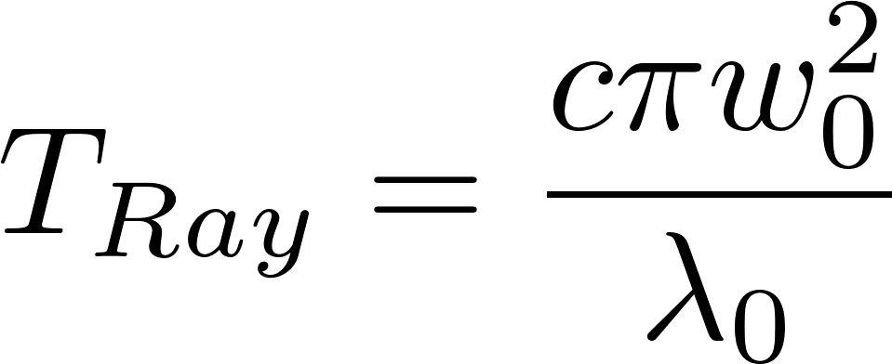
Multiscale expansion from a plane wave
Multiscale approximation starting from the plane wave solution
[Cowan, Bruhwiler et al., JCP 2011; Mora, Antonsen, POP, 1996]
Zeroth order results
Fast time scale
Slow time scale
‘‘Average’’ motion: equations for slow varying components can be found if
Lawson – Woodward theorem holds: no net energy gain
Time vatiations in a comoving r.f.
w0

Slide 7
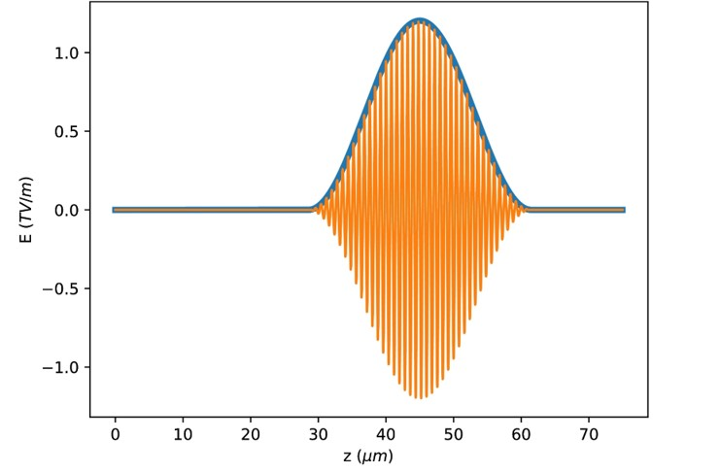
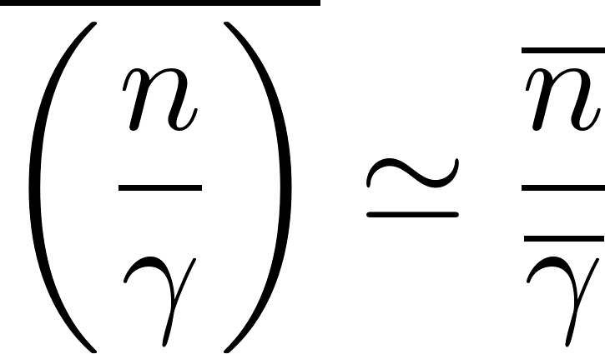
Laser envelope evolution equation
Maxwell’s equation for vector potential
Laser pulse
From Poisson’s equation
The average current can be written as
We can express the slow varying factor as combination of slow varying quantities
[Mora, Antonsen, POP, 1996]
Comoving frame: No back propagating waves
Lab frame: fully selfconsistent equation

Slide 8
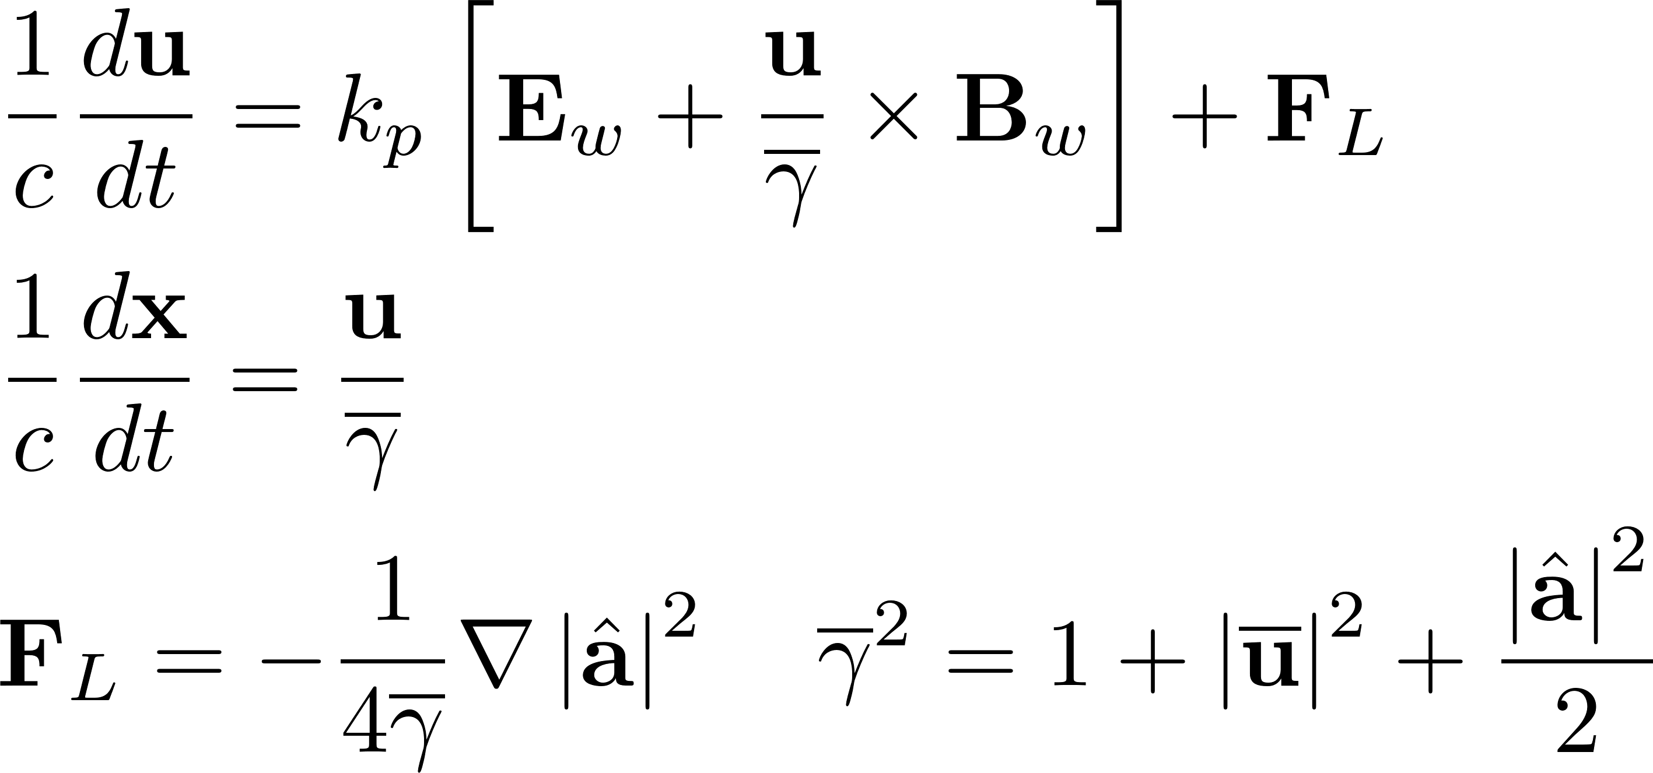
Averaged particles dynamics
Particle phase space evolves on long time scales
Wake fields and laser pulse are two computationally different objects
We define the average γ as the sum of the averaged terms
The ponderomotive force due to the laser pulse contributes separately
Laser pulse: fast varying currents
This is possible because we can split the sources
Wake fields: slow varying currents
Ponderomotive approximation
?
This in an a priori assumption
Empirical observations suggest this is a good approximation

Slide 9
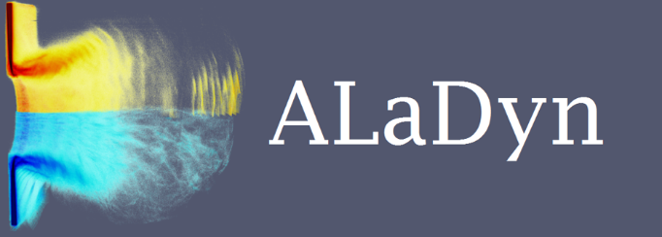
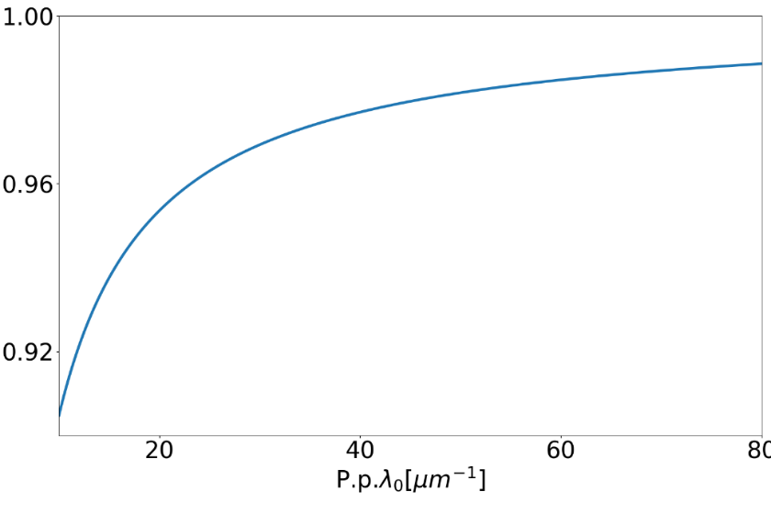
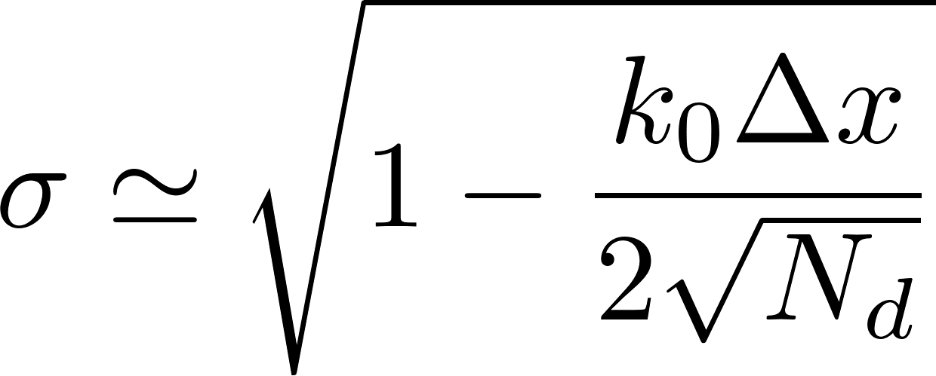
Laser equation solver
Retains the second temporal derivative (full wave operator)
Solved in the LAB frame
The operator is inverted explicitly
Second derivative is important for depleted pulses [Benedetti, Schroeder et al., PFCF, 2018] and regularizes the explicit inversion of the operator
Numerical evolution equation
Invert the formula by the means of centered derivatives
The lab frame is chosen for consistency reasons with the rest of ALaDyn and to be able to perform an explicit inversion
One step explicit advance
Stability
Explicit inversion is faster than the implicit one and guarantees the same CFL (stability) condition of a standard PIC
CFL
[Terzani, Londrillo, CPC, 2019]

Slide 10
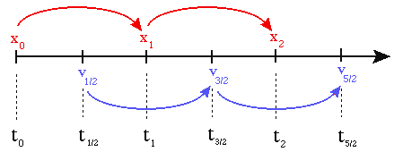
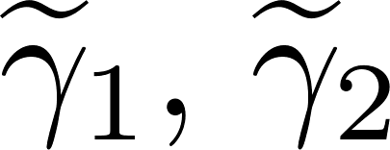
Computing particles evolution
Revised version of the Boris pusher
Recovers Boris pusher for no laser
Momentum update
Position update
Modified Lorentz factor in the ponderomotive approximation
[Terzani, Londrillo, CPC, 2019]

Slide 11
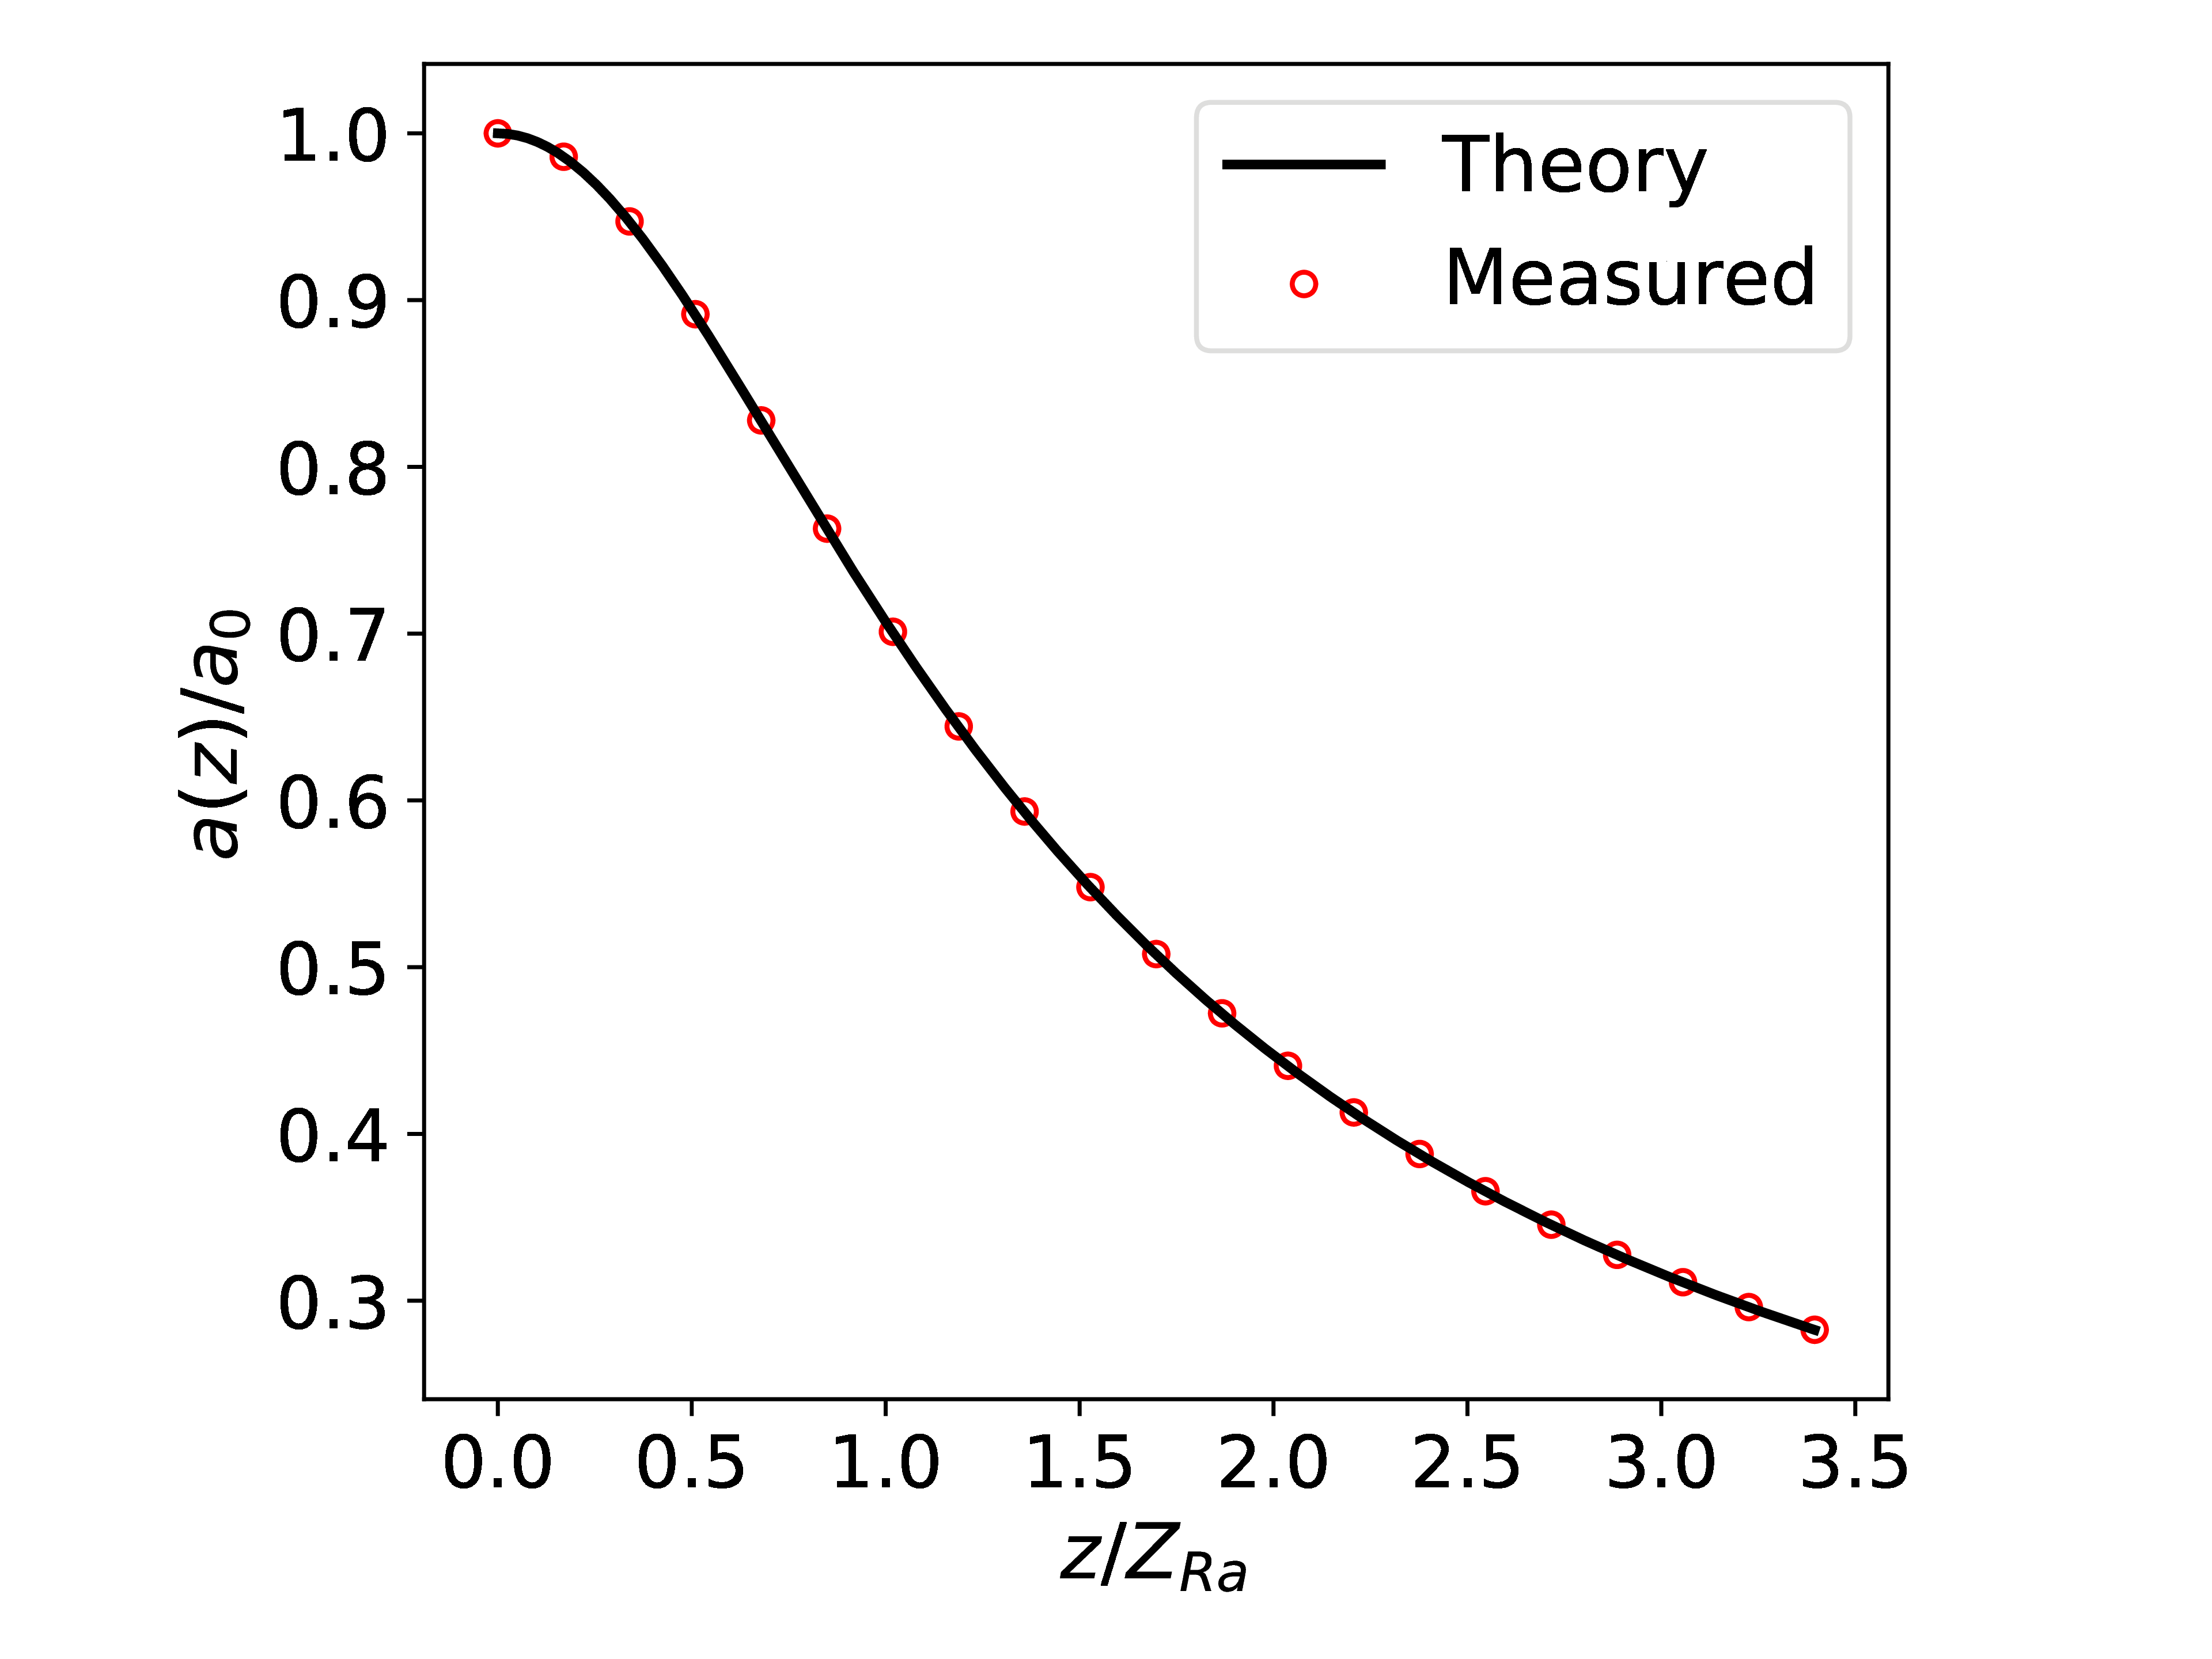
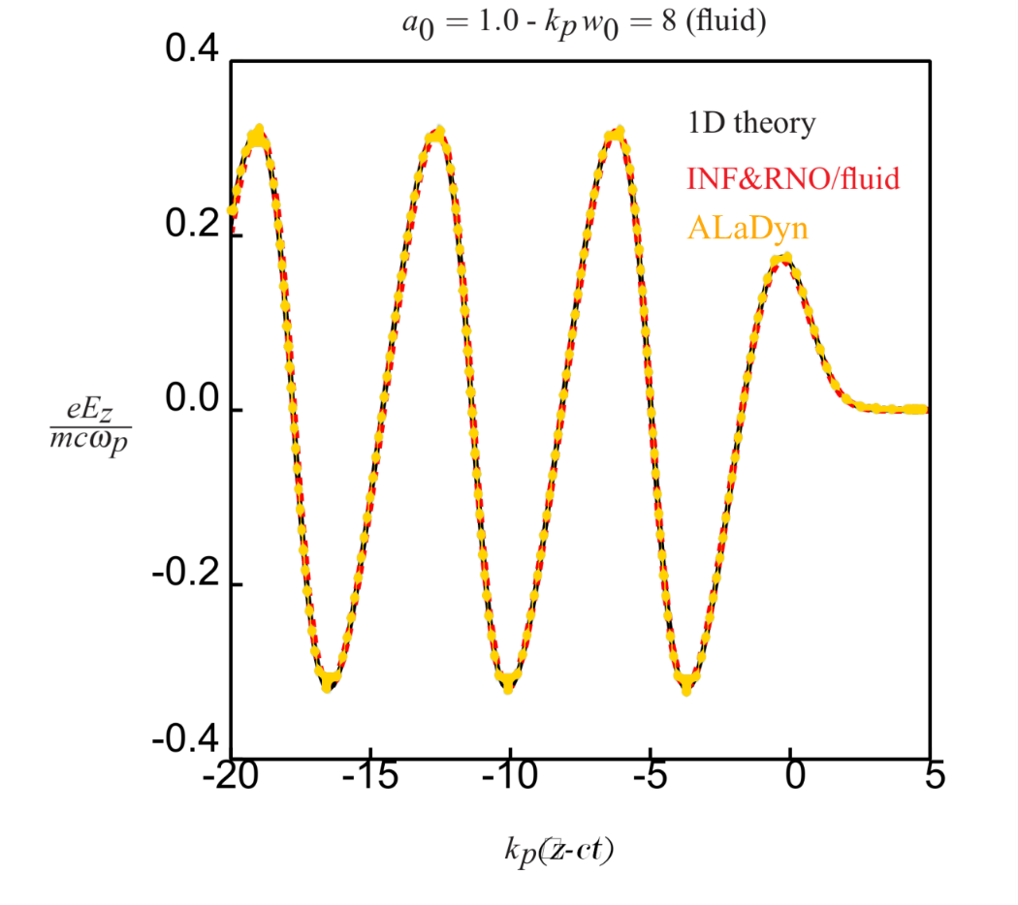
Envelope benchmarks
Rayleigh diffraction in vacuum
Longitudinal electric field in 1D approximation
Verified correctness of laser solver
Verified correctness of particle pusher

Slide 12
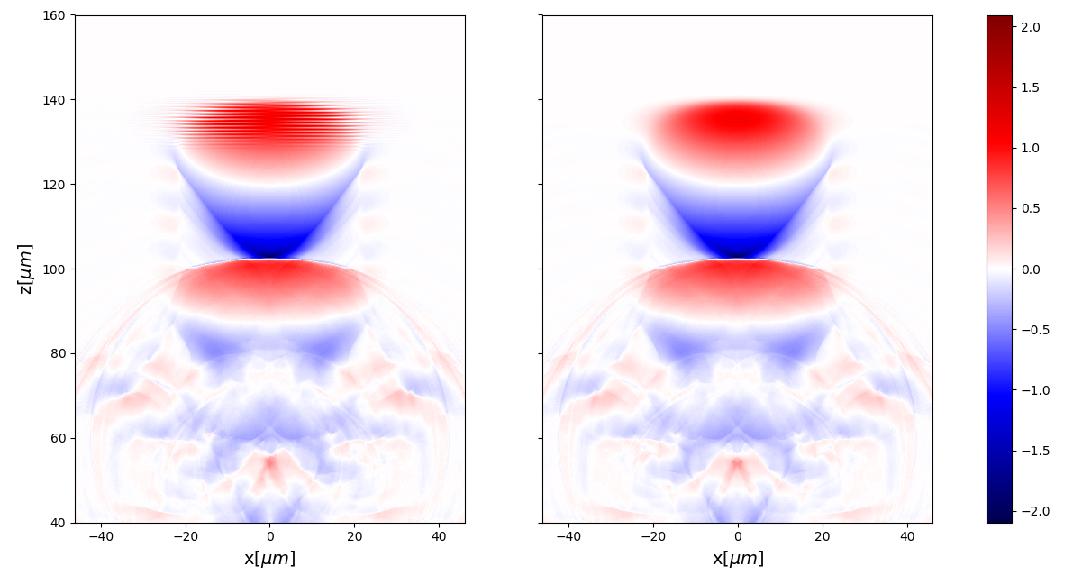
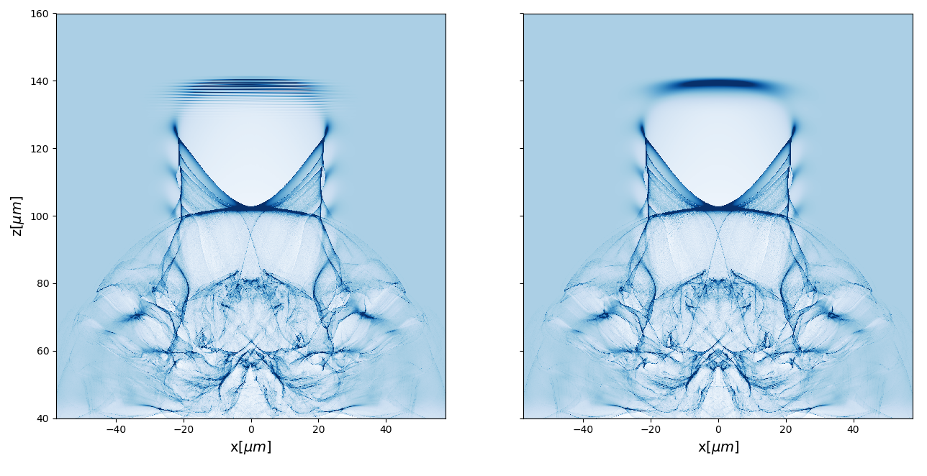
Envelope benchmarks/2
We simulated an ultra strong laser pulse that travels into a uniform electron plasma
Density map (saturated)
PIC
Envelope
PIC
Envelope
Longitudinal electric field

Slide 13
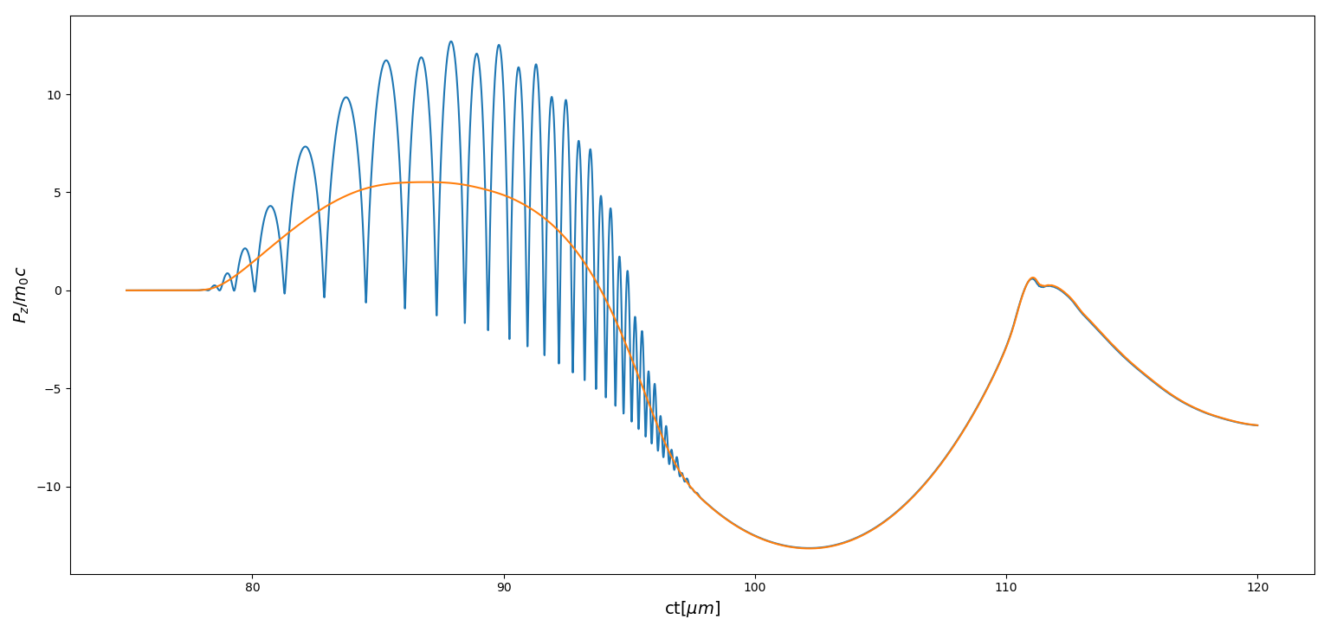
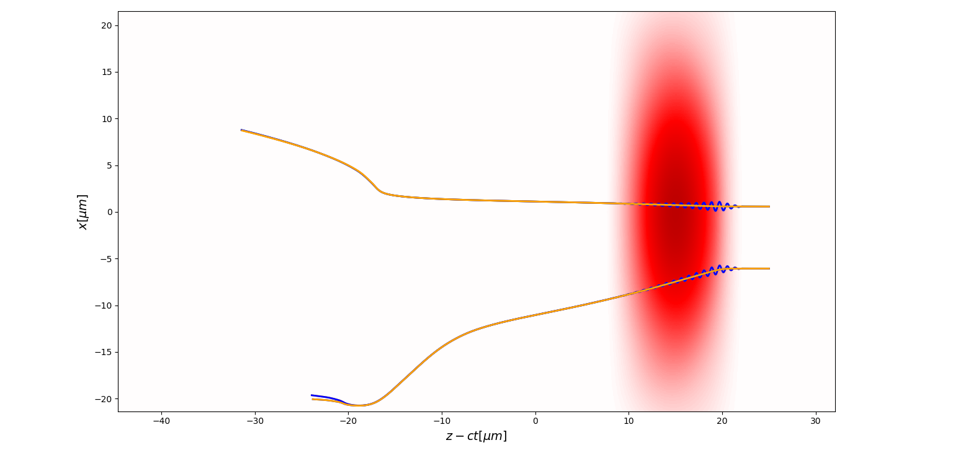
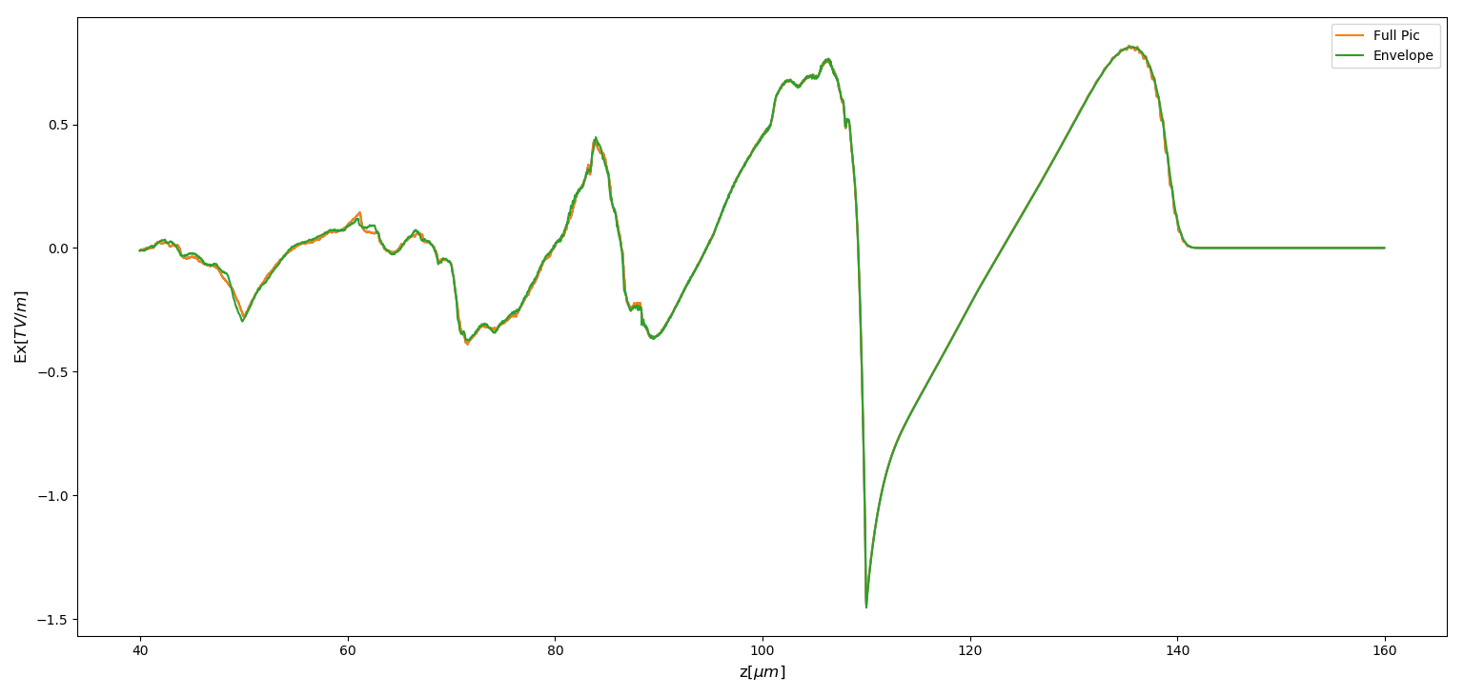
Envelope benchmarks/3
Longitudinal electric field lineout (along propagation axis)
Tracked particle longitudinal momentum in the fully PIC and Envelope scheme

Slide 14
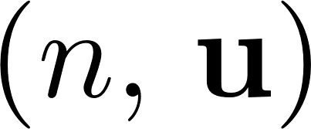
Cold fluid approximation
Plasma is described making use of 3D (spatial) functions
Averaged on momentum space
In case of ponderomotive approxiamtion
Valid until kinetic effects arise: density and momentum must be single – valued
Pros
Doesn’t need a lot of particles
Less (a lot of!) memory usage
Very fast
Cons
Implementation not straightforward
Loses accuracy near the wavebreaking

Slide 15
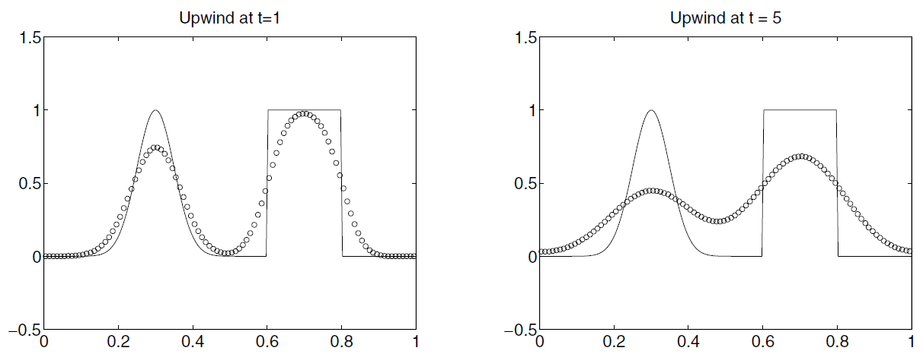
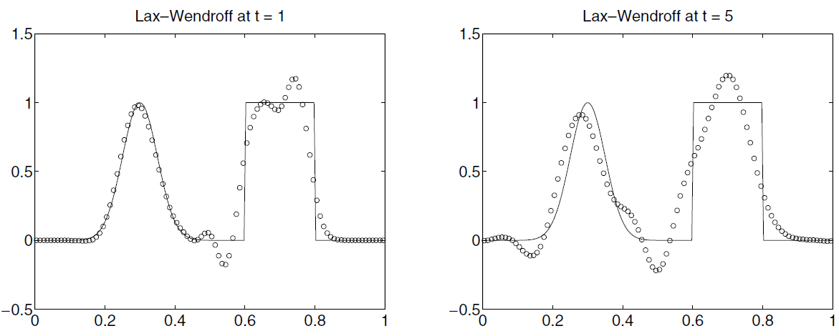
Computational Fluid Dynamics
Several nontrivial problems related to the hyperbolic structure of the equations.
Numerical induced dissipation
Do not preserve positivity (density)
Unstable oscillations
Even for linear hyperbolic equations
[Leveque, Finte volume methods for hyperbolic equations]

Slide 16
Implementation in ALaDyn
Plasma (relativistic pressureless Euler + Maxwell’s equations)
Huge literature available for hyperbolic equations for conservative and compressible Euler equations
Easier in non – conservative form
No natural diffusive term
[Terzani, Londrillo, CPC, 2019]
Consistent with ALaDyn’s framework
Adams-Bashfort discretization
Second order Boris pusher for particle dynamics
Electromagnetic field solved on a staggered spatiotemporal grid (FDTD)
Particle and fluid dynamics can cooperate for a hybrid approach
Weighted Essentially Non – Oscillatory Reconstruction (WENO)

Slide 17
Temporal integration
Adams – Bashfort method
Method is one step (faster)
Second order accuracy
Consistent with PIC Electromagnetic and particle solver
Leading order dispersive plus a small dissipative error
Source term known at integer times:
compatible with Maxwell solver

Slide 18
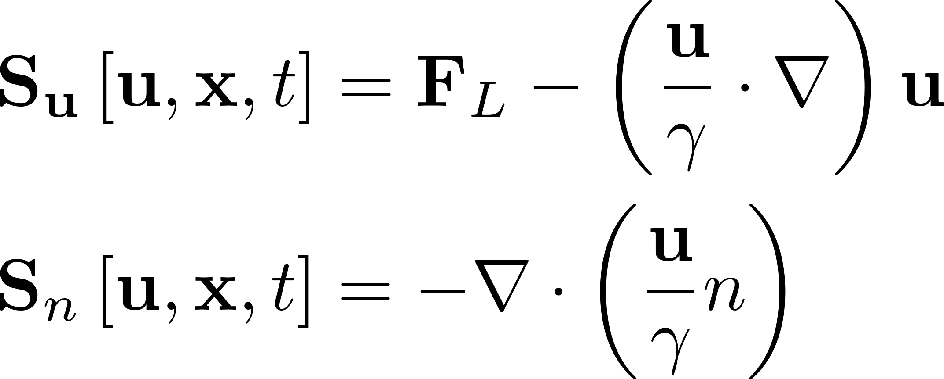
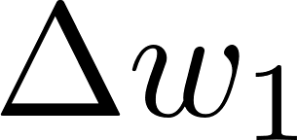
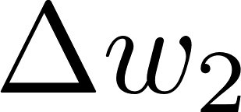
Spatial integration
Reconstruct $\frac{u}{γ}, u$and $n$ values using grid (known) points such that (1D example)
2nd order WENO reconstruction
Could be of any order
Choice of the interpolating stencil
In WENO scheme $c_{1}$and $c_{2}$ are nonlinear weights to assure smoothest non oscillatory solution

Slide 19
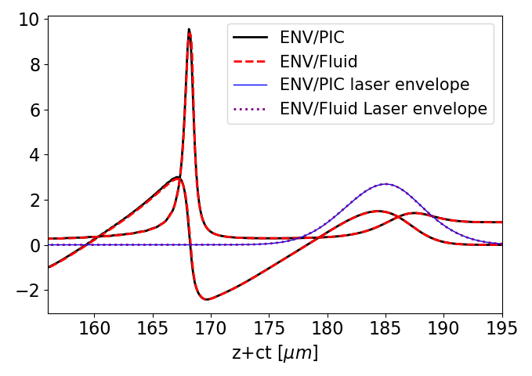
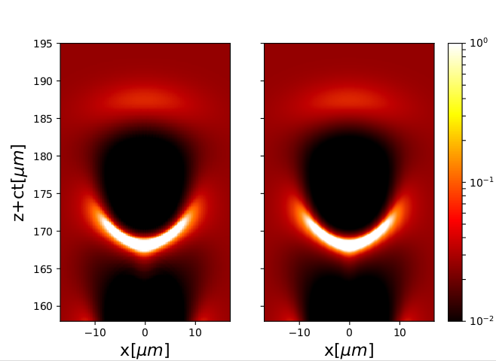
Eulerian integrator benchmarks
PIC
Fluid

Slide 20
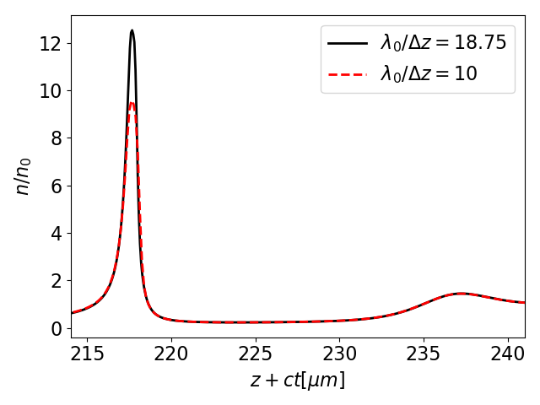
Eulerian integrator benchmarks/2
For lower resolution, numerical dissipation is very strong
Can higher order temporal and spatial schemes reduce the numerical dissipation and allow to simulate stronger nonlinearities?

Slide 21
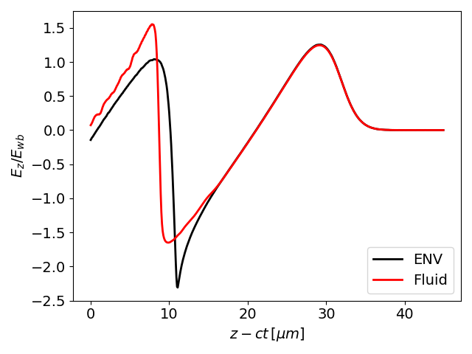
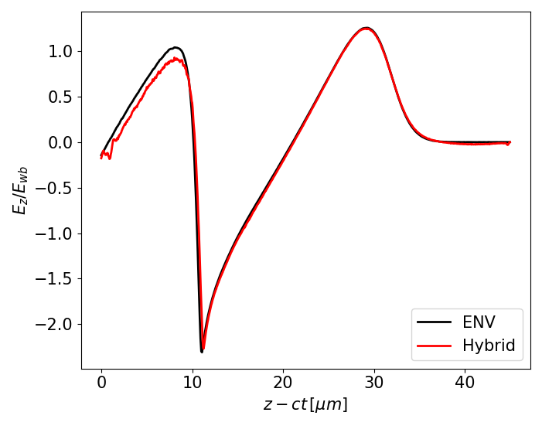
Towards strongly nonlinear regimes (preliminary)
Fluid theory is reaching the limit of validity
Numerically the discontinuity is smeared
Let us add some particles

Slide 22
Outline
ALaDyn: envelope and fluid solvers
Explicit envelope solver
Second order Envelope Boris pusher
Plasma equations in fluid approximation
High quality injection scheme
REMPI
Outcomes of the optimized injection scheme

Slide 23
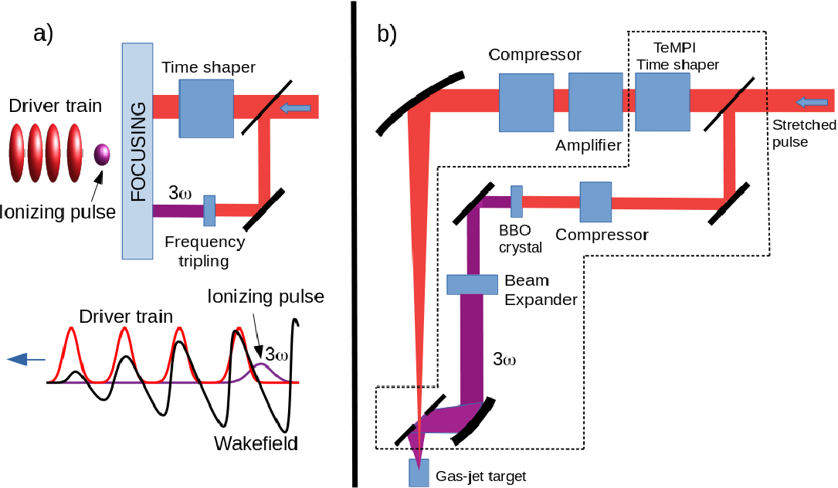
High quality injection scheme
Experiments have shown accelerated bunches, but with a poor quality
New acceleration scheme proposed within the EuPRAXIA project
Single 150 TW laser pulse
Feasible with present technology
Wakefield is excited by a train of pulses
Particle bunch injected in the plasma ionizing a dopant with a frequency doubled (or tripled) pulse
Beam emittance is kept low
Experimental realization is WIP
[Tomassini et al., POP, 2017
Tomassini et al., PPCF, accepted
Tomassini et al., PRAB, submitted]

Slide 24
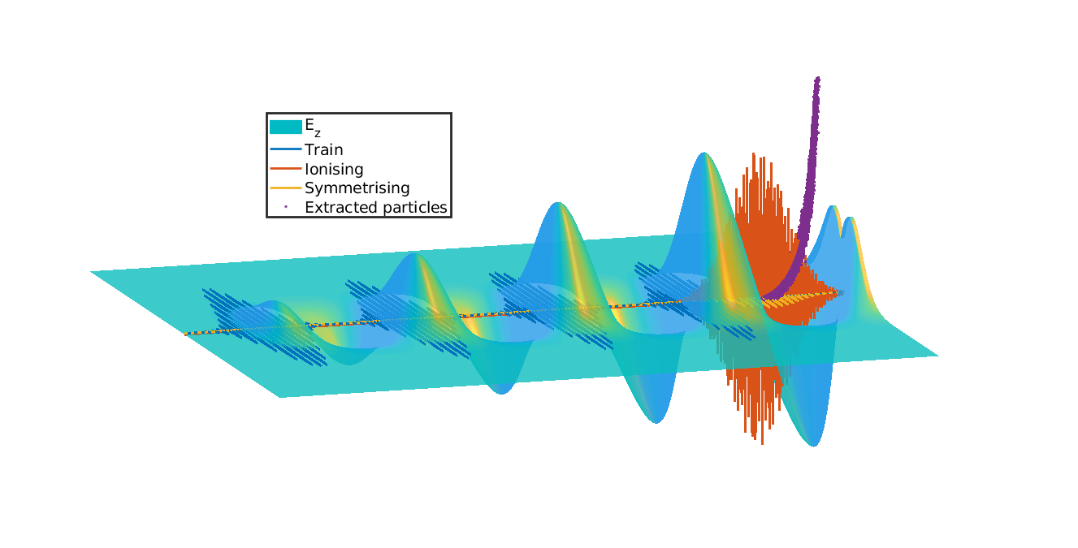
The REMPI scheme

Slide 25
Optimization of the injection scheme
Four laser driver to produce the wakefield
One frequency tripled laser pulse to inject particles
Very large pulse waist to avoid fast diffraction
Independence of the system from the small frequencies
Very different largest and smallest length scales and we only want to see the slow ones
Strategy
Reduced models very recommended
QFluid
ALaDyn
Fast computational tool for a parameter scan
Very reduced model: quasistatic approximation, plasma fluid description, 2D cylinidrical simmetry
Runs on a laptop
Parameter space has already been reduced
Fully selfconsistent (challenging) simulation
Need computational resources from HPC (e.g. CINECA)
[Tomassini et al., PRAB, submitted]

Slide 26
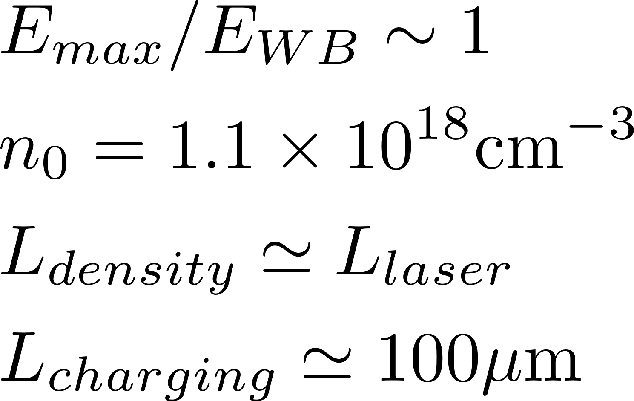
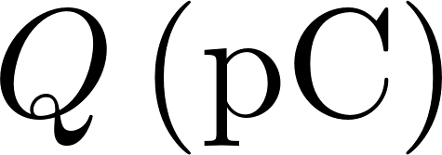
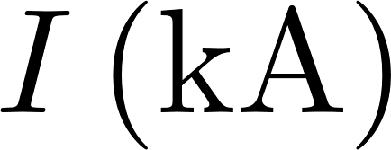
Working point
[Tomassini et al., PRAB, submitted]
Criticalities
Fluid model
Self charge/beam loading
Quasistatic approximation
Transverse motion near the axis
Obtained with QFluid
Verified with ALaDyn in hybrid configuration
Requested | << 5 % | << 1 | < 200 | ≥ 30 | >1
Obtained | 1.65 % | 0.23 | 140 | 32 | 4

Slide 27
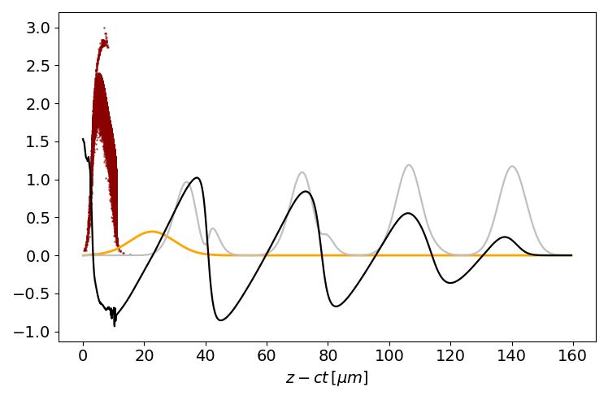
Hybrid simulation
Particles are ionized from the ion background (numerically generated) and injected into the wakefield
Macroparticles
Driver pulses
Kinetic particles (standard PIC) are moving in a fluid framework
Ionizing pulse
Fluid background

Slide 28
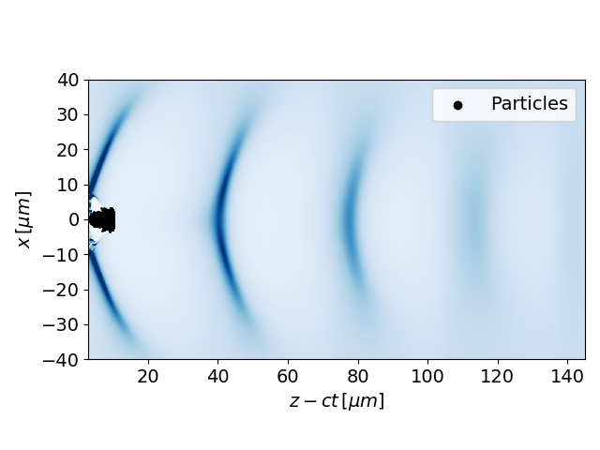
Hybrid simulation/2
Density map + injected particles
Macroparticles generated via ionization are forming the accelerating beam, moving in a fluid density
Simulation time is strongly reduced because particles are only evolved where needed. Of course this could determine some load unbalance

Slide 29
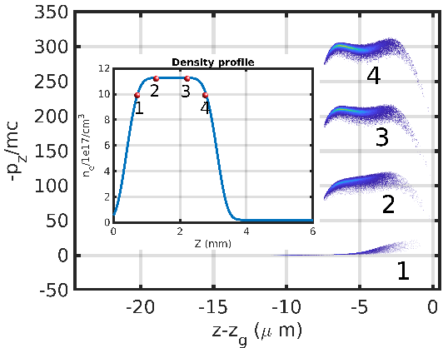
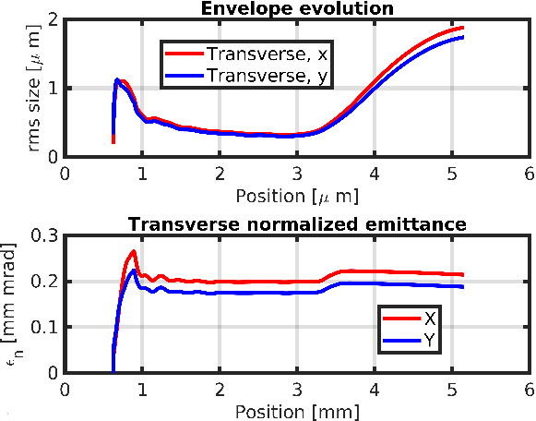
Outcomes of the REMPI scheme

Slide 30
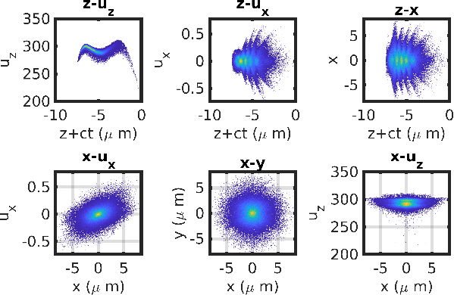
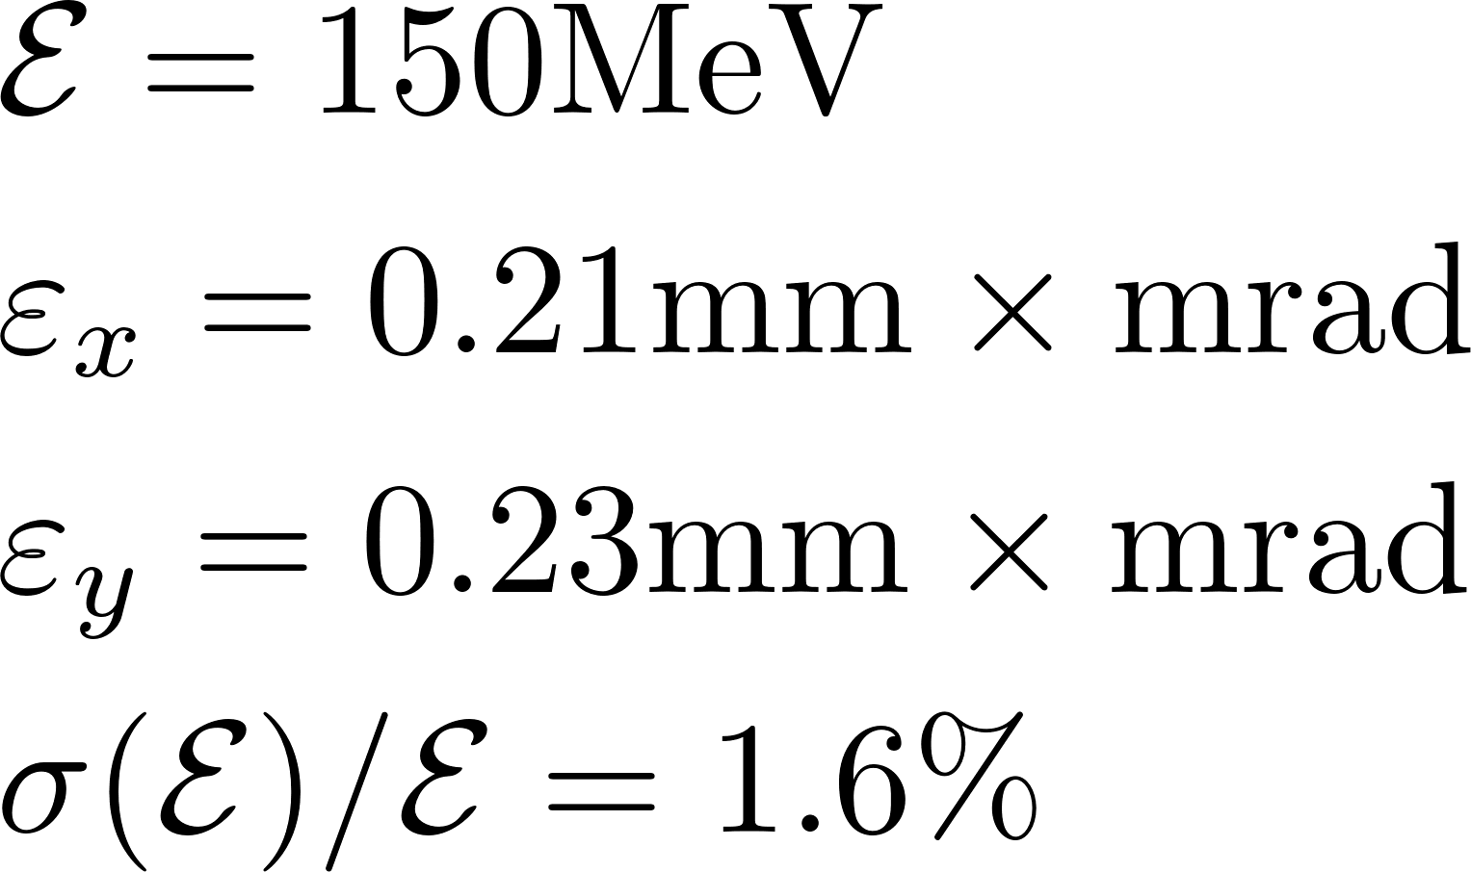
Outcomes of the REMPI scheme/2
At the end of the plateau

Slide 31
Conclusions
Envelope approximation allows to model LWFA without any loss of the interesting physics
Explicit laser solver
Approximated particle pusher
Fluid approximation greatly boost simulations where fluid theory holds (no kinetic effects)
Execution time $τ$~ 1 p.p.c.
Physics is entirely retained
WENO schemes can offer a flexible, easy and robust option for integration
For strongly nonlinear regimes a hybrid approach (fluid + few macroparticles) is a promising alternative. WARNING: correctness of the results and time gains must be evaluated case by case
REMPI scheme is very demanding in terms of computational time
Preliminary parameter scan with QFLUID
ALaDyn in fluid + ionized macroparticles configuration to simulate physics with more accuracy

Slide 32
References
D. Terzani, P. Londrillo, “A fast and accurate numerical implementation of the envelope model for laser–plasma dynamics”, Computer Physics Communications 242 (2019)
P. Tomassini, D. Terzani, L. Labate, G. Toci, A. Chance, P. Nghiem, L. A. Gizzi, PRAB, submitted
P. Tomassini, S. De Nicola, L. Labate, P. Londrillo, R. Fedele, D. Terzani, L. A. Gizzi, “The resonant multi – pulse ionization injection”, Physics of Plasmas (2017)
P. Tomassini, S. De Nicola, L. Labate, P. Londrillo, R. Fedele, D. Terzani, F. Nguyen, G. Vantaggiato, L. A. Gizzi, “High – quality GeV – scale electron bunches with the Resonant Multi – Pulse Ionization Injection”, NIMA, 2018

