Slide 1
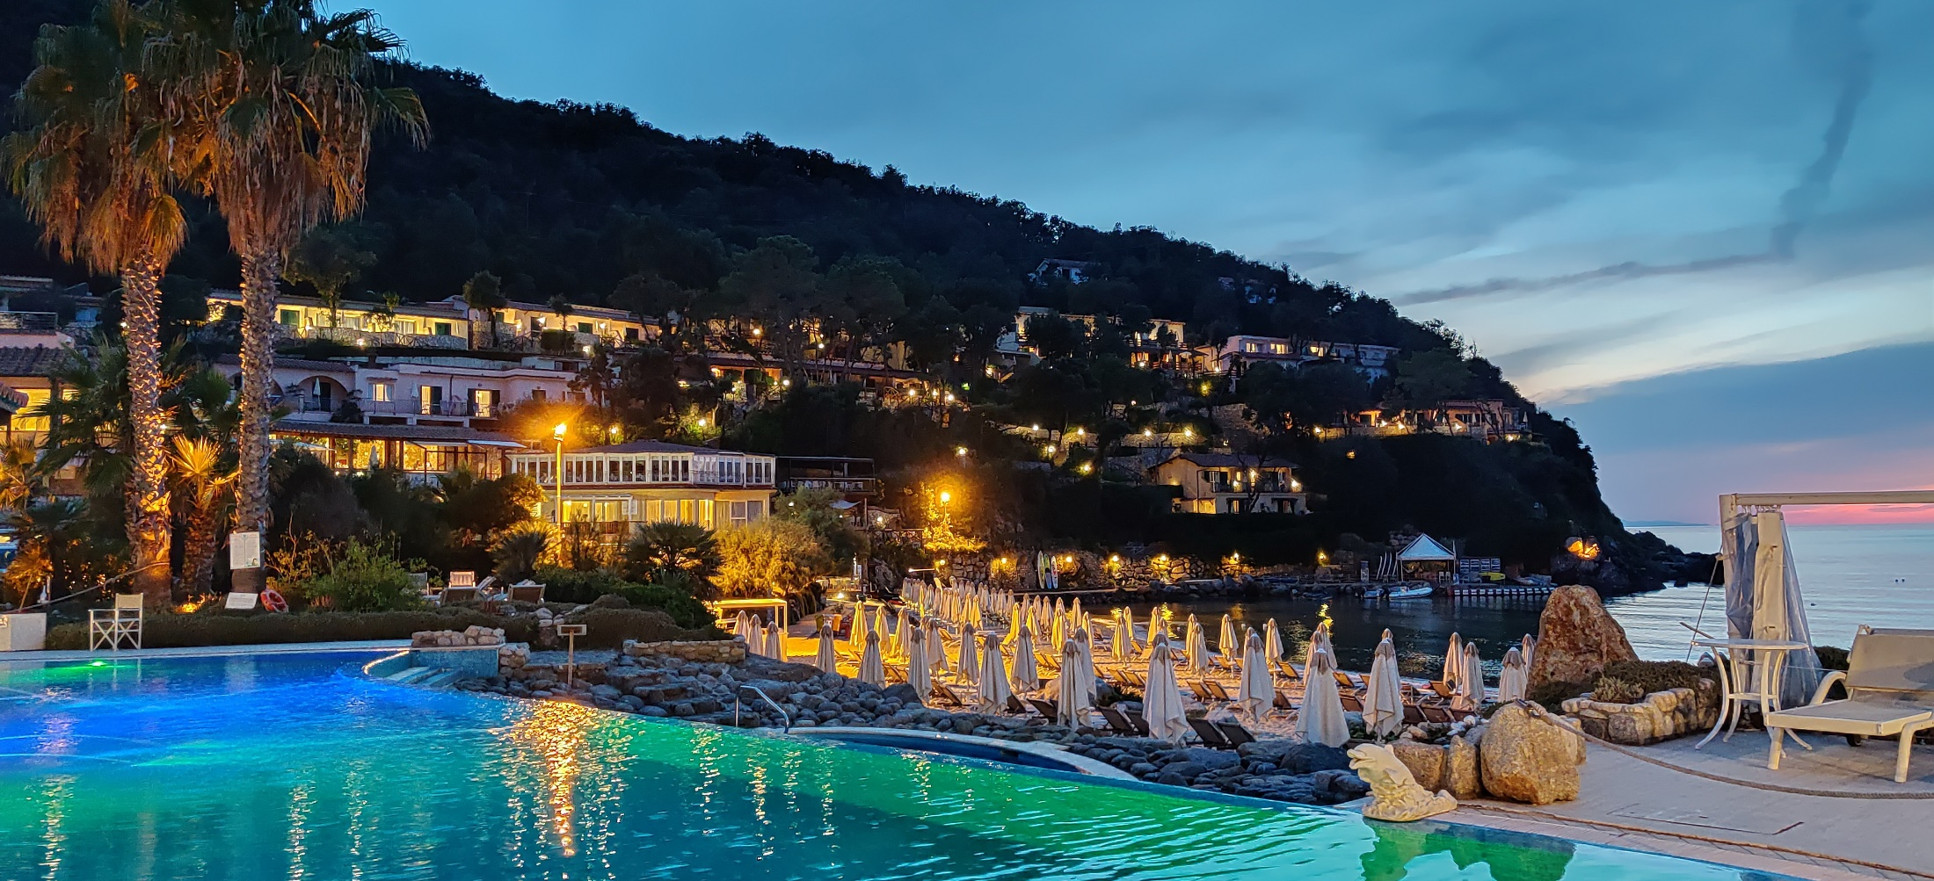
arXiv:1906.10500v2 (2019)
A.Pukhov
Institute for Theoretical Physics I
University of Dusseldorf, Germany
Quasi-1D dispersionless Maxwell Solver NCI-free
EAAC, Elba, 19 September 2019

Slide 2
The relevant quasi-1D problem: Plasma-based particle acceleration
Popular (in PIC community) Maxwell solvers
FDTD
Spectral
Yee lattice
Global
Large stencil “quasi-local”

Slide 3
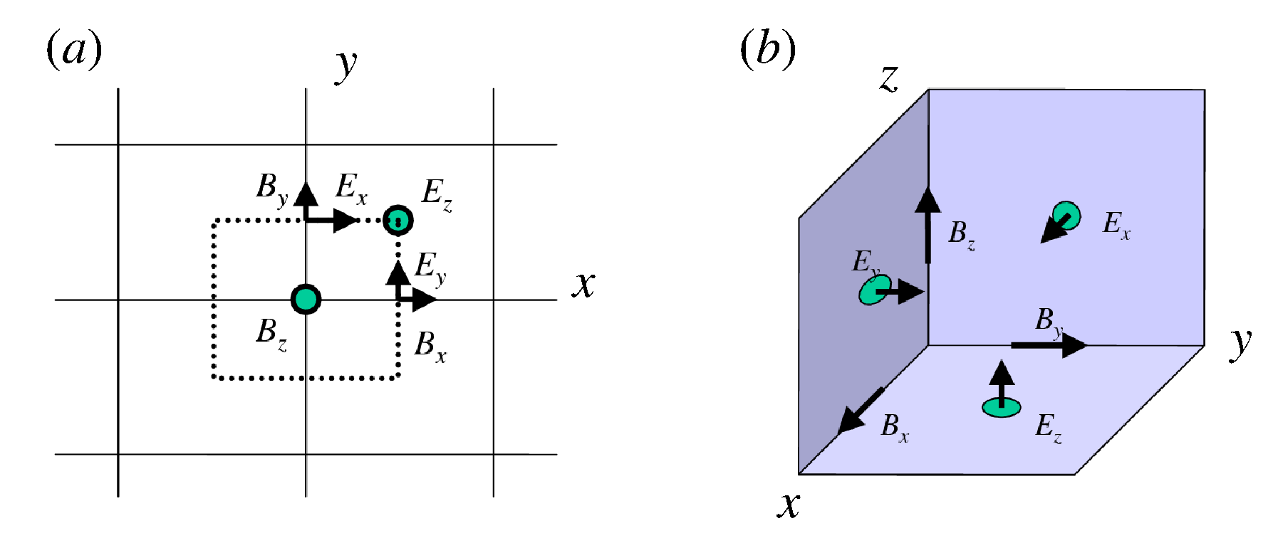
FDTD: Yee lattice Leap-frog (mid-point) in time & space universal conservative scheme
4D staggering The fields positions are staggered in space and time:

Slide 4
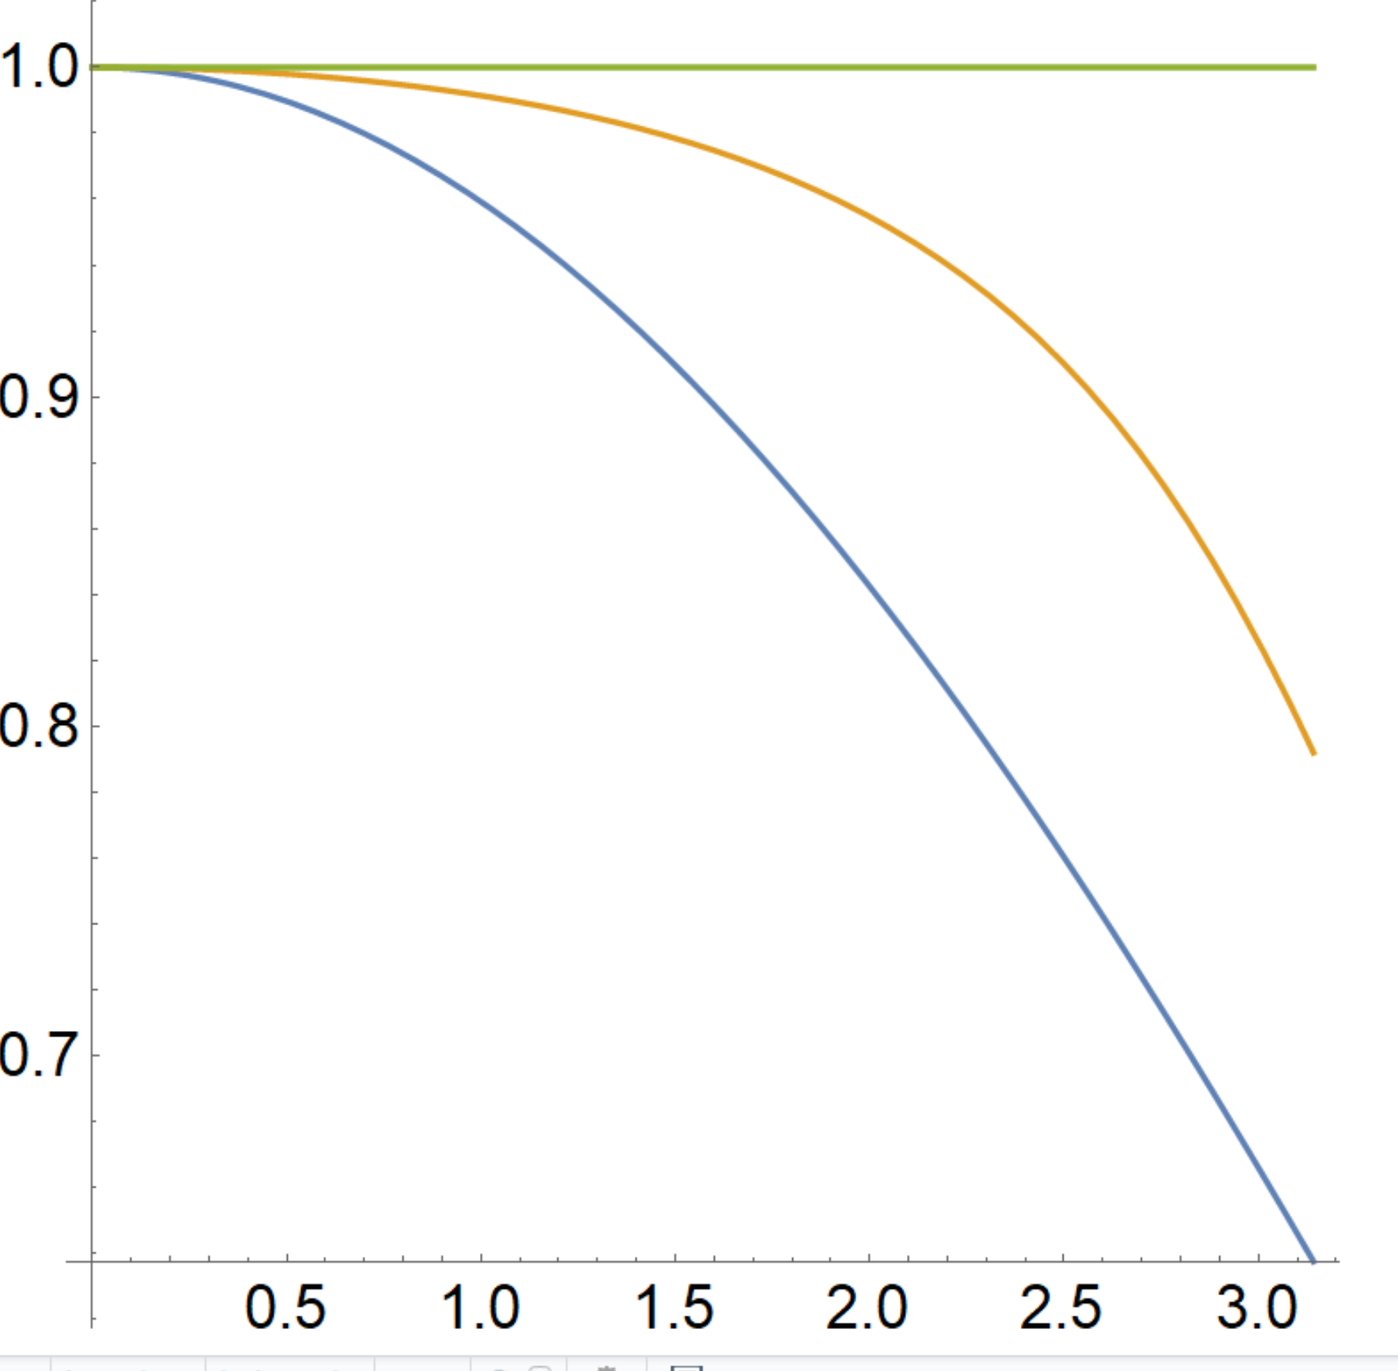
Poor numerical dispersion of the Yee Maxwell solver
Analytics
V_{ph}/c
Yee cτ = 0.9h
Numerical phase velocity is lower than the real one
Yee
cτ = 0.1h
Numerical Cerenkov Instability (NCI) of relativistic plasma streams
kh_{x}/2

Slide 5
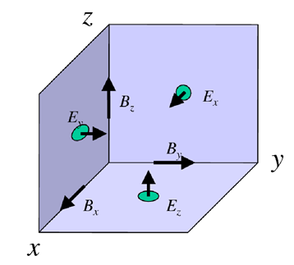
Staggered Yee lattice: a problem for acceleration
The radial force is F_{y}= E_{y}-B_{z} and F_{z}= E_{z}+B_{y}
Unfortunately, the Yee Lattice defines the pairs E_{y}, B_{z} and E_{z}, B_{y} at positions staggered in space and time. This leads to a numerical self-action of relativistic beams

Slide 6
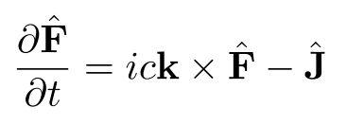
Spectral solvers based on FFT or other transforms
Maxwell equations on the complex field F=E+iB
The big advantage: exact dispersion in 3D
The issues: (i) global/large stencil (ii) prone to aliasing, NCI

Slide 7
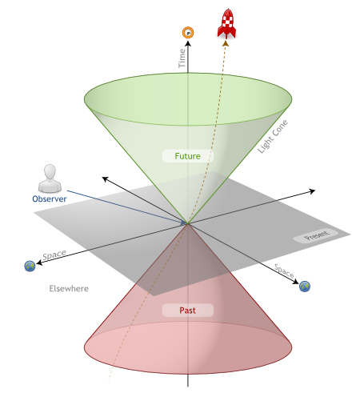
Spectral method global/large stencil: the causality issue
Light cone of causality
Spectral/large stencil solvers take information from “elsewhere” places: no causality relation to the local field
Information (aka numerical errors due to aliasing, BC, etc) spreads over domain immediately and/or at superluminal velocity

Slide 8
Which Maxwell solver do we want for plasma-based acceleration?
It must be local (SRT causality principle): only the next neighbor cells must contribute
It must be 2nd order (as the Maxwell Eqs.)
It must be symplectic (conservative)
It must have perfect (analytical) dispersion both in vacuum and in plasma
Must have no NCI
The field pairs E_{y}, B_{z} and E_{z}, B_{y} must be co-located in space and time
It must be computationally cheap and infinitely scalable

Slide 9
Available centered symplectic integrators
Mid-point (leap-frog)
2. Trapezoidal
The both are 2nd order accurate

Slide 10
The RIP Maxwell solver
arXiv:1906.10500v2 (2019)
Suitable for problems with a selected direction (like PWFA along one axis)
Uses trapezoidal integration along the selected axis
Yee-like (or any other) solver in the transverse plane

Slide 11
The Rhombi-in-Plane (RIP) grid: 3D Yee lattice reduced to a 2D (YZ) plane
arXiv:1906.10500v2 (2019)
Yee
RIP
E_{y},B_{z}
E_{x}
E_{y},B_{z}
B_{x}
E_{z},B_{y}
B_{x}
E_{y},B_{z}
E_{x}
E_{y},B_{z}
E_{x}
E_{y},B_{z}
E_{x}
E_{z},B_{y}
B_{x}
E_{z},B_{y}
B_{x}
E_{z},B_{y}
E_{y},B_{z}
E_{x}
E_{y},B_{z}
squeeze along X and T to the YZ plane
E_{z},B_{y}

Slide 12
The quasi-1D Maxwell solver: the semi-implicit RIP scheme
arXiv:1906.10500v2 (2019)
We project the Yee lattice onto the transverse plane
All field are defined at the same x- and t-positions
E_{y},B_{z}
E_{x}
E_{y},B_{z}
B_{x}
E_{z},B_{y}
B_{x}
E_{y},B_{z}
(i,j-1/2,k+1/2)
(i,j,k+1/2)
(i,j+1/2,k+1/2)
E_{x}
E_{y},B_{z}
E_{x}
E_{y},B_{z}
E_{x}
E_{y},B_{z}
(i,j-1/2,k)
(i,j,k)
(i,j+1/2,k)
E_{z},B_{y}
B_{x}
E_{z},B_{y}
B_{x}
E_{z},B_{y}
(i,j-1/2,k-1/2)
(i,j,k-1/2)
(i,j+1/2,k-1/2)
E_{y},B_{z}
2D staggered: Trapezoidal along X-axis with leap-frog (Yee) transversely
E_{x}
E_{y},B_{z}
E_{z},B_{y}

Slide 13
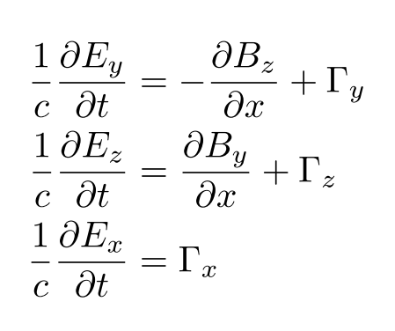
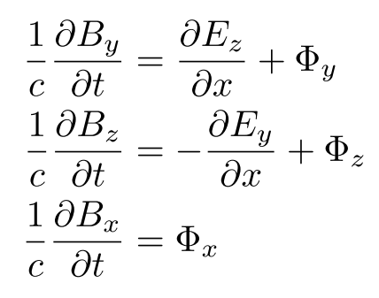
The RIP scheme: trapezoidal along X, Yee in transverse plane
arXiv:1906.10500v2 (2019)
We separate field propagation along X and transverse diffraction/refraction Γ, Φ
(transverse derivatives and currents)

Slide 14
The RIP scheme: trapezoidal along X, Yee in transverse plane
arXiv:1906.10500v2 (2019)
Discretization along X: averaging to a virtual mid-point of the (x,t) cell at i+1/2, n+1/2

Slide 15
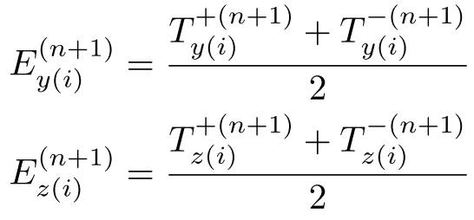
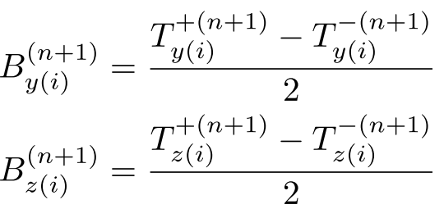
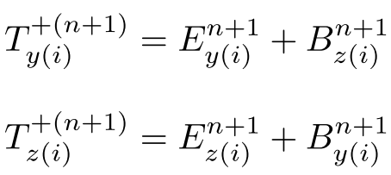
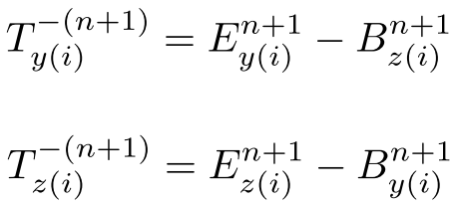
The RIP scheme: The “magic” time step τ=h_{x}/c
arXiv:1906.10500v2 (2019)
For the special time step Δ=h_{x}=cτ, the equations can be solved explicitly:
Where the field transport components T^{+/-} are

Slide 16
The RIP scheme: The diffraction/refraction terms (Yee-style)
arXiv:1906.10500v2 (2019)

Slide 17
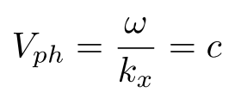
The RIP scheme: Numerical dispersion and stability
arXiv:1906.10500v2 (2019)
Dispersion relation in vacuum:
For waves, running in X (set k_{y}=k_{z}=0), we recover the exact analytical dispersion:
The RIP solver stability condition:

Slide 18
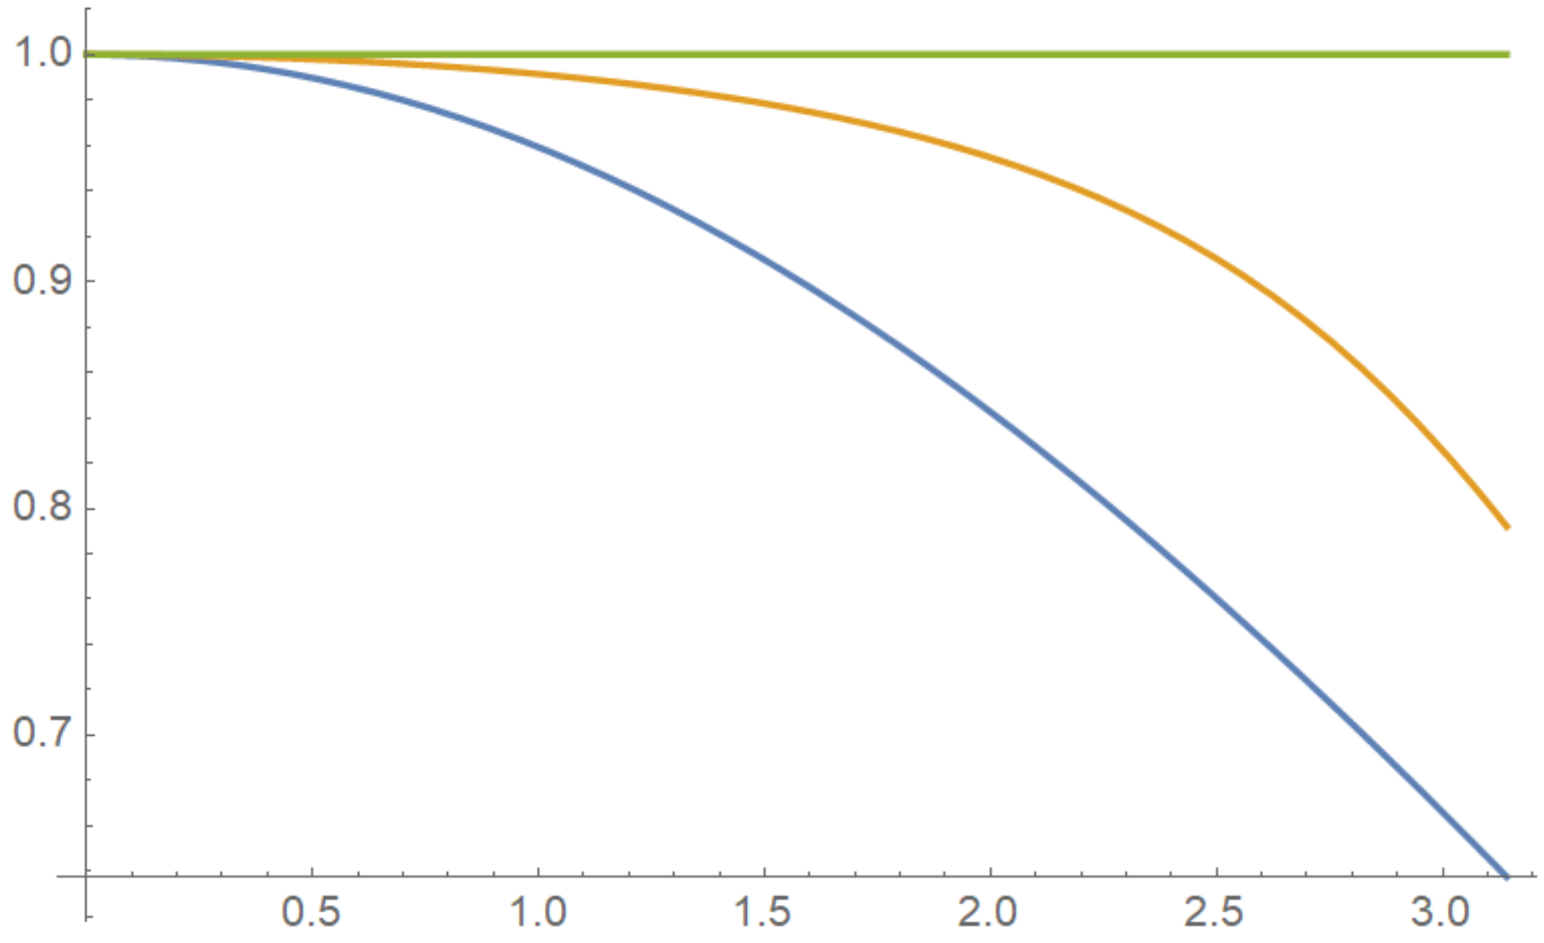
Numerical dispersion RIP vs Yee Maxwell solver
RIP, for any h_{x}
V_{ph}/c
Yee cτ = 0.9h
Yee
cτ = 0.1h
kh_{x}/2

Slide 19
The RIP scheme computational costs
arXiv:1906.10500v2 (2019)
The RIP solver is local, only neighbor cells communicate and thus infinitely scalable
Essentially the same computational effort as the Yee solver
RIP does require a memory overhead. Two sets of fields and currents must be maintained at full and half time step: E^{n}, B^{n}, J^{n+1/2} and E^{n+1/2}, B^{n+1/2}, J^{n}
Only one particle push is required per time step The current at the full time step can be found via simple on-grid averaging: J^{n} = (J^{n-1/2} + J^{n+1/2}) / 2

Slide 20
arXiv:1906.10500v2 (2019)
The simulation example: a laser-driven Bubble a₀=5, n/n_{c}=0.01

Slide 21
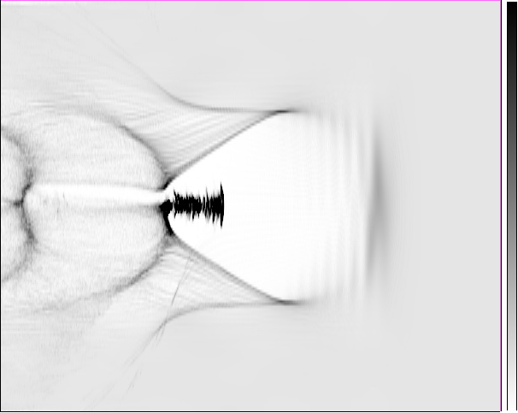
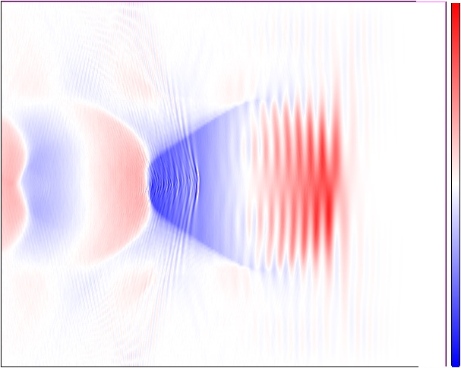
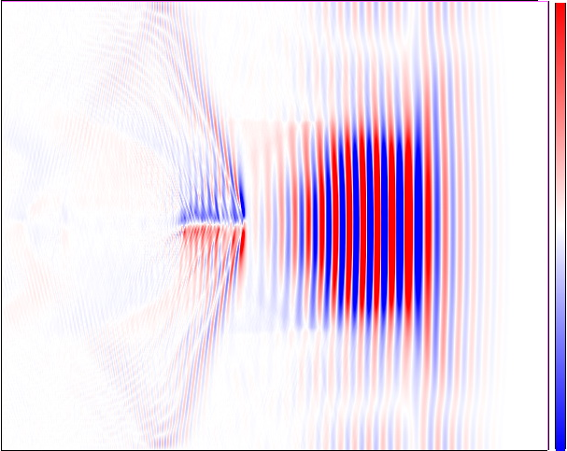
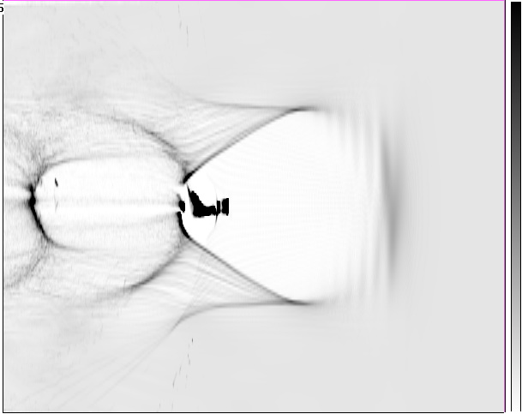
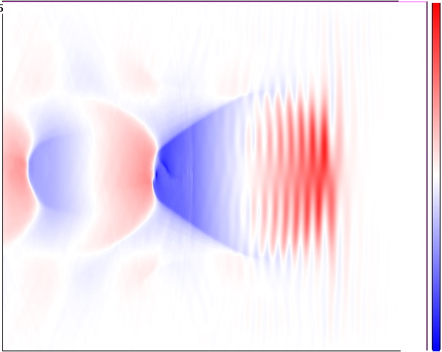
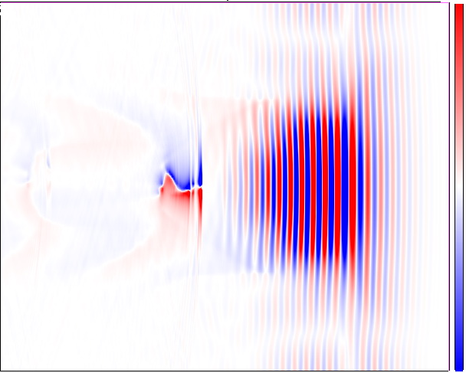
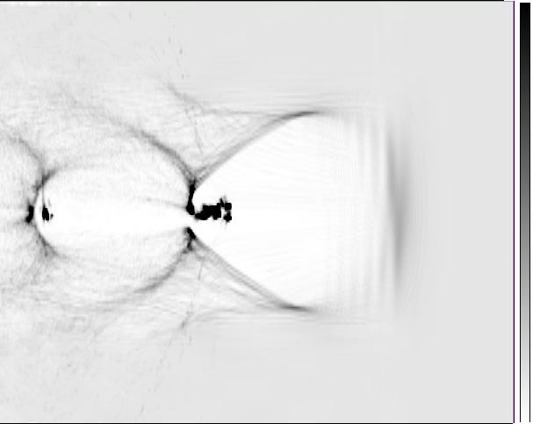
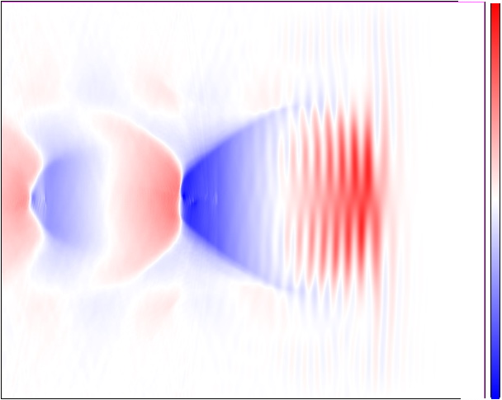
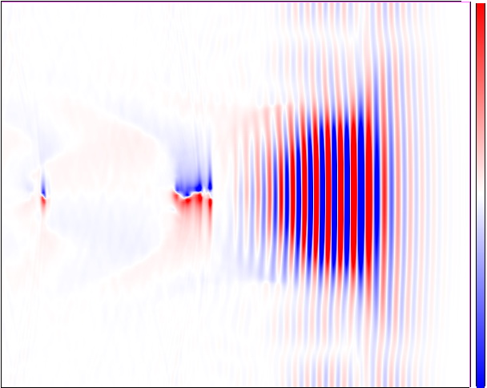
arXiv:1906.10500v2 (2019)
The simulation example: a laser-driven Bubble
n_{e}/n_{c}
eE_{x}/m_{e}cω
eE_{y}/m_{e}cω
20
(a)
0.1
(b)
0.5
(c)
1
y/λ
Yee
h_{x}=0.05λ
-20
0
-0.5
-1
20
(e)
0.1
(f)
0.5
(g)
1
y/λ
RIP Δ=0.05λ
-20
0
-0.5
-1
0.5
20
(h)
0.1
(i)
0.5
(j)
1
y/λ
RIP Δ=0.1λ
-20
0
-0.5
-1
460 500
460 500
460 500
x/λ
x/λ
x/λ

Slide 22
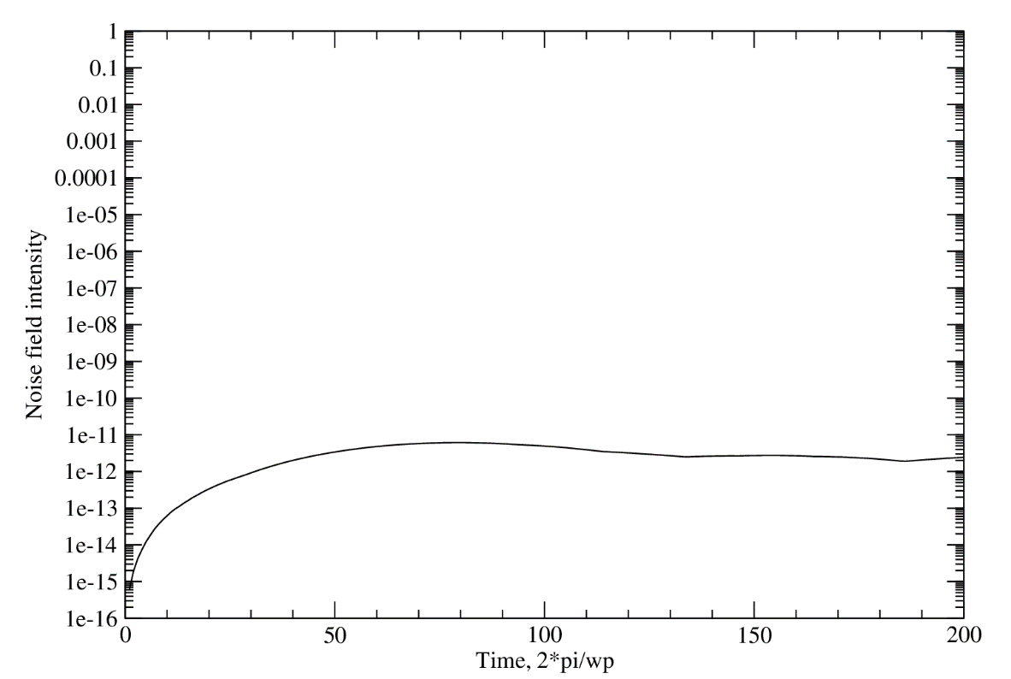
RIP test of NCI (the Lehe test): Streaming uniform plasma at γ = 130

Slide 23
NCI in Yee solver Flying plasma sphere test
arXiv:1906.10500v2 (2019)

Slide 24
NCI in spectral (FFT) solver Flying plasma sphere test
arXiv:1906.10500v2 (2019)

Slide 25
RIP test of NCI: flying plasma spheres test
arXiv:1906.10500v2 (2019)

Slide 26
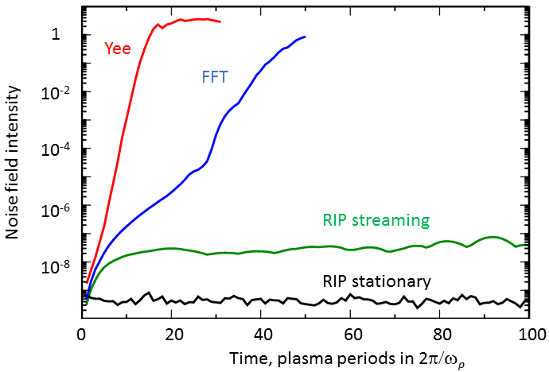
Comparison of NCI in different solvers flying plasma spheres
arXiv:1906.10500v2 (2019)

Slide 27
RIP simulation of proton bunch SSM in Lorentz-boosted frame (γ =10)

Slide 28
Outlook
The RIP is a second order local Maxwell solver with the analytical dispersion along a selected axis Unique for FDTD solvers!
The RIP solver is free from NCI
Computational costs of the RIP solver are comparable to those of the Yee solver

