Slide 1
Force exerted on particle bunch propagating near plasma-vacuum boundary
Konstantin Lotov
Budker Institute of Nuclear Physics SB RAS, Novosibirsk, Russia
Novosibirsk State University, Novosibirsk, Russia

Slide 2
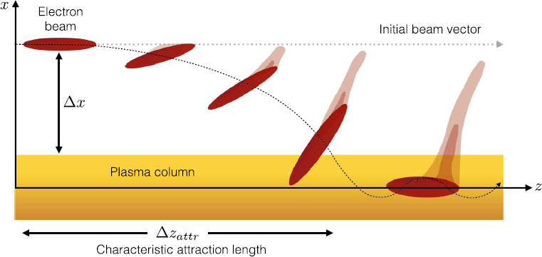
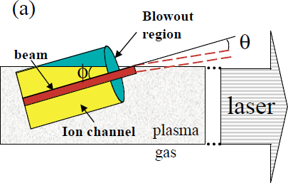
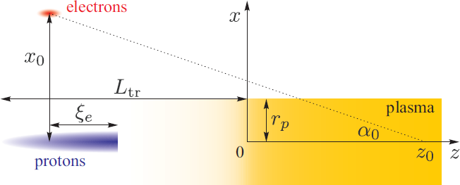
K.Lotov, EAAC-2019, Elba, Italy, 17.09.2019, slide 2 of 10
Where does the problem come from?
Parallel beams
Misaligned beams
E Adli et al, New J. Phys. 18 (2016) 103013
P. Muggli et al, PRST-AB 4, 091301 (2001)
Side injected witness beams
N. Moschüring et al, https://doi.org/10.1088/1361-6587/ab411e

Slide 3
K.Lotov, EAAC-2019, Elba, Italy, 17.09.2019, slide 3 of 10
How the problem is formulated mathematically?
A point charge is moving parallel to the plasma boundary in z-direction with velocity c (if with v, everything is similar, but the result is longer)
Plasma responds linearly, all perturbations are small
Permittivity, of vacuum
of plasma
We want to find all fields everywhere
If the charge is in plasma, everything is the same but indexes 1 ↔ 2
Because of the linear response, we can then find the fields produced by any beam by integrating “elementary” fields of point charges
x
y
d
x
y
d

Slide 4
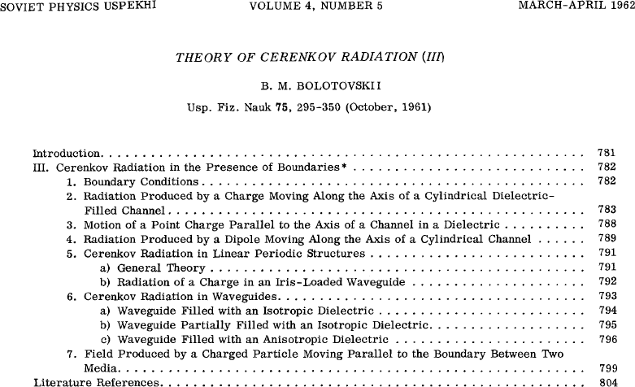
K.Lotov, EAAC-2019, Elba, Italy, 17.09.2019, slide 4 of 10
The problem looks like a classical one, so the solution may be in old journals:

Slide 5
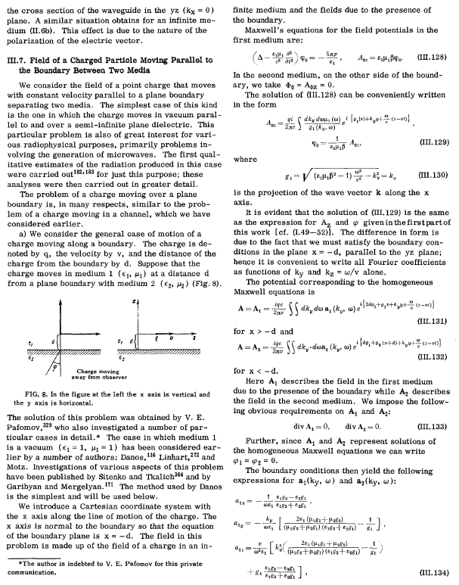
K.Lotov, EAAC-2019, Elba, Italy, 17.09.2019, slide 5 of 10
Unfortunately, authors of that time were very brief,
ideas of solution
and papers full of misprints,
so we reproduced the solution (see next slide)
problem definition
result
review of earlier works
essence of result

Slide 6
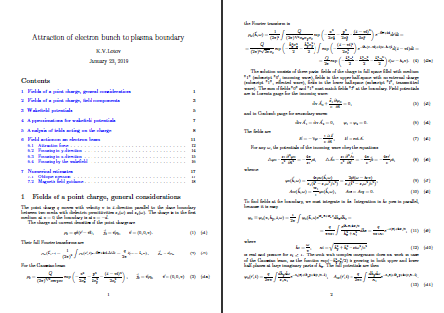
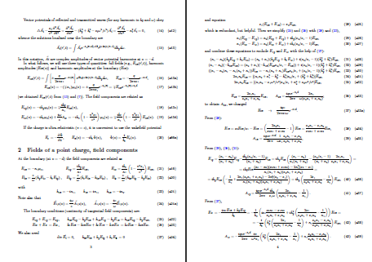
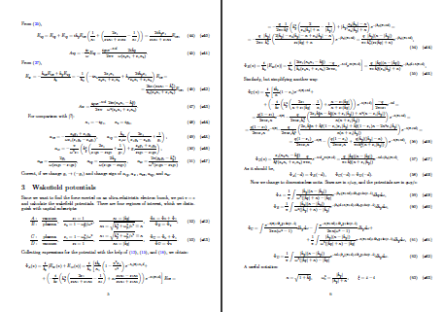
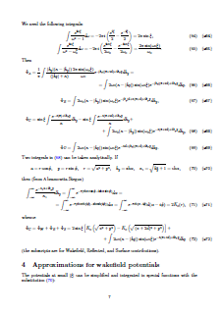
K.Lotov, EAAC-2019, Elba, Italy, 17.09.2019, slide 6 of 10
The same result, but at the modern detail level:
Reproduction of old results (1error + 1 misprint found)
Calculation of wakefield potentials
The idea of solution:
3 waves (similar to incident, transmitted and reflected waves),
the “incident” wave is that of a point charge in free space,
the “reflected” and “transmitted” waves decrease with distance from the boundary
tangential field components are matched at the boundary
this is to be done for separate Fourier harmonics of the fields, as reflectance is different for different frequencies
Difficulty (and novel thing):
to combine Fourier harmonics back and obtain fields in real space
x
y
d

Slide 7
K.Lotov, EAAC-2019, Elba, Italy, 17.09.2019, slide 7 of 10
The solution
Most conveniently presented in terms of wakefield potential Φ,
the force acting on an axially moving ultra-relativistic charge is
x
y
Point charge q in vacuum creates (at ξ<0)
d
x
y
d
Point charge q in plasma:
usual wakefield
wakefield of reflection charge
surface wave
We cannot make the final integration, so the analysis is tricky

Slide 8
K.Lotov, EAAC-2019, Elba, Italy, 17.09.2019, slide 8 of 10
If the charge is close to the boundary (d << c/ω_{p}):
different periodicity
non-integrable dependence on d
x
attraction +
defocusing
y
d
focusing
x
x
q
Q
y
ξ
The force linearly grows with distance from the drive charge
d
repulsion +
focusing
defocusing
strong focusing
by wakefields

Slide 9
K.Lotov, EAAC-2019, Elba, Italy, 17.09.2019, slide 9 of 10
Cross-check, theory vs simulations (A.Petrenko with A.Pukhov’s code)
Cold high-energy Gaussian e-beam crosses the plasma boundary at a shallow angle, the transverse momentum gained is compared with the theory
Boundary crossing is at z=300
attraction of electrons located close to axis
beam focusing in vacuum
The agreement is surprisingly good (having in mind that theoretical values are approximations)

Slide 10
K.Lotov, EAAC-2019, Elba, Italy, 17.09.2019, slide 10 of 10
Summary
If a charged particle bunch propagates near a plasma-vacuum boundary, it experiences an additional force caused by the boundary.
For the linearly responding plasma and short and narrow bunch, this force can be approximated with elementary functions.
The force is attracting to the boundary, if the bunch is in vacuum, and repelling otherwise.
There are also additional focusing and defocusing components of the force.
Numerical simulations of electron beam crossing the boundary at a small angle agree with the theory, proving validity of the both.
Thank you

