Slide 1
Working Group 3
Summary
Co-conveners:
David Alesini
Reinhard Brinkmann

Slide 2
Session Plan
Reinhard
Monday 16.00 – 19.00h room SB1 | Tuesday 16.00-16.40h room SB1 | Wednesday 16.00 – 19.00h room SB1 | Thursday 18.00h – 19.30h room SB2
Dielectric laser-driven acceleration Dielectric beam-driven acceleration | Particle sources | Dielectric beam-driven acceleration THz acceleration | High gradient rf technology WG summary discussion
In total 19 oral presentations (+summary discussion)
  + 1 presentation jointly with WG4
28 posters related to WG3 (15 on Monday, 13 on Wednesday)
Many thanks to all WG3 participants for excellent presentations and good discussions!

Slide 3
Session Plan
David
Monday 16.00 – 19.00h room SB1 | Tuesday 16.00-16.40h room SB1 | Wednesday 16.00 – 19.00h room SB1 | Thursday 18.00h – 19.30h room SB2
Dielectric laser-driven acceleration Dielectric beam-driven acceleration | Particle sources | Dielectric beam-driven acceleration THz acceleration | High gradient rf technology WG summary discussion
In total 19 oral presentations (+summary discussion)
  + 1 presentation jointly with WG4
28 posters related to WG3 (15 on Monday, 13 on Wednesday)

Slide 4


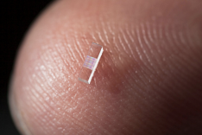
Dielectric Laser Acceleration DLA
Many of the studies performed within framework of ACHIP Collaboration
  13 collaboration partners, coordination by Stanford Univ./SLAC and Univ. Erlangen-Nuernberg
  Strong financial support by Moore Foundation (in addition to institutes own contributions)
  Major goal at end of 5-year period: demonstration of MeV-scale integrated compact (“shoebox”) accelerator at optical wavelength (0.8 - 2µm)

Slide 5
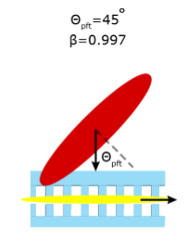
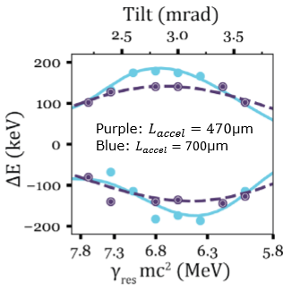
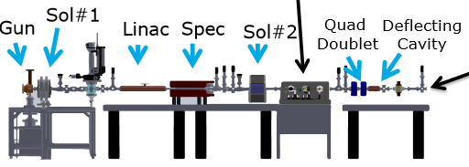
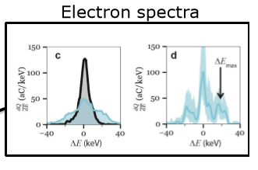
DLA Highlights: acc. Gradient, max ΔE
At PEGASUS facility / UCLA (talk P. Musumeci), injection of external 6 MeV beam
  Laser pulse front tilt for longer interaction (0.7mm structure)
  Max gradient 0.9 GV/m
  Max energy modulation 300keV

Slide 6
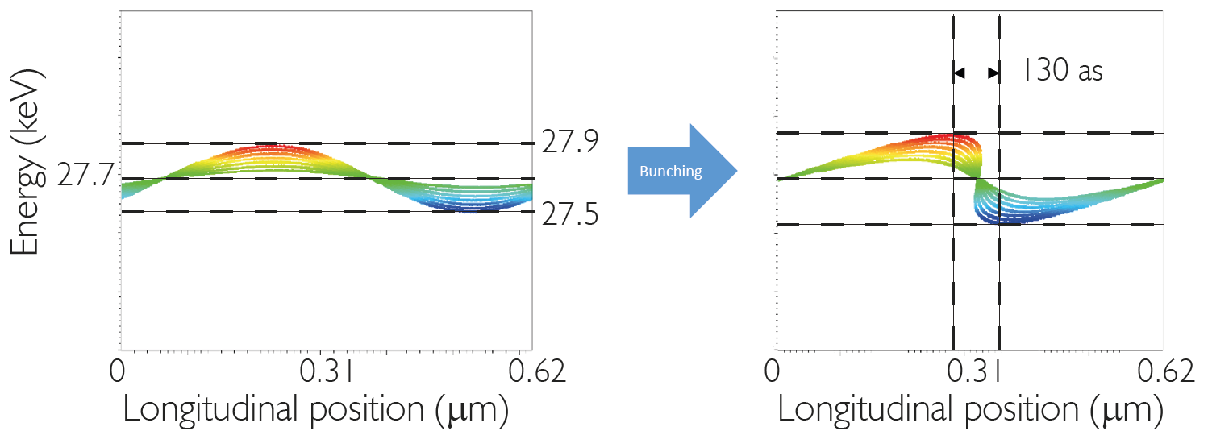
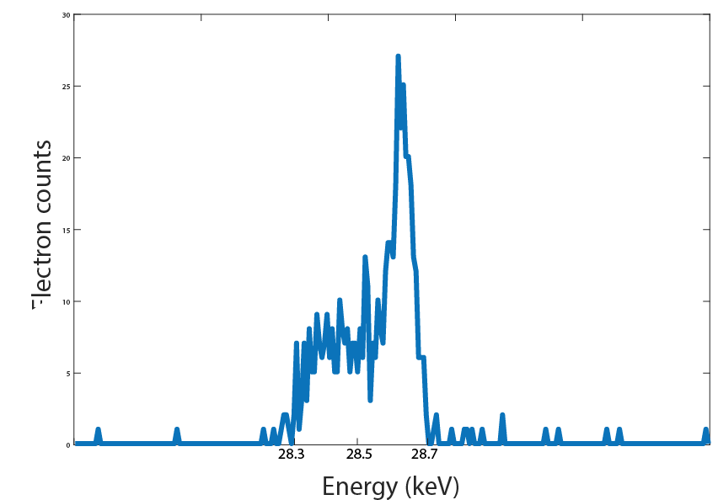
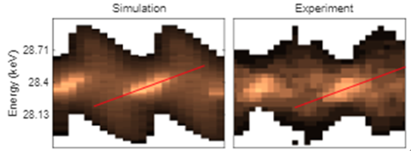
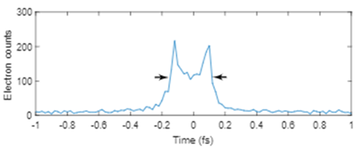
DLA Highlights: micro-bunched beam
Exp. at Erlangen (talk N. Schoenenberger)
  Buncher-accelerator setup produced microbunch train
  Net energy gain demonstrated
  Bunch length derived from spectograms (phase scan)
buncher
acceleration
~400as FWHM

Slide 7
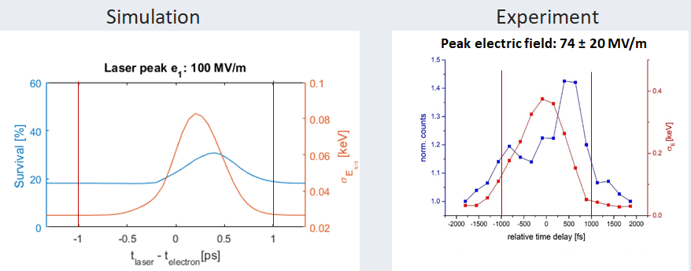
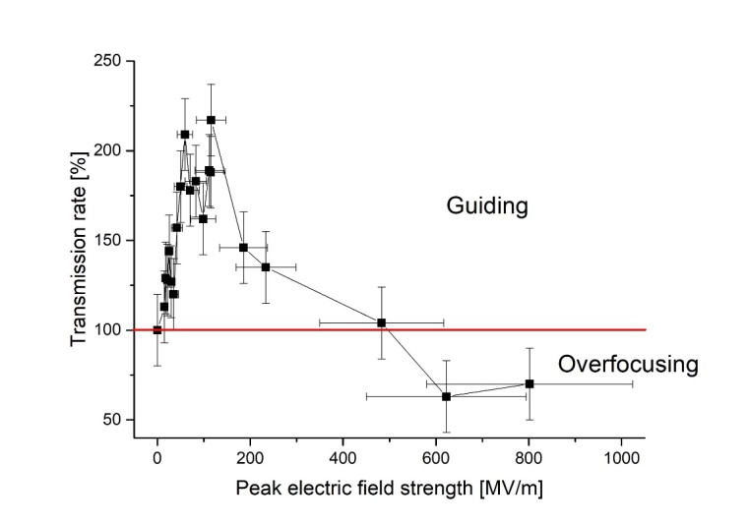
DLA Highlights: Focusing/beam transmission
APF concept (U. Niedermayer et al 2018) tested in 86µm structure (talk J. Illmer)
  Good agreement time delay scan exp vs sim
  Observe significant increase in transmission due to alt phase focusing
  Effect of over-focusing at higher fields also clearly visible
preliminary

Slide 8
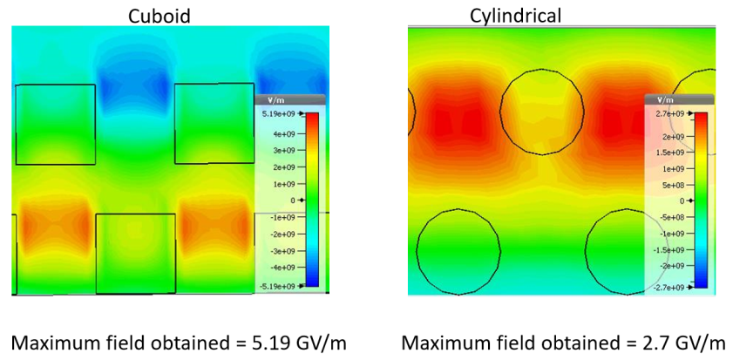
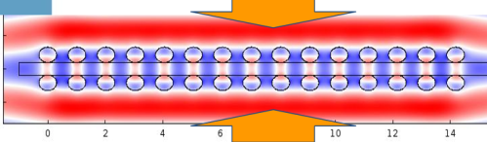
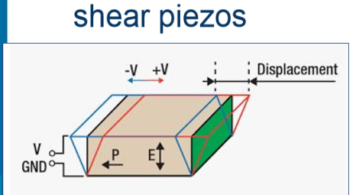
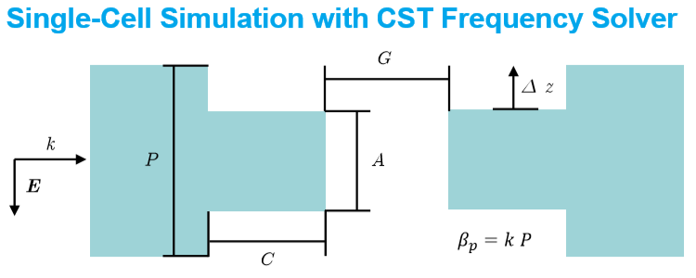
DLA structure design & tolerances
Studies of pillar shape optimization (talk G. Yadav)
  Maximize accelerating field
Structure errors ( talk A. Szczepkowicz)
  Study beam dynamics → beam focusing still present
  Consider piezo elements & feedback systems
Study robustness of structure vs errors w.r.t. coupling (Poster W. Kuropka)

Slide 9
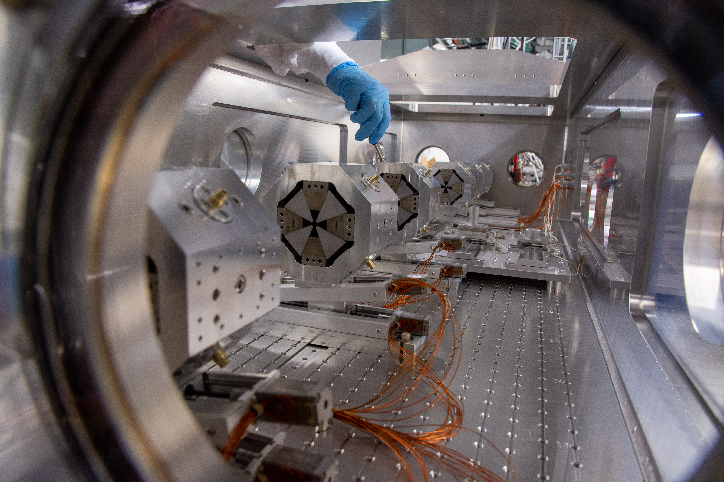
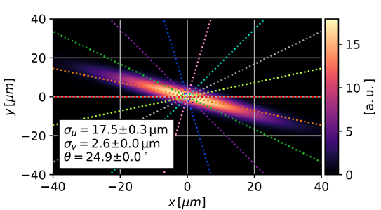
High energy beam experiments with DLA structures
Objectives of high energy beam tests at PSI and DESY:
  Testing DLA with well characterized, well focused, variable charge bunches
  Investigate beam-structure interaction (wakefields)
  And use DLA for manipulating beam for special applications (e.g. microbunching) side remark: not restricted to DLA, also much potential for merging conventional acc with other advanced concepts THz, LWFA, …
Setup at SwissFEL 6GeV beam (talk R. Ischebeck)
  Strong focusing
  Sub-micro meter beam diagnostics
  Beam commissioning started

Slide 10
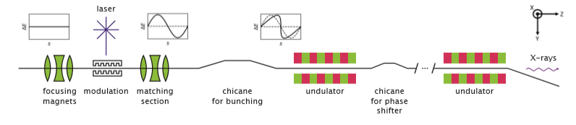
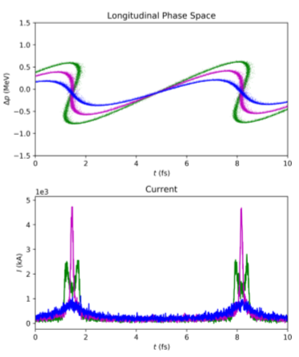
Beam modulation @SwissFEL (Poster H. Benedikt)
Generation of comb of very short micro-bunches of the 6GeV beam

Slide 11
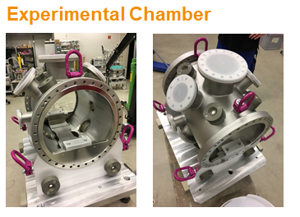
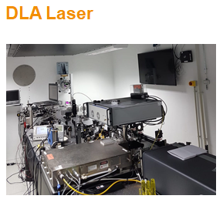
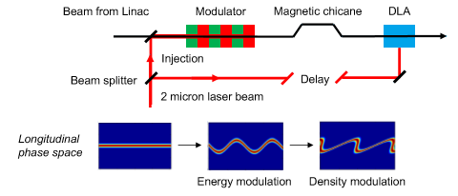
DLA test at SINBAD/DESY
Test setup under construction at 100 MeV ARES linac (Poster F. Mayet)
  Electron beam commissioning starting
  1st experiments by end 2019
  Generation of micro-bunching and phase-stable injection into DLA as 2nd phase of exp

Slide 12
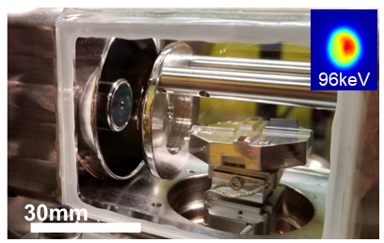
DLA perspectives & challenges
Much progress in ACHIP collaboration with many innovative ideas and concepts (→ inv talk P. Hommelhoff)
Crucial ingredients for building a DLA accelerator are available – make them all work together!
Integration into a working complete compact 1 MeV accelerator (“Shoebox”) under way, short term goal
Mid-longer term development towards applications (talk J. England in WG3-WG4 session) with higher beam energy & intensity

Slide 13
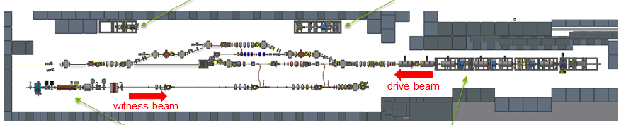
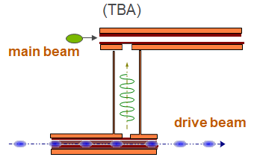
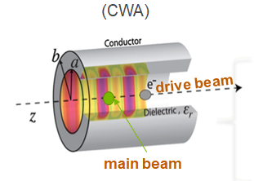
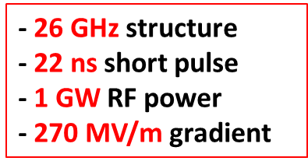
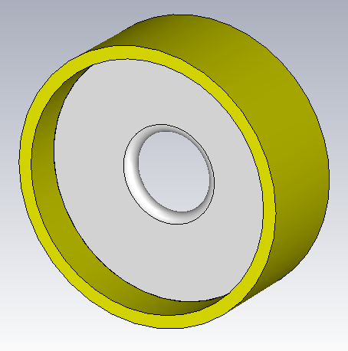
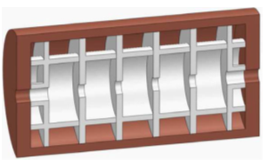
Beam driven dielectric acceleration
AWA facility tailored to beam-driven wakefield acc studies with high drive and witness beam flexibility (talk M. Conde)
  Dielectric structures for TBA and CWA tested
  Recent development: dielectric disk structure (talk A. Kanareykin)
  Planned demonstration of 500 MeV unit with 26 GHz dielectric disc technology
Very high shunt impedance
Short pulse – high gradient

Slide 14
WG3 REPORT: PARTICLE SOURCES, THz AND High gradient technology
Particle sources
    4 presentations (K. Floettmann, J. Scifo, M. Croia, T. Vinatier)
    Oriented to design new generation of compact injectors for ultra high brightness electron sources
    Different type of applications (FEL injectors, UED, etc…)
    Very interesting e-sources with extremely attractive properties (emittance, peak current,…) but, simulation/theoretical results only that need tests, realizations and implementations of most critical components
THz
High gradient/high frequency technology

Slide 15
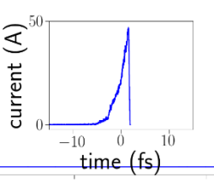
S band gun driven by a compact solid state amplifier (10 kW) CW, high field (100 MV/m) on the cathode (e- initial energy 200 keV)
Tapered DLW (75 GHz, 25 mm) to match the low energy electrons, 100 MV/m
charge: 100 fC, bunch length: (1.6 fs), emittance: 227 nm,energy spread: 59 keV, E≅1 MeV

Slide 16
WG3 REPORT: PARTICLE SOURCES, THz AND High gradient technology
Particle sources
    4 presentations (K. Floettmann, J. Scifo, M. Croia, T. Vinatier)
    Oriented to design new generation of compact injectors for ultra high brightness electron sources
    Different type of applications (FEL injectors, UED, etc…)
    Very interesting e-sources with extremely attractive properties (emittance, peak current,…) but, simulation/theoretical results only that need tests, realizations and implementations of most critical components
THz
    4 presentations (T.H. Pecey, S.P. Jamison, V. Tsakanov, T. Feurer) + 1 poster (P. Musumeci)
    THz generation ⇒ very interesting exp. data but relatively low THz power produced (laser based, beam based CCR, IFEL sources), need for more R&D, charge increase, dielectric structure length, THz transport
    THz acceleration ⇒ very interesting exp. but very low gradient achieved up to now (few MV/m). High power, long and tunable THz pulses not available yet. Critical points related to the match of the group velocity with beam (important for short THz pulses)
    THz longitudinal beam diagnostics (THz deflector) ⇒ extremely interesting and consolidated exp. results with split resonators
High gradient/high frequency technology

Slide 17
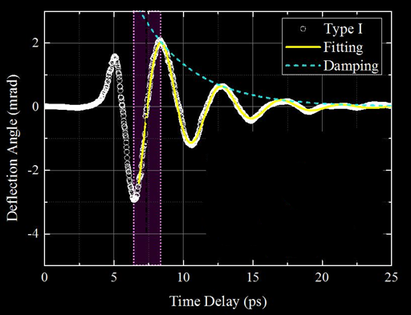
20 MV/m, 0.33 THz, 2 μJ

Slide 18
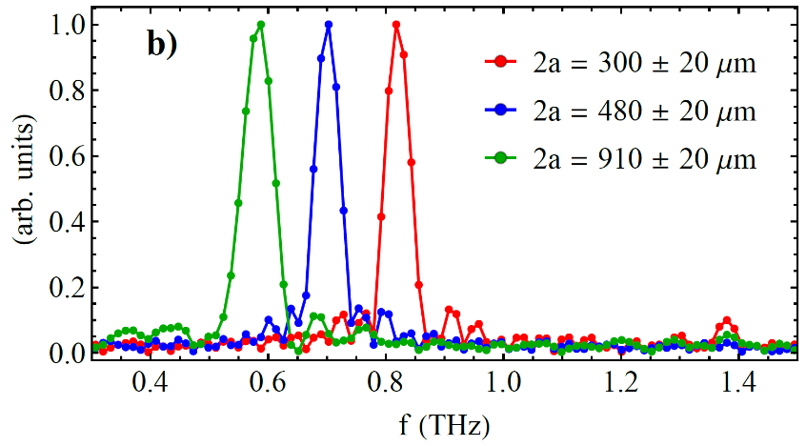
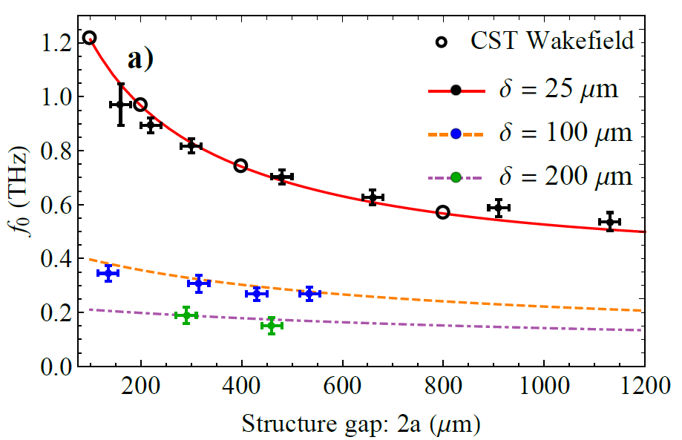
⇒ Coherent Cherenkov radiation enerated in a rectangular dielectric waveguide with variable gap (DWA)
⇒ Demonstrated tunablility across band 0.55 – 0.95 THz
⇒ Single mode operation with negligible excitation of HOMs
⇒ Estimate pulse energy of 0.6 µJ from only 70 pC bunch, at frequency of 0.65 THz

Slide 19
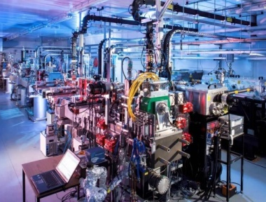
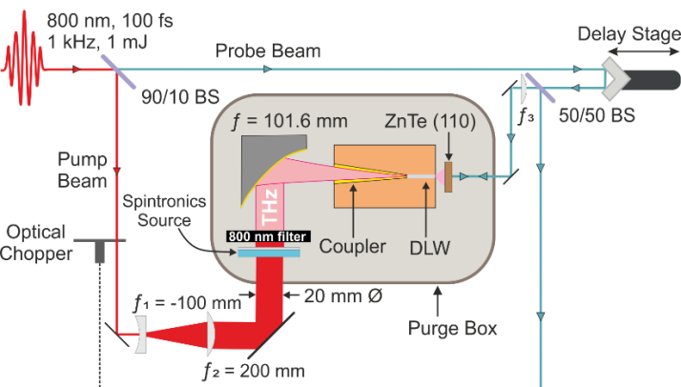
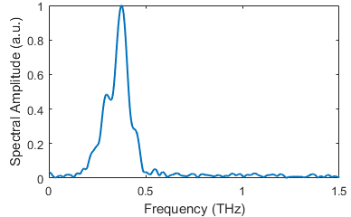
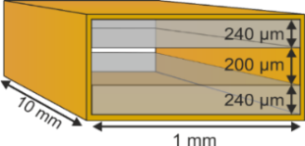
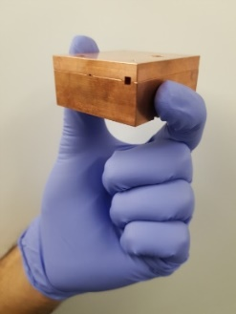
CLARA test facility
Bunch parameters
Energy: ≈ 50 MeV
Charge: 20 – 100 pC
Duration: 0.3 – 6 ps
Spot size: 100 µm
Rep. rate: 10 Hz

Slide 20
WG3 REPORT: PARTICLE SOURCES, THz AND High gradient technology
Particle sources
    4 presentations (K. Floettmann, J. Scifo, M. Croia, T. Vinatier)
    Oriented to design new generation of compact injectors for ultra high brightness electron sources
    Different type of applications (FEL injectors, UED, etc…)
    Very interesting e-sources with extremely attractive properties (emittance, peak current,…) but, simulation/theoretical results only that need tests, realizations and implementations of most critical components
THz
    4 presentations (T.H. Pecey, S.P. Jamison, V. Tsakanov, T. Feurer) + 1 poster (P. Musumeci)
    THz generation ⇒ very interesting exp. data but relatively low THz power produced (laser based, beam based CCR, IFEL sources), need for more R&D, charge increase, dielectric structure length, THz transport
    THz acceleration ⇒ very interesting exp. but very low gradient achieved up to now (few MV/m). High power, long and tunable THz pulses not available yet. Critical points related to the match of the group velocity with beam (important for short THz pulses)
    THz longitudinal beam diagnostics (THz deflector) ⇒ extremely interesting and consolidated exp. results with split resonators
High gradient/high frequency technology
    2 presentations (B. Spataro, L. Faillace) + 1 poster (M. Behtouei)
    Interesting applications of 36 GHz technology to compact LINAC for industrial applications or linearizers
    Simulation/theoretical results only
    A strong R&D is required not only on power sources but also on RF components (circulator are possible at this frequency of operation?
    Other critical points that need R&D: tuning on long structures (bead pull is easy to implement)?), machining tolerances,…

Slide 21
THANK YOU FOR YOUR ATTENTION!

