Slide 1
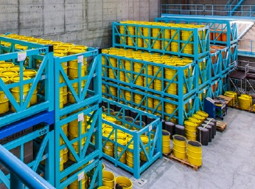
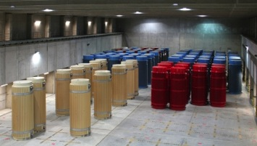




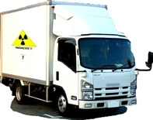
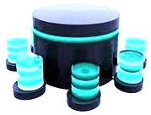
Radwaste Monitoring
P. Finocchiaro
INFN Laboratori Nazionali del Sud, Catania, Italy
Data
Data
data
storage
Data
the DMNR project

Slide 2

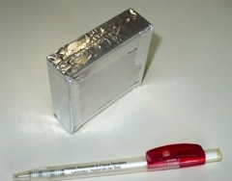
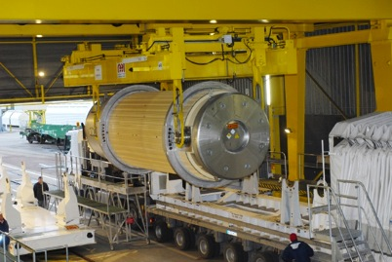
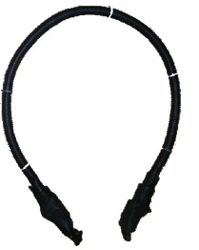
protection of nuclear material
and nuclear facilities
what
why
how

Slide 3

what

Slide 4
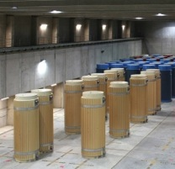
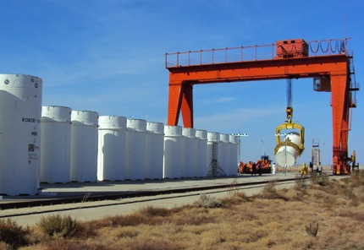
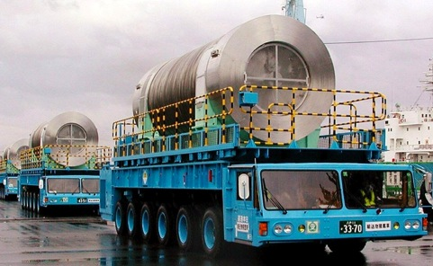


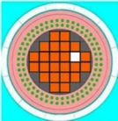

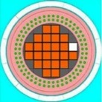
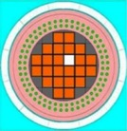
what
storage
handling
transport
inspection
check
security & safety issues:
maintaining the continuity of knowledge (e.g. legacy waste)
checking package integrity

Slide 5
why

Slide 6
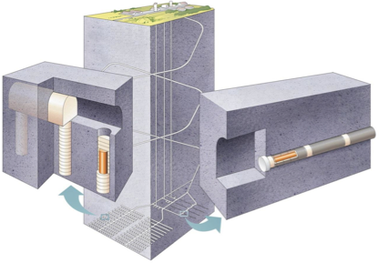
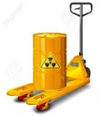



why monitoring? why new tools?
nuclear material lasting hundreds of thousands years
➔ geological repository
but... predisposal & preclosure?
handling, transportation, interim, legacy waste...
➔ inspecting? monitoring?
need to prevent, detect and respond to
theft, sabotage, unauthorized access and illegal transfer
or other malicious acts
conventional methods
new technologies?

Slide 7
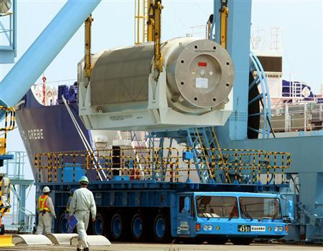

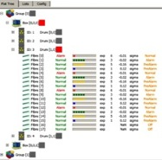


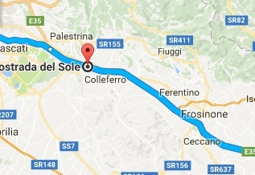
why monitoring?
To have a complete and detailed record of the history of each cask
What would be the goal?
individual and continuous online monitoring of casks
to improve safety, security, transparency

Slide 8
Why monitoring?
WIPP
Waste Isolation Pilot Plant
14-Feb-2014 New Mexico
Could individual online monitoring have prevented
or limited the accident?

Slide 9
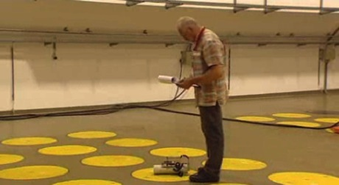
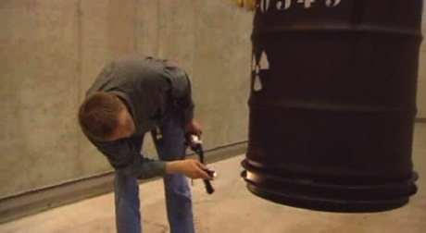
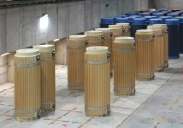
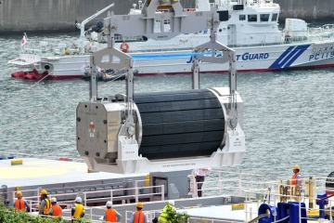
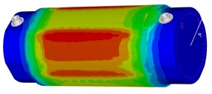
Why (online) monitoring?
minimizing direct
human intervention
(accidents, mistakes, malicious acts)
monitoring in place and/or during transportation
detecting possible diversion from casks
preventing illicit trafficking

Slide 10
how

Slide 11
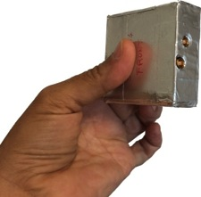
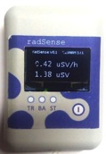
how
low-cost linear gamma ray counter
low-cost
thermal neutron counter
miniature low-cost
gamma ray spectrometer / dosimeter

Slide 12
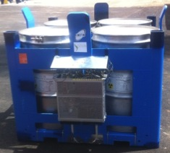





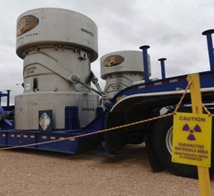
how
in place
counters
local Data Base
LAN
wireless
remote Data Base
in place
counters
IAEA
transport
counters
control
authorities
organizations
nuclear
material
data acquisition
and control
local wireless and LAN
global WAN

Slide 13
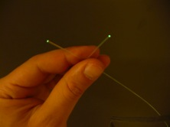
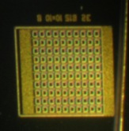
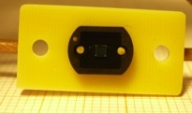
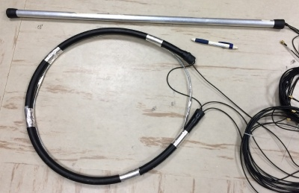

how
low-cost linear gamma ray counter
SiPM
scintillating fiber + 2 SiPM
1 mm
low voltage (30V)
high gain
1÷2m long
  radiation hard
  flexible
  robust
  reliabile
  easily handled
  low cost
developed with the support of
Ansaldo Nucleare

Slide 14
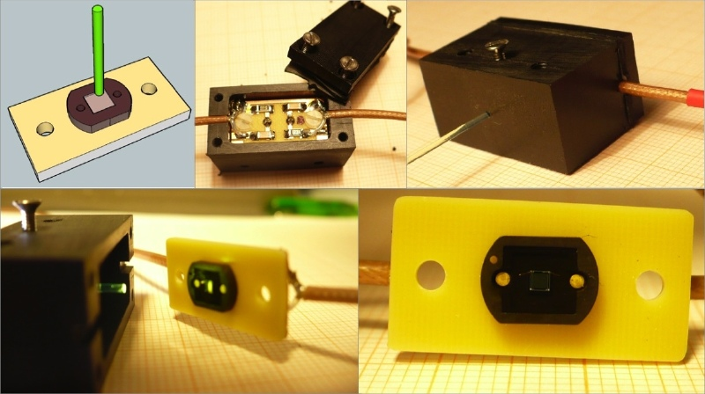
how

Slide 15

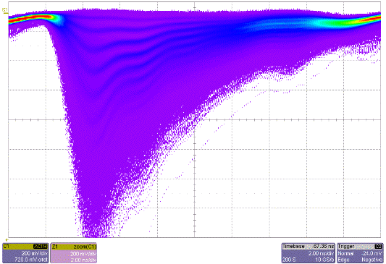
how
Photon
Radiation
1 mm x 1 mm
SciFi
SiPM
SiPM
Silicon PhotoMultiplier
array of photodiodes biased beyond breakdown (Geiger mode)
the avalanche is quenched by means of integrated resistors
sensitive to single photons
Coincidence
output
whenever radiation stimulates the fibre, a tiny light pulse is produced, and the SiPM is capable of detecting it
1-cell ⇒ charge = k
n-cells ⇒ charge = nk

Slide 16
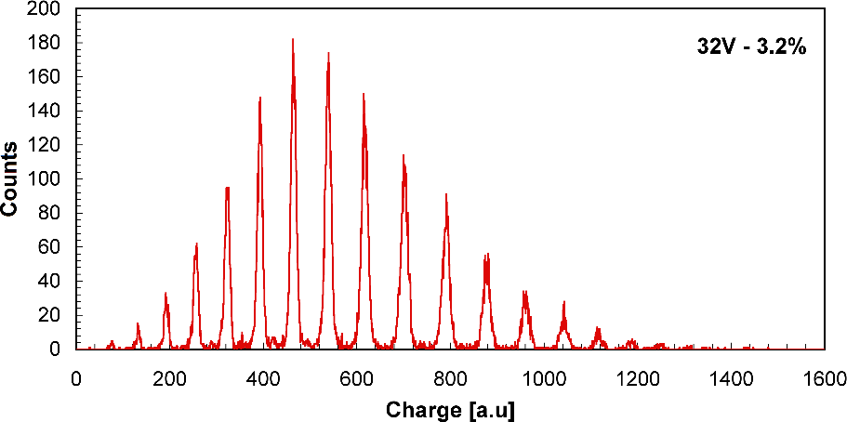
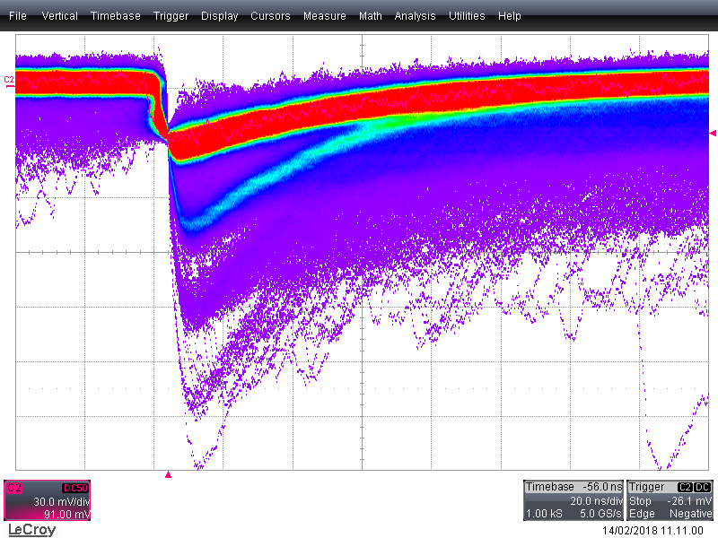
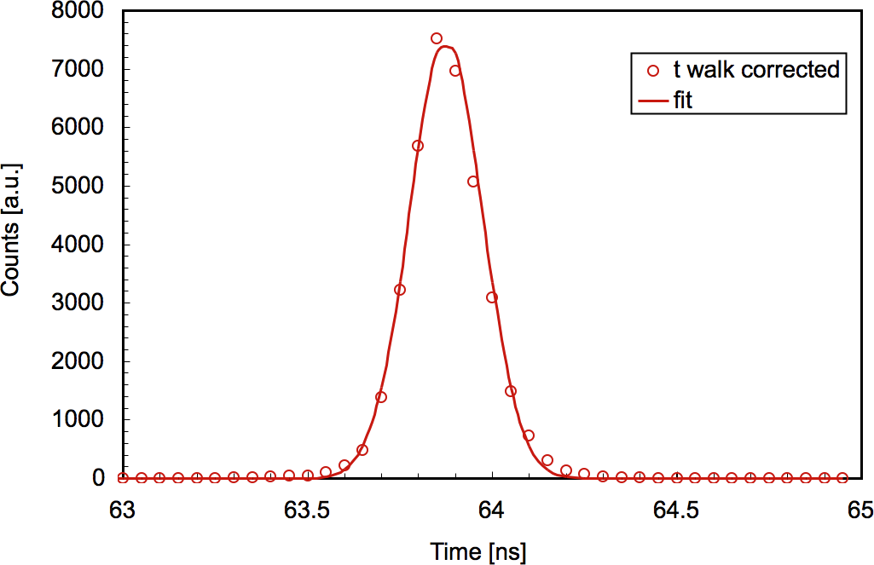
how
7
8
illuminated with laser light
operated at 32V
resolving power >100
6
9
low bias voltage (≈ 30V)
high physical amplification (gain)
1 photon gives rise to
a signal of ≈10⁶ electrons
10
5
11
4
12
3
13
14
1
2
15
16
measured charge Q (from QDC)
time resolution
<100ps
(not needed for this application)
1-4 photons
t_{rise} ≈ 10 ns

Slide 17
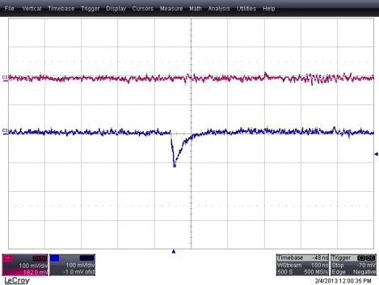
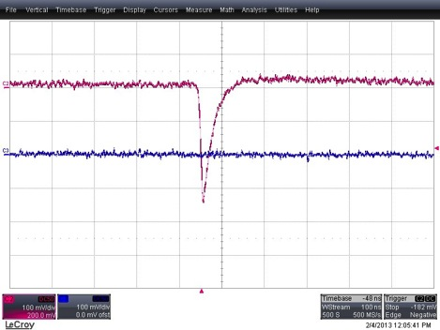
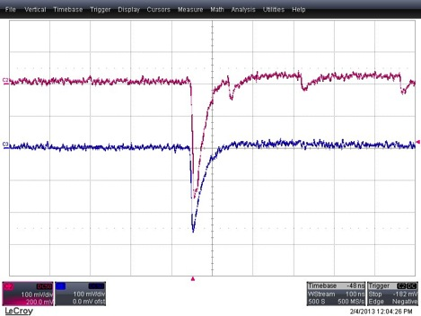
how
One-SiPM light spectrum
threshold
counts
we count the number of events (i.e. tiny light flashes) in the fiber in a given time interval
4
5
6
7
8
9
10
11
12
13
14
15
16
number of photons
left only: noise
right only: noise
left + right: signal

Slide 18
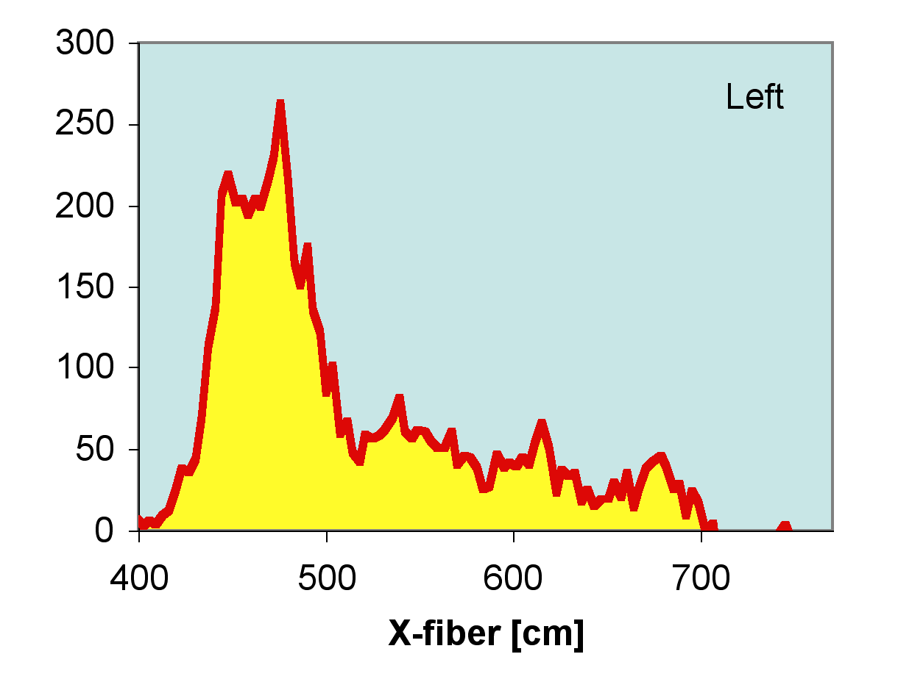
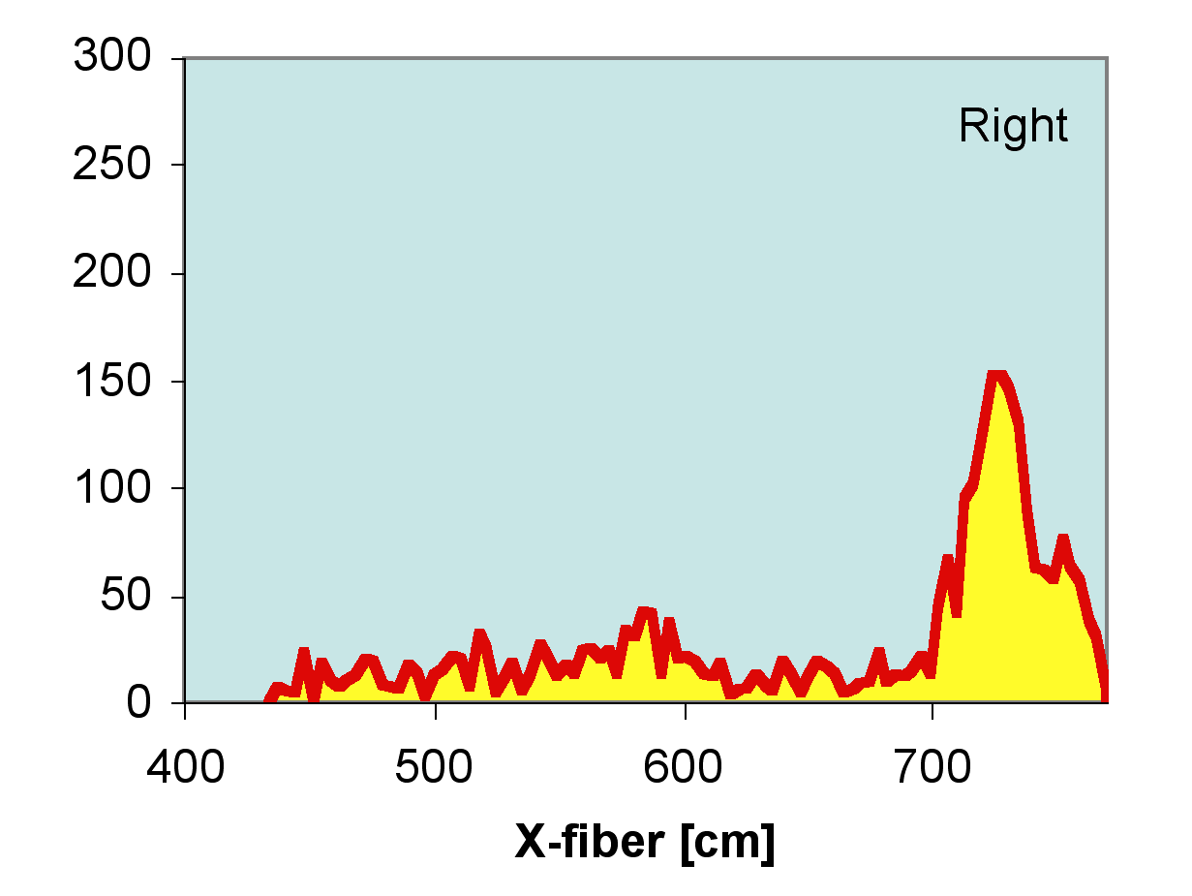
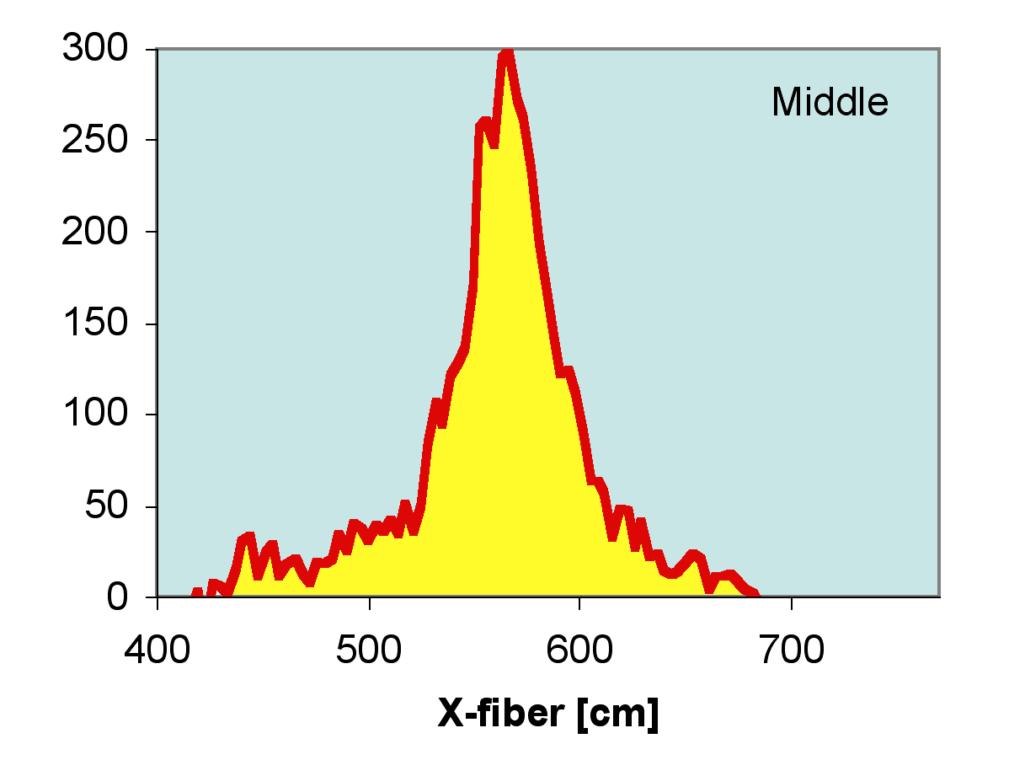
but... do we actually detect gamma rays?
Counts [a.u.]
Counts [a.u.]
YES! Tests with ⁶⁰Co source in 3 positions along the fiber
Counts [a.u.]
the half-difference between the left and right arrival times provides the impact coordinate

Slide 19
#photons in one SiPM
in coincidence
with the other one
how
energy deposited in the fiber:
≈ constant above 500keV
1m long fiber: uniform efficiency
2.5m long fiber: good efficiency,
not uniform

Slide 20
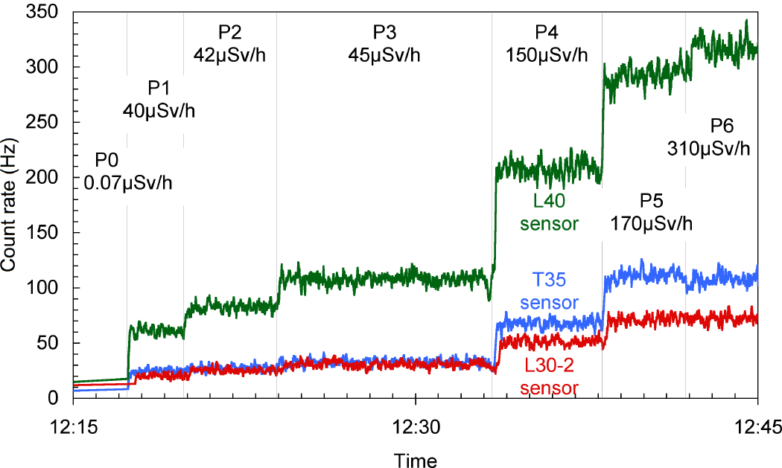
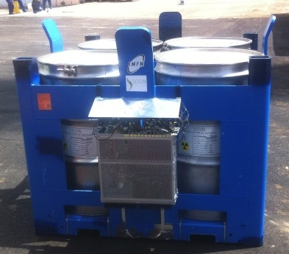
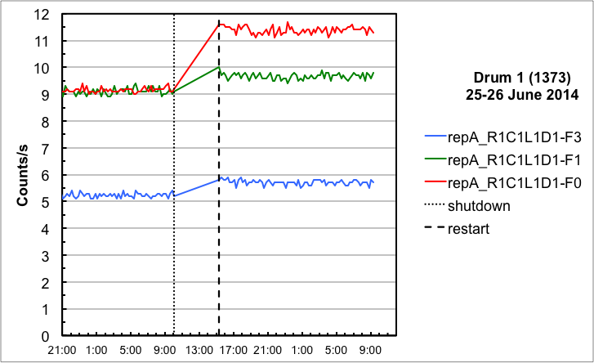

how
low-cost linear gamma ray counter
tested with ILW at
decreasing distances
tested with LLW
for three months
tested in collaboration with SOGIN

Slide 21

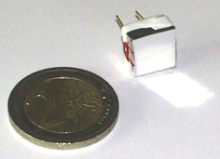
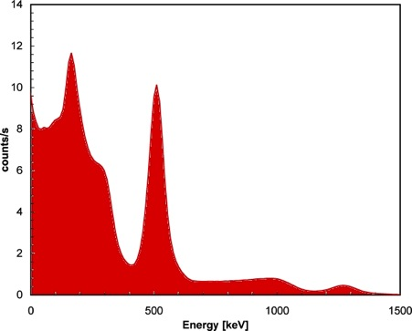








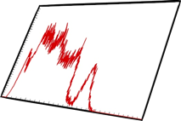



how
miniature low-cost gamma ray spectrometer / dosimeter
equipped with
test with ²²Na
radioactive source
developed by Wisnam
under INFN license

Slide 22
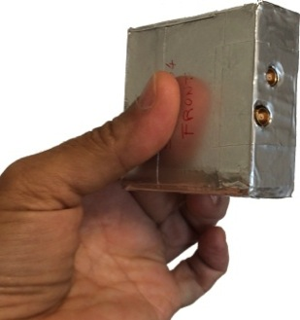
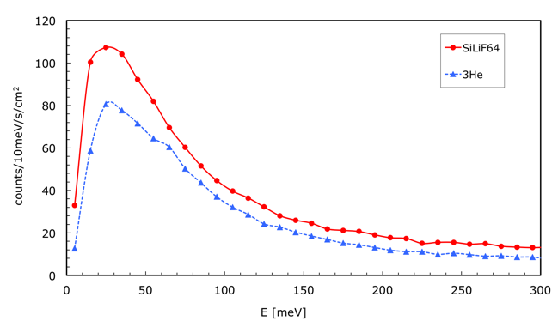

how
low-cost thermal neutron counter
solid state (Silicon + ⁶LiF)
this sample 3cm x 3cm
also available 5cm x 5cm
low cost technology, cheaper than ³He
low voltage (25 V)
compact, robust, manageable
good detection efficiency (5 ÷ 10%)
SiLiF
optimum gamma discrimination (<10⁻⁸)
³He tube
tested and in use at neutron
beam facilities
nTOF at CERN and ISIS at RAL
partly supported by JRC Ispra

Slide 23


materials for thermal neutron conversion
³He
σ(0.025)
≈ 5330 b
available energy
0.76 MeV
no gamma rays
⁶Li
perfect gas detector but... worldwide lack of ³He
σ(0.025)
≈ 940 b
available E
4.78 MeV

Slide 24


slow-neutron detection
cross section ≈ proportional to 1/v
the longer the transit time, the higher the capture probability
thermal 0.025 eV
large cross section for slow neutrons

Slide 25

neutron detection
⁶Li – natural abundance: 7%
Si + ⁶LiF (enriched at @95%)
a ⁶LiF converter
captures a neutron...
n
⁶Li
⁷Li
⁴He
³H
2.05 MeV
2.73 MeV
...and produces ⁴He ed ³H
which can be detected

Slide 26





⁶LiF
SiLiF technique
⁴He
n
⁷Li
⁶LiF converter
⁶Li
³H
triton detection
double-sided
silicon detector
alpha detection
⁴He
⁶LiF converter
n
⁷Li
⁶Li
³H
⁶LiF

Slide 27



3cm x 3cm silicon pad
+ ⁶LiF converter
neutron detector

Slide 28


Slide 29






how
radiological characterization
storage & monitoring
via a sensor network
= fingerprinting
transport
neutrons and gamma rays convey information from the inside
an unexpected change in counting rate is an indication of anomaly

Slide 30













Nuclear
Power Plant
Temporary
Storage
Interim
Storage
Processing
Disposal
nuclear fuel
direct disposal
recycled
nuclear fuel
wet
storage
deep
geological
disposal
dry
storage
temporary
storage
treatment
reactor
Spent Fuel Management Cycle
transport
monitoring
in place
monitoring
intermediate
depth
disposal
partitioning
(& transmutation)

Slide 31






Conclusion
the deployment of many compact low-cost radiation sensors
for in-place and transport monitoring of nuclear material
can improve
trust
public acceptance
reliability
accident prevention
safety
security
and help preventing and detecting
theft, sabotage, unauthorized access and illegal transfer
or other malicious acts
new technologies provide viable solutions
for full continuity of knowledge

Slide 32

Thank you
FINOCCHIARO@LNS.INFN.IT
Catania and the Etna volcano

Slide 33




now the Excel exercise
and then the scintillation signals

