Slide 1
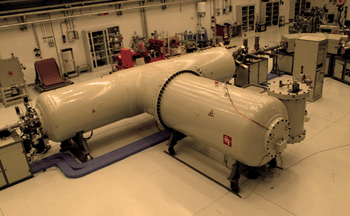
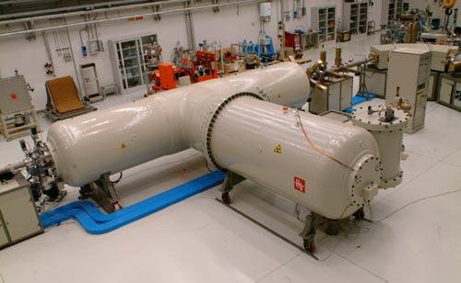



How a small accelerator can be useful for interdisciplinary applications.
Part I: the study of air pollution
Franco Lucarelli
Department of Physics and Astronomy, University of Florence
and I.N.F.N. - Florence
Notes:
<numero>

Slide 2
Overview of my talk
Short History of LABEC
I IBA Techniques: principles
SShort introduction to particulate matter (what it is,
influence on climate, health, cultural heritage…)
Why IBA in aerosol studies
Specific set-up and experimental developments
Examples of applications
Notes:
<numero>

Slide 3

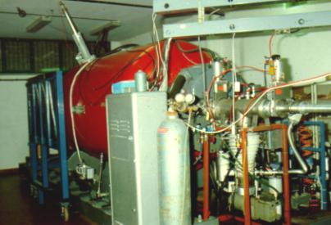
In Florence....
Long-time tradition with PIXE (and IBA in general) applied to Cultural Heritage and Environment
This activity started in the middle of the Eighties with an old Van de Graaff single-ended accelerator...
Until mid 1980’s a local activity of nuclear physics with the 3 MV van de Graaff accelerator
From mid 1980’s its “research goals” were changed to applications, mainly Ion Beam Analysis, IBA (mostly Particle-Induced X ray Emission, PIXE)
Notes:
3

Slide 4
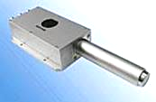

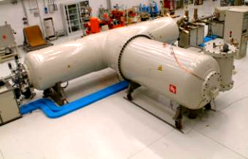
Ion Beam Analysis (IBA)
Material composition analysis through beam particle bombardment
typically proton or alpha beams at some MeV energy
radiation detection and spectral analysis
emission of radiation of characteristic energies (X-rays, γ-rays, particles…)
particle beam
particle accelerator
<numero>
Notes:
3

Slide 5
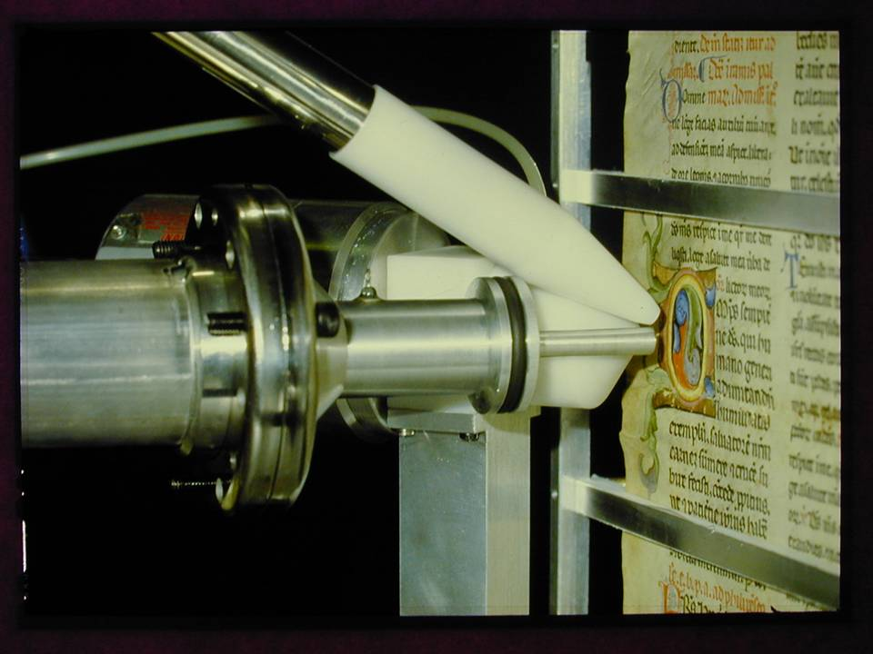
Notes:
<numero>

Slide 6
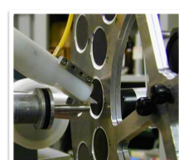
Study of air pollution due to particulate matter
Notes:
<numero>

Slide 7
2002-2003
move of the Physics Department to the new campus in Sesto Fiorentino
INFN and University create a new lab
new 3 MV Tandetron, designed from the beginning to perform both IBA and Accelerator Mass Spectrometry (AMS)
The new laboratory, LABEC, is operational in May 2004
Notes:
Because of our long experience and reputation , ….
<numero>

Slide 8
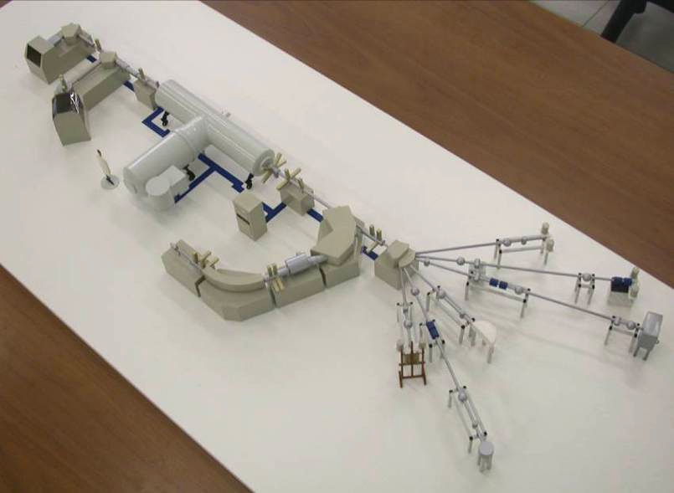
The Tandetron facility at LABEC
3 MV Tandetron
external beam
(Environment)
IBA dual
source
external
micro-beam
multi-sample
AMS source
high-energy
AMS
spectrometer
external beam
(Cultural Heritage)
chopped beam line
multi-angle scattering chamber
multipurpose IBA vacuum chamber
Notes:
<numero>

Slide 9
Activities at LABEC
technological developments (electronics and process automation, data acquisition systems, detection setups, further beamlines)
methodological developments (test of new ideas for application procedures)
measurements in the framework of both:
interdisciplinary research projects in collaboration with other Institutions (CNR, Cultural Heritage safeguard Institutions, Environmental Protection Agencies, IAEA) and University Departments other than Physics Dpts
“internal” collaborations supporting other nuclear physics groups (detector tests, radiation damage measurements, etc.)
Notes:
This is an import part of our activity.
<numero>

Slide 10
25-30% AMS
30% IBA aerosol
30-35% IBA for Cultural Heritage and other applications
10% neither AMS nor IBA
Beam time
Notes:
<numero>

Slide 11
Ion Beam Analysis (IBA)
X-rays PIXE
Gamma-rays
PIGE
MeV ion beam
Charge collection IBIC
Transmitted ions On axis STIM
and
Oﬀ axis STIM
Backscattered ions RBS and Channeling
Ion induced ﬂuorescence
Nuclear reactions NRA
Recoiling target atoms ERDA
Multi-elemental (ftom H to U)
Non destructive
Sensitive to trace elements (µg/g)
Quantitative (few %)
Depth profile
Surface analisys (up to 1-50 µm)
Microanalisys (lateral resolution <1 μm)
Compositional 2D Maps

Slide 12




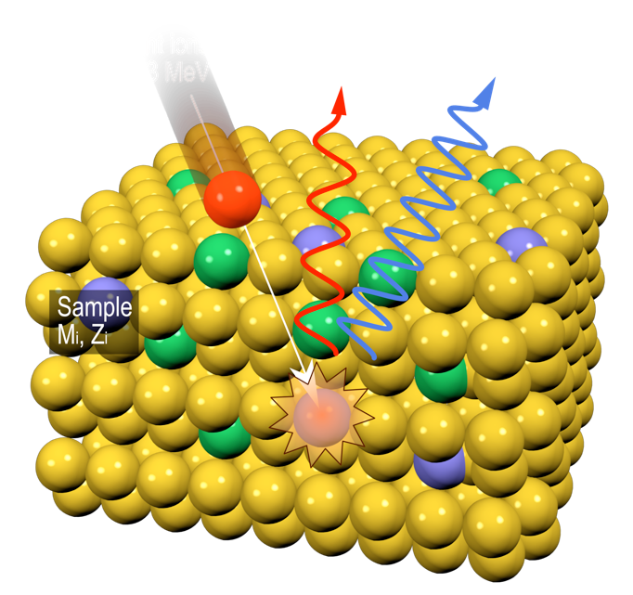


PIXE / PIGE
Proton Induced X-ray / Gamma-ray Emission
Emission of characteristic X-rays due to the ionization induced by the beam
“Prompt” emission of gamma rays during the beam bombardment
Li, B, F,
Na, Al...
Z>10

Slide 13
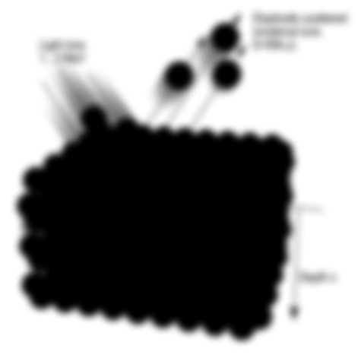
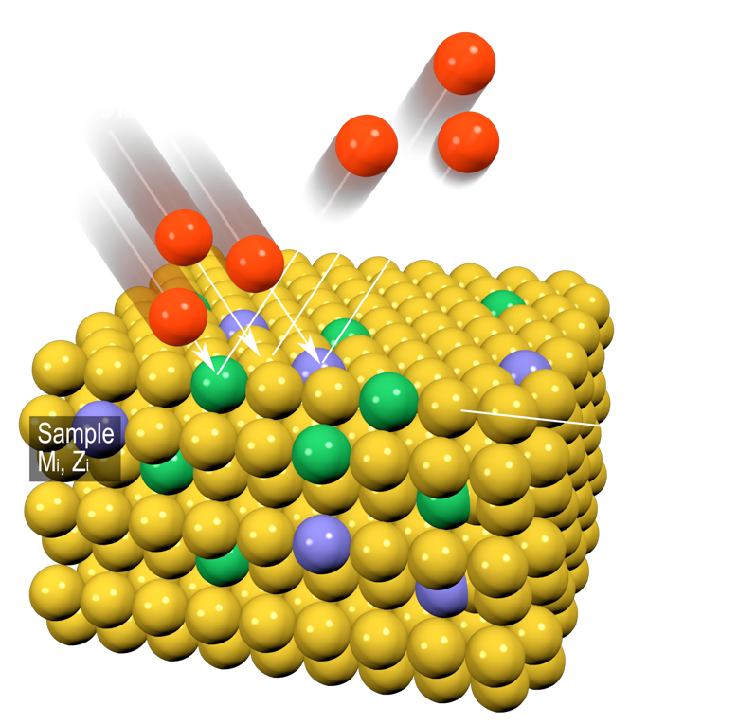
RBS
Rutherford Backscattering Spectrometry
Back-scattering of the ions of the beam after the elastic scattering with the taget nuclei
A>Ap

Slide 14


RBS
Rutherford Backscattering Spectrometry
•
Signal position (information on the mass A)
Signal width (information on depth profile/thickness)
Signal height (information on element concentration)
H₂
•
ΔE₂
H
1
ΔE₁
•
K₂E₀
K₁E₀

Slide 15


PIXE
(Particle Induced X-ray Emission)
Protons 1-3 MeV
Characteristic X-ray
The energies of the electrons in the different atomic levels are characteristic of each atomic species.
Thus, also the differences between them, the X-ray energies, are characteristic of the atomic species from which they are emitted.
The detection and classification of the X-ray energies allows to identify and quantify the different elements present in the target sample
Gamma-ray
Sample M,Z
2000
Si
3000
S
2500
Fe
PIXE spectra of PM10 on Teflon collected in an industrial area (Montelupo Fiorentino).
1600
Counts/μC
1200
Counts/μC
2000
1500
Ca
As + Pb
800
Na
Cl
Ca
Zn
Mg
Al
1000
400
Ar K
Ca
Cu
500
Fe
Zn
Br
Ca
Ar
K
Ti
V Cr
Mn
As
Pb
0
0
1
2
3
Energy (keV)
4
5
0
2
3
4
5
6
7
8 9 10
Energy (keV)
11
12 13 14

Slide 16


Atomic Transitions
Energy levels of core electrons
Livelli energetici degli elettroni orbitali
N shell
M shell
n=2
L shell
n=1
} subshells
Lα Lβ
Lγ
K shell
n=0
Lη
Kα Kβ
L lines: filling vacancies in the L shell
K lines: filling vacancies in the K shell
Linee L: riempimento lacune nella
shell L
Linee K: riempimento lacune nella shell K
Lα : Lβ ~ 2:1
Kα : Kβ ~ 6:1

Slide 17

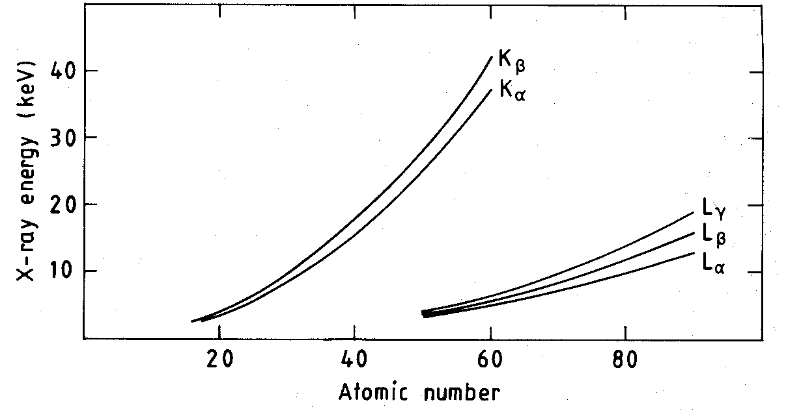
Characteristic X-ray Energies
Legge di Moseley:
E = K⋅(Z - b)²

Slide 18



X-RayCross Sections
σ
σ
σ

Slide 19


Advantages and limitations of PIXE analisys
No information on organic components
No information on chemical bonds
No information on depth profile
Possible self-absorption of low-energy X.rays inside the sample itself
Rapid, highly sensitive, non destructive
Quantitative analisys
All the elements from Na to U are detected simultaneously
Can be performed out of vacuum (external beam set-up)

Slide 20


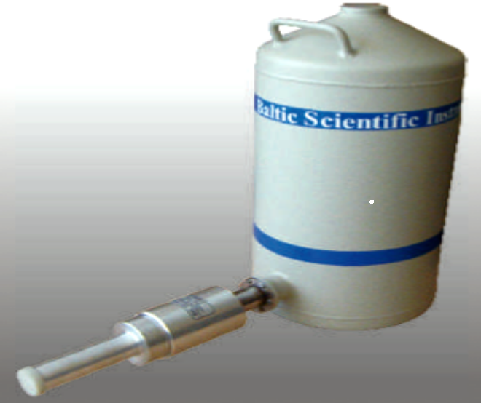
Typical PIXE detectors
Silicon Drift Detector (SDD)
• Active area: 7 - 100 mm²
• Thickness: 300 - 450 μm
• Energy resolution <140 eV
• High count-rate (100 kHz)
• Peltier cooling (-10, -20 °C)
Lithium-drifted Si / Ge, Si(Li) / Ge(Li)
• Active area: 10 - 100 mm²
• Thickness: 3 - 5 mm
• Energy resolution <180 eV
• Liquid N2 cooling (77 K)
• Ge(Li): high-Z material, but “escape peak”

Slide 21
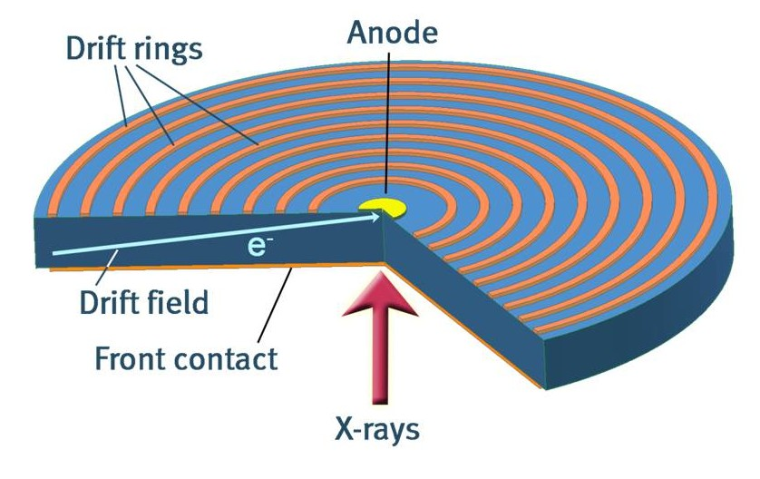
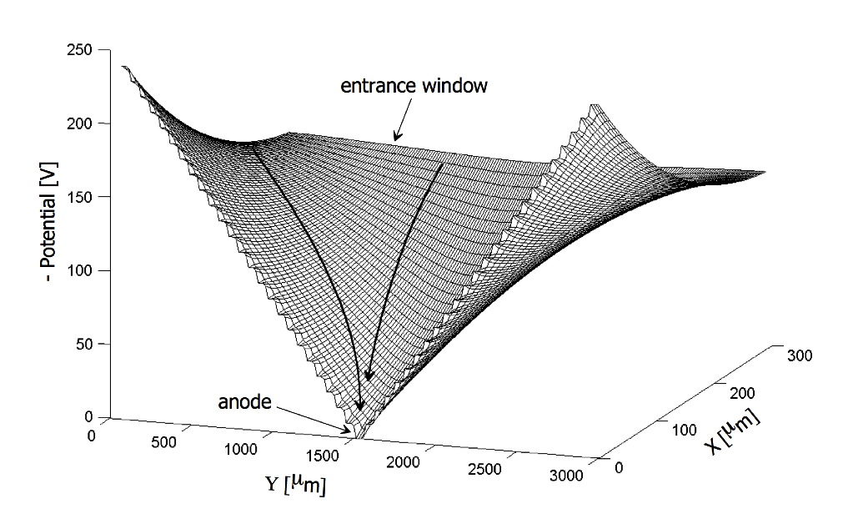
The working principle of Silicon Drift Detectors
The Silicon Drift Detector (SDD) was first proposed in the early '80s by Emilio Gatti and Pavel Rehak [Gatti & Rehak, NIM 225 (1983) 608] as a position sensitive semiconductor detector for high energy charged particles, based on a novel charge transport scheme where the field responsible for the charge transport is independent of the depletion field
Typical SDD voltages: Ring-1 = -20 V ± 5 V Ring-X = -130 V ± 20 V Back = -60 V ± 5 V
Schematic diagram of the Silicon Drift Detector for X-ray spectroscopy with radiation entrance window of the detector consisting of a continuous shallow p+ implant
Energy potential for electrons inside a SDD with homogeneous entrance window.

Slide 22
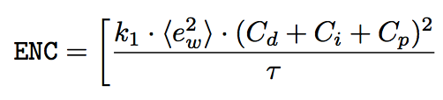
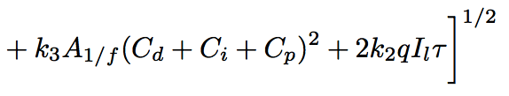
The SSD for X-ray spectroscopy
The SDD is employed in high-resolution X-ray spectroscopy because of the low capacitance of the collecting electrode (0.5-1 pF/cm²) and the low leakage current (1-2 nA/cm² at room temperature) resulting in improved energy resolution
SDD Roentec 10 mm², 0.3 mm
1000
220
T = –27.5°
T = –20°
T = –10°
Ambient T
SDD Si(Li)
800
Energy resolution
FWHM (eV)
200
FWHM (eV)
140-160 eV 180-200 eV
600
Shaping time
1 μs
6 μs
180
Sustainable count-rate
50 kHz
5 kHz
400
160
Cooling
-10/-20 °C -195 °C
0.0
0.5
1.0 1.5
Shaping time (usec)
2.0
2.5

Slide 23
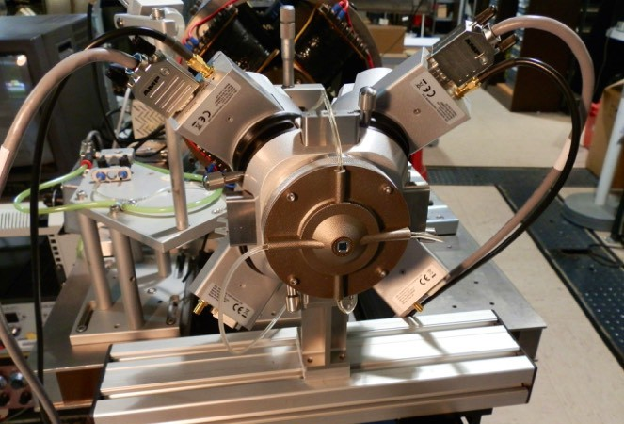


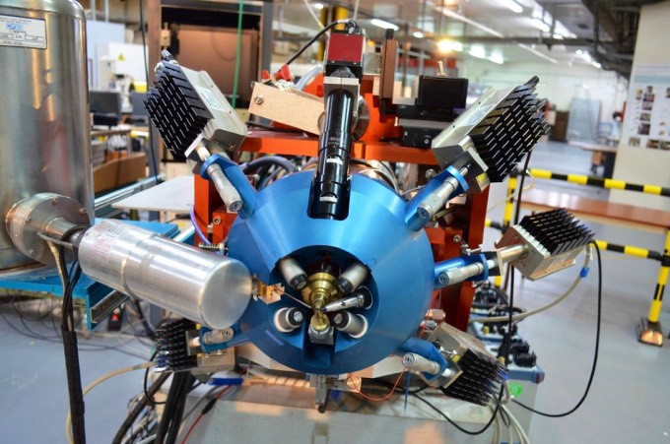
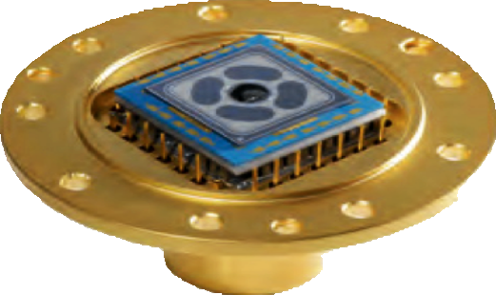
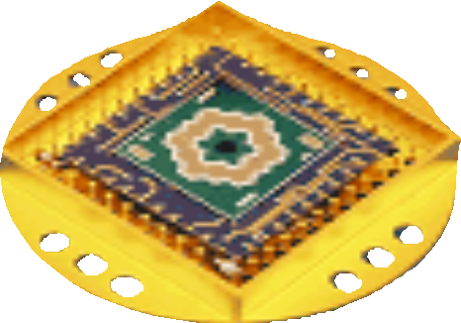
Large area SDD
A single SDD with active area up to 150 mm² is now commercially available (Ketek Gmbh)
Larger areas can be obtained using arrays of individual systems or integrated multi-channel SDDs
4-channel SDD (30 mm² each) PIXE system at Surrey Ion Beam Centre(SGX Sensortech, UK)
Ring-shaped multi cell SDD with 12 x 5 mm² hexagonal cells (PN Detectors, Germany)
Multi SDD PIXE system (1 low and 4 high energy), total solid angle 500 msr, at AGLAE, Paris (Ketek Gmbh, Germany)

Slide 24


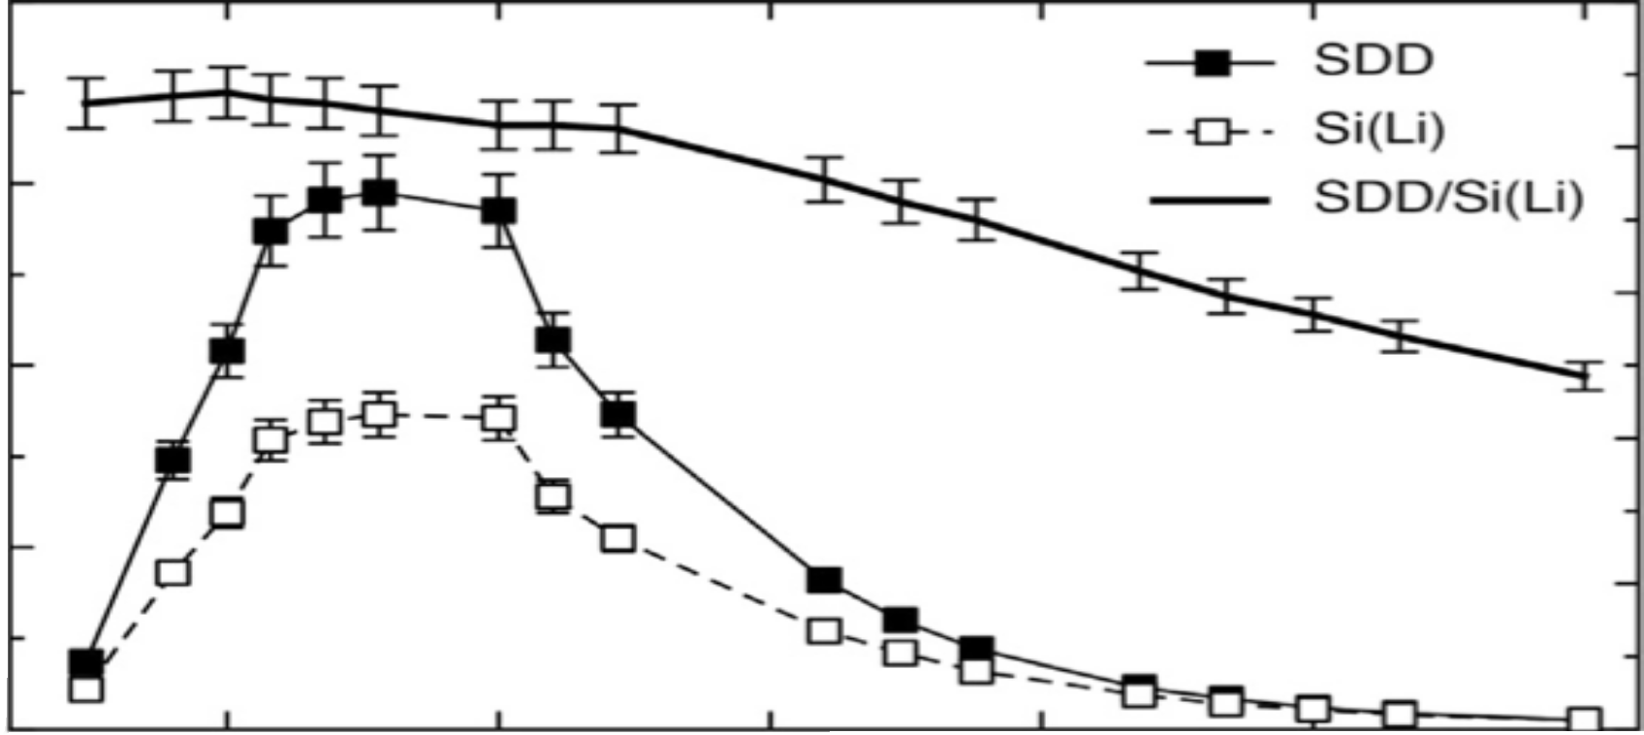


















Sensitivity curve for large area SDD and Si(Li)

Slide 25


Backscattered protons effects on SDD
PIXE detectors with thin entrance window used in presence of a large backscattered protons flux from the sample can suﬀer unrecoverable damages (long-term eﬀects) and worsening of the energy resolution under beam irradiation (short-term eﬀects)
2000
57_{Co}
T = -11 °C
(eV)
1600
FWHMnoise ^{α τ1/2}
FWHMnoise
1200
800
After irradiation with 10¹¹ protons/cm² of 2 MeV
400
0
0.5
1 1.5
^{τ} (^{μ}sec)
2
2.5
300
250
3 MeV protons on Mn/6.3 μm Mylar
FWHM (eV)
200
150
100
8 μm Be
8 μm Be + 125 μm Mylar
50
0
0.0
0.5 1.0 1.5
X-ray count rate (kHz)
2.0

Slide 26
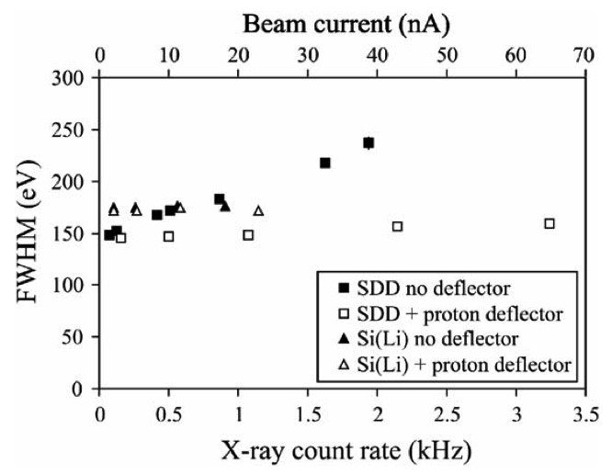

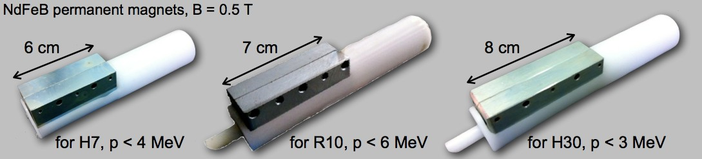
Magnetic proton deflector
The use of a properly designed magnetic deflector to filter out the backscattered protons without substantial limitations to the SDD intrinsic eﬃciency at low X-ray energies is mandatory to prevent any long-term damages and to avoid the worsening of the energy resolution

Slide 27























































Quantitative analysis
(thin target)
Y₀(Z) = N_{P}⋅N_{Z}⋅t⋅σ_{Z,E0}⋅(α_{Z}⋅ε_{Z}⋅ΔΩ/4π)
Y₀(Z) = (Q/e)(N_{A}/A)(ρ_{Z}t)⋅σ_{Z,E0}⋅(α_{Z}⋅ε_{Z}⋅ΔΩ/4π)
η_{Z} = (1/e)(N_{A}/A)⋅σ_{Z,E0}⋅(α_{Z}⋅ε_{Z}⋅ΔΩ/4π)
Y₀(Z) = η_{Z}⋅Q⋅(ρ_{Z}t)
(ρ_{Z}t) = Y₀(Z) / (η_{Z}⋅Q)

Slide 28




















Quantitative Analisys by comparison with certified reference standards
Sample Standard
Y₀(Z)camp = η_{Z}⋅Qcamp⋅(ρ_{Z}t)camp Y₀(Z)std = η_{Z}⋅Qstd⋅(ρ_{Z}t)std
(ρ_{Z}t)camp = (ρ_{Z}t)std ⋅[Y₀(Z)camp/Y₀(Z)std ]⋅(Qstd/Qcamp)

Slide 29
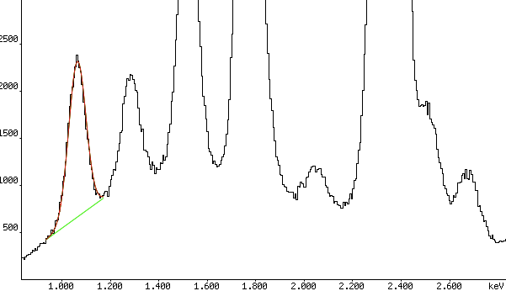
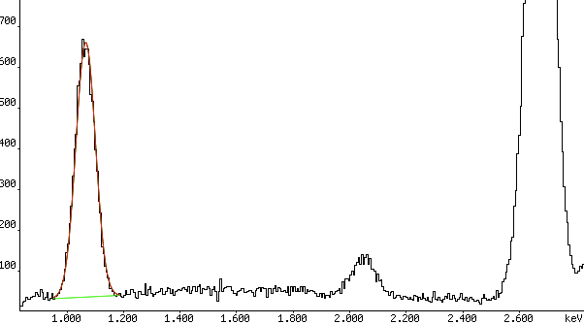
Example of PIXE quantitative analysis for thin target (1)
ANa,camp = 25858 ± 396
ANa,std = 9581 ± 132

Slide 30
Example of PIXE quantitative analysis for thin target (2)
Some corrections must be introduced
Y₀(Z) = A_{Z} ⋅1/(1-DT)⋅1/(1-PU)
Pile-Up correction
X-ray Peak Area
Dead Time Correction

Slide 31
Example of PIXE quantitative analysis for thin target (3)
ANa,camp = 25858 ± 396
DT = 0.077 (7.7%)
PU = 0.000
Y0(Na)camp = 28001 ± 429
ANa,std = 9581 ± 132
DT = 0.015 (1.5%)
PU = 0.000
Y0(Na)std = 9727 ± 134

Slide 32

Example of PIXE quantitative analysis for thin target (4)
aerosol sample PM2.5 standard NaCl (51.7 μg/cm²)
Y0(Na)camp = 28001 ± 429 cts
Qcamp = 5.37 ± 0.05 µC
Y0(Na)std = 9727 ± 134 cts
Qstd = 0.160 ± 0.002 µC
(ρt)Na,std = 51.7⋅[23/(23+35.5)]
= 20.3 ± 1.0 µg/cm²
(ρt)Na,camp = 20.3⋅(28001/9727)⋅(0.160/5.37) = 1.74 ± 0.10 µg/cm²

Slide 33
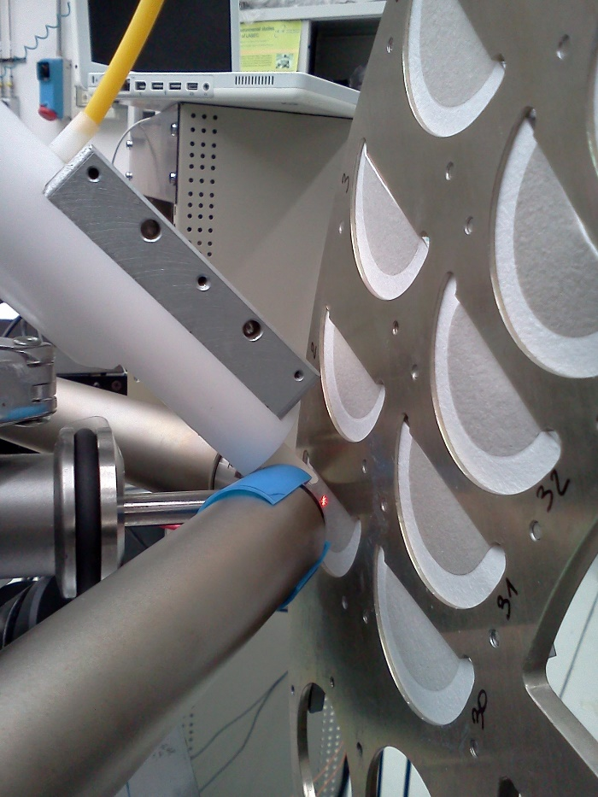
External Ion Beam
We do not perform the measurements in vacuum!
We use an external ion beam

Slide 34
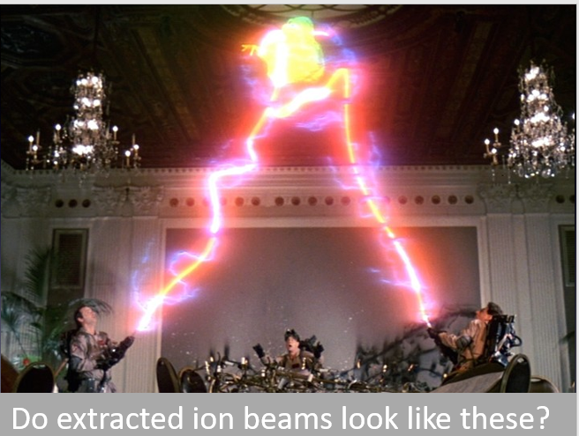
Do extracted ion beams look like these?

Slide 35
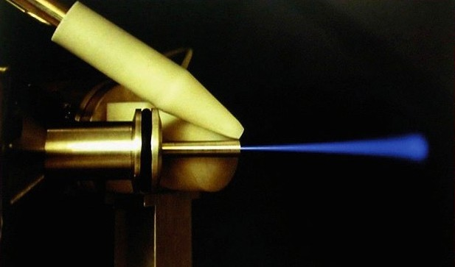
External ion beam

Slide 36
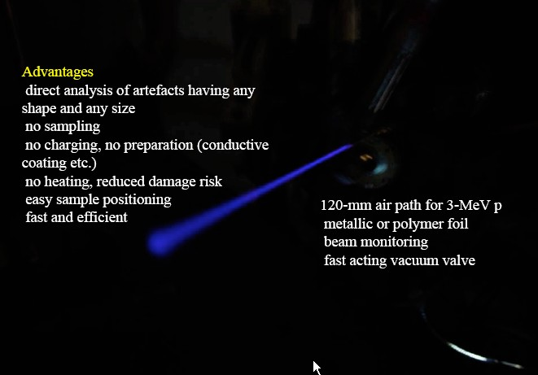
External ion beam

Slide 37
External ion beam
Disadvantages energy loss energy straggling
beam lateral spread x-ray attenuation
The use of an helium fllow is recommended for PIXE

Slide 38
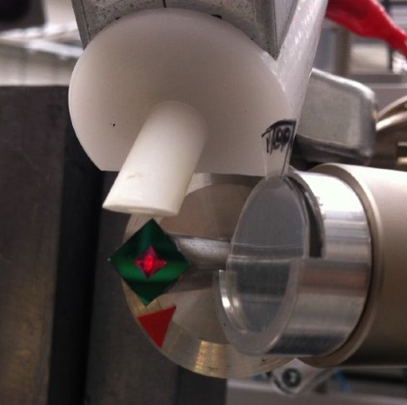
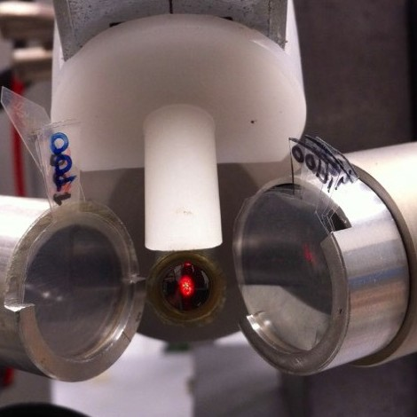
Typical extraction windows
0.5 μm Si3N4
7.5 μm Upilex
Material | Thickness (μm) | ΔE (keV) | σE (keV) | σθ (μm/mm)
Kapton | 8 | 130 | 9 | 6
 | 0.1 | 8 | 5 | < 1
Si3N4
 | 0.5 | 40 | 9 | < 2

Slide 39
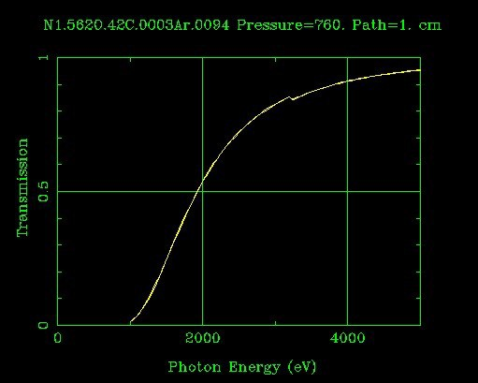
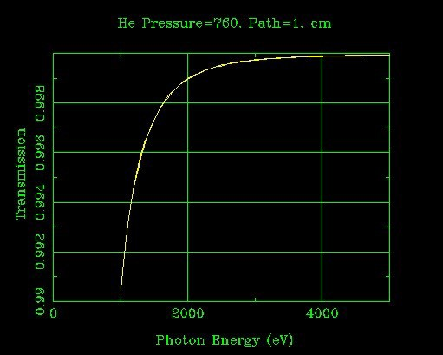
Choice of external atmosphere
Air Helium
The use of an helium-saturated atmosphere in front of the X-ray detector is mandatory

Slide 40


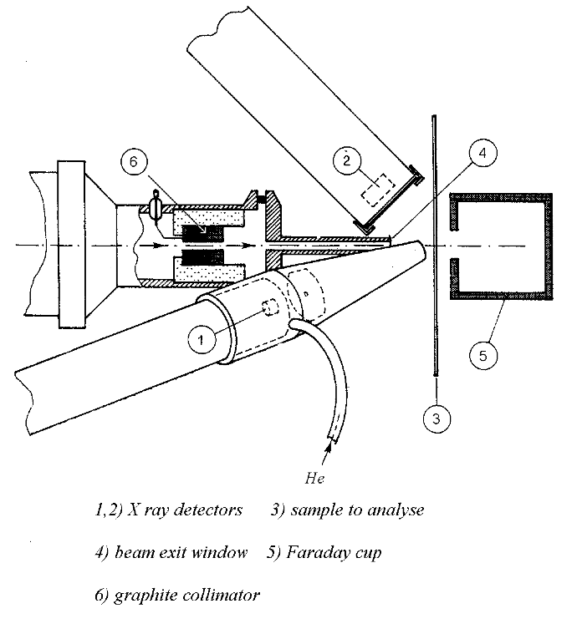
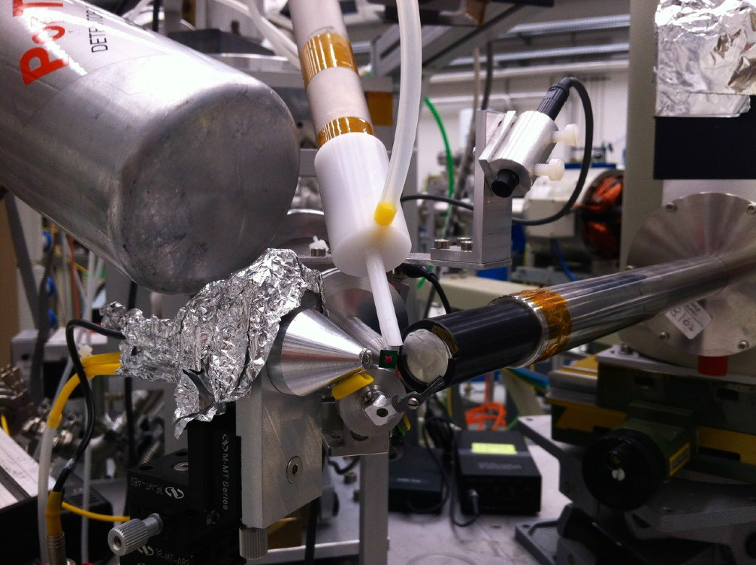
2-detectors PIXE set-up
Target
X-rays
What is needed
Detector features
Low-Z elements
Low energy
Minimum dead layers
Thin entrance window
High cross sections
Small solid angles
Small active area
Medium-high- Z elements
High energy
Large solid angles
Large active area
Low cross sections
Efficiency
Large active thickness

Slide 41

2-detectors PIXE set-up
Target
X-rays
What is needed
Detector features
Low-Z elements
Low energy
Minimum dead layers
Thin entrance window
High cross sections
Small solid angles
Small active area
Medium-high- Z elements
High energy
Large solid angles
Large active area
Low cross sections
Efficiency
Large active thickness

Slide 42

2-detectors PIXE set-up
Target
X-rays
What is needed
Detector features
Low-Z elements
Low energy
Minimum dead layers
Thin entrance window
High cross sections
Small solid angles
Small active area
Medium-high- Z elements
High energy
Large solid angles
Large active area
Low cross sections
Efficiency
Large active thickness

Slide 43

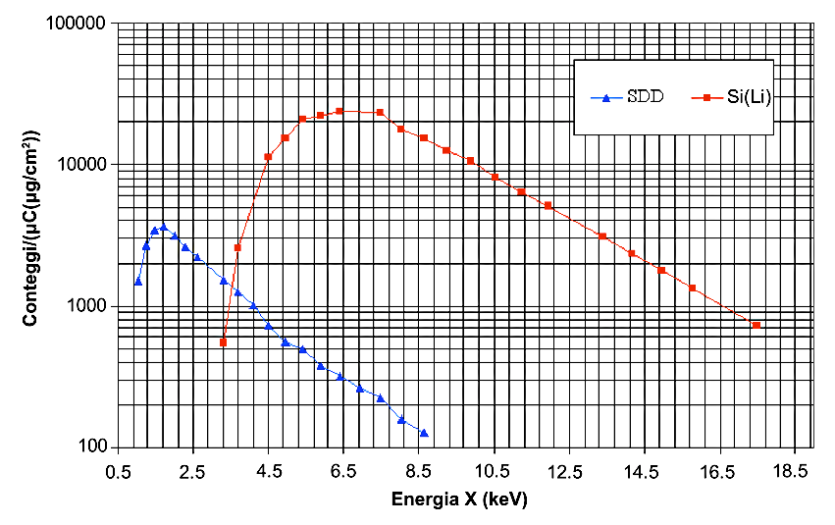
Efficiency curve for a two detector PIXE set-up

Slide 44
Example of PIXE spectra of APM samples
2000
Si
3000
«Small» detector
«Big» detector
S
2500
Fe
1600
2000
1200
As + Pb
Counts/μC
Counts/μC
Na
1500
Ca
Zn
800
Cl
Ca
Mg
Al
1000
Ar K
Ca
Cu
400
500
Fe
Ar ^{K}
Mn
Zn
Br
Ca
Ti
V Cr
As
Pb
0
0
1
2
3
Energy (keV)
4
5
0
2
3
4
5
6
7
8 9 10
Energy (keV)
11
12 13 14
PIXE spectra of a PM10 sample on Teflon collected in an industrial area. Proton beam energy 2.2 MeV, beam current 6 nA

Slide 45

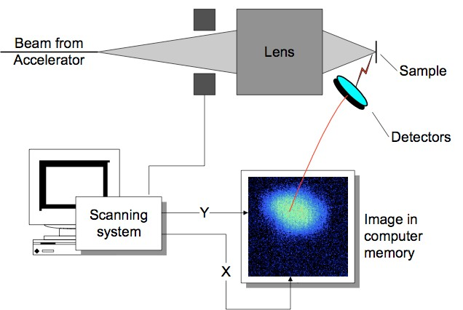
Nuclear microscopy

Slide 46

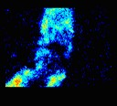
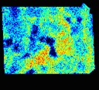
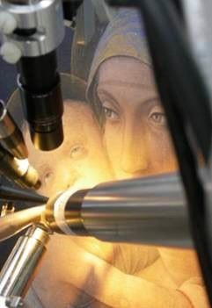
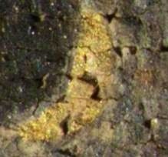

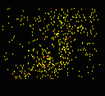
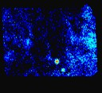
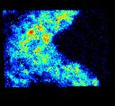
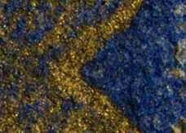
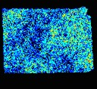
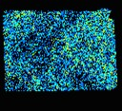
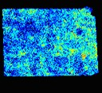
Elemental mapping with microPIXE
The eye of the Virgin
2 mm
Au L_{α}
Pb L_{α}
Sn K
Fe
2 mm
The veil
Au L_{α}
Andrea Mantegna, “Madonna col Bambino”, oil on canvas, Bergamo, Italy
Si
Al
Pb L_{α}

Slide 47



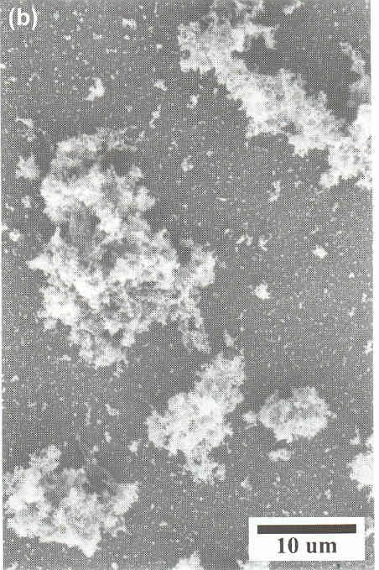











Airborne particulate matter (aerosol)
Solid or liquid particles with a diameter from 10⁻³ to 10² μm Origin: primary or secondary
Diesel engine emission
Black carbon
Mineral dust
Vegetal fibre
NaCl crystal

Slide 48












Natural sources of aerosols
Sea Spray
Volcanic eruptions
Forest fires
Desert dust transport
Long range transport of natural aerosol

Slide 49













Anthropogenic sources of aerosols
Traffic
Waste incinerator
Thermoelectric power plants
Domestic heating
Industrial activities

Slide 50

Estimate of the emission at a global scale

Slide 51


Aerosol impact on environment
Visibility reduction
PM_{2.5} < 2.5 μg/m³
PM_{2.5} ~ 35 μg/m³
<numero>
Notes:
<numero>

Slide 52





Aerosol impact on environment
Reduce visibility
Absorption and scattering of solar radiation
Cloud formation
Climate forcing
IPCC 2013

Slide 53




Aerosol impact on human health
Chronic or severe respiratory diseases
Toxic or carcinogen effects
EU LIMIT VALUES FOR PM
CONCENTRATION (2008/50/CE)
PM10: 40 μg/m³ annual mean
50 μg/m³ 24-h mean (not more than 35 days/year)
PM2.5: 25 μg/m³ annual mean
Nos
Larynx
WHO AIR QUALITY LIMIT
PM10: 20 μg/m³ annual mean 50 μg/m³ 24-h mean
VALUES
Bronchi
Bronchioles
PM2.5: 10 μg/m³ annual mean 25 μg/m³ 24-h mean
Alveoli

Slide 54



67 fattori di rischio
Inquinamento domestico:
3ª causa di DALY
Inquinamento da PM:
9ª causa di DALY
2012

Slide 55


Impatto sulla salute
2000
Perdita dell’aspettativa di vita (in mesi) dovuta all’esposizione a PM_{2.5} da sorgenti antropogeniche
Notes:
<numero>

Slide 56

The Great Smog of London
From December 5 to 8 1952, due to particular meteorological conditions, London was covered by a very dense smog cloud which caused 4000 deaths in only one week!!
XVII century document
Notes:
<numero>

Slide 57

MEAN ANNUAL PM10 CONCENTRATIONS
FIRENZE
ATENE
PORTO
MILANO
BARCELLONA

Slide 58







Aerosol impact on cultural heritage
Soiling
Black crust formation
Soluble salt crystallization
Funerary monument from 1837, English Cemetery, Florence (before and after restoration)
Aesthetic damages
Chemical reactions and physical interaction with the materials

Slide 59

Aerosol samplers
Air inlet
Sampling head
A pump draws the air through a sampling head
Particle size
depends on the geometry of sampling head
PM collected by filtration on suitable filters
or
by impaction on suitable foils
Junction tube
Filtering membrane
Pump
Filtro
Notes:
<numero>

Slide 60



Impactors
If a gaseous flow is subjected to a sudden change in its direction, the biggest transported particles tend to continue in the original direction, thus it is possible to obtain an inertial separation.
The inertial impactor deflects (and thus stops) the “biggest” particles letting the “smaller” ones pass
Typical impactor efficiency curve
Sampling head↔ single stage impactor: the size selection by inertial separation in the head
Other impact stages: multistage impactor
Aerosol sampling in dimensional classes
Collection on filter
Notes:
<numero>
The biggest the partciles the farther they go
Il campionamento del particolato atmosferico avviene mediante l’aspirazione dell’aria ambiente attraverso opportune membrane filtranti che trattengono le particelle con efficienza solitamente superiore al 99 %.
L’aspirazione viene effettuata con opportune centraline dotate di pompa, flussimetro, contatore volumetrico, barometro, termometro, timer...
Normalmente non si raccoglie tutto il particolato, ma

Slide 61


What do we need to study aerosols
Many good data concerning:
PM concentration and
composition
size distribution
optical properties
time and space evolution
Quantification and identification of PM emissions sources through receptor models
OUTPUT
Contribution to pollution abatement policies to improve air qualitity
Contribution to climate models to assess the role of atmospheric aerosols in radiative forcing
Notes:
<numero>

Slide 62



















Why the use of PIXE for aerosol studies?
Sampling campaigns produce a huge quantity of samples with low mass (10-300 μg/cm²)
Campionatori sequenziali
Impattori multistadio
Campionatori
continui
“Dayly
“hourly
samples”
samples
47 mm
25 mm
100 mm
Multielemental, rapid, highly sensitive, quantitative and, possibly, non destructive analytical techniques are necessary.

Slide 63

Start of PIXE
PIXE and also its application to aerosol samples started with the seminal paper of Johansson et al., NIM (1970)
Carbon foil placed outdoors for 1 day
Analyzed for 60 min with 2.5 µA current of 1.5 MeV protons
Amounts (ng)
  S : 20
  Fe : 8.5
  Pb : 0.3
<numero>

Slide 64
Role of PIXE for aerosols analysis
5‑10 min bombardment to detect up to 20 elements (Na to Pb)
good detection limits down to µg/g (ng/m³)
Possibility to analyse sample with little mass
High time resolution
nondestructive analysis without any sample preparation
it can be complemented with other ion beam analysis techniques
PIXE provides only part of the desired information
  Other competitive techniques: ICP-MS
XRF
SR-XRF
atmospheric aerosol research
exclusively based on PIXE
is NOT sufficient anymore!
http://labec.fi.infn.it
Notes:
<numero>

Slide 65
IBA techniques (PIXE) must be used when their application can give unique information or can give final results in a far simpler way respect to other competing techniques
Very short measuring time (~ 60 sec respect to several minutes or hours) : hundreds of samples can be analyzed in one day
it is possible to analyze samples with very low mass : samples collected with high time resolution (e.g. 1 hour instead of 24 hours)
Detection of all soil related elements: study of Saharan dust episodes
No sample pre-tratment: it is important when sample with very low mass must be analyzed and therefore any contamination is dramatic (e.g mineral aerosol in polar ice cores for paleoclimatic studies)
A prerequisite is the use of a proper experimental set-up which fully exploits PIXE potentialities
Notes:
<numero>

Slide 66
High time resolution
In the majority of the aerosol field campaigns PM is collected with a 24-h time resolution
However, many particulate emissions change within few hours (industrial or traffic emissions, construction works, …)
Moreover, as many meteorological parameters, like wind intensity and direction, change within a 1-h time scale and the boundary layer evolution shows strong diurnal patterns, atmospheric transport and dilution processed change within few hours
As a consequence, the aerosol concentration and composition may significantly change within few hours and daily samples are not capable of tracking these rapid changes
For this reason, the measurement of the PM composition with high time resolution is important to: assess health and environmental effects, understand transport processes and determine source contributions.
Notes:
<numero>

Slide 67




Fine and coarse hourly samples
Continuous “streaker” sampler
PM2.5÷10
100 mm
1 Hour
The beam spot cover a sector of the filter equal to 1h sampling. The analysis of the streak point by point gives the elemental concentrations with one-hour resolution
Kapton foils
Nuclepore
PM2.5
Beam current 100 ÷ 300 nA
Beam size: 1 mm x 2 mm
1 week at 1h resolution:
168 hours (168+168 spots)
Notes:
Abdomen!!!

Slide 68

IBA techniques (PIXE) must be used when their application can give unique information or can give final results in a far simpler way respect to other competing techniques
Very short measuring time (~ 60 sec respect to several minutes or hours) : hundreds of samples can be anakyzes in one day
it is possible to analyze samples with very low mass : samples collected with high time resolution (e.g. 1 hour instead of 24 hours)
Detection of all soil related elements: study of Saharan dust episodes
No sample pre-tratment: it is important when sample with very low mass must be analyzed and therefore any contamination is dramatic (e.g mineral aerosol in polar ice cores for paleoclimatic studies)
A prerequisite is the use of a proper experimental set-up which fully exploits PIXE potentialities
Notes:
<numero>

Slide 69




1-3 min/sample
Z>10

Slide 70




The upgraded set-up for aerosols small
145 eV (FWHM at 5.9 keV)
300 μm thick, 7 mm² active area
ultrathin window (8 μm Be)
(+ He flow & magnetic p deflector)
140 eV (FWHM at 5.9 keV)
450 μm thick, 30 mm² active area
ultrathin window (8 μm Be)
(+ He flow & magnetic p deflector)
He between the detector window and the target AND between the target and the faraday cup behind it.
Notes:
<numero>

Slide 71
The upgraded set-up for aerosols big
165 eV (FWHM a 5.9 keV @ τ=1 μs)
450 μm thick, 80 mm² active area
with absorber (450 μm Mylar) to attenuate low-energy X-rays
X 2
Notes:
<numero>

Slide 72

PIXE-PIGE External beam set-up
Ge detector
He flow
SDD
«big2»
SDD «small»
FC
SDD
«big 1»
Sample holder

Slide 73

The beam extraction window
Up to 2013, 7.5 µm Upilex window:
Progressive thinning of the window
Measuring with ~100 nA, replacement needed every ~ 2-3 h.
Since 2013, 500 nm thick Si₃N₄ window by Silson: BS tests after 4600 µC showed no thinning
After more than 3y, no need to change it!
(unfortunately it was victim of a black-out during this summer...)
Notes:
<numero>

Slide 74

Standard daily samples
PM1, PM2.5 or PM10
47 mm
Teflon filters:
Teflon (CF₂) is very clean
It is possible to quantify Si.
BUT
Strong Compton background due to γ-rays from F that worsen the MDLs
Notes:
<numero>

Slide 75

Daily samples: which energy?
MDL (µg/cm²)
The F of Teflon gives rise to a strong Compton background in PIXE spectra due to the emission of several γ-rays from the ¹⁹F(p,p’ γ)¹⁹F and ¹⁹F(p,αγ)¹⁶O reactions
Notes:
<numero>

Slide 76

“High speed PIXE”
Daily samples
High sensitivity for mineral dust elements (Na, Mg, Al, Si, K, Ca, Ti, Mn, Fe, Sr)
~ half minute/sample is sufficient
1 year of daily samples
1 day of beam time
SDD detector
30 sec.
automatic sample handling by a multi-target holder
Measuring time: ~ 0.5 - 3 minutes
Currents up to 100 nA
Notes:
<numero>

Slide 77
Scelta dell’energia del fascio

Slide 78






ANALYS: An integrated approach involving many different analytical techniques
PM10 mass measured gravimetrically, by weighting the Teflon filters by an analytical balance
Thermo Optical-Analyzer
(Sunset)
Carbon (OC, EC, TC)
IC
(Ion Chromatography)
Main soluble ions
Na⁺, NH₄⁻, K⁺, Mg²⁺, Ca²⁺, Cl⁻, NO₃⁻, SO₄²⁻, MSA, For, Gly, Ox
PIXE
(Particle Induced
X-ray Emission)
Elements with Z>10 (from Na to Pb)
Teflon
filter
Levoglucosan and organic compounds
ICP-AES
Metals soluble in HNO₃ pH=1.5
Al, Si, P, Ti, V, Cr, Mn, Fe, Co, Ni, Cu, Zn, As, Sr, Mo, Cd, Ba, Pb, La, Ce
Quartz
fiber filter
STATISTICAL ANALYS FOR THE IDENTIFICATION OF THE SOURCES (PMF, Positive Matrix Factorization)
Notes:
<numero>

Slide 79

Quality Assurance

Slide 80

“High speed PIXE”
Hourly samples
Example of spectra collected in 30 s
Fine fracion
Coarse fraction
i ~ 50-300 nA
Measuring time:
45-60 seconds/sample
1 week =168 h
1 filter <5 hour
Notes:
<numero>

Slide 81


Hourly samples: which energy?
Increasing the beam energy:
X-ray emission cross-sections increase
BUT: also the background increases
MDL study
Notes:
<numero>

Slide 82

Streaker + PIXE campaigns
Optimized analytical capability +
increasing request for hourly data in aerosol research: increasing number of studies in urban, industrial and cultural heritage sites
Many campaigns have been carried out, usually within projects involving daily sampling for long periods for the identification of the aerosol sources,to obtain information complementary to the ones obtained with 24-h resolution
and/or in parallel with other high time resolution instruments (AMS, field EC-OC, etc.)
It can be very useful in industrial sites or in complicated situations like the megacities where many sources are emitting simultaneosly.
Notes:
<numero>

Slide 83

Receptor model basic idea
Identify the sources and quantify their contribution to PM mass (source apportionment) starting from the measured PM concentrations and aerosol chemical composition at the sampling location (RECEPTOR SITE)
Aerosol particles retain elemental-chemical composition characteristic of their origin: the PM composition at the receptor site is a combination of the compositions of the aerosols emitted by the different sources
Notes:
<numero>

Slide 84
Mass balance equation
All receptor models are based on the mass balance equation:
Source weight
Measured concentrations
Source profile
Sum on the contributions of the different sources
x_{ij} = concentration of element j in sample i
g_{ik} = contribution of source k in sample i
f_{kj} = fraction of the element j in the particulate matter produced by source k
The aim of receptor models is determining source weights (G) from measured concentrations (X).
In some models source profiles (F) are assumed as known in others they are determined by the model itself.
A high number of samples (>100) is necessary
Notes:
<numero>

Slide 85
Positive Matrix Factorization
matrices G and F forced to be positive
Minimization of the difference between the measured concentrations and those reconstructed by the model
WEIGHED LEAST SQUARE WITH «NON NEGATIVITY CONSTRAINT»
F and G non negative
minimum
Matrix of the data
Experimental uncertainties and MDL
Profile Matrix (F)
and Source Matrix (G)
errors on F and G
Model Parameters (e.g. n° of factors P)
[Paatero and Tapper, Environmetrics, 1994]
Notes:
<numero>

Slide 86
IBA techniques (PIXE) must be used when their application can give unique information or can give final results in a far simpler way respect to other competing techniques
Very short measuring time (~ 60 sec respect to several minutes or hours) : hundreds of samples can be anakyzes in one day
it is possible to analyze samples with very low mass : samples collected with high time resolution (e.g. 1 hour instead of 24 hours)
Detection of all soil related elements: study of Saharan dust episodes
No sample pre-tratment: it is important when sample with very low mass must be analyzed and therefore any contamination is dramatic (e.g mineral aerosol in polar ice cores for paleoclimatic studies)
Notes:
<numero>

Slide 87





The role of PIXE in the AIRUSE project "Testing and Development of air quality mitigation measures in Southern Europe"
Notes:
<numero>

Slide 88





THE AIRUSE PROJECT AIMS
Characterizing similarities & differences in PM sources & contributions across S-EU (5 cities)
Once the main sources of PM10 and PM2.5 are identified, the strategic goal of the AIRUSE project is to develop, test and propose specific measures to abate urban ambient air PM in S.-EU, to meet AQ standards & to approach WHO guidelines.
Specific objectives
Obtaining harmonized source contributions to PM for AIRUSE cities & to identify those responsible for exceedances of the PM limit values and WHO guidelines
Develop, test and propose cost-effective air mitigation measures for South European countries
Support adaptation of control strategies for reducing PM exposure in South Europe
Specific PM mitigation measures
Street washing & dust suppressants for road dust and deposited African dust
Biomass burning
Industrial emissions (channelled and fugitive)
Strategies from other European countries (LEZ, eco-efficient vehicles, labelling, shipping, biomass burning…)

Slide 89





Sampling
1 year daily sampling of PM10 and PM2.5
Jan.2013 - Jan.2014 (every 3rd day*)
quartz and teflon
Shorter samplings 1 hour time resolution
~ 2 weeks in winter and summer
fine and coarse
7400 analysed samples!
* All the days if saharan intrusions foreseen (Hysplit, Skiron)
Notes:
<numero>

Slide 90



Analysis
DAILY SAMPLES
PM2.5 and PM10 concentrations (gravimetric analysis)
EC-OC (thermo-optical methods)
Levoglucosan (Milan), organic compounds and carbonates on a reduced number of samples
QUARTZ FILTER
Thermo-optical analysis (Sunset)
→ TC, EC, OC
TEFLON FILTER
IC
→ ions
PIXE
→ Elemental concentrations (Z>10)
HR-ICPMS
→ soluble
component of metals
Ionic composition (IC)
Major and minor elements (PIXE, ICP-MS, ICP-AES)
HOURLY SAMPLES
Elements Z>10 (streaker sampler + PIXE)
FINE FRACTION
COARSE FRACTION
The external beam PIXE
set-up at INFN LABEC
Notes:
<numero>

Slide 91





Source apportionment
In highly polluted days, major sources:
BCN traffic
POR, FLR, MIL traffic and biomass burning
ATH Saharan dust
Notes:
<numero>

Slide 92


It is important both to identify the Saharan days and to assess the ground level contribution of this natural source
The maximum allowed number of exceedances of the 50 μg/m³ daily limit value (DLV) is 35/year. However, if an exceedance can be attributed to a natural event it can be discounted by the State Members of the European Union after scientific validation.
As a consequence, in case of DLV exceedance the estimate of African dust contribution to PM10 concentration has become a primary task for both scientists and policy makers.
A EU directive suggest to calculate the net contribution of African dust to PM10 on a daily basis, by subtracting the PM10 regional background (RB) level from the PM10 concentration values.
Notes:
<numero>

Slide 93
Si concentrations
Florence
Athens
Porto
Notes:
<numero>

Slide 94
Mineral dust
Sum of all main crustal element oxides (Na₂O, MgO, SIO₂, Al₂O₃, TiO₂, K₂O, CaO, Fe₂O₃):
Dust = 1.35 [Na]+ 1.66 [Mg] + 1.89 [Al] + 2.14 [Si] + 1.21 [K] + 1.40 [Ca] + 1.67 [Ti] + 1.43 [Fe]
    Possible anthropogenic inputs to K, Ca and Fe should be taken into account;
    if EFs of these elements are > 10, their contribution is calculated as:
    mineral-K = 0.32 x [Al]
    mineral-Ca = 0.45 x [Al]
    mineral-Fe = 0.62 x [Al]
    Na and Mg should be corrected for seal salt (ss) contributions
Notes:
<numero>

Slide 95

Mineral dust
Florence
Florence-Athens (Skiron-hysplit)
μg/m³ (% of PM)
PM10 | 2.2 (12%)
PM2.5 | 0.5 (4%)
ratio | 0.23
Athens
(Skiron-hysplit)
μg/m³ (% of PM)
PM10 | 4.3 (20%)
PM2.5 | 1.1 (9%)
ratio | 0.26
All the days with exceedances were dust events!
Porto
Porto (Skiron)
μg/m³ (% of PM)
PM10 | 4.0 (11%)
PM2.5 | 2.1 (8%)
ratio | 0.52
Notes:
<numero>

Slide 96







Desert dust intrusions
in Florence
Backward trajectory calculations (HYSPLIT model, NOAA)
for all days every 6 hours, at 3 altitudes (500, 1500 and 2500 mAGL): rough classifications of all the samples in
African Days (AD) and Non African Days (NAD)
Notes:
<numero>

Slide 97





Elemental ratios (Florence)
Notes:
<numero>

Slide 98

(μg/m³)
PM10
μg/m³
μg/m³

Slide 99
(μg/m³)
PM10
μg/m³
μg/m³
EU method: the net contribution of African dust to PM10 on a daily basis by subtracting the PM10 regional background (RB) level from the PM10 concentration values measured in rural background sites only on dust-days.

Slide 100
BIOMASS BURNING (Firenze)
All in the fine fraction, only in winter

Slide 101



BIOMASS BURNING: HOURLY RESOLUTION
FIRENZE
K (ng/m³)
PORTO
K (ng/m³)
Notes:
<numero>

Slide 102




TRAFFIC SOURCE
Peaks during traffic rush hours
Cu (ng/m³)
TRAFFIC DAILY PATTERNS
TRAFFIC-fine
TRAFFIC-coarse
Notes:
<numero>

Slide 103

Hourly elemental composition and source identification of fine
and coarse particulate matter in the high polluted industrial area of Taranto (Italy)
Notes:
<numero>

Slide 104

SAMPLING
During 2004, an extensive investigation, promoted by the Italian Health Ministry, and ISPESL (Istituto Superiore per la Prevenzione e la Sicurezza del Lavoro), was carried out, with the aim to quantify the level of pollution in the area (including air, soil and water pollution))
Sampling sites:
Site A (Orsini): polluted district
in Taranto
Site B (Statte) : small town 7 Km N
of Taranto
Sampling periods:
23/02-9/03 2004
23/06-1/07 2004
Notes:
104

Slide 106


Fine fraction: Steel mill 1 (BF)
Moreno et al., 2004; Connell et al., 2006; Tsai et al., 2007; Dall’Osto et al., 2008; Mazzei et al. (2008) ; Hleis et al., 2013;
Winter
Summer
Statte
Orsini
Notes:
<numero>

Slide 107


Steel mill 2 (BOS)
Oravisjarvi et al., 2003; Hleis et al. 2013;
Winter
Summer
Statte
Orsini
Notes:
<numero>

Slide 108


Steel mill 3 (Sinter)
Zhan , JES 25, 2013
Winter
Summer
Statte
Orsini
Notes:
<numero>

Slide 109


Cement plant
Notes:
<numero>

Slide 110





Study of the elemental concentration with 1-hour resolution during
Mascletas at Alicante (Spain)
F. Lucarelli, G. Calzolai, M. Chiari, S. Nava,
Dipartimento di Fisica e Astronomia e INFN, Università di Firenze
Eduardo Yubero, Jose Nicolas, Javier Crespo
Laboratorio de Contaminación Atmosférica (LCA), Área de Física Aplicada, Universidad Miguel Hernández, Elche, Spagna
Notes:
<numero>

Slide 111



Mascletà
10000 m²
125 kg of gunpowder
8 minutes
20000 people
Mascletàs stimulate the auditory system and body vibration through the strong rhythmic noise.
The masclet is a powerful sound firecracker that can be burst both at ground level and at low altitude level (1.5–2.0 m).
When it burns, a loud intensity detonation, light effects and abundant smoke generation are produced as a function of its composition.
Notes:
111

Slide 112





Cremà and fireworks
Notes:
<numero>

Slide 113
Elemental Concentrations
Similar trend for Mg, Al, Si, Cl, Ti, V, Cr, Mn, Fe, Co, Cu, Zn, Br, Rb, Pb
Notes:
<numero>

Slide 114

Fireworks and Cremà
Notes:
<numero>

Slide 115

Size distribution
Notes:
115

Slide 116


Highly polluted urban environments: Beijing
APHH-Beijing (Atmospheric Pollution and Human Health in a Chinese Megacity) is an international collaborative project to examine the emissions, processes and health effects of air pollution in Beijing.
Identify sources of urban atmospheric pollution and their absolute contribution to PM;
Identify processes affecting urban atmospheric pollution;
Study the impacts on health
Propose interventions and solutions to reduce health impacts.
Notes:
115
<numero>

Slide 117


Beijing
Two month-long intensive field campaigns:
10 November – 10 December 2016 (winter); due to many black-outs most of the data were lost.
15 May- 22 June 2017 (late spring).
The aerosol was collected in parallel in two sites:
Central Beijing, in the Tower Section of Institute of Atmospheric Physics (IAP), Chinese Academy of Sciences. It is a residential area, typical of central Beijing, there are various roads nearby.
A rural (Pinggu) 60 km from IAP. The monitoring station is away from significant local combustion sources.
Notes:
<numero>
<numero>

Slide 118
Highly polluted urban environments: Beijing (May-June 2017)
EXAMPLES OF HOURLY CONCENTRATIONS
Notes:
<numero>
S is related to the secondary sulphates which have a regional origin
It is interesting to note that the concentration of the dust component obtained by the sum of the crostal elements as oxides is up to 35 microgram/m3
<numero>

Slide 119

Highly polluted urban environments: Beijing (May-June 2017)
L
R
L
R
R
R
L
L
R

Slide 120

High polluted urban environments: Beijing (May-June 2017)
Notes:
<numero>

Slide 121




Highly polluted urban environments: Delhi
Delhi was recently ranked the most polluted city in the world for air pollution by the WHO.
The aerosol was collected in two sites:
The urban baseline site in Delhi at the Indian Institute of Technology IIT campus (a “supersite” heavily instrumented)
The urban centre site at IGDTW which will directly sample emissions from Old Delhi.
Two month-long intensive field campaigns :
10 January - 10 February
20 May - 20 June
Notes:
<numero>
<numero>

Slide 122
Highly polluted urban environments: Delhi
40 μg/m³!!
50 μg/m³!!
Notes:
<numero>
<numero>

Slide 123
Identification of the Aerosol sources in Delhi
Notes:
open refuse burning
<numero>

Slide 124
IBA techniques (PIXE) must be used when their application can give unique information or can give final results in a far simpler way respect to other competing techniques
Very short measuring time (~ 60 sec respect to several minutes or hours) : hundreds of samples can be anakyzes in one day
it is possible to analyze samples with very low mass : samples collected with high time resolution (e.g. 1 hour instead of 24 hours)
Detection of all soil related elements: e.g. study of Saharan dust episodes
No sample pre-tratment: it is important when sample with very low mass must be analyzed and therefore any contamination is dramatic (e.g mineral aerosol in polar ice cores for paleoclimatic studies)
Notes:
<numero>

Slide 125
dust belt
Prospero, 2002
Influence of dust on the Earth system:
-size distribution
-mixing state with pollutants
-mineralogy
-solubility
dust
-direct with radiation
-cloud formation (radiation, rain)
-fertilization of ocean
➔ marine biomass ➔ CO₂ absorption
climate

Slide 126
dust belt
Prospero, 2002
Influence of dust on the Earth system:
-size distribution
-mixing state with pollutants
-mineralogy
-solubility
For understanding and quantifying how dust and the earth system
interacts, we need both experimental observations and models:
we do not have such data
dust
-direct with radiation
-cloud formation (radiation, rain)
-fertilization of ocean
➔ marine biomass ➔ CO₂ absorption
climate

Slide 127




At Izaña Observatory (Tenerife), we performed the first high-resolution measurements of elemental composition of dust exported to the North Atlantic addresses three questions:
how quick does dust composition change in the SAL?
what is the connection to dust sources?
and what is the role of meteorology?
Izaña Observatory (IZO) , 2367 m a.s.l.

Slide 128




Saharan Air Layer
0.9
6h, change in factor 2
Ca / Al
0.6
0.3
0.30
Along 1-week of continuous dust presence at Izaña (50 – 200 µg/m³), 7 concatenated impacts, which were traced by the variability in the ratios of the different elements to Al.
This variability was induced by the alternated impacts of three of the large North African dust sources
Mg / Al
0.25
0.20
0.2
S / Al
0.1
0
0.4
0.2
Na / Al
0
24
25
26
27
28
29
30
August

Slide 129









The potential source areas of dust were identified by analysing the “Median Ratios At Receptor” (MRAR) plots, the median ratio of each X/Al measured at the receptor site (Izaña) when the air mass was previously passed above each 1◦ × 1◦ degree pixel over North Africa. Back-trajectories were calculated with HYSPLIT software
PSA1
PSA2
PSA3
Si / Al
Ca / Al
Na / Al
Fe / Al
Sr / Al
Mg / Al
Mn / Al
S / Al
K / Al
Notes:
NE Algeria, Western Sahara to Bechar region and SW Sahara - Western Sahel
<numero>

Slide 130
We found a correlation between dust composition in the SAL and NAFDI
NAFDI: ratio of the tropical Saharan high -Morocco- to the monsoon tropical low –Nigeria
The NAFDI: traces the observed variability in dust composition.
These results point that long term variability of meteorology in North Africa may have implications on the composition of the dust exported to the North Atlantic and this is relevant for the interconnection between aerosol desert dust – meteorology – climate.

Slide 131

NAFDI
Difference of the anomalies of the daily values of the 700hPa geo-potential height (Φ _{(d)}) over Morocco (Mo, 30–32ºN, 5– 8ºW) and Nigeria (Ni, 30–32ºN, 5–8ºE), with respect to the climatological (average) values from 1980 to 2010 (Φ_{(clim)})
NAFDI values (0 to +2) were associated with Ca, K, Na, Mg and S rich dust linked to dust sources in NE Algeria, whereas higher NAFDI values (+2 to +4) were linked to Fe rich dust (Ca, Na and S depleted) linked to dust sources in SW Sahara - Western Sahel.

Slide 132




Saharan dust intrusions: validation of models
Streaker-PIXE
Saharan dust outbreaks are observed over Mediterranean region several times a year and contribute to the exceedance of PM10 legal limit value.
The characterization of the main Saharan dust outbreaks affecting the Tuscany Region was performed using the SPARTA model chain developed by LaMMA Consortium.
Hourly resolution allows a better comparison between measured data and the model predictions respect to daily data
SPARTA model (LAMMA, CNR-IBIMET)
Comparison meas. - model (Livorno – summer 2014)
Notes:
<numero>

Slide 133
IBA techniques (PIXE) must be used when their application can give unique information or can give final results in a far simpler way respect to other competing techniques
Very short measuring time (~ 60 sec respect to several minutes or hours) : hundreds of samples can be anakyzes in one day
it is possible to analyze samples with very low mass : samples collected with high time resolution (e.g. 1 hour instead of 24 hours)
Detection of all soil related elements: study of Saharan dust episodes
No sample pre-tratment: it is important when sample with very low mass must be analyzed and therefore any contamination is dramatic (e.g mineral aerosol in polar ice cores for paleoclimatic studies)
Notes:
<numero>

Slide 134
Paleoclimate research in Antartica
Insoluble mineral aerosol (dust) deflated from continental surfaces is an important player in Earth’s climate by its influence on the Earth-Atmosphere radiative budget.
Dust particles are deposited over Antarctica after long-range transport from desert and semi-desert continental areas, Potential Source Areas (PSAs), of the Southern Hemisphere (local sources are negligible).
The study of both current-days and ice-core-archived (past) Antarctic mineral dust is extremely useful in recognising the main polar dust PSAs and, therefore, the present day and past atmospheric dust pathways
the dust mass is used to infer past atmospheric dustiness, aridity at the source regions and en-route scavenging processes;
the dust isotopic and geochemical composition is used to infer dust source locations and to study the geochemical evolution, in turn linked to paleo-environmental conditions, of dust at the source.
Notes:
<numero>

Slide 135




Paleoclimate research in Antartica
Ice core samples
Polar ice cores are extensive archives of records of past atmospheric compositions, allowing paleoclimate research.
Snow, accumulated layer by layer and gradually compressed into solid ice, contains traces of the gases and the aerosols being in the atmosphere at the deposition time.
Dust: no post-depositional process.
Samples from the ice core drilled at Dome C in the framework of the EPICA* project (European Project for Ice Coring in Antarctica), spanning the last 800 kyr. Analysed samples regarded the main cold events of the last 220 kyr.
Very low elemental concentrations: ng÷mg/kg of ice
Ice cores are melted and the liquid is filtered through Nuclepore
membranes on a 1 cm² area
Dome C, Concordia Station
* EPICA community members, Nature 429 (2004), 623
EPICA community members, Nature 444 (2006), 195
Notes:
<numero>

Slide 136

PIXE measurements
PIXE: a reliable tool for major and minor elements investigation of ice-core dust.
After ice melting and filtering, no pre-treatment is required: contaminations are minimized!
Irradiation time per sample: ~1000 s.
Beam current: from 5 nA to 30 nA.
Beam collimated to 2x1 mm².
Target moved in front of the beam to scan all the deposit area
Notes:
<numero>

Slide 137
PIXE spectra
ice dust
blank
Counts/μC
ice dust
blank
Counts/μC
Energy (keV)
Energy (keV)
El. | MDL* (ng/cm²) | Ice dust sample av. (ng/cm²) | Blank (ng/cm²)
Na | 20 | 100 | < MDL
Mg | 12 | 85 | < MDL
Al | 9 | 520 | < MDL
Si | 6 | 1880 | 36
K | 8 | 160 | < MDL
Ca | 7 | 63 | < MDL
Ti | 4 | 36 | < MDL
Mn | 1.0 | 2.2 | < MDL
Fe | 0.6 | 360 | 5
Sr | 0.7 | 1.2 | < MDL
* Minimum detection limit at 3σ confidence level
Blank values for elements of interest always largely below the measured concentrations!
Quantity of ice-core dust collected on each sample (~1-2 μg/cm² in the scarcest samples) sufficient to obtain good statistics for both PIXE and PIGE.
Notes:
<numero>

Slide 138

Dust concentrations
The oxides sums calculated from the PIXE measured elemental compositions agree very well with the dust mass measured with other techniques.
There is evidence that, during the cold periods (LGM, MIS4 and MIS6), dust concentrations are much higher than during hot periods.
Notes:
<numero>

Slide 139
Ice-dust and PSA-sediments composition
Antarctica during cold stages (MIS4 and MIS6)
Australia
South Africa
South
South-America
Ice dust composition during the cold stages is similar to the South-American one, while it relevantly differs from both the Australian and the South-African ones.
Notes:
<numero>

Slide 140





The “Aerosol”
group at LABEC:
Giulia Calzolai
Massimo Chiari
Franco Lucarelli
Silvia Nava
Thank you for your attention!
Franco Lucarelli : lucarelli@fi.infn.it
Notes:
<numero>

