Slide 1
WP 5: Coordination of the experimental activities
Responsible: Chiara La Tessa
(INFN-TIFPA and University of Trento)

Slide 2
WP5 in NEPTUNE
WP2
[Imaging]
Leading institute: INFN-TIFPA
WP3
[Microdosimetry]
WP5
WP4
[Radiobiology]
WP1
[Modeling]
Goal: to link and coordinate the measurement campaigns described in all WPs, ensuring a consistency in the methodologies and produce high-quality data.
The standardization of the experimental procedures will be defined in collaboration with WP1.
Additional task: On-site support for experiments carried out at the INFN-TIFPA experimental room @ Trento protontherapy center.

Slide 3
Milestones and deliverables of WP5

Slide 4
Timeline for 2019
December 2018: a beam time proposal for a total of 16 BTU (4 BTU for WP3 and 12 BTU for WP4) was submitted to the PAC of LNS and has been presented this week. The proposal has been APPROVED!
After this meeting: gather all inputs from the other WPs concerning the experimental activities and in collaboration with WP1 define some guidelines for the experimental activities of 2019.
Sometimes in 2019: prepare an additional beam time proposal for TIFPA if necessary.

Slide 5
Workflow
Make a list of all experimental activities planned for 2019, underlying the methodologies that have been selected.
Discuss the experimental procedures with WP1 to identify the points that might make a comparison between different datasets and between the data and the simulations difficult.
If necessary, suggest modifications for optimizing the procedures in agreement with all WPs.
Reiterate the process until a set of standard guidelines is established and used for future experiments.

Slide 6
Allocated FTE and budget
Personnel involved:
C. La Tessa (RTDB) - 20% FTE
G. Petrigna (Postdoc) - ??? – (should be 100% MoVe IT)
S. Colombi (PhD student) - 30% FTE
Picciotto (Researcher) - 20% FTE
Budget:
2 y post-doc position shared with WP1
Beam time at Protontherapy-TIFPA
Dedicated equipment for experimental activities
Travels

Slide 7
Why coordination is so crucial
Justifyng and understanding with modeling an experimentally observed Radiosensitizing (RSS) effect is not trivial
Historical example for Electromagnetic driven RSS

Slide 8
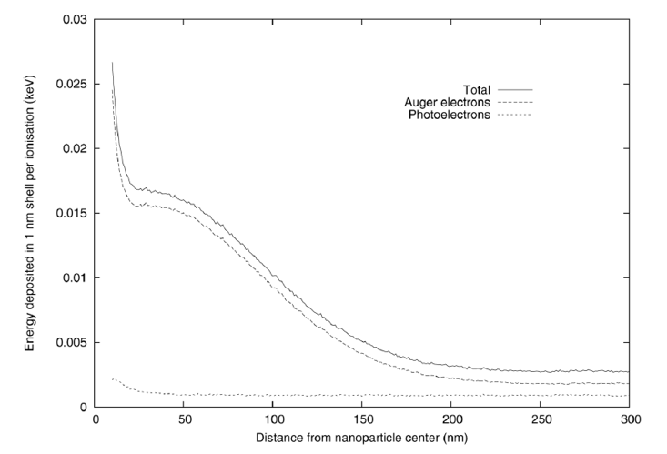
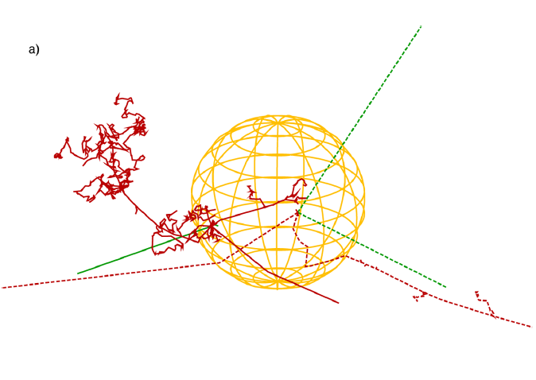
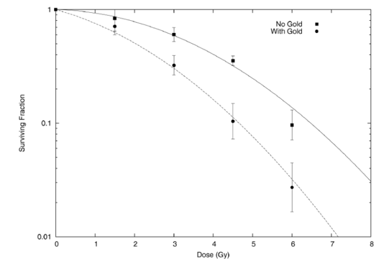
Au NP with photons – Mechanistic insight
Auger electrons play a crucial
role for photons
local dose enhancement
analysis based on track structure and
LEM adaptation
DEF~1.5
Mc Mahon et al. Sci. Rep. 2011

Slide 9
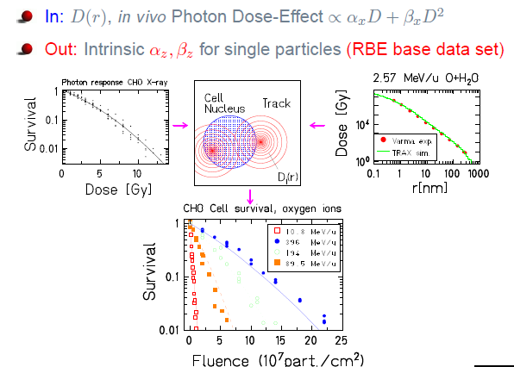
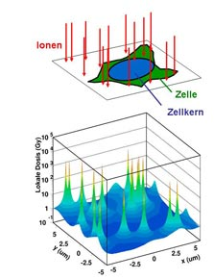
Local dose enhancement?
Local Effect Model (LEM)
(Courtesy of Fred Currell)
photon +NP ≈ Ion ?
Then, what about:
Ion+NP= ??
Elsaesser,Scholz 2008

Slide 10
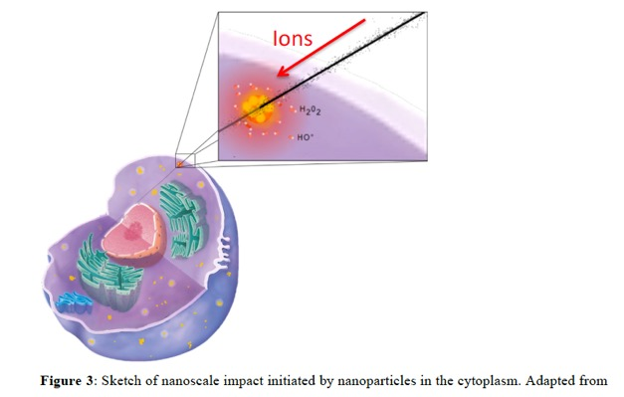
Cellular Localization
Porcel et al. 2010
Confocal microscopy show evidence of localization in the citoplasm
Usami et al. 2010
Stefancikowa et al 2015

Slide 11
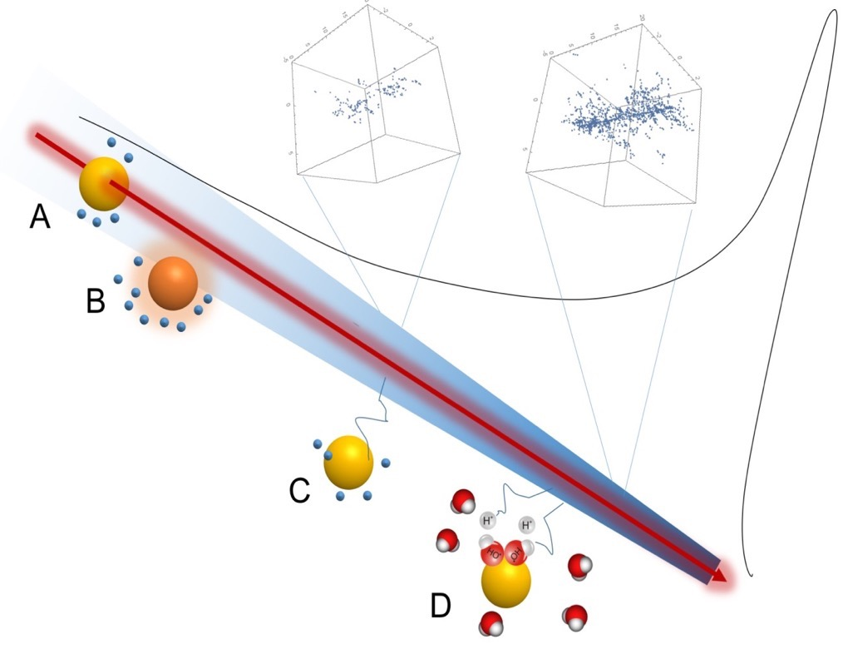
Coordination is crucial!
Lacombe & Scifoni
Particle therapy and nanomedicine: state of art and research perspectives
Cancer Nanotech. 2017

