Slide 1

NEPTUNE
Nuclear process-driven Enhancement of Proton
Therapy UNrav Eled
Soilid-state microdosimetry with silicon telescopes

Slide 2
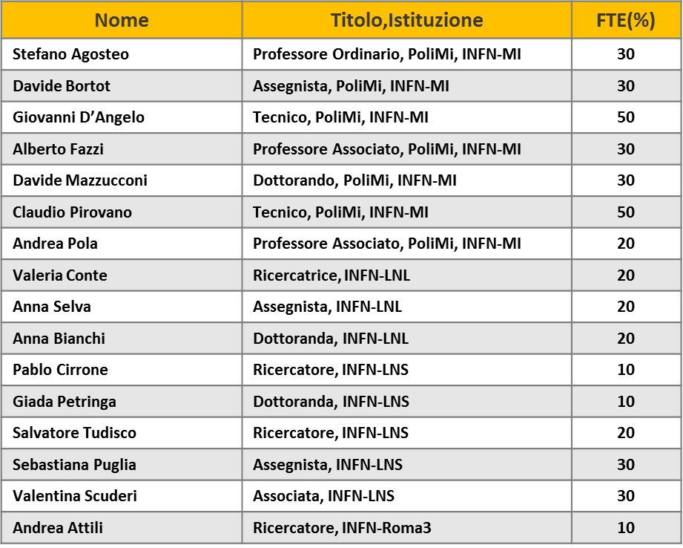
WG3 - Microdosimetry
Goal
Microdosimetric spectra across the proton Bragg peak will be measured with detectors with tissue-equivalent (TE) walls/converters unloaded and loaded with boron and fluorine. The microdosimetric spectra will be assessed at the same depths where cells will be irradiated by WG4 (Radiobiology), thus providing a physical characterization of the radiation field at cellular dimensions.

Slide 3
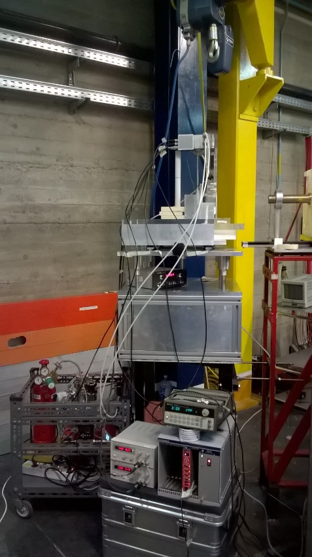
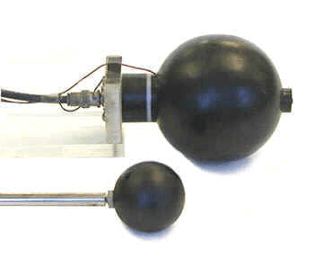
Microdosimetry
Statistical fluctuations of the local energy imparted at the micrometric level
the single-event distribution of energy imparted
TEPC is the reference device for measuring the microdosimetric properties of hadron beams
Need of a continuous flow of TE gas
Need of high voltages for the electrodes
Complex system

Slide 4
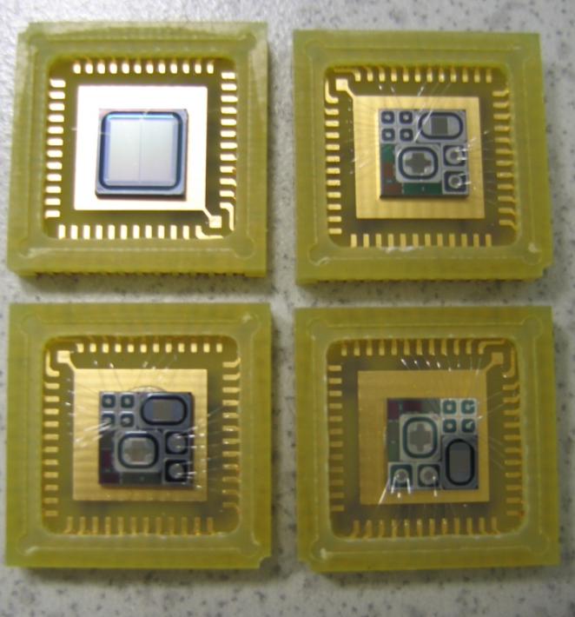
Silicon microdosimetry
possibility of obtaining real micrometric sites
transportable, cheap, low power consumption
customized (arrays, matrices…)
electronic noise (minimum detectable energy)
“non-tissue equivalence” of silicon
The silicon microdosimeter is based on the monolithic telescope technology^{[1]}
The ΔE stage (≈ 2 µm in thickness) acts as a solid-state microdosimeter^{[2]}
The E residual-energy stage (≈ 500 µm in thickness) gives information on the energy and the type of the impinging particle^{[2]}
[1] Tudisco S et al., A new large area monolithic silicon telescope. Nuclear Instruments and Methods A 426, 436-445 (1999)
[2] Agosteo S et al., A pixelated silicon telescope for solid state microdosimetry. Radiation Measurements 43 , 585-589 (2008)

Slide 5
Tissue-equivalent correction
possibility of obtaining real micrometric sites
transportable, cheap, low power consumption
customized (arrays, matrices…)
electronic noise (minimum detectable energy)
“non-tissue equivalence” of silicon
Analytical procedure for tissue-equivalence correction
Spectrum of the energy imparted in silicon
Spectrum of the energy imparted in tissue
A suitable correction to the measured distribution in order to obtain a spectrum equivalent to that acquired with an hypothetical tissue detector
Scaling factor : stopping powers ratio

Slide 6
Tissue-equivalent correction
For single-stage devices an approximate correction is applied by adopting
an average correction factor ζ
The presence of the E-stage offers the opportunity of measuring event-by-event the residual energy of particles with range lower than about 500 µm (protons of energy lower than about 8 MeV or alpha particles of energy lower than about 32 MeV, etc.)
For the DE-E silicon telescope, an optimized event-by-event correction is performed by measuring the residual energy deposited in the E-stage

Slide 7
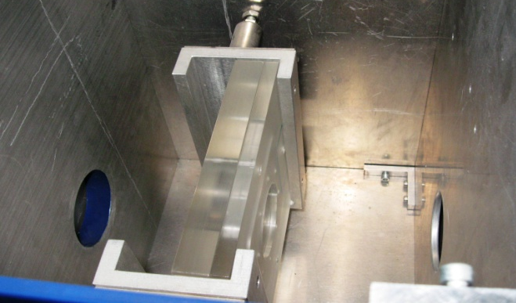
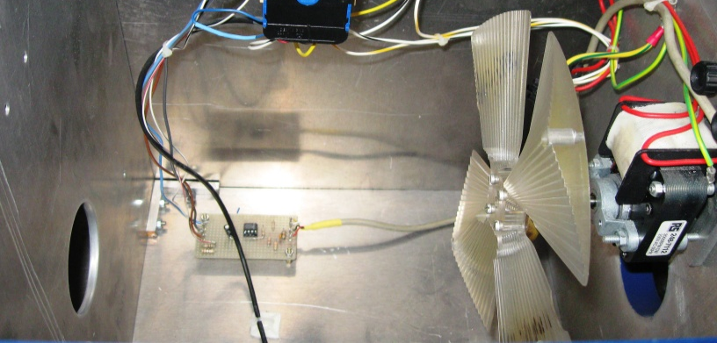
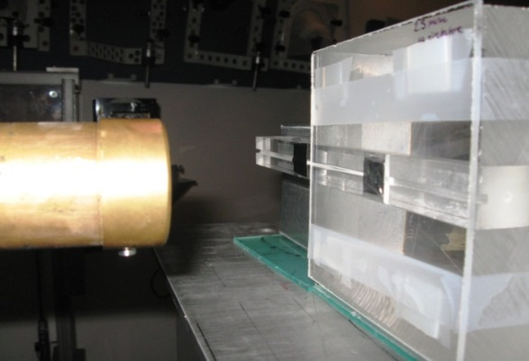
Characterization of the 62 MeV proton beam at CATANA
Range Shifter
(4.58 mm PMMA)
Range Modulator
(13.4 mm PMMA)
62 MeV protons

Slide 8
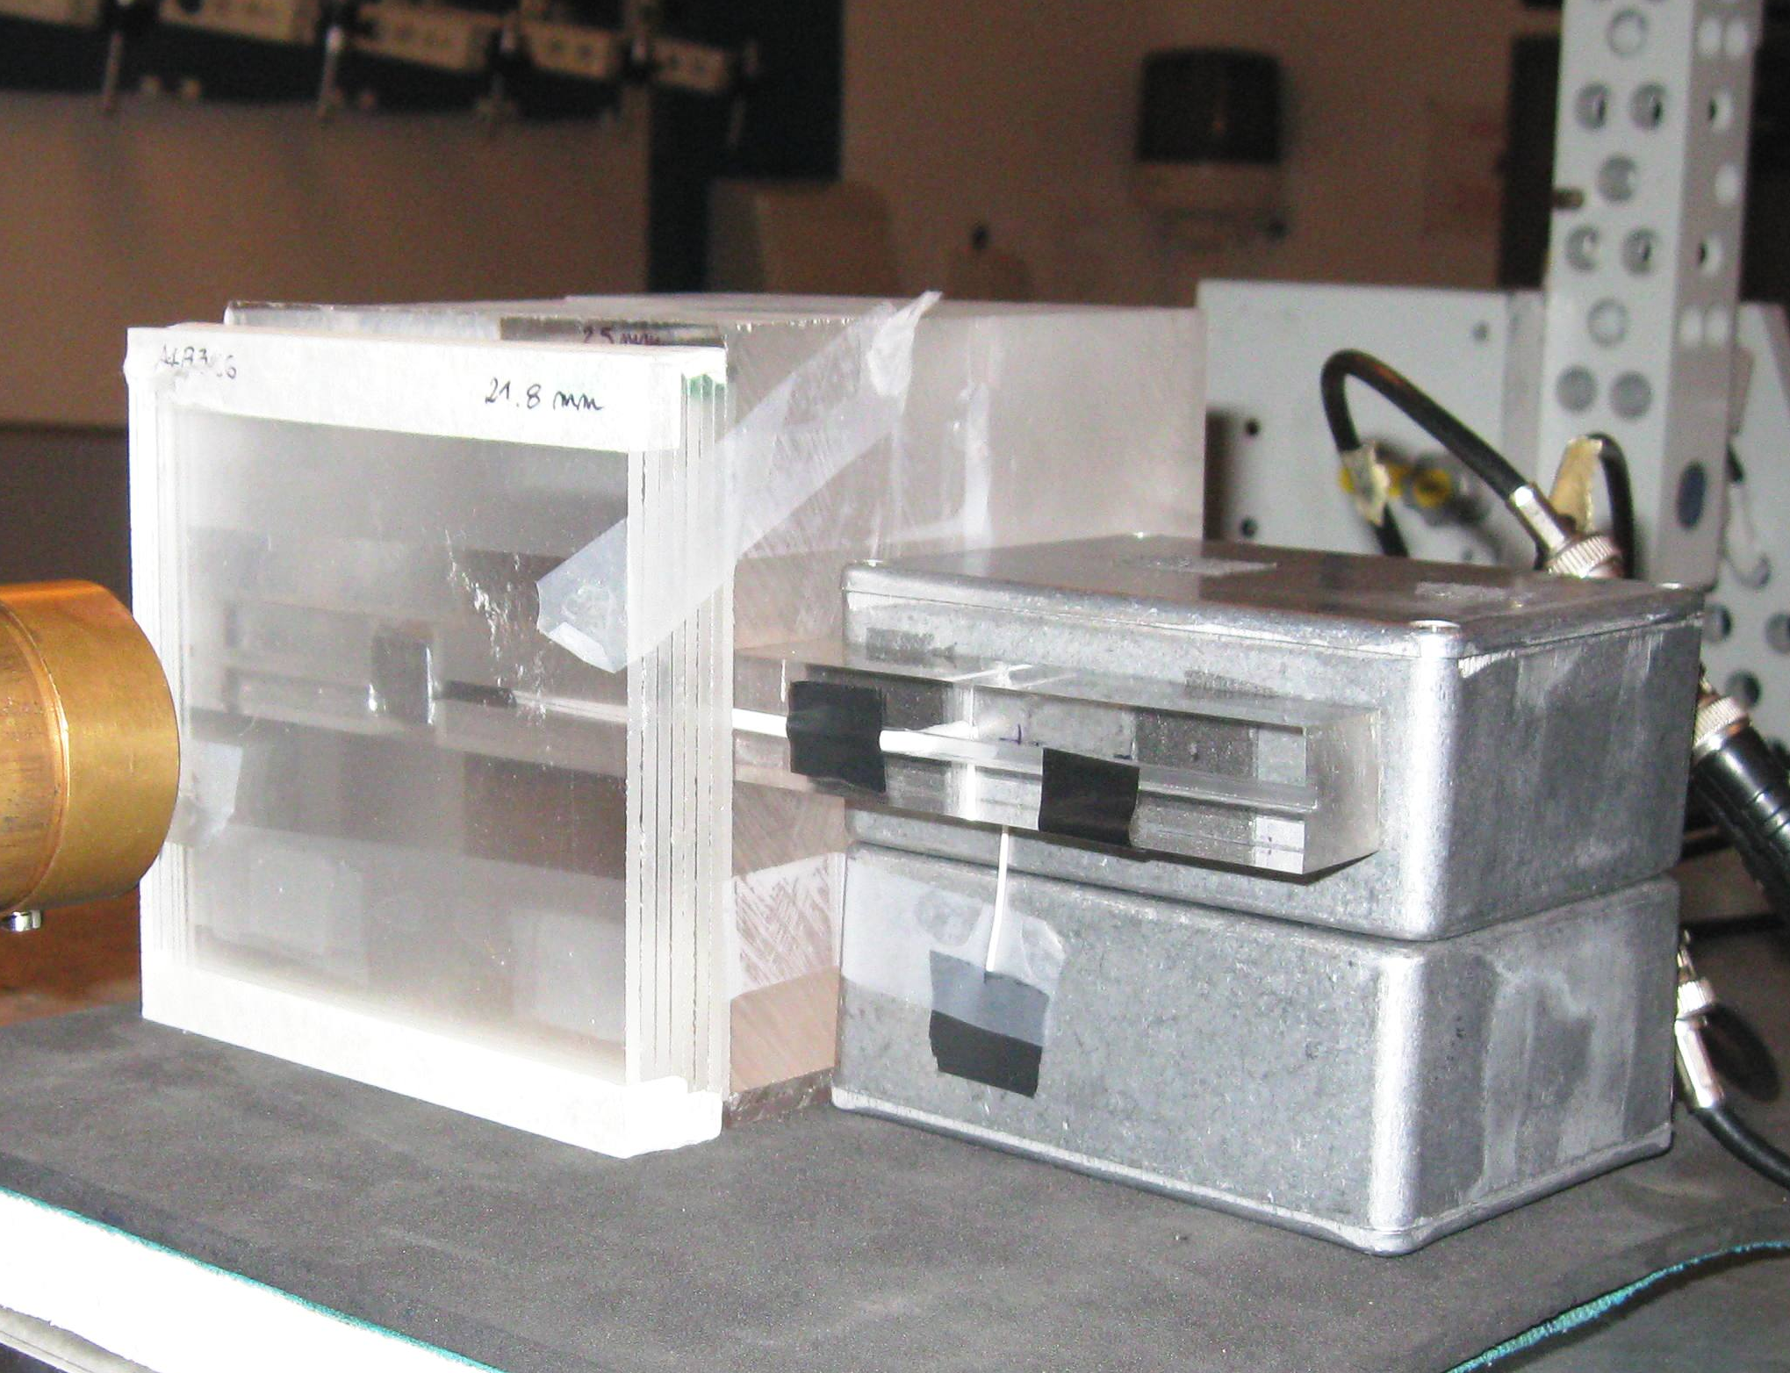
Characterization of the 62 MeV proton beam at CATANA^{[3,4]}
PMMA
foils
PMMA
phantom
Detector
Front-end electronics
[3] De Nardo L et al., Microdosimetric investigation at the therapeutic proton beam facility of CATANA. Radiat. Prot. Dosim. 110 (2004).
[4] Agosteo S et al., Study of a silicon telescope for solid state microdosimetry: Preliminary measurements at the therapeutic proton beam of CATANA. Radiation Measurements 45 , 1284-1289 (2010).

Slide 9
Experimental results: comparison with a mini-TEPC
Constant TE scaling factor

Slide 10
Experimental results: comparison with a mini-TEPC
Event-by-event TE correction

Slide 11
Experimental results: comparison with a mini-TEPC
Correction with av. factor
Correction event-by-event

Slide 12
Example of scatter plots across a carbon Bragg peak
∆E-E scatter plots and lineal energy spectra

Slide 13
Example of scatter plots beyond a carbon Bragg peak
∆E-E scatter plots and lineal energy spectra

