Slide 1
LAG
(Liquid Actuated Gravity)
Luciano Di Fiore
INFN - Sezione di Napoli
Massimo Bassan^{1,2}, Martina De Laurentis^{3,4}, Rosario De Rosa^{3,4},
Luciano Errico^{3,4}, Fabio Garufi^{3,4}, Aniello Grado^{4,5,} Yury Minenkov¹,
Giuseppe Pucacco^{1,2}, Massimo Visco^{2,6}
1 Dipartimento di Fisica, Università di Roma Tor Vergata, Roma, Italy
2 INFN - Sezione Roma Tor Vergata, Roma, Italy
3 Dipartimento di Fisica, Università di Napoli “Federico II”, Napoli, Italy
4 INFN - Sezione di Napoli, I-80126, Napoli, Italy
5 INAF - Osservatorio Astronomico di Capodimonte, Napoli, Italy
6 INAF - Istituto di Astrofisica e Planetologia Spaziali, Roma, Italy
this work is supported by INFN commission V

Slide 2
Talk summary
Introduction
Scientific motivation
Principle of operation
Background and available facility
Application to ISL test
Current R&D activity
Effect of microseism and advantages of underground operation
Conclusions and next steps

Slide 3
Introduction
This R&D activity is devoted to the development of a new actuation technique for gravity experiments
The basic idea is to use as an attractor field mass (FM) a container where the level of a liquid can be changed in a controlled and repeatable way in order to modulate the gravitational force acting on a test mass (TM), that is suspended to a torsion pendulum
Modulation of the gravitational force is essential in gravity experiments to improve S/N ratio by coherent detection. This is generally achieved by changing the position of a FM with respect to the TM
In the proposed technique, we can modulate the gravitational force without moving parts close to the apparatus

Slide 4

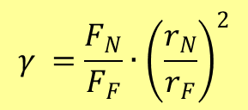
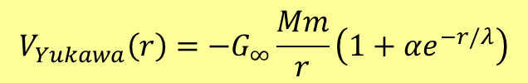
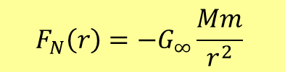
Scientific motivation
Newton interaction between point-like masses follows inverse square law (ISL) dependence on distance
$$F_{N}\left(r\right)=−G_{∞}\frac{Mm}{r^{2}}$$
Several theories predict deviation form ISL that manifest their effect below a characteristic scale λ (that can be related to the mass of the boson mediating the interaction or to the characteristic size of extra dimensions). This can be regarded as a distance depending gravity constant:
$F\left(r\right)=−G\left(r\right)\frac{Mm}{r^{2}}= −G_{∞}\frac{Mm}{r^{2}}\left(1+a(r\right)$)
This can be parametrized introducing a Yukawa potential:
$$V_{Yukawa}\left(r\right)=−G_{∞}\frac{Mm}{r}\left(1+αe^{−r/λ}\right)$$
In ISL test experiments, gravity force (or torque) is generally measured at two (or more) FM-TM distances. We define the quantity γ as (if the same, point-like masses are used at the two positions):
$$γ =\frac{F_{N}}{F_{F}}∙{\left(\frac{r_{N}}{r_{F}}\right)}^{2}$$
with: r_{N} and r_{F} the near and far position
F_{N} and F_{F} the corresponding forces acting on the TM.
Where γ = 1 if Newtonian gravity holds; deviations is represented introducing δ = 1 - γ

Slide 5
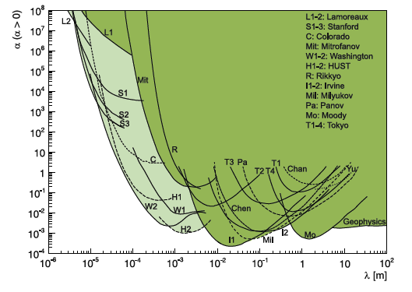
So far, only upper limits to the strength α have been set for specific values of λ
region of interest for torsion pendulum experiments (including LAG)
plot form: Murata J and Tanaka S 2015 Class. Quantum Grav. 32 033001

Slide 6
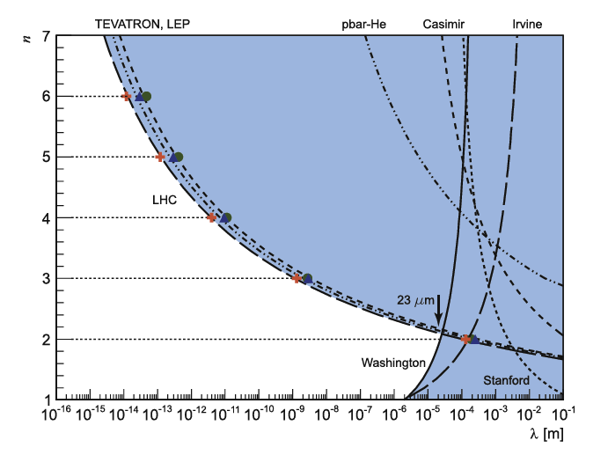
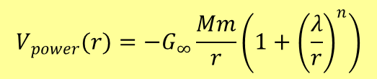
Power law parametrization
Another possible representation of deviation from ISL is the power law parametrization.
in 1998 Arkani-Hamed, Dimopoulos, and Dvali (ADD) introduced a model with n large extra dimensions (n > 2) to explain the so called hierarchy problem of the weakness of gravity with respect to other forces.
It can be represented by a potential of the form:
$$V_{power}(r)=−G_{∞}\frac{Mm}{r}\left(1+{\left(\frac{λ}{r}\right)}^{n}\right)$$
plot form: Murata J and Tanaka S 2015 Class. Quantum Grav. 32 033001

Slide 7
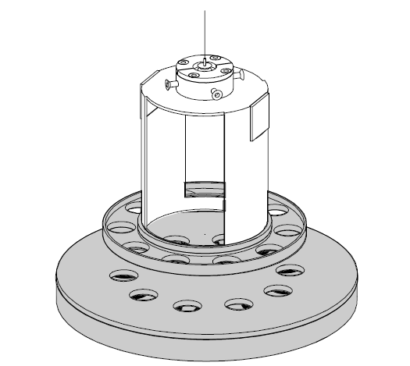
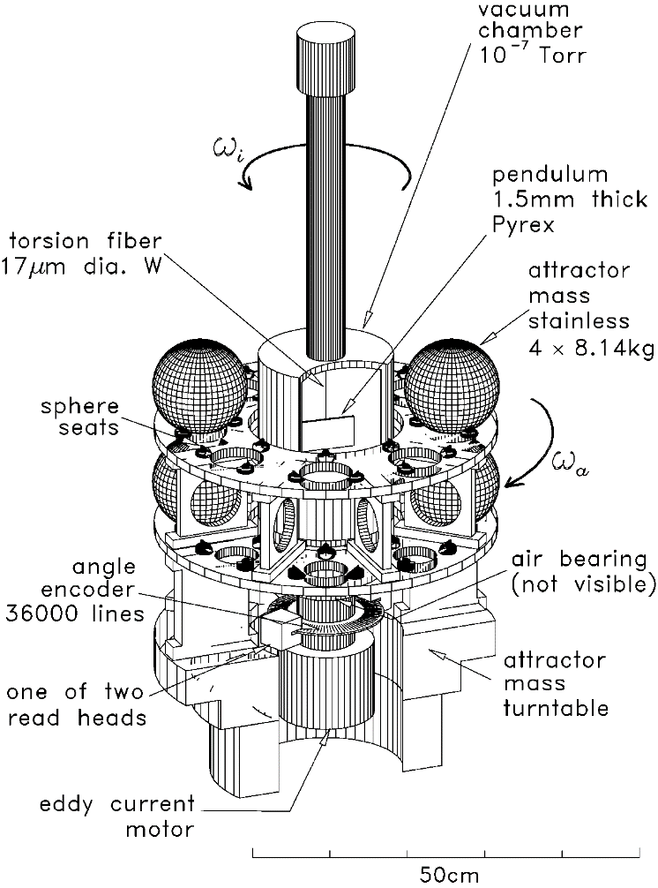
Modulation of the Gravitational force is essential to improve S/N ratio in laboratory experiments
This is generally obtained by moving periodically one or more Field Masses (FM) acting on a TM suspended to a torsion pendulum
5 cm
Torsion balance
Field mass
rotation
Gundlach, Merkowitz, Phys. Rev. Lett.,85, 2869, 2000
D.J.Kapner et al., Phys. Rev. Lett., 98, 021101, 2007

Slide 8
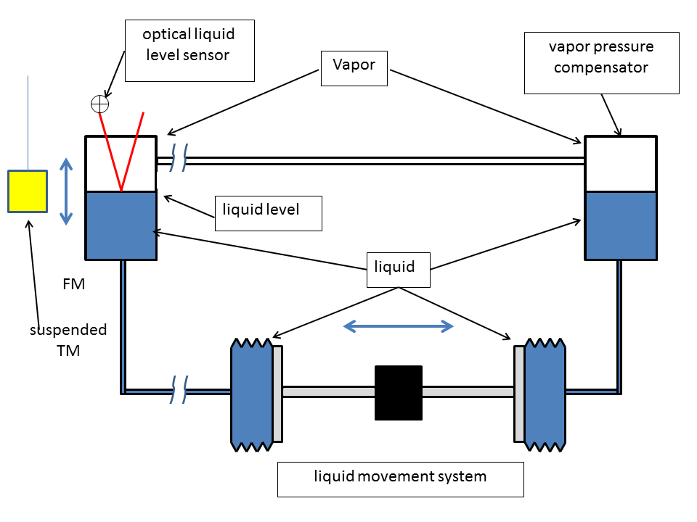
LAG: Principle of operation
We propose a new modulation technique based on a liquid Field Mass (FM)
gravity force is modulated by the varying liquid level
all moving parts are far away (meters)
liquid level is monitored by an optical sensor
force/torque are modulated in low frequency (5-10 mHz) and measurement is averaged for long time (order of 80000 s)
TM- FM relative position can be changed and measurement repeated
inside vacuum chamber
far from TM

Slide 9
Background
PETER (PEndolo Traslazionale e Rotazionale): a two-fold torsion pendulum facility
it was developed for ground testing of the LISA-Pathfinder Gravitational Reference Sensor (GRS)
it is a unique apparatus that allows simultaneous measurement of both force and torque acting on the TM
It is an ideal instrument for gravity (and other small forces) experiments
ORO
PETER in the Gravitational Physics Laboratory in Napoli. (left). The GRS inside the PETER facility (right).
ORO
for more details:
F.De Marchi et al. Phys. Rev. D 87 (2013)122006.
M.Bassan et al. Phys. Rev. Lett. 116 (2016)051104
M. Bassana et al. Astroparticle Phys. 97 (2018)19
GRS

Slide 10
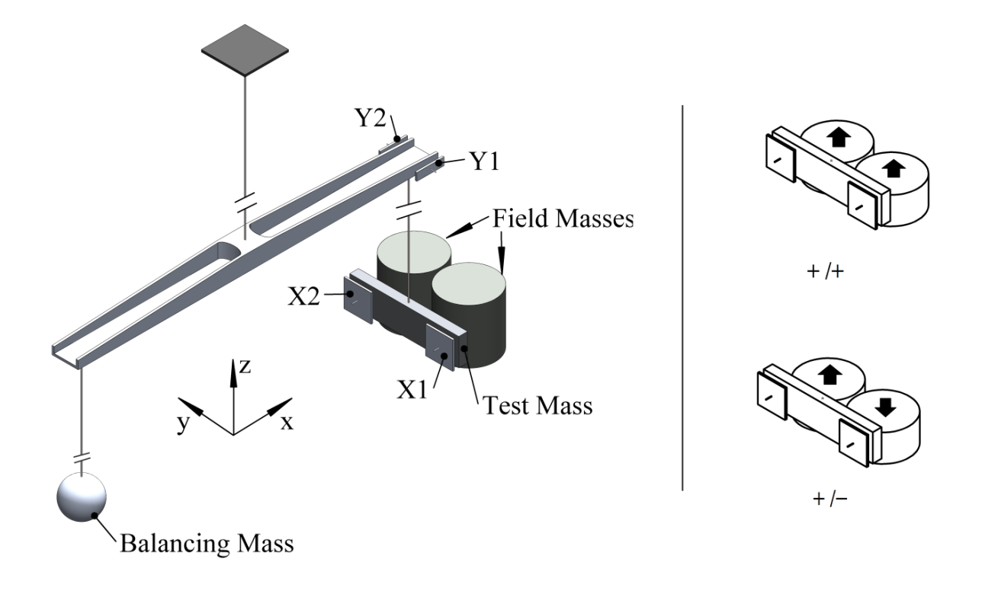
The proposed set-up for ISL test
two FMs that we can fill in phase (+/+) or anti-phase (+/-) to disentangle system asymmetries
force and torque measurement at various TM FMs relative position in the x-y plane
pure Liquids are more uniform in density than solids
both TM and FMs are not point-like masses: need for an accurate mechanical model to compute the expected values to compare to experimental results
force and torque depend on density, but their ratio only depend on geometry
to keep relative TM-FMs distance and orientation we control the pendulum in closed loop by electrostatic actuation (with electrodes X1, X2, Y1 and Y2
TM (Mo) L= 0.1 m h_{TM}=0.025 m t=0.008 m M= 0.2 kg
2 FMs (Hg) R=0.024 m, h_{fFM} =0.1 m
centers distance = L/2 , M_{tot}=1.3 kg

Slide 11
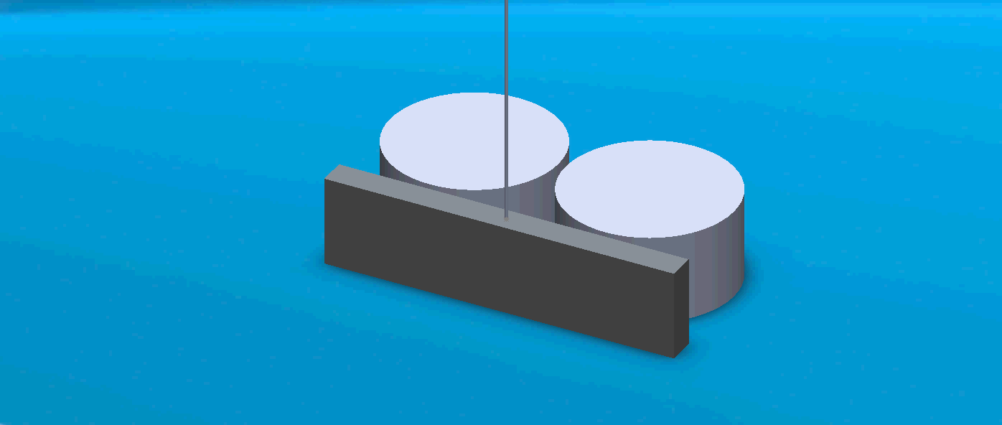
Example of the +/- actuation mode

Slide 12
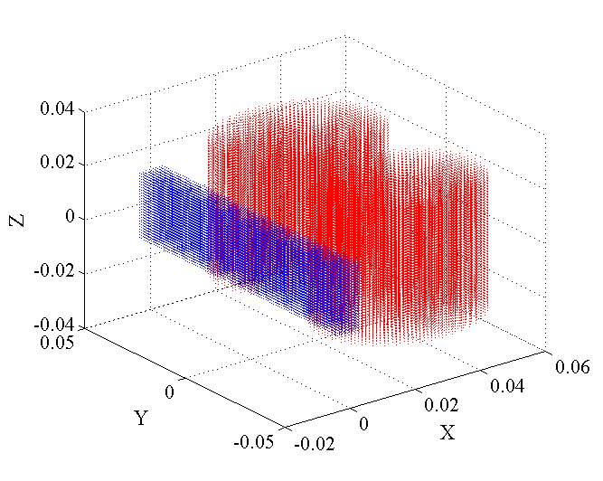
one example of Force and Torque computation
we divide TM and FM in small elements and compute the sum of forces and torques on all the TM elements due to all the FM elements
(for each liquid level) at various TM-FM relative positions
liquid level modulation h = ± 25 mm
frequency 10 mHz
lateral FM displacement -L < y < L
5 x position from 2 to 22 mm with steps of 5 mm

Slide 13
Expected S/N ratio
f_{m} = 10 mHz h_{m} =.024 m, measurement time = 80000 s
noise: assumed present PETER sensitivity
S/N ratio larger that 10⁴ for force and 10⁵ for torque
Assuming uncertainty on δ of 10⁻⁵ limited by torque sensitivity (provided geometry and model incertitude is lower) we can compute α−λ exclusion from a set of measurement in +/- mode from 2 to 22 mm

Slide 14
Estimated α−λ upper limits with present PETER sensitivity (black)
We can improve by more than one order of magnitude the exclusion for 1 mm < λ < 1 m approaching the region of interest for probing axion's mass
For the ADD model, we could limit λ ≤ 15 μm (with present sensitivity)
for more details see: "Liquid actuated gravity experiments", IJMP D (accepted)

Slide 15
LAG R&D
This activity started in 2019, with financial support from INFN commission V and will last for two years. The goal is:
To develop and test the LAG actuator (using bi-distilled water for simplicity)
To validate the system acting on the TM already used in the existing PeTER facility (that is well characterized and calibrated)
To develop and validate a complete medialization of the apparatus to compare the experimental results with the expected signals
In a second phase, we will upgrade the apparatus to the final LAG configuration but still using water for limiting security issues.
Improving current exclusion plot is still possible
If successful, we will move to the final experiment with mercury

Slide 16
Effect of seism on the different frequency bands
~ 1.3 mHz
~ 2 mHz
~ 0.4 Hz
~ 0.52 Hz
low frequency
two torsion modes
1.3 and 2 mHz
high frequency
two swing modes
0.4 and 0.53 Hz
just in the middle of
micro-seismic peak

Slide 17
Limitation to pendulum performance due to microseism
peak-peak TM displacement at swing modes depends on seismic noise amplitude
good sea condition: ➔ 5-10 μm ➔ good sensitivity
bad sea condition: ➔ >>100 μm ➔ out of Science Mode range (operation impossible)
This implies a limited duty cycle (max SM operation 3-4 days)
In a 2 stage pendulum we cannot passively damp (by eddy current) both the swing modes (because we cannot attach permanent magnets to the suspended stages)
We cannot damp them actively because electrostatic actuation is not strong enough (or actuation noise is too large).
In order to allow for the duty cycle required for the LAG experiment we adopted a solution based on active control of the suspension point

Slide 18
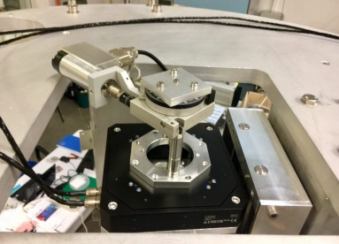
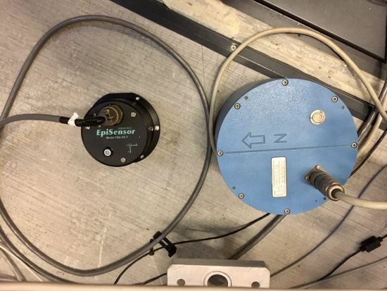
Principle scheme
ground seismic noise is measured (in 3 dof) at the base of the pendulum
The signal is filtered in a random band around the fundamental swing more (0.4 Hz)
The seismic motion of the pendulum suspension point is reduced by controlling it in feed-forward with a (3dof) PZT actuator
The swing amplitude is reduced proportionally to the suspension point noise reduction
We tested two kind of seismometers
accelerometer: EpiSensor FBA-ES-T
velocimeter: LennartzLE-3D/5s
suspension point
PZT actuator
Feed-forward
control
seismometer

Slide 19
Active control results
no
control
accell.
control
veloc.
control
no
control
accell.
control
veloc.
control
no
control
accell.
control
veloc.
control
no
control
No control
Accelerometer control
Velocimeter control
zoom with only:
Accelerometer control
Velocimeter control

Slide 20
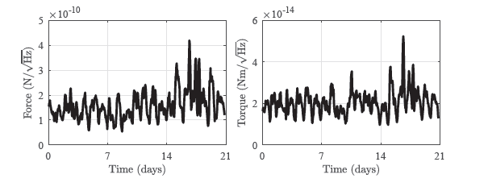
Active control results
With active suspension point control (with the velocimeter) we have been able to improve the duty cycle in science mode
we report the PSD noise in force and torque measured at 10 mHz without interruption during three weeks
It is evident that going to a seismically quiet plase, like an underground laboratory, we could considerably symplify system operation and improve the performances

Slide 21
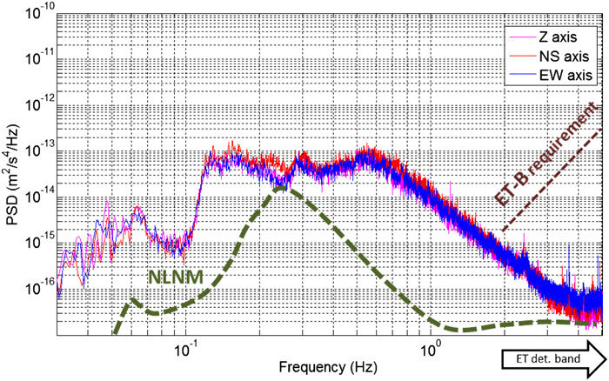
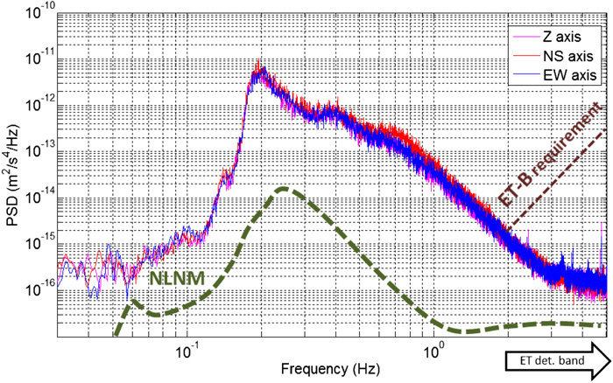
Measurements in SOS-Enattos
(Class. Quantum Grav. 31 (2014) 105016)
Measurements in Napoli Lab
~ 0.4 Hz
~ 0.4 Hz
excellent sea condition
~ 0.4 Hz
~ 0.4 Hz
very bad sea condition

Slide 22
Conclusion and future steps
We have presented a new liquid actuation technique (LAG) for gravity experiments
We propose as first application to test violation of ISL with perspective to improve current limits in the mm to cm λ region, where interesting physics is existence of axions and range of extra dimensions (ADD model)
A two years R&D program funded by INFN (commission V) is starting in 2019 to test principle of operation and reliability of the LAG actuator
We are now designing a LAG prototype that will be integrated in the existing two fold torsion pendulum facility (PETER) operational in Napoli
If the test is successful, the full experiment for testing ISL will be performed
Moving the experiment to a low seismic site (like the SarGrav laboratory) would simplify operation and improve performance
The principle of the LAG actuator can be adapted to other gravity experiments (for example measurement of gravity constant G).

Slide 23
Thank you for your attention

Slide 24
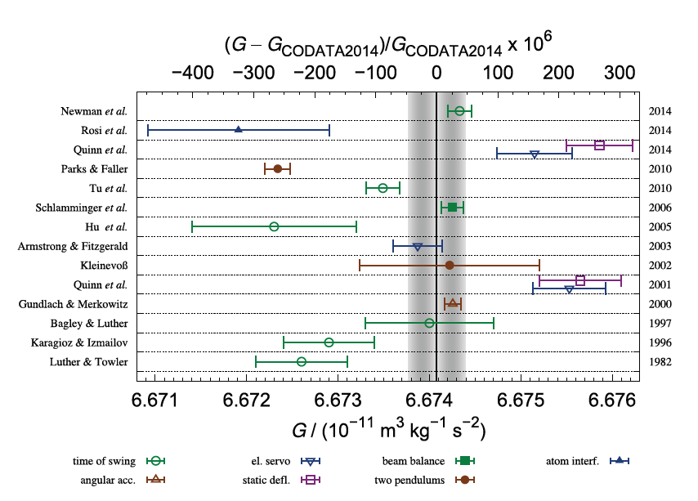
Determination of Newtonian constant G
G is the least known fundamental constant in physics. According to the CODATA, standard uncertainty on the current G value is 4.7·10-5,
Any further measurement of G with a new experimental technique , with an accuracy of about 10⁻⁴ or better, can contribute to a better determination of the CODATA value of G.
The LAG actuator can be used for such an experiment, provided that all the experimental parameters are well modeled; main advantages are:
Repeatable measurement without moving parts
Almost perfect uniformity of liquids inhomogeneity, mainly limited by the isobaric pressure gradient and liquid compressibility.
For LAG size ~ 5·10⁻⁶ (H₂O), ~ 4·10⁻⁷ (Hg) to compare to typically 10⁻⁴ for solids

Slide 25
Effect of imperfections: one example ➔ rotated actuator
Empty
No torque
No torque
half-filled
No torque
finite torque
full
No torque
No torque
centered and aligned
Cylinder
centered and rotated
Cylinder

Slide 26
Results of (simplified) simulations (torque)
empty -full
filling
torque for various angles
variation of torque with angle
empty -half
filling
Δτ = + 2·10⁻¹⁶ Nm
torque for various angles
variation of torque with angle

Slide 27
Results of (simplified) simulations (force)
ΔF = + 10⁻¹² N
The effect of FM angle on the Force is completely negligible
we can constrain or measure angular defects smaller than the one that could affect measurement results

